Slide 1
Important Information on
PRECINCT CAUCUS MEETINGS
march 5
UTAH PTA - ADVOCACY 2024

Slide 2
UTAH PTA - ADVOCACY 2024
What is a Caucus?
Where people from the same political party in a neighborhood (precinct)
gather to elect neighbors to represent them in the following:
◼ As a delegate to the county party convention
◼ As a delegate to the state party convention
◼ As precinct officers (chair, vice chair, secretary, etc)

Slide 3
UTAH PTA - ADVOCACY 2024
What happens at Caucus?
Sample Agenda:
1. Welcome
2. Sign-in
3. Call to order
4. Pledge
5. Read the Party Platform
6. Collect Donations/Pledges
7. Elect Precinct Officers
8. Elect State and County Delegates
9. Ask for Election Judges

Slide 4
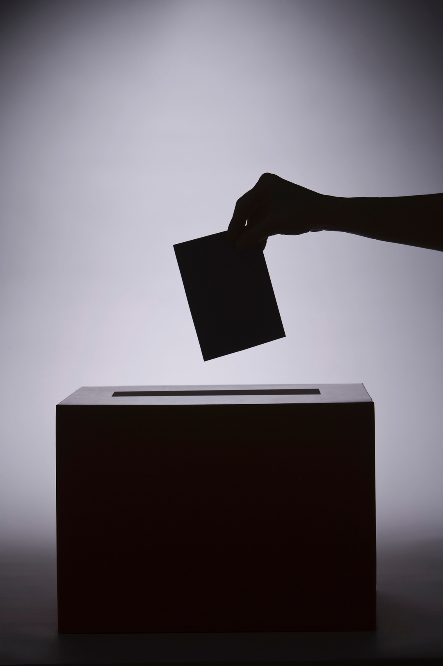
Why should I attend a precinct caucus meeting?
◼ To influence politics at the grass-roots level (Be an INFLUENCER!)
◼ To become a county or state delegate, who select candidates to represent the party of your choice for the primary or general election ballot
◼ To become a precinct officer
◼ To elect public education-friendly neighbors to represent you
UTAH PTA - ADVOCACY 2024

Slide 5
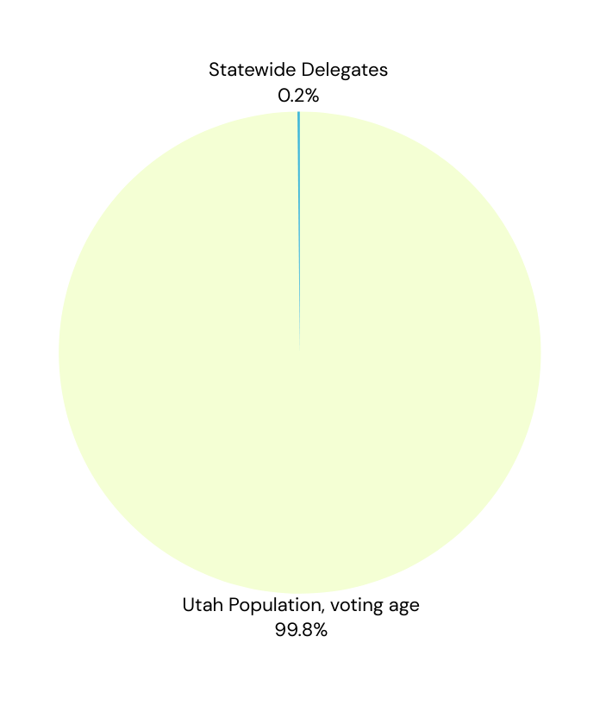
Why is Caucus Important ?
Delegates (chosen at Caucus) vote for who is on the ballot
In some cases less than 1% of voters can choose who is in office
.
How does this happen? State Delegates chosen at caucus vote for candidates in their political party conventions. They determine if there is a primary election between candidates of their party.
UTAH PTA - ADVOCACY 2024

Slide 6
Remember PTA is non partisan
Support the party of your choice -->
(Alphabetical)
Constitution Party
Democratic Party
Green Party
Independent American Party
Libertarian Party
Republican Party
United Utah Party
Utah Forward Party
No Labels Party
UTAH PTA - ADVOCACY 2024

Slide 7
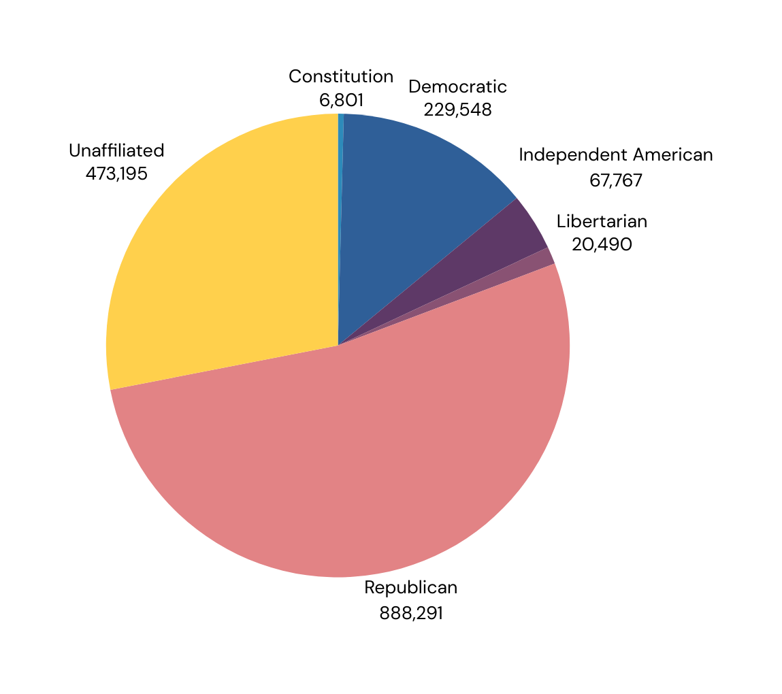
Party Affiliation of Utahns (Feb 2024)
Green 9
Utah Forward 55
No Labels 1,702
United Utah 2,343
Constitution 6,801
Libertarian 20,490
Independent American 67,767
Democratic 229,548
Unaffiliated 473,195
Republican 888,291
UTAH PTA - ADVOCACY 2024

Slide 8
UTAH PTA - ADVOCACY 2024
Utah Democratic Party Dates
Utah Republican Party Dates
Democratic County Conventions
○ Iron, Kane, Washington – Saturday, March 23
○ Summit, Wasatch –Tuesday, March 26
○ Box Elder, Cache, Davis, Salt Lake, Weber – Saturday, March 30
○ Carbon, Emery – Saturday, April 6
○ San Juan – Sunday, April 14
○ Grand – Monday, April 15
○ Sevier – Saturday, June 15
Democratic – State Convention – Saturday, April 27
Republican County Conventions
○ Millard –Wednesday, March 13
○ Carbon, Grand – Saturday, March 16
○ Garfield – Thursday, March 21
○ Washington – Saturday, March 23
○ Sevier – Tuesday, March 26
○ Emery, Wayne – Thursday, March 28
○ Wasatch – Tuesday, April 2
○ Beaver –Wednesday, April 10
○ Sanpete –Thursday, April 11
○ Davis, Salt Lake, Cache, Box Elder, Weber – Saturday, April 13
○ Uintah, Duchesne, Daggett –Tuesday, April 16
○ Tooele – Friday, April 19
Republican – State Convention –
Saturday, April 27

Slide 9
Requirements for Caucus
Republican
Democratic
○ Be a registered republican
○ Show picture identification
○ Reside in the precinct
○ Register beginning at one hour prior to start at https://utgop.org/
○ Be a registered voter of any party
○ Show picture identification
○ Reside in the precinct
○ https://utahdemocrats.org/
Top 2 parties in Utah - see party websites for more information
UTAH PTA - ADVOCACY 2024

Slide 10
UTAH PTA - ADVOCACY 2024
BECOMING A COUNTY OR STATE DELEGATE?
Delegates are voted for during the Neighborhood (precinct) Caucus Night
○ Bring family members or neighbors with you to the precinct caucus meeting
○ Ask one of your neighbors to nominate you
○ Introduce yourself to others attending the caucus meeting
○ Be prepared to talk about why you want to be a delegate
○ Verify in advance that you are available the day of the state or county convention

Slide 11
UTAH PTA - ADVOCACY 2024
Become a Political Influencer
Get involved at the grassroots level to have the biggest impact

