Slide 1
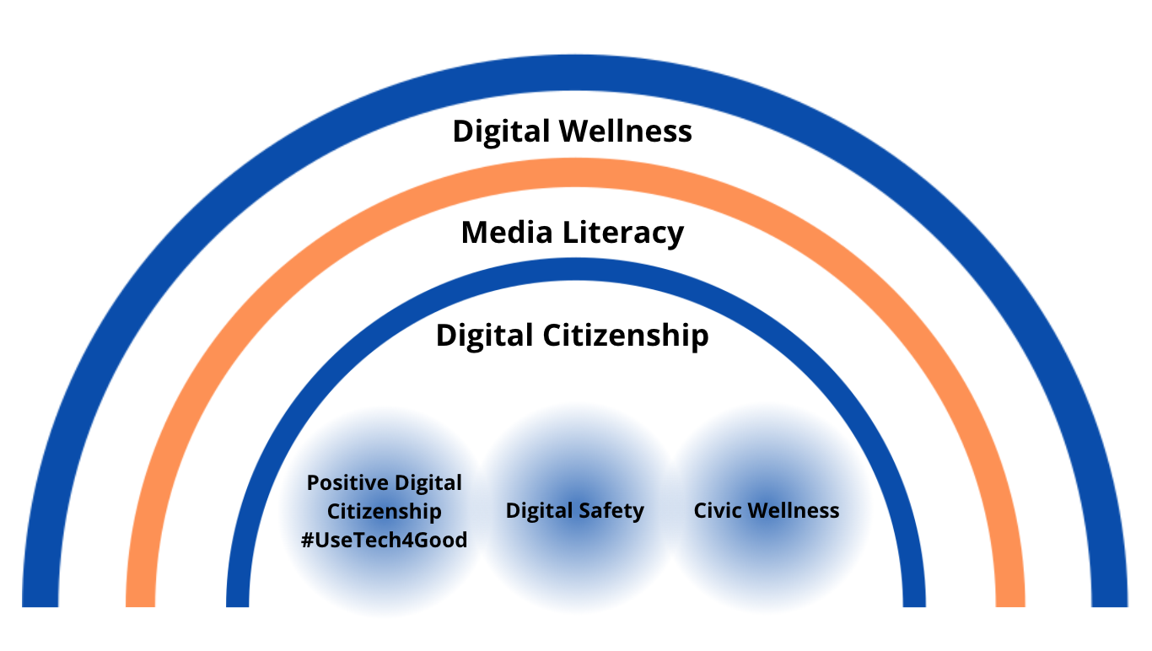
“Let it begin with me”
Notes:
=

Slide 2
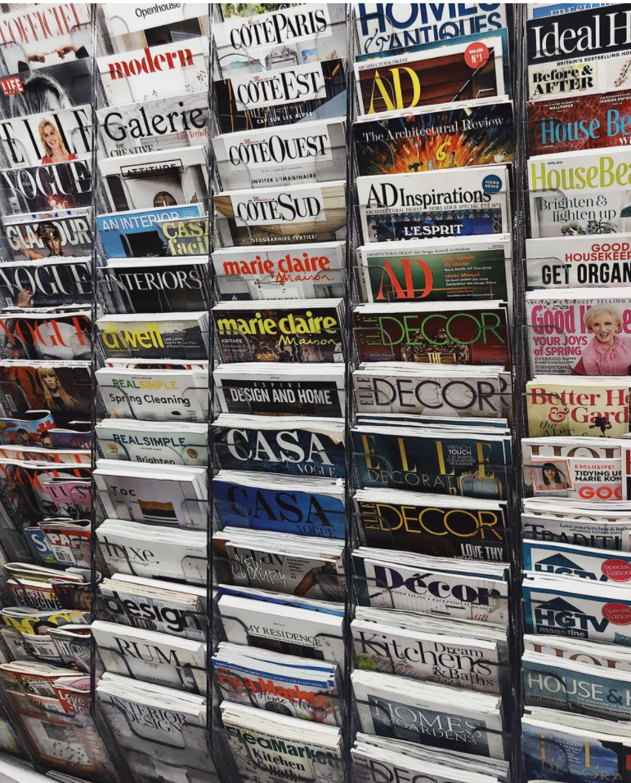
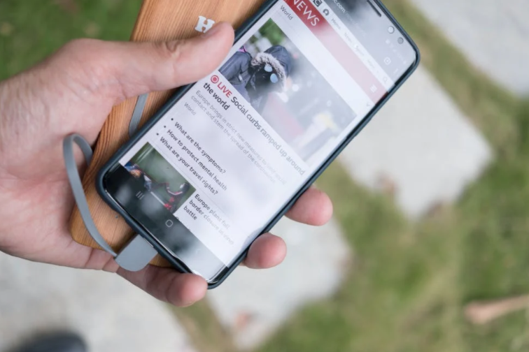

Ideas for Media Literacy/Civic Wellness Activities
Help for Headline-itis, v.1
You can do this activity alone or with family or friends or colleagues (etc).
Pick three headlines that have recently caught your attention.
Do 5HW (Who, What, When, Where, Why, How) on the headline alone first.
Then read the entire story. Do 5HW again.
Do you think the headline accurately captures the story? Does it capture what you got out of the story? What do you wish had been covered?
Bonus: Find headlines that tell the other “side” of the story and do the same activities with those stories.
Notes:
=

Slide 3
Ideas for Media Literacy/Civic Wellness Activities
Help for Headline-itis, v.2
You can do this activity alone or with family, friends, colleagues, etc.
Scroll through the top 10 stories in your favorite news resource
How many stories are political in nature?
How many seem to want to induce negative emotions?
How many share something of general human interest (nonpartisan, inspirational content)?
Bonus question: How many headlines did you have to skim before you found something of general human interest?
Notes:
=

Slide 4
Ideas for Media Literacy/Civic Wellness Activities
Help for Headline-itis, v.3
You can do this activity alone or with family, friends, colleagues, etc.
As you finish each day this week (or at the end of each time period you have set for news-checking. Write down any headline topics that are lingering in your head.
What issues are keeping you awake at night? Are these issues incited by outside forces and distracting you from your center, or are they reflecting issues you want to do something about that align with your core right now?
If it’s the latter, give some thought as to what you want to do and talk about your ideas with a trusted friend.
Notes:
=

Slide 5
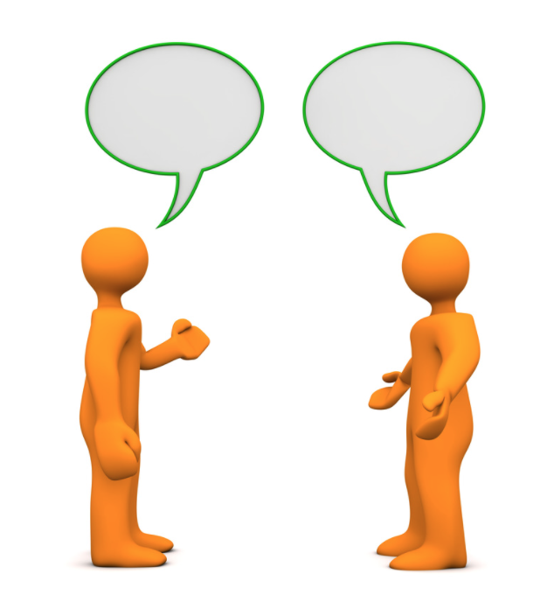
Ideas for Media Literacy/Civic Wellness Activities
Stage a Discussion
Pick a topic that isn’t too charged but still has relevance to our social/cultural/political environment.
Come prepared with news articles that represent different "sides" of the issue
Divide randomly into two groups.
Assign Group 1 one “side” to represent and Group 2 the other. Then switch. (10-15 minutes prep, 5 minutes presentation.) Instead of debating the topic, use KSAM and the sentence frames tool from Utah3Rs to practice using de-fusing phrases.
Discuss. How did that feel? What are your observations about these tools?
Notes:
=

Slide 6
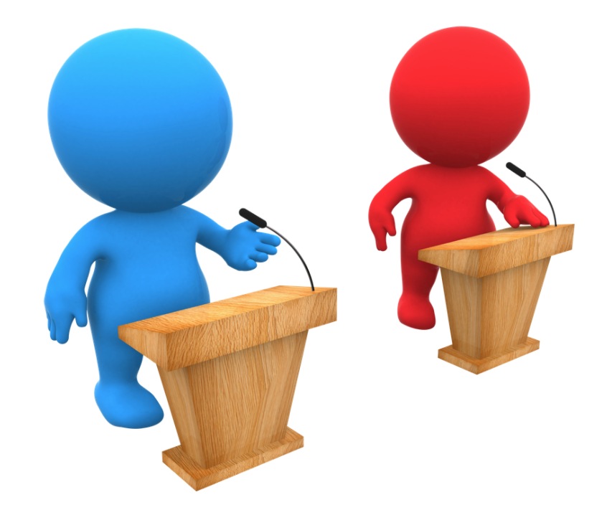
Ideas for Media Literacy/Civic Wellness Activities
Stage a Debate (or Gauge the Gauntlet)
Pick a topic that isn’t too charged but still has relevance to our social/cultural/political environment.
Plan a COVID-friendly or virtual event in advance so people have time to do a little research on both sides of a topic.
Divide randomly into two groups.
Assign Group 1 one “side” to debate and Group 2 the other. Then switch. (10-15 minutes prep, 5 minutes presentation.)
Discuss. How did that feel? Can you see any Venn diagram spaces within the debate? etc.
Notes:
=

Slide 7
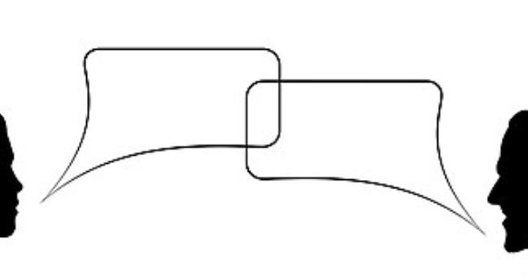
Ideas for Media Literacy/Civic Wellness Activities
Stage a Debate: Food for Thought for Discussion
"Normally, we used forced choice and false dichotomies during times of significant emotional stress. Our intentions may not be to manipulate, but to force the point that we’re in a situation where neutrality is dangerous. ...
"The problem is that these emotional pleas…prey on our fears of not belonging or being seen as wrong or part of the problem. We need to question how the sides are defined. Are these really the only options? Is this the accurate framing for this debate….?
"If alternatives exist outside of these forced choices (and they almost always do), then the statements are factually wrong. It’s turning an emotion-driven approach into weaponized belonging. And it always benefits the person throwing down the gauntlet and brandishing those forced, false choices.
"The ability to think past either/or situations is the foundation of critical thinking, but still, it requires courage. Getting curious and asking questions happens outside our ideological bunkers. It feels easier and safer to pick a side. The argument is set up in a way that there’s only one real option. If we stay quiet we’re automatically demonized as ‘the other.’
"The only true option is to refuse to accept the terms of the argument by challenging the framing of the debate. But make no mistake; this is opting for the wilderness. Why? Because the argument is set up to silence dissent and draw lines in the sand that squelch debate, discussion, and questions—the very processes that we know lead to effective problem solving.”
-Brené Brown, Braving the Wilderness
Notes:
=

Slide 8
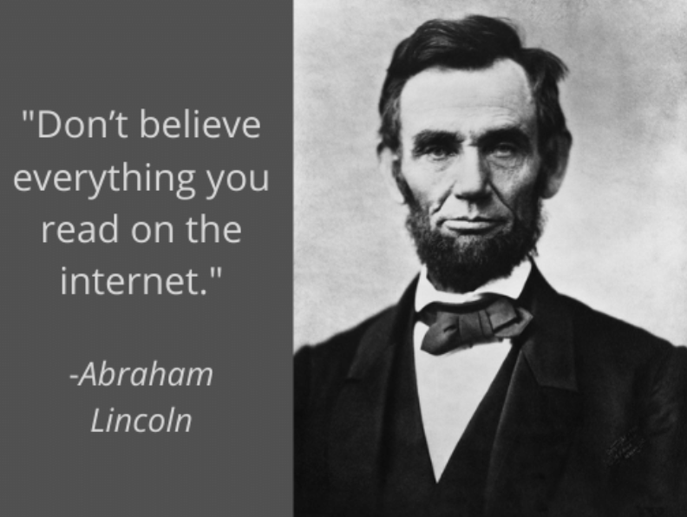
Ideas for Media Literacy/Civic Wellness Activities
Quote-a-Rama, or Three Lies and a Truth
Invite individuals in your circle to do some homework on incorrect quotes, misattributed quotes, or quotes shared that don’t have a known source.
Have an activity where everyone shares three quotes that aren’t accurate, and one that is. See who can pick the true quote.
Turn this into a game or competition as desired.
Discuss why and how even sharing false quotes can be harmful to democracy, and why the opposite is true.
Notes:
=

Slide 9
Quote-a-Rama: Food for Thought & Discussion
Some research on why people share inaccurate content
“[P]eople do care more about accuracy than other content dimensions, but accuracy nonetheless often has little effect on sharing, because (ii) the social media context focuses their attention on other factors such as the desire to attract and please followers/friends or to signal one’s group membership.”
But, the researchers found, attention can be "primed" toward accuracy {just reminding the brain that it matters} to influence content sharing.
Ergo, there is a sort of attention economy in our own brains. If we value accuracy of information, we can remind ourselves of that before engaging with and deciding what to share online. [Could this apply to consciously giving attention to other values before engaging online? Why not try?]
Research study reported in Nature: https://www.nature.com/articles/s41586-021-03344-2
Emphasis added.
Notes:
=

Slide 10

Ideas for Media Literacy/Civic Wellness Activities
Pause the Like
For at least one week, refrain from liking (or disliking) anyone’s content on social media.
Observe how you feel, what you think, what you want to actually say or do (or not say or do) in response.
If you actually like something, let the person know what your thoughts are and why one-on-one. Focus on the person, not the pixelized content. Let them know you see them.
If after a week you still feel like engaging around political content, find ways offline to do so. Consider even writing a representative.
Remember, algorithms often thrive on discord, division, and emotional discussion. +Bad actors leverage this.
Notes:
=

Slide 11

Notes:
=

Slide 12
“Let it begin with me”: Media Literacy
Media Literacy encompasses how we
Access
Analyze
Assimilate (or not)
Act on (or not)
Add to the pool of
any and all forms of media
Notes:
=

Slide 13
Media Literacy is pivotal to wellness, both individual and collective
Media Literacy can impact mental, intellectual, emotional, physical, relational, spiritual, and civic health.
As such, it is much more than just “fact checking” or just how/if we might engage the news
Notes:
=

Slide 14
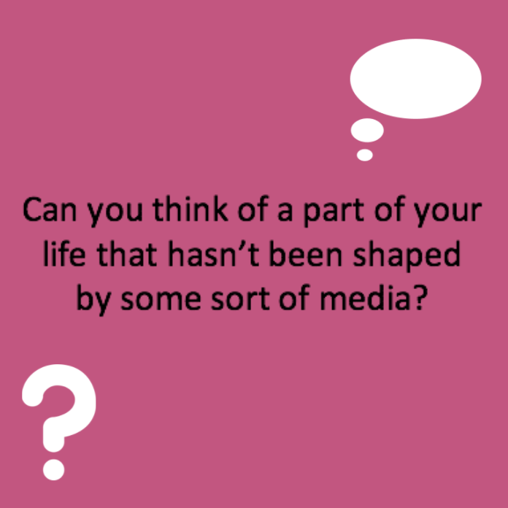
Thought question:
Think of positive and negative ways media can impact you
Notes:
=

Slide 15

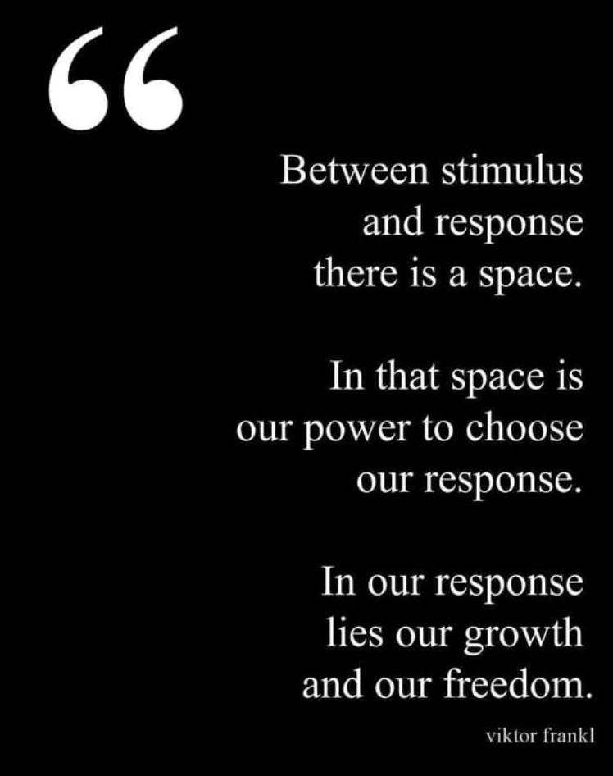
Every form of media (stimulus) is constructed in some way, usually to elicit emotion
Image source: https://www.instagram.com/p/BvCEI1mlFha/
Notes:
=

Slide 16

Most (not all) forms of media are constructed to elicit emotion to make money
Ads 🡪 Spend money
Algorithms🡪prefer, feed off of, and feed us emotionally-charged content
More emotion=more engagement/reaction=more money for advertisers. This is how social media tools can offer services for ”free.”
To respond without using Media Literacy skills is, in essence, to be exploited by these dynamics
Watch (or re-watch) The Social Dilemma for more information on the business models driving media https://www.youtube.com/watch?v=7mqR_e2seeM
Notes:
=

Slide 17
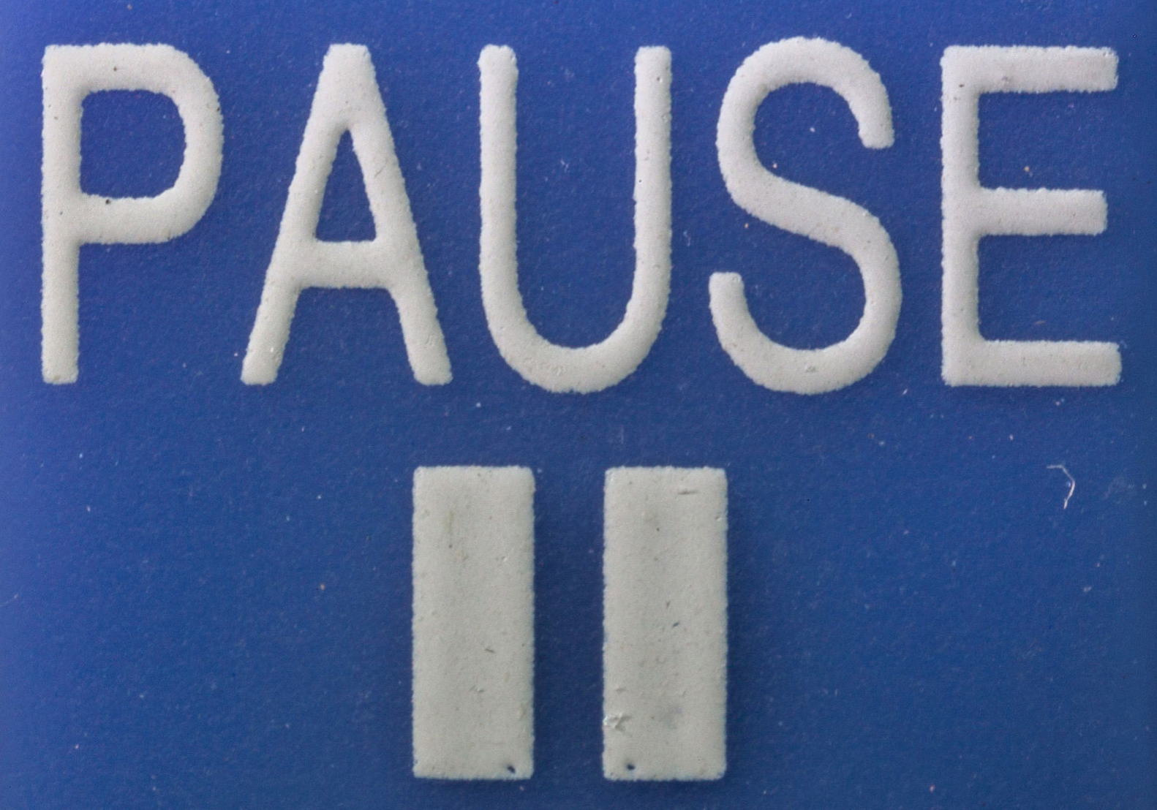
Every form of media is constructed in some way, usually to elicit emotion
Taking a step back from the emotion is key to practicing media literacy. (We’re circling back to the concept of awareness.)
Media literacy invites us to pause and to ask questions, such as…
Credit: Maximilian Schönherr, CC license 3.0 https://commons.wikimedia.org/wiki/File:PAUSE-button_-_Macro_photography_of_a_remote_control.jpg
Notes:
=

Slide 18






…Questions we learn(ed) in school!
For more examples of questions, see http://medialiteracyweek.us///wp-content/uploads/2019/08/NAMLE-Key-Qs.pdf
Notes:
=

Slide 19
Media Literacy: Pause and Ask Questions
Who: e.g., Who created this? Are they the original content creators? Who will be making money from this content (if applicable)? Who is the intended audience? Who is and isn’t likely to be reached with this content? Who comes to mind when you engage with this media content?
[Can you think of other Who? questions to ask?]
For more examples of questions, see http://medialiteracyweek.us///wp-content/uploads/2019/08/NAMLE-Key-Qs.pdf
Notes:
For more examples of questions, see http://medialiteracyweek.us///wp-content/uploads/2019/08/NAMLE-Key-Qs.pdf

Slide 20
“Let it begin with me”: Media Literacy
What: What methods do the creators use to grab/keep attention? What message do you think they want to portray? What message do you take away from it? What senses are engaged for you by this media form and its message(s)?
Can you think of other What? questions to ask?
For more examples of questions, see http://medialiteracyweek.us///wp-content/uploads/2019/08/NAMLE-Key-Qs.pdf
Notes:
=

Slide 21
“Let it begin with me”: Media Literacy
When was it created? Shared? (Reshared?) Is the content relevant today? When do you find yourself engaging in/thinking about/remembering this content? Is that “when” good for your well-being? (e.g., consuming news at morning or at night or can impact emotional, mental, physical health)
Can you think of Other When? questions to ask?
For more examples of questions, see http://medialiteracyweek.us///wp-content/uploads/2019/08/NAMLE-Key-Qs.pdf
Notes:
=

Slide 22
“Let it begin with me”: Media Literacy
Where: Where have creators placed this media? Where can it be found/accessed (physically, socially, technologically)? Where isn’t it being accessed? Where is the creator located geographically? Where were you when you found it? [Was that a place where you wanted to be?] Where is this content being shared/reshared/discussed (if applicable)?
Can you think of other Where? questions to ask?
For more examples of questions, see http://medialiteracyweek.us///wp-content/uploads/2019/08/NAMLE-Key-Qs.pdf
Notes:
=

Slide 23
“Let it begin with me”: Media Literacy
Why do you think this content was created? Why does this catch your attention (if it does)? Or why doesn’t it? Why would you want/not want to learn more after engaging in this content? Why would you want/not want to share it?
For more examples of questions, see http://medialiteracyweek.us///wp-content/uploads/2019/08/NAMLE-Key-Qs.pdf
Notes:
=

Slide 24
“Let it begin with me”: Media Literacy
How do you feel when you engage with this? How do you want to act, respond, engage (or not), etc. as a result? How might you have chosen to create this media/message? How would your approach be different? How might you imagine creating a response to this media?
For more examples of questions, see http://medialiteracyweek.us///wp-content/uploads/2019/08/NAMLE-Key-Qs.pdf
Notes:
=

Slide 25
Please don’t forget that…
Just because something is liked or shared a lot or shared doesn’t make it accurate or reliable
Algorithms are creating personalized, designed, focused media that exploits strong emotions and reactions, usually for $$ – even if the results often provide a net negative for our health and citizenry. Remember that “Mindfulness is activism.”
The Social Dilemma – we are all seeing different information about the same issues largely based on algorithms.
p.s. You can now watch The Social Dilemma on YouTube ”for free” (just remember to be alert to how we pay for free content): https://www.youtube.com/watch?v=7mqR_e2seeM
Notes:
=

Slide 26
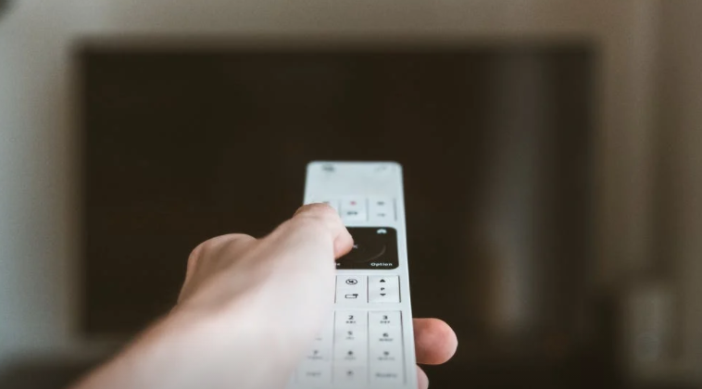
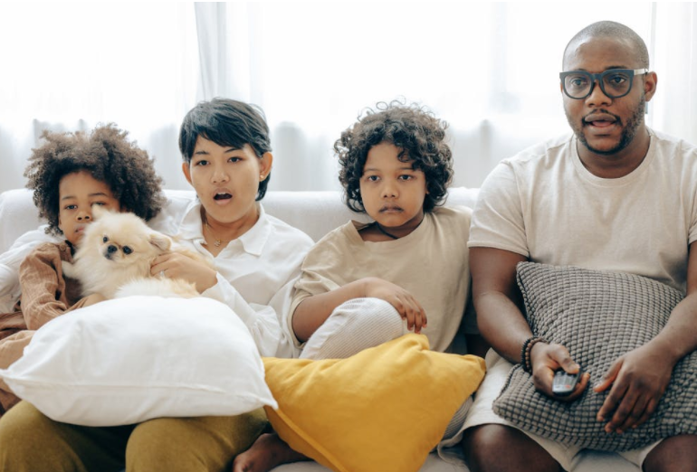
Ideas for Media Literacy Activities
TV Show Telepathy
Watch an episode of your favorite TV show together (preferably one you have already watched)
Engage in the Who, What, Where, When, Why, How (5WH) questions with the episode.
Note what elements of the show align with your values (or align with T.H.I.N.K.)
Note what elements may not (sometimes we ignore such elements because of the entertainment value, but ignoring it doesn’t mean it doesn’t affect the mental, emotional, physical, social, or cultural water we swim in)
Bonus: This time, don’t skip the ads. Instead, do 5WH with them
Notes:
=

Slide 27

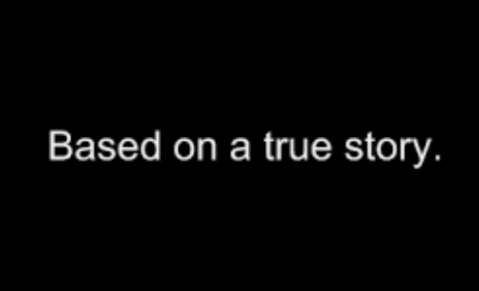
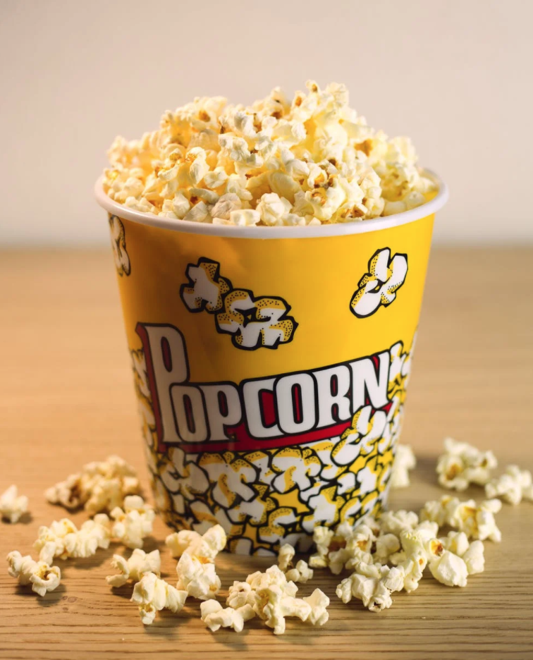
Ideas for Media Literacy Activities
Moved by a Movie: Fact vs. Fiction
Watch your favorite “based on a true story” film (or ask for a recommendation)
If it’s a favorite, why do you like the film?
What do you think the writers and producers wanted you to feel/do? How does it make you feel?
Do research on the actual story on which the story is based. What is fact in the movie? What is fictionalized? Why do you think they fictionalized those parts?
Have any of your feelings about the film changed after doing research about it?
Notes:
=

Slide 28
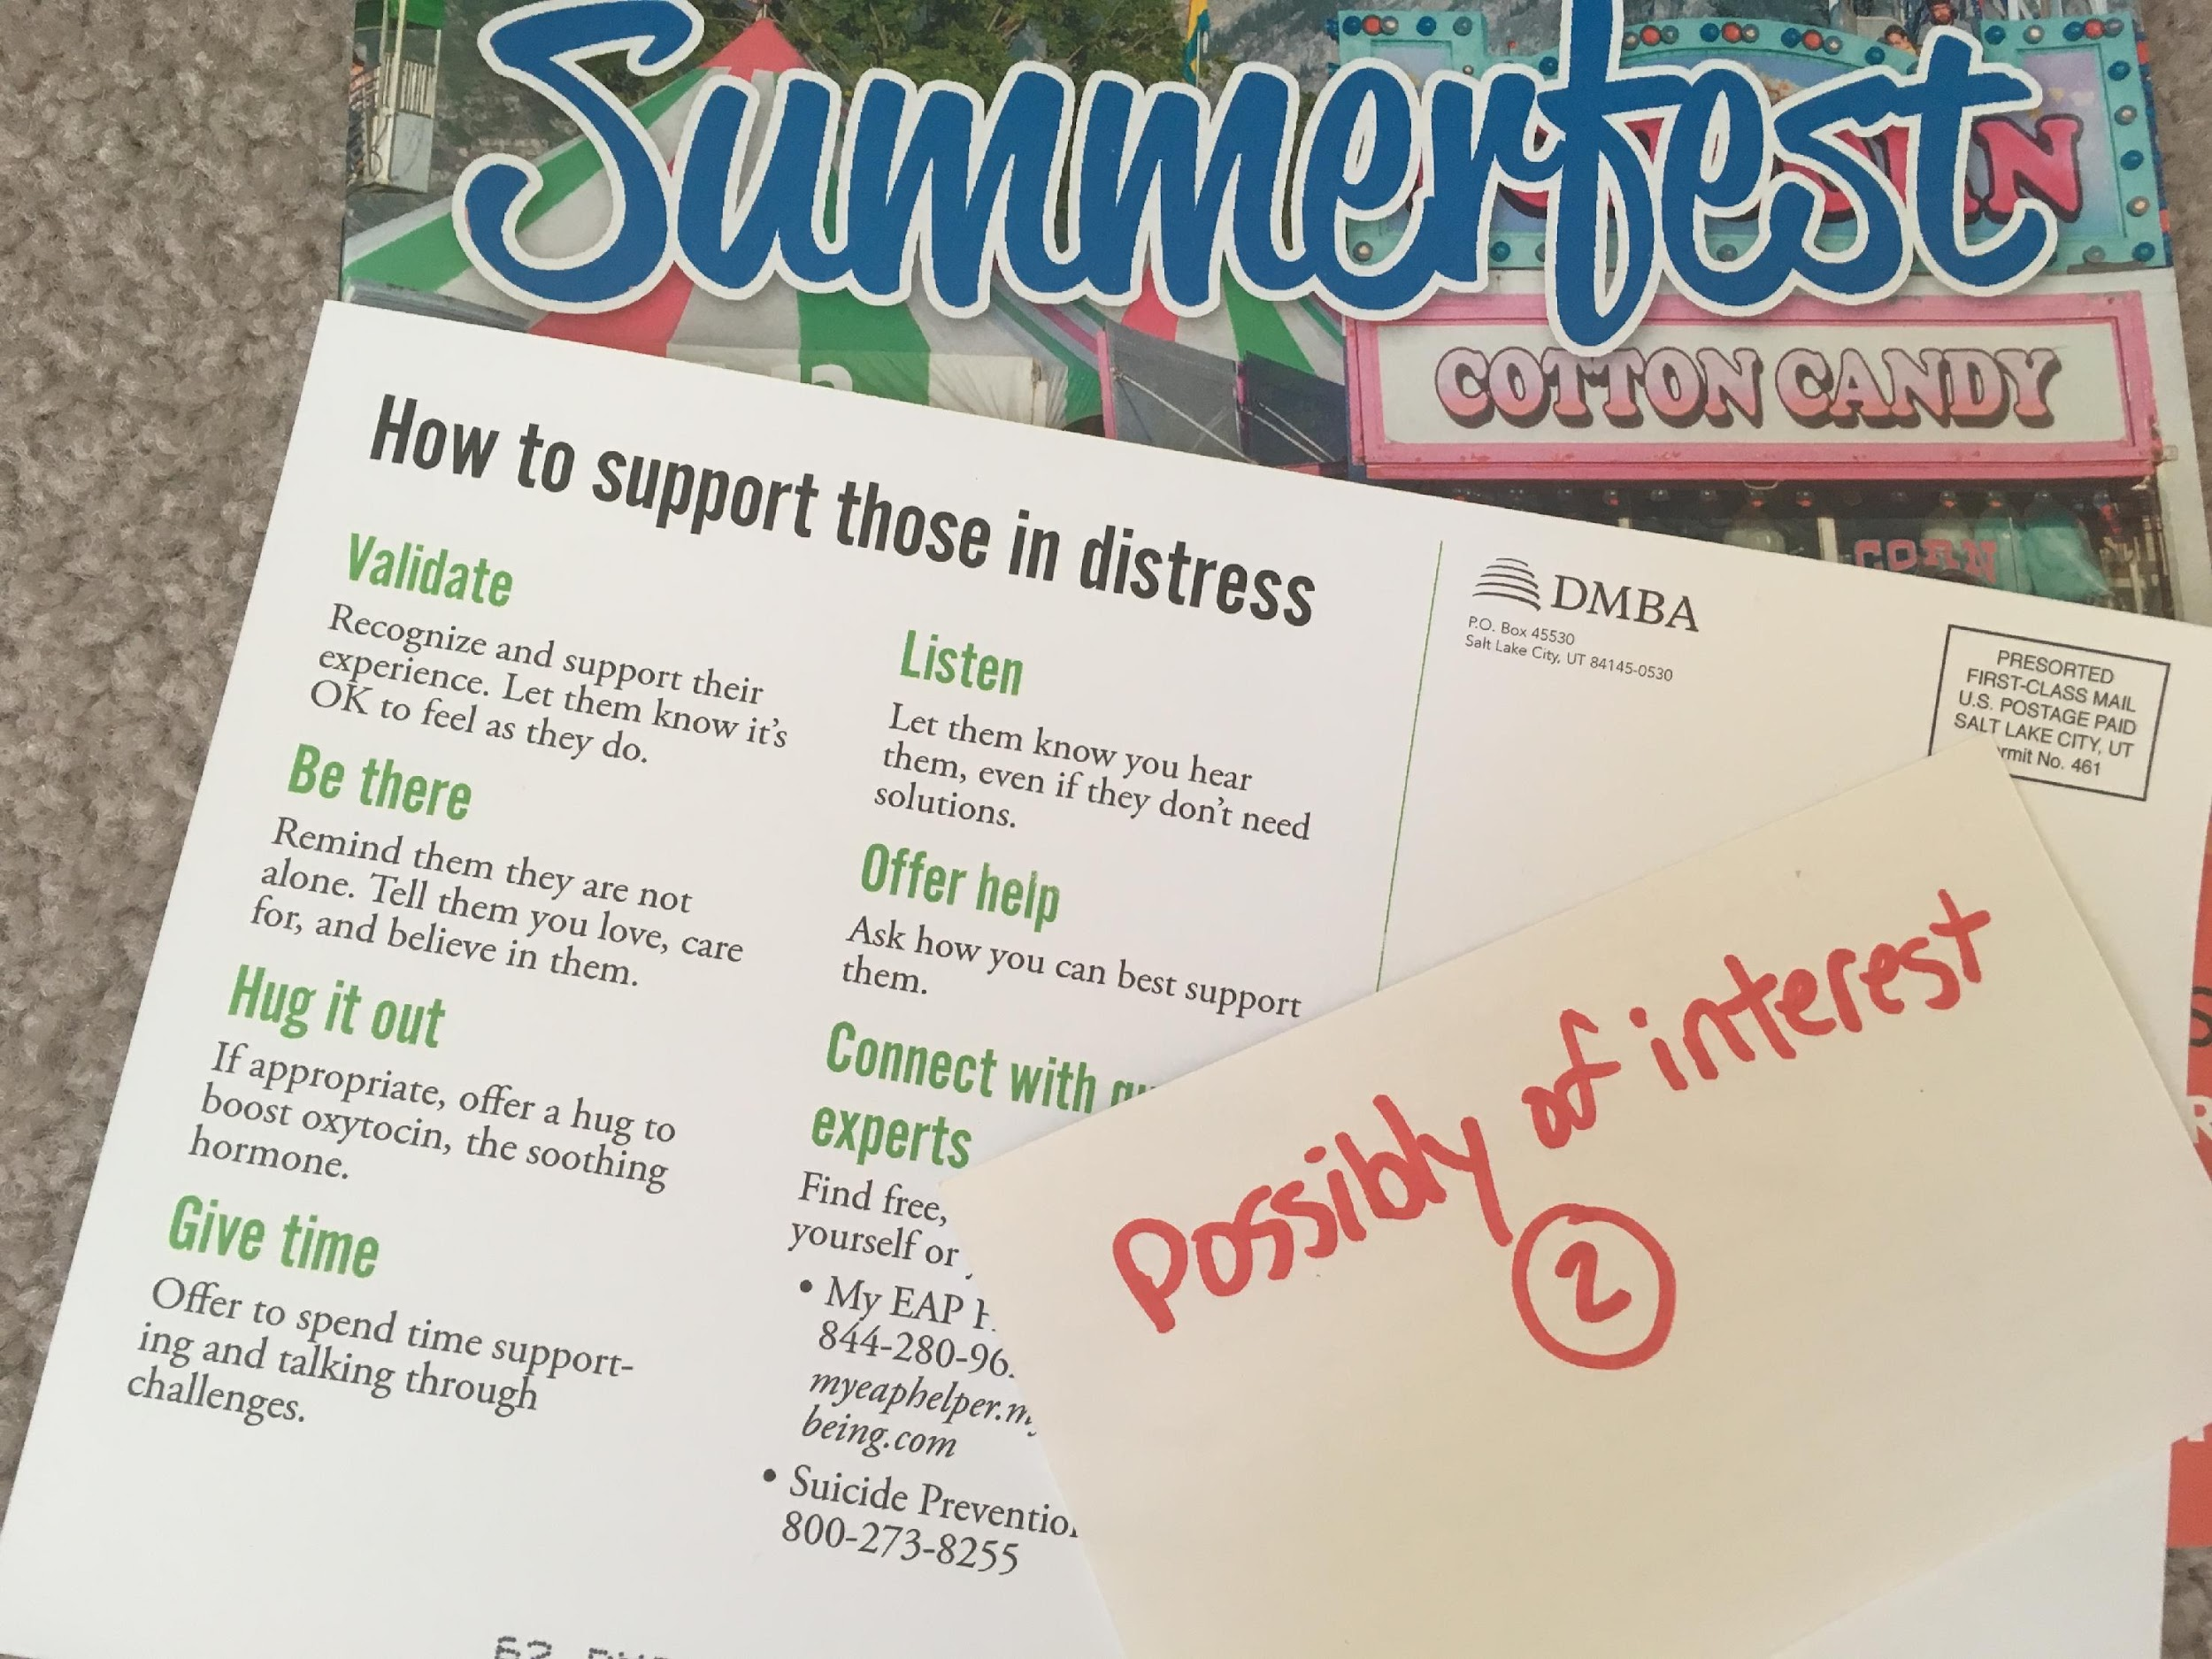
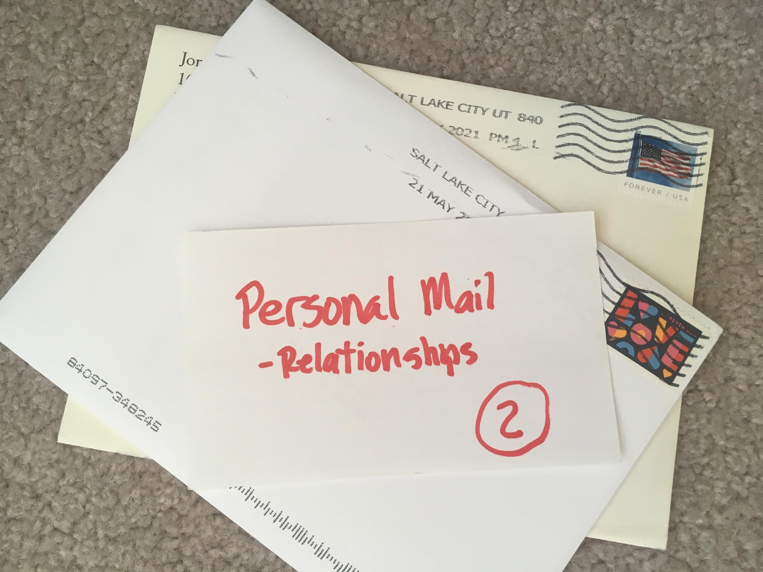
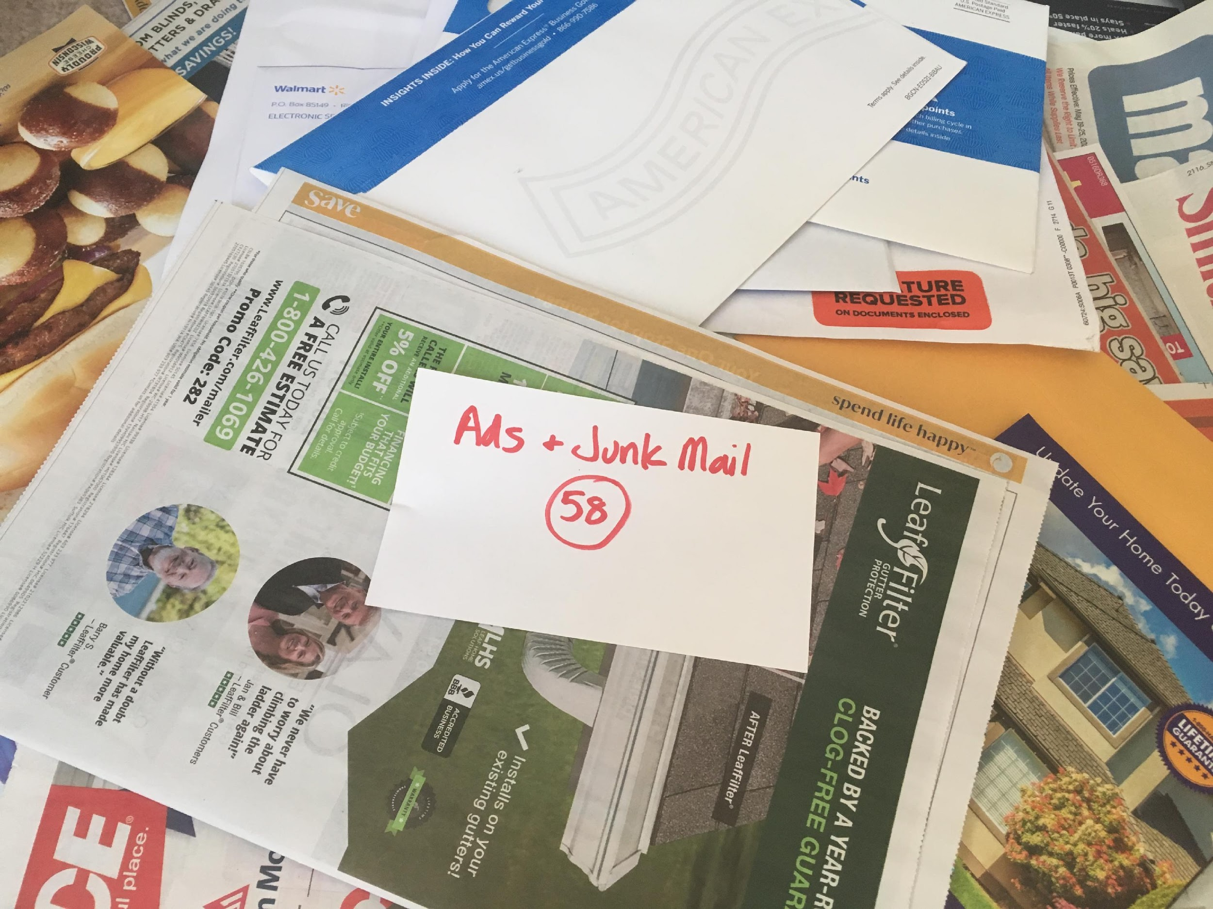
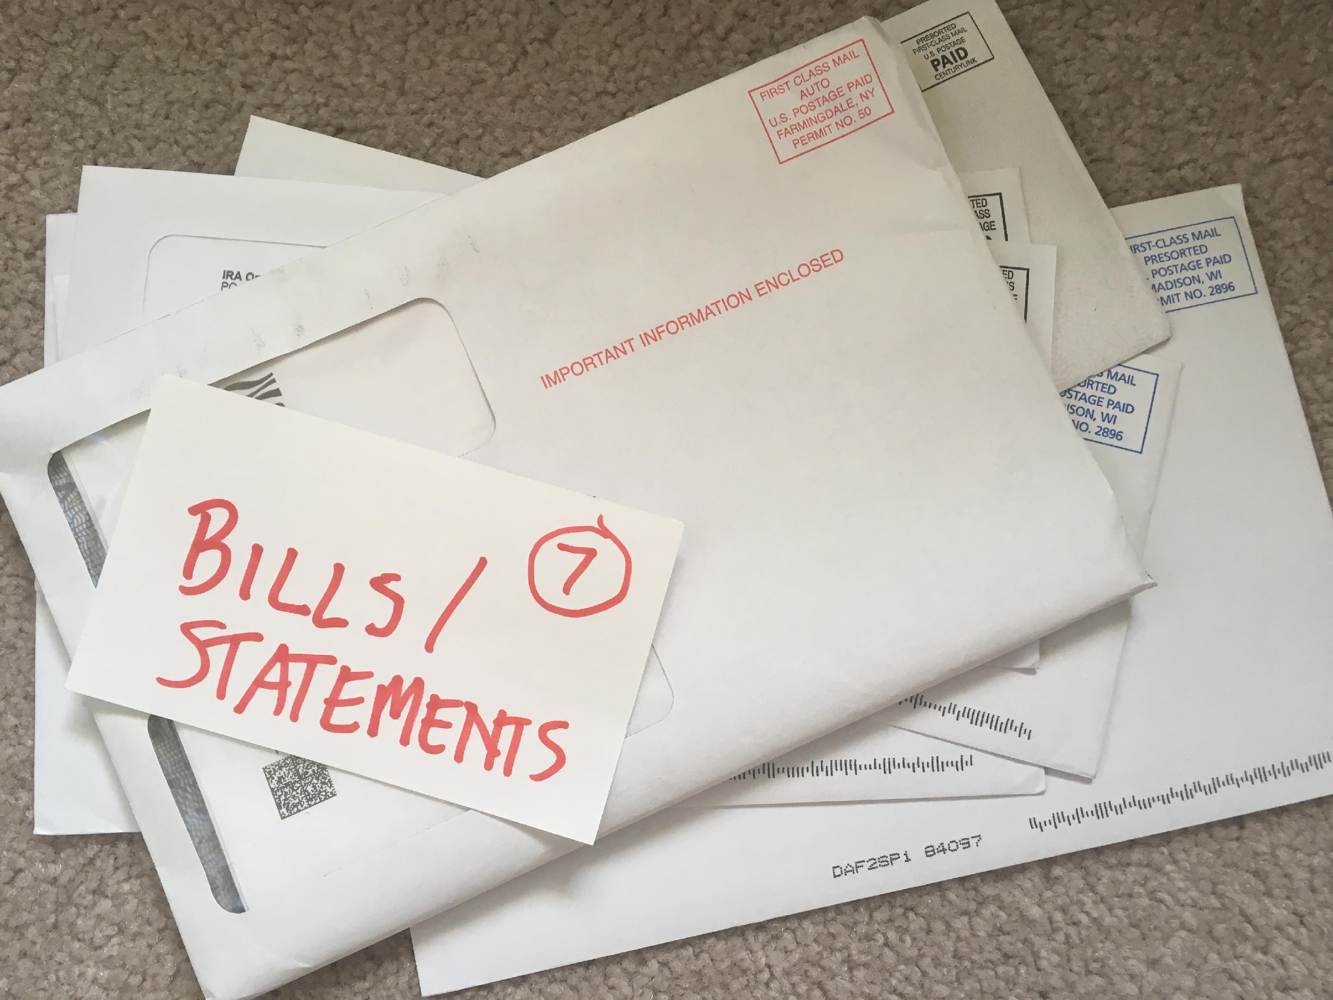
Ideas for Media Literacy Activities
Mail Madness
Collect mail for a week and then sort into four piles. Count the number of each kind of mail you are getting.
Necessary (bills, etc.)
Inspiring/Uplifting (personal mail, building connections, inspiring magazines you’ve subscribed to)
May be of interest (activities, community involvement, candidate information, etc.)
Ads/Junk Mail
Notes:
=

Slide 29
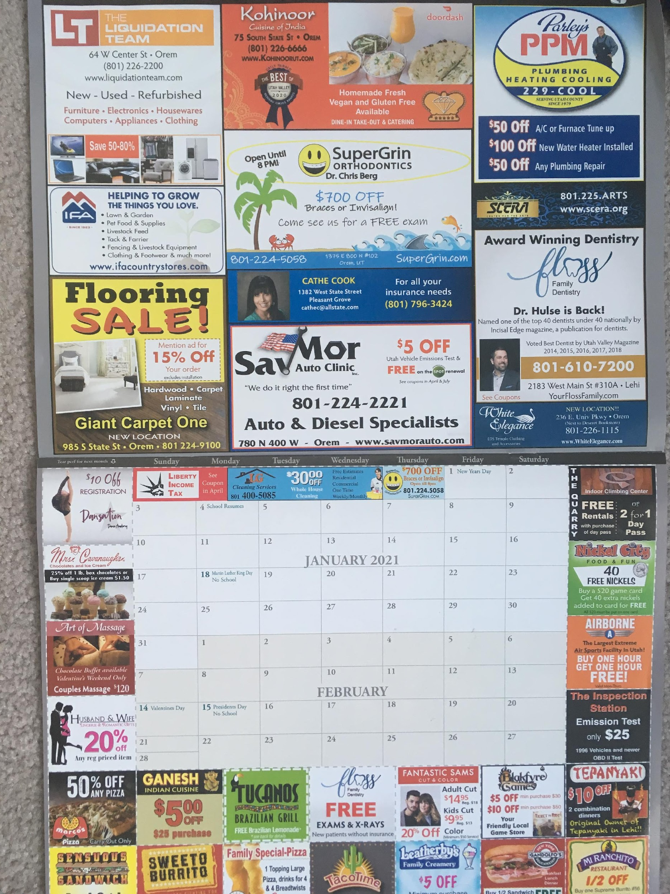
Ideas for Media Literacy Activities
Ad Alert! v.1
Select some form of advertising material you have received in the mail
What techniques do the companies use to get your attention, impact your emotion, cause you to consider possible action?
Look at things like color, font, punctuation, images, ”deals” [“Look family, we can save money by spending it!”], etc.
Notes:
=

Slide 30
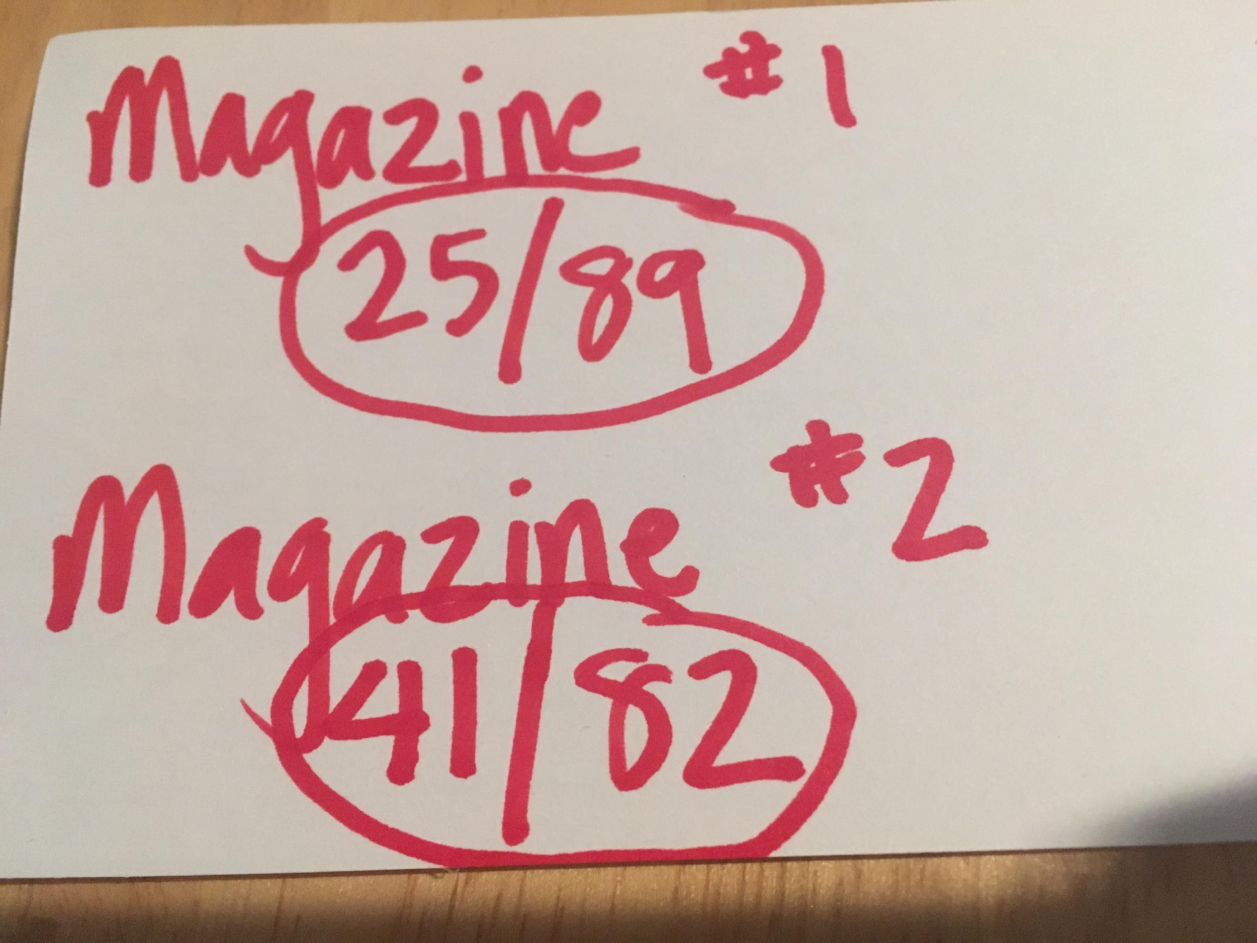
Ideas for Media Literacy Activities
Ad Alert! v.2
Look through your favorite magazine or newspaper. (I did two magazines)
Count the number of ads that appear vs. the number of pages of content. You can count by quarter or half pages to get more granular in your data gathering.
What techniques do the companies use to get your attention, impact your emotion, cause you to consider possible action?
Notes:
=

Slide 31
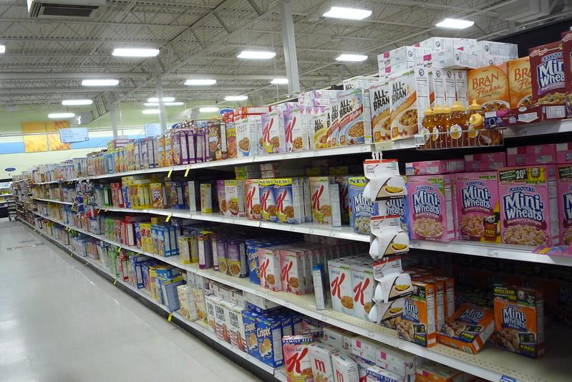
Ideas for Media Literacy Activities
Un-bedazzle the Box
Pull out your favorite cereal, or snack box (or your favorite treat) [or walk through the breakfast food, snacks, or candy aisle]
What techniques do the companies use to get your attention, impact your emotion, cause you to consider possible action?
What information on the packaging sounds good but may be misleading? e.g., a cereal could talk about including whole grain but may be high in sugar; juices use 100% a lot, but 100% of what?
Bonus: Do research on what FDA standards are set for companies to make certain claims on their packaging
https://www.flickr.com/photos/rexroof/3243790269
shared under Creative Commons License 2.0
Notes:
=

Slide 32
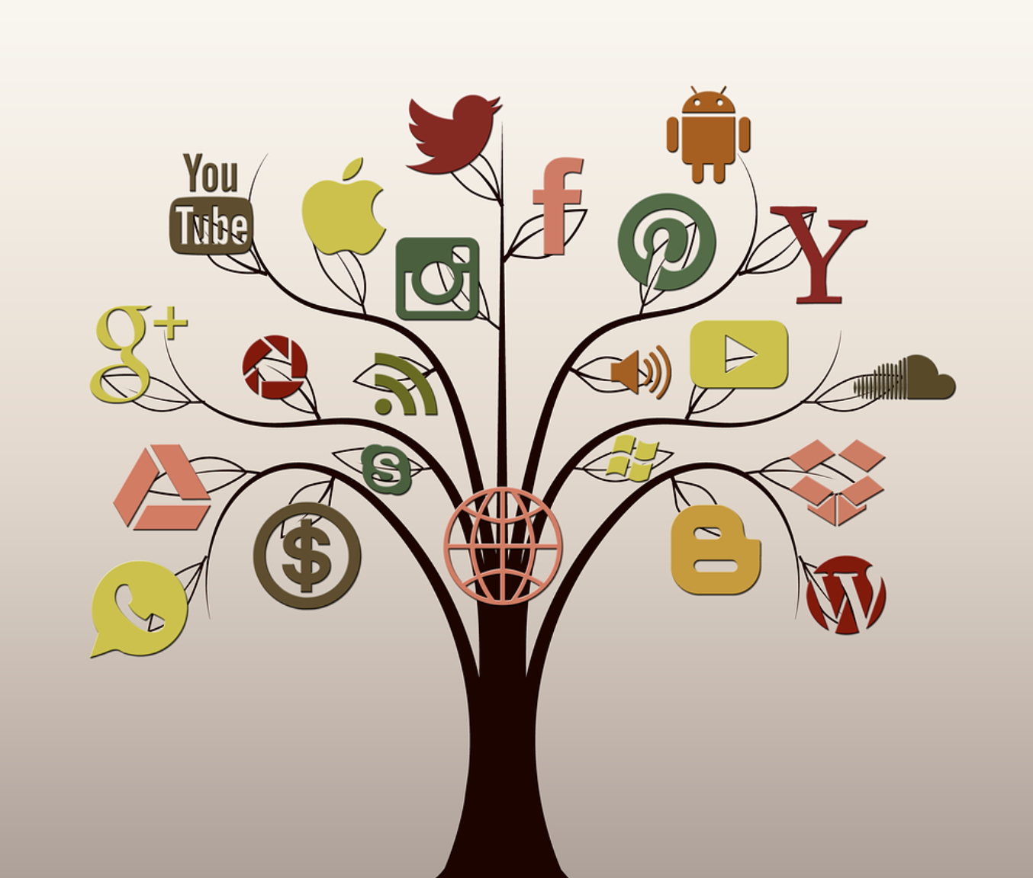
Ideas for Media Literacy Activities
Social Media Sleuth
Sit with your friends or family members on Zoom etc. or in a COVID-safe setting
Each of you open your most-used social media app
Share with each other the top three ads appearing in your feed and/or on your sidebar. Close the tab/window/app.
Now run a search on three recent products, podcasts, or books of interest to you. Share what you are searching with the others.
Re-open the app. Have the ads changed? Keep an eye on your ads in the coming days and see what happens. [I even had ads a while back on a product my son was searching on even though I wasn’t. Or ads that were inaccurately tied to a podcast title that stayed in my feed for at least a week.]
Notes:
=

Slide 33
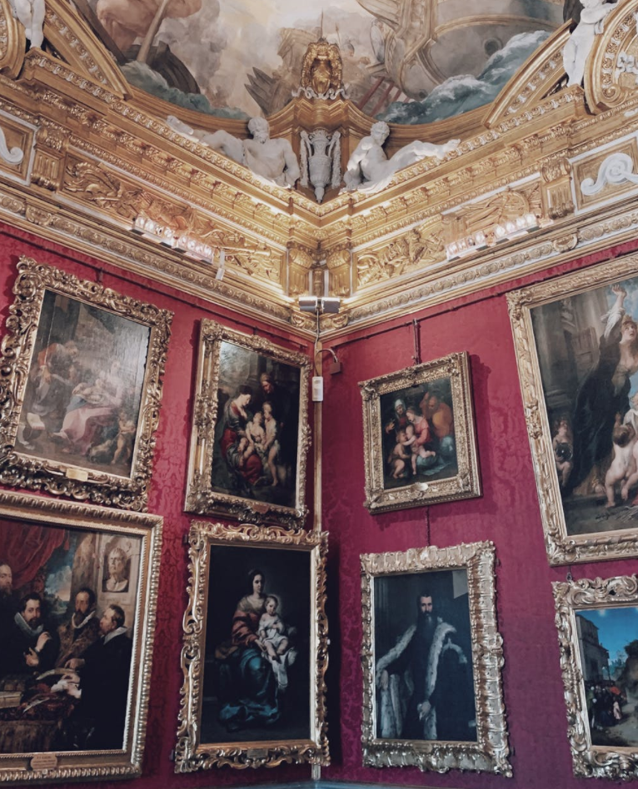
Ideas for Media Literacy Activities
Antsy for Art (theater, music, etc)
If and when it is safe to do so, go to an art museum with family or friends, or visit an online exhibit. Or explore theater or music, etc.
Discuss a piece or two of art, without looking at the artist statement first.
Share what you see, what you feel, what the art makes you think about, and/or anything it may make you want to do.
Now read the artist statement. Do you see, feel, think, or want to act differently after reading it?
Bonus: Do more research about the artist, or research others’ thoughts on the art, if available. Note if there are any shifts in your thoughts and feelings as a result.
Notes:
=Engage with some form of art
Discuss that creation with someone, without looking at the artist statement first or before researching about the piece.
Share what you see, what you feel, what the art makes you think about, and/or anything it may make you want to do.
Now read the artist statement. Do you see, feel, think, or want to act differently after reading it?
Bonus: Do more research about the artist, or research others’ thoughts on the art, if available. Note if there are any shifts in your thoughts and feelings as a result.

Slide 34

Ideas for Media Literacy Activities
Dislike the Like
For at least one week, refrain from liking (or disliking) anyone’s content on social media.
Observe how you feel, what you think, what you want to actually say or do (or not say or do) in response.
If you actually like something, let the person know what your thoughts are and why one-on-one. Focus on the person, not the pixelized content. Let them know you see them.
If after a week you still feel like engaging around social media content, find ways offline to do so where possible.
Remember, algorithms often thrive on discord, division, and emotional discussion. +Bad actors leverage this.
Notes:
=

Slide 35
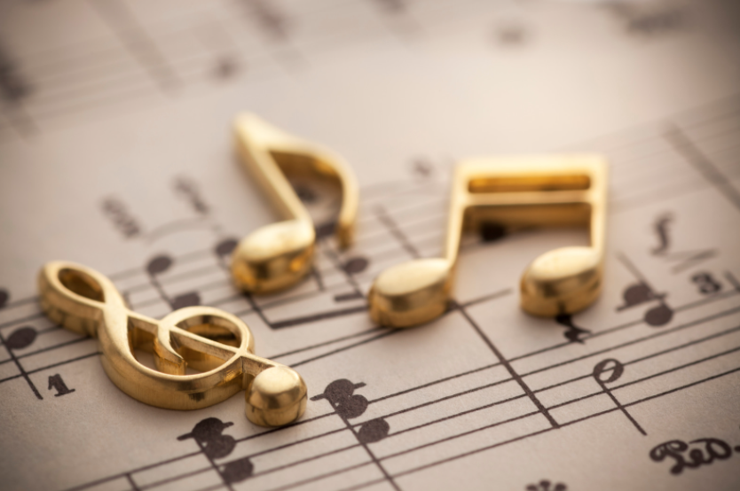
Ideas for Media Literacy Activities
Musical Moments
Share one of your favorite pieces of music (or a song you liked in the past) with a family member, friend, or colleague. Ask them to do the same. (Choose a song with lyrics for this activity.)
Share with each other why you like the music.
Look up the lyrics. Do you have any additional thoughts to share with each other? [e.g., some of the music I liked as a teen now isn’t so high on my list, because of my work and increased awareness around media messaging.]
Bonus: Research the artist’s reasons for writing the piece, if you can find anything about it. Again note if that influences any of your thoughts and feelings about the song.
Notes:
=

Slide 36

Ideas for Media Literacy Activities
Bookish Buddies
With a book group, your family, a friend group, or another group of people, either read the same book and discuss, or come together (this can be done virtually or on social media, too) to each share about a book that has had an impact on you.
Try using the Who, What, When, Where, Why, How analysis questions to share about the book and why it has had an impact on you.
Bonus: Read others’ thoughts/reviews of the book. How is their their 5WH different from or similar to yours? Are they things they saw that you missed? Have your feelings, thoughts, ideas about the book changed at all after reading others’ reviews?
Notes:
=

Slide 37
Ideas for Media Literacy Activities
Help for Headline-itis, v.1
You can do this activity alone or with family or friends or colleagues (etc).
Pick three headlines that have recently caught your attention.
Do 5HW on the headline alone first.
Then read the entire story. Do 5HW again.
Do you think the headline accurately captures the story? Does it capture what you got out of the story? What do you wish had been covered?
Bonus: Find headlines that tell the other “side” of the story and do the same activities with those stories.
Notes:
=

Slide 38
Ideas for Media Literacy Activities
Help for Headline-itis, v.2
You can do this activity alone or with family, friends, colleagues, etc.
Scroll through the top 10 stories in your favorite news resource
How many stories are political in nature?
How many seem to want to induce negative emotions?
How many share something of general human interest (nonpartisan, inspirational content)?
Bonus question: How many headlines did you have to skim before you found something of general human interest?
Notes:
=

Slide 39
Ideas for Media Literacy Activities
Help for Headlineitis, v.3
You can do this activity alone or with family, friends, colleagues, etc.
As you finish each day this week (or at the end of each time period you have set for news-checking. Write down any headline topics that are lingering in your head.
What issues are keeping you awake at night? Are these issues incited by outside forces and distracting you from your center, or are they reflecting issues you want to do something about that align with your core right now?
If it’s the latter, give some thought as to what you want to do and talk about your ideas with a trusted friend.
Notes:
=

Slide 40
Ideas for Digital Citizenship Activities
Stage a Debate (or Gauge the Gauntlet)
Pick a topic that isn’t too charged but still has relevance to our social/cultural/political environment.
Plan a COVID-friendly or virtual event in advance so people have time to do a little research on both sides of a topic.
Divide randomly into two groups.
Assign Group 1 one “side” to debate and Group 2 the other. Then switch. (10-15 minutes prep, 5 minutes presentation.)
Discuss. How did that feel? Can you see any Venn diagram spaces within the debate? etc.
If you were to create media to represent each side, what might that look like? How would media messages different in 5HW ?
Notes:
=

Slide 41
Ideas for Media Literacy Activities
Stage a Debate: Food for Thought for Discussion
"Normally, we used forced choice and false dichotomies during times of significant emotional stress. Our intentions may not be to manipulate, but to force the point that we’re in a situation where neutrality is dangerous. ...
"The problem is that these emotional pleas…prey on our fears of not belonging or being seen as wrong or part of the problem. We need to question how the sides are defined. Are these really the only options? Is this the accurate framing for this debate….?
"If alternatives exist outside of these forced choices (and they almost always do), then the statements are factually wrong. It’s turning an emotion-driven approach into weaponized belonging. And it always benefits the person throwing down the gauntlet and brandishing those forced, false choices.
"The ability to think past either/or situations is the foundation of critical thinking, but still, it requires courage. Getting curious and asking questions happens outside our ideological bunkers. It feels easier and safer to pick a side. The argument is set up in a way that there’s only one real option. If we stay quiet we’re automatically demonized as ‘the other.’
"The only true option is to refuse to accept the terms of the argument by challenging the framing of the debate. But make no mistake; this is opting for the wilderness. Why? Because the argument is set up to silence dissent and draw lines in the sand that squelch debate, discussion, and questions—the very processes that we know lead to effective problem solving.”
-Brené Brown, Braving the Wilderness
Notes:
=

Slide 42
Quote-a-Rama: Food for Thought & Discussion
“[P]eople do care more about accuracy than other content dimensions, but accuracy nonetheless often has little effect on sharing, because (ii) the social media context focuses their attention on other factors such as the desire to attract and please followers/friends or to signal one’s group membership.”
But, the researchers found, attention can be primed toward accuracy {just reminding the brain that it matters} to influence content sharing.
Ergo, there is an attention economy in our own brains. If we value accuracy of information, we can remind ourselves of that before engaging with and deciding what to share online. [Could this apply to consciously giving attention to other values before engaging online? Why not try?]
Research study reported in Nature: https://www.nature.com/articles/s41586-021-03344-2
Emphasis added.
Notes:
=

Slide 43
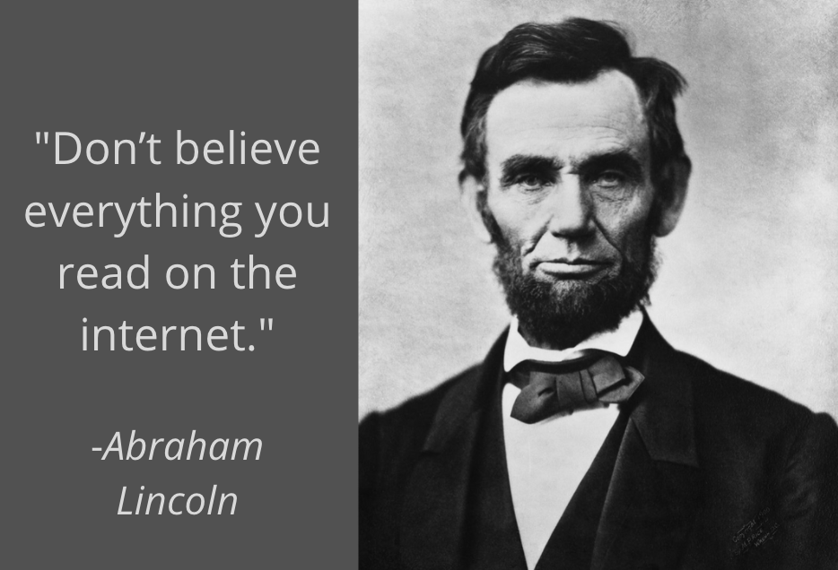
Ideas for Media Literacy Activities
Quote-a-Rama, or Three Lies and a Truth
Invite individuals in your circle to do some homework on incorrect quotes, misattributed quotes, or quotes shared that don’t have a known source.
Have an activity where everyone shares three quotes that aren’t accurate, and one that is. See who can pick the true quote. (Be sure you can source it!_
Turn this into a game or competition as desired.
Discuss why and how even sharing false quotes can be harmful to democracy, and why the opposite is true.
Notes:
=

Slide 44

Before you share, comment, reshare, engage, etc.,
T.H.I.N.K.
Is it TRUE?
Is it HELPFUL?
Is it INSPIRING?
Is it NECESSARY?
Is it KIND?
Notes:
=

Slide 45


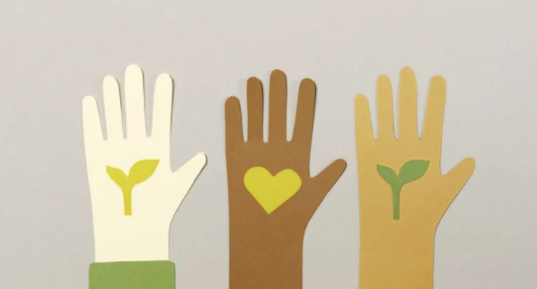
Ideas for #UseTech4Good
Beyond the Ballot
Remember that civic engagement involves more than politics.
Find ways to use the internet to find or create opportunities for service in your community, whether that community be geographical or virtual.
Invite others to join you via social media, or in other forms of communication.
Share how it feels to help another. We can use the our time, attention, energy, and focus to build or destroy. Every choice matters.
Notes:
=

Slide 46
5HW can be used for Digital Citizenship
Where do I spend most of my time online? Are these places that align with who I want to be and what matters most? Is it healthy virtual water to swim in?
Who do I want to be? Am I the same person on and offline?
What matters most to me? Does my online engagement reflect this?
What’s my why for being online? Does that align with who I want to be, what matters most, and…
When am I most likely to engage online? Is it when I’m feeling centered, or when I’m tired and needing a break, or stressed and escaping from life, etc.?
How [do] I want to show up in the world? How do I hope others might feel if they engage with me and my content online?
Notes:
=

Slide 47
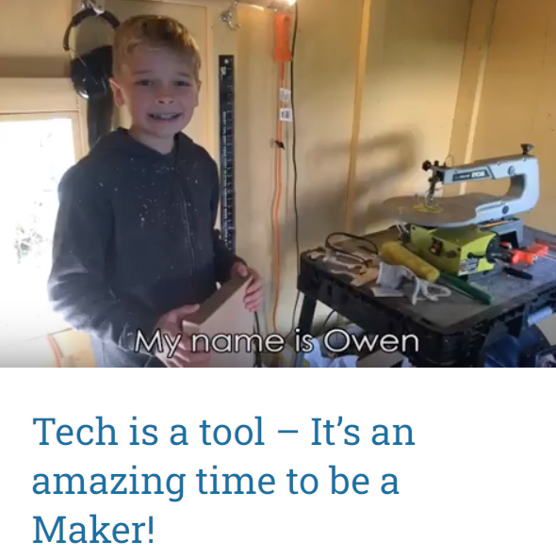
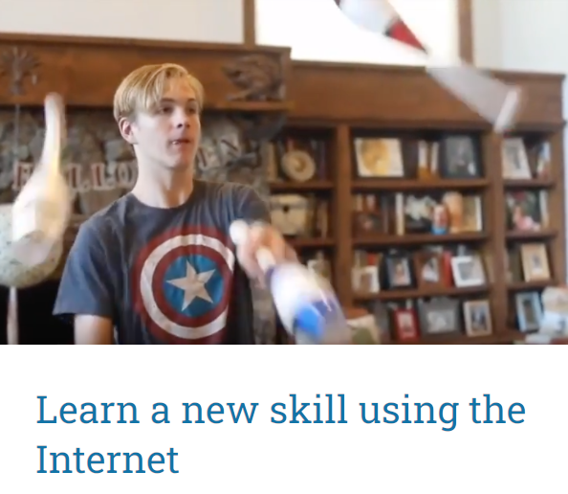

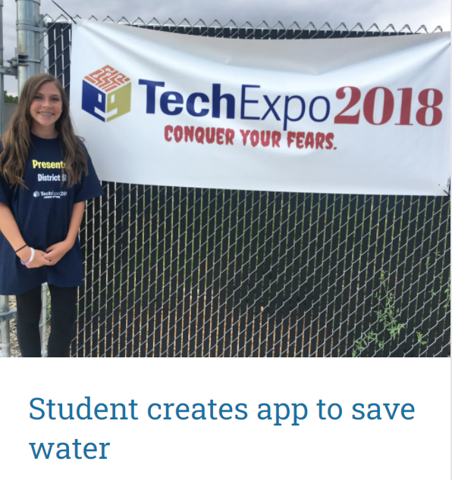
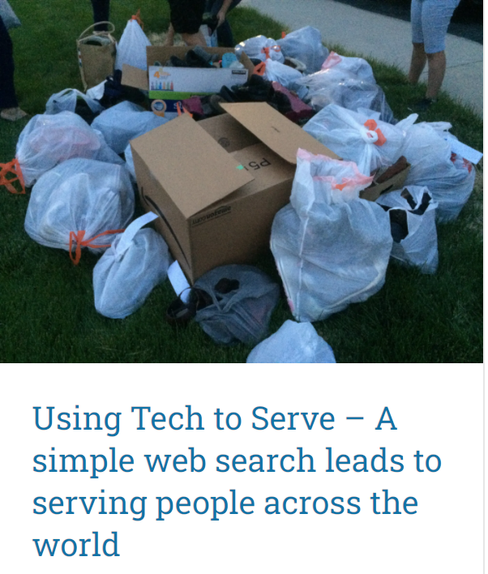
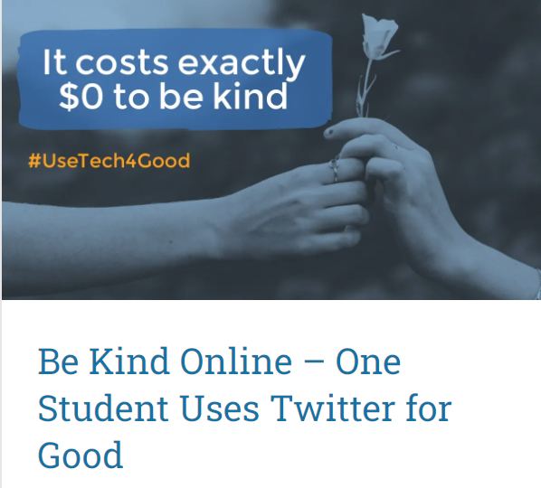
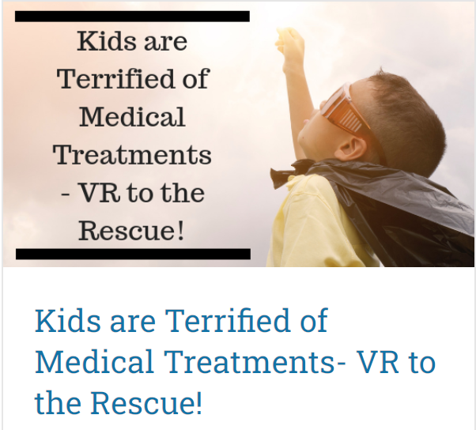


Examples of #UseTech4Good…
…to Connect, Learn, Serve, Lift, Support
Notes:
=

Slide 48
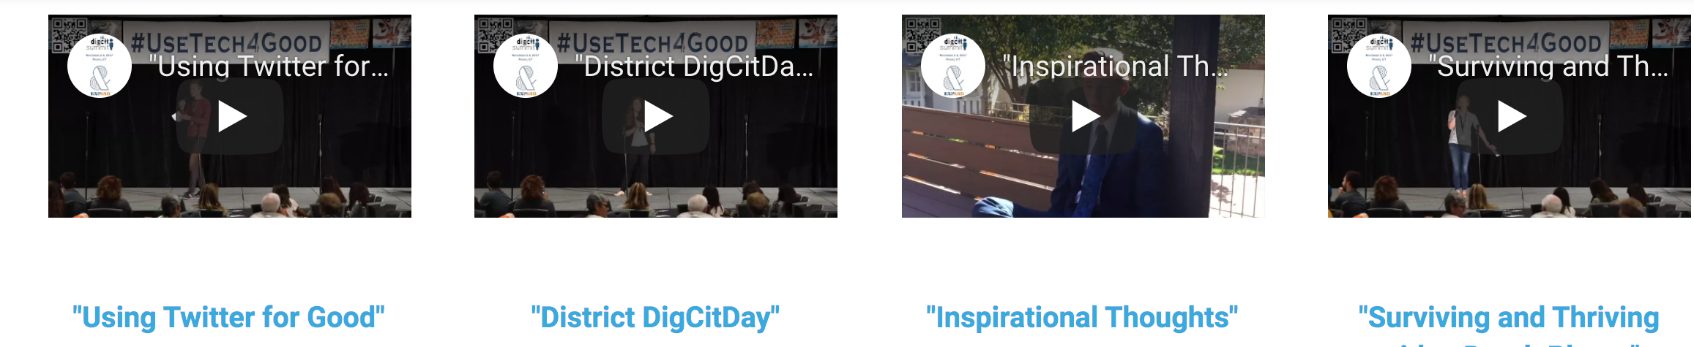
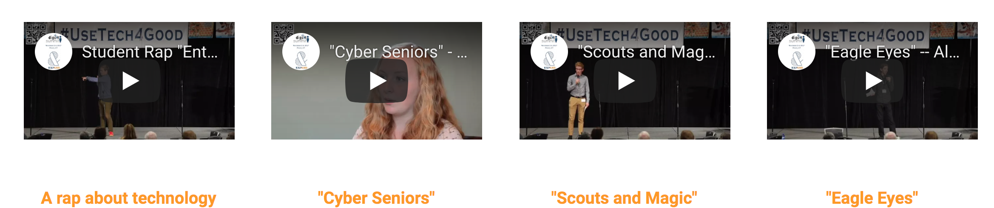
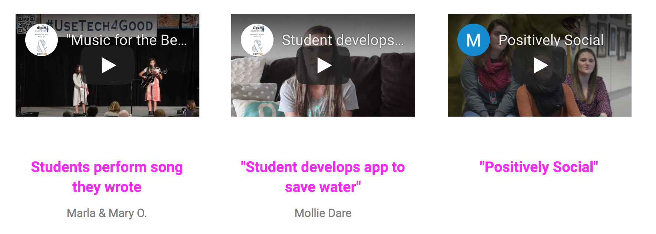
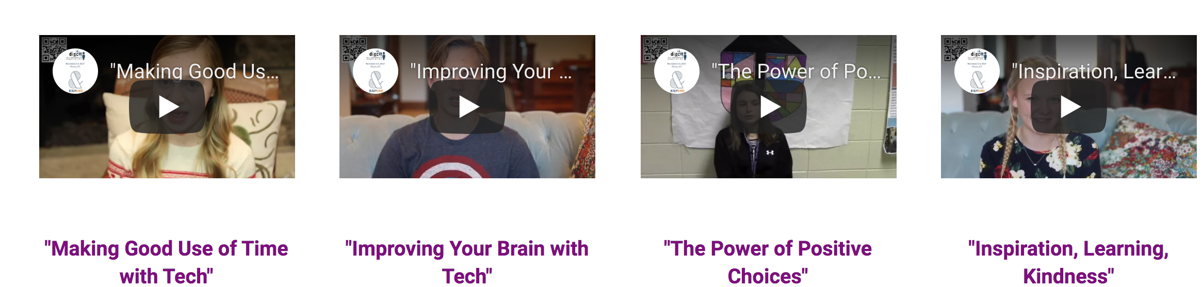
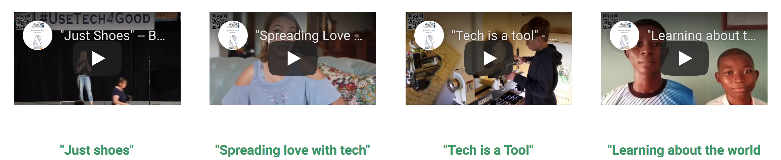
#UseTech4Good Youth Extravaganza
https://www.epik.org/conferences/youth-extravaganza-usetech4good/
Notes:
=

Slide 49
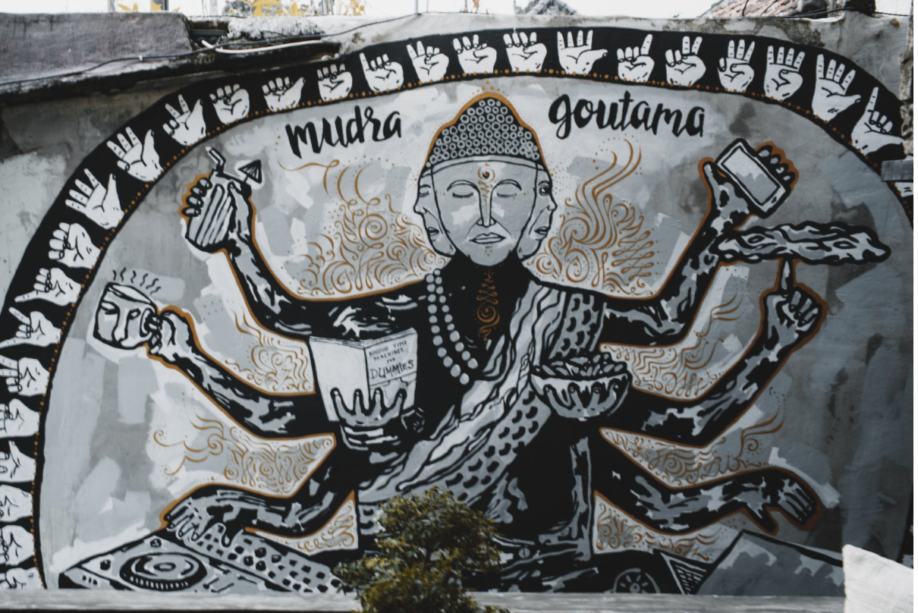
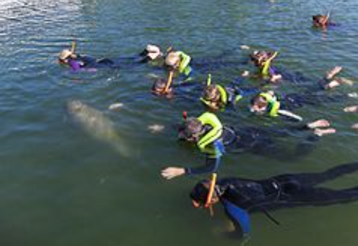
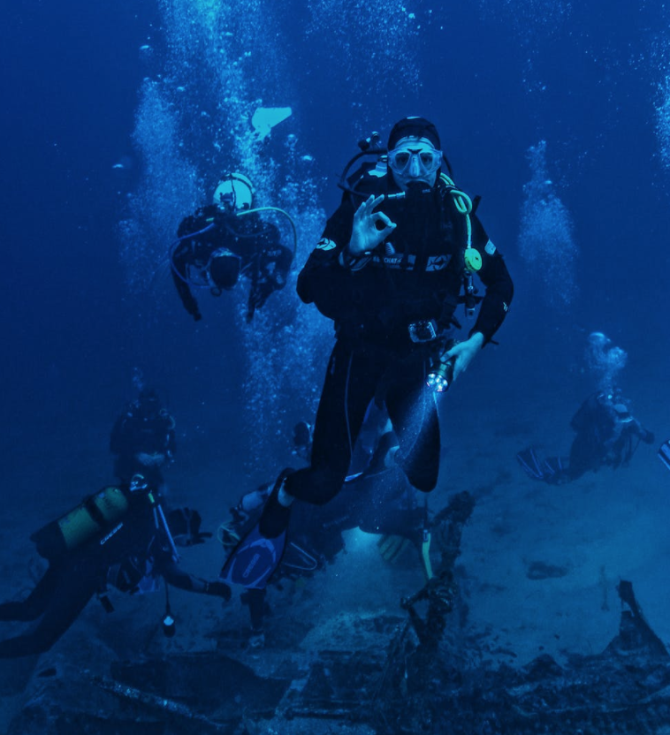
Dislike the Like: Practice Going Deeper
Dislike the Like = Go deeper on relationships and ideas that matter to you. Relationships are not built via drive-by engagement. Problems aren’t solved by memes. See also the discussion guide on Productivity.
“What the [internet] seems to be doing is chipping away my capacity for concentration and contemplation. Whether I’m online or not, my mind now expects to take in information the way the Net distributes it: in a swiftly moving stream of particles. Once I was a scuba diver in the sea of words. Now I zip along the surface like a guy on a Jet Ski.” ― Nicholas G. Carr, The Shallows: What the Internet is Doing to Our Brains
Distraction
/Fragmentation
Shallow Work
Deep Work
Notes:
=

