Slide 1
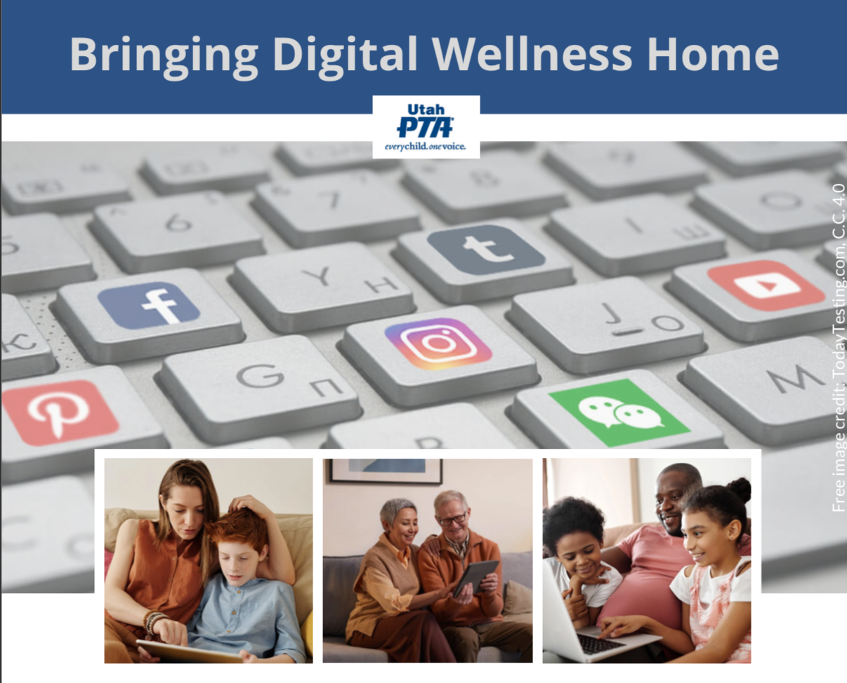
Note: All material in this series is for educational and informational purposes only, and is not meant to be exhaustive or used as a replacement for professional health support. Also, any sharing of resources doesn't imply full endorsement of all of that person or group's work. We share what we find helpful, but invite you to use your media literacy skills in all your study and research.
Notes:
Note: All material in this series is for educational and informational purposes only, and is not meant to be exhaustive or used as a replacement for professional health support. Sharing resources doesn't imply EPIK's endorsement of the individuals or organizations, or endorsement of said entities. Also, the presentation is best viewed in slideshow format, as some of the slides are animated, but we have also included notes for many of the slides that you might want to review as well. Whatever works best for you.
NOTE: Portions of this work first appeared in or are derived or adapted from the Digital
Wellness Certificate Program. Those portions are Copyright © 2021, Digital Wellness Institute.

Slide 2
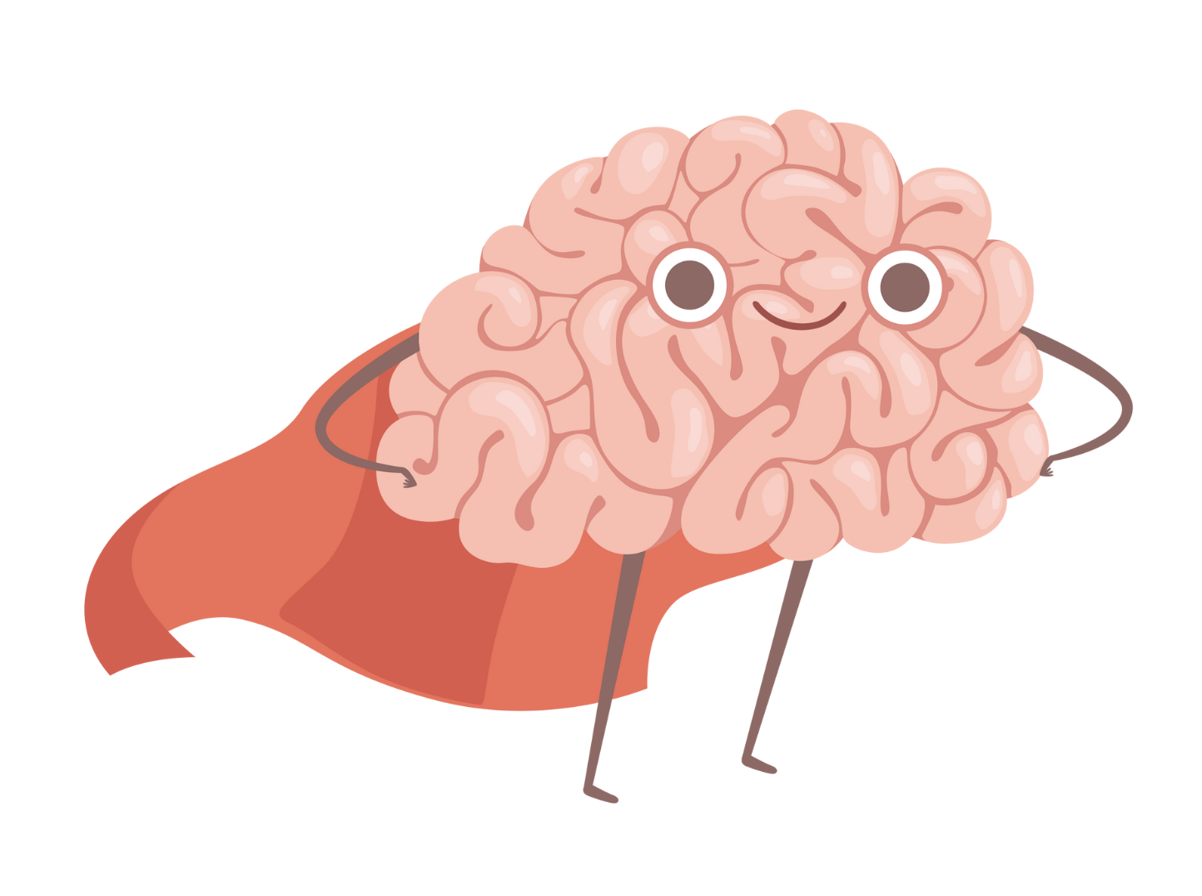
Notes:
As we start to talk about how to engage with the children and youth in our sphere, here's a fun graphic to kick us off. What we talk about today builds on what we have talked about throught the series, and the reflection and connection activity is especially connected to the Mental Wellness module…but we hope you'll be able to see how it ties into the content today as well as we expand on how to build bonding connections with the children and youth we care about.

Slide 3
-Dr. BJ Fogg, Tiny Habits
"People change best by feeling good, not by feeling bad."
"Celebrate successes, no matter how small they are. This is how we take advantage of our neurochemistry."
"Our brains want to feel good. Celebrating small wins gives them something to repattern our life around."
Notes:
p.s. Dr. Fogg is a Behavioral Scientist at Stanford as well. (I hear he's working on material for children and youth that will come out in 2023.) https://www.bjfogg.com/

Slide 4
"When we think about progress, we often imagine how good it feels to achieve a long-term goal or experience a major breakthrough. These big wins are great—but they are relatively rare. The good news is that even small wins can boost inner [elements of well-being] tremendously."
"The Power of Small Wins"
by Teresa M. Amabile and Steven J. Kramer, Harvard Business Review, May 2011
Bonus quote: "the progress principle: Of all the things that can boost emotions, motivation, and perceptions during a workday, the single most important is making progress in meaningful work."
Consider the parallels to Social Development Strategy for youth!
Notes:
This quote comes from an article written for managers – about how to build more of a culture of motivation and positive "inner work life." The principles could be applied in a home or other setting as well. https://hbr.org/2011/05/the-power-of-small-wins – "the progress principle: Of all the things that can boost emotions, motivation, and perceptions during a workday, the single most important is making progress in meaningful work." Consider the parallels to Social Development Strategy for youth!

Slide 5
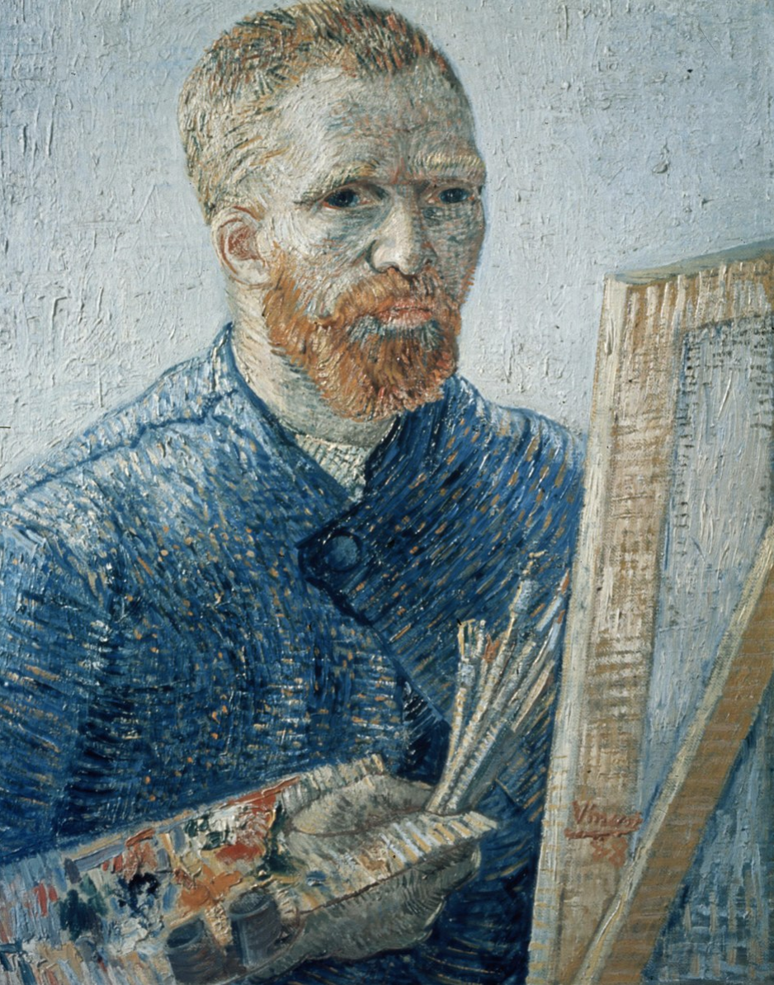
"[T]he great doesn’t happen through impulse alone, and is a succession of little things that are brought together." -Vincent Van Gogh
Notes:
https://vangoghletters.org/vg/letters/let274/letter.html

Slide 6

Think & Write: What is one small win you have experienced in the past six weeks?
Notes:
30 second free write – write at least one small win you have noticed or experienced…and feel free to write as many as come to mind …but really, for this exercise, the goal is to keep it simple!

Slide 7

Share: One small win you have experienced
Notes:
We did an around-the-Zoom share. We also invite you to share one small win from this series with someone you know.

Slide 8
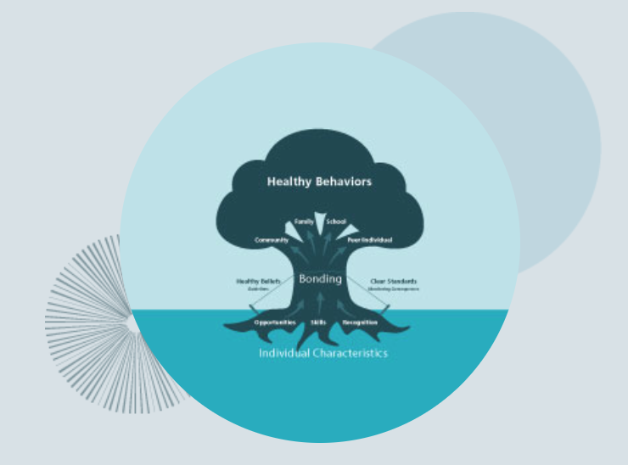
Week #7 Social Development Strategy
Bringing Digital Wellness Home
Notes:
In this week's folder, we've included a collaborative white paper that was written as part of the 2017 Digital Citizenship Summit that EPIK hosted. It attempted to explore connections between reducing risks through filters/monitoring software (the monitoring company that helped write the paper is located in the UK). I also noticed when reviewing it again that the final copy does not clearly mark some of the direct quotes. We did not do the final layout, but I should have caught that in final editing processes. My apologies. We were very thorough in our footnoting, however, so we encourage exploring the footnotes for more detailed exploration of the different topics. White papers are a snapshot in time, so we would include different things now than we did then, and would not repeat having a product company co-sponsor a document. We liked the processes that Impero helped schools develop, but we do not endorse one particular product over another.

Slide 9
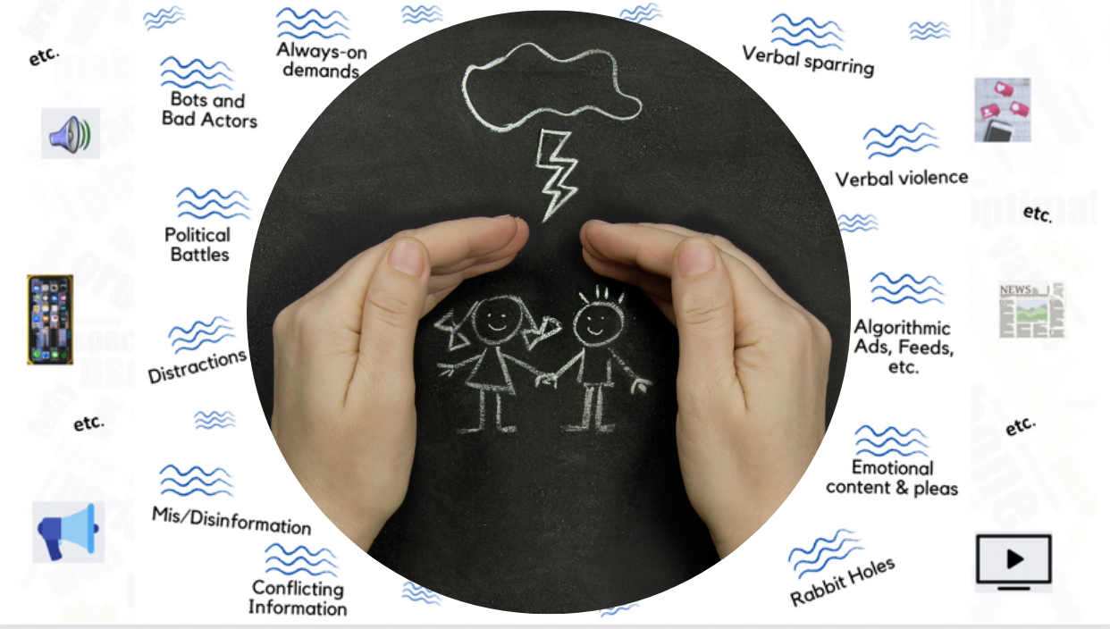
Finally! We're going to talk about protecting our kids! :)
Notes:
We've spent a lot of time during this series talking about putting on our own oxygen masks first, but ultimately, we hope our individual efforts toward Digital Wellness can mean we have more capacity to do some good in the world, to be influencers for good. There is perhaps no more important place for that to happen than with our direct interactions with children and youth in our own spheres of influence – in our homes, in classrooms, and in our communities.

Slide 10
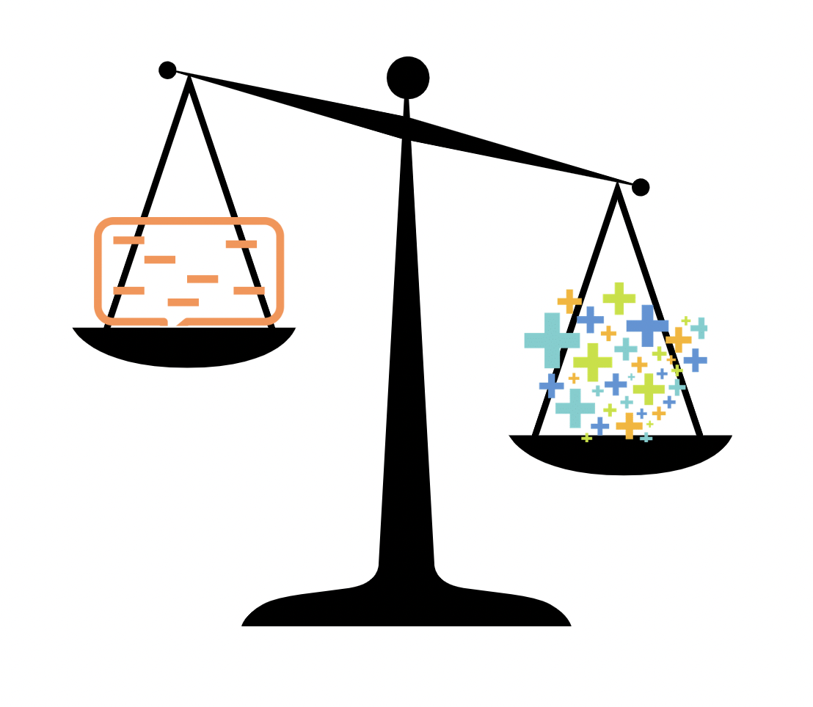
Prevention Science:
Reduce Negatives, Increase Positives
Notes:
Prevention Science can really be boiled down to two simple ideas: reducing negatives and increasing positives.
One thing I didn't mention when talking about heart disease – if we look at behaviors like alcohol or smoking or overeating – these all often have emotional roots (ways to cope with pain that end up creating more pain) or even can be connected to attachment wounds. Even looking at heart disease, we can come to understand that it's not just about telling people to just stop harmful behaviors – it's about helping them build awareness of what is happening inside of them (point and name, internal triggers in the language Nir Eyal uses) to make behavioral improvements. In addiction recovery circles, the process of healing is not simply about stopping unwanted behaviors – it's about healing and growth in beliefs, thoughts, self-talk, emotional awareness…and a sense of belonging and worth in a social context.

Slide 11
Reduce Risk Factors, Increase Protective Factors
Notes:
These are the terms used in prevention science to increase positives (increase protective factors) and reduce negatives (risk factors)

Slide 12
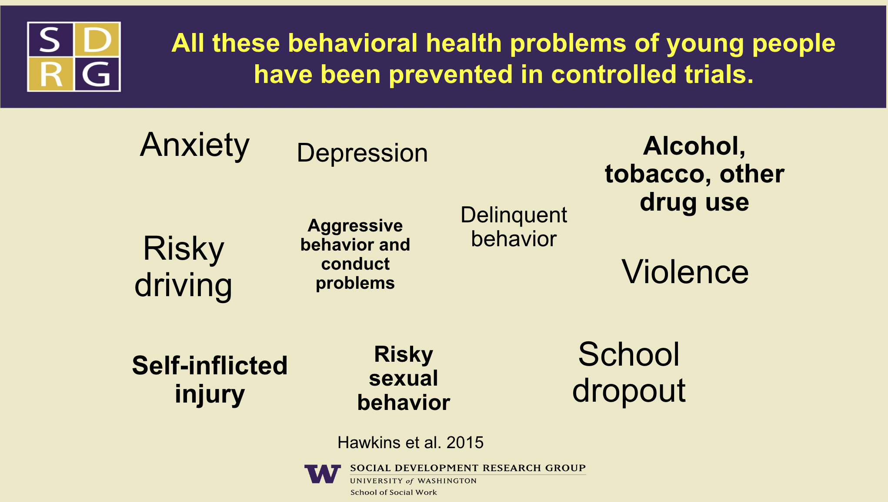
Notes:
As a caveat before we talk about Prevention Science research (including Social Development Strategy), the research in this sphere has been focused on "analog" behavioral and wellness concerns. This slide comes from the presentation that Dr. David Hawins (one of the two primary researchers behind Social Development Strategy) gave at the DigCitSummit in 2017. https://www.epik.org/conferences/2017-digcitsummit/
https://drive.google.com/file/d/0B9Mgfq363IyGQ2ZoX0tDUmZSSldvVHUxYl84QVdyaDVjTmRv/view?usp=sharing&resourcekey=0-r8pxHrxAzMUfl0tL7EtSDA

Slide 13
Notes:
But consider how each of these issues that has been researched has been and continues to be impacted by the internet. We need to keep expanding how we talk about and measure wellness.
This slide comes from the presentation that Dr. David Hawkins (one of the two primary researchers behind Social Development Strategy) gave at the DigCitSummit in 2017. https://www.epik.org/conferences/2017-digcitsummit/
https://drive.google.com/file/d/0B9Mgfq363IyGQ2ZoX0tDUmZSSldvVHUxYl84QVdyaDVjTmRv/view?usp=sharing&resourcekey=0-r8pxHrxAzMUfl0tL7EtSDA

Slide 14
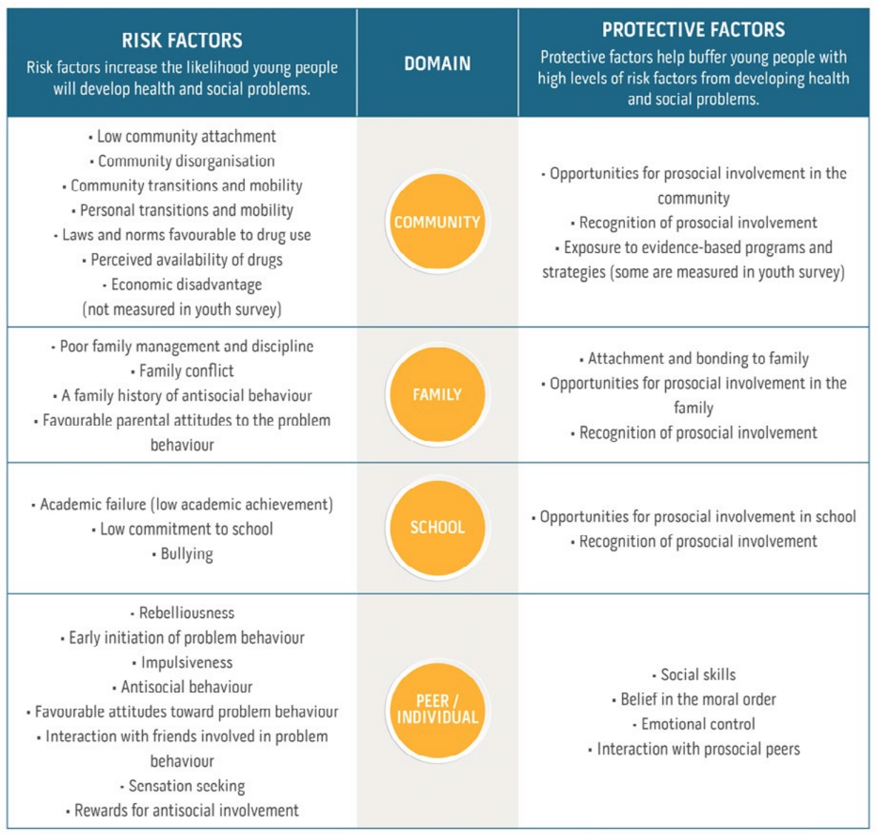
Notes:
https://www.communitiesthatcare.org.au/how-it-works/risk-and-protective-factors

Slide 15
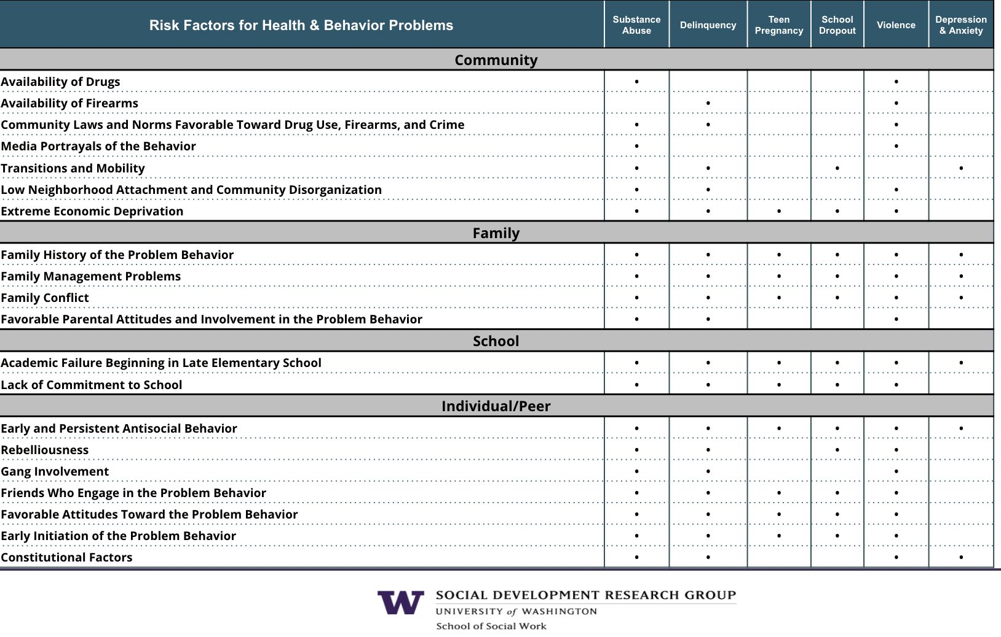
Notes:
Other research has shown more extensive impacts of media on the well-being of youth, including with regard to sexual behaviors, e.g., https://www.ncbi.nlm.nih.gov/pmc/articles/PMC2792691/
This chart that shows how risk factors can cut across multiple behavioral/health concerns, from Dr. J. David Hawkins' presentation at the 2017 DigCitSummit. Again, bear in mind that this research has not looked at the impact of digital devices on behavioral health, and there is more research specifically in the realm of media and health that perhaps could supplement the research they have done.
https://drive.google.com/file/d/12t2ZDz_p9M2KAPdQI_Ca8bI_Og5OYjpE/view?usp=sharing

Slide 16
Notes:
https://www.communitiesthatcare.org.au/how-it-works/risk-and-protective-factors – Social Development Strategy is a model designed to distill the patterns around Protective Factors that were found in Prevention Science research, such as the ideas circled in red. (I added one more circle than what was on the slide for our live gathering.)

Slide 17
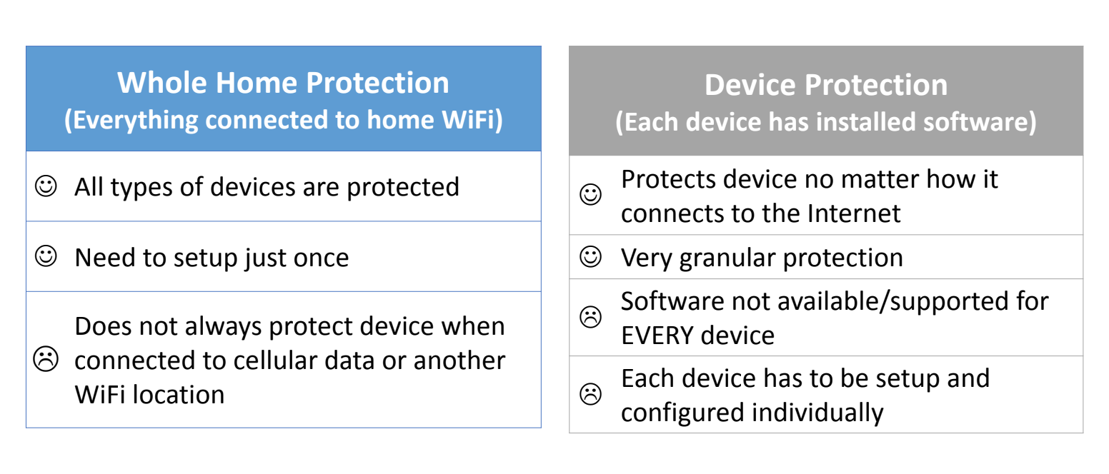
Decreasing the Negatives, e.g.,
Notes:
This presentation by Ken Knapton, internet safety expert, can be found in this week's folder. [Note: Was created for a Latter-day Saint audience. Shared with permission. Some material may be out of date; this was given in 2018. Be sure to do your own homework on tech tools. We don't endorse or recommend any specific products. https://drive.google.com/file/d/1J0H8EV0zBF4TmgZt5Xi9ozCuAaYOYOGU/view?usp=sharing

Slide 18
More tech tools for your exploration (bonus slide)
I mentioned tools recommended by (or sponsored by?) Nir Eyal. Here's the link: https://www.nirandfar.com/indistractable-tools/ A few of these tools were mentioned in our Digital Wellness Certification course. We don't endorse or recommend any specific product.
Note: We didn't have time to cover his four-step plan for Digital Wellness (see bonus materials in the Honoring Time slide deck)...but notice in which order he organizes the tools.
Internal triggers come first (mental, emotional awareness)
Traction comes next (matching time with values)
Then comes tech support to reduce external distractions (be careful – some tools like this can become their own distraction)
Then he talks about "pacts" with one's self.
Nir's work is for adults; for children and youth, some adults may want to use technology to help prevent accidental exposure to harmful material (reducing unnecessary risk factors) and/or to have a finger on the pulse on the tech use of young people – but no matter how good filters may be at home, the minute a child steps out the door, they will need their own internal filters – skills and abilities to be aware and responsible – in order to stay well in their young lives.

Slide 19

Notes:
We've talked about the importance of mentoring over monitoring, and Social Development Strategy reinforces this idea. ("Just say no" alone also doesn't work – see next slides.) However, Prevention Science also espouses appropriate "finger on the pulse" monitoring of behavior. (It's hard to mentor if you don't know where a child or youth is in their behavioral development and choices.)
And yet, as the research we shared last week suggests, overly rigid control re: digital life can backfire. https://wheatley.byu.edu/report-teaching-by-example
And here's the article I mentioned about how being overly controlling about candy can also backfire (not saying we should let kids have a free-for-all with tech, but consider where parallels across different wellness spheres might exist): https://www.ksl.com/article/50500200/should-you-let-halloween-be-a-candy-free-for-all-maybe-experts-say

Slide 20
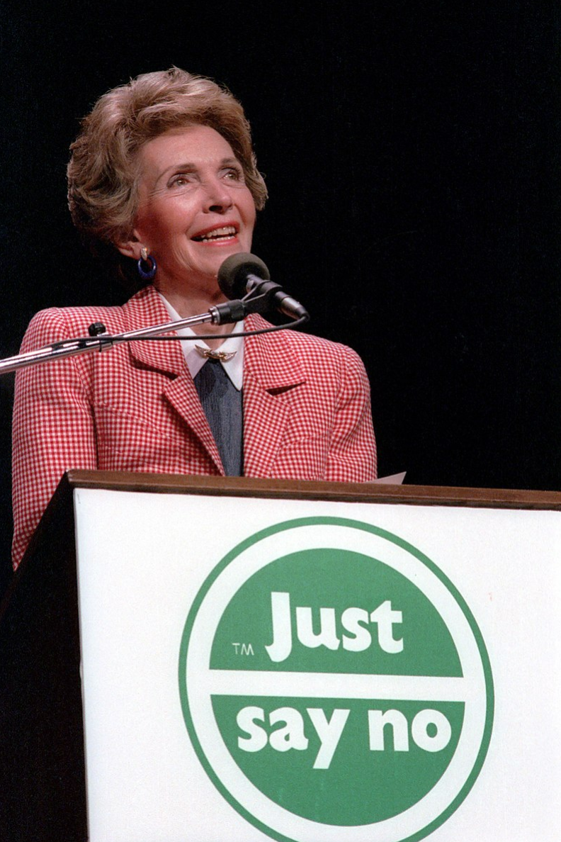
"Just Say No" didn't work (and sometimes makes things worse e.g.,"Don't think of the elephant")
Notes:
We've spent a lot of time during this series talking about putting on our own oxygen masks first, but ultimately, we hope our individual efforts toward Digital Wellness can mean we have more capacity to do some good in the world, to be influencers for good. There is perhaps no more important place for that to happen than with our direct interactions with children and youth in our own spheres of influence – in our homes, in classrooms, in community service settings.

Slide 21
"Just Say No" could work for those youth who had healthy bonding in their lives
See Dr. J. David Hawkins here: https://www.youtube.com/watch?v=jmiaTn9SoKQ @ time stamp 27:45
Notes:
I'd not heard a Prevention Science expert talk about this concept until this time around while reviewing some of Dr. Hawkins' presentations. See Dr. David Hawkins here: https://www.youtube.com/watch?v=jmiaTn9SoKQ @ time stamp 27:45

Slide 22
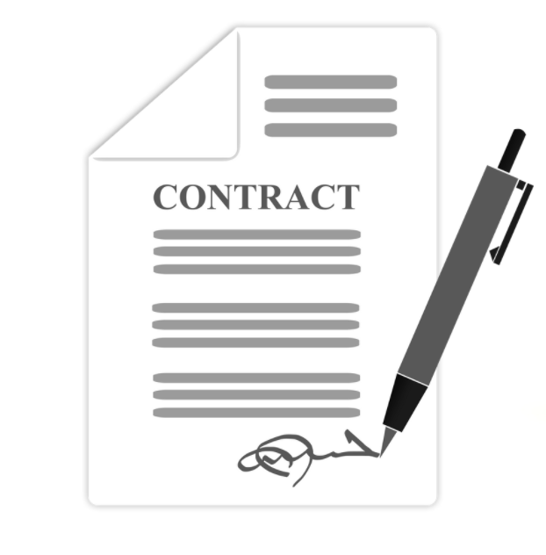
Contracts ("just say no") alone = not a good strategy
Notes:
Contracts alone will be even less effective if they are just thrown over the wall AT children and youth. At the very least, if you engage a contract, engage them in its creation (see later slides about meaningful, age-appropriate opportunities for involvement as being a key part of Social Development Strategy.

Slide 23

Increasing Protective Factors
= Social Development Strategy
See the white paper, Unleashing the Power of Prevention:https://nam.edu/wp-content/uploads/2015/06/DPPowerofPrevention.pdf and
https://www.communitiesthatcare.net/
Notes:
Social Development Strategy folds in principles and patterns that experts in the Behavioral Health space have discovered can work across multiple behavioral issues, from substance abuse to suicide risk to school dropout issues to violence to unhealthy sexual behaviors, and more. See the white paper, "Unleashing the Power of Prevention:" https://nam.edu/wp-content/uploads/2015/06/DPPowerofPrevention.pdf and
https://www.communitiesthatcare.net/

Slide 24
Notes:
This is my favorite image from Social Development Strategy but there is not a version of it that is big enough to explore. I like the idea of looking at roots that can help across multiple branches of behavior, which is what Social Development Strategy is about. This is from https://www.communitiesthatcare.net/
See the white paper, Unleashing the Power of Prevention:
https://nam.edu/wp-content/uploads/2015/06/DPPowerofPrevention.pdf and
https://www.communitiesthatcare.net/
or presentations by Dr. J. David Hawkins, e.g., https://www.youtube.com/watch?v=nTQd9n6vCgA or https://www.youtube.com/watch?v=jmiaTn9SoKQ

Slide 25
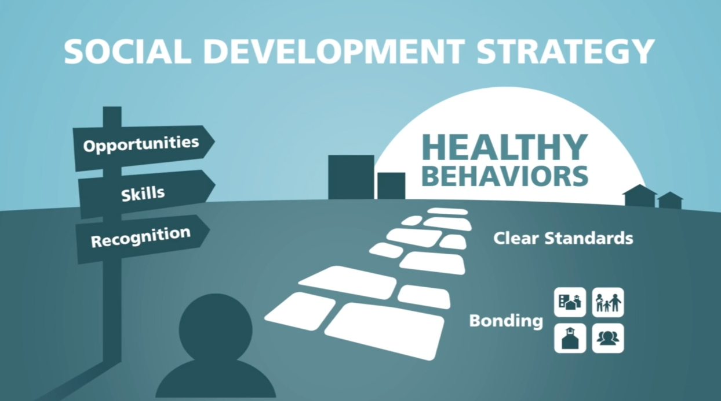
For evidence-based programs that are connected to Prevention Science and Youth Development Research, see Blueprints for Healthy Youth Development: https://www.blueprintsprograms.org/
Notes:
See the white paper, Unleashing the Power of Prevention:
https://nam.edu/wp-content/uploads/2015/06/DPPowerofPrevention.pdf and
https://www.communitiesthatcare.net/
or presentations by Dr. J. David Hawkins, e.g., https://www.youtube.com/watch?v=nTQd9n6vCgA or https://www.youtube.com/watch?v=jmiaTn9SoKQ

Slide 26

Social Development Strategy = 5 elements
Notes:
Dr. Hawkins like to share Social Development Strategy using five fingers.
e.g., https://www.youtube.com/watch?v=nTQd9n6vCgA or https://www.youtube.com/watch?v=jmiaTn9SoKQ

Slide 27


Notes:
The end results of engaging in Social Development Strategy is youth who are more invested in the standards of behavior of the social sphere (be it home, school, or community). This implies, of course, that adults need to have a sense for what healthy behaviors are – first so they can model them. A culture of healthy behavior around the children and youth is important (and the lack thereof can be a risk factor).
See the white paper, Unleashing the Power of Prevention:
https://nam.edu/wp-content/uploads/2015/06/DPPowerofPrevention.pdf and
https://www.communitiesthatcare.net/
or presentations by Dr. J. David Hawkins, e.g., https://www.youtube.com/watch?v=nTQd9n6vCgA or https://www.youtube.com/watch?v=jmiaTn9SoKQ

Slide 28
“Don't aim at success. The more you aim at it and make it a target, the more you are going to miss it. For success, like happiness, cannot be pursued; it must ensue…in the long-run."
Viktor Frankl
[T]he pursuit of success can be a catalyst for failure. Put another way, success can distract us from focusing on the essential things that produce success in the first place.”
― Greg McKeown, Essentialism: The Disciplined Pursuit of Less
Notes:
As I was reviewing the principles from Social Development Strategy, these concepts came to mind. Often we may go directly for behavioral management, but what Social Development Strategy illustrates is that often, focusing on the elephant can increase the problem. Focusing on building the well-being of the young person, and building bonding relationships, can have significant impact across multiple behavioral concerns within multiple spheres in a youth's life.

Slide 29
Hold Onto Your Kids
“The key to activating maturation is to take care of the attachment needs of the child. To foster independence we must first invite dependence; to promote individuation we must provide a sense of belonging and unity; to help the child separate we must assume the responsibility for keeping the child close. We help a child let go by providing more contact and connection than he himself is seeking. When he asks for a hug, we give him a warmer one than he is giving us. We liberate children not by making them work for our love but by letting them rest in it. We help a child face the separation involved in going to sleep or going to school by satisfying his need for closeness.”
Notes:
Often we may go directly for behavioral management or expect our young people to be able to "just say no" or to just be able to manage the process of learning to use digital devices wisely without much support. But attachment theory supports what what Social Development Strategy illustrates – that building bonding relationships is essential for the healthy development of children and youth.

Slide 30


Notes:
1, 2, and 3 work together to build bonding – remember: Opportunities, Skills, Recognition (taking individual characteristics and situations into account)
See the white paper, Unleashing the Power of Prevention:
https://nam.edu/wp-content/uploads/2015/06/DPPowerofPrevention.pdf and
https://www.communitiesthatcare.net/
or presentations by Dr. J. David Hawkins, e.g., https://www.youtube.com/watch?v=nTQd9n6vCgA or https://www.youtube.com/watch?v=jmiaTn9SoKQ

Slide 31
Notes:
1, 2, and 3 work together to build bonding – remember: Opportunities, Skills, Recognition (taking individual characteristics and situations into account)
See the white paper, Unleashing the Power of Prevention:
https://nam.edu/wp-content/uploads/2015/06/DPPowerofPrevention.pdf and
https://www.communitiesthatcare.net/
or presentations by Dr. J. David Hawkins, e.g., https://www.youtube.com/watch?v=nTQd9n6vCgA or https://www.youtube.com/watch?v=jmiaTn9SoKQ

Slide 32
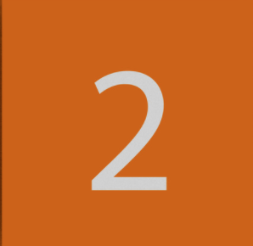
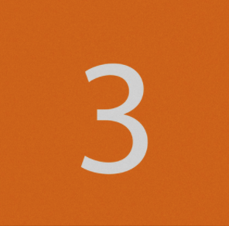
OPPORTUNITIES for
Age-appropriate active involvement
SKILLS
RECOGNITION
for effort, progress, successes
Notes:
1, 2, and 3 work together to build bonding – remember: Opportunities, Skills, Recognition (taking individual characteristics and situations into account)
See the white paper, Unleashing the Power of Prevention:
https://nam.edu/wp-content/uploads/2015/06/DPPowerofPrevention.pdf and
https://www.communitiesthatcare.net/
or presentations by Dr. J. David Hawkins, e.g., https://www.youtube.com/watch?v=nTQd9n6vCgA or https://www.youtube.com/watch?v=jmiaTn9SoKQ

Slide 33
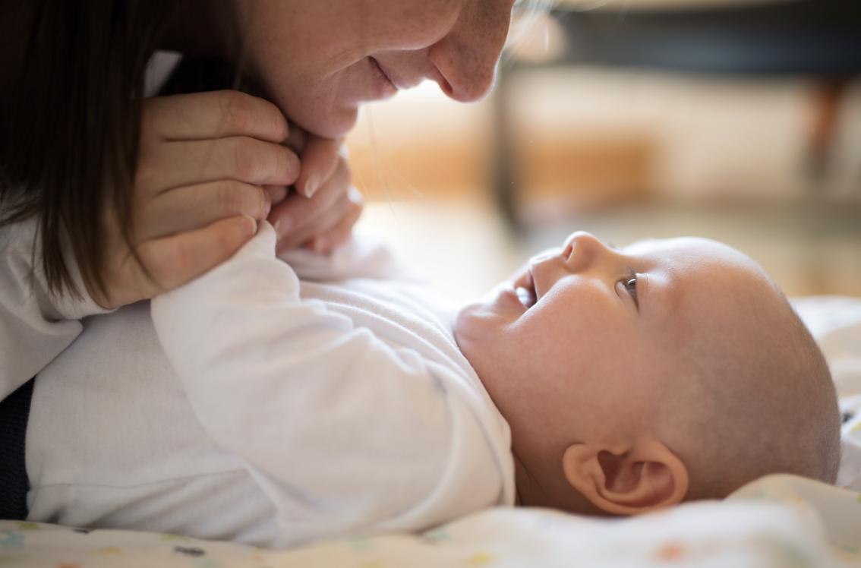
Notes:
See the recording for explanations of the following examples.
Similar examples are used by Dr. Hawkins or in other research.
1, 2, and 3 work together to build bonding – remember: Opportunities, Skills, Recognition (taking individual characteristics and situations into account)
See the white paper, Unleashing the Power of Prevention:
https://nam.edu/wp-content/uploads/2015/06/DPPowerofPrevention.pdf and
https://www.communitiesthatcare.net/
or presentations by Dr. J. David Hawkins, e.g., https://www.youtube.com/watch?v=nTQd9n6vCgA or https://www.youtube.com/watch?v=jmiaTn9SoKQ

Slide 34
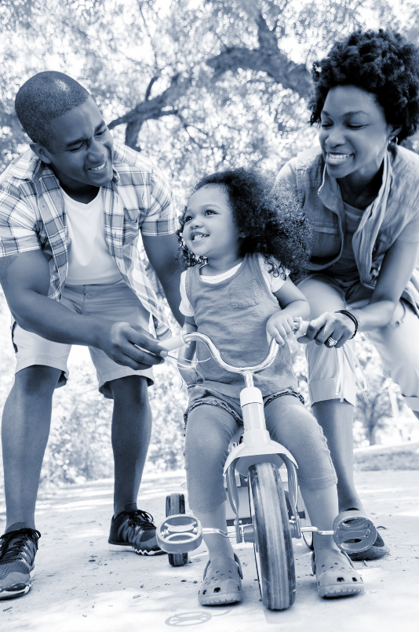
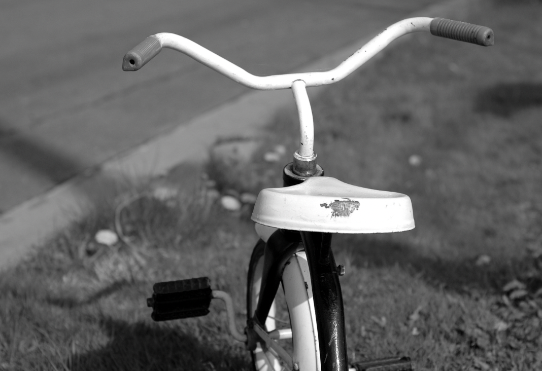
Notes:
This example is explored in this paper: https://www.journals.uchicago.edu/doi/full/10.1086/700274
1, 2, and 3 work together to build bonding – remember: Opportunities, Skills, Recognition (taking individual characteristics and situations into account)
See the white paper, Unleashing the Power of Prevention:
https://nam.edu/wp-content/uploads/2015/06/DPPowerofPrevention.pdf and
https://www.communitiesthatcare.net/
or presentations by Dr. J. David Hawkins, e.g., https://www.youtube.com/watch?v=nTQd9n6vCgA or https://www.youtube.com/watch?v=jmiaTn9SoKQ

Slide 35
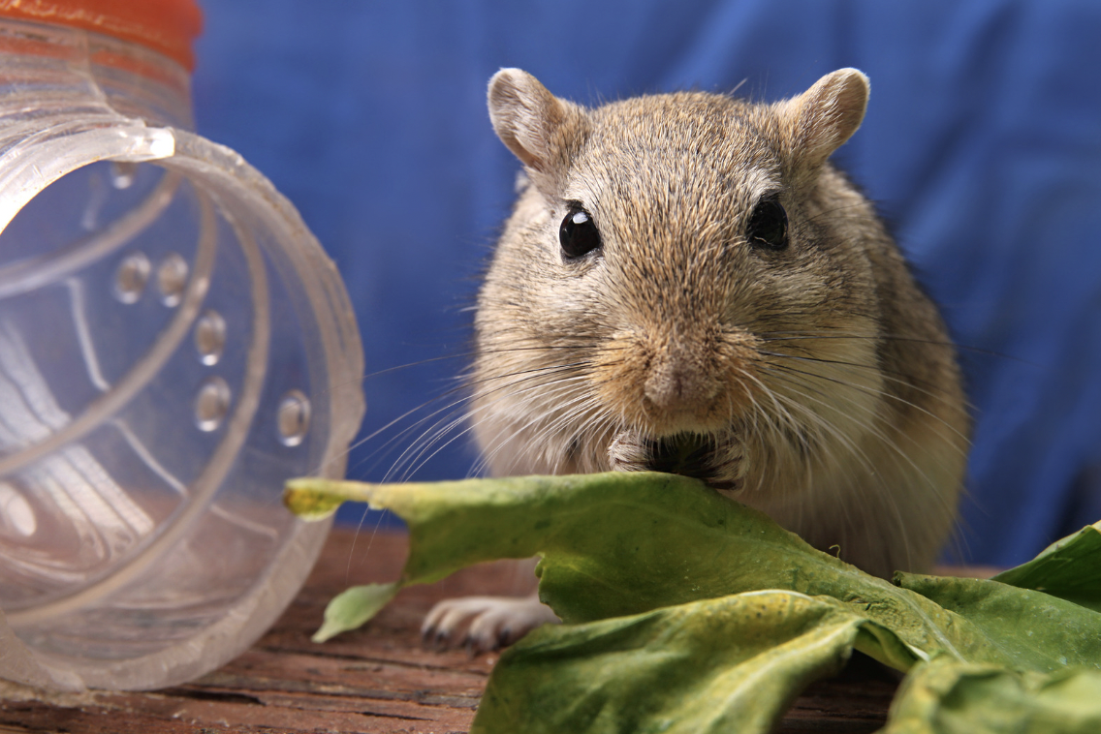

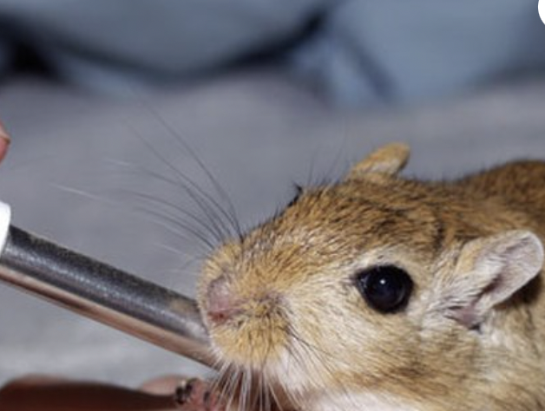
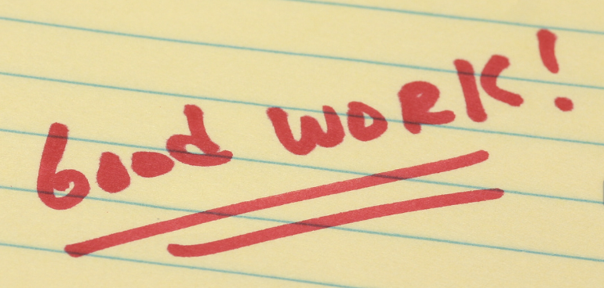
Notes:
Dr. Hawkins often uses the example of "Nate" in his presentations.
1, 2, and 3 work together to build bonding – remember: Opportunities, Skills, Recognition (taking individual characteristics and situations into account)
See the white paper, Unleashing the Power of Prevention:
https://nam.edu/wp-content/uploads/2015/06/DPPowerofPrevention.pdf and
https://www.communitiesthatcare.net/
or presentations by Dr. J. David Hawkins, e.g., https://www.youtube.com/watch?v=nTQd9n6vCgA or https://www.youtube.com/watch?v=jmiaTn9SoKQ

Slide 36
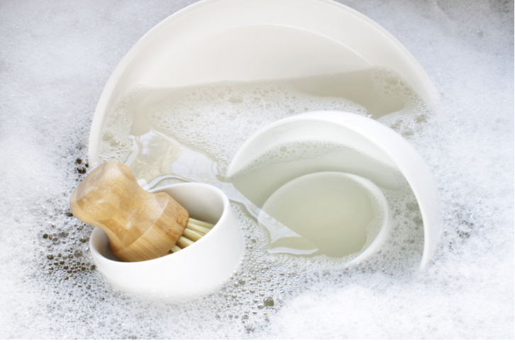



Notes:
This was adapted from an experience Dr. Hawkins shared here: https://www.youtube.com/watch?v=jmiaTn9SoKQ
1, 2, and 3 work together to build bonding – remember: Opportunities, Skills, Recognition (taking individual characteristics and situations into account)
See the white paper, Unleashing the Power of Prevention:
https://nam.edu/wp-content/uploads/2015/06/DPPowerofPrevention.pdf and
https://www.communitiesthatcare.net/
or presentations by Dr. J. David Hawkins, e.g., https://www.youtube.com/watch?v=nTQd9n6vCgA or https://www.youtube.com/watch?v=jmiaTn9SoKQ

Slide 37

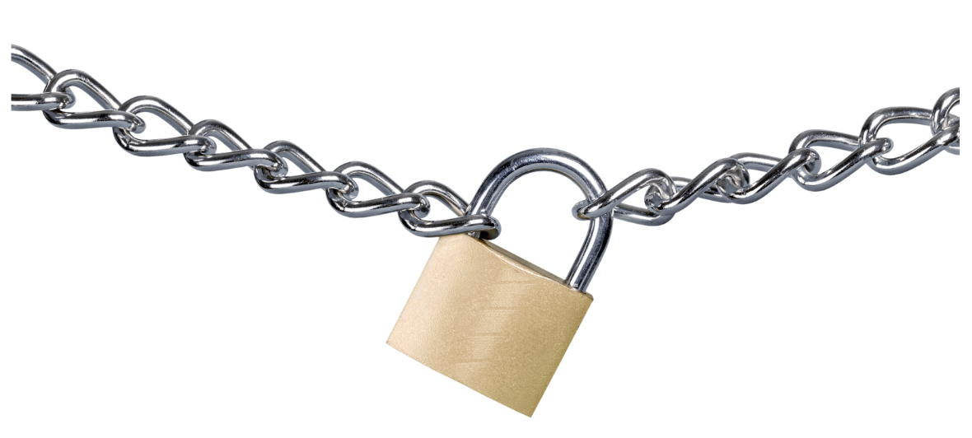
Notes:
This example comes from https://www.journals.uchicago.edu/doi/full/10.1086/700274
1, 2, and 3 work together to build bonding – remember: Opportunities, Skills, Recognition (taking individual characteristics and situations into account)
See the white paper, Unleashing the Power of Prevention:
https://nam.edu/wp-content/uploads/2015/06/DPPowerofPrevention.pdf and
https://www.communitiesthatcare.net/
or presentations by Dr. J. David Hawkins, e.g., https://www.youtube.com/watch?v=nTQd9n6vCgA or https://www.youtube.com/watch?v=jmiaTn9SoKQ

Slide 38
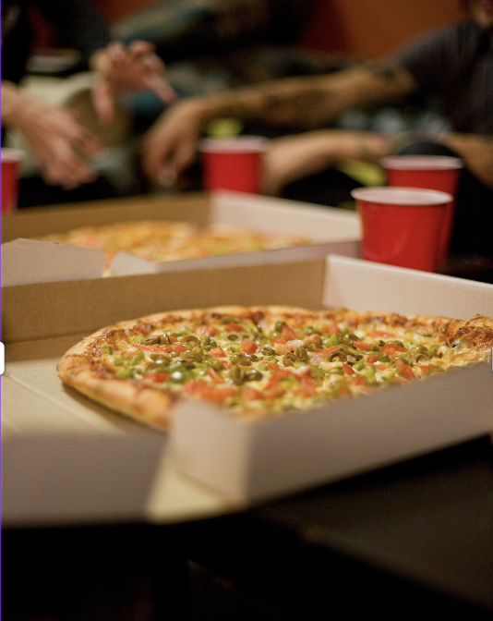

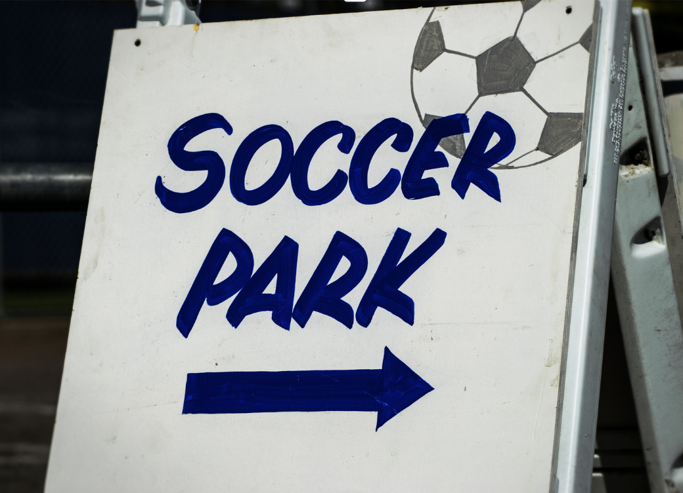
Notes:
This example comes from https://www.journals.uchicago.edu/doi/full/10.1086/700274
1, 2, and 3 work together to build bonding – remember: Opportunities, Skills, Recognition (taking individual characteristics and situations into account)
See the white paper, Unleashing the Power of Prevention:
https://nam.edu/wp-content/uploads/2015/06/DPPowerofPrevention.pdf and
https://www.communitiesthatcare.net/
or presentations by Dr. J. David Hawkins, e.g., https://www.youtube.com/watch?v=nTQd9n6vCgA or https://www.youtube.com/watch?v=jmiaTn9SoKQ

Slide 39

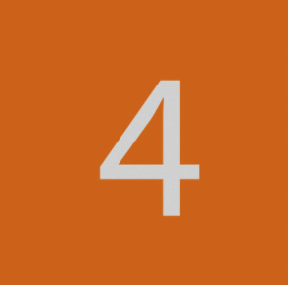
Notes:
1, 2, and 3 work together to build bonding – remember: Opportunities, Skills, Recognition (taking individual characteristics and situations into account)
See the white paper, Unleashing the Power of Prevention:
https://nam.edu/wp-content/uploads/2015/06/DPPowerofPrevention.pdf and
https://www.communitiesthatcare.net/
or presentations by Dr. J. David Hawkins, e.g., https://www.youtube.com/watch?v=nTQd9n6vCgA or https://www.youtube.com/watch?v=jmiaTn9SoKQ

Slide 40
Notes:
1, 2, and 3 work together to build bonding – remember: Opportunities, Skills, Recognition (taking individual characteristics and situations into account)
Bonding makes it more likely that youth will adopt the standards for healthy behavior in their different spheres. (You can consider the flip side of this, that if children bond with those who engage in unhealthy behaviors, that can be a Risk Factor for unhealthy behaviors – see the previous charts on slides 14-16
See also the white paper, Unleashing the Power of Prevention:
https://nam.edu/wp-content/uploads/2015/06/DPPowerofPrevention.pdf and
https://www.communitiesthatcare.net/
or presentations by Dr. J. David Hawkins, e.g., https://www.youtube.com/watch?v=nTQd9n6vCgA or https://www.youtube.com/watch?v=jmiaTn9SoKQ

Slide 41
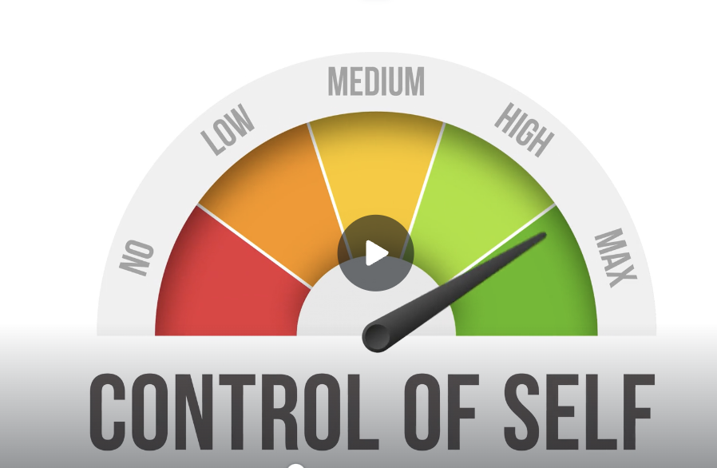
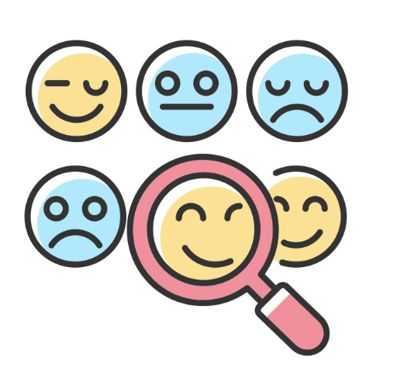
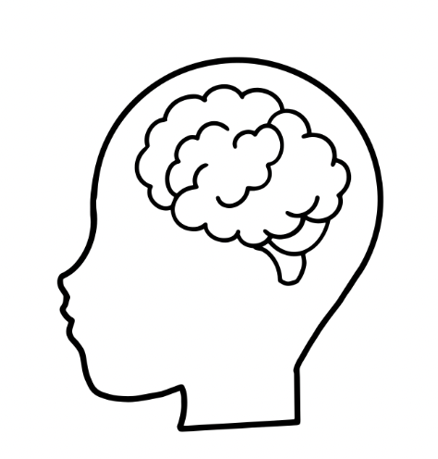
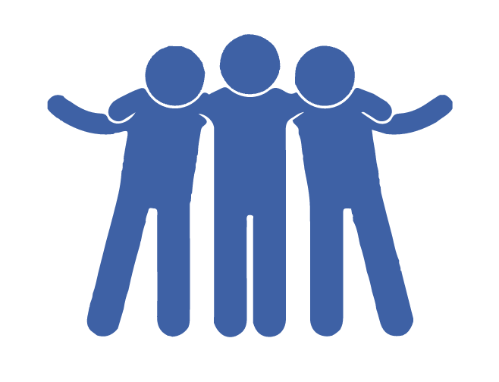
SKILLS can include…
Notes:
See Dr. Hawkins' presentation from the DigCitSummit: https://drive.google.com/file/d/12t2ZDz_p9M2KAPdQI_Ca8bI_Og5OYjpE/view?usp=sharing
This also relates to Week 9.
See the white paper, Unleashing the Power of Prevention:
https://nam.edu/wp-content/uploads/2015/06/DPPowerofPrevention.pdf and
https://www.communitiesthatcare.net/
or presentations by Dr. J. David Hawkins, e.g., https://www.youtube.com/watch?v=nTQd9n6vCgA or https://www.youtube.com/watch?v=jmiaTn9SoKQ

Slide 42
Take-home Food for Thought and Discussion
How do we use the advances in digital technology to promote young people's prosocial
opportunities
skills
recognition
bonding
and healthy standards for behavior?
Notes:
Ah, the discussions we could have if we had more time. This thought/discussion question was posed by Dr. Hawkins in the DigCitSummit: https://drive.google.com/file/d/12t2ZDz_p9M2KAPdQI_Ca8bI_Og5OYjpE/view?usp=sharing

Slide 43
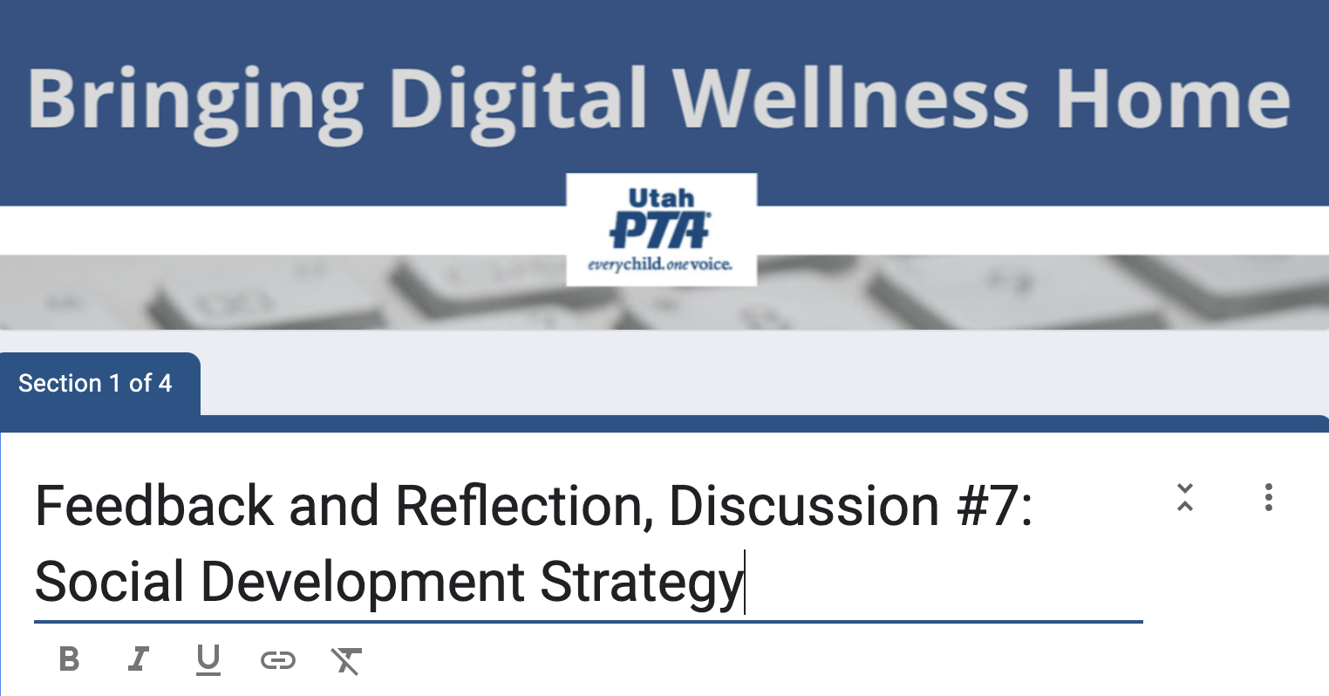
https://forms.gle/XqMqvZuX9cBrnCBn7
Notes:
Thank you for sharing feedback with us. If you would like to give more specific feedback on any of these questions, please feel free to email me at michelle@epik.org

Slide 44

We wish you well(ness)!

Slide 45
Some research on prosocial behavior (and prosocial behavior in a digital age)
The classic Prevention Science world may not yet be trying to connect research on the impact of the internet and the digital age on wellness of children and youth, but others are doing research, as we mentioned in the live gathering.
Here are a few articles I've come across since the live gathering:
Eveline A. Crone, Sophie W. Sweijen, Lysanne W. te Brinke, Suzanne van de Groep, Pathways for engaging in prosocial behavior in adolescence, 10.1016/bs.acdb.2022.03.003, (2022).
Emma Armstrong-Carter, Eva H. Telzer, Understanding prosocial development in the context of systemic inequalities in the US and worldwide, Current Research in Behavioral Sciences, 10.1016/j.crbeha.2021.100040, 2, (100040), (2021).
Carlo, G. and Padilla-Walker, L. (2020), Adolescents’ Prosocial Behaviors Through a Multidimensional and Multicultural Lens. Child Dev Perspect, 14: 2
Notes:
https://www.communitiesthatcare.org.au/how-it-works/risk-and-protective-factors – Social Development Strategy is a model designed to distill the patterns around Protective Factors that were found in Prevention Science research, such as the ideas circled in red. (I added one more circle than what was on the slide for our live gathering.)

Slide 46
Some research on prosocial behavior (and prosocial behavior in a digital age)
The classic Prevention Science world may not yet be trying to connect research on the impact of the internet and the digital age on wellness of children and youth, but others are doing research, as we mentioned in the live gathering.
Here are a few articles I've come across since the live gathering:
Padilla-Walker LM, Memmott-Elison MK, Coyne SM. Associations between Prosocial and Problem Behavior from Early to Late Adolescence. J Youth Adolesc. 2018 May;47(5):961-975. doi: 10.1007/s10964-017-0736-y. Epub 2017 Sep 2. PMID: 28866855.
Ciocanel O, Power K, Eriksen A, Gillings K. Effectiveness of positive youth development interventions: a meta-analysis of randomized controlled trials. J Youth Adolesc. 2017;46(3):483–504.
Effectiveness of Prosocial Behavior Interventions: A Meta-analysis: From Translational Research to a Humanistic Approach - Volume III, January 2019. DOI:10.1007/978-3-319-95360-1_21.In book: Psychiatry and Neuroscience Update (pp.259-271)
Notes:
https://www.communitiesthatcare.org.au/how-it-works/risk-and-protective-factors – Social Development Strategy is a model designed to distill the patterns around Protective Factors that were found in Prevention Science research, such as the ideas circled in red. (I added one more circle than what was on the slide for our live gathering.)

Slide 47
Some research on prosocial behavior (and prosocial behavior in a digital age)
The classic Prevention Science world may not yet be trying to connect research on the impact of the internet and the digital age on wellness of children and youth, but others are doing research, as we mentioned in the live gathering.
Here are a few articles I've come across since the live gathering:
Romersi S, Martínez-Fernández J, Roche R. Efectos del Programa Mínimo de Incremento Prosocial en una muestra de estudiantes de educación secundaria. An Psicol. 2011;27(1):135–46.
Schonert-Reichl KA, Smith V, Zaidman-Zait A, Hertzman C. Promoting children’s prosocial behaviors in school: impact of the “Roots of Empathy” program on the social and emotional competence of schoolaged children. Sch Ment Heal. 2012;4(1):1–21.
Sukys S, Majauskiene D, Dumciene A. The effects of a three-year integrated Olympic education programme on adolescents’ prosocial behaviours. Eur J Sport Sci. 2016;17(3):335–42.
Notes:
https://www.communitiesthatcare.org.au/how-it-works/risk-and-protective-factors – Social Development Strategy is a model designed to distill the patterns around Protective Factors that were found in Prevention Science research, such as the ideas circled in red. (I added one more circle than what was on the slide for our live gathering.)

