Slide 1
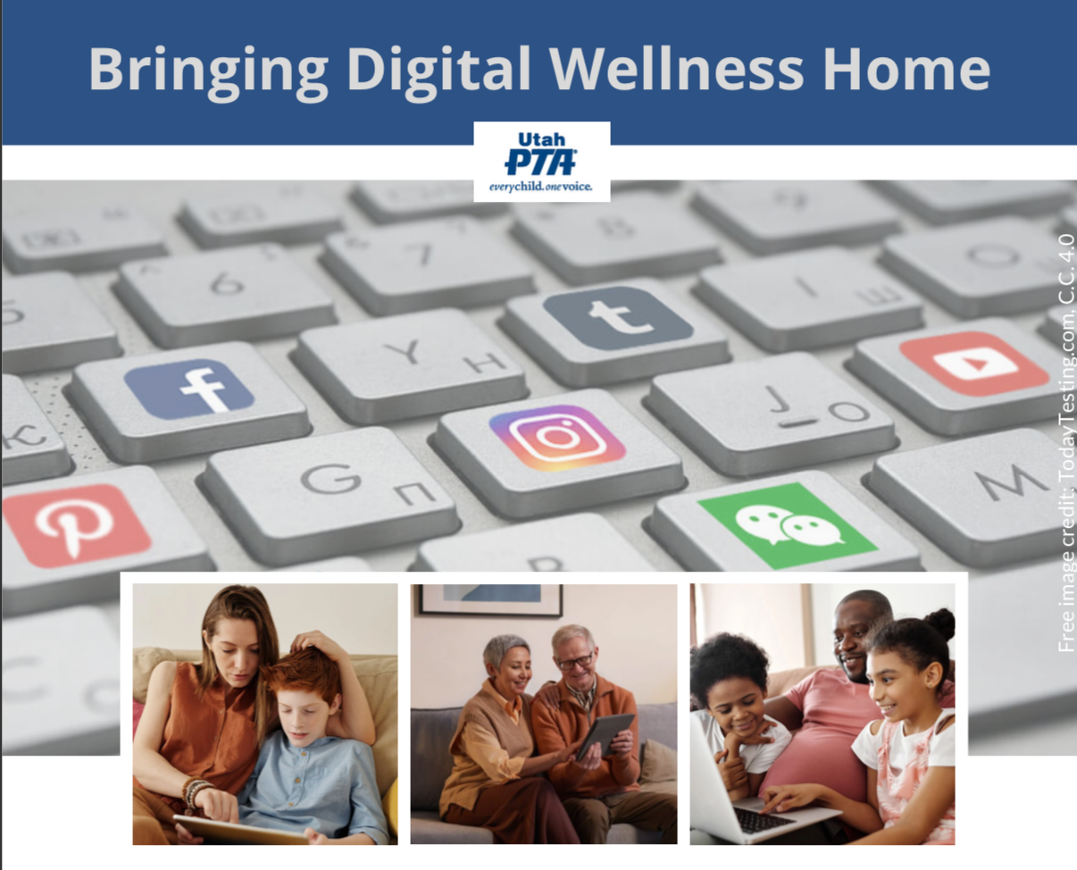
Note: All material in this series is for educational and informational purposes only, and is not meant to be exhaustive or used as a replacement for professional health support.
Notes:
Note: All material in this series is for educational and informational purposes only, and is not meant to be exhaustive or used as a replacement for professional health support. Also, the presentation is best viewed in slideshow format, as some of the slides are animated, but we have also included notes for many of the slides that you might want to review as well. Whatever works best for you!
NOTE: Portions of this work first appeared in or are derived or adapted from the Digital
Wellness Certificate Program. Those portions are Copyright © 2021, Digital Wellness Institute.

Slide 2
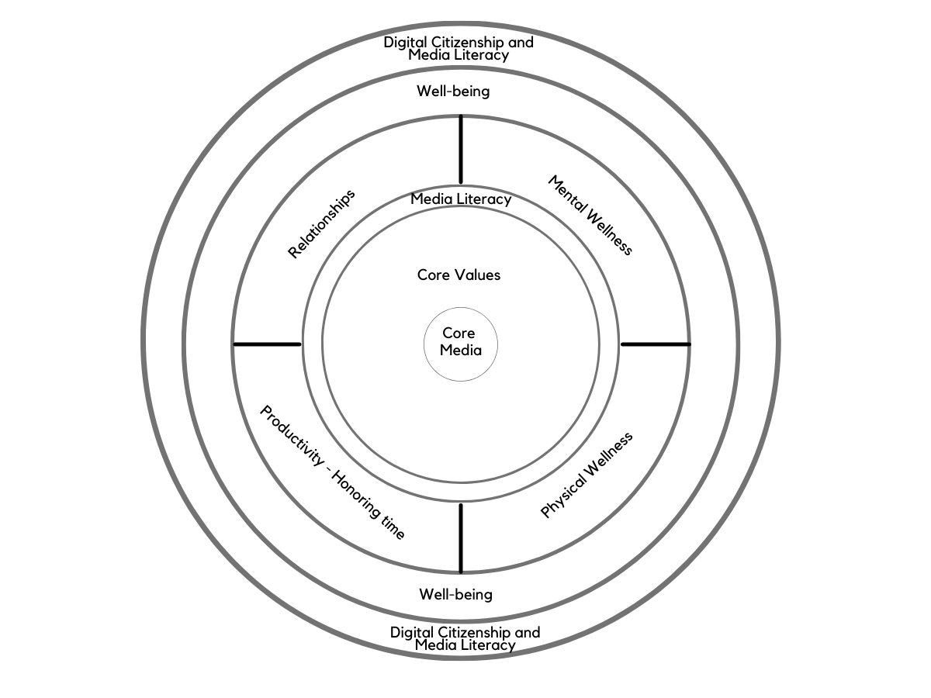

Slide 4
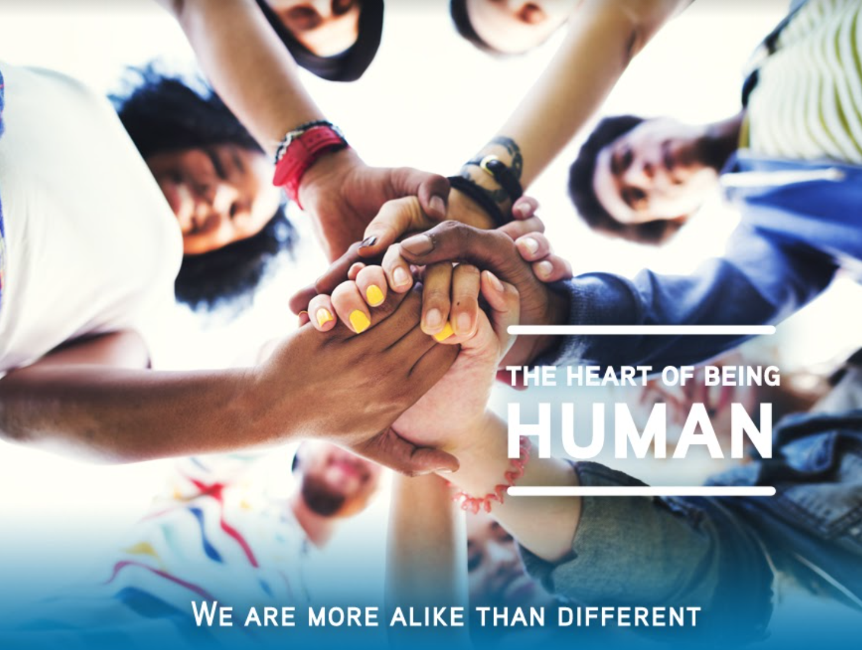
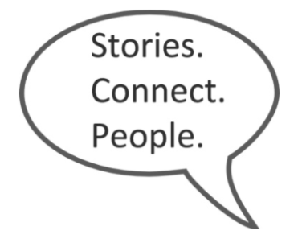
Think & Write:
What are some of your weak spots with Digital Wellness?
Notes:
Getting a little vulnerable with each other today…with intention (see next slides)

Slide 5
What are some of your weak spots with Digital Wellness?
Share one with the group
Notes:
By sharing this journey, and being real about the fact that we each and all have struggles (opportunities for growth), we can create an environment where it's safe to be human and to make mistakes and to be learning by experience (it's messy, as Sherry Turkle says). This kind of grace (see John's video) is important for us. This is important for the children and youth in our circles of influence. It's important for us as a larger community. Think, too, about how this connects to mental wellness. We aren't in a state of wellness when we are being driven by fear, anger, or reactive energy. Our shared humanity can remind us that we all need space and grace in this complex world in which we live.

Slide 6
“Everybody feels they are different…from everybody else, when really in at least some ways we are all the same.”
https://news.stanford.edu/pr/2011/pr-improve-minority-grades-031711.html
Notes:
One of EPIK's values (co-created with the Digital Citizenship Institute in 2017 ahead of the DigCitSummit) is to remind us to stay centered around a "shared human" heart. "We are more alike than different"
Quote related to this study, and quoted from the Stanford page:
https://www.science.org/doi/10.1126/sciadv.aay3689. See also: Walton, G. M. & Cohen, G. L. (2007). A question of belonging: Race, social fit, and achievement. Journal of Personality and Social Psychology, 92, 82-96.
https://news.stanford.edu/news/2011/march/improve-minority-grades-031711.html

Slide 7
We're in this together
“Belonging uncertainty” = the state of mind in which one suffers from doubts about whether one …[could be] accepted."
Notes:
I'm fascinated by this research on belonging uncertainty and what the researchers discovered helped counteract it. It was simply reinforcing the normalcy of hard things. This was in a specific context (black students starting college) but the concept rings true for other settings as well, and reflects part of the reason we do connection activities at EPIK – because there is value in remembering our shared human experience.
Research reference: https://www.science.org/doi/10.1126/sciadv.aay3689. See also: Walton, G. M. & Cohen, G. L. (2007). A question of belonging: Race, social fit, and achievement. Journal of Personality and Social Psychology, 92, 82-96.

Slide 8

This video no longer appears on UMass's website. See next slide
Notes:
This is a snippet from John's presentation that he gave for the last PTA cohort, Winter 2022. He had a not-so-great connection (both because of background noise and issues with his air pods) but we hope you can get the bulk of what he shared. https://www.youtube.com/watch?v=Y7U59kvh0Fw
The full presentation, including the magic tricks to which he referred, can be found in this week's folder or here on YouTube: https://www.youtube.com/watch?v=fIHVaPaILYA

Slide 9
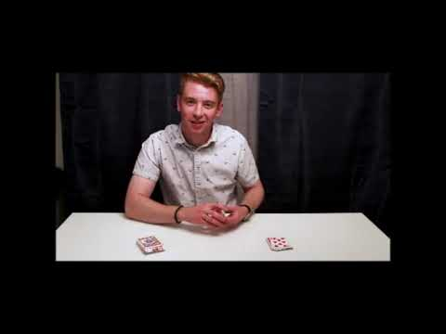
*Bonus: Magic Tricks & Explanations
This video no longer appears on UMass's website. See next slide
Notes:
To complement the previous video, here is the magic to which John referred. https://youtu.be/Ha_55KyVry0

Slide 10
Three Relationship Categories
Relationship with self
Bonding relationships
Bridging relationships
Notes:
These categories can be relevant to the question someone asked in the registration form about helping teens navigate social media. When we understand different types of relationships and connections, we can make more deliberate decisions about how/if we use tools as part of our relationship dynamics, and we can exercise our self-reflection muscle to discern whether what we are doing is building true relationship or may be giving us more the illusion of relationship or connection. We can also think of these categories when we assess priorities for time boxing as well. e.g., "How much time per week do I want to spend on bridging relationships vs. bonding relationships?" "How much time do I want to devote to filling my own well so I have capacity to give to and help others, and to show up in my relationships with integrity to who I am trying to be?"
More on the difference between these kinds of relationships: https://www.socialcapitalresearch.com/difference-bonding-bridging-social-capital/

Slide 11
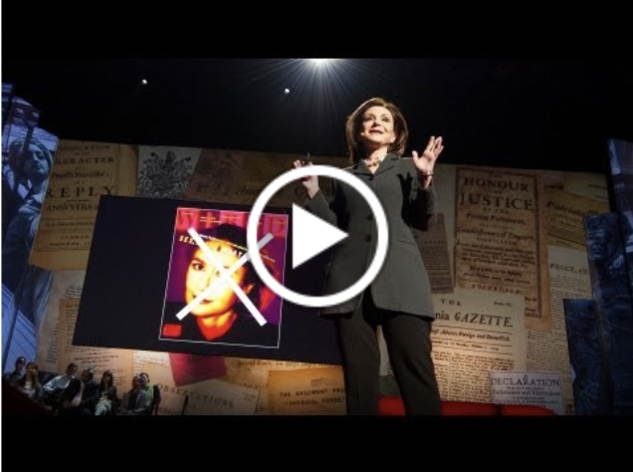
Founder (2001) and current director of MIT's Initiative on Technology and Self.
-Joint doctorate in sociology and personality psychology from Harvard University
-Licensed clinical psychologist
Notes:
Keep the three categories in mind as you listen to this clip. I started the clip at about 2:35, but I would recommend watching the whole video.
https://www.ted.com/talks/sherry_turkle_connected_but_alone/transcript?language=en – start at 2:48, run until 9:36 [on 1.5 speed, this takes just a little over 5 minutes): Sherry Turkle is the Abby Rockefeller Mauzé Professor of the Social Studies of Science and Technology in the Program in Science, Technology, and Society at MIT, and the founding director of the MIT Initiative on Technology and Self. Professor Turkle received a joint doctorate in sociology and personality psychology from Harvard University and is a licensed clinical psychologist. https://sherryturkle.mit.edu/
02:51
So just to take some quick examples: People text or do email during corporate board meetings. They text and shop and go on Facebook during classes, during presentations, actually during all meetings. People talk to me about the important new skill of making eye contact while you're texting. (Laughter) People explain to me that it's hard, but that it can be done. Parents text and do email at breakfast and at dinner while their children complain about not having their parents' full attention. But then these same children deny each other their full attention. This is a recent shot of my daughter and her friends being together while not being together. And we even text at funerals. I study this. We remove ourselves from our grief or from our revery and we go into our phones.
03:56
Why does this matter? It matters to me because I think we're setting ourselves up for trouble -- trouble certainly in how we relate to each other, but also trouble in how we relate to ourselves and our capacity for self-reflection. We're getting used to a new way of being alone together. People want to be with each other, but also elsewhere -- connected to all the different places they want to be. People want to customize their lives. They want to go in and out of all the places they are because the thing that matters most to them is control over where they put their attention. So you want to go to that board meeting, but you only want to pay attention to the bits that interest you. And some people think that's a good thing. But you can end up hiding from each other, even as we're all constantly connected to each other.
04:56
A 50-year-old business man lamented to me that he feels he doesn't have colleagues anymore at work. When he goes to work, he doesn't stop by to talk to anybody, he doesn't call. And he says he doesn't want to interrupt his colleagues because, he says, "They're too busy on their email." But then he stops himself and he says, "You know, I'm not telling you the truth. I'm the one who doesn't want to be interrupted. I think I should want to, but actually I'd rather just do things on my Blackberry."
05:27
Across the generations, I see that people can't get enough of each other, if and only if they can have each other at a distance, in amounts they can control. I call it the Goldilocks effect: not too close, not too far, just right. But what might feel just right for that middle-aged executive can be a problem for an adolescent who needs to develop face-to-face relationships. An 18-year-old boy who uses texting for almost everything says to me wistfully, "Someday, someday, but certainly not now, I'd like to learn how to have a conversation."
06:14
When I ask people "What's wrong with having a conversation?" People say, "I'll tell you what's wrong with having a conversation. It takes place in real time and you can't control what you're going to say." So that's the bottom line. Texting, email, posting, all of these things let us present the self as we want to be. We get to edit, and that means we get to delete, and that means we get to retouch, the face, the voice, the flesh, the body -- not too little, not too much, just right.
06:57
Human relationships are rich and they're messy and they're demanding. And we clean them up with technology. And when we do, one of the things that can happen is that we sacrifice conversation for mere connection. We short-change ourselves. And over time, we seem to forget this, or we seem to stop caring.
07:24
I was caught off guard when Stephen Colbert asked me a profound question, a profound question. He said, "Don't all those little tweets, don't all those little sips of online communication, add up to one big gulp of real conversation?" My answer was no, they don't add up. Connecting in sips may work for gathering discrete bits of information, they may work for saying, "I'm thinking about you," or even for saying, "I love you," -- I mean, look at how I felt when I got that text from my daughter -- but they don't really work for learning about each other, for really coming to know and understand each other. And we use conversations with each other to learn how to have conversations with ourselves. So a flight from conversation can really matter because it can compromise our capacity for self-reflection. For kids growing up, that skill is the bedrock of development.
08:49
Over and over I hear, "I would rather text than talk." And what I'm seeing is that people get so used to being short-changed out of real conversation, so used to getting by with less, that they've become almost willing to dispense with people altogether. So for example, many people share with me this wish, that some day a more advanced version of Siri, the digital assistant on Apple's iPhone, will be more like a best friend, someone who will listen when others won't. I believe this wish reflects a painful truth that I've learned in the past 15 years. That feeling that no one is listening to me is very important in our relationships with technology. That's why it's so appealing to have a Facebook page or a Twitter feed -- so many automatic listeners. And the feeling that no one is listening to me make us want to spend time with machines that seem to care about us.

Slide 12
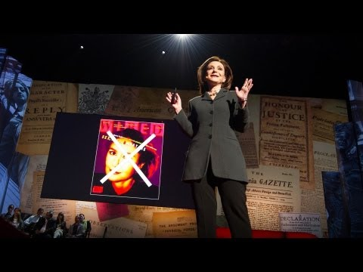
Notes:
Keep the three categories in mind as you listen to this clip. I started the clip at about 2:35, but I would recommend watching the whole video.
https://www.ted.com/talks/sherry_turkle_connected_but_alone/transcript?language=en – start at 2:48, run until 9:36 [on 1.5 speed, this takes just a little over 5 minutes): Sherry Turkle is the Abby Rockefeller Mauzé Professor of the Social Studies of Science and Technology in the Program in Science, Technology, and Society at MIT, and the founding director of the MIT Initiative on Technology and Self. Professor Turkle received a joint doctorate in sociology and personality psychology from Harvard University and is a licensed clinical psychologist. https://sherryturkle.mit.edu/
02:51
So just to take some quick examples: People text or do email during corporate board meetings. They text and shop and go on Facebook during classes, during presentations, actually during all meetings. People talk to me about the important new skill of making eye contact while you're texting. (Laughter) People explain to me that it's hard, but that it can be done. Parents text and do email at breakfast and at dinner while their children complain about not having their parents' full attention. But then these same children deny each other their full attention. This is a recent shot of my daughter and her friends being together while not being together. And we even text at funerals. I study this. We remove ourselves from our grief or from our revery and we go into our phones.
03:56
Why does this matter? It matters to me because I think we're setting ourselves up for trouble -- trouble certainly in how we relate to each other, but also trouble in how we relate to ourselves and our capacity for self-reflection. We're getting used to a new way of being alone together. People want to be with each other, but also elsewhere -- connected to all the different places they want to be. People want to customize their lives. They want to go in and out of all the places they are because the thing that matters most to them is control over where they put their attention. So you want to go to that board meeting, but you only want to pay attention to the bits that interest you. And some people think that's a good thing. But you can end up hiding from each other, even as we're all constantly connected to each other.
04:56
A 50-year-old business man lamented to me that he feels he doesn't have colleagues anymore at work. When he goes to work, he doesn't stop by to talk to anybody, he doesn't call. And he says he doesn't want to interrupt his colleagues because, he says, "They're too busy on their email." But then he stops himself and he says, "You know, I'm not telling you the truth. I'm the one who doesn't want to be interrupted. I think I should want to, but actually I'd rather just do things on my Blackberry."
05:27
Across the generations, I see that people can't get enough of each other, if and only if they can have each other at a distance, in amounts they can control. I call it the Goldilocks effect: not too close, not too far, just right. But what might feel just right for that middle-aged executive can be a problem for an adolescent who needs to develop face-to-face relationships. An 18-year-old boy who uses texting for almost everything says to me wistfully, "Someday, someday, but certainly not now, I'd like to learn how to have a conversation."
06:14
When I ask people "What's wrong with having a conversation?" People say, "I'll tell you what's wrong with having a conversation. It takes place in real time and you can't control what you're going to say." So that's the bottom line. Texting, email, posting, all of these things let us present the self as we want to be. We get to edit, and that means we get to delete, and that means we get to retouch, the face, the voice, the flesh, the body -- not too little, not too much, just right.
06:57
Human relationships are rich and they're messy and they're demanding. And we clean them up with technology. And when we do, one of the things that can happen is that we sacrifice conversation for mere connection. We short-change ourselves. And over time, we seem to forget this, or we seem to stop caring.
07:24
I was caught off guard when Stephen Colbert asked me a profound question, a profound question. He said, "Don't all those little tweets, don't all those little sips of online communication, add up to one big gulp of real conversation?" My answer was no, they don't add up. Connecting in sips may work for gathering discrete bits of information, they may work for saying, "I'm thinking about you," or even for saying, "I love you," -- I mean, look at how I felt when I got that text from my daughter -- but they don't really work for learning about each other, for really coming to know and understand each other. And we use conversations with each other to learn how to have conversations with ourselves. So a flight from conversation can really matter because it can compromise our capacity for self-reflection. For kids growing up, that skill is the bedrock of development.
08:49
Over and over I hear, "I would rather text than talk." And what I'm seeing is that people get so used to being short-changed out of real conversation, so used to getting by with less, that they've become almost willing to dispense with people altogether. So for example, many people share with me this wish, that some day a more advanced version of Siri, the digital assistant on Apple's iPhone, will be more like a best friend, someone who will listen when others won't. I believe this wish reflects a painful truth that I've learned in the past 15 years. That feeling that no one is listening to me is very important in our relationships with technology. That's why it's so appealing to have a Facebook page or a Twitter feed -- so many automatic listeners. And the feeling that no one is listening to me make us want to spend time with machines that seem to care about us.

Slide 13


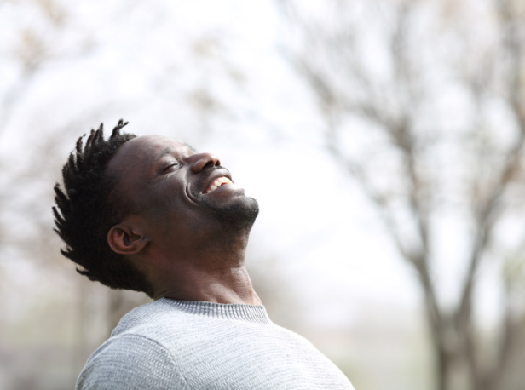
Relationship Category #1: Self
Notes:
We've spent most of our time to this point talking about building wellness for ourselves, so we'll touch on this only briefly today.

Slide 14

Notes:
We've spent the last five weeks focusing a lot on how you can build more awareness, more wellness, into your own lives. We hope some of the information has been helpful, or a helpful review.

Slide 15
Circles of control, influence, concern
Circle of control=
Looking inward
influence
concern
Notes:
When we focus on what we have control over, this is part of the heart of wellness. In truth, we can't change anyone else. But we can and do have influence on each other, both indirectly and directly.
This is a powerful concept or tool that we can use to practice centeredness. I first came upon this idea in grad school or before (30 or so years ago) when learning about Stephen Covey's work, although I don't think he was the creator of this concept. If you search on these ideas, you can find many resources that explore them, each with their own lens and application. In the literature on mental wellness, parenting, and other spheres, sometimes these concepts are connected to an internal or external "locus of control."

Slide 16
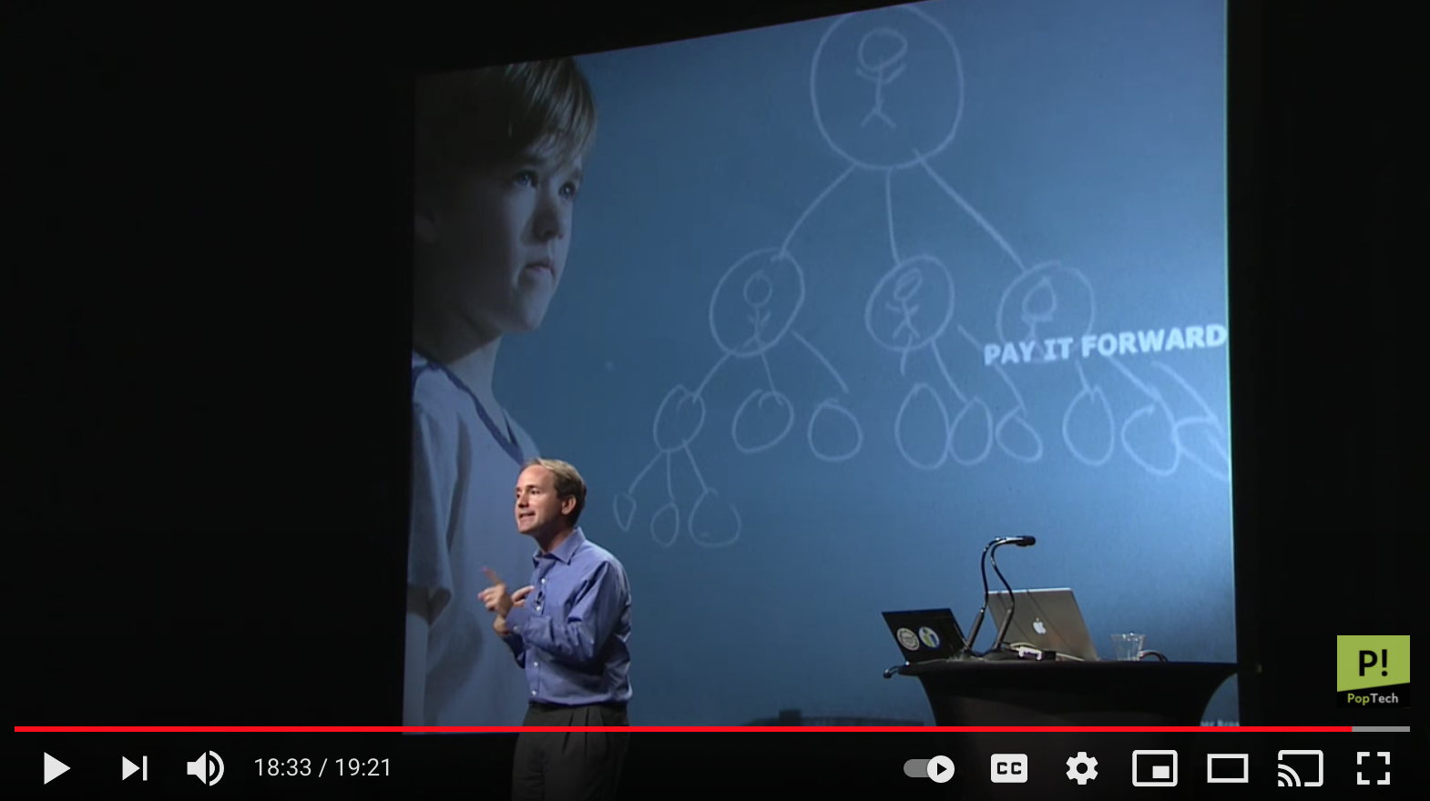
Personal wellness choices can impact others
“I’m not just changing my own outcome. I’m potentially changing my son’s life. And my son’s friend’s life. And my son’s friend’s mother’s life. I’m not just taking care of myself…[but taking care of people I care about].” ~ James Fowler (and Nicholas Christakis)
Notes:
The concept of influencing people three degrees out, even when we aren't trying to have influence, is both exciting and sobering. It can cut both ways. Harmful habits and choices can impact people as well as positive choices we make. This, too, requires grace, as no one can mitigate all negative impacts of their choices, even with the best of intentions. But we can seek to be intentional – for our own well-being, and with hopes that perhaps some positive, organic ripples can flow outward.
https://www.youtube.com/watch?v=zkmsjFisW_A -- See also https://www.youtube.com/watch?v=8dO6Wwh_tiU for thoughts from Nicolas Christakis, the other researcher who worked on this study.

Slide 17
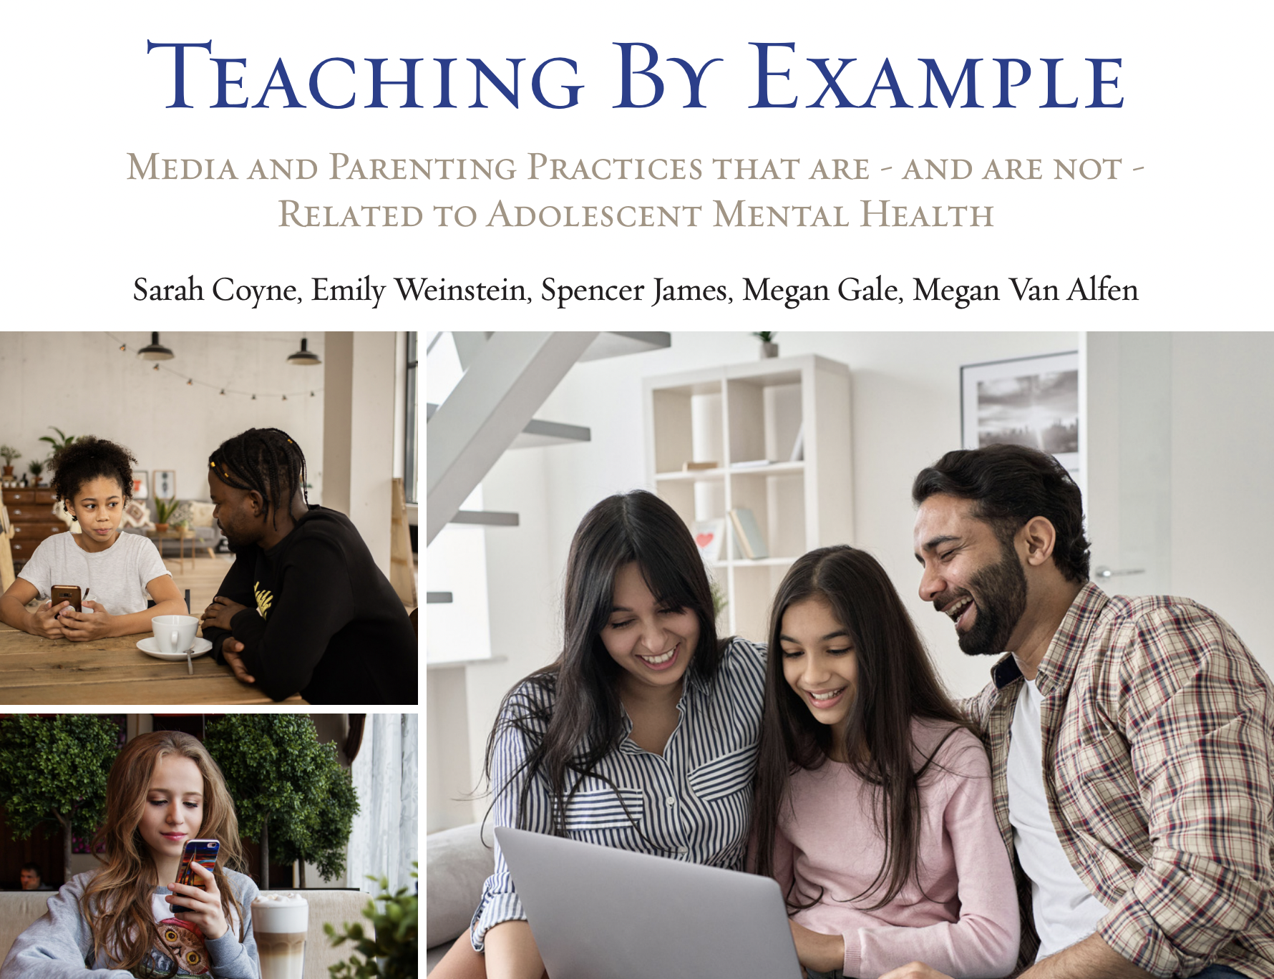
Notes:
This 52-page report contains a lot of information (we recommend it for many reasons). We did find it interesting that the title they choice related to parental example.
https://wheatley.byu.edu/00000182-8d78-dff6-afab-8ffd11ce0001/teaching-by-example-pdf

Slide 18
"In general, parent media use is an even stronger predictor of [a] child’s mental health than the child’s own social media use."
Notes:
https://wheatley.byu.edu/00000182-8d78-dff6-afab-8ffd11ce0001/teaching-by-example-pdf

Slide 19
"Media use is but one part of a larger picture of teen life and well-being."
Notes:
https://wheatley.byu.edu/00000182-8d78-dff6-afab-8ffd11ce0001/teaching-by-example-pdf

Slide 20
"It appears that we should be less concerned about teaching parents specific skills related to media management and instead focus on teaching general parenting skills and engagement. This will likely have the greatest impact on adolescent mental health."
Notes:
https://wheatley.byu.edu/00000182-8d78-dff6-afab-8ffd11ce0001/teaching-by-example-pdf

Slide 21


Relationship Category #2: Bonding Social Capital
Notes:
We wanted to spend the bulk of our time talking about bonding relationships. Another word that could be a synonym for Bonding relationships is Building relationships. Who helps bring constructive, building energy into our lives? Are we working to be builders in our spheres of influence, especially with those closest to us?

Slide 22
Circles of control, influence, concern
Circle of control=
Looking inward
influence
concern
Notes:
When we start with an internal locus of control, being clear about what is ours and is not ours to manage, we are more grounded to be able to then engage in meaningful ways to have influence in various ways in our spheres. You can find different interpretations and applications of these three circles in many places online.
This is a powerful concept or tool that we can use to practice centeredness. I first came upon this idea in grad school or before (30 or so years ago) when learning about Stephen Covey's work, although I don't think he was the creator of this concept. If you search on these ideas, you can find many resources that explore them, each with their own lens and application. In the literature on mental wellness, parenting, and other spheres, sometimes these concepts are connected to an internal or external "locus of control."

Slide 23
Think & Write
Notes:
Once again, here is an invitation to write. To "point and name" in quite a literal way…to name people who are "your people."

Slide 24
Think & Write (point and name)
Who are "my people"?
List 1:
The people who help me
feel seen, supported, and cared about
List 2:
The people closest to me whom I want to see, support, and
care about
Notes:
Once again, here is an invitation to write. To "point and name" in quite a literal way…to name people who are "your people."

Slide 25



Reflection
Does tech support or interfere with your
bonding relationships?
Notes:
Another reflection question to keep in mind in an ongoing way. I deliberately chose images that capture how technology can help build and foster bonding. We all know what images look like of the opposite.

Slide 26
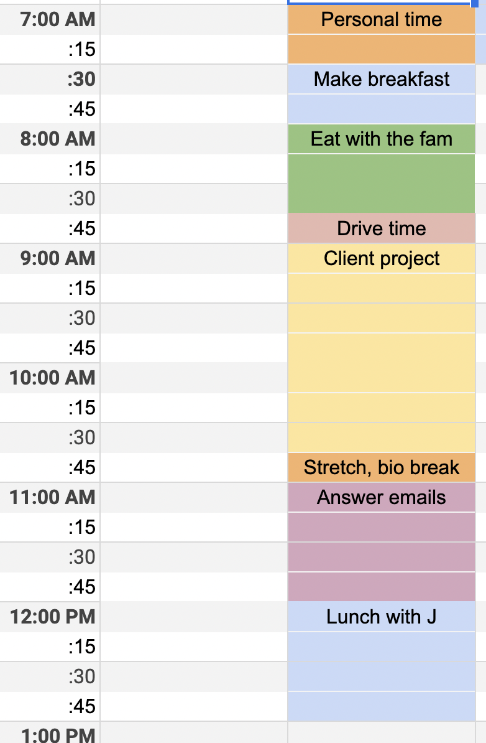
Does how I spend my time reflect
my relationship priorities?
Notes:
One more reflection question…

Slide 27
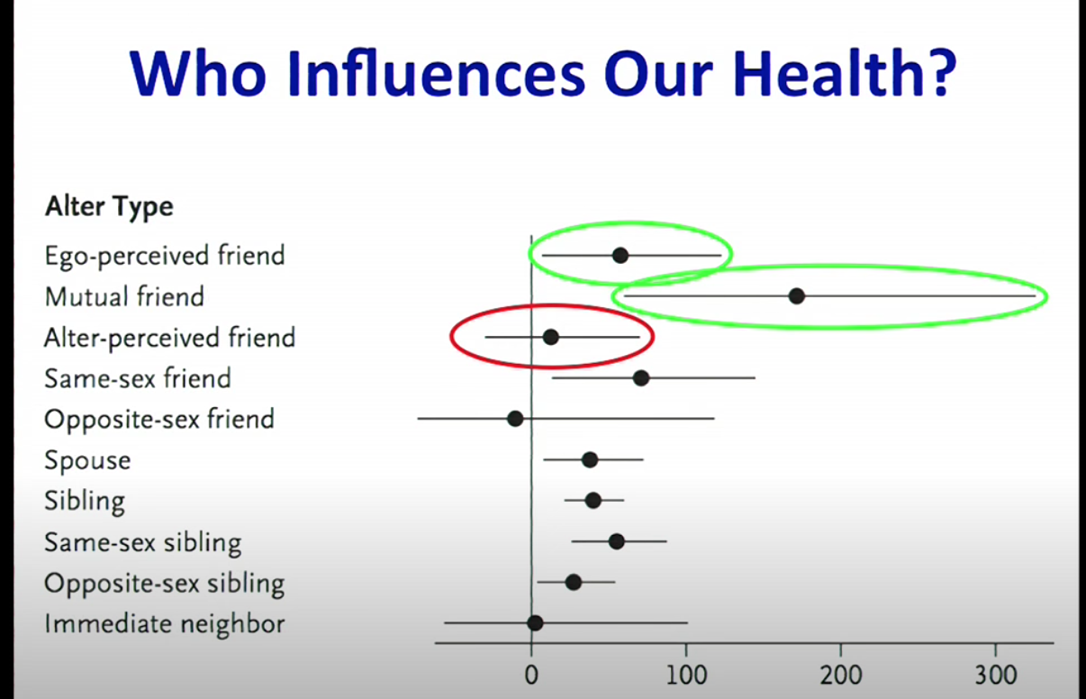
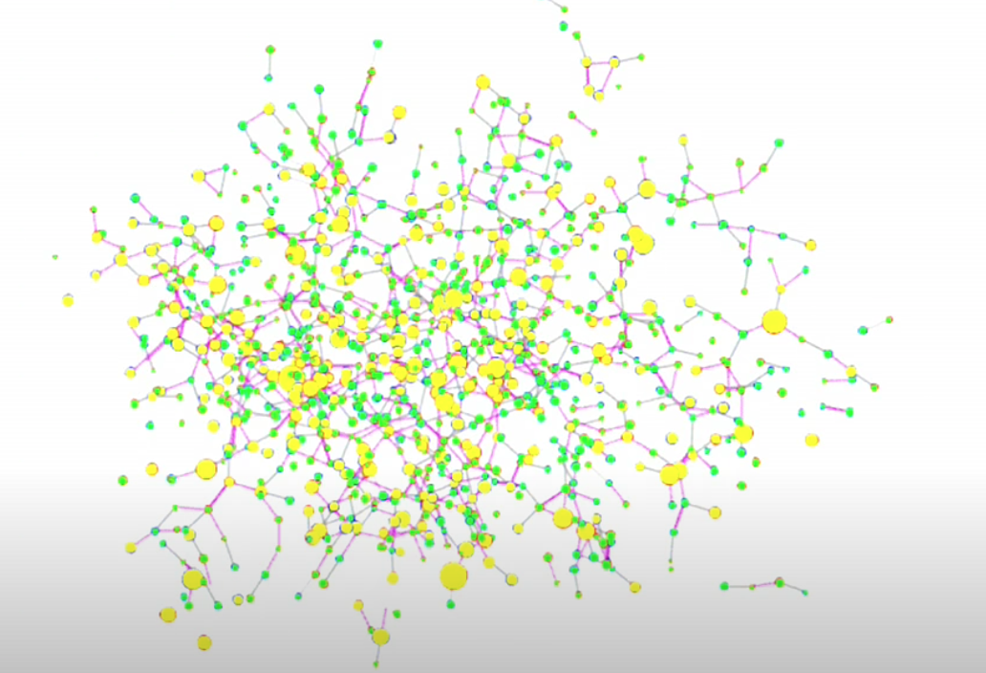
The Power of Networks
Our existing social relationships impact our health, and…
https://www.youtube.com/watch?v=zkmsjFisW_A
Notes:
We can't always influence who is in our networks…

Slide 28

We can be deliberate about relationships
"The [groups] we belong to shape our behavior…. [You can choose to] join a group where your desired behavior is the normal behavior."
~James Clear
Notes:
…but we can make intentional choices about who is in our close circles. Especially in a digital world, this is true. We have so many choices about where to spend our connection time. [We’ll talk more about connection with the intent to understand others in the Digital Citizenship module, but it’s essential to keep center in order to do that, so for now, we are focusing here on building your networks deliberately to have enough of the water you want to swim in ever-present…at that deep values level, not just at task levels.]

Slide 29

Too often tech is not used for true bonding,
but rather gives us the illusion of connection

Slide 30

Or we may spend more time than we really need to in Bridging vs. Bonding Social connections
(this is particularly easy to do on social media)
Notes:
=

Slide 31
Category #3: Bridging Social Capital
Relationship with self
Bonding relationships
Bridging relationships
Notes:
We'll be talking more about this in the Digital Citizenship module. Here is a good summary of the difference between Bonding and Bridging Capital
https://www.socialcapitalresearch.com/difference-bonding-bridging-social-capital/

Slide 32
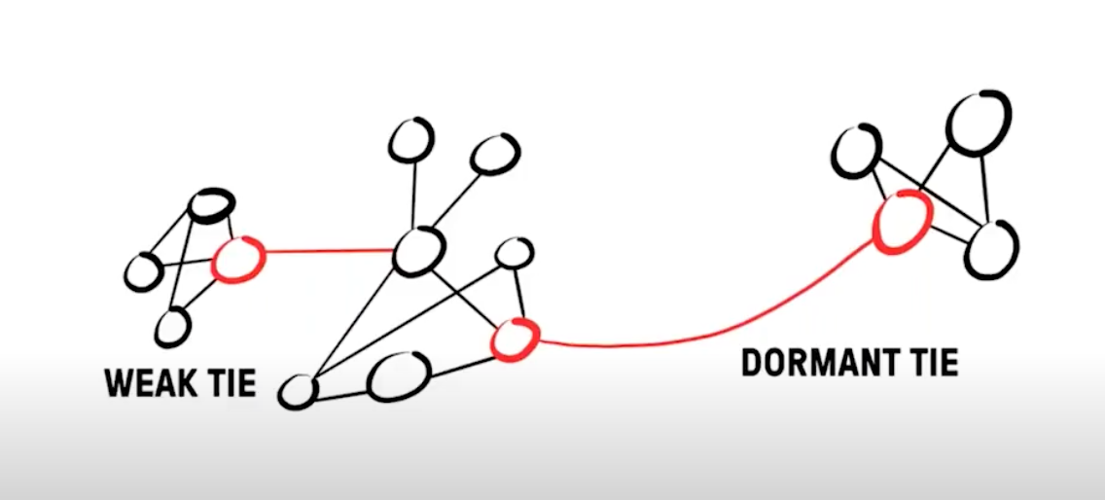
Bridging Social Capital can also Build
David Burkus – even an hour a week on “weak ties” can improve your professional and personal network – opportunities to be helped and to help
Friend of a Friend ...: Understanding the Hidden Networks That Can Transform Your Life and Your Career by David Burkus
Notes:
=

Slide 33
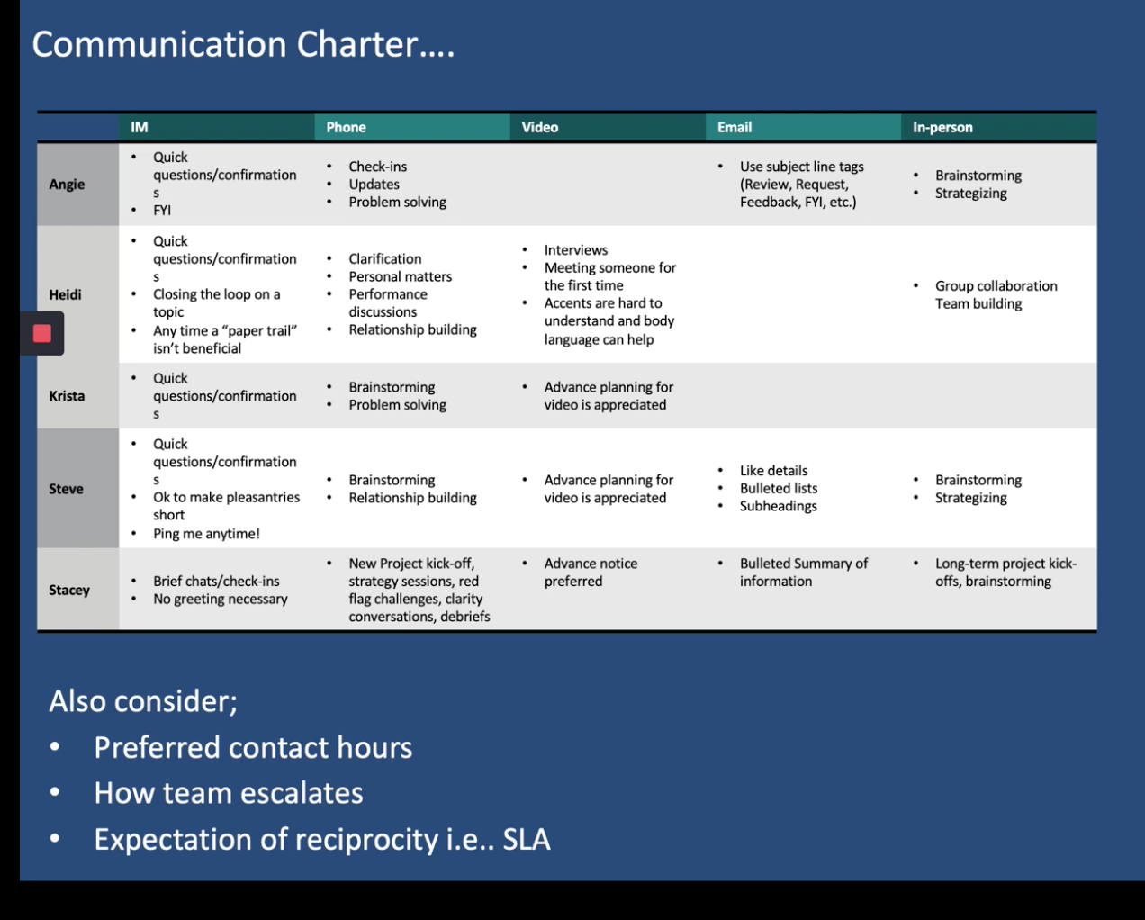
A tool for bonding and bridging relationships:
Communications Charters
Notes:
This charter was shared in the DWI course, credit Digital Wellness Institute and Amy Blankston
https://www.forbes.com/sites/darrenmenabney/2021/03/14/to-have-better-remote-meetings-create-a-team-communication-charter/?sh=51e802a68182
There is a Google worksheet you can copy and use with your team for work or other project teams https://docs.google.com/spreadsheets/d/1PZ8ClP0zHBL7t5QdpHkj0-IfjkQFfkvCnz1_JE-RY04/edit?usp=sharing
There is a lot out there on communications charters, but here is one example of a link with more information:
https://www.forbes.com/sites/darrenmenabney/2021/03/14/to-have-better-remote-meetings-create-a-team-communication-charter/?sh=51e802a68182

Slide 34
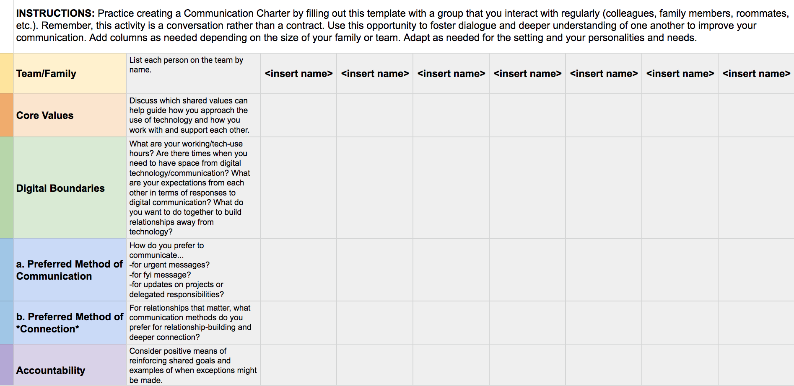
Communications Charters
https://docs.google.com/spreadsheets/d/11zDrV4bwSZGxML2MzGi_YqvLiZI23PmRrNBEy7BD3nA/edit?usp=sharing
Notes:
This is a Google worksheet you can copy and use with your team for work or other project teams. PLEASE REMEMBER TO MAKE A COPY OF THIS BEFORE USING IT! :)
https://docs.google.com/spreadsheets/d/1PZ8ClP0zHBL7t5QdpHkj0-IfjkQFfkvCnz1_JE-RY04/edit?usp=sharing
There is a lot out there on communications charters, but here is one example of a link with more information:
https://www.forbes.com/sites/darrenmenabney/2021/03/14/to-have-better-remote-meetings-create-a-team-communication-charter/?sh=51e802a68182

Slide 35
Let's Go Back to Bonding
Attachment, Relationship-building, Presence…
Relationship with self
Bonding relationships
Bridging relationships
Notes:
In the academic or research world, bonding and bridging are sometimes referred to as "social capital." See, e.g., https://www.socialcapitalresearch.com/difference-bonding-bridging-social-capital/

Slide 36
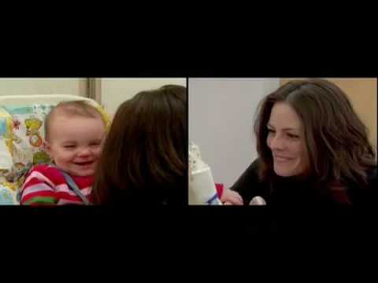
This video no longer appears on UMass's website. See next slide
Notes:
The Still Face Experiment (Developmental Sciences at UMass Boston: https://www.youtube.com/watch?v=vmE3NfB_HhE&t=1s) reiterates a few core principles about humans. First, communication needs and abilities begin early, even before a child can form words. (This was not always believed to be true, but is so clearly obvious in Dr. Tronick's work.) Secondly, humans are responsive to others and their attentiveness (or lack thereof). Although this may vary from person to person, in general, this need for connection and attention, eye contact, non-verbal cues, etc. is pretty universal. And relationships can be repaired when repair is done intentionally. So what we see here is not just true for infants. See following slides for more examples.
Video source from UMass Boston https://www.youtube.com/watch?v=apzXGEbZht0 - start at 1:03
For more information on this research, ZERO TO THREE www.zerotothree.org.
Still face experiment with dads: https://www.youtube.com/watch?v=BUwEwv3Wl58
Debrief with dads: https://www.youtube.com/watch?v=rLNiXnJccUQ
Remember that relationships are full of ebbs and flows of rupture and repair (see later slides)

Slide 37
Relationships are in constant state of mismatch…it's the repair that matters!
“Repairing ruptures is the most essential thing in parenting.”
UCLA neuropsychiatrist Dan Siegel
https://greatergood.berkeley.edu/article/item/family_conflict_is_normal_its_the_repair_that_matters
Notes:
https://greatergood.berkeley.edu/article/item/family_conflict_is_normal_its_the_repair_that_matters
See also this interview with Dr. Tronick: https://www.youtube.com/watch?v=O8AdOai6wug

Slide 38
*Bonus Slide on Relationship Repair
"Life is a series of mismatches, miscommunications, and misattunements that are quickly repaired, says [Edward] Tronick [Still Face Experiment researcher], and then again become miscoordinated and stressful, and again are repaired. This occurs thousands of times in a day, and millions of times over a year."
"Even in healthy, securely attached relationships, caregivers and babies are in sync only 30% of the time. The other 70%, they’re mismatched, out of synch, or making repairs and coming back together. Cheeringly, even babies work toward repairs with their gazes, smiles, gestures, protests, and calls."
“Repairing ruptures is the most essential thing in parenting.”
UCLA neuropsychiatrist Dan Siegel
“Relationships shrink to the size of the field of repair,” says Rick Hanson, psychologist
Notes:
https://greatergood.berkeley.edu/article/item/family_conflict_is_normal_its_the_repair_that_matters

Slide 39
Notes:
https://wheatley.byu.edu/00000182-8d78-dff6-afab-8ffd11ce0001/teaching-by-example-pdf

Slide 40
Additionally, about 50% of adolescents reported that “parental technoference” is an issue in their homes – meaning that parents allow technology to interfere with their interactions with their child. This pattern is strongly related to child outcomes. For example, among adolescents who reported low parental technoference, only 8% (fewer than 1 in 12) struggled with depression. However, among adolescents who reported high parental technoference, 63% - almost 2 in 3 – struggled with depression. Adolescents feel frustrated that their parents appear distracted, especially if they are trying to tell them something important. This may indirectly impact adolescent mental health and behavioral outcomes, especially if children feel like their parents invalidate their experiences by being less than present in the moment.
Notes:
https://wheatley.byu.edu/00000182-8d78-dff6-afab-8ffd11ce0001/teaching-by-example-pdf

Slide 41
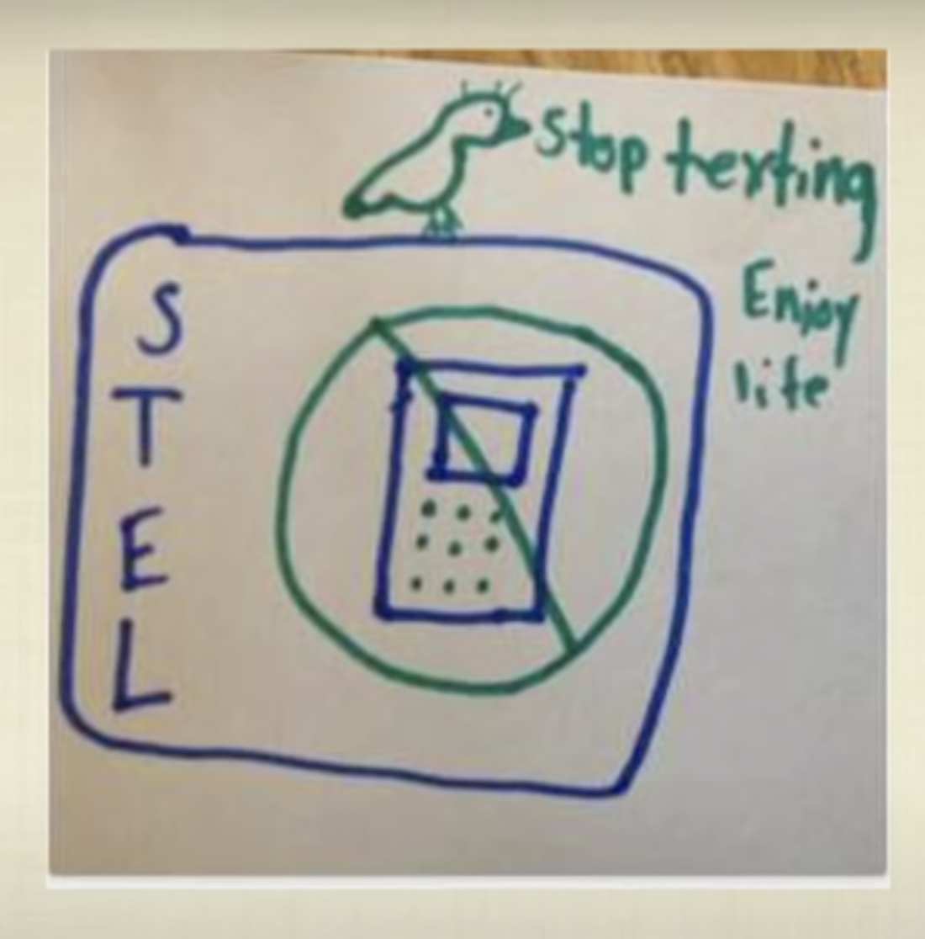
Devorah Heitner: Every single [child] I have met, this age [tweens], who I've talked to about "what problems in your life does technology exacerbate" have all talked about the most important people in their lives being inaccessible because of technology."
[Parents may feel like they are not needed, but they are so needed!]
Notes:
From Devorah Heitner's TED talk. NOTE: We don't recommend giving kids smart phone at such young ages, but interestingly, the recent research report out of BYU, in collaboration with Harvard School of Education, doesn't show any significant connection between age of first phone and wellness markers. It does shows connections between a rigid environment and health markers. Interesting concepts to mull over.
Here's Devorah's TED talk link: https://www.youtube.com/watch?v=eRQdAOrqvGg

Slide 42
"The tweens designed an app…for their parents.
"This app is voice-activated and it will shut down [a parent's] phone. You train the app to recognize the voice of your children so that random kids can't come up to you on the street and turn off your phone…If you are [using your phone] and [your child] starts speaking, it can either turn it off right away, or because the kids have so much empathy, if you are doing something really important, it might give you a little extra time. So you can set it on a three minute setting, or if you're fond of 5-more-minutes-ing your children, you can get five more minutes, but they're turning the timer back on us.
"This app doesn't exist, but when your children are trying to speak to you can close your eyes and picture this little bird and think okay, STEL, stop texting enjoy life. "Okay I'm here. I'm here now."
"The fact that the kids feel urgent enough that they designed an app that would actually shut down their parents' devices tells us a lot about their day-to-day experience with technology. They do want our attention!"
Notes:
https://wheatley.byu.edu/00000182-8d78-dff6-afab-8ffd11ce0001/teaching-by-example-pdf

Slide 43
“The key to activating maturation is to take care of the attachment needs of the child. … We liberate children not by making them work for our love but by letting them rest in it."
From Hold Onto Your Kids
Notes:
This is from Gabor Maté and Gordon Neufeld's book, _Hold Onto Your Kids_ – a fascinating read about childhood attachment and while peer attachments cannot replace them – and how parents often misunderstand how important their role is. It's a book I wish I'd had when my children were young; I found it as they were starting to launch!

Slide 44

A moment that changed (and is still impacting) my parenting
from author Toni Morrison
https://www.youtube.com/watch?v=9Jw0Fu8nhOc
(I started the video at about the 0:36 mark.)
Notes:
https://www.oprah.com/oprahs-lifeclass/does-your-face-light-up-video
As mentioned by France, Toni Morrison is a Nobel Peace Prize winner. France mentioned that some of her content is also considered pornographic. By sharing this clip, EPIK doesn't endorse any of her work – just sharing this one insightful clip with you to consider on its own merits – which is an example of media literacy. :) (I had an Oprah stint in my early motherhood, and this interview is one I will never forget.)

Slide 45
Bonus: The longer version of the previous quote
“The key to activating maturation is to take care of the attachment needs of the child. To foster independence we must first invite dependence; to promote individuation we must provide a sense of belonging and unity; to help the child separate we must assume the responsibility for keeping the child close. We help a child let go by providing more contact and connection than he himself is seeking. When he asks for a hug, we give him a warmer one than he is giving us. We liberate children not by making them work for our love but by letting them rest in it. We help a child face the separation involved in going to sleep or going to school by satisfying his need for closeness.”
From Hold Onto Your Kids
Notes:
https://www.oprah.com/oprahs-lifeclass/does-your-face-light-up-video
As mentioned by France (thank you), Toni Morrison is a Nobel Peace Prize winner. France mentioned that some of her content is also considered pornographic. By sharing this clip, EPIK doesn't endorse any of her work – just sharing this one insightful clip with you to consider on its own merits – which is an example of media literacy. :) (I had an Oprah stint in my early motherhood, and this interview is one I will never forget.)

Slide 46
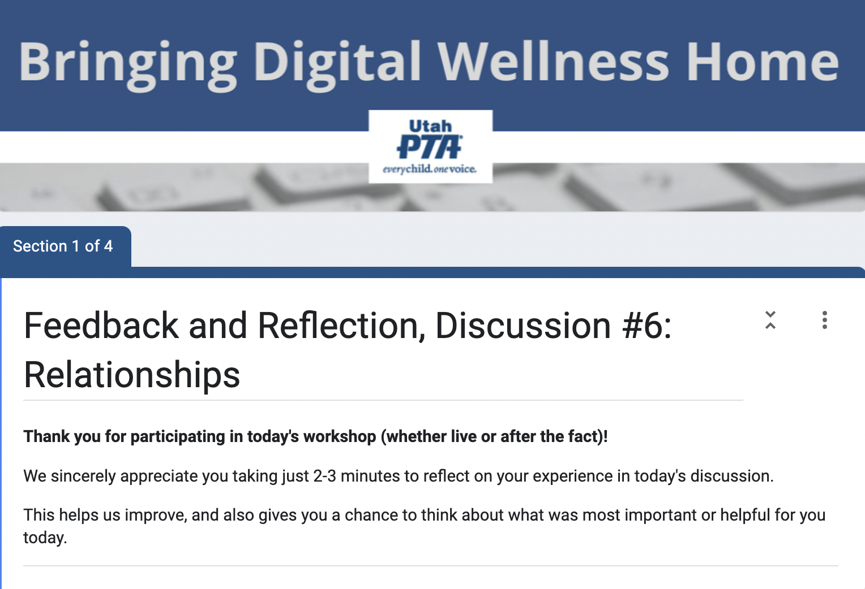
https://forms.gle/WVvLdyL8wQJcR8Tf6
Notes:
https://forms.gle/WVvLdyL8wQJcR8Tf6

Slide 47

We wish you well(ness)!
"We but mirror the world. All the tendencies present in the outer world are to be found in the world of our body. If we could change ourselves, the tendencies in the world would also change. … We need not wait to see what others do.”
~ Mahatma Gandhi
“In the attention economy, mindfulness is activism.”
-Jay Vidyarthi, Mindful Tech designer and consultant

Slide 48


Slide 49
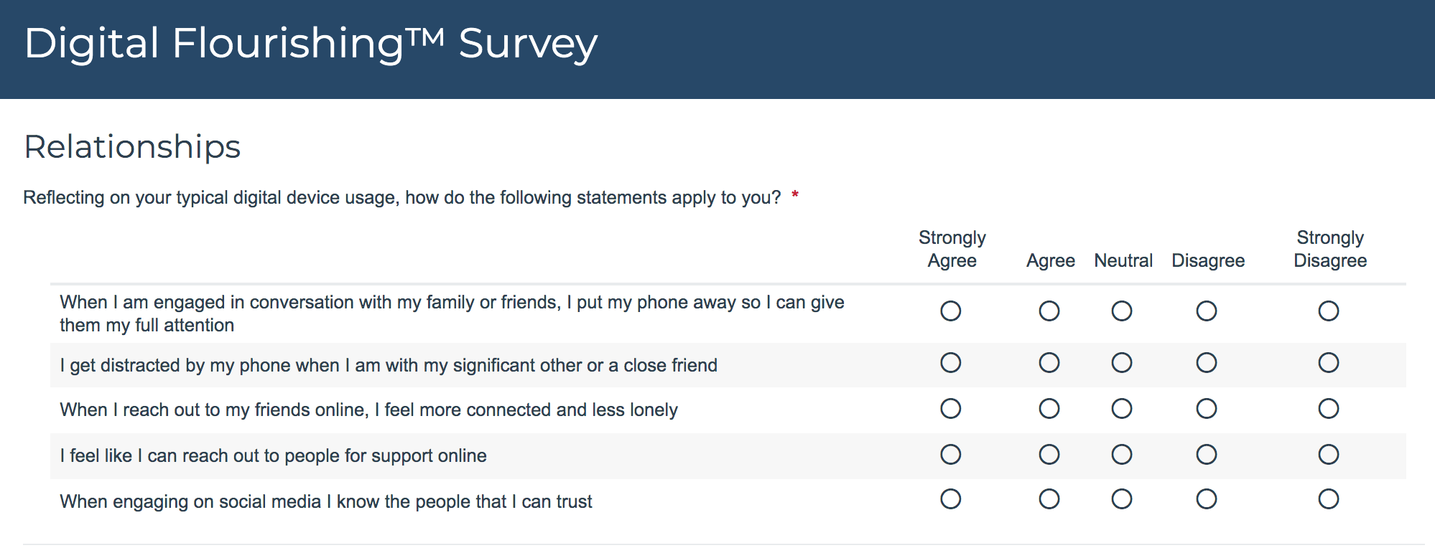
DWI Digital Wellness Self-assessment Questions
Notes:
https://survey.alchemer.com/s3/5504604/b153c792d361
You could also think about what relationships in your life in general (not just online) help you feel more connected, less lonely, supported, able to trust. As always, write any other questions that may come to mind that you would like to use for self-assessment. We know ourselves best and know what we want to work on and build awareness around.

Slide 50
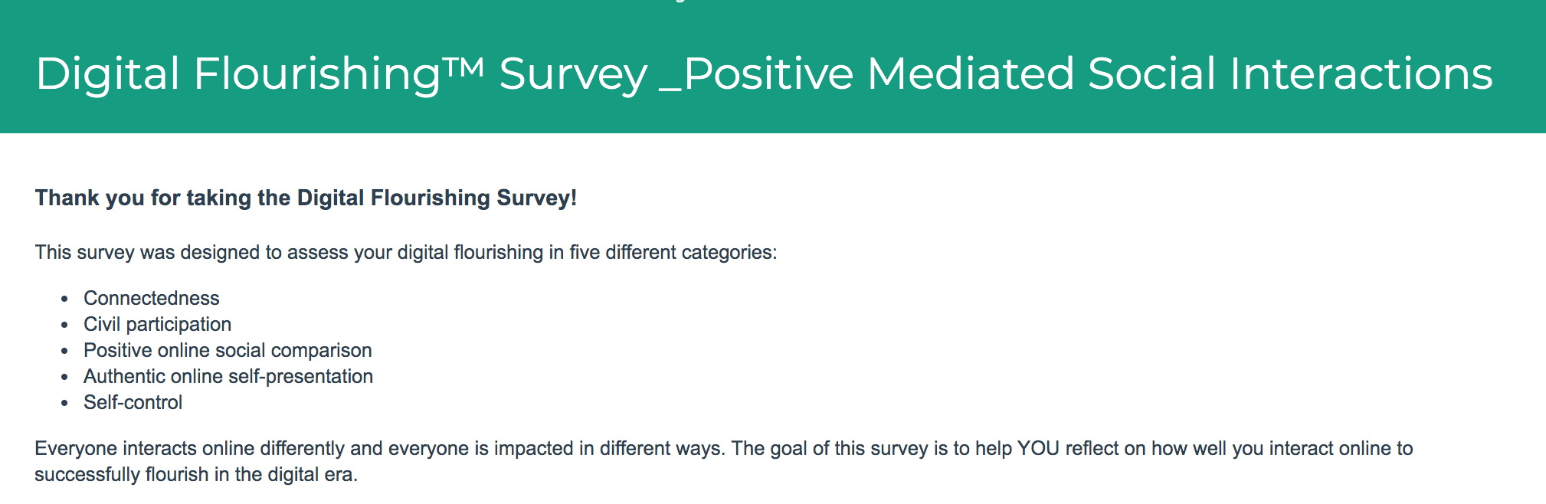
Social Connectedness Assessment from DWI
Allows for self-reflection about:
Connectedness
Civil participation
Positive online social comparison
Authentic online self-presentation
Self-control
Notes:
https://survey.alchemer.com/s3/6226945/Digital-Flourishing-Survey-PositiveMediatedSocialInteractions
We didn't review the questions from this assessment in this week. We might dig into them a little more in the Digital Citizenship module, but for now, we do invite you to at least skim over the assessment. I neglected to mention in our gathering that this tool has been validated for anyone 12 and up.

Slide 51


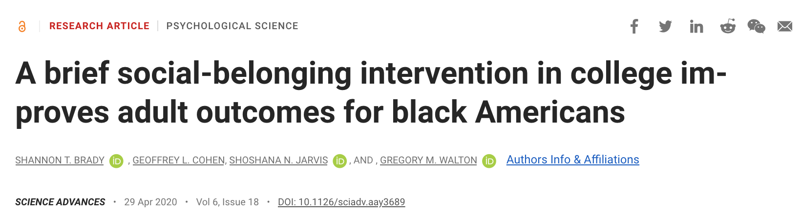

More Research on Relationships
Notes:
See also Kelly McGonigal’s book, "The Upside of Stress" on the social-belonging intervention research.

Slide 52
Research for your Reference
Harvard Study on Adult Development
https://www.adultdevelopmentstudy.org/
- - - - -
“The clearest message that we get from this 75-year study is this: Good relationships keep us happier and healthier. Period.”
“Social connections are really good for us, and … loneliness kills.”
“[I]t's the quality of your close relationships that matters”
“It turns out that people who are more socially connected to family, to friends, to community, are happier, they're physically healthier, and they live longer than people who are less well connected.”
“[T]he people who fared the best were the people who leaned in to relationships, with family, with friends, with community.”
Notes:
https://www.adultdevelopmentstudy.org/

Slide 53
Research for your Reference
Harvard Study on Adult Development
https://www.adultdevelopmentstudy.org/
https://www.inc.com/melanie-curtin/want-a-life-of-fulfillment-a-75-year-harvard-study-says-to-prioritize-this-one-t.html
- - - - -
“It's the quality of the relationships--how much vulnerability and depth exists within them; how safe you feel sharing with one another; the extent to which you can relax and be seen for who you truly are, and truly see another.”
“[T]here are two foundational elements to this: ‘One is love. The other is finding a way of coping with life that does not push love away.’” -George Vaillant (Harvard Study's lead)
This idea of not pushing love away ties back to mental/emotional wellness. Melanie Curtin writes: "This is a very good reminder to prioritize not only connection but your own capacity to process emotions and stress. If you're struggling, get a good therapist. Join a support group. Invest in a workshop. Get a grief counselor. Take personal growth seriously so you are available for connection."

Slide 54
Connection: Fundamental to human health
Brigham Young University
https://socialhealth.byu.edu/
- - - - -
e.g.,
Holt-Lunstad, J, Smith, T.B., *Baker, M., *Harris, T., & *Stephenson, D. (2015). Loneliness and Social Isolation as Risk Factors for Mortality: A Meta-Analytic Review. Perspectives on Psychological Science, 10 (2), 227-237. doi: 10.1177/1745691614568352
Holt-Lunstad, J., & *Clark, B.D. (2014). Social stressors and cardiovascular response: Influence of ambivalent relationships and behavioral ambivalence. International Journal of Psychophysiology, 93(3), 381-389. doi:10.1016/j.ijpsycho.2014.05.014
Holt-Lunstad J. (2013). Social Integration, Social Networks and Health, Stress. International Encyclopedia of the Social and Behavioral Sciences (2nd Edition). Elsevier​
Holt-Lunstad, J. & Uchino, B.N. (2013). Social Support and Health. In Health Behavior: Theory, Research and Practice (5th Edition). Jossey-Bass Publishers, a Company of John Wiley & Sons, Inc.
Holt-Lunstad, J. (2012). Social Support and Longevity: A Review. Social and Personality COMPASS, 6, 41–53, DOI: 10.1111/j.1751-9004.2011.00406.x

Slide 55
Relationships are in constant state of mismatch…it's the repair that matters…
coming back to co-regulation
"Even in healthy, securely attached relationships, caregivers and babies are in sync only 30% of the time. The other 70%, they’re mismatched, out of synch, or making repairs and coming back together. Cheeringly, even babies work toward repairs with their gazes, smiles, gestures, protests, and calls."
"Life is a series of mismatches, miscommunications, and misattunements that are quickly repaired, says Tronick, and then again become miscoordinated and stressful, and again are repaired. This occurs thousands of times in a day, and millions of times over a year."
“Repairing ruptures is the most essential thing in parenting.”
UCLA neuropsychiatrist Dan Siegel
“Relationships shrink to the size of the field of repair,” says Rick Hanson, psychologist
Notes:
https://greatergood.berkeley.edu/article/item/family_conflict_is_normal_its_the_repair_that_matters

Slide 56
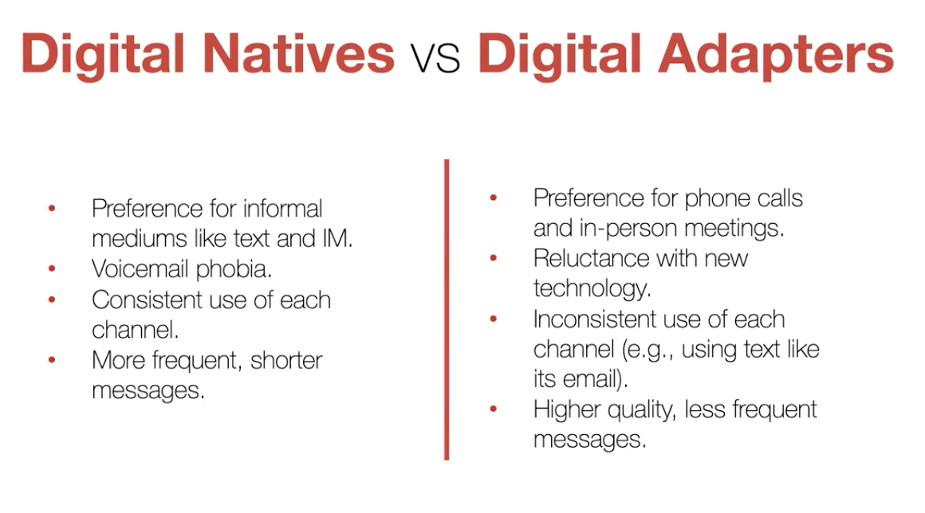
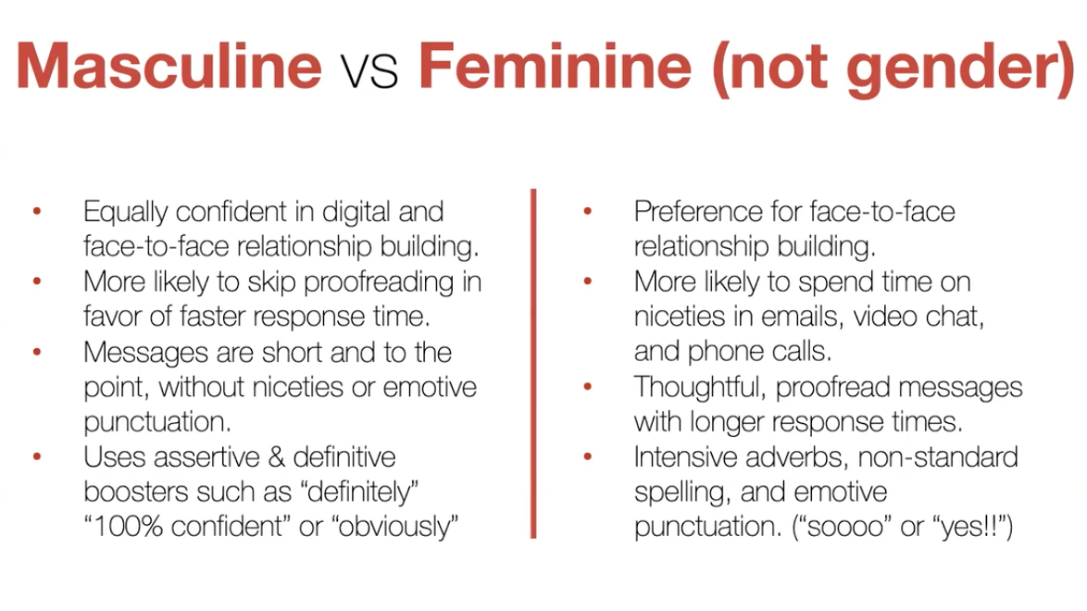
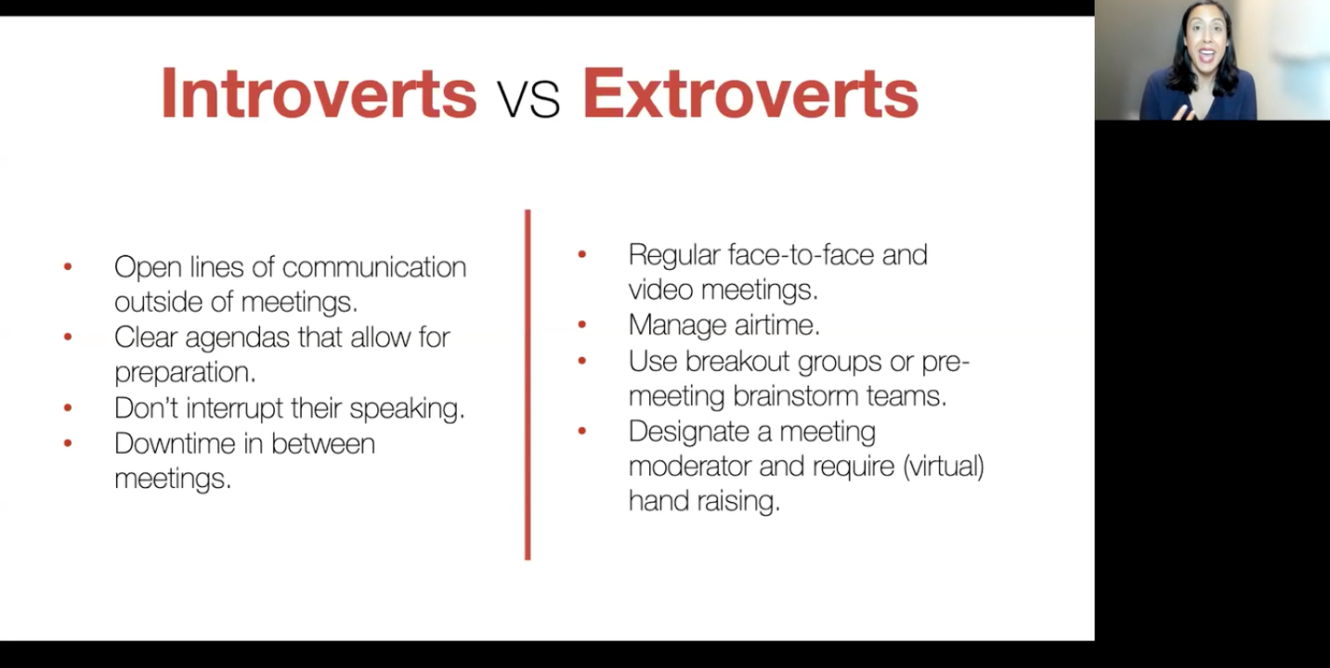
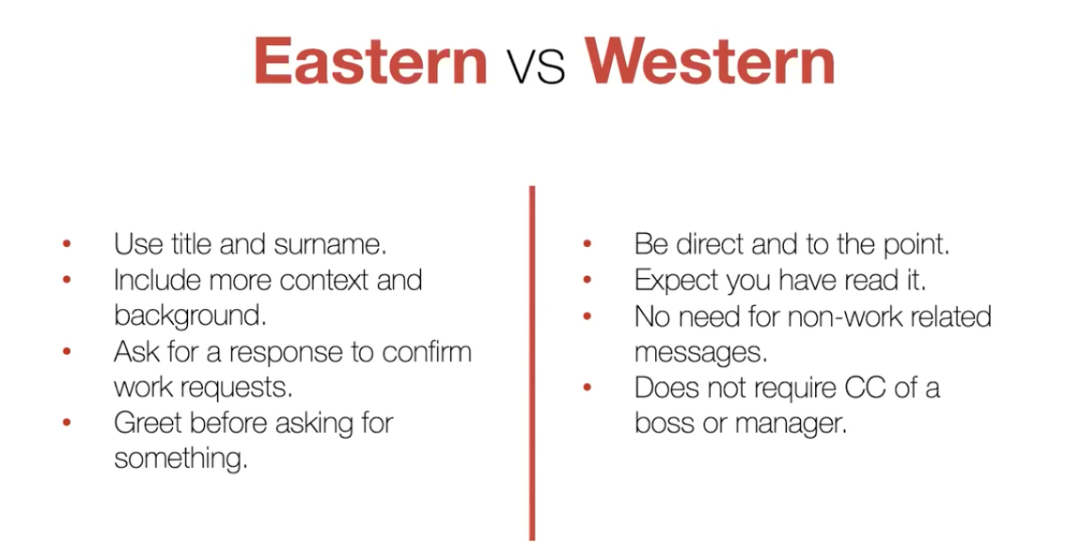
For all kinds of relationships with others:
Digital Communication Styles vary
By generation (e.g., Digital Natives vs. Digital Adapter
Masculine vs Feminine (not gender but communication style)
By culture (e.g., Eastern/Western)
By personality (e.g., Introvert/Extrovert)
Erica Dawahn: How to Read Digital Body Language: https://summit.digitalwellnessday.com/talks/how-to-read-digital-body-language/
Notes:
=

Slide 57
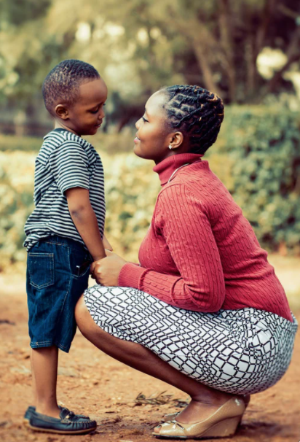


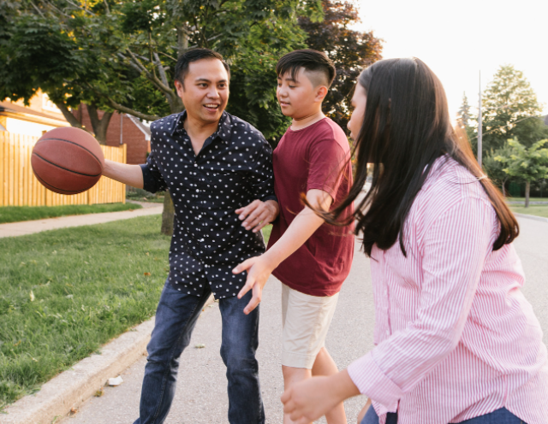
Gabor Maté: Hold Onto Your Kids
"It is the role of culture to cultivate connections between the dependent [children] and the dependable [parents/caring adults] and to prevent attachment voids from occurring."
Notes:
This is a remarkable book that explains the problems of a primary peer orientation in youth, and how critical attachment with parents and/or caring adults is for healthy development of children and youth. This is a book I wish I'd had when my children were young. I discovered it as they were beginning to launch.

Slide 58
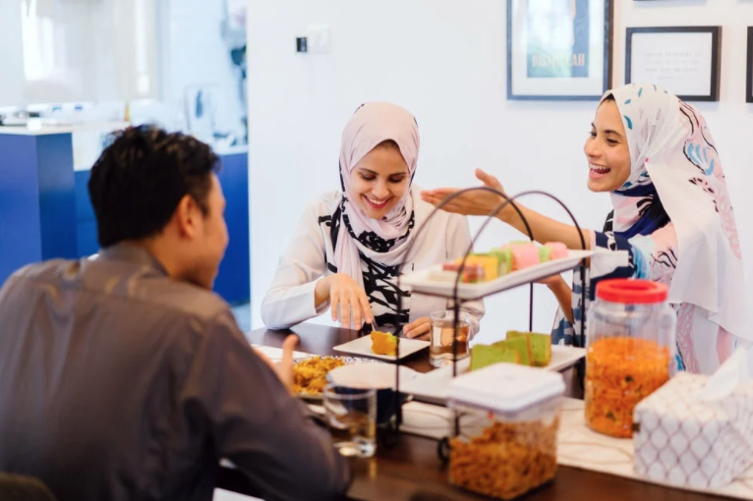
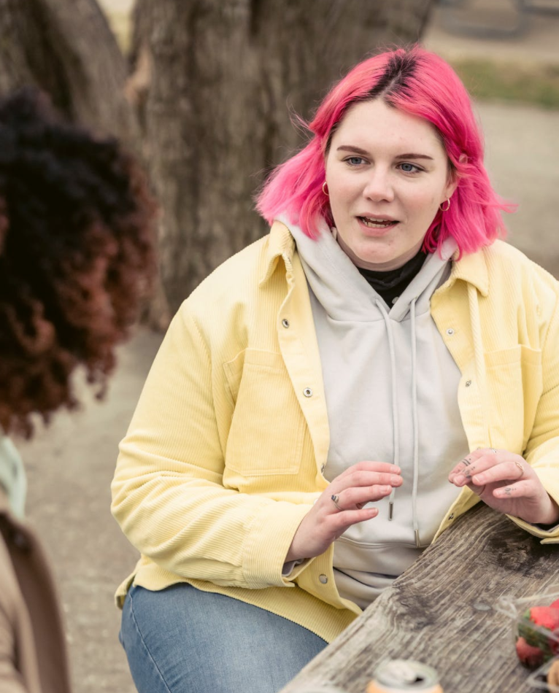
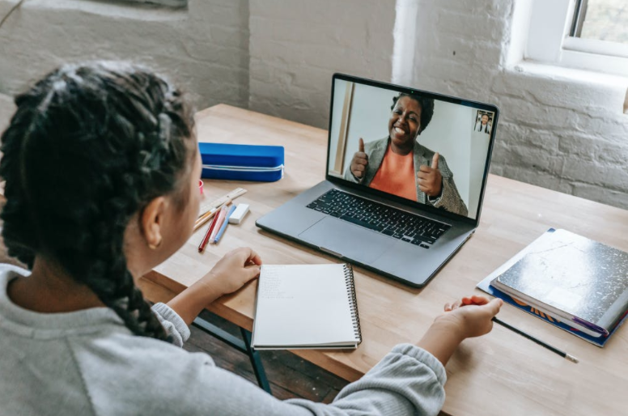
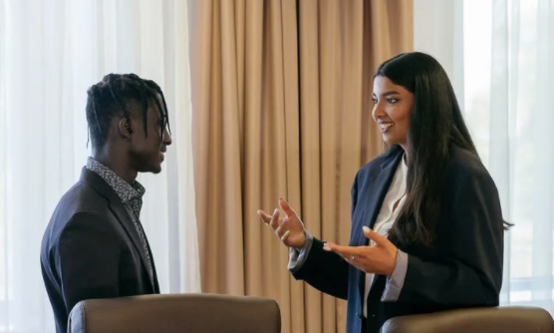

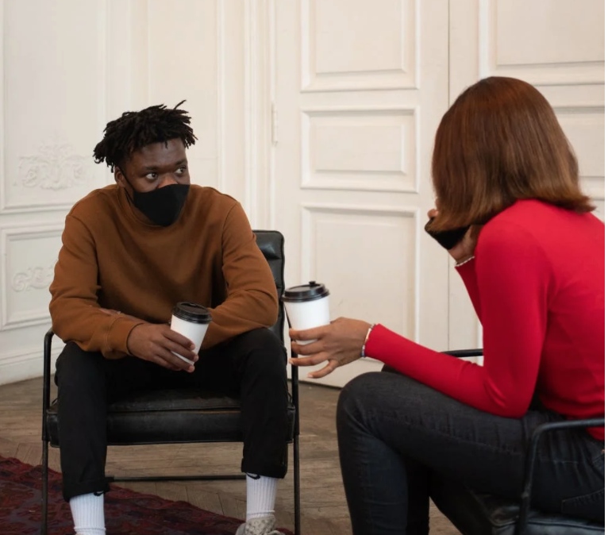

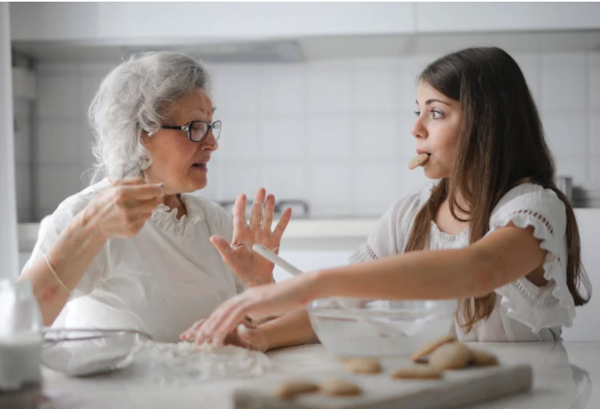

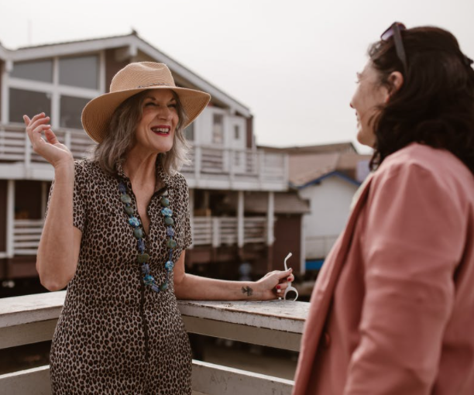

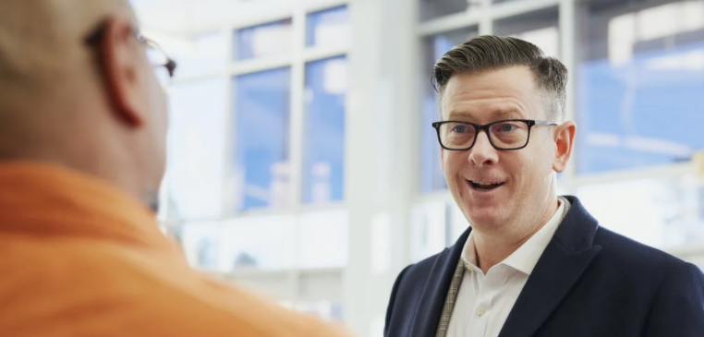
The power of conversation
“[W]e use conversations with each other to learn how to have conversations with ourselves. So a flight from conversation [retreat into technology or surface connection] can really matter because it can compromise our capacity for self-reflection. For kids growing up, that skill is the bedrock of development.” [And adults need the skill, too!] –Sherry Turkle
Notes:
=

Slide 59
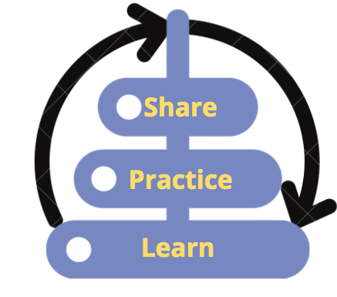
One last thought from Dr. Turkle
As COVID started to impact our relationship with technology even more, Dr. Turkle said the following:
This is “a liminal time. It's like a time out of time. It's a time betwixt and between where you get a chance - the rules are broken and you get a chance to reassess what you really need. And I think that's what we have now. We have a chance to come back and not be wowed by technology and reassess the virtue of the human and relationships and to act more deliberately in our relationship with them.”
–Dr. Sherry Turkle
You can also learn a little more about Dr. Turkle's life in this interview: https://www.npr.org/2021/03/10/975607758/in-the-empathy-diaries-sherry-turkle-considers-the-burden-of-family-secrets
Notes:
You can also learn a little more about Dr. Turkle's life in this interview: https://www.npr.org/2021/03/10/975607758/in-the-empathy-diaries-sherry-turkle-considers-the-burden-of-family-secrets

Slide 60


Juggling, dancing in the tensions
As with most things in life, it's a balancing act to nurture our relationships with ourselves, with those we care most about (Bonding relationships) and with Bridging relationships.
Notes:
We didn't have time to cover this in our discussion, but it's worth reflecting on (see next slide)

Slide 61
Dancing in the Tensions
See also Barbara Sher’s TEDx talk (When it comes to problem-solving and reaching your goals, there is a tension with solitude, because problems are meant to be solved via connection and collaboration and mutually helping each other) https://www.tedxprague.cz/en/videa/isolation-is-the-dream-killer-not-your-attitude-barbara-sher
Barbara’s work also reinforces building small networks of support for reaching your goals (where bridging social capital can even become more like bonding social capital)
Notes:
We hope to talk more about "dancing in the tensions" in week 8.

Slide 62
“You not Them” principle
Back to center, again ☺
“We can avoid authoritarian interactions with children [and others] by focusing on our own values and actions; we can’t draw from empty wells.”
~Jodi Chaffee, of the Family Culture Movement https://familyculture-movement.captivate.fm/
https://www.youtube.com/watch?v=wJSzi9ypOCo
“A leader needs to have presence, to show up to the moment grounded in one’s self, as centered as one can be, ready to hear, to listen, to discern.” ― Raymond M. Kethledge, Lead Yourself First: Inspiring Leadership Through Solitude

