Slide 1
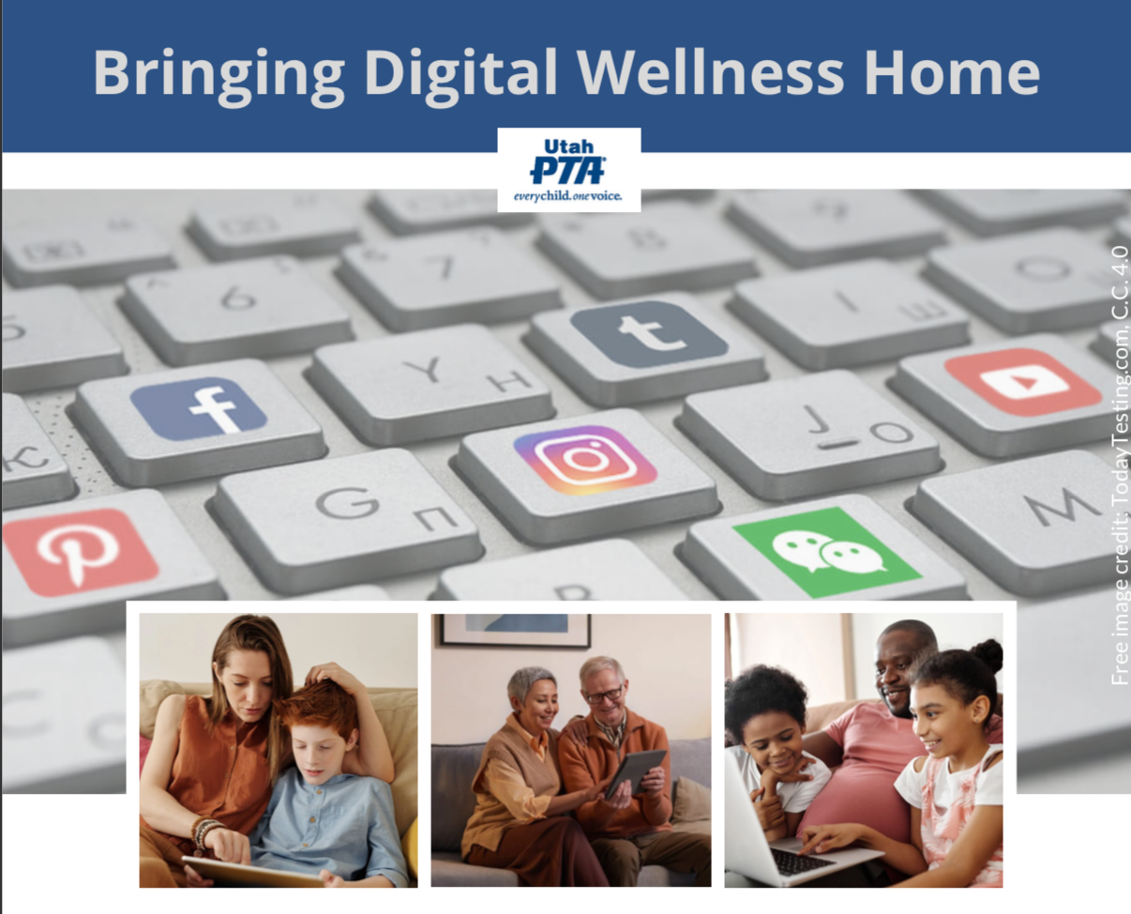
Note: All material in this series is for educational and informational purposes only, and is not meant to be exhaustive or used as a replacement for professional health support.
Notes:
Note: All material in this series is for educational and informational purposes only, and is not meant to be exhaustive or used as a replacement for professional health support. Also, the presentation is best viewed in slideshow format, as some of the slides are animated. That said, these notes are here for your benefit.
NOTE: Portions of this work first appeared in or are derived or adapted from the Digital
Wellness Certificate Program. Those portions are Copyright © 2021, Digital Wellness Institute.

Slide 2


Introspection
"Point and name": Identify three words that describe emotions you are feeling at the moment
Notes:
So much of wellness is simply about self-awareness. Wellness is built as we build our self-observation skills. About taking moments to stop and check in with yourself. There are many emotions charts, wheels, and other resources available out there. Many parents use these as a way to help their children learn to find words, pictures, etc. to be able to communicate what is going on inside their inner world. That connection to their inner world is a key tool for digital health. This is true for us as adults, too.

Slide 3
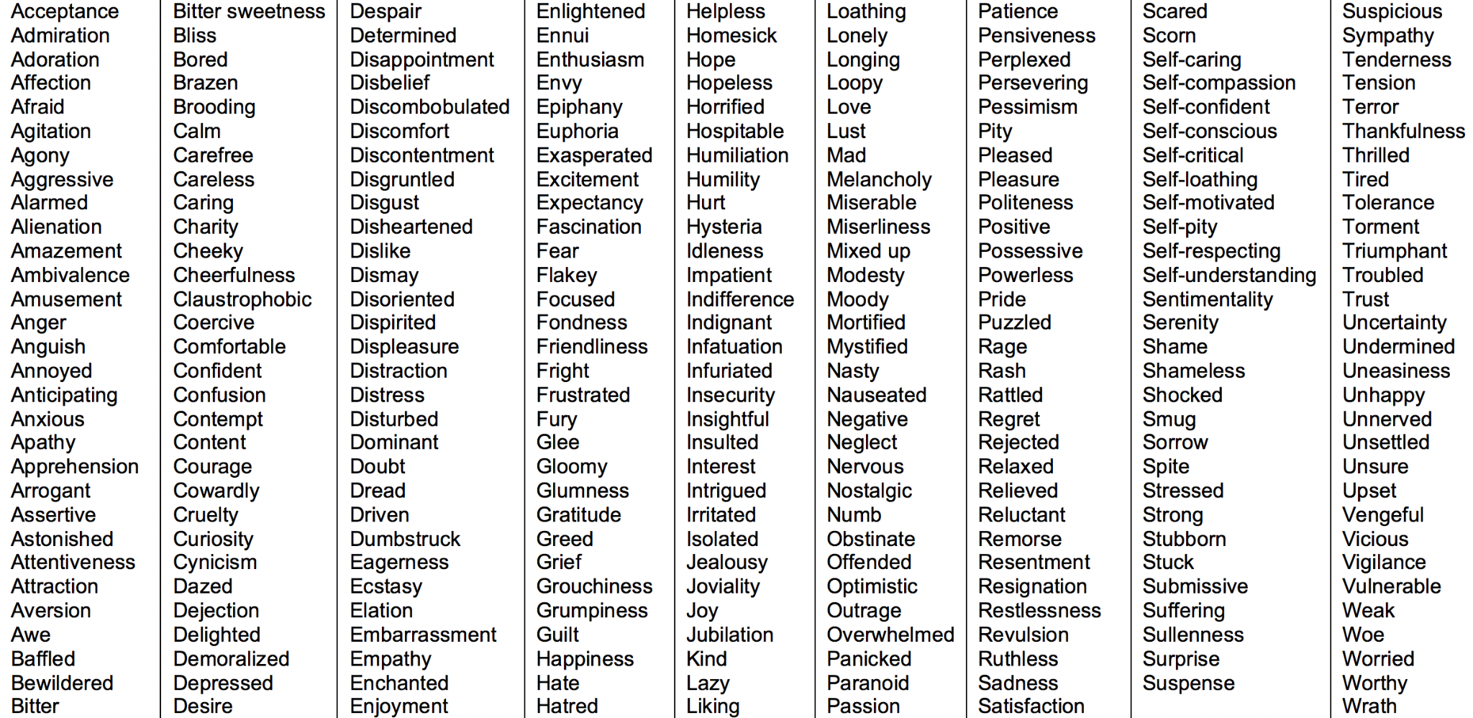
Boredom
adapted slightly from https://www.berkeleywellbeing.com/list-of-emotions.html
Notes:
Mentioning your daughter-in-law here might be good!
For notes to share with the group with the slide deck later:
Another resource: Dr. Robert Plutchik's emotion wheel from https://positivepsychology.com/emotion-wheel/
So much of wellness is simply about self-awareness. Wellness is built as we built our self-observation skills. About taking moments to stop and check in with yourself. There are many emotions charts, wheels, and other resources available out there. Many parents use these as a way to help their children learn to find words, pictures, etc. to be able to communicate what is going on inside their inner world. That connection to their inner world is a key tool for digital health. This is true for us as adults, too.
Pick from a list if you’d like: 271 emotions listed! https://www.berkeleywellbeing.com/list-of-emotions.html

Slide 4
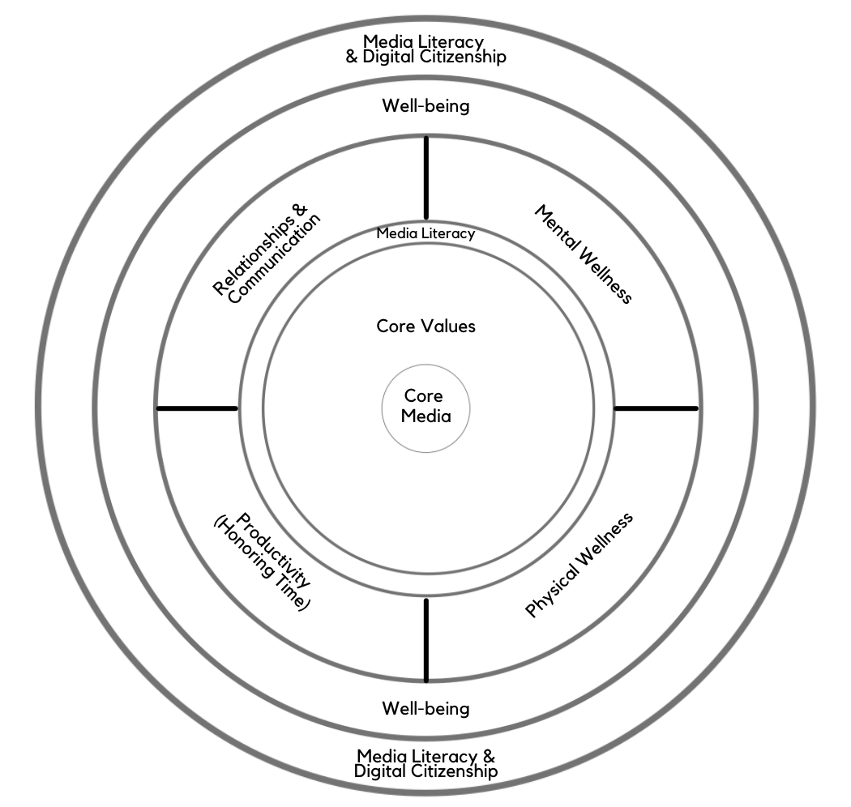
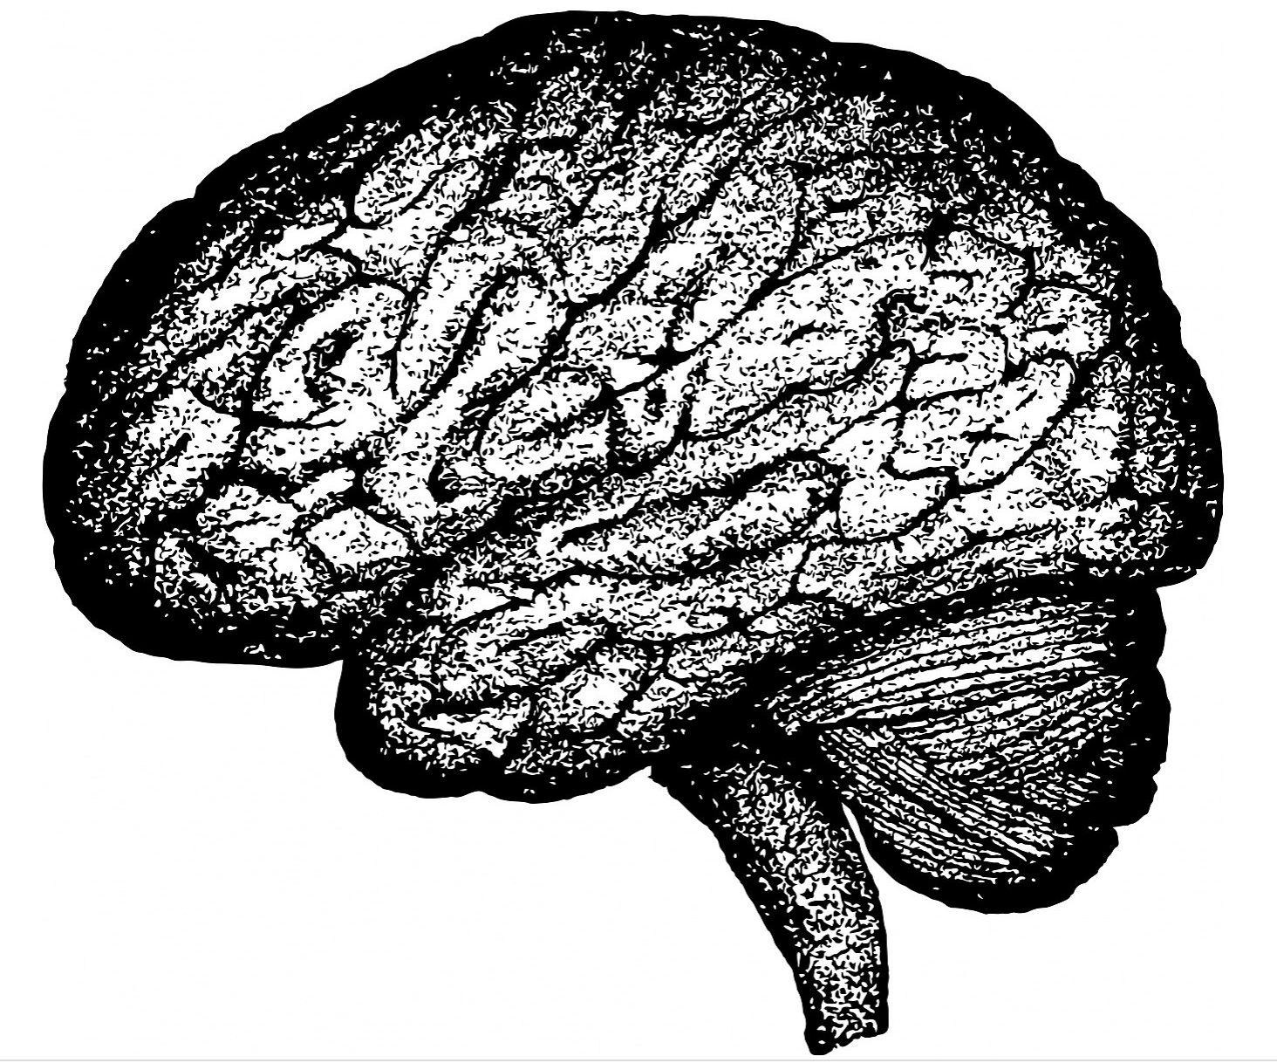


Digital Centeredness Model
Start with Your Center
Media Literacy
Mental Wellness*
Physical Wellness*
Productivity (Honoring time)*
Relationships*
Well-being*
Digital Citizenship* & Media Literacy
Bonus: Social Development Strategy
All of the topics with an asterisk are included in the DWI Digital Wellness self-assessment https://survey.alchemer.com/s3/5504604/b153c792d361
Notes:
As we add a new topic each week, you'll see the red ring grow. Each week's content builds on the previous weeks. This week we address the third in a wellness trifecta of heart, mind, body. We've talked about media literacy and learning the language of our emotions. Today we're talking about body literacy. There is no way to really mark where the heart (our center, spirit, soul) ends and the mind or the body begins. They all interact together.

Slide 5
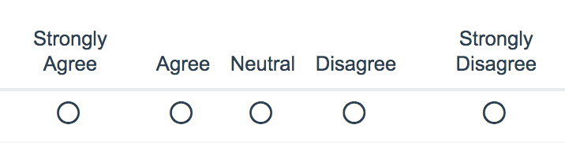
Part 1: Basic Tips
https://survey.alchemer.com/s3/5504604/b153c792d361
Notes:
We'll start today with the Digital Wellness Institute's Physical Wellness section of their self-assessment. We encourage you to review the whole assessment. As you will see today, it's not only a way to reflect but also teaches principles as it asks questions. https://survey.alchemer.com/s3/5504604/b153c792d361

Slide 6
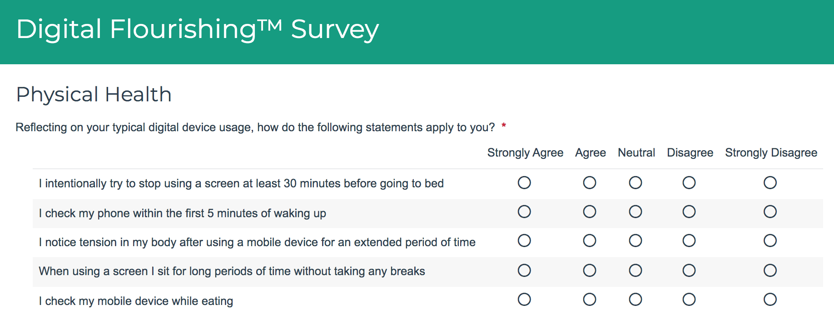
Introspection: Self-assessment
https://survey.alchemer.com/s3/5504604/b153c792d361
Notes:
https://survey.alchemer.com/s3/5504604/b153c792d361

Slide 7
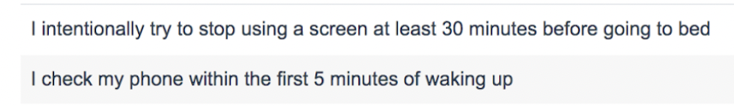


Qs 1&2: Sleep Hygiene
https://survey.alchemer.com/s3/5504604/b153c792d361
Notes:
the first two questions in the DWI self-assessment deal with sleep hygiene, on both ends of our sleep time

Slide 8
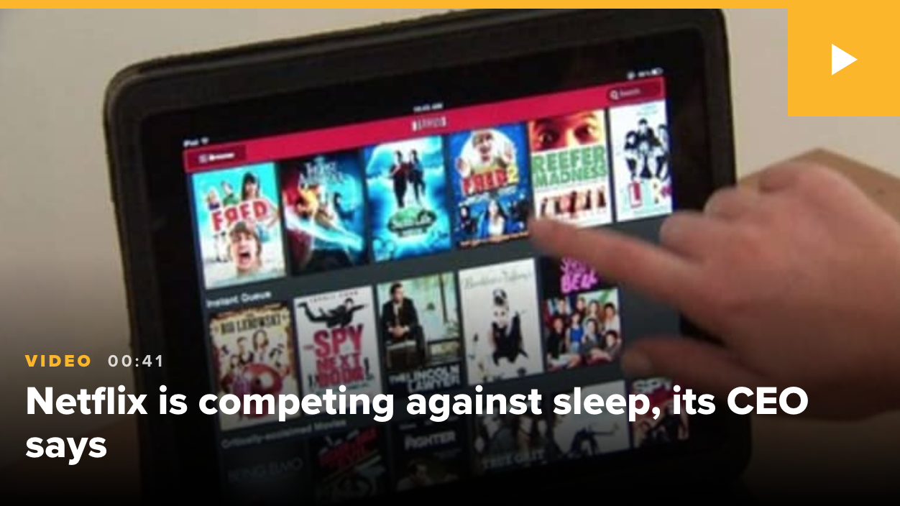
Sleep Hygiene
Notes:
https://www.cnbc.com/2017/04/17/amazon-hbo-netflix-thinks-its-real-competitor-is--sleep.html – this is an example of what we mean when we talk about “The Attention Economy.” Companies PLAN ways to keep us on our devices with endless streams of content, endless scrolling, tailored content in our social media feeds, autoplay, etc.
Interestingly, at the time of this discussion, a hearing was happening in Washington about the negative impacts of the algorithm- and profit-driven Attention Economy on the well-being of youth, with input from a former Facebook employee.

Slide 9




Sleep Hygiene
One study showed
  74% check devices 15 minutes before sleeping
  61% of people check phones 5 minutes after waking up
  88% check their phones within 30 minutes of waking up
  96% check within an hour of waking up
https://www.bgr.in/news/61-people-check-their-phones-within-5-minutes-after-waking-up-deloitte-435501/
Also see research about blue light impacts on sleep: https://www.sleep.org/ways-technology-affects-sleep/
Notes:
Just because it's common doesn't mean it's healthy. :) We'll be talking more about this next week, but the sooner we check our devices, the more susceptible we are to others' influence on how we start our day and spend our attention and mental, emotional, physical, and relational energy.
https://www.bgr.in/news/61-people-check-their-phones-within-5-minutes-after-waking-up-deloitte-435501/

Slide 10

Sleep Hygiene
Blue light can impact the body’s circadian rhythm [biological sleep cycle)
Children are more sensitive to the impacts of blue light
https://www.sleep.org/ways-technology-affects-sleep/
Notes:
https://www.sleep.org/ways-technology-affects-sleep/

Slide 11
Sleep Hygiene Tips
Before bed: at least 30 minutes with no tech
Upon awakening: Do a no-tech morning routine
Remember the impact of negative news
  At the very least, try to avoid beginning or ending the day with news
Notes:
Can just hat tip the research we already mentioned (3 minutes = 27% less positive by the end of the work day)
Another news article about news for when we share the slide deck: https://michellegielan.com/project/hbr-consuming-negative-news-can-make-you-less-effective-at-work

Slide 12
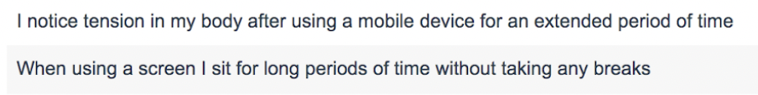


Qs 3&4: Overwork & Physical Strain
Notes:
DWI Survey link: https://survey.alchemer.com/s3/5504604/b153c792d361

Slide 13
Introspection: Point & Name:
Where in your body do you feel the impact when you have been on a device for too long?
Notes:
Where do you often feel impact in your body when you overuse tech?

Slide 14
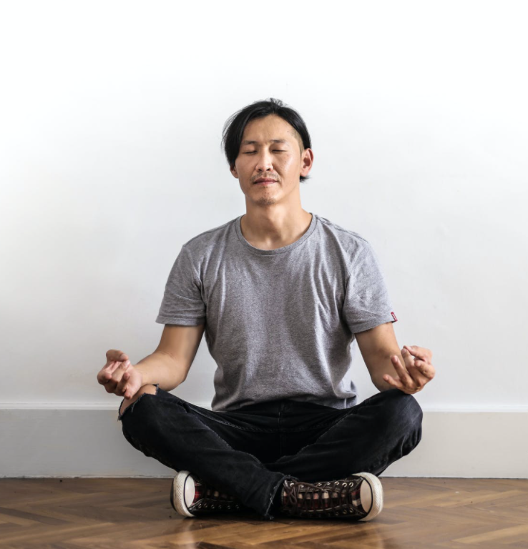
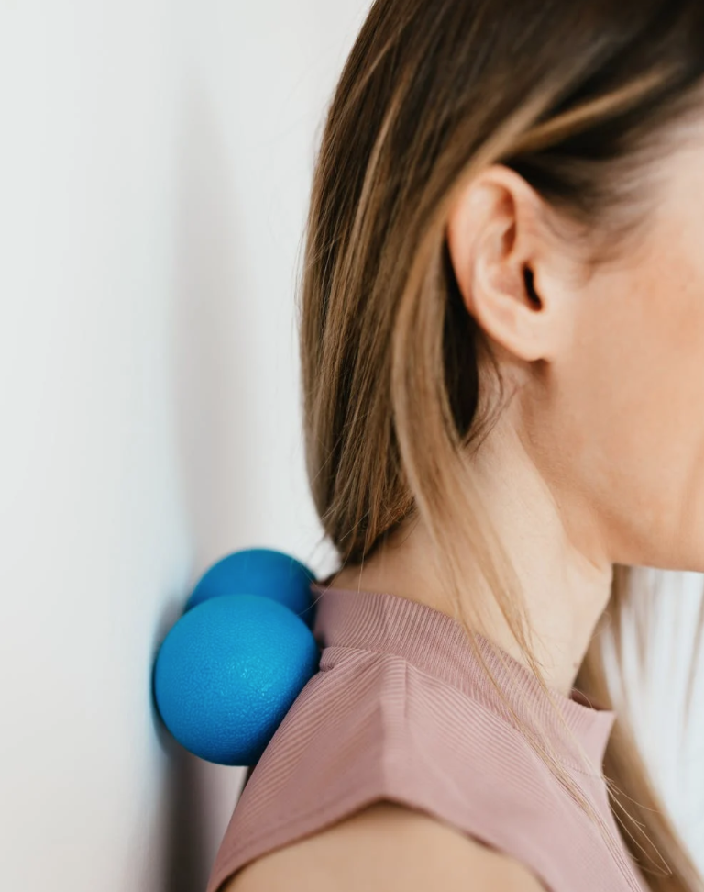

Overwork and Physical Strain Tips
Recommendation: ~5-15 minutes of a break every 60-90 minutes (or at least 30-60 seconds every 30 minutes)
Give care to stressed and strained body parts
Note: We’ll be talking more about productivity and time management next week
*https://theenergyproject.com/ideas/activity-does-not-always-equal-productivity/
Notes:
There are lots of resources out there for releasing strain. We'll be sharing a few in this week's folder of resources.

Slide 15
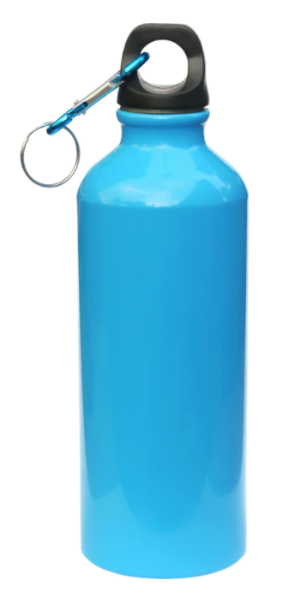
p.s. A simple trick to build in breaks ☺
Notes:
Drinking water regularly throughout the day can build in natural breaks throughout the day. :) –As we take care of our body by drinking water, it helps take care of us by ensuring we don't go too long without a break (if we listen to our bodies, that is). Jan talked about not filling the water bottle too full so you can refill many times through the day. Also, when we drink more, we need more bio breaks.
idea credited to James Garrett, shared in a brain plasticity/brain health small group course. The idea of doing a couple of pushups mentioned in the recording comes from BJ Fogg's book, Tiny Habits.

Slide 16


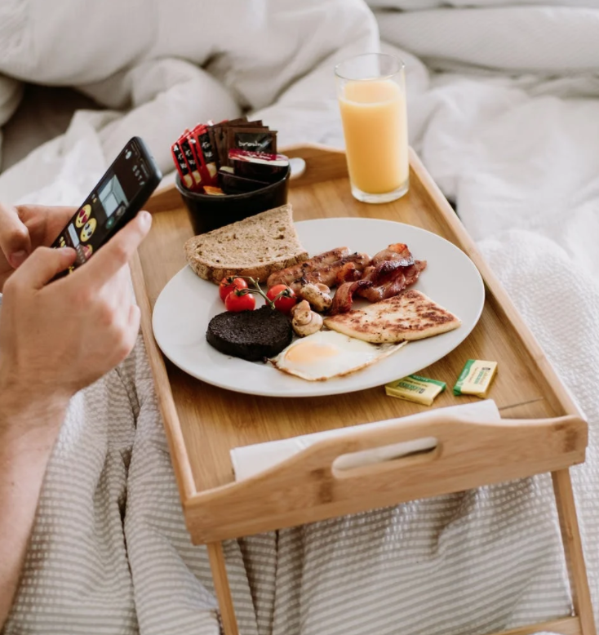
Q5: Screen-free Eating
Q: How often do you personally practice screen-free eating (or not)?
Notes:
You may already have family time that is guarded without tech around the table, but what about your own personal time? Do you find yourself multitasking and eating and "getting things done" on the computer (or just scrolling mindlessly while eating?)

Slide 17
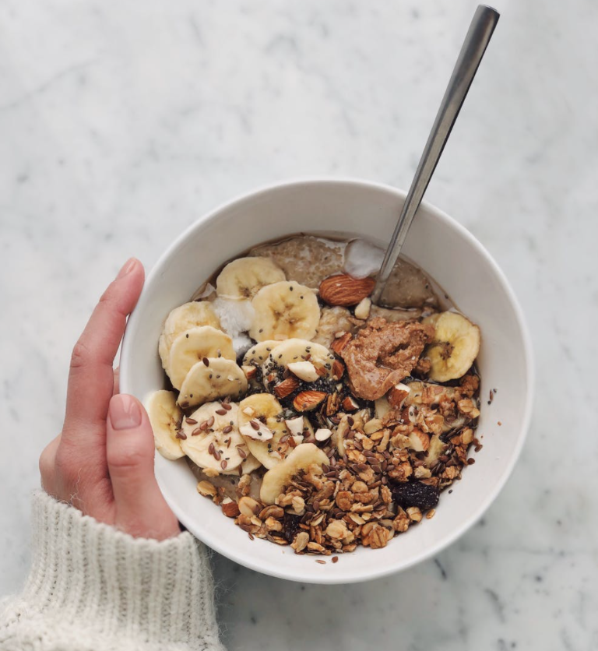

Tip
Eat at least one meal (or snack) a day screen-free
(aim for more)…good for brain and body!
p.s. This can be good for relationships, too!
Notes:
Someone shared in a discussion elsewhere that single-tasking felt “like a walk in the forest.” Making this one change to do tech-free eating has had a significant impact for EPIK’s Michelle. Some take this idea even further to practice what is called Mindful Eating, something we did not discuss…but the idea is to slow wayyyyy down and connect with the sensory experience of eating and appreciating all that the body does and experiences while eating.
We’ll be talking more about single-tasking next week.

Slide 18
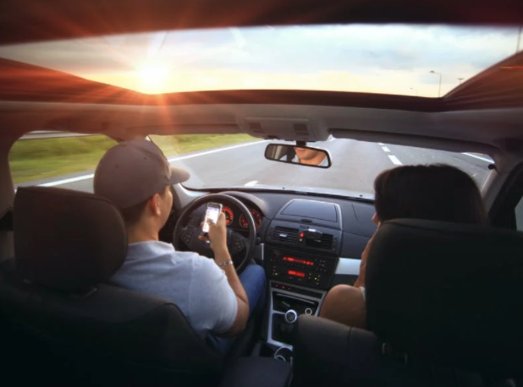
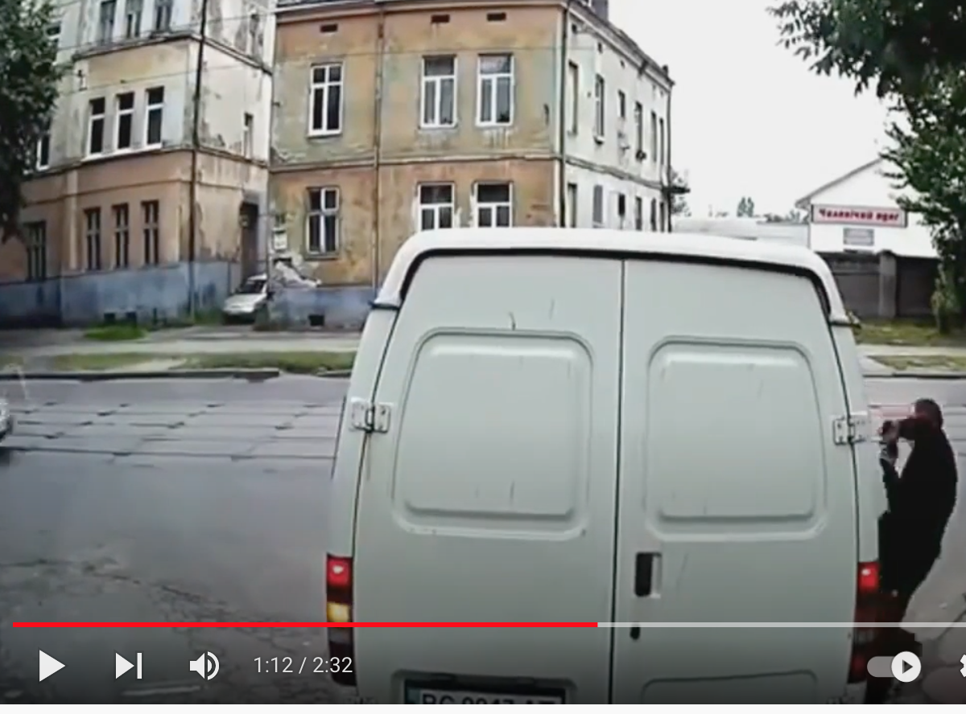
Physical Wellness also includes safety
PLEA: Commit to Screen-free Driving and Walking
https://www.youtube.com/watch?v=ynvd70b-uCY
Notes:
We wanted to be sure to cover this topic as part of our Physical Wellness discussion. Many statistics show the dangers of texting and driving. Videos like the above even show the dangers of walking and looking at our phones. Our brains really can’t be in two environments at once. We’ll talk more about multi-tasking next week, but in this context, this is about physical safety, perhaps even impacting mortality rates.

Slide 19

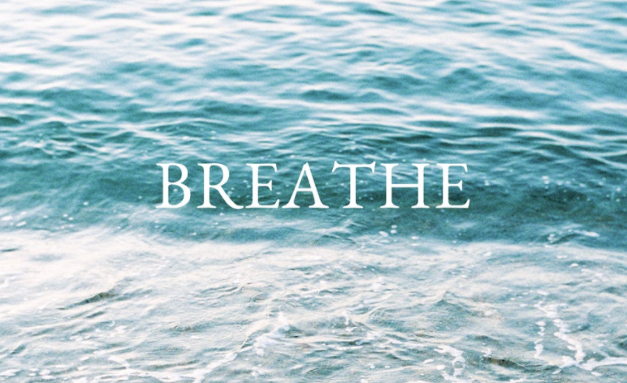
~~~ Blink and Breathe Break ~~~
Blinking can provide
"wakeful rest" to the brain!
Notes:
https://summit.digitalwellnessday.com/talks/digital-strain-how-it-affects-our-sleep-and-why-our-blinks-matter/
Research on the impact of the blink on the brain: https://www.pnas.org/content/110/2/702 or https://www.researchgate.net/publication/233984548_Blink-related_momentary_activation_of_the_default_mode_network_while_viewing_videos]
In sadness, we breathe heavy sighs.
In joy, our lungs feel almost like they will burst.
In fear we hold our breath and have to be told to breathe slowly to help us calm down.
When we’re about to do something hard, we take a deep breath to find our courage.
(from a post ‘YHWH’ by Don L Mills)

Slide 20
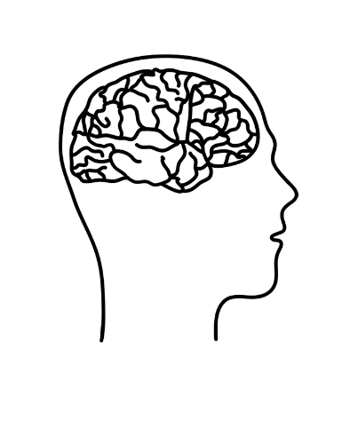
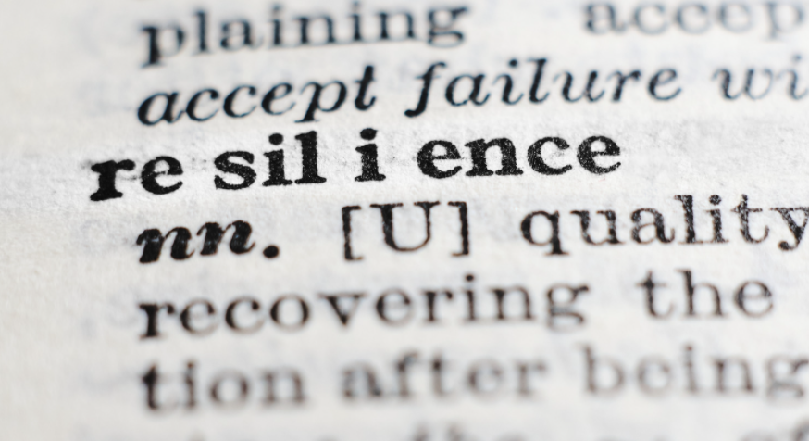
Part 2:
Befriending the body’s
stress response
Notes:
Another word here is CURIOSITY. The image of the brain is connected to last week's discussion on stopping to THINK about what is going on inside of us when fight-or-flight hits. Simply engaging our brain can impact how our body responds to stress and can build resilience skills and even change brain pathways (plasticity)
https://www.ted.com/talks/kelly_mcgonigal_how_to_make_stress_your_friend?language=en – Look at the little girl peeking out to look at what she may have been hiding from before. Note that we are talking about our physical stress responses, but obviously physical and mental wellness are interconnected

Slide 21
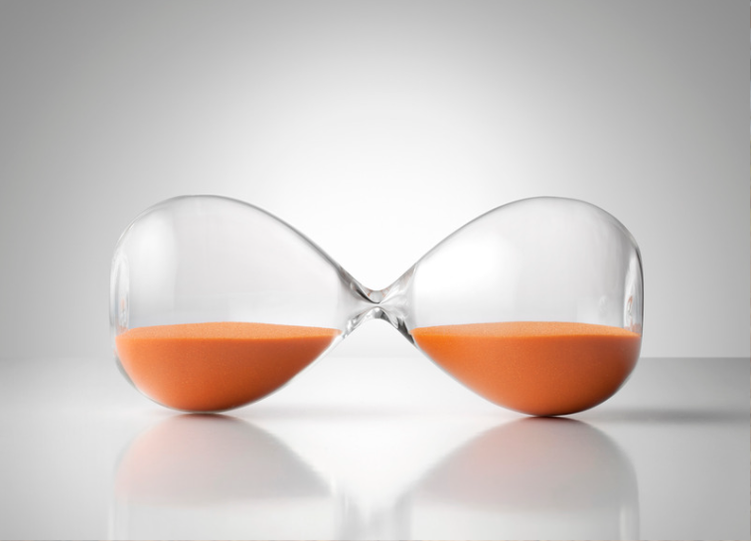

Pause + Ask Questions + "Point and Name"
Notes:
We're continuing to add on what we have talked about already.
(Note: In all of these activities, the pointing doesn't have to be literal, although you can engage your body in this way if desired. :) )
On the power of pointing and naming, as it were, on improving wellness, habits, etc. see this from James Clear, an excerpt from chapter 4 of his books, Atomic Habits (shared on his website). In his book, he calls it "pointing and calling," from a safety process (Shisa Kanko) on Japanese trains that has significantly reduced accidents. https://www.japantimes.co.jp/news/2008/10/21/reference/jr-gestures/ or you can read this blog post about it since the original story is behind a paywall: https://www.christopherroosen.com/blog/2020/4/20/how-the-ritual-of-pointing-and-calling-shisa-kanko-embeds-us-in-the-world
"pointing and calling" - "Shisa Konko"
*Alice Gordenker, “JR Gestures,” Japan Times

Slide 22
Think & Write:
Think of a recent stressful experience, and
Write about what happened
in your mind and different parts of your body
Notes:
We may feel stress in different ways at different times in our bodies, but in general, how would you describe what happens in your body when you are feeling fight or flight responses? Do you feel things in your head, your belly, your chest? Do your palms sweat? Does your heart race? Does your mind race?

Slide 23
Is the stress response all negative?
Notes:
We may feel stress in different ways at different times in our bodies, but in general, how would you describe what happens in your body when you are feeling fight or flight responses? Do you feel things in your head, your belly, your chest? Do your palms sweat? Does your heart race? Does your mind race?

Slide 24
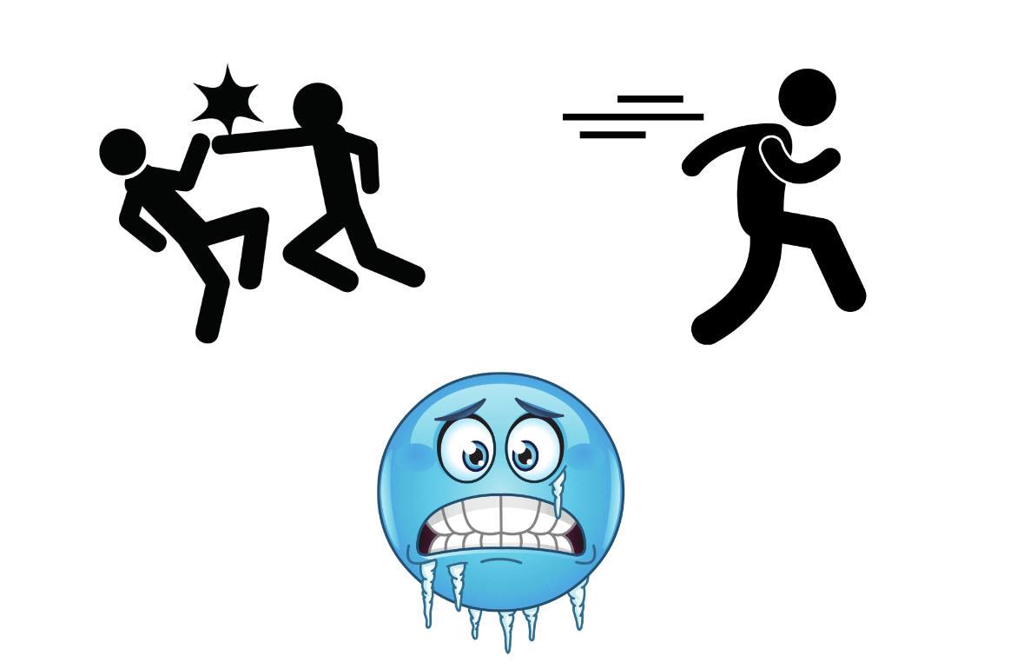

Notes:
Last week, we talked about how when we are in Reactor mode, the chemistry in our bodies can "drive the bus" – if we don't stop and think.

Slide 25
But there is more to the story!
Notes:
But our body chemistry in fight-or-flight doesn't stop at adrenaline and cortisol. Other chemicals are at play, and we can bring their benefits into play as we practice awareness, mindfulness, connecting with and even talking to our bodies.

Slide 26
Hope is built into our Biology
Notes:
https://www.ted.com/talks/kelly_mcgonigal_how_to_make_stress_your_friend?language=en
See also her book and this interview on NPR: https://www.npr.org/transcripts/747384008

Slide 27
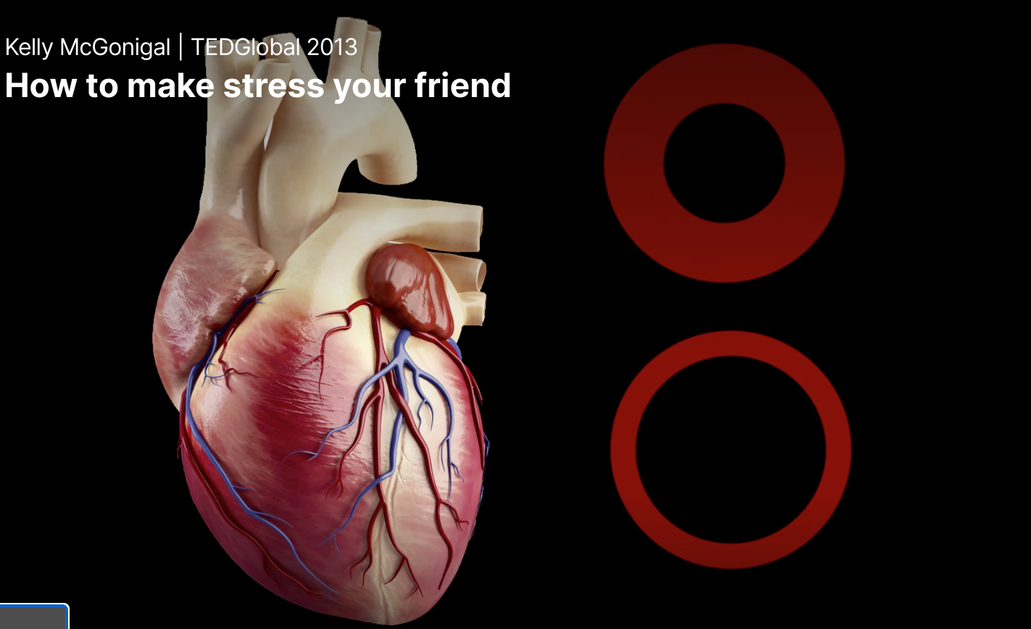
Reframe Stress = Build Wellness
https://www.ted.com/talks/kelly_mcgonigal_how_to_make_stress_your_friend?language=en
“When we change our mindset about stress, even in ‘stressful’ situations, our bodies can respond in healthy ways, even at the cardiovascular and chemical level. Scientists are discovering more that how we think about stress has a great impact on our health vs. just stress itself. In fact, those with a resilient mindset about stress…can show even greater health markers than those not under similar ‘stress.’”
Notes:
https://www.ted.com/talks/kelly_mcgonigal_how_to_make_stress_your_friend?language=en
Note: The two circles represent what happens to blood vessels when experiencing stress as a negative (constricted top cross section) vs. those who have befriended stress (bottom e.g.). Blood vessels, as shown in a study at Harvard mentioned by Dr. McGonigal, are softer and more relaxed in the lower representation. Similar to how blood vessels are when you are experienceing JOY or COURAGE. See the TED talk for more information. Different hormones can also be released depending on our mindset (see her book for more details).
See also this interview on NPR: https://www.npr.org/transcripts/747384008

Slide 28

Reframing can help us access biological benefits
Reframing
Notes:
animated – when fight-flight-freeze is happening, if we stop to pause, ask questions and point and name, we can help our brain and body engage with stress differently

Slide 29
The fight-or-flight response includes chemicals that can help us:
Do what is meaningful in the moment
Connect & care
Learn and grow from experience
Notes:
Within the fight-or-flight response, we don't just have adrenaline and cortisol flowing through our bodies. In fact, there are other chemicals that can help us do what is meaningful in the moment, or connect and care, or to learn and grow from whatever experience brought the sense of stress in the first place. Every time we feel stress, we can pause, and ask questions and point and name what our bodies seem to be encouraging us to do. Different situations may bring a different mix of hormones and other chemicals in our bodies, and if we reframe the stress response as an opportunity

Slide 30
What is going on in my body?
How am I feeling?, e.g.,
"I'm stressed. My heart is pounding. I'm feeling lonely. I'm feeling confused. I'm feeling overwhelmed."
Notes:
Point and name and reframe. Note how first, Dr. McGonigal encourages awareness and acceptance. "OK, this is happening in my situation and in my mind and emotions and body as a response." But then she invites that prefrontal engagement, and connects that engagement to centering values. This kind of process can transform the stress response from something that can breed more anxiety or sense of failure into positive, conscious action that aligns with who you are and who you want to be and how you want to show up in the world.
Such a process of mindset change can actually change the mix of chemicals and hormones flowing through your body!
Remember, "In the attention economy, mindfulness is activism." -Jay Vidyarthi https://medium.com/mindfulness-and-meditation/in-the-attention-economy-mindfulness-is-activism-4241cc766ac

Slide 31
Pause and ask more questions to help you:
Do what is meaningful in the moment…
"What's something I can do in this moment that is going to accept [the stress], figure out what it is that matters most and then use some of this energy, use some of this biochemistry to make choices or take actions that are consistent with what is [meaningful]"?
Notes:
Point and name and reframe. Note how first, Dr. McGonigal encourages awareness and acceptance. "OK, this is happening in my situation and in my mind and emotions and body as a response." But then she invites that prefrontal engagement, and connects that engagement to centering values. This kind of process can transform the stress response from something that can breed more anxiety or sense of failure into positive, conscious action that aligns with who you are and who you want to be and how you want to show up in the world.
Such a process of mindset change can actually change the mix of chemicals and hormones flowing through your body!
Remember, "In the attention economy, mindfulness is activism." -Jay Vidyarthi https://medium.com/mindfulness-and-meditation/in-the-attention-economy-mindfulness-is-activism-4241cc766ac

Slide 32
What is happening in your body may be because what you are doing IS meaningful to you, so your body is giving you extra energy to take on the challenge!
So you can say "thank you" to your body!
!!
!!
Notes:
(Organ playing e.g. “this is meaningful to me” changes the way I take on the challenge ) Point and name and reframe. Note how first, Dr. McGonigal encourages awareness and acceptance. "OK, this is happening in my situation and in my mind and emotions and body as a response." But the energy our body often creates (at least in fight or flight responses) can be named and channeled intentionally…or is being sent to your body because what you are doing matters to you!

Slide 33
2) Connect & Care
Does what is happening in my body leave me wanting connection?
Does it leave me wanting to help or protect people I care about?
What does that feel like in my mind and body?
Notes:
Point and name and reframe. (why we are taking this class?) our concerns for others? youth? families? grand-children?,
We may feel fear, anger, etc – the FIGHT part of the response, but if we pause, ask questions, and point and name what we REALLY care about, our bodies have the capacity to transform the FIGHT response into giving us the energy to CARE AND CONNECT - to focus on the relationships rather than exerting all of our energy fighting the dragon…while they are right there in front of us needing our care and support

Slide 34
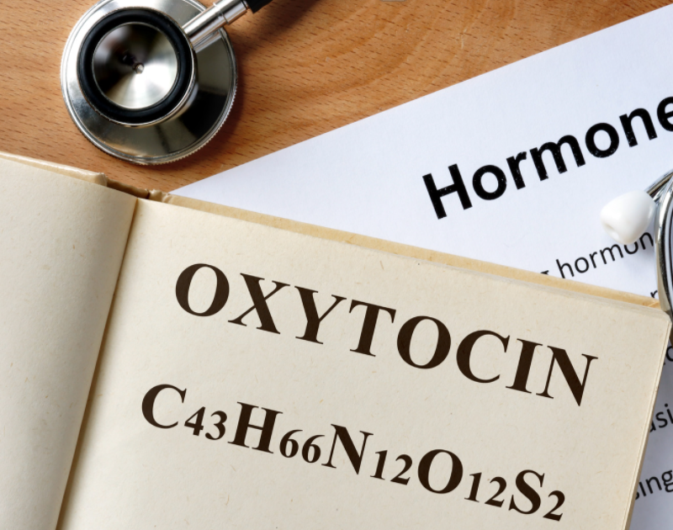
"[O]xytocin is as much a part of your stress response as the adrenaline that makes your heart pound."
- Dr. Kelly McGonigal
Notes:
"[Oxytocin is] as much a part of your stress response as the adrenaline that makes your heart pound. And when oxytocin is released in the stress response, it is motivating you to seek support. Your stress response [also] wants to make sure you notice when someone else in your life is struggling so that you can support each other."
"OK, so how is knowing this side of stress going to make you healthier? Well, oxytocin doesn't only act on your brain. It also acts on your body. Oxytocin helps heart cells regenerate and heal from any stress-induced damage. This stress hormone strengthens your heart. And the cool thing is that all of these physical benefits of oxytocin are enhanced by social contact and social support. Your stress response has a built-in mechanism for stress resilience, and that mechanism is human connection."

Slide 35
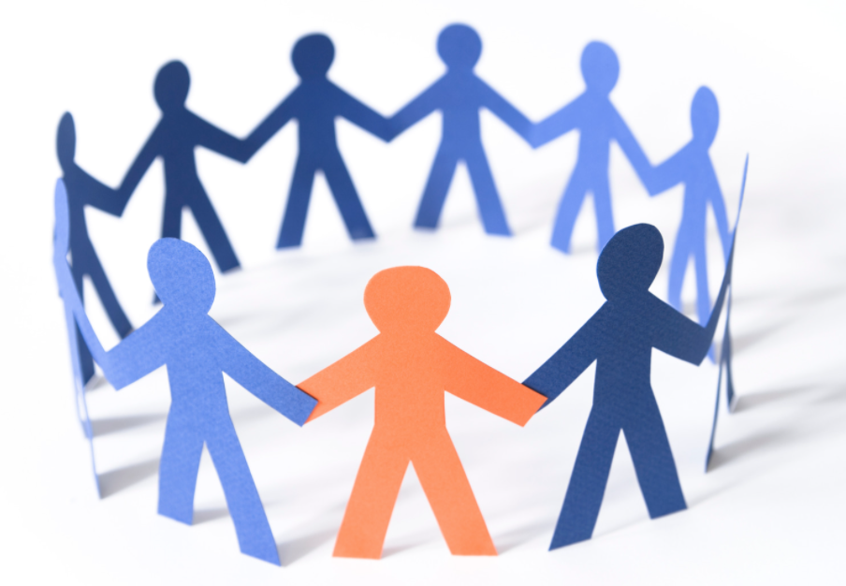
"tend and befriend" response
amplifies courage by dampening fear
Notes:
"[Oxytocin is] as much a part of your stress response as the adrenaline that makes your heart pound. And when oxytocin is released in the stress response, it is motivating you to seek support. Your stress response [also] wants to make sure you notice when someone else in your life is struggling so that you can support each other."
"OK, so how is knowing this side of stress going to make you healthier? Well, oxytocin doesn't only act on your brain. It also acts on your body. Oxytocin helps heart cells regenerate and heal from any stress-induced damage. This stress hormone strengthens your heart. And the cool thing is that all of these physical benefits of oxytocin are enhanced by social contact and social support. Your stress response has a built-in mechanism for stress resilience, and that mechanism is human connection."
Oxytocin can also help dampen feelings of fear.

Slide 36
"Oxytocin…helps heart cells regenerate and repair from microdamage."
Notes:
Oxytocin also has physical benefits. The heart has receptors for oxytocin that like this hormone because it can do microrepairs.

Slide 37
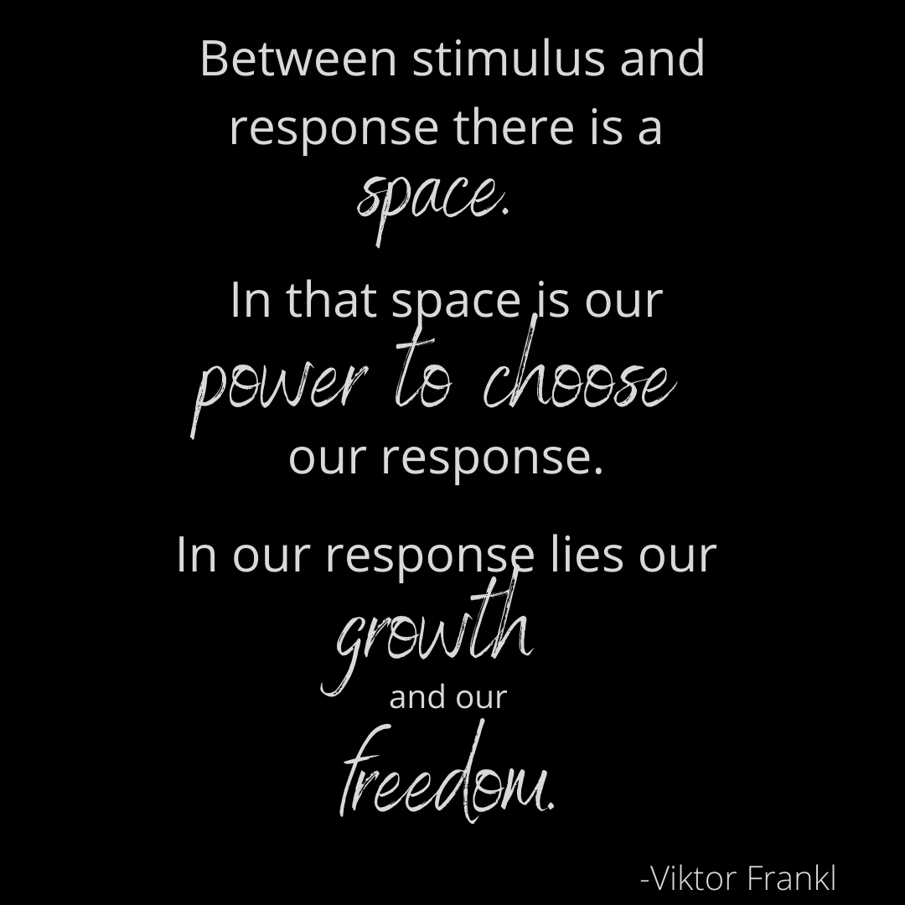
3) Learn and Grow
Do I keep replaying the stress in my mind even though it's passed?
Do I feel like I want to talk about it with someone?
Do I feel the desire to pray or engage in some other spiritual practice?
Notes:
(Slide is in Kelly McGonigal’s words.) Point and name and reframe. The stress response includes chemicals that want to help our bodies reset back to a non-fight-or-flight response. If we are conscious of their potential benefits, we can practice noticing when these dynamics are kicking in, and we can reframe things like ruminating or hamster wheel thoughts as a way our body wants to create meaning out of our experience and learn how to both avoid unnecessary stress and build resilience against stress. (see Dr. Kelly McGonigal's book)
animate with comparison with Frankl
An upward spiral

Slide 38

I no longer think my opportunity for growth is gone because I didn’t do something right in the first place.
The desire to ruminate or replay situations can be reframed as a desire to make meaning … and to learn and build plasticity and resilience.
Notes:
I usi

Slide 39
"Every moment of stress is an opportunity to transform stress instincts"
Notes:
Such a process of mindset change can actually change the mix of chemicals and hormones flowing through your body!
Remember, "In the attention economy, mindfulness is activism." -Jay Vidyarthi https://medium.com/mindfulness-and-meditation/in-the-attention-economy-mindfulness-is-activism-4241cc766ac

Slide 40
Invitation: Notice stressful experiences
Do what is meaningful in the moment
Connect & care
Learn and grow from experience
Notes:
This week we invite you to apply a tip you’ve learned today that will promote digitally associated physical well-being AND find an opportunity to practice befriending stress

Slide 41
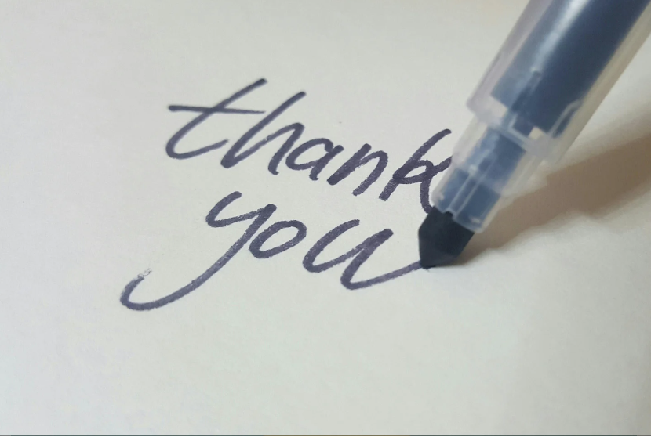
Give your body a hug and say "thank you" for how it wants to help you be resilient.
Brain & body & heart working together can do good things!

Slide 42
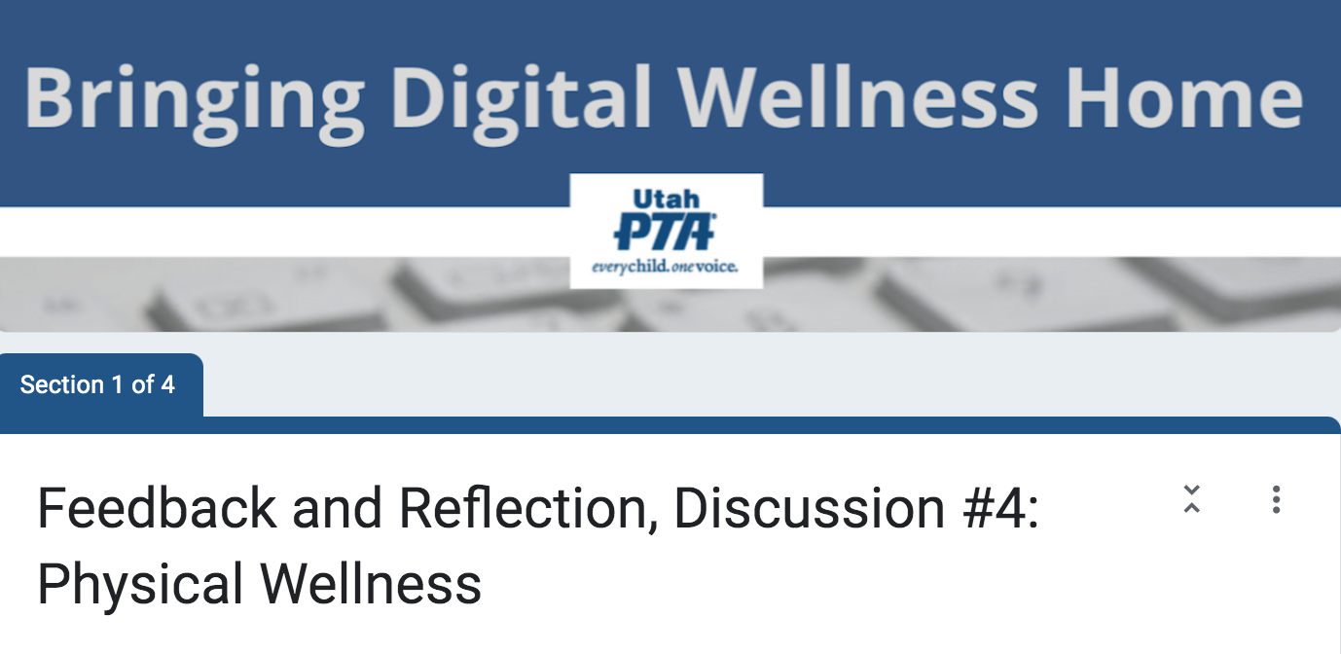
Thank you for taking 2-3 minutes to fill out the feedback & reflection form
https://forms.gle/LvDp9QM7fd1VjhA7A
Notes:
https://forms.gle/LvDp9QM7fd1VjhA7A

Slide 43

We wish you well.

Slide 44

Bonus Materials

Slide 45
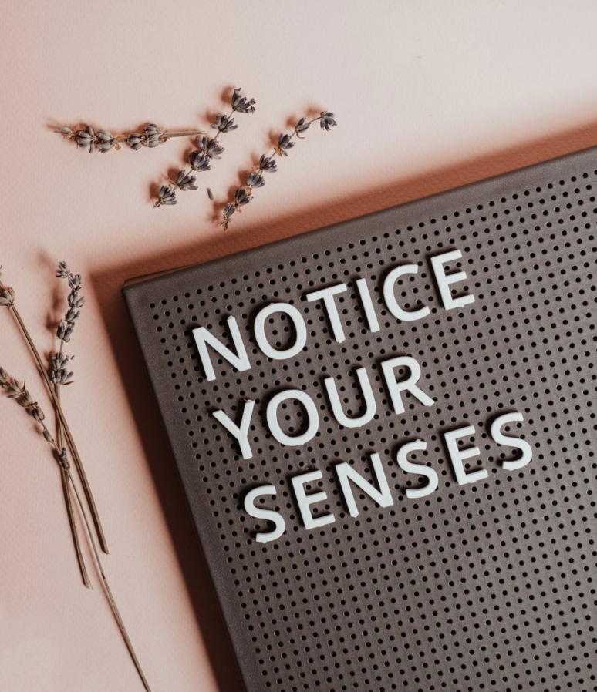
"Come to your Senses" resources
The title of this slide comes from a book by Dr. Stanley Block by the same name. See also https://www.youtube.com/watch?v=tFK9c3N3IVs or a free workshop offered by USU: https://chass.usu.edu/social-work/i-system-institute/building-resilience-workshops
See more in the Resources document in this week's folder
Notes:
On the power of pointing and naming, as it were, on improving wellness, habits, etc. see this from James Clear, an excerpt from chapter 4 of his books, Atomic Habits (shared on his website). https://jamesclear.com/habits-scorecard

Slide 46
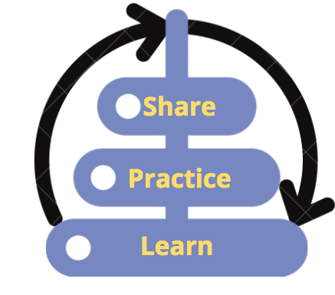
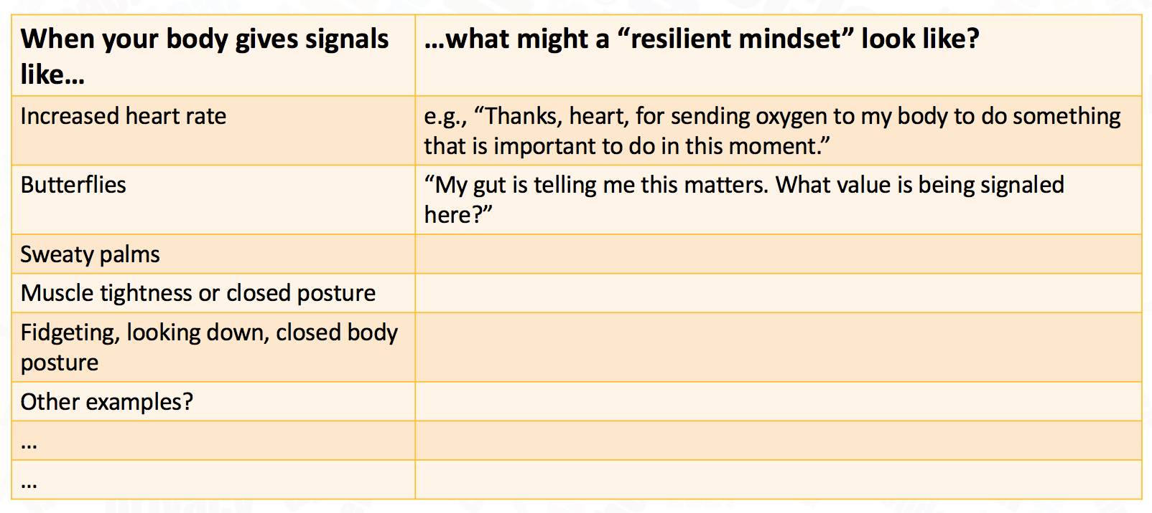
Reframing our mindset about stress
When your body gives signals like… | …what might a “resilient mindset” look like?
Increased heart rate | e.g., “Thanks, heart, for sending oxygen to my body to do something that is important to do in this moment.”
Butterflies | “My gut is telling me this matters. What value is being signaled here?”
Sweaty palms
Muscle tightness or closed posture
Fidgeting, looking down, closed body posture
Other examples?
…
…
Notes:
See The Upside of Stress for research on using the body to reframe and befriend stress. Note especially her notes pages for research she is curating. Or see this paper for another curation of similar ideas: https://cimbaitaly.com/wp-content/uploads/sites/6/2015/12/Als-Book-Club-PDF-December-2015.pdf

Slide 47
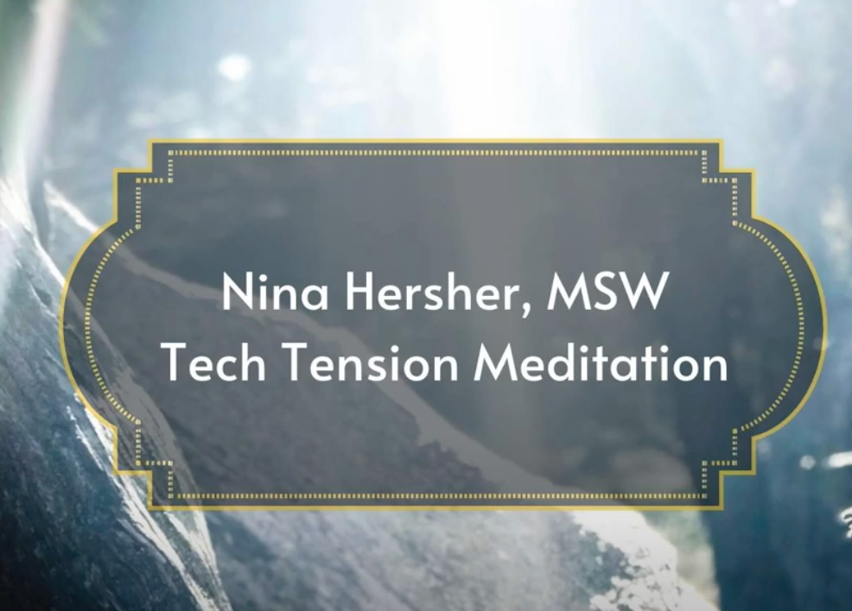
A Tech Tension Release Meditation
p.s. You can find many stretches online for
Neck
Lats
Glutes
Wrist extensors
Wrist flexors
Chin tucks
Walks (best outside)
Planks
Side planks
Squats
Skydiver
https://www.youtube.com/watch?v=olpOsrP_bTI
Notes:
Check with a doctor or physical therapist before starting any new routine

Slide 48
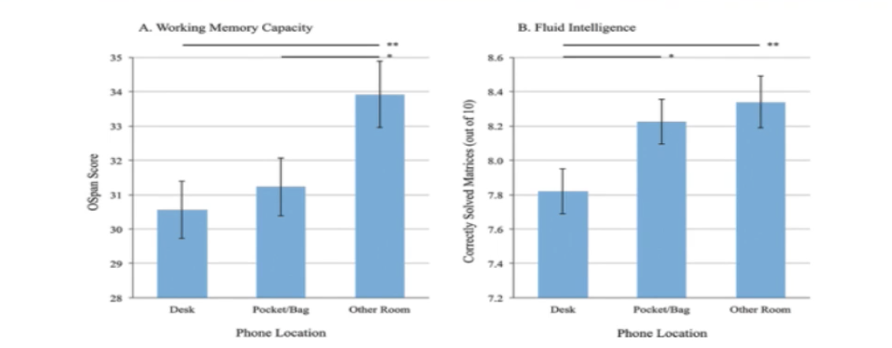
The "Mere Presence" Phenomenon
“[T]he "mere presence" of a cell phone may be sufficiently distracting to produce diminished attention and deficits in task-performance, especially for tasks with greater attentional and cognitive demands.”
Notes:
https://repositories.lib.utexas.edu/bitstream/handle/2152/64130/braindrain.pdf?sequence=2: “Working memory capacity” (WMC) reflects the availability of attentional resources, which serve the “central executive” function of controlling and regulating cognitive processes across domains (Baddeley and Hitch 1974; Miyake and Shah 1999; Engle 2002; Baddeley 2003). “Fluid intelligence” (Gf ) represents the ability to reason and solve novel problems, independent of any contributions from acquired skills and knowledge stored in “crystallized intelligence” (Cattell 1987). Similar to WM, Gf stresses the ability to select, store, and manipulate information in a goal-directed manner. Also similar to WM, Gf is constrained by the availability of attentional resources (e.g., Engle et al. 1999; Halford et al. 2007). Crucially, the limited capacity of these domaingeneral resources dictates that using attentional resources for one cognitive process or task leaves fewer available for other tasks; in other words, occupying cognitive resources reduces available cognitive capacity.

Slide 49
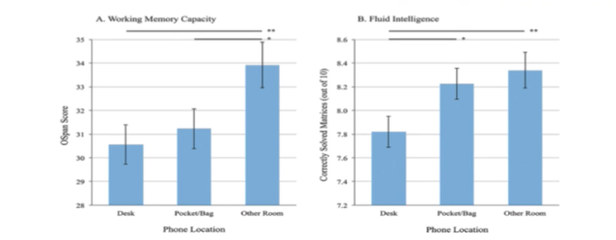
Reduce “brain drain”
=Practice social distancing from your phone!
Working Memory: resources for “controlling and regulating cognitive processes across domains”
Fluid Intelligence: ”ability to reason and solve novel problems” and manage cognitive processes for goal-oriented tasks
https://repositories.lib.utexas.edu/bitstream/handle/2152/64130/braindrain.pdf?sequence=2
Notes:
https://repositories.lib.utexas.edu/bitstream/handle/2152/64130/braindrain.pdf?sequence=2: “Working memory capacity” (WMC) reflects the availability of attentional resources, which serve the “central executive” function of controlling and regulating cognitive processes across domains (Baddeley and Hitch 1974; Miyake and Shah 1999; Engle 2002; Baddeley 2003). “Fluid intelligence” (Gf ) represents the ability to reason and solve novel problems, independent of any contributions from acquired skills and knowledge stored in “crystallized intelligence” (Cattell 1987). Similar to WM, Gf stresses the ability to select, store, and manipulate information in a goal-directed manner. Also similar to WM, Gf is constrained by the availability of attentional resources (e.g., Engle et al. 1999; Halford et al. 2007). Crucially, the limited capacity of these domaingeneral resources dictates that using attentional resources for one cognitive process or task leaves fewer available for other tasks; in other words, occupying cognitive resources reduces available cognitive capacity.

Slide 50
Reduce “brain drain” = “Mere Presence” Phenomenon
Practice social distancing from your phone!
“’Working memory capacity’ (WMC) reflects the availability of attentional resources, which serve the ‘central executive’ function of controlling and regulating cognitive processes across domains (Baddeley and Hitch 1974; Miyake and Shah 1999; Engle 2002; Baddeley 2003). ‘Fluid intelligence’ (Gf ) represents the ability to reason and solve novel problems… (Cattell 1987). Similar to WM, Gf stresses the ability to select, store, and manipulate information in a goal-directed manner. Also similar to WM, Gf is constrained by the availability of attentional resources (e.g., Engle et al. 1999; Halford et al. 2007). Crucially, the limited capacity of these … resources dictates that using attentional resources for one cognitive process or task leaves fewer available for other tasks; in other words, occupying cognitive resources reduces available cognitive capacity.”
https://repositories.lib.utexas.edu/bitstream/handle/2152/64130/braindrain.pdf?sequence=2
Notes:
https://repositories.lib.utexas.edu/bitstream/handle/2152/64130/braindrain.pdf?sequence=2: “Working memory capacity” (WMC) reflects the availability of attentional resources, which serve the “central executive” function of controlling and regulating cognitive processes across domains (Baddeley and Hitch 1974; Miyake and Shah 1999; Engle 2002; Baddeley 2003). “Fluid intelligence” (Gf ) represents the ability to reason and solve novel problems, independent of any contributions from acquired skills and knowledge stored in “crystallized intelligence” (Cattell 1987). Similar to WM, Gf stresses the ability to select, store, and manipulate information in a goal-directed manner. Also similar to WM, Gf is constrained by the availability of attentional resources (e.g., Engle et al. 1999; Halford et al. 2007). Crucially, the limited capacity of these domaingeneral resources dictates that using attentional resources for one cognitive process or task leaves fewer available for other tasks; in other words, occupying cognitive resources reduces available cognitive capacity.

Slide 51
“Mere Presence” Impact on Sleep Hygiene
Mere presence research link: https://www.journals.uchicago.edu/doi/10.1086/691462
Many experts also talk about how having screens in the bedroom can impact sleep, particularly when it comes to personal devices with their ever-presence siren song to check for one more thing….

Slide 52
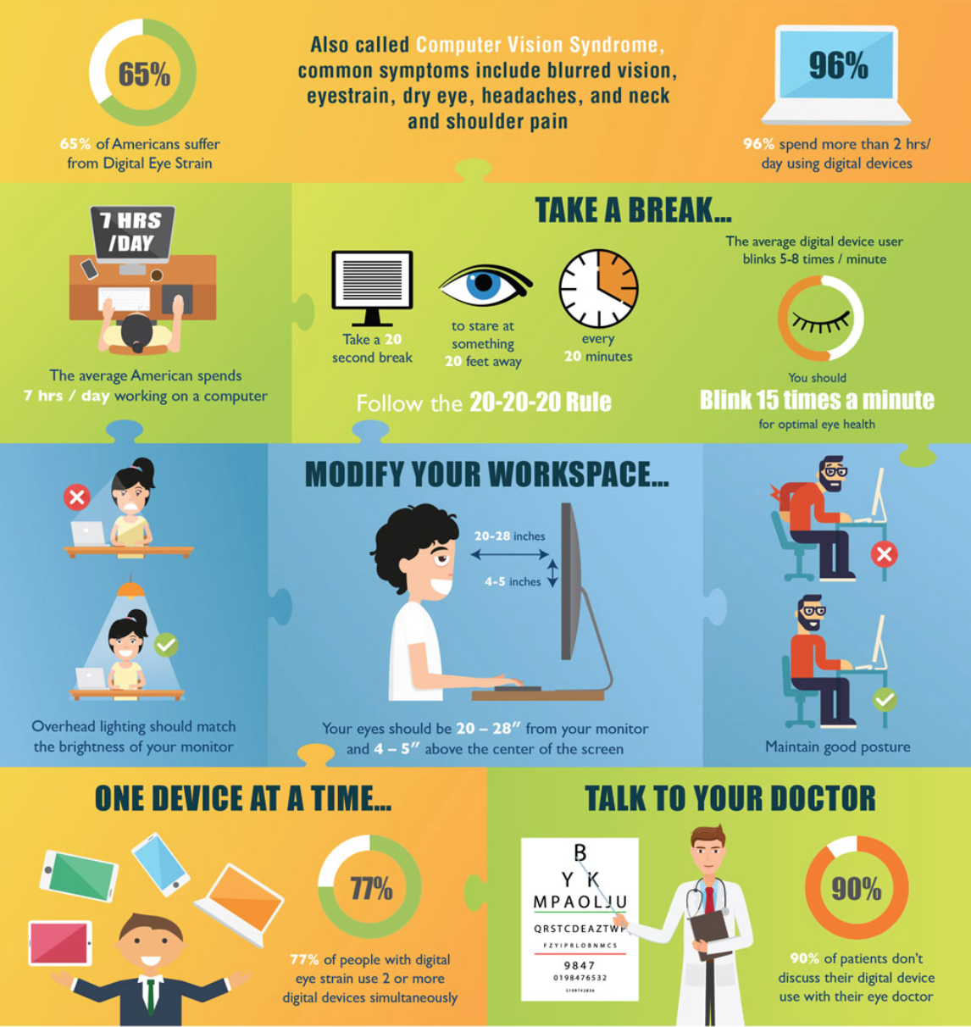
Today’s Blink and Breathe Break
is also a Digital Wellness tip!
https://www.bettervisionguide.com/digital-eye-strain-infographic/
https://eyecenter.com/2018/07/computer-vision-syndrome/
Notes:
Set timer for 20 seconds so everyone can actually practice it. 20 seconds can feel like a long time when you are in the zone…all the more reason to build in this practice, because we can get lost in the zone

Slide 53
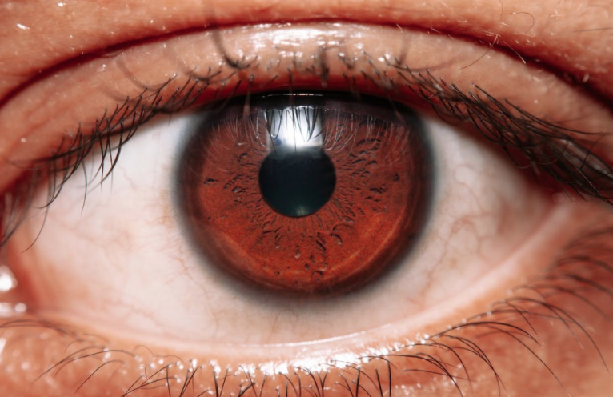
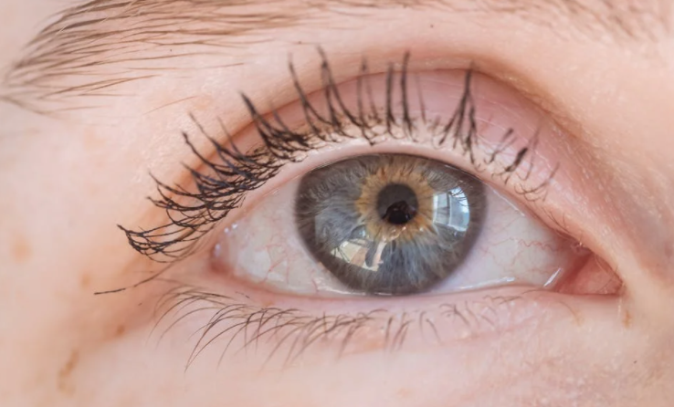
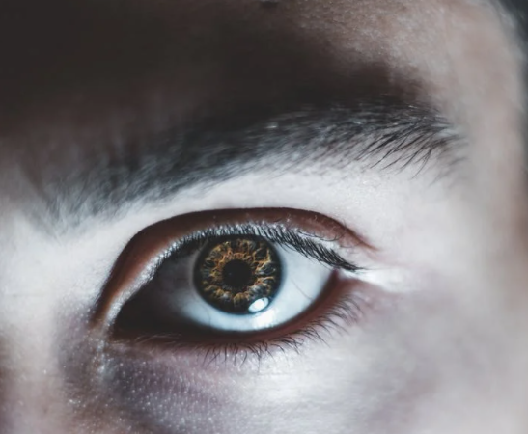
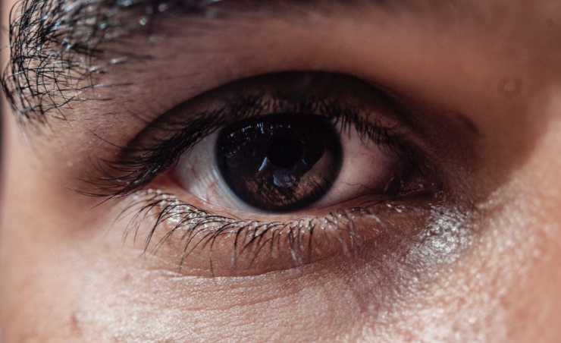
Other tips and tricks
Reducing Eyestrain

Slide 54
Tips and Tricks: Reducing Eyestrain
https://www.bettervisionguide.com/digital-eye-strain-infographic/

Slide 55
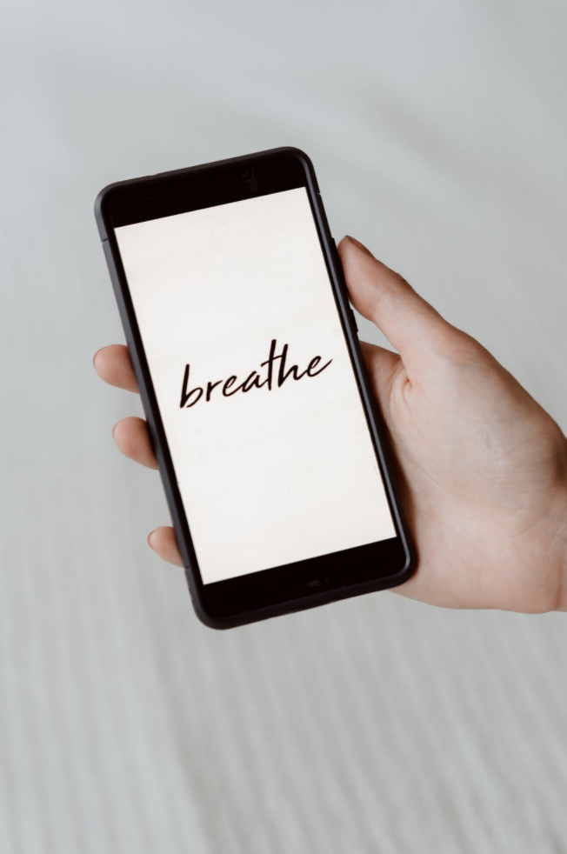
Email (tech) Apnea –
don’t forget to breathe!
We often stop breathing normally while using tech. This can put our body into a higher “stress” state.
What can we do?
Be aware [awareness is key to so many facets of digital health!]
Take a break (even a walk around your workstation)
Dance
Sing
Etc. …similar to many Mental Wellness tips
[In this research, dancers, musicians, highly-trained athletes, and test pilots did not exhibit tech apnea. Why? They’d been taught breathing techniques to manage emotions and energy. Perhaps other practices can provide similar benefits as well?]
https://lindastone.net/2014/11/24/are-you-breathing-do-you-have-email-apnea/

Slide 56













Discussion: Ergonomics Issues
Notes:
What do you see in these examples about ways that physical strain might develop with how devices are being used; variables like posture, position, and environment, or other ergononic issue? What do you see, relate to, or notice in your own device usage? This connects to the question about physical strain and taking breaks.

Slide 57
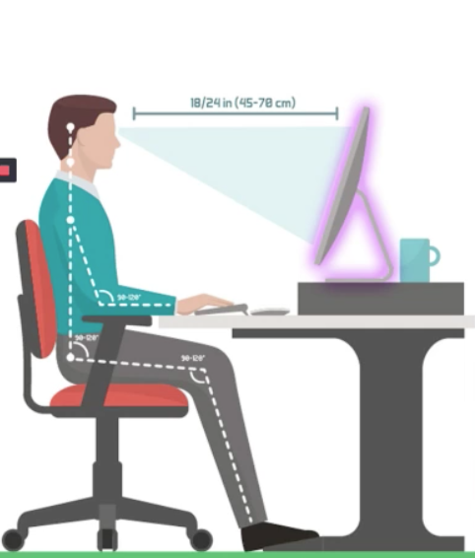
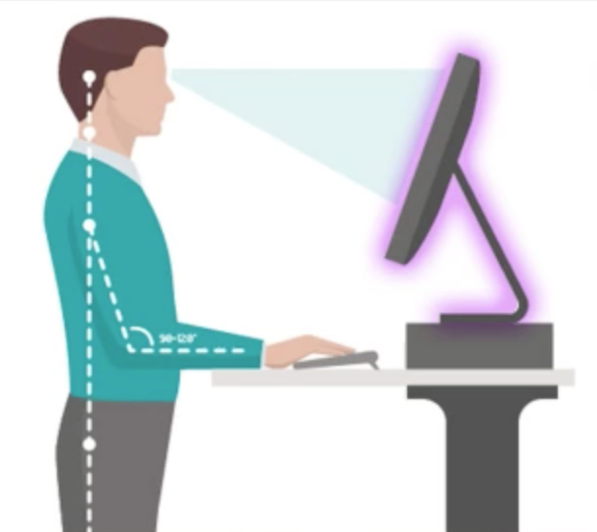
Tips and Tricks: Ergonomics
Also pay attention to:
-Mouse ergonomics
-Air temperature and flow
-Display brightness
-Keyboard position and design
-Doing stretches
What works for you?
Detailed workstation ideas:
https://ehs.unc.edu/workplace-safety/ergonomics/office/
Notes:
These images are from the DWI course that we took.

Slide 58

Benefits of Writing by Hand?
This topic came up in the discussion with the Winter 2022 PTA group. We did a little research on any known benefits of writing by hand (using "old school" methods for note-taking or ). Most sample sizes are relatively small, but patterns show up in the research across nations and years. This is also relevant for conversations about whether children should be learning cursive. A question to consider is, "Might there be other benefits outside of the handwriting itself from "learning to write?"
Mueller, Pam A. and Oppenheimer, Daniel M. "The Pen Is Mightier Than the Keyboard: Advantages of Longhand Over Laptop Note Taking." Psychological Science (2014) Vol. 25(6), 1159–1168. https://linguistics.ucla.edu/people/hayes/Teaching/papers/MuellerAndOppenheimer2014OnTakingNotesByHand.pdf
"[T]he mastery of handwriting is based on the involvement of a network of brain structures whose involvement and inter-connection are specific to writing alphabet characters. This network is built upon the joint learning of writing and reading and depends on the level of expertise of the writer."
https://pubmed.ncbi.nlm.nih.gov/28190914/ - "Neuroanatomy of Handwriting and Related Reading and Writing Skills in Adults and Children with and without Learning Disabilities: French-American Connections." Pratiques. 2016 Dec;171-172:3175. doi: 10.4000/pratiques.3175. Epub 2017 Feb 7.

Slide 59
Benefits of Writing by Hand?
This topic came up in the discussion with the Winter 2022 PTA group. We did a little research on any known benefits of writing by hand (using "old school" methods for note-taking or ). Most sample sizes are relatively small, but patterns show up in the research across nations and years. This is also relevant for conversations about whether children should be learning cursive. A question to consider is, "Might there be other benefits outside of the handwriting itself from "learning to write?"
Research done in Tokyo: https://www.frontiersin.org/articles/10.3389/fnbeh.2021.634158/full "Paper Notebooks vs. Mobile Devices: Brain Activation Differences During Memory Retrieval." Frontiers in Behavioral Neuroscience. (2021) Vol. 15, DOI=10.3389/fnbeh.2021.634158
An article exploring the research:
https://www.u-tokyo.ac.jp/focus/en/press/z0508_00168.html – this article summarizes the researcher's perspective, including noting even the difference of writing by hand on an e-ink device vs. writing by hand on paper. "[P]aper notebooks contain more complex spatial information than digital paper. Physical paper allows for tangible permanence, irregular strokes, and uneven shape, like folded corners. In contrast, digital paper is uniform, has no fixed position when scrolling, and disappears when you close the app." (Michelle here: I'm experimenting with e-ink so this was interesting for me to consider.)
Note: The research from Tokyo also looks at digital vs. paper calendaring. Here's another article summarizing the research. https://www.psychologytoday.com/us/blog/the-athletes-way/202103/4-reasons-writing-things-down-paper-still-reigns-supreme

Slide 60
Benefits of Writing by Hand?
This topic came up in the discussion with the Winter 2022 PTA group. We did a little research on any known benefits of writing by hand (using "old school" methods for note-taking or ). Most sample sizes are relatively small, but patterns show up in the research across nations and years. This is also relevant for conversations about whether children should be learning cursive. A question to consider is, "Might there be other benefits outside of the handwriting itself from "learning to write?"
E.O. Askvik et al. The importance of cursive handwriting over typewriting for learning in the classroom: a high-density EEG study of 12-year-old children and young adults. Frontiers in Psychology. July 28, 2020. doi: 10.3389/fpsyg.2020.01810.
Someone's summary of this researcher's views: "writing gives you brain “hooks” to hang information on, similar to marking pages in books. Add to this the importance of fine motor skills: a keystroke is repetitive and uncreative, whereas you’re constantly challenging your motor skills when writing." https://bigthink.com/the-present/handwriting-memory/
"The slow nature of handwriting might seem counterintuitive in the digital age, but van der Meer argues that it’s beneficial. You can only think as fast as you can write, whereas typing allows for a quicker transmission of ideas. While on the surface that might seem like a productivity boon, the time necessary for critical reflection is shortened. Not only do you not remember as much information, you likely aren’t thinking through situations as deeply."
Another article about this study: https://www.sciencedaily.com/releases/2020/10/201001113540.htm
https://journals.sagepub.com/doi/10.1177/0963721417709821: James KH. The Importance of Handwriting Experience on the Development of the Literate Brain. Current Directions in Psychological Science. 2017;26(6):502-508. doi:10.1177/0963721417709821 [one summary I read basically said that children who write by hand have parts of their brains activate in ways that are similar to adults' brains, but when they type, there is less brain activation] [Researcher's other works: https://citations.cogs.indiana.edu/profile.php?faculty=khjames]

Slide 61
Benefits of Writing by Hand?
This topic came up in the discussion with the Winter 2022 PTA group. We did a little research on any known benefits of writing by hand (using "old school" methods for note-taking or ). Most sample sizes are relatively small, but patterns show up in the research across nations and years. This is also relevant for conversations about whether children should be learning cursive. A question to consider is, "Might there be other benefits outside of the handwriting itself from "learning to write?"
A few articles:
An article reviewing research done by professors at University of North Carolina, Greensboro and Johns Hopkins: https://www.iflscience.com/brain/writing-by-hand-most-effectively-increases-reading-skills/
Video: https://www.youtube.com/watch?v=RWT9ETRm6RY
https://www.npr.org/2016/04/17/474525392/attention-students-put-your-laptops-away
https://www.topeducationdegrees.org/proven-reasons-to-write-by-hand/ (I think this is written by the site owner, Tracey M. Armstrong, Ph.D., but can't be sure the way the website is organized.)
https://www.oxfordlearning.com/writing-by-hand-is-good-for-the-brain/

