Slide 1
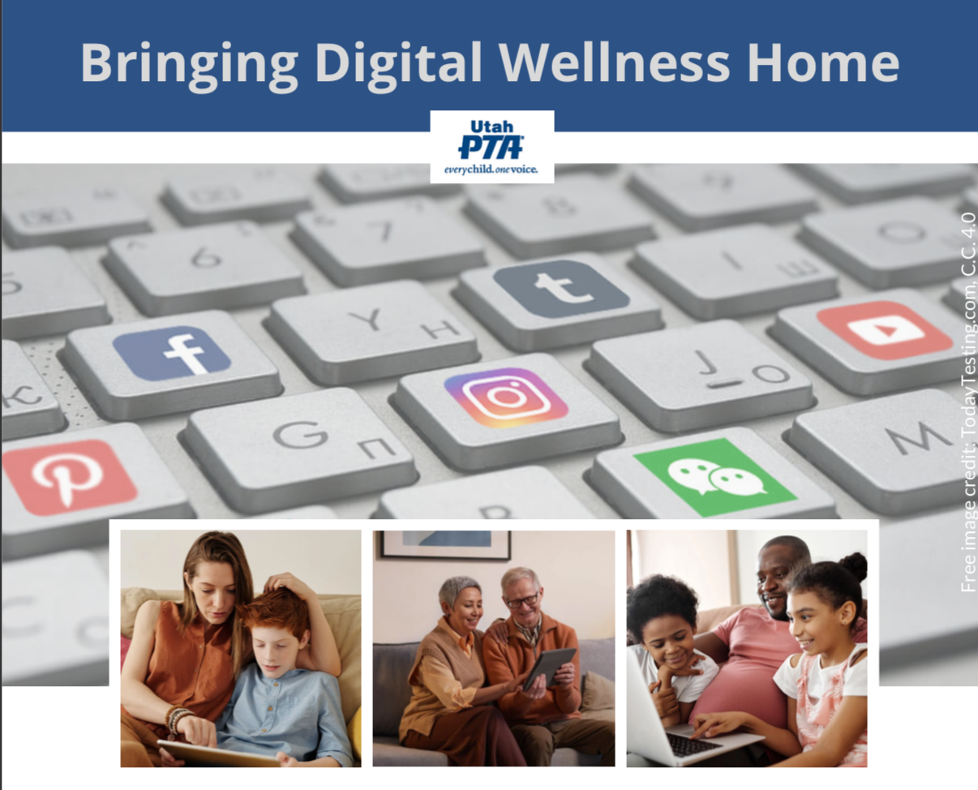
Note: All material in this series is for educational and informational purposes only, and is not meant to be exhaustive or used as a replacement for professional health support.
Notes:
Note: All material in this series is for educational and informational purposes only, and is not meant to be exhaustive or used as a replacement for professional health support. Also, the presentation is best viewed in slideshow format, as some of the slides are animated.
NOTE: Portions of this work first appeared in or are derived or adapted from the Digital Wellness Certificate Program. Those portions are Copyright © 2021, Digital Wellness Institute.

Slide 2
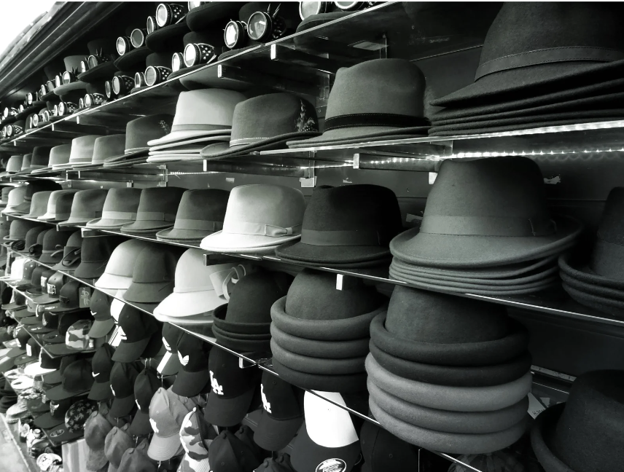

Introductions
Hello, my name is __________________
and hats I wear include ________________________
Notes:
We had a chance to get to know each other a bit by sharing our names and three different "hats" we wear coming to this series. We know you wear many, and we honor all the many ways you make a difference in your world. We'll explore more about the "hats" we wear – different roles and responsibilities we have in our lives – in module 5 on Honoring Time.

Slide 3
Connection
Content
Introspection
Action
Notes:
For today's gathering, please have a paper and writing utensil (or a digital equivalent), a browser open to Menti.com.
From its beginnings, EPIK has deliberately designed gatherings to be interactive, participatory, and action-oriented. We'll start every week with something that can help us check in (and build our sense of shared humanity, community, and group safety), explore some content (we'll not be able to cover it all, so we provide a repository of resources for you), and a challenge/invitation to take home and practice and/or share with your family/friends/coworkers.

Slide 4
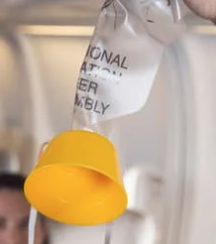
Notes:
With all the different roles and responsibilities you have, we imagine you likely have various reasons you want to participate in this series. When we took the Digital Wellness Institute's certification course, they invited us to engage in the material and activities starting first with our own individual wellness in mind. This was difficult for me; I love sharing and talking about things that are helpful and interesting to me. But this advise was wise, and we will extend the same invitation to you - to start first by "putting on your own oxygen mask." Especially during the first several modules, we invite you to think about and practice the principles with your own wellness in mind. The more we practice as individuals, the more able we are to share from experience, not just theory or concept.

Slide 5
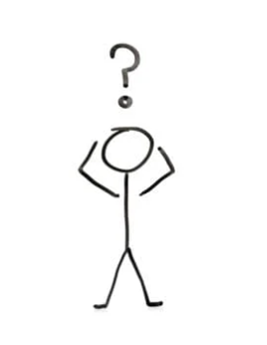
Introspection: Think & Write
What's my Why?
Notes:
The first introspection activity for today is simply to reflect on why you are here, on why you chose to participate in this series. Do you have questions or concerns that are weighing on your mind? Do you have people in your life you are concerned about? Are you working on your own personal growth? Does a particular role or responsibility bring you here? This exercise is sometimes called "setting your intention." Practicing being plugged into our purpose, our intentions, is good for Digital Wellness.

Slide 6

Notes:
We also invite you to keep your favorite writing tool handy, because you never know what kinds of unexpected ideas or insights may flow as you engage. Being part of a learning community means that there is more than just content. The conversations that ensue and even just taking and making the time to gather with others creates a different kind of learning environment than learning alone. Sometimes insights that aren't even related to the topic at hand may come. We encourage to you write them down if and when they do!

Slide 7
What is Digital Wellness?
Notes:
It makes sense to start with the question: "What is Digital Wellness?" We will share some thoughts on this question today, but the reality is there is no one right answer to this question, especially because…

Slide 8

Digital Wellness is multifaceted
Notes:
Digital Wellness is a multifaceted concept, in fact, you have helped illustrate this point by participating in the pre-work invitation to share three synonyms of Digital Wellness.

Slide 9
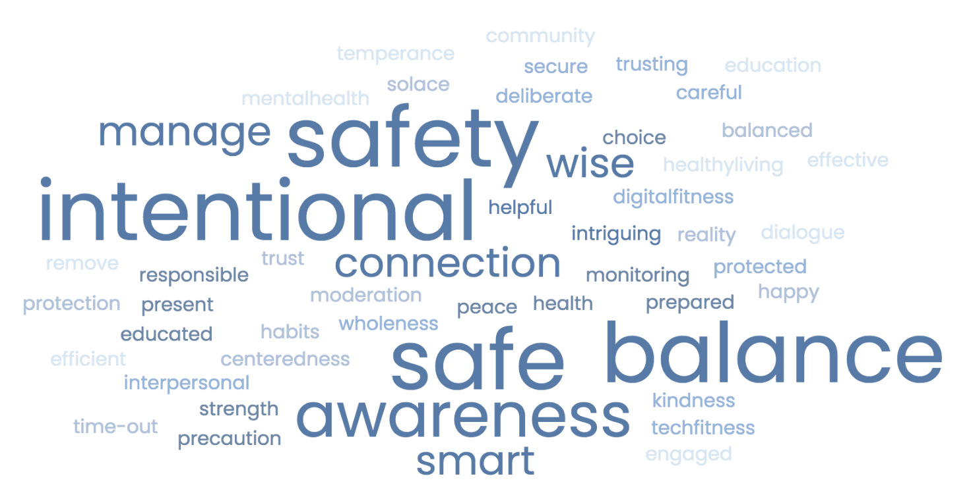
Notes:
At the moment (as of Tuesday night around 11 p.m.) this is our group word cloud. If you responded after that time, or have not yet had a chance to respond, this word cloud will be updated for next week, and will be the watermark for our slide deck. The larger words in the word cloud reflect patterns in the responses of the group, meaning more than one person shared that concept as well.) So we see both patterns and also the wide variety of thoughts you have on Digital Wellness. All of the things shared have relevance; there are no "wrong" answers around what Digital Wellness means. We hope, too, that by the end of this series you might have an expanded view on what Digital Wellness can include. If we do another word cloud activity at the end of the series, perhaps we might find even more variety in the responses…and perhaps see more patterns. We'll see!

Slide 10
michelle@epik.org
Notes:
A little housekeeping: If you didn't receive my welcome email, aren't receiving reminder emails, or haven't had a chance to share your three synonyms of Digital Wellness, please email me at michelle@epik.org.

Slide 11
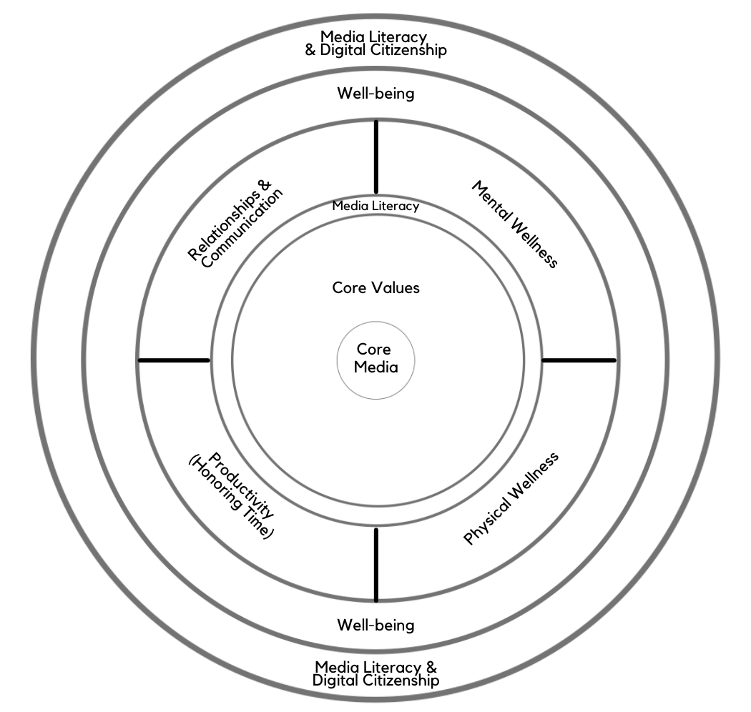
Digital Centeredness Model
Start with Your Center
Media Literacy/Critical Thinking
Mental Wellness*
Physical Wellness*
Productivity (Honoring time)*
Relationships*
Bonus: Social Development Strategy
Well-being*
Digital Citizenship* & Media Literacy
Notes:
For our purposes, some of the "multifaceted" elements we will cover during this series are summed up in this slide. The model includes 8 topics (media literacy actually shows up a few times), and we have a bonus module on Social Development Strategy. Since that is related to relationships, we decided to cover that topic the week after talking about relationships. All of the topics marked with an asterisk connect to a Digital Wellness Institute self-assessment that you can find here: https://survey.alchemer.com/s3/5504604/b153c792d361

Slide 12
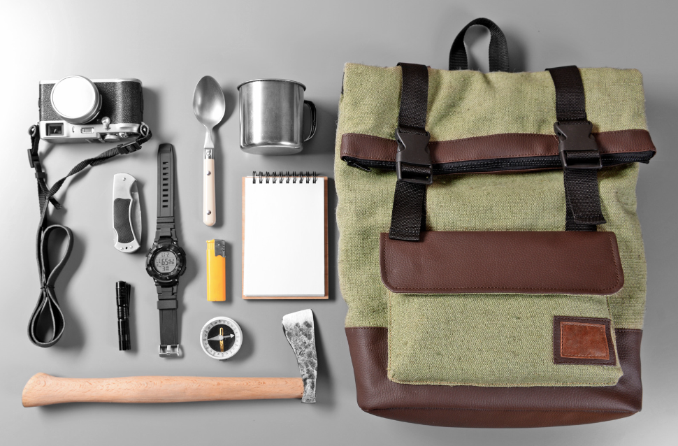
Digital Wellness is a journey
Notes:
Another way to think about Digital Wellness is as a journey. None of us will ever "arrive" at a place where we don't have to practice self-awareness and self-exploration that is involved in engaging well in a digital world. Our world is constantly changing, and each day is its own journey. Digital Wellness is an ongoing experience, which is great because it means we can always be learning, growing, improving, and expanding our understanding through experience.

Slide 13
Brian Solis
“[Digital wellness is a] deep self-exploration for understanding where we are in this life and our relationship with technology, or the relationship technology has with us…
"…recognizing that as many things as we juggle at once…as many ways and as many different platforms we [use to] communicate...they all take their toll. Little by little but inevitably...they take their toll. [A]nd that impacts [us] in ways that -- unfortunately when it counts – are going to reveal themselves….
"[S]o this is about going on a journey, not necessarily to take control of technology …[but to] realize that there's…a bigger opportunity for…[how we approach] management of day-to-day life and how [we] use technology in that life…."
“[The goal is to]...get in front of distractions, to get in front of all the potential that we might be missing today.”
Notes:
Brian Solis, a guru in the tech industry, had his own personal breaking point with what he talks about above. He'd realized that he'd become fragmented and had lost touch with his center and his creative energy. So he speaks from experience as he reflects on what Digital Wellness is to him. As you look through this quote, what are the warnings, concerns, negatives (etc.) mentioned? What are the words or phrases that show the positive possibilities we might discover as we learn about and practice Digital Wellness principles?
Transcript created from Brian Solis, https://www.youtube.com/watch?v=Kbcilw2WJVw

Slide 14
Digital Centeredness Model
Start with Your Center
Media Literacy/Critical Thinking
Mental Wellness*
Physical Wellness*
Productivity (Honoring time)*
Relationships*
Bonus: Social Development Strategy
Well-being*
Digital Citizenship* & Media Literacy
Notes:
We were invited often enough in the DWI course to "make decisions based on your values" but that wasn't represented in their model. So our model starts there.

Slide 15
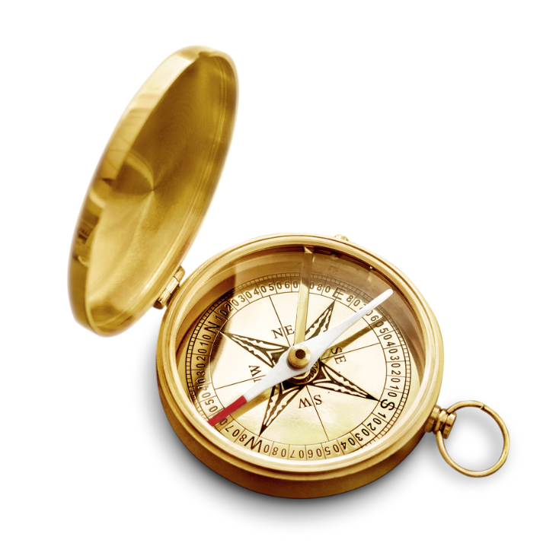
Breakout Activity:
Identify Centering Values
Notes:
So what do we mean when we say, "Start with Your Center?" We'll explore that through the following activities around identifying centering values.

Slide 16
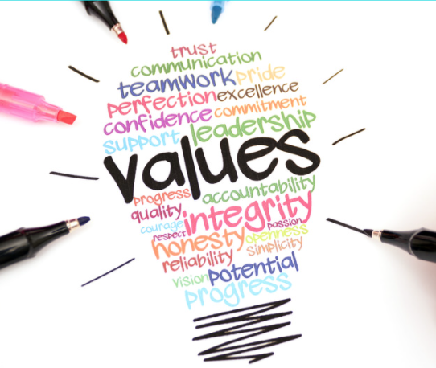
Think, Write, Share Activity
Identify three core values
Share the list with your group; talk about (expand upon) one of your values
This week's invitation: Write for
10 minutes about one of your values
Notes:
The activity comes in two parts – an introspection and writing portion (Think and Write) and a breakout group discussion.

Slide 17
What do we mean by values?
They are attributes or character traits (vs "things that matter to me")
They are relevant in all roles & responsibilities, all spheres & settings
They are actionable, practice-able: "I want to be a _________ person in all areas of my life"
"If someone can take it away from you, then it's not one of your values" - Nir Eyal
Notes:
For more on the difference between values as attributes and values as "things that matter to me" see the following by Nir Eyal, behavioral designer and author of Hooked and Indistractable.
https://www.nirandfar.com/common-values/
https://forge.medium.com/you-dont-know-your-values-here-s-why-that-s-hurting-you-52b02a43e869
https://forge.medium.com/tis-the-season-for-reexamining-your-values-aea9aad5e46

Slide 18

Think, Write, Share Activity
Questions to consider:
Who do you want to be?
What character traits do you want to nurture or develop?
How do you want to show up in your life, your relationships, your roles, and in the world?

Slide 19
Think, Write, Share Activity
Possible prompt ideas
Core Media / Touchstones
A person you admire
Someone from history/family history
Brainstorming from a values list
Notes:
When I've engaged in this activity in other settings, sometimes having some additional prompts helps people think through what values they want to focus on.

Slide 20




Core/Touchstone/Compass Media
Classical texts, pieces of art or music, or other forms of media that have helped shape you as an individual, and that help you define and stay focused on your center.
Notes:
Core/Touchstone/Compass Media are books, art, music, etc. that you return to over and over again, media that help you re-center, reflect, recommit to the kind of person you want to be. We'll talk more about core media next week.

Slide 21
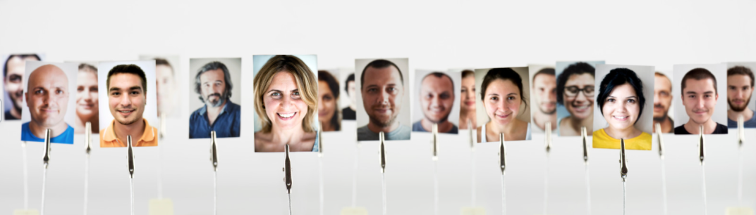
Who is someone who inspires you?
What character traits do they exhibit?
Notes:
Perhaps there is a person or people who admire you. As you reflect on why you admire them, what character traits do you admire in them? What about them fosters admiration? (For me, for one of our series, this is how I identified the trait I wanted to focus on: equanimity.)

Slide 22
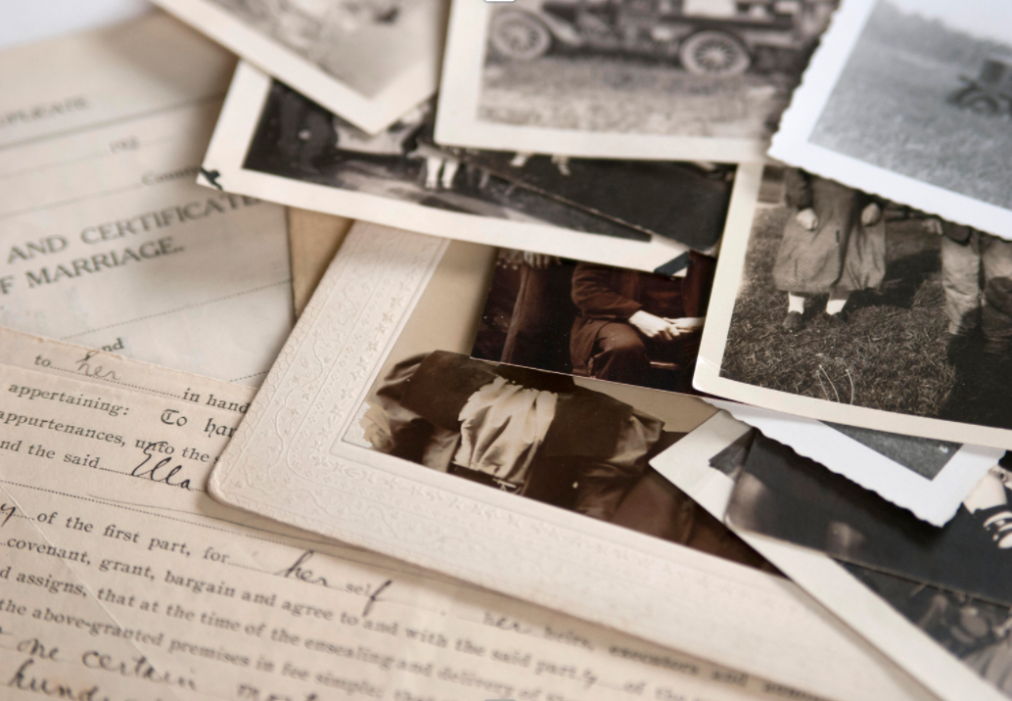

Consider traits you admire in someone
from your family history or general history
Notes:
You may have someone in your family history or a person from our more shared/general history who inspires you. Again, what trait or traits in this person inspire you to want to be better? How?

Slide 23
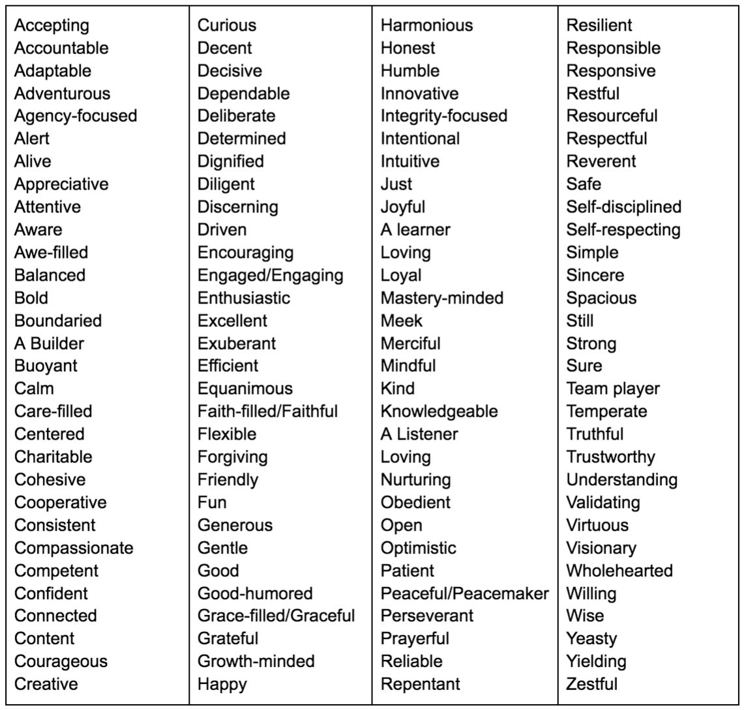
Notes:
For some, looking at a list helps them connect to their inner compass. This list includes ideas from many other lists that people have created to try to spark reflection on values. Again, however, we'd adapted the values so that they are attributes or characteristics.

Slide 24

Think, Write, Share Activity, part 1
Think & Write: List 3 values (1 minute)
Again, questions to answer:
Who do you want to be?
What character traits do you want to nurture or develop?
How do you want to show up in your life, your relationships, your roles, and in the world?
Thank you for muting your mic during this activity.
Notes:
Everyone was given 1 minute to write three values that have come to mind. These could be values you want to work on right now, values you are already working on, values you want to have in mind during this series…whatever works for you. This is an exercise that you can do at home if you weren't able to join us.

Slide 25
Notes:
(We put the list on the screen during the Think and Write portion – or better said, someone asked that we would, and that reminded me to advance to this screen. :)

Slide 26
Think, Write, Share Activity, part 2
Share: Breakout room activity
In breakout rooms (groups of 3 or 4):
Each person gets one minute to read their list and then share about one of the values they listed
Each person self-times, and when your timer rings, simply say, "Thanks, I pass to the next person" (even if you are in the middle of a sentence).
  Please honor the time limit, and please also use your full time.
  Everyone has an equal voice in these activities
Go in alphabetical order of first name for ease of flow
Notes:
Breakout rooms gave everyone an opportunity to take one minute to read their list of three values, and then to expand on one of them – talking about why they chose that attribute to focus on.

Slide 27

Invitation: Write for 10 minutes
Bonus: Write for a few minutes each day about your value
“In the short term, writing about personal values makes people feel more powerful, in control, proud, and strong. It also makes them feel more loving, connected, and empathetic toward others. It increases pain tolerance, enhances self-control, and reduces unhelpful rumination after a stressful experience. In the long term, writing about values has been shown to boost GPAs, reduce doctor visits, improve mental health, and help with everything from weight loss to quitting smoking and reducing drinking. It helps people persevere in the face of discrimination and reduces self-handicapping. In many cases, these benefits are a result of a one-time mindset intervention. People who write about their values once, for ten minutes, show benefits months or even years later.”
-Kelly McGonigal, Stanford professor and psychologist, The Upside of Stress

Slide 28
Digital Wellness is about practicing centeredness

Slide 29
Digital Wellness is less about
managing technology, but more about the journey and practice of
aligning technology use
with values and goals.
It's about using technology in ways that
magnify the kind of person
you want to be.
Notes:
If we were to sum up our simple definition of Digital Wellness, it would be this, and you will see us coming back throughout the series to invite you to continue to reflect on your centering values as you consider different facets of Digital Wellness. This is why we call our model a Digital Centeredness model.

Slide 30
Circles of control, influence, concern
control
influence
concern
Notes:
This is a powerful concept or tool that we can use to practice centeredness. I first came upon this idea in grad school or before (30 or so years ago) when learning about Stephen Covey's work, although I don't think he was the creator of this concept. If you search on these ideas, you can find many resources that explore them, each with their own lens and application. In the literature on mental wellness, parenting, and other spheres, sometimes these concepts are connected to an internal or external "locus of control."

Slide 31
Circles of control, influence, concern
control
influence
concern
Notes:
We focused on the two conceptual endpoints of this model to introduce it. The circle of control and the circle of concern are polar opposites. The circle of control is what I can do something about with no reliance on anyone or anything else. The circle of concern is everything we have no control over. It is very common as humans to get into the circle of concern – to focus on things we have no control over. To be in the circle of concern is to risk losing energy, focus, and hope. To be in the circle of control is to find growth, clarity, and progress. I can practice naming the things I can't change/control; I can claim the things I can; and I can practice the discernment to know the difference.

Slide 32
Circles of control, influence, concern
control
Modules 1-5, 8
influence
Modules 6, 7
concern
Module 9
Notes:
Our modules loosely map to this tool

Slide 33
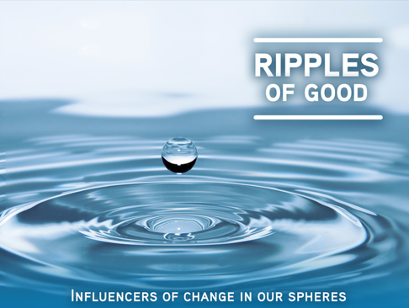

Centeredness: Essential for leadership & influence
“A leader needs to have presence, to show up to the moment grounded in one’s self, as centered as one can be, ready to hear, to listen, to discern.”
-Raymond M. Kethledge
Lead Yourself First: Inspiring Leadership Through Solitude
Notes:
The more grounded we are, the better leaders and influencers we can be.

Slide 34

"We but mirror the world. All the tendencies present in the outer world are to be found in the world of our body. If we could change ourselves, the tendencies in the world would also change. … We need not wait to see what others do.”
~ Mahatma Gandhi
Notes:
If you are familiar with the saying attributed to Ghandi that says, "Be the change you want to see in the world," this is the actual quote! (There's a little media literacy example, with a hat tip to next week's topic.) AND ALAS – we hadn't gotten to the full bottom of the attributions. There is no original source for this quote either. Apparently a version of the quote appeared in an article in 1913 about…snakes! http://www.gandhiashramsevagram.org/gandhi-literature/mahatma-gandhi-collected-works-volume-13.pdf

Slide 35
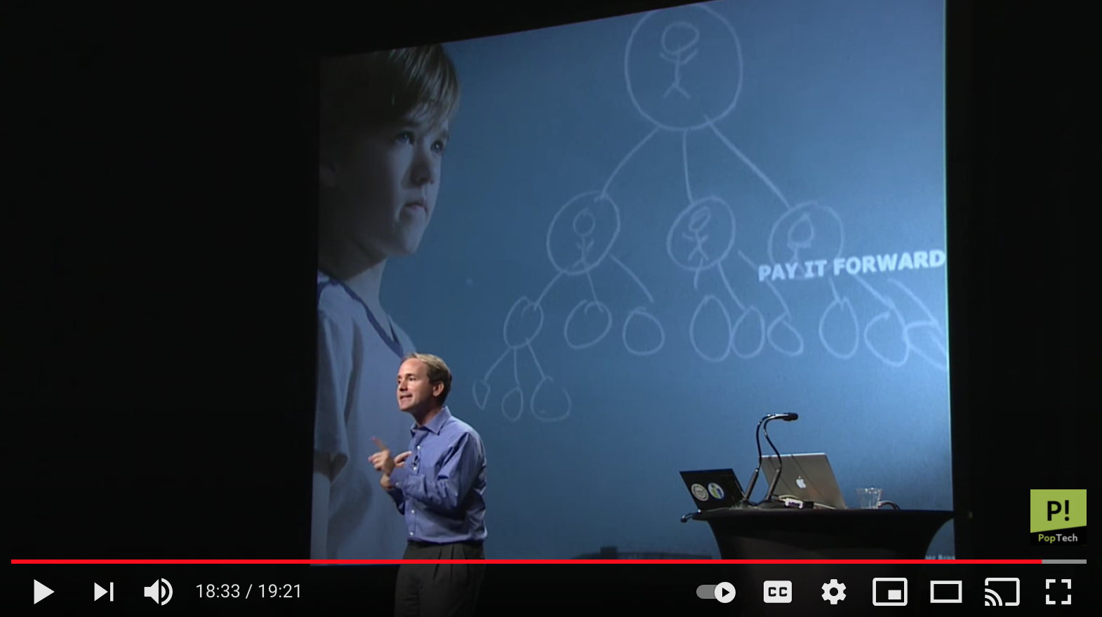
James Fowler - Three Degrees of Influence
“I’m not just changing my own outcome. I’m potentially changing my son’s life. And my son’s friend’s life. And my son’s friend’s mother’s life. I’m not just taking care of myself…[but taking care of people I care about].”
~ James Fowler (and Nicholas Christakis)
https://www.youtube.com/watch?v=zkmsjFisW_A -- See also https://www.youtube.com/watch?v=8dO6Wwh_tiU
Notes:
We came across this research from James Fowler and Nicholas Christakis last year we were piloting our Digital Centeredness model. This concept is one that has left a mark for us. The simple idea is that regardless of whether we intentionally seek to influence others or not, simply by nature of how human networks work, we do influence each other, three degrees out. That means that the decisions we make, for good or ill, impact our world, including people we don't even know. See the above presentation here https://www.youtube.com/watch?v=zkmsjFisW_A -- See also https://www.youtube.com/watch?v=8dO6Wwh_tiU

Slide 36
Please take 2-3 minutes to fill out the
Reflection and Feedback form:
Thisis chance to reflect on what you have learned, to give us feedback, and to identify what was most important for you personally from today's discussion
https://forms.gle/rrEz9ScEcSy2J2GY7
Notes:
Thank you again for taking and making the time to be with us today! Here's the link to the feedback and reflection form: https://forms.gle/rrEz9ScEcSy2J2GY7

Slide 37
We wish you well.
Notes:
Thank you again for taking and making the time to be with us today!

