Slide 1
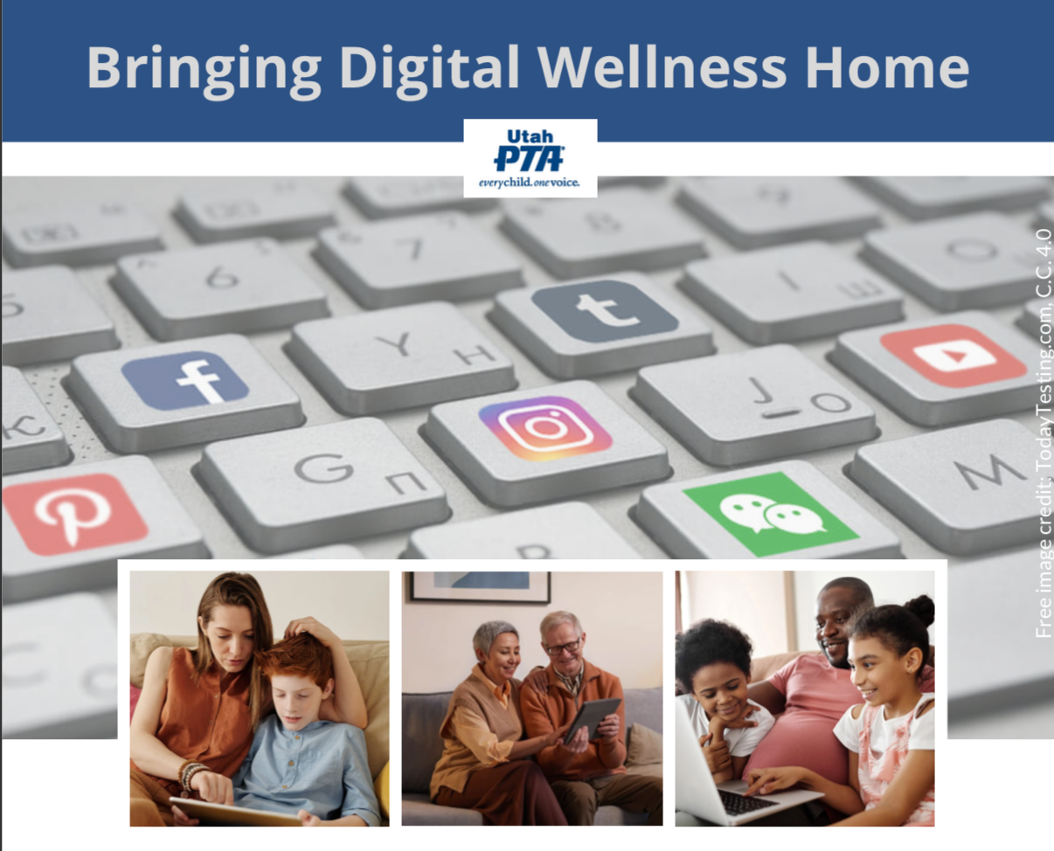
Note: All material in this series is for educational and informational purposes only, and is not meant to be exhaustive or used as a replacement for professional health support. Also, any sharing of resources doesn't imply full endorsement of all of that person or group's work. We share what we find helpful, but invite you to use your media literacy skills in all your study and research.
Notes:
Note: All material in this series is for educational and informational purposes only, and is not meant to be exhaustive or used as a replacement for professional health support. Also, the presentation is best viewed in slideshow format, as some of the slides are animated, but we have also included notes for many of the slides that you might want to review as well. Whatever works best for you!
NOTE: Portions of this work first appeared in or are derived or adapted from the Digital
Wellness Certificate Program. Those portions are Copyright © 2021, Digital Wellness Institute.

Slide 2
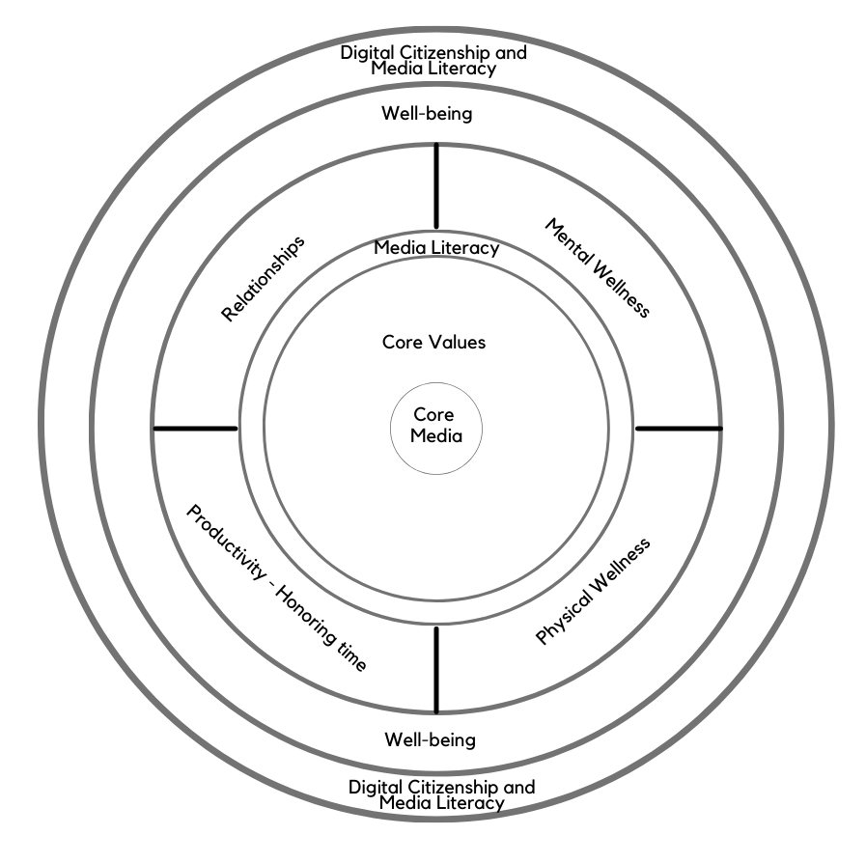
Discussion #8: Well-being
Note: EPIK’s Digital Centeredness model is adapted from the Digital Wellness Institute’s six-pronged model that aligns with DWI’s original survey
Notes:
We moved our reflection & connection activity to midway through the discussion this week.
In our model, the Digital Well-being module gives us a chance to reflect on all that we have learned to this point, and to go back inward again before we start to look outward and consider citizenship (engagement in the larger community). A community is only as well as the individuals in it. And civic and political engagement is impacted by the personal wellness and centeredness of the people engaging in these activities.

Slide 3
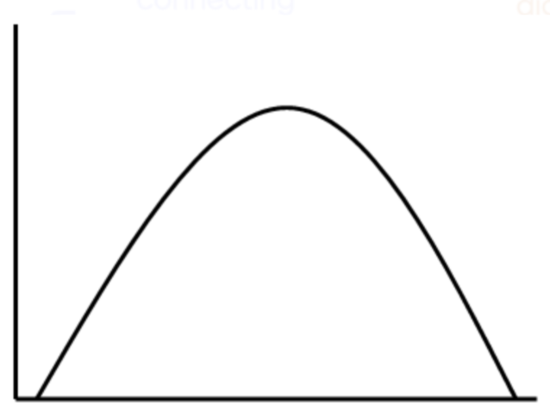
"Dancing in the tensions"
Notes:
This week's topic also gives us a chance to explore a wellness concept that I like to call "dancing in the tensions." The DWI self-assessment section that we explore also reinforces this notion that there aren't any easy answers when it comes to navigating life in a digital world, so we have the opportunity to be observant, aware, curious as we navigate what wellness looks and feels like for each one of us. The wellness journey is very personal – there is no formula, no one-size-fits-all approach that will work.

Slide 4
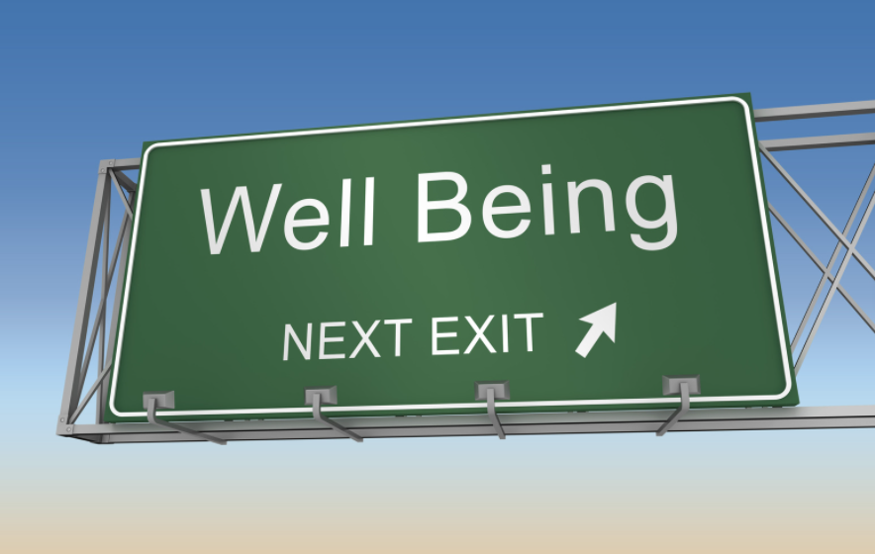
Wellness is not a destination
Notes:
Said another way, digital wellness is not a destination, a formula, a checklist, a one-and-done kind of thing. It's a constant practice toward a more balanced way of life where technology can foster and support our intentions and goals, and where we build habits and mindsets that help us keep technology in its proper place in our lives, our days, our moments….

Slide 5
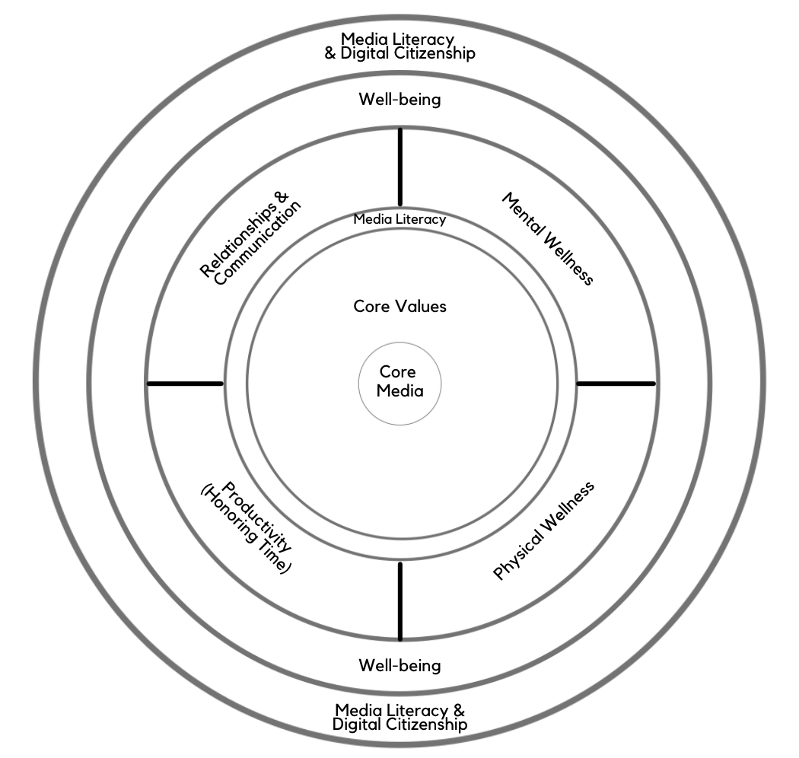
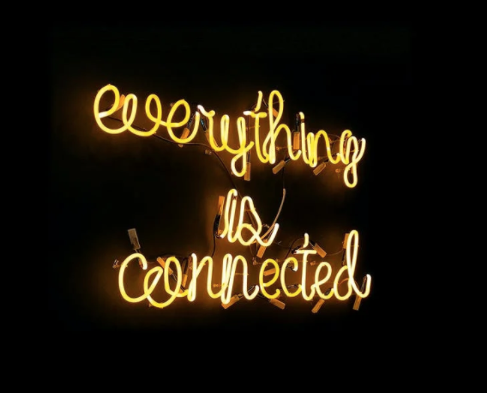
It's a dance between many life domains
Notes:
It's all a dance, and includes all the many facets we have explored during this series. As we have discussed, concepts in each module interrelate to other modules. Similarly, although this is a series on Digital Wellness, many concepts we explore relate to Wellness in general. We hope you have been able to benefit by the interrelated concepts in the modules to this point.

Slide 6

Notes:
This metaphor of gears can be another way to look at Wellness. Wellness in a digital world is about learning to co-exist in healthy ways with that world. At any given moment in time or in any given phase of our lives, how to balance things may look different – for each person, for each situation, for each family or group. There are so many moving parts to consider in building wellness!

Slide 7
"In the attention economy,
mindfulness is activism."
~Jay Vidyarthi
Notes:
The "oil" that can help all the "gears" work together is awareness or mindfulness. Mindfulness is essential to wellness, and wellness impacts our activism.

Slide 8
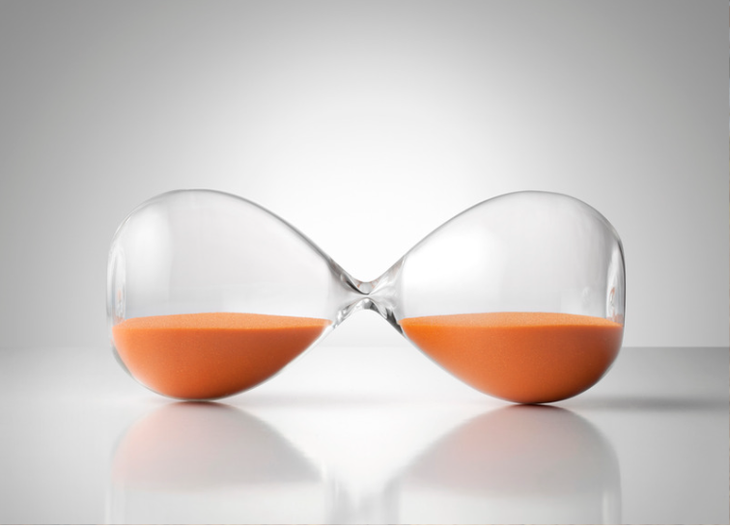

Notes:
There are a few simple things we hope you can remember from this series. One is the concept of practicing the pause, and pausing and asking questions (PAQ). This concept has been woven throughout the modules of this series.

Slide 9
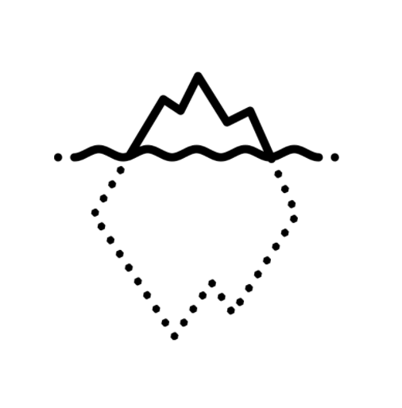

"Point and Name"
Notes:
The idea of pausing and naming is a simple thread that is woven through all that we have talked about to this point. And everything that we have talked about to this point is like pre-work for good relationships.
This concept of "point and name" can apply in various facets of our lives. We can name the kinds of persuasion tactics being used as we practice all of the facets of Wellness. See the following slides, as well as the following ideas:
As we name our centering values, the attributes we want to develop and nurture, they can stay more present in our day-to-day lives. Pointing and naming the Who, What, When, Where, Why, and How with media consumption can help us be more alert and aware with regard to messages all around us (even those that are spoken, not just shared via media sources). We can name the emotions we are feeling (research shows that this simple act can calm down the nervous system). We can look objectively at (name, identify) thoughts we have, especially when we encounter a difficult situation, but also as we look for tender mercies in our lives. We can build awareness by becoming more alert to messages our bodies are sending us, and where we are experiencing stress and other things in our bodies. And when it comes to honoring time, James Clear shares this idea in his book, Atomic Habits. Catch a glimpse of his writing on this here: https://jamesclear.com/habits-scorecard In his book, he calls it "pointing and calling," from a safety process (Shisa Kanko) on Japanese trains that has significantly reduced accidents. This technique can help during transition times between tasks, when it can be easy to fall into distraction. e.g., When I'm done with a chunk of work and need to go eat, I to often find myself wandering into social media land and getting lost there for a bit, when my body really needs food. When I speak out loud what I want to do next, I also feel a little more accountability to myself to follow through, and it helps my brain remember better. James Clear's wife uses this technique to help her remember where she has put her keys or other things. :) https://www.japantimes.co.jp/news/2008/10/21/reference/jr-gestures/ or you can read this blog post about it since the original story is behind a paywall: https://www.christopherroosen.com/blog/2020/4/20/how-the-ritual-of-pointing-and-calling-shisa-kanko-embeds-us-in-the-world
"pointing and calling" - "Shisa Konko"
*Alice Gordenker, “JR Gestures,” Japan Times
(Note: In all of these activities, the pointing doesn't have to be literal. :) )
On the power of pointing and naming, as it were, on improving wellness, habits, etc. see this from James Clear, an excerpt from chapter 4 of his books, Atomic Habits (shared on his website). In his book, he calls it "pointing and calling," from a safety process (Shisa Kanko) on Japanese trains that has significantly reduced accidents. https://www.japantimes.co.jp/news/2008/10/21/reference/jr-gestures/ or you can read this blog post about it since the original story is behind a paywall:
Or see this from Dr. Dan Siegel, an expert in integrative neurobiology: Reflection, Relationships, Resilience as three keys to wellness: https://www.youtube.com/watch?v=LiyaSr5aeho

Slide 10
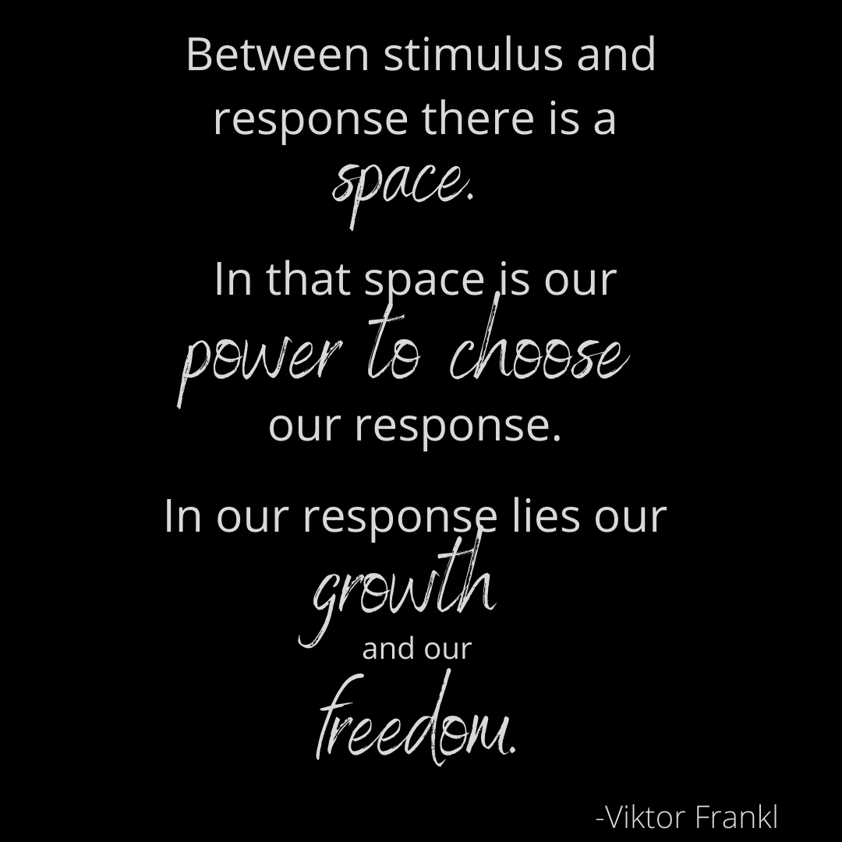
Notes:
It can be easy to think that we are helpless in a sea of so much distraction and commotion around us, in both the digital and non-digital worlds. But we always, always have the power to choose. In the tech activism world, they often use the word agency. We can be agents in our own lives and choices, and Digital Wellness involves claiming (or re-claiming) our agency, one moment, one hour, one time boxed section, one day at a time.

Slide 11
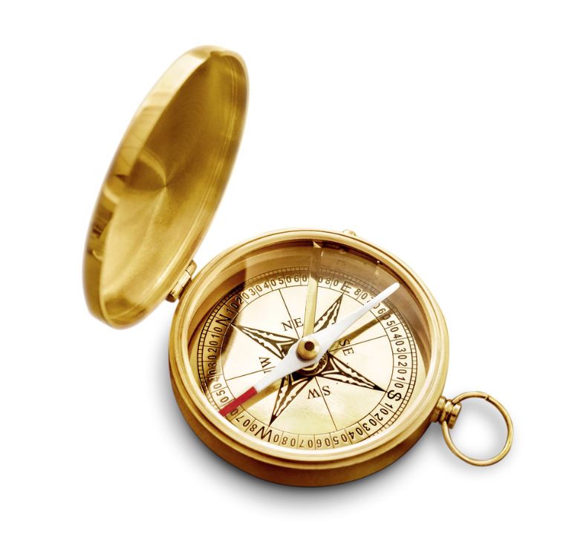
Week 1 folder: https://drive.google.com/drive/folders/18ZQ-ySDQW7UxXe8L_75UMBKzvKldC_L9?usp=sharing
Notes:
If you haven't yet written about a core value/attribute you want to work on, we invite you to do that. There is value in writing a little bit every day or two to keep it fresh in your mind. Visual reminders of your core principles/values/attributes can also help us be more intentional about practicing them.

Slide 12
[V]alues are central to human flourishing. We need to define and understand our values if we want
to live with personal integrity."
Nir Eyal
Week 1 folder: https://drive.google.com/drive/folders/18ZQ-ySDQW7UxXe8L_75UMBKzvKldC_L9?usp=sharing
Notes:
https://www.nirandfar.com/common-values/

Slide 13
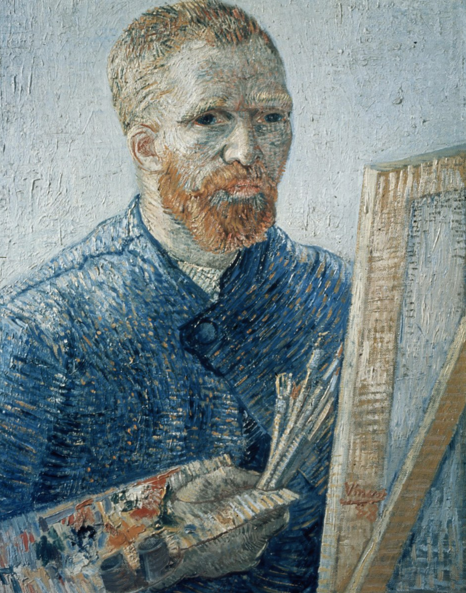
[H]ow can one remain dedicated to…
a task without allowing oneself to be lured from it or distracted, unless one
reflects and organizes one’s life
according to principles?
Week 1 folder: https://drive.google.com/drive/folders/18ZQ-ySDQW7UxXe8L_75UMBKzvKldC_L9?usp=sharing
Notes:
Two weeks ago, we quoted from Vincent Van Gogh when we talked about celebrating small wins. Here we share his thoughts about a principle-centered approach to reflection and life organization.
Image: In the public domain from https://commons.wikimedia.org/wiki/File:Foto_van_een_zelfportret_van_Vincent_van_Gogh,_Bestanddeelnr_255-9139.jpg
quote: https://vangoghletters.org/vg/letters/let274/letter.html - Website: Van Gogh Museum of Amsterdam: Vincent van Gogh Letters, Letter number: 274, Letter from: Vincent van Gogh, Location: The Hague, Letter to: Theo van Gogh, Date: October 22, 1882, Website description: Van Gogh

Slide 14
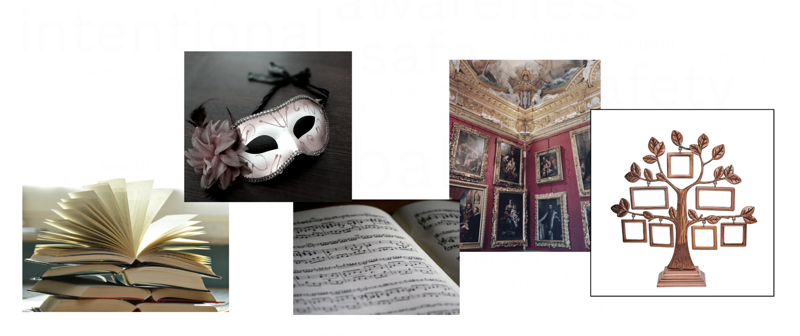
Week 2 folder: https://drive.google.com/drive/folders/1927uy5aT0--hTG_Q8Y0-f5Kxfx5k8Cht?usp=sharing
Notes:
The concept of "core media" or touchstone media relates to content from both weeks 1 and 2. Media Literacy (week 2) is dependent first on our own literacy, and having "core media" to help us define and refine and revisit and recenter on our core values can be very helpful in such a noisy world. Touchstone media also give us something by which we can make decisions about what to do with all the other messages we encounter. We can each ask, "How does what I'm hearing/seeing/being told/etc. align with my center? Do these messages help me get traction toward who I want to be and how I want to show up in the world? Do they expand my heart and mind? Not all that is out there is out to get us – there are messages and ideas and insights and perspectives that can help us grow and learn and improve. We each have the opportunity and responsibility and power to choose what to do with the messages we receive, and having a center, and having core media and principles as a compass for our lives, can help us sift through all the stuff.

Slide 15
WHO
WHAT
WHERE
WHEN
WHY
HOW
Message/Input
Week 2 folder: https://drive.google.com/drive/folders/1927uy5aT0--hTG_Q8Y0-f5Kxfx5k8Cht?usp=sharing
Notes:
Media Literacy, in its basic form, is about taking the time to ask questions about the messages we encounter, regardless of the medium through which they are communicated. See the Media Literacy slide deck for more Media Literacy resources and information https://docs.google.com/presentation/d/1Ad3dQLkJOnW-go-s5JCX76A2kCOtRE5RJVuHvPLVI18/edit?usp=sharing, and/or see the Media Literacy page of DigCitUtah.com for a variety of resources, including curricula, activities, games and more. https://digcitutah.com/media-literacy/

Slide 16
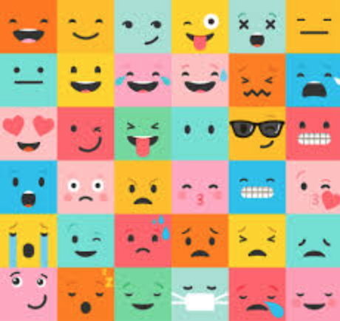
Week 3 folder: https://drive.google.com/drive/folders/1qu1SHlz6urw2jq-FuQXcffmSCHvrOohh?usp=sharing
Notes:
I sometimes consider covering Mental Wellness before covering Media Literacy, because emotional awareness (literacy, you could call it) and Media Literacy are so intertwined. How do messages "hook" us? Usually through our emotions. The more we can "point and name" our emotions, the more aware we can be of the impact of media on our emotions. More generally, research shows that naming our emotions can help calm the nervous system (see week 3's slides [https://docs.google.com/presentation/d/15aqmRVeNQfKuWUHjQMlwMinHYdyIj0fvdZxmnLlocaE/edit?usp=sharing], or this link:https://www.scn.ucla.edu/pdf/AL(2007).pdf). We also can communicate more effectively when we are in tune with our emotions. Like I would tell my kids when they were young, "Use your words." The invitation to find words, to find names, for our feelings, can also engage the part of the brain that enables us to engage in more rational decision-making. When emotions just run under the surface, they can often unwittingly be allowed to drive our bus.

Slide 17

Week 3 folder: https://drive.google.com/drive/folders/1qu1SHlz6urw2jq-FuQXcffmSCHvrOohh?usp=sharing
Notes:
In the world of meditation and in other spaces, the idea is shared that we are the thinker of our thoughts, not the thoughts themselves. It can be all too easy to get swept up in our thoughts, but when we take on the role of the observer of our thoughts, we can build more awareness and that can help foster more mental wellness. Emotional intelligence also helps in relationships: https://www.youtube.com/watch?v=LiyaSr5aeho I also see it as an invitation to foster curiosity. "Hmmmm. What's going on in my thoughts right now?" When we take the role of observer of our thoughts, once again, that can take them out of the sub/unconscious driver's seat and give us an opportunity to get more of the iceberg above the surface of the water. Many times, thoughts can drive emotions, and stories in our minds can drive the drama triangle (which we will discuss next week).

Slide 18
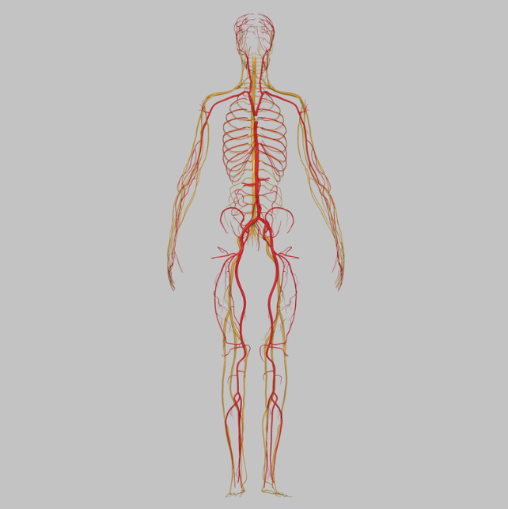
Week 4 folder: https://drive.google.com/drive/folders/13VvzpiknSWsBs6OtzT6E5gGfzEpm75dr?usp=sharing
Notes:
It's a powerful thing to also build body awareness and literacy. What is going on in my muscles, my organs, my nerves, my senses, my posture, my stance, my energy level, my comfort (or lack thereof) with eye contact? What body language am I using when I am communicating with others, or when I'm engaging with messages or media that others have created? What does wellness feel like in my body?

Slide 19
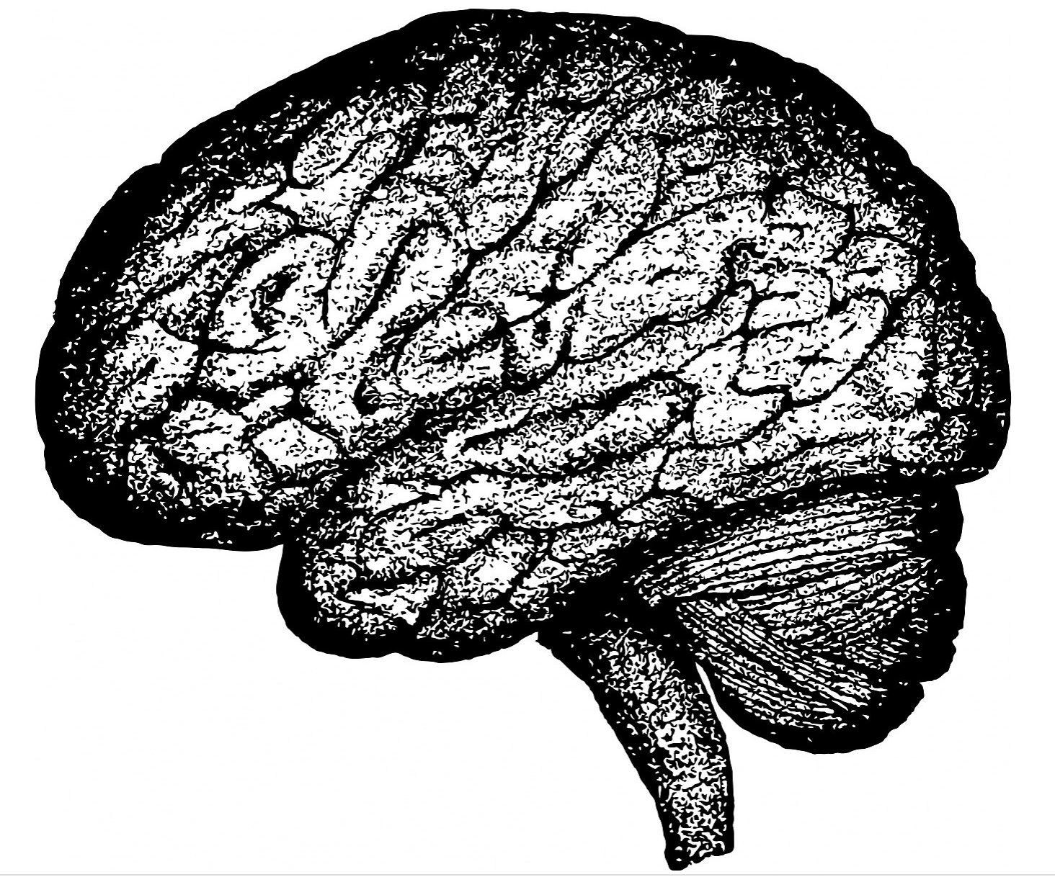


Notes:
Here's a great video about integration that fosters wellness: https://www.youtube.com/watch?v=LiyaSr5aeho
Wellness involves bringing together heart, mind, and body, and…

Slide 20

Week 5 folder: https://drive.google.com/drive/folders/1yFYOHKezAkvqhjjwV0ScV2q7F7beoQTm?usp=sharing
Notes:
Last week we talked about identifying our key priority areas in our lives so that we can build more traction (more intention, the opposite of dis-traction). When combined with our core values (the who we want to be, the how we want to show up in the world), and with awareness in other areas of our lives (mental, physical) getting clear about traction helps us with the what of our lives. What matters most? What is most worth my time? What is needed for me to do to fulfill my roles and responsibilities, to meet my goals, to turn ideas or hopes into action, etc.?

Slide 21
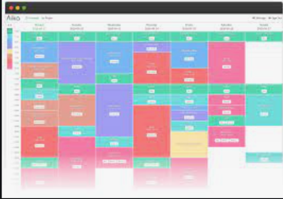
Week 5 folder: https://drive.google.com/drive/folders/1yFYOHKezAkvqhjjwV0ScV2q7F7beoQTm?usp=sharing
Notes:
We can then translate our traction items – the what of our lives – into our planning. When we schedule what matters to us, and are accountable to ourselves for how we use our time, we can be more centered, living with more integrity.
On the other hand, if we aren't clear about budgeting our time, we can easily become overwhelmed, which can lead to stress or burnout. Likewise, if we aren't intentional about building in breaks, we could end up taking them in ways that dull our minds and spirits rather than rejuvenate them. All of these things can impact our relationships.

Slide 22
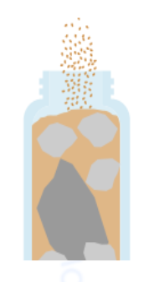
Week 5 folder: https://drive.google.com/drive/folders/1yFYOHKezAkvqhjjwV0ScV2q7F7beoQTm?usp=sharing
Notes:
The idea of "putting the bigger rocks in the jar" is a concept often used in financial management, and is also relevant for honoring time.
The image about the jars and rocks is from this Personal Finance course (https://bit.ly/3Uw3bzr, p. 49), adapted from Stephen R. Covey, A. Roger Merrill, and
Rebecca R. Merrill, First Things First: To Live, to Love, to Learn, to Leave
a Legacy [1994], 88–89)

Slide 23
Relationship with self
Relationship with family, close friends, close support networks (Bonding social capital)
The “getting things done” relationships (including weak and dormant ties)
(Bridging social capital)
Week 6 folder: https://drive.google.com/drive/folders/1nF5jLlb4j-5jwKG-QAw-yzc4aybG5zNg?usp=sharing
Week 7 folder: https://drive.google.com/drive/folders/1zP57pWjFoTMZo3lUBTWnQQs97InhAILG?usp=sharing
Notes:
With all the other concepts in mind, we are more prepared to engage more intentionally in all of our relationships. Much research reiterates how importance relationships are to wellness. See the slide deck bonus resources. See also this video from Dr. Dan Siegel: https://www.youtube.com/watch?v=LiyaSr5aeho
In Week 7, we covered Social Development Strategy, which is especially relevant to building stronger bonds in relationships with children and youth.

Slide 24
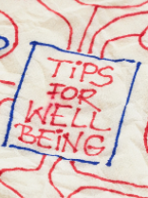
Reflection Question (& Around-the-Zoom)
Moving forward, what wellness concepts
might you want to practice?
Notes:
We did an around-the-Zoom share on this question.

Slide 25
Notes:
We've used the metaphor of gears working together. Now we'll talk about a different metaphor, or a few different models that are relevant to Wellness.

Slide 26




Consider a continuum
Notes:
Another possible tool to consider the balancing act, or finding happy mediums, in digital well-being is a continuum. Most of us wouldn't be able to do what we need to do with zero technology, and there are real benefits (like this series!) that come because of technology. But, as we've all experienced, it is not hard to get overwhelmed or flooded by too many digital things going on or vying for our attention. Some of us may even struggle with using technology when we really don't want to – we can build bad habits or even addictive tendencies with some tools or with our devices.
We could draw more continua (continuums) for various modules.

Slide 27
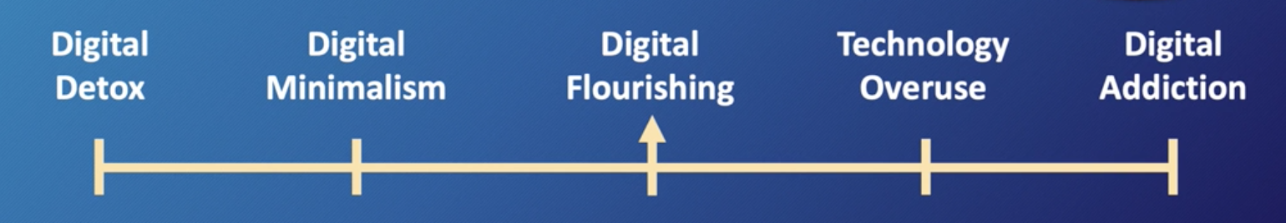
Digital Flourishing™: “health, personal fulfillment, and interpersonal satisfaction that each individual using technology is capable of achieving.”
This image and definition are from the Digital Wellness Institute's certification course.
Notes:
The Digital Wellness Institute uses this continuum to explore the range, and to define that "sweet spot" in the middle.

Slide 28
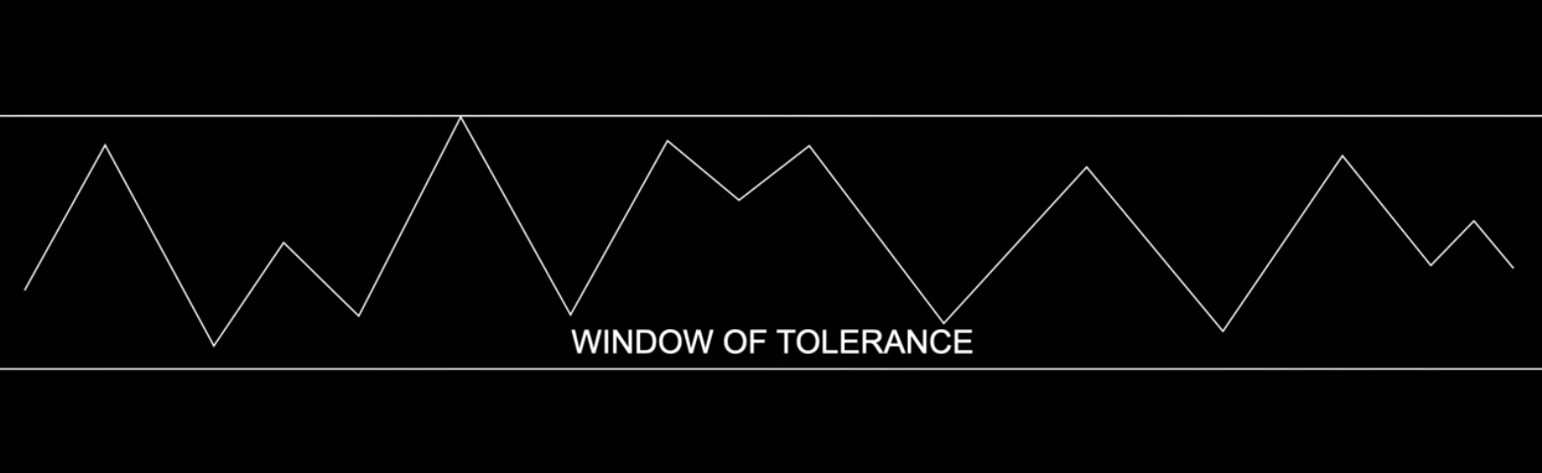
Notes:
https://www.youtube.com/watch?v=TNVlppGz0zM
This concept from Dan Siegel (image from Lewis Psychology video listed above) illustrates that we have a range in our capacity for stress and such. When we have a "straw that broke the camel's back" moment and we cross out of our capacity, those are times when we might get angry, be more critical, be less patient, etc (hyperaroused). Or, on the flip side, we could turn inward more, shut down, isolate, etc. (hypoarousal). Either way, when we move beyond either upper or lower limits, that impacts our degree of wellness in those moments. But it wasn't the piece of figurative straw that actually pushes us past our limits.
You can As with the water in delicate tension on that penny, the one more drop that will send the water spilling out was not what created or broke the tension. All the water added onto the penny before created that tenuous tension.
The more aware we are of where we are all along the way can enable us to sense when we might be needing a recharge *before* we cross out of our window of tolerance. Of course, we are human and will make mistakes, but awareness is something we can practice, and our window of tolerance can even be widened through all the positive practices we have discussed throughout this series (and which we reviewed today).

Slide 29
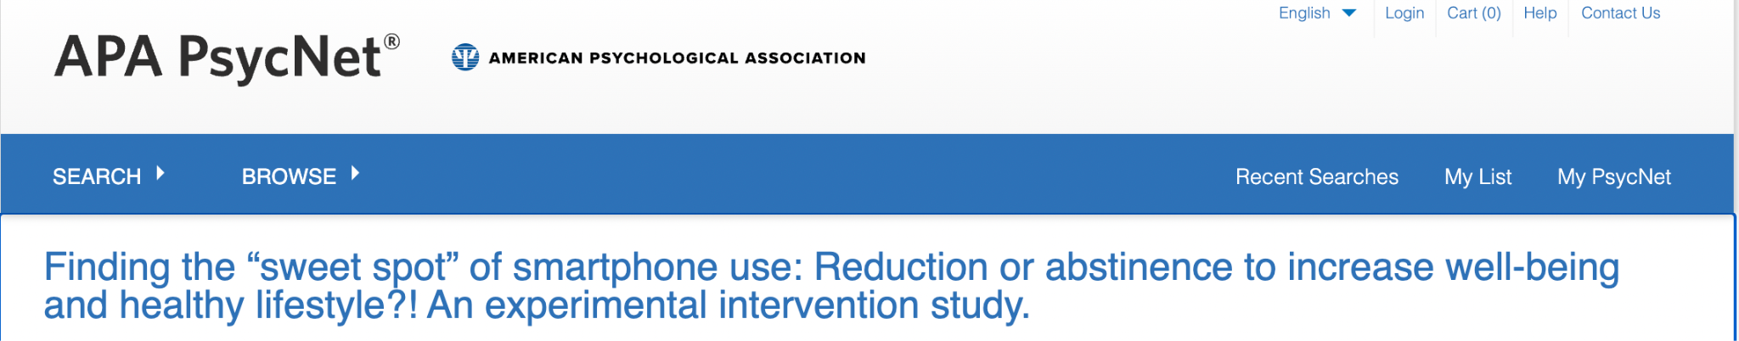
Notes:
https://psycnet.apa.org/record/2022-50916-001?doi=1 – sweet spot of tech use
In Spanish, synonyms can include punto justo, punto ideal, punto óptimo
The "sweet spot: idea is sometimes used in tennis or baseball - connecting the ball with the part of the racket or bat that provides the most responsive and controlled and powerful hit

Slide 30
Digital Well-being can be like a greased hump
Notes:
Consider this abstract as a simple example about how debates around digital well-being (in this case, for teens) can be charged and polarized. https://journals.sagepub.com/doi/abs/10.1177/1363461512474623

Slide 31
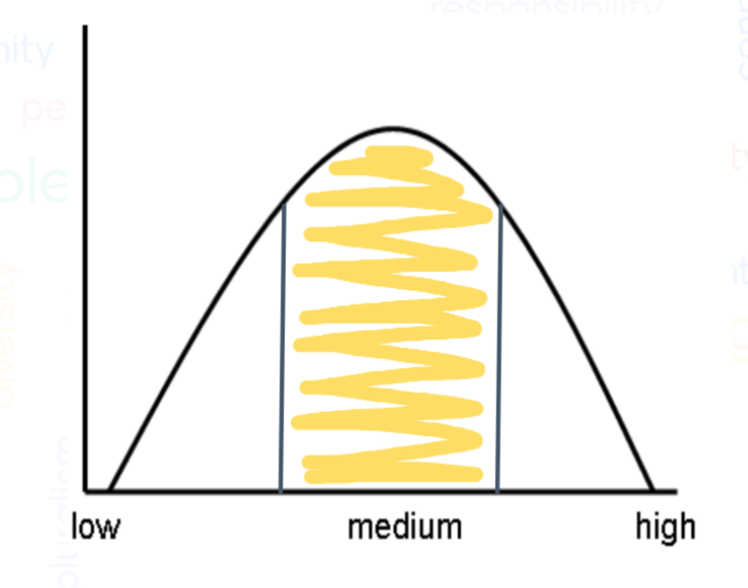
Inverted U theory
Notes:
This simple model is used in a variety of fields, and could be used for a variety of variables in Digital Wellness. Consider, for example, the tensions between isolation and social connection. Too much isolation on one end can minimize wellness, where overstimulation with too much social connection and a dearth of isolation can also have its impacts (isolation deprivation, something people struggled with, for example, during COVID shut-downs). We could also think of this in terms of digital use itself. We may not be able to do the things we need to do if we don't have *some* digital access, but its very easy to swing to the other side of a curve like this and get flooded with too many too many messages/ads/opinions/lights/sounds/pings/dings.
Or too many tools [studies show that too many social media tools can decrease mental wellness, see Primack, Brian A., Ariel Shensa, César G. Escobar-Viera, Erica L. Barrett, Jaime E. Sidani, Jason B. Colditz, A. Everette James (2017). Use of multiple social media platforms and symptoms of depression and anxiety: A nationally-representative study among U.S. young adults, Computers in Human Behavior, 69, 1-9. https://doi.org/10.1016/j.chb.2016.11.013.)
If you've ever taken a personality test, you may have noticed that questions often try to measure where you land on a continuum of preferences, behaviors, attitudes, etc. They may want to measure your degree of introversion vs. extroversion, of use of logic vs. use of instinct, etc. If you are a religious person (or even in the realm of civic concepts), you could think about tensions between concepts like justice and mercy.
Examples of Inverted U in writings in the realm of psychology: https://pubmed.ncbi.nlm.nih.gov/26162116/
https://pubmed.ncbi.nlm.nih.gov/31971864/
https://pubmed.ncbi.nlm.nih.gov/26162116/

Slide 32
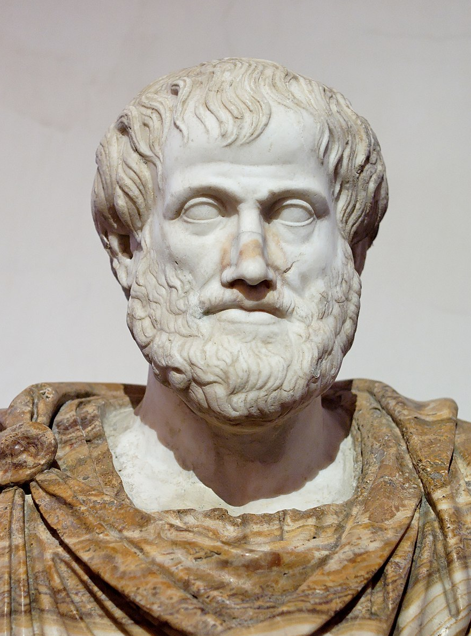
Inverted U theory
Notes:
This concept is not new at all. Aristotle had something that has been called "The Golden Mean." This concept is one I've seen used in therapeutic settings and religious settings as well.

Slide 33
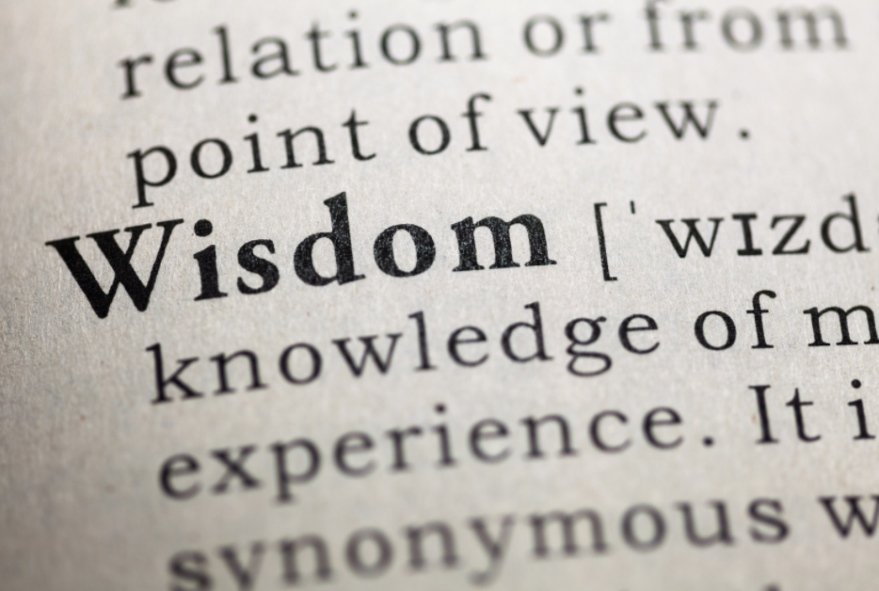
Practicing Wisdom/Wise Reasoning
https://www.researchgate.net/publication/301821371_Wise_Reasoning_in_the_Face_of_Everyday_Life_Challenges
Notes:
Next week, we hope to talk a little more about the research around wise reasoning and how it relates to Digital and Civic Wellness.

Slide 34
DWI Survey Questions: Well-being Section
Notes:
We use this section not just as a self-assessment, but as an exercise in Media Literacy, in pausing and asking questions of the questions DWI presents!

Slide 35


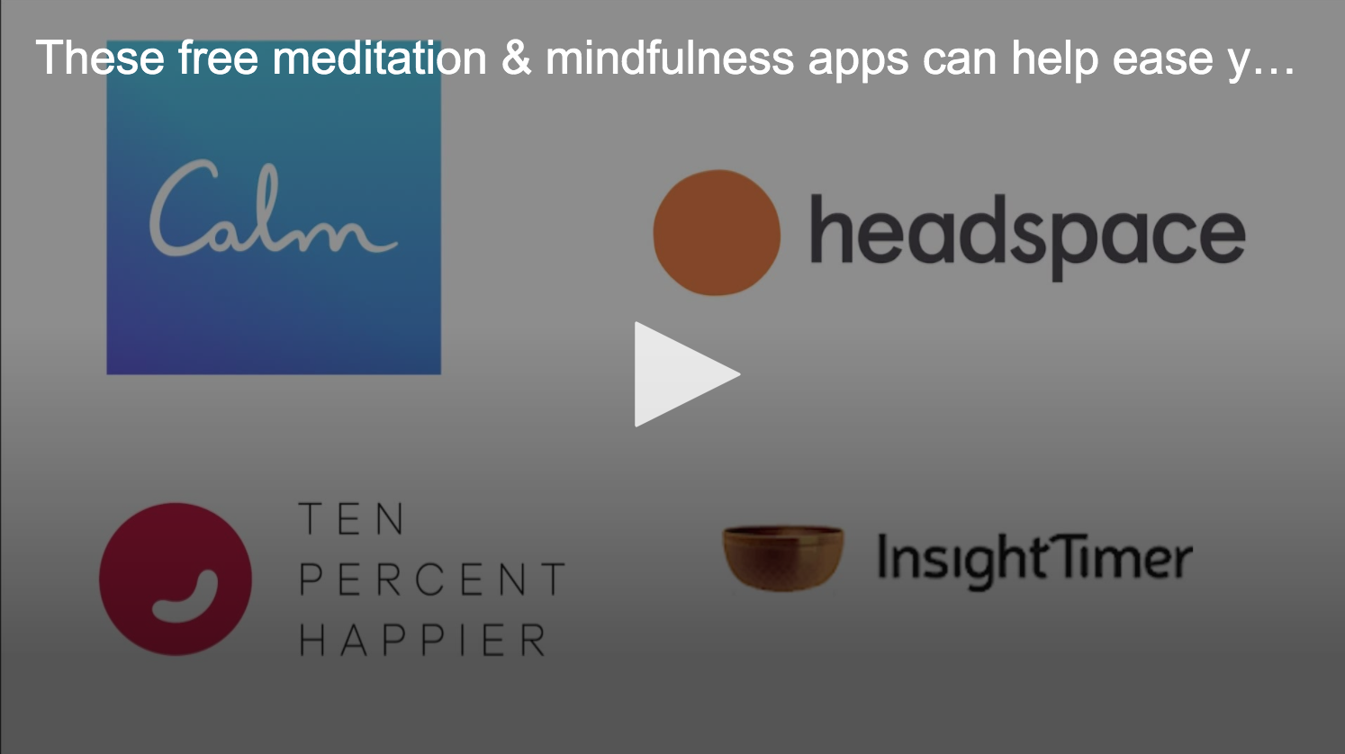

Think/Write:
What devices/tools/apps do you use most?
Notes:
Before we move into reviewing the Digital Wellness Institute's Well-being section of their self-assessment, please take a few moments to write down the tools you use most. The tools we use most offer more opportunities for us to experience both the benefits and the downsides of technology. Those tools are the ones with which we most likely will have to navigate the "balancing act" we've been discussing.

Slide 36

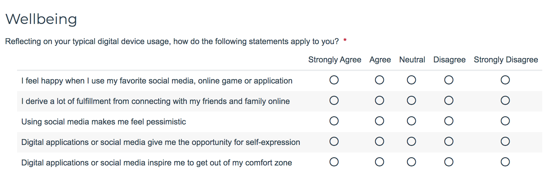
Survey courtesy of DWI: https://survey.alchemer.com/s3/5504604/b153c792d361
Notes:
Before we go into detail with these questions, what tensions, nuances, both/and, continuums, etc. come to mind? This section of the survey is one that could produce a lot of "it depends" – and that is what we want to explore today together.
https://survey.alchemer.com/s3/5504604/b153c792d361
We hope you will listen to the recording to get others' thoughts on each of these questions.

Slide 37
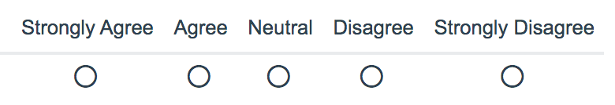

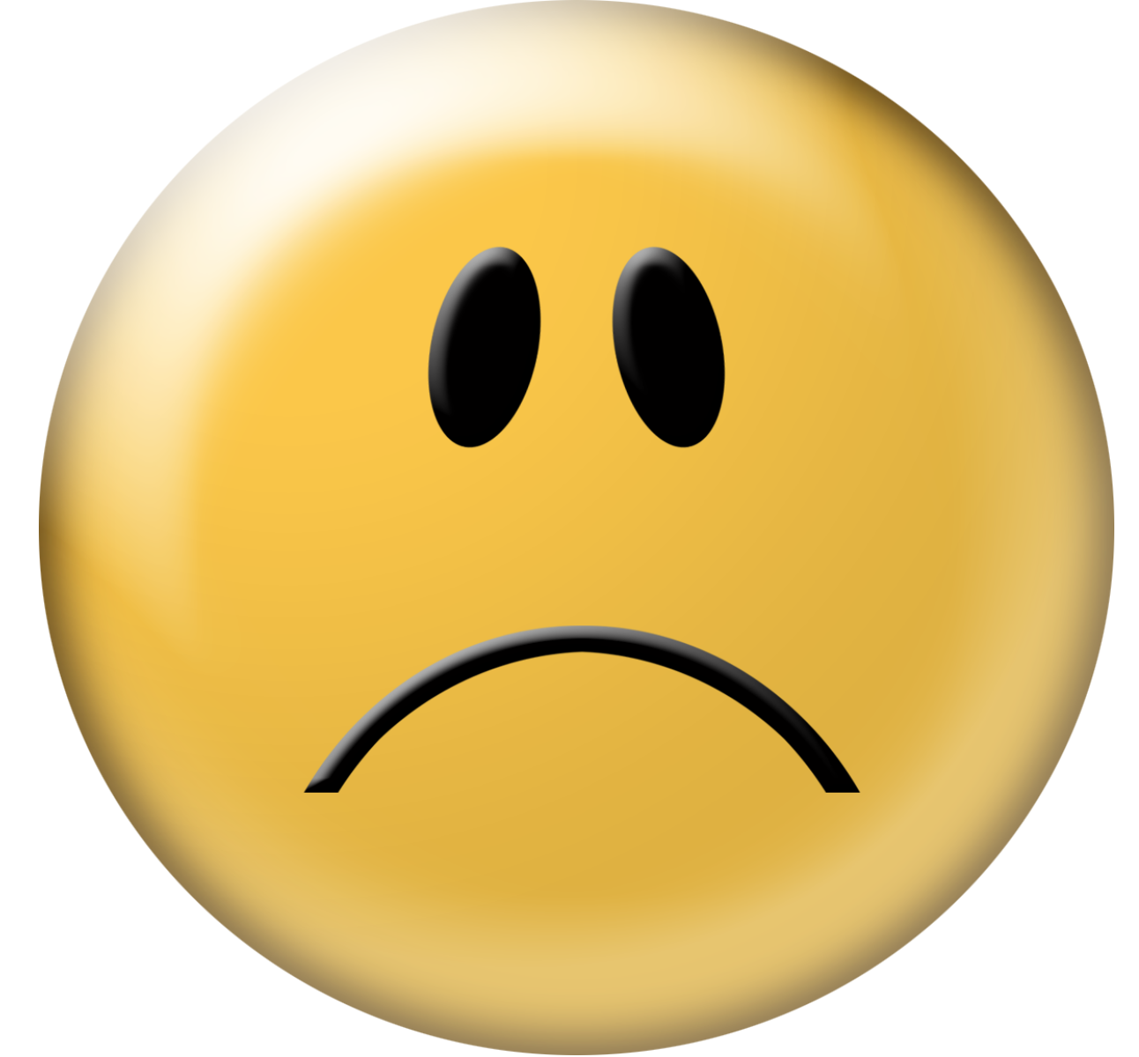
Q1: “I feel happy when I use my favorite social media, online game or application”
Survey courtesy DWI: https://survey.alchemer.com/s3/5504604/b153c792d361
Notes:
We hope you will listen to the recording to get others' thoughts on each of these questions.

Slide 38

PAQ: Thought Questions about Q1:
What does it mean to you to feel happy?
Is feeling happy always the goal of online activity?
Notes:
We hope you will listen to the recording to get others' thoughts on each of these questions.
e.g, Someone personally working in a space that includes exposure to sad or hard information may not always feel happy, but what they are doing may still be in line with their “Why” and ”Who” and “What” values –
enough to choose to hold space for the hard.
Values-centeredness, self-awareness, deliberateness, and self-honesty are critical to maintaining well-being in all digital situations, but all the more so in these kinds of circumstances.

Slide 39


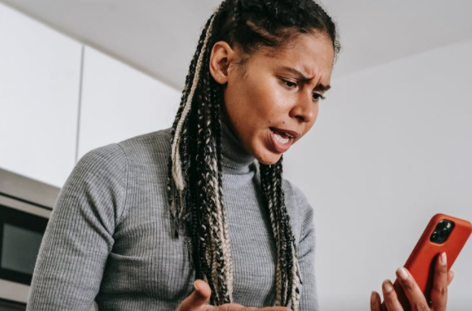

Q2: “I derive a lot of fulfillment from connecting with my friends and family online”
(bonding capital?)
Survey courtesy DWI: https://survey.alchemer.com/s3/5504604/b153c792d361
Notes:
We hope you will listen to the recording to get others' thoughts on each of these questions.

Slide 40
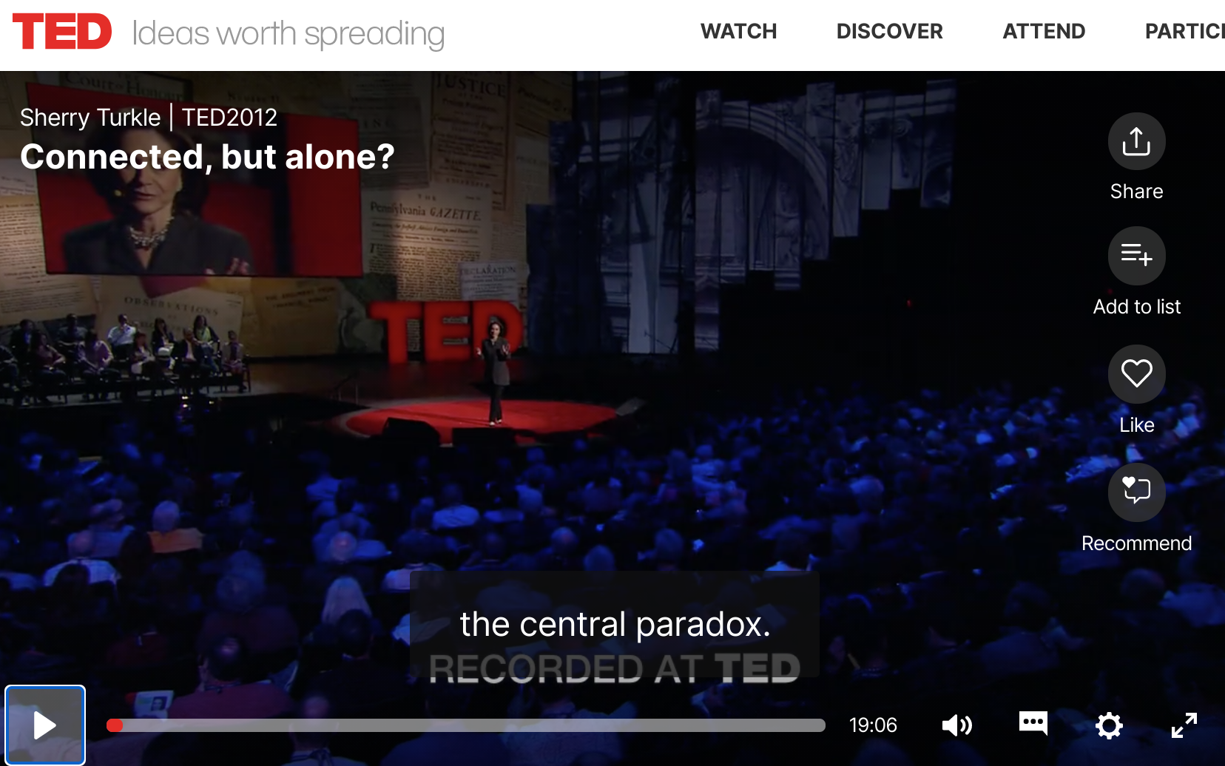
Remember the difference between connection and conversation from Dr. Sherry Turkle
Notes:
See our discussion on relationships for more: https://drive.google.com/drive/folders/1nF5jLlb4j-5jwKG-QAw-yzc4aybG5zNg?usp=sharing
Also, see
https://www.ted.com/talks/sherry_turkle_connected_but_alone/transcript?language=en – start at 2:48, run until 9:36 [on 1.5 speed, this takes just a little over 5 minutes): Sherry Turkle is the Abby Rockefeller Mauzé Professor of the Social Studies of Science and Technology in the Program in Science, Technology, and Society at MIT, and the founding director of the MIT Initiative on Technology and Self. Professor Turkle received a joint doctorate in sociology and personality psychology from Harvard University and is a licensed clinical psychologist. https://sherryturkle.mit.edu/
2:41
So just to take some quick examples: People text or do email during corporate board meetings. They text and shop and go on Facebook during classes, during presentations, actually during all meetings. People talk to me about the important new skill of making eye contact while you're texting. (Laughter) People explain to me that it's hard, but that it can be done. Parents text and do email at breakfast and at dinner while their children complain about not having their parents' full attention. But then these same children deny each other their full attention. This is a recent shot of my daughter and her friends being together while not being together. And we even text at funerals. I study this. We remove ourselves from our grief or from our revery and we go into our phones.
03:56
Why does this matter? It matters to me because I think we're setting ourselves up for trouble -- trouble certainly in how we relate to each other, but also trouble in how we relate to ourselves and our capacity for self-reflection. We're getting used to a new way of being alone together. People want to be with each other, but also elsewhere -- connected to all the different places they want to be. People want to customize their lives. They want to go in and out of all the places they are because the thing that matters most to them is control over where they put their attention. So you want to go to that board meeting, but you only want to pay attention to the bits that interest you. And some people think that's a good thing. But you can end up hiding from each other, even as we're all constantly connected to each other.
04:56
A 50-year-old business man lamented to me that he feels he doesn't have colleagues anymore at work. When he goes to work, he doesn't stop by to talk to anybody, he doesn't call. And he says he doesn't want to interrupt his colleagues because, he says, "They're too busy on their email." But then he stops himself and he says, "You know, I'm not telling you the truth. I'm the one who doesn't want to be interrupted. I think I should want to, but actually I'd rather just do things on my Blackberry."
05:27
Across the generations, I see that people can't get enough of each other, if and only if they can have each other at a distance, in amounts they can control. I call it the Goldilocks effect: not too close, not too far, just right. But what might feel just right for that middle-aged executive can be a problem for an adolescent who needs to develop face-to-face relationships. An 18-year-old boy who uses texting for almost everything says to me wistfully, "Someday, someday, but certainly not now, I'd like to learn how to have a conversation."
06:14
When I ask people "What's wrong with having a conversation?" People say, "I'll tell you what's wrong with having a conversation. It takes place in real time and you can't control what you're going to say." So that's the bottom line. Texting, email, posting, all of these things let us present the self as we want to be. We get to edit, and that means we get to delete, and that means we get to retouch, the face, the voice, the flesh, the body -- not too little, not too much, just right.
06:57
Human relationships are rich and they're messy and they're demanding. And we clean them up with technology. And when we do, one of the things that can happen is that we sacrifice conversation for mere connection. We short-change ourselves. And over time, we seem to forget this, or we seem to stop caring.
07:24
I was caught off guard when Stephen Colbert asked me a profound question, a profound question. He said, "Don't all those little tweets, don't all those little sips of online communication, add up to one big gulp of real conversation?" My answer was no, they don't add up. Connecting in sips may work for gathering discrete bits of information, they may work for saying, "I'm thinking about you," or even for saying, "I love you," -- I mean, look at how I felt when I got that text from my daughter -- but they don't really work for learning about each other, for really coming to know and understand each other. And we use conversations with each other to learn how to have conversations with ourselves. So a flight from conversation can really matter because it can compromise our capacity for self-reflection. For kids growing up, that skill is the bedrock of development.
08:49
Over and over I hear, "I would rather text than talk." And what I'm seeing is that people get so used to being short-changed out of real conversation, so used to getting by with less, that they've become almost willing to dispense with people altogether. So for example, many people share with me this wish, that some day a more advanced version of Siri, the digital assistant on Apple's iPhone, will be more like a best friend, someone who will listen when others won't. I believe this wish reflects a painful truth that I've learned in the past 15 years. That feeling that no one is listening to me is very important in our relationships with technology. That's why it's so appealing to have a Facebook page or a Twitter feed -- so many automatic listeners. And the feeling that no one is listening to me make us want to spend time with machines that seem to care about us.

Slide 41

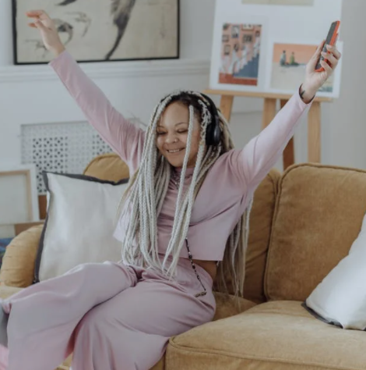

Q3: “Using social [or news or other] media makes me feel pessimistic”
Survey courtesy DWI: https://survey.alchemer.com/s3/5504604/b153c792d361
Notes:
We hope you will listen to the recording to get others' thoughts on each of these questions.

Slide 42
Q4: “Digital applications or social media give me the opportunity for self-expression”
Survey courtesy DWI: https://survey.alchemer.com/s3/5504604/b153c792d361
Notes:
We hope you will listen to the recording to get others' thoughts on each of these questions.

Slide 43
PAQ: Thought Questions about Q4:
What does digital self-expression mean or look like to/for you?
How do you determine the who, what, where, when, why, and how of digital self-expression?
How might we help children navigate this?
Survey courtesy DWI: https://survey.alchemer.com/s3/5504604/b153c792d361
Notes:
We hope you will listen to the recording to get others' thoughts on each of these questions.

Slide 44
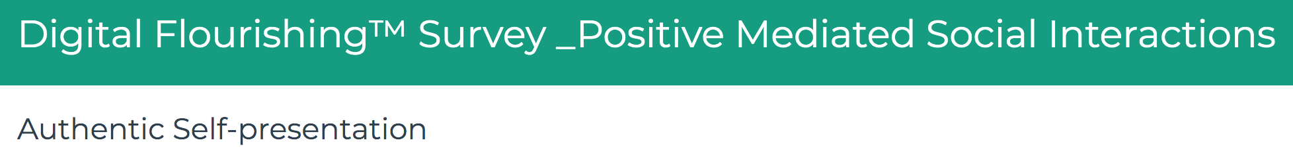
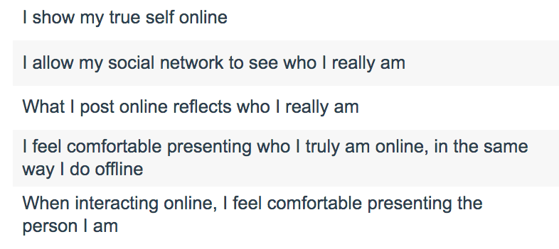
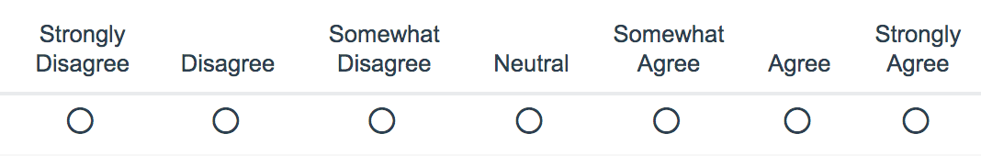
Survey courtesy of DWI: https://survey.alchemer.com/s3/6226945/Digital-Flourishing-Survey-PositiveMediatedSocialInteractions
Notes:
https://survey.alchemer.com/s3/6226945/Digital-Flourishing-Survey-PositiveMediatedSocialInteractions

Slide 45
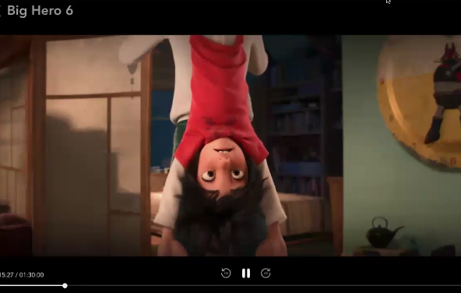

Q5: “Digital applications or social media inspire me to get out of my comfort zone”
e.g., creative expression, civic engagement, compassion, intellectual curiosity, humility, bridging social capital/networking
Survey courtesy DWI: https://survey.alchemer.com/s3/5504604/b153c792d361
Notes:
We reached our time limit before being able to discuss this question, but there are many tensions inherent in this question that are worth exploring. We'll be covering some of these concepts in the Digital Citizenship section as well.
See also https://survey.alchemer.com/s3/6226945/Digital-Flourishing-Survey-PositiveMediatedSocialInteractions

Slide 46
Keep these concepts in mind…
The tensions inherent in these topics are relevant to
next week's discussion on Digital Citizenship
Happiness
Fulfillment
Pessimism
Self-expression/presentation
Comfort Zone
Depending on size of group, this will either be a large group discussion or can be broken into smaller groups of 3-4.
Image shared under CC BY-SA 3.0 (https://creativecommons.org/licenses/by-sa/3.0/deed.en). Credit: https://commons.wikimedia.org/wiki/User:Rahulkepapa

Slide 47
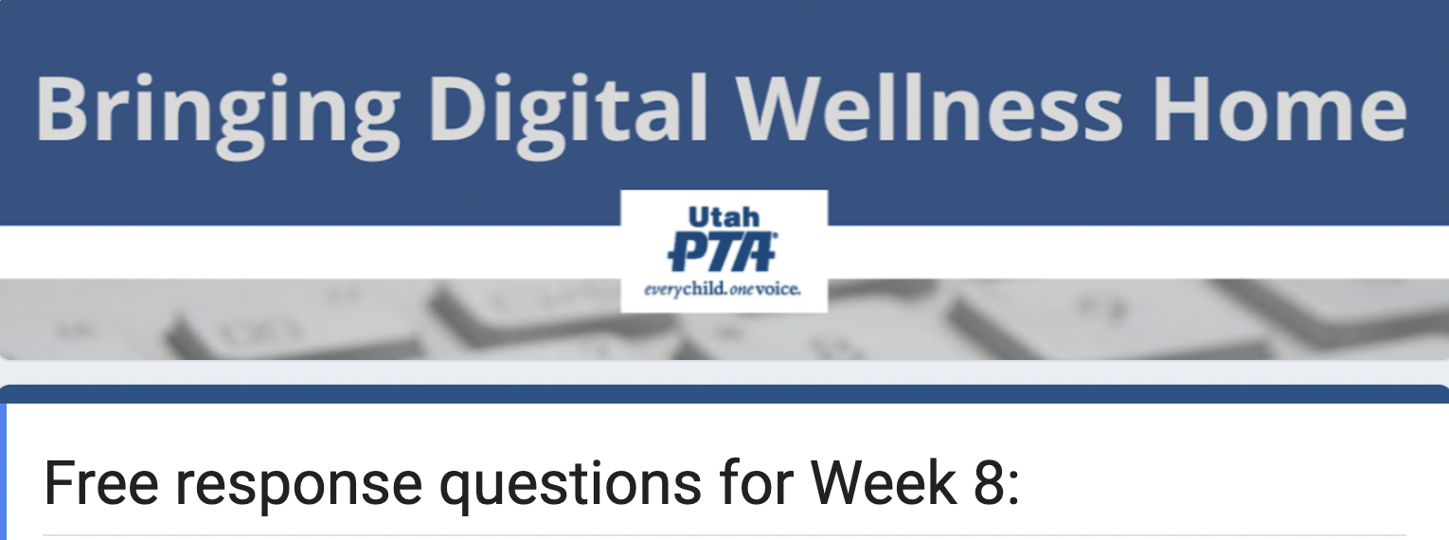
https://forms.gle/CCsAf7o5c6wgHY1E7

Slide 48

We wish you well(ness)!

Slide 49

Bonus Material

Slide 50
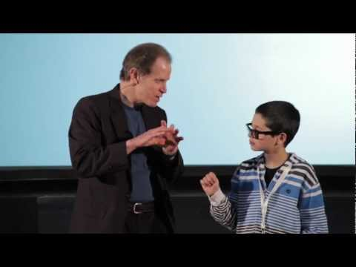
Reflection, Relationship, Resilience –
key elements of well-being, according to Dr. Dan Siegel
Notes:
We'll be talking more about this next week.
https://www.sacred-texts.com/cla/ari/nico/nico019.htm

Slide 51
Aristotle: The Golden Mean
"For instance, both fear and confidence and appetite and anger and pity and in general pleasure and pain may be felt both too much and too little, and in both cases not well; but to feel them at the right times, with reference to the right objects, towards the right people, with the right motive, and in the right way, is what is both intermediate and best, and this is characteristic of virtue."
Notes:
We'll be talking more about this next week.
https://www.sacred-texts.com/cla/ari/nico/nico019.htm

Slide 52


Dancing in the Tensions
See also Barbara Sher’s TEDx talk (When it comes to problem-solving and reaching your goals, there is a tension with solitude, because problems are meant to be solved via connection and collaboration and mutually helping each other) https://www.tedxprague.cz/en/videa/isolation-is-the-dream-killer-not-your-attitude-barbara-sher
  Barbara’s work also reinforces building small networks of support for reaching your goals (where bridging social capital can even become more like bonding social capital)
Notes:
=

Slide 53

For a smile – from Oh, the Places You'll Go!
Notes:
Created by Viraj Kothari, https://quotesaga.com/quote/2179

Slide 54







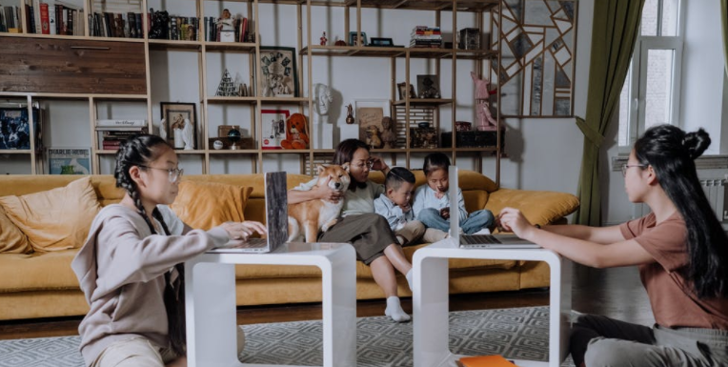
Family Tech Tips
and Resources
Notes:
=

Slide 55
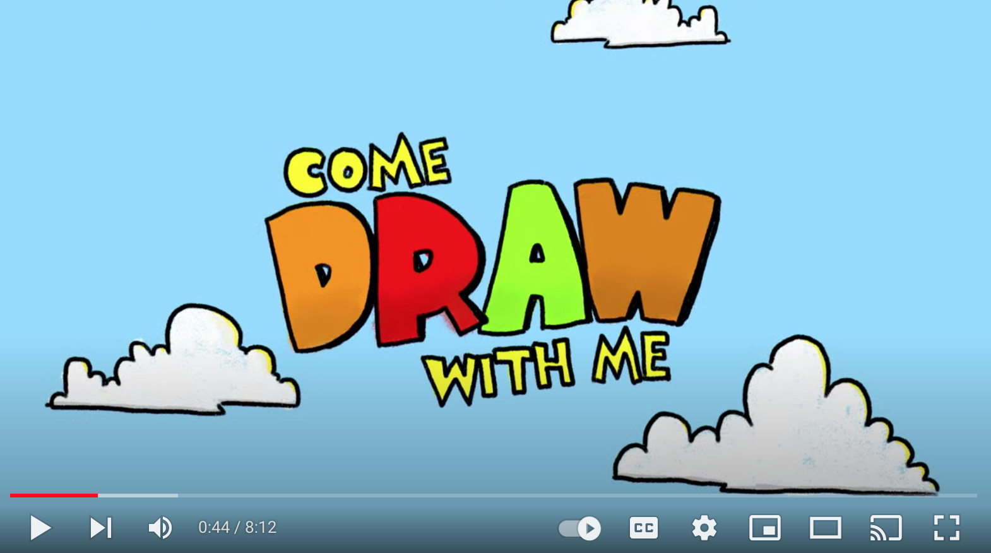
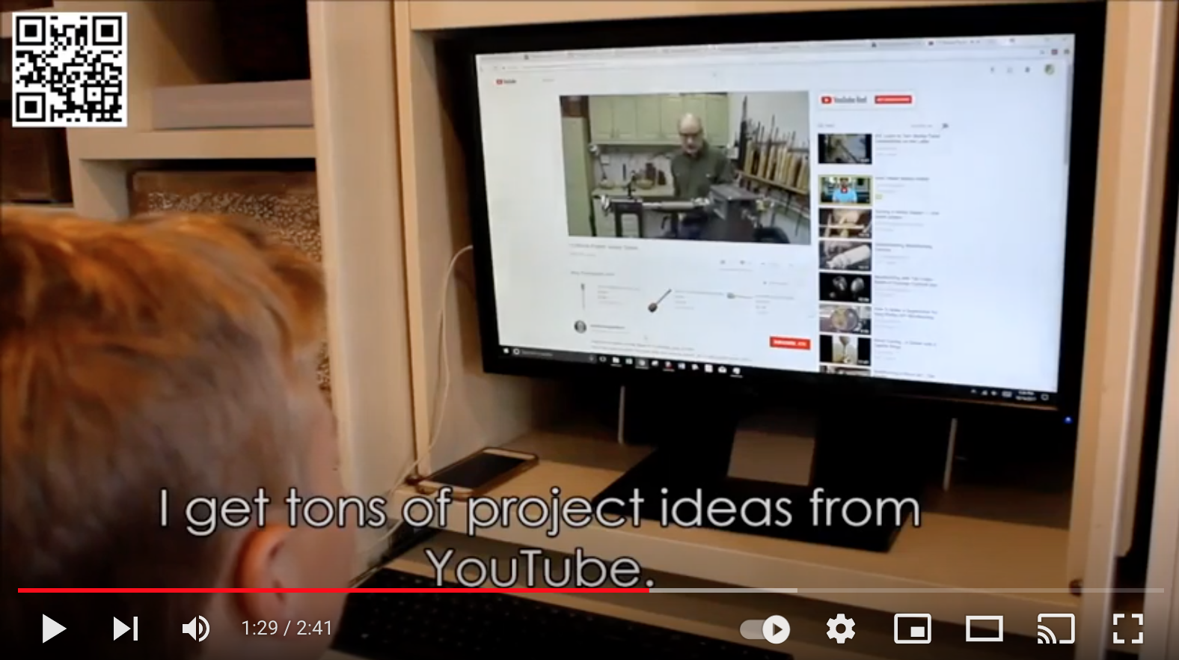
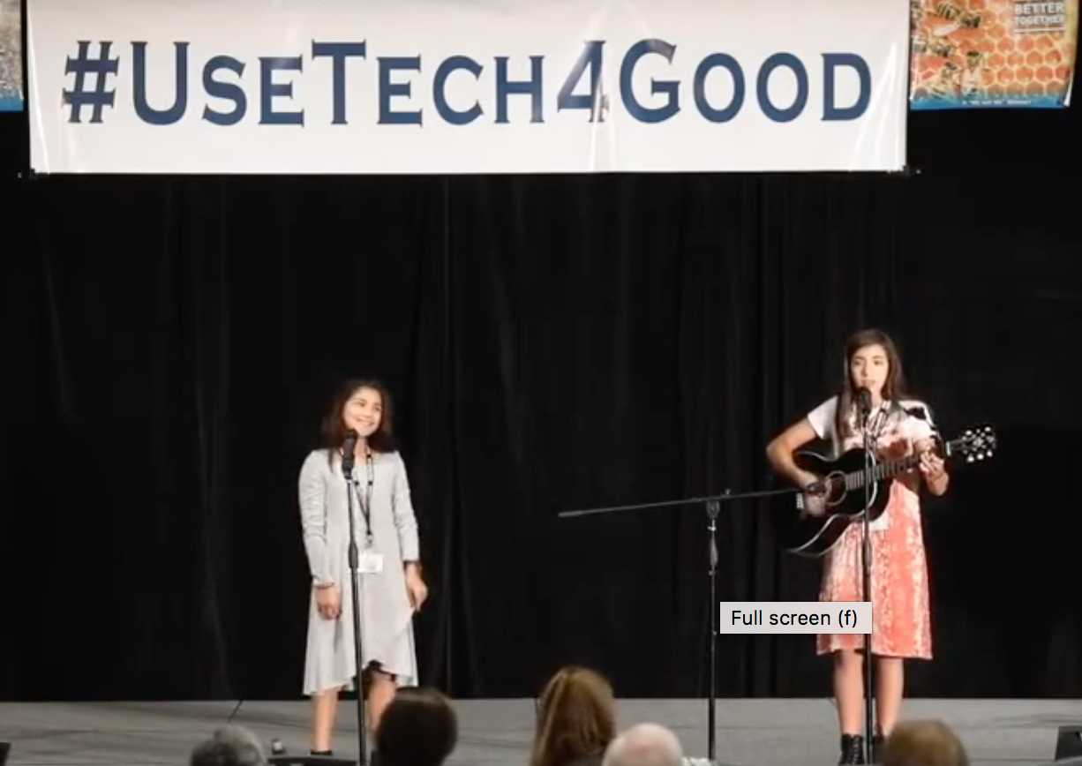
If your children use YouTube…

Slide 56
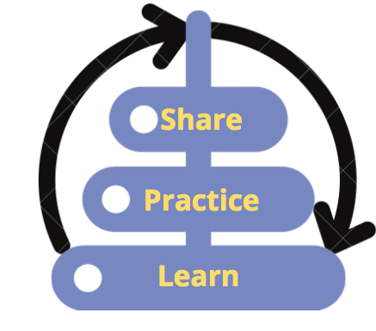
If your children use YouTube…
Make sure the device is in a public area and at least within your visual field and earshot.
Turn off autoplay [avoid rabbit holes and inane (or worse) content]
Put the video on full screen [prevents sidebar distractions & rabbit holes]
Alone as the parent, prepare the video by getting past the initial ad first.
  Watch/listen for intermediate ads, and ads at the end
Agree together with your child on how much time you/they will spend on the activity. [This can help model principles of time-boxing and single-tasking, which are powerful Digital Wellness principles.]
*Wherever possible, use technology *with* your child. This is good for both relationship-building and safety, and side-by-side learning with positive reinforcement can potentially be a protective factor for overall behavioral health, as per Social Development Strategy
Notes:
https://www.instagram.com/p/CU8JuQvBs-K/

Slide 57
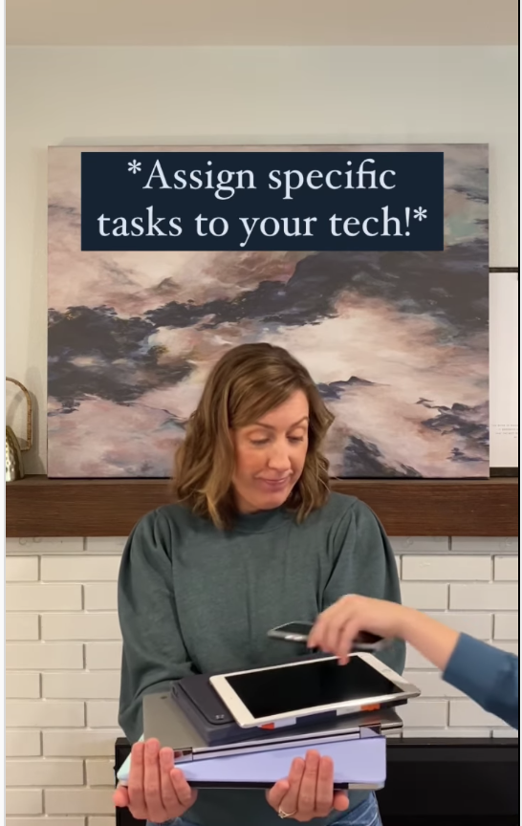
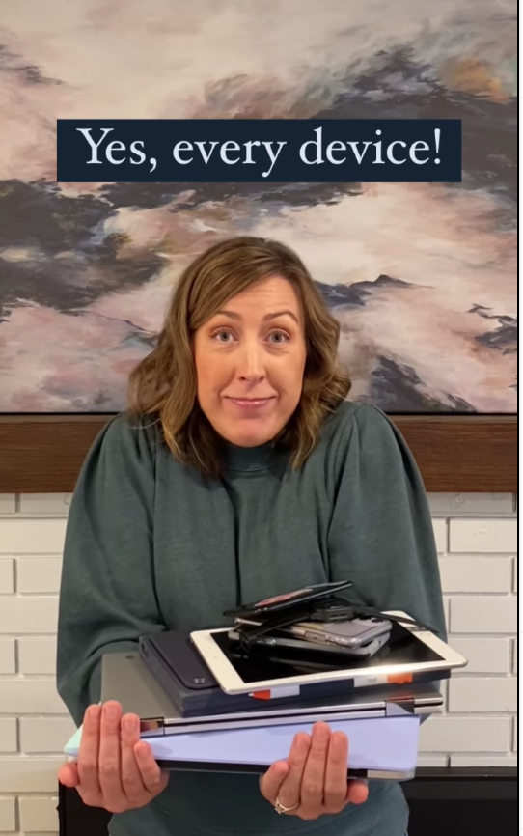
Family tech tip from Better Screen Time
https://www.instagram.com/p/CU8JuQvBs-K/ or @BetterScreenTime or https://www.instagram.com/betterscreentime/
Notes:
https://www.instagram.com/p/CU8JuQvBs-K/ @BetterScreenTime https://www.instagram.com/betterscreentime/

Slide 58
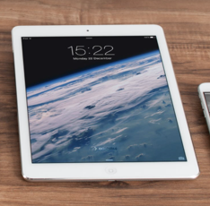
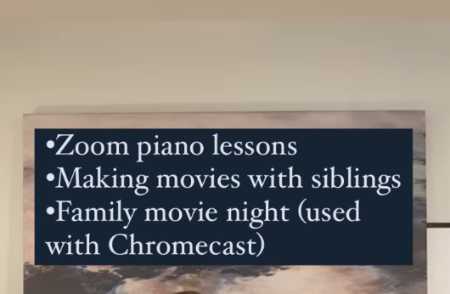
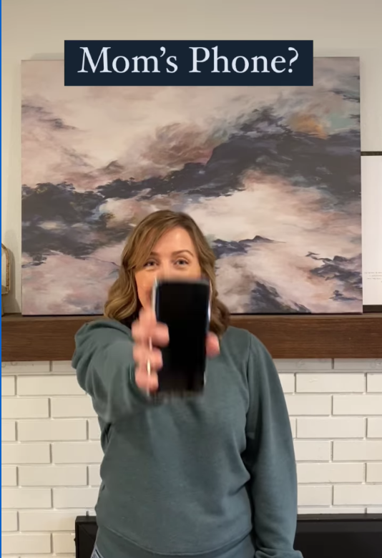
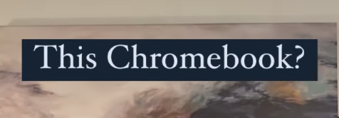
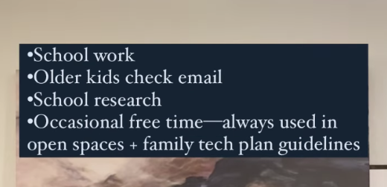
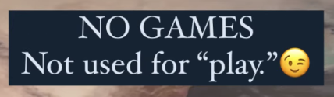

e.g., from Andrea Davis at Better Screen Time
https://www.instagram.com/p/CU8JuQvBs-K/
https://www.instagram.com/betterscreentime/
@BetterScreenTime
Notes:
https://www.betterscreentime.com/create-a-family-technology-plan-not-a-cell-phone-contract/ and quick guide is here:

Slide 59





from WiredHuman.org

Slide 60




Other resources
We know many parents are concerned about pornography so some resources below include that topic
DigCitUtah: https://digcitutah.com/resources-library/ [resources covering various facets of Digital Citizenship and Digital Safety]
Educate Empower Kids: https://educateempowerkids.org/
  Conversations with My Kids: 30 Essential Family Discussions for the Digital Age
  Petra’s Power to See
  Noah’s New Phone: A Story About Using Technology for Good
  Messages About Me: Sydney’s Story, A Girl’s Journey to Healthy Body Image
  Kids and Pornography: A Public Health Crisis
  30 Days to a Stronger Child
  30 Days of Sex Talks [different books for different ages]
  How to Talk to Your Kids About Pornography
Defend Young Minds: https://www.defendyoungminds.com/
Reach10 for young adults: https://reach10.org/
Others you use/like?

Slide 61
A second DWI survey on
Social Connectedness (relates to well-being)
https://survey.alchemer.com/s3/6226945/Digital-Flourishing-Survey-PositiveMediatedSocialInteractions
See also resources and research from the Relationships module
Notes:
https://survey.alchemer.com/s3/6226945/Digital-Flourishing-Survey-PositiveMediatedSocialInteractions

Slide 62

Social Connectedness Assessment from DWI
Allows for self-reflection about:
Connectedness
Civil participation
Positive online social comparison
Authentic online self-presentation
Self-control
Notes:
We didn't review the questions from this assessment in this week. We might dig into them a little more in the Digital Citizenship module, but for now, we do invite you to at least skim over the assessment. I neglected to mention in our gathering that this tool has been validated for anyone 12 and up.

Slide 63
A second DWI survey! Social Connectedness
https://survey.alchemer.com/s3/6226945/Digital-Flourishing-Survey-PositiveMediatedSocialInteractions
“Are you getting the most out of your online communication? Do you feel like the way you interact online is helping you flourish in your digital life? Are your online interactions meaningful?”
Measures the following:
  Connectedness
  Civil Participation [this will be revisited in the Digital Citizenship/Media Literacy discussion in two weeks]
  Positive Social Comparison
  Authentic Self-disclosure
  Self-control [this will be revisited in the Digital Citizenship/Media Literacy discussion in two weeks]

Slide 64

Well-being is tied to relationships…for your review
Notes:
You could also think about what relationships in your life in general (not just online) help you feel more connected, less lonely, supported, able to trust. As always, write any other questions that may come to mind that you would like to use for self-assessment. We know ourselves best and know what we want to work on and build awareness around.

