Slide 1
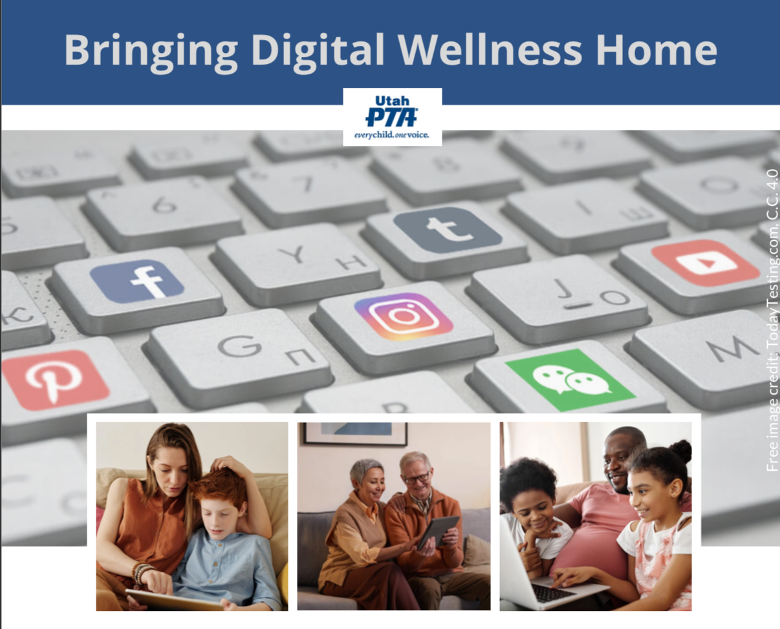
Note: All material in this series is for educational and informational purposes only, and is not meant to be exhaustive or used as a replacement for professional health support. Also, any sharing of resources doesn't imply full endorsement of all of that person or group's work. We share what we find helpful, but invite you to use your media literacy skills in all your study and research.
Notes:
Note: All material in this series is for educational and informational purposes only, and is not meant to be exhaustive or used as a replacement for professional health support. Also, the presentation is best viewed in slideshow format, as some of the slides are animated, but we have also included notes for many of the slides that you might want to review as well. Whatever works best for you!
NOTE: Portions of this work first appeared in or are derived or adapted from the Digital
Wellness Certificate Program. Those portions are Copyright © 2021, Digital Wellness Institute.

Slide 2
A couple of notes before you review this slide deck:
We recognize our registered audience for this Fall 2022 series includes people not from the United States. As mentioned in the recording, examples of "red" and "blue" are meant to be symbolic of *any* opposing entities or ideas that can fall into rigid division (even in personal relationships).
Also, discussions of democratic ideals are not meant for United States citizens alone; many countries use some form of a democratic republic. We would love to hear about resources that exist in your respective countries and spheres of influence that explore similar ideas of how people from diverse perspectives can work together.
Notes:
We engage with this question later – the idea here is to respond with the first thing that comes to mind. There is no wrong answer!

Slide 3
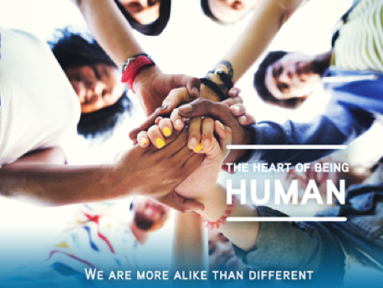
Response Question:
What's your favorite date?
(Write the first thing that comes to mind. There is no wrong answer!)
Notes:
We engage with this question later – the idea here is to respond with the first thing that comes to mind. There is no wrong answer!

Slide 4
What does it mean to you to be
"a good citizen"?
Week 9: Citizenship
Think & Write
Notes:
We've spent a lot of time during this series talking about putting on our own oxygen masks first, but ultimately, we hope our individual efforts toward Digital Wellness can mean we have more capacity to do some good in the world, to be influencers for good.

Slide 5
What does it mean to you to be
"a good citizen"?
Week 9: Citizenship
Think & Write
https://www.menti.com/alu2vcp1ocgw
Or enter code 8217 9233
Notes:
We've spent a lot of time during this series talking about putting on our own oxygen masks first, but ultimately, we hope our individual efforts toward Digital Wellness can mean we have more capacity to do some good in the world, to be influencers for good.

Slide 6
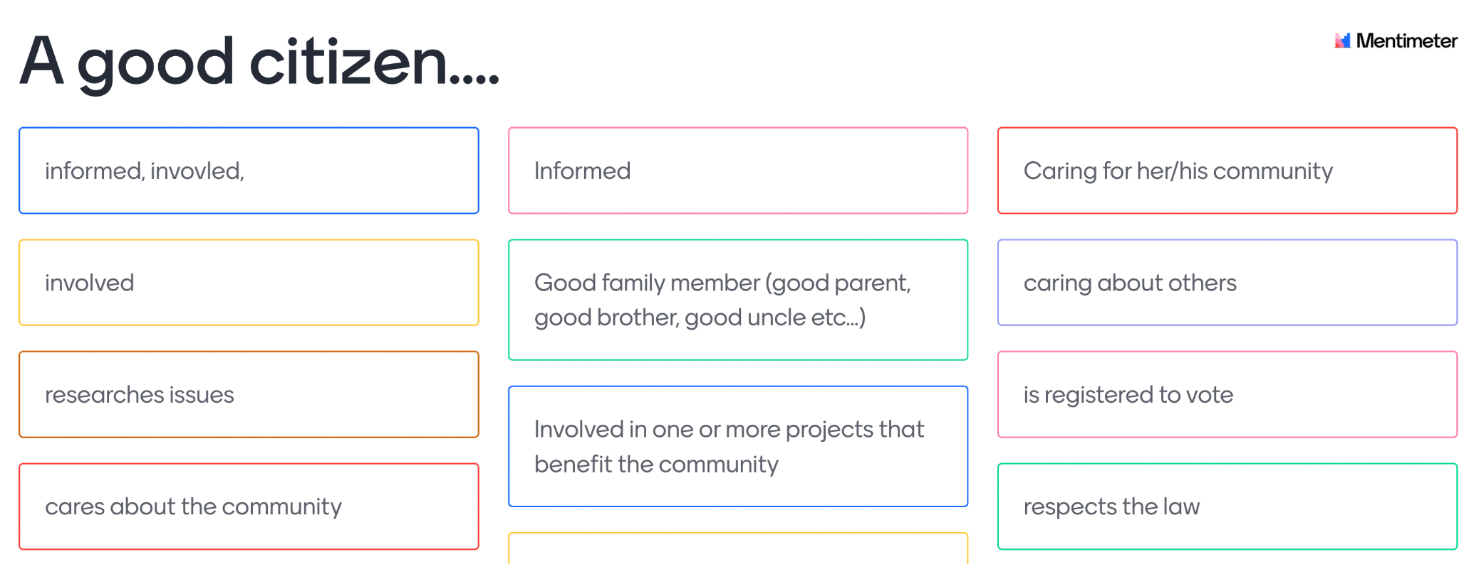
What does it mean to you to be
"a good citizen"? (responses)
Notes:
We've spent a lot of time during this series talking about putting on our own oxygen masks first, but ultimately, we hope our individual efforts toward Digital Wellness can mean we have more capacity to do some good in the world, to be influencers for good.

Slide 7
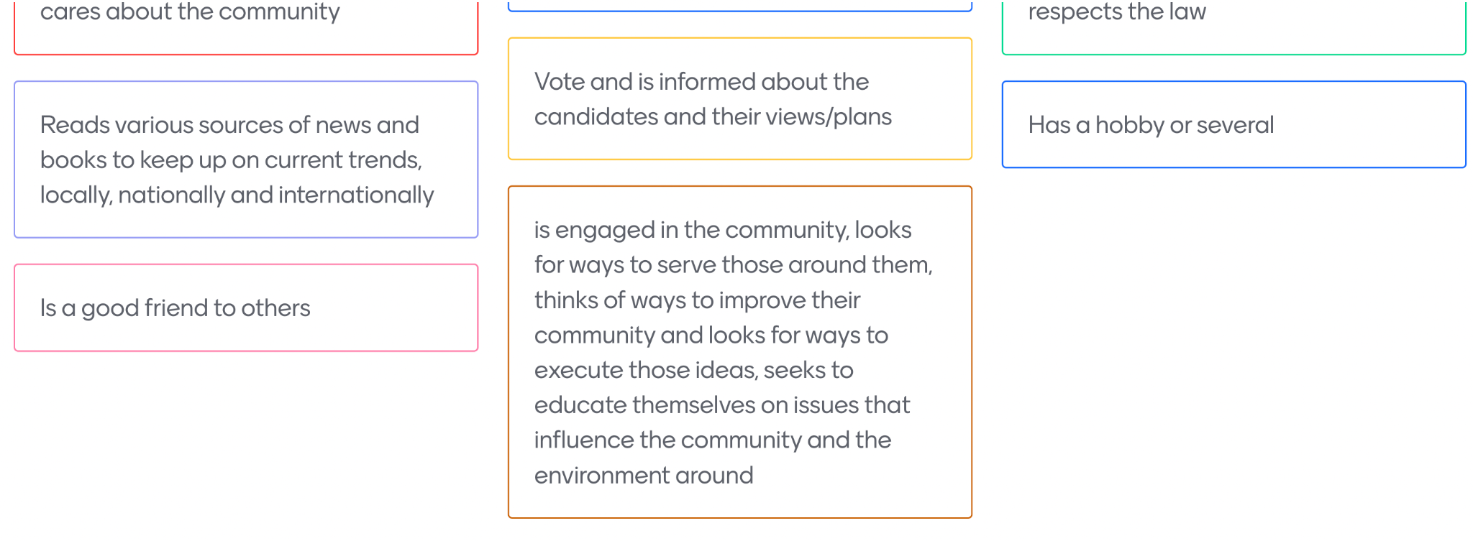
What does it mean to you to be
"a good citizen"? (responses)
Notes:
We've spent a lot of time during this series talking about putting on our own oxygen masks first, but ultimately, we hope our individual efforts toward Digital Wellness can mean we have more capacity to do some good in the world, to be influencers for good.

Slide 8
In your mind, what does "good citizenship" look like in the digital realm"?
Week 9: Citizenship
Reflection
Notes:
We've spent a lot of time during this series talking about putting on our own oxygen masks first, but ultimately, we hope our individual efforts toward Digital Wellness can mean we have more capacity to do some good in the world, to be influencers for good.

Slide 9
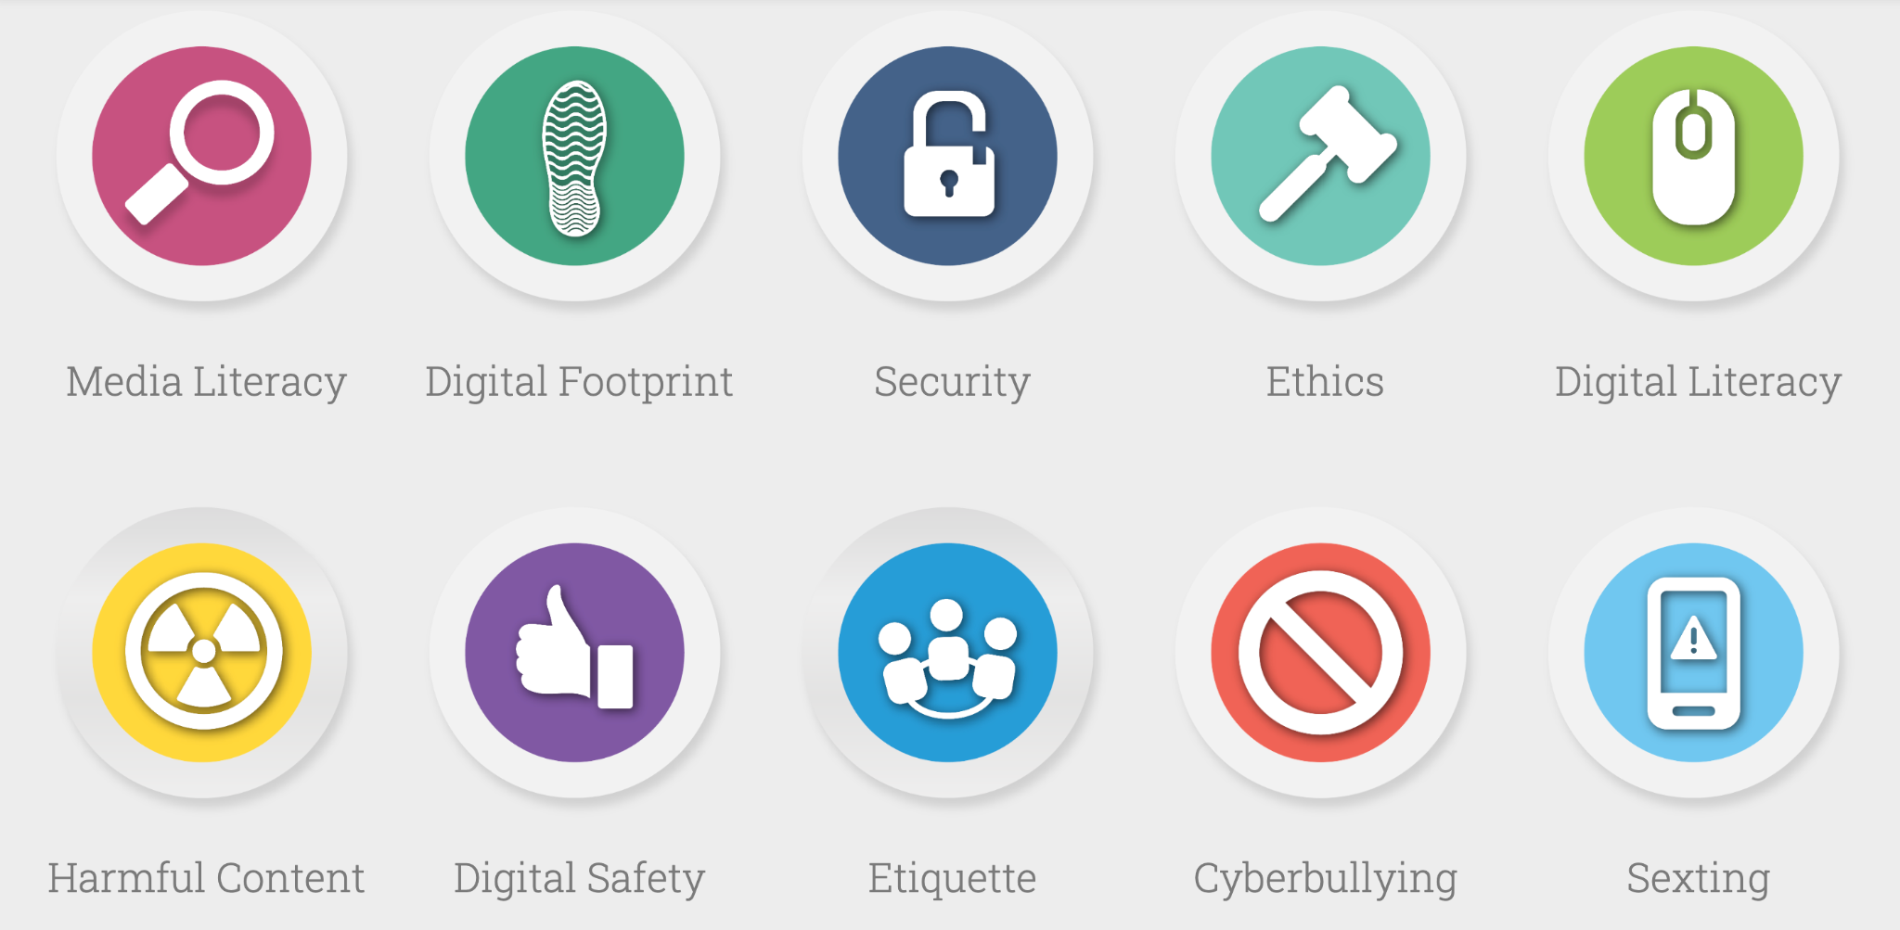
"Norms of appropriate, responsible, and healthy behavior related to technology use, including digital literacy, ethics, etiquette, and security."
- Utah's HB213 (2015)
https://digcitutah.com/ - -see more resources in the bonus section
Notes:
In 2015, Utah became the first state to have a Digital Citizenship bill, and it was used as a model for the first Media Literacy bill. In truth, the impact wasn't as high as was intended; even though HB213 created a mandate and opened up funding, it's not regularly and widely applied. But there is a website that represents curation of over 200 resources, a service that EPIK provided in cooperation with USOE to bring resources to schools and families. It's not exhaustive and is years old, but it does give an idea of the multifaceted nature of Digital Citizenship. We could have devoted a whole class to these topics, but decided, since the resources are available already for your perusal, that we would cover some different elements of Citizenship. As always, there is more to cover than we ever have time to cover. https://digcitutah.com/

Slide 10
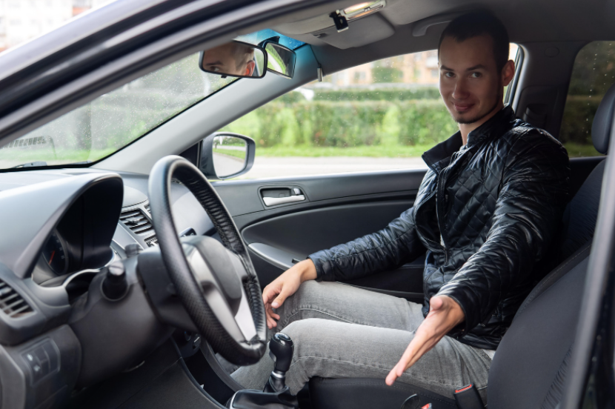
The Driver's Journey - Stephanie's story
Notes:
During the Winter 2022 PTA series, a participant, Stephanie, shared some insights about how her mom taught her to think about her responsibility to show up well in the world. She used the analogy of driving. This could be a way to explore with youth some of what Digital (or non-Digital) Citizenship might look and feel like

Slide 11
The Driver's Journey - from Stephanie
"My mom used to always remind me to think about driving. You are alone in a car, you don't really have to talk to anybody and you can behave a certain way as you are driving – to either be part of the larger group and contribute – or be kind of bossy or mean or pushy or cutting people off or not following rules, etc. And that was her way to show me how to behave in the right way.
"And now there's this whole other avenue of social networks where you can be passive-aggressive and you can behave certain ways and kind of show your true character in the ways you use social media [and engage in the public square]….
"You have to put a lot of trust in people that you are driving down the freeway with – that they're going to stay at a certain speed or they're not going to suddenly swerve over into the lane or they're going to follow the same type of rules, etc. When those things go awry or when they go haywire or they're not really behaving themselves, it can throw a lot of people off. So that's kind of the mentality I have with [all of this]: Hey, be a good driver."
**More thoughts in the bonus section
Notes:
This was my attempt at transcribing what Stephanie shared. See the link to this video to hear Stephanie's share
https://drive.google.com/file/d/1YKQrrlgXO6r4W52UKqXNW02E4g9X8dZq/view?usp=sharing

Slide 12
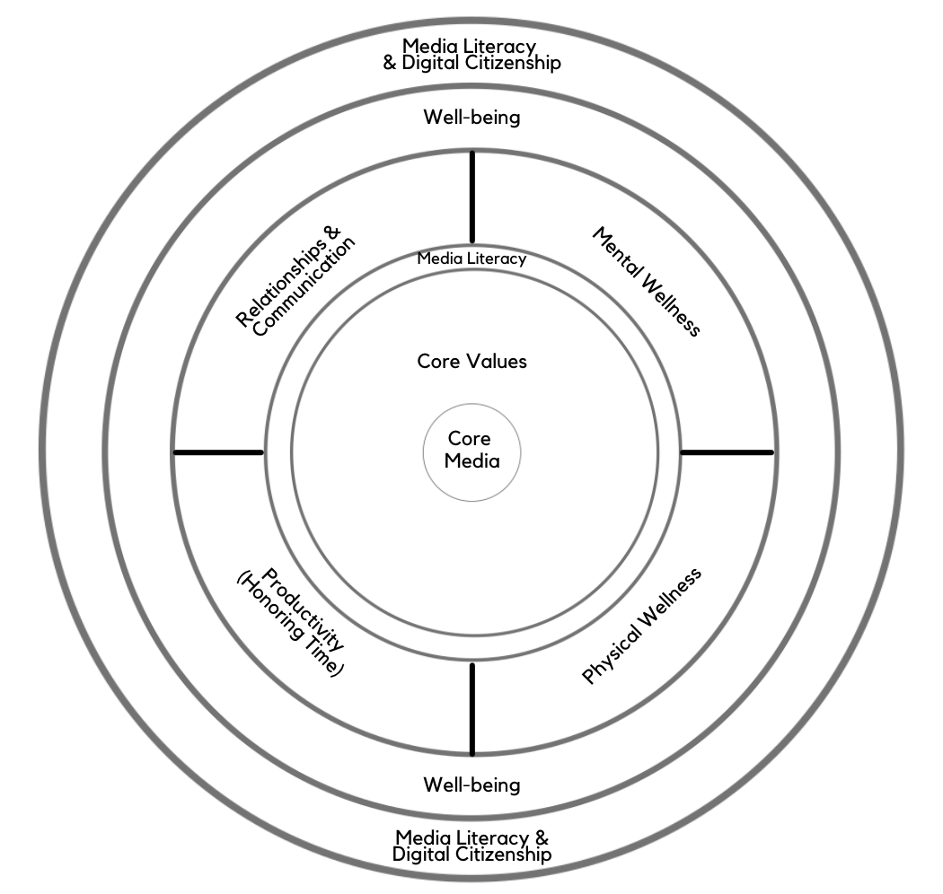
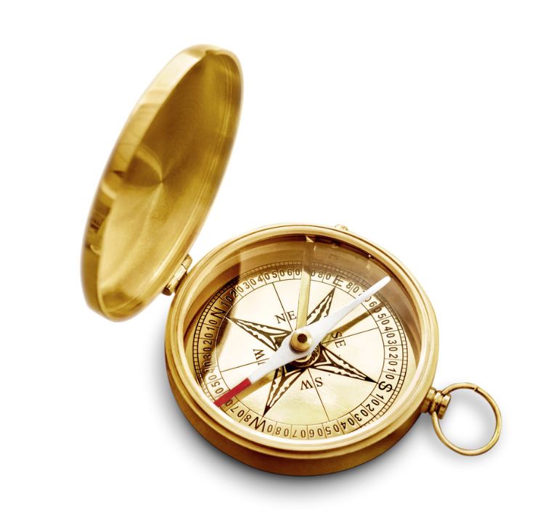





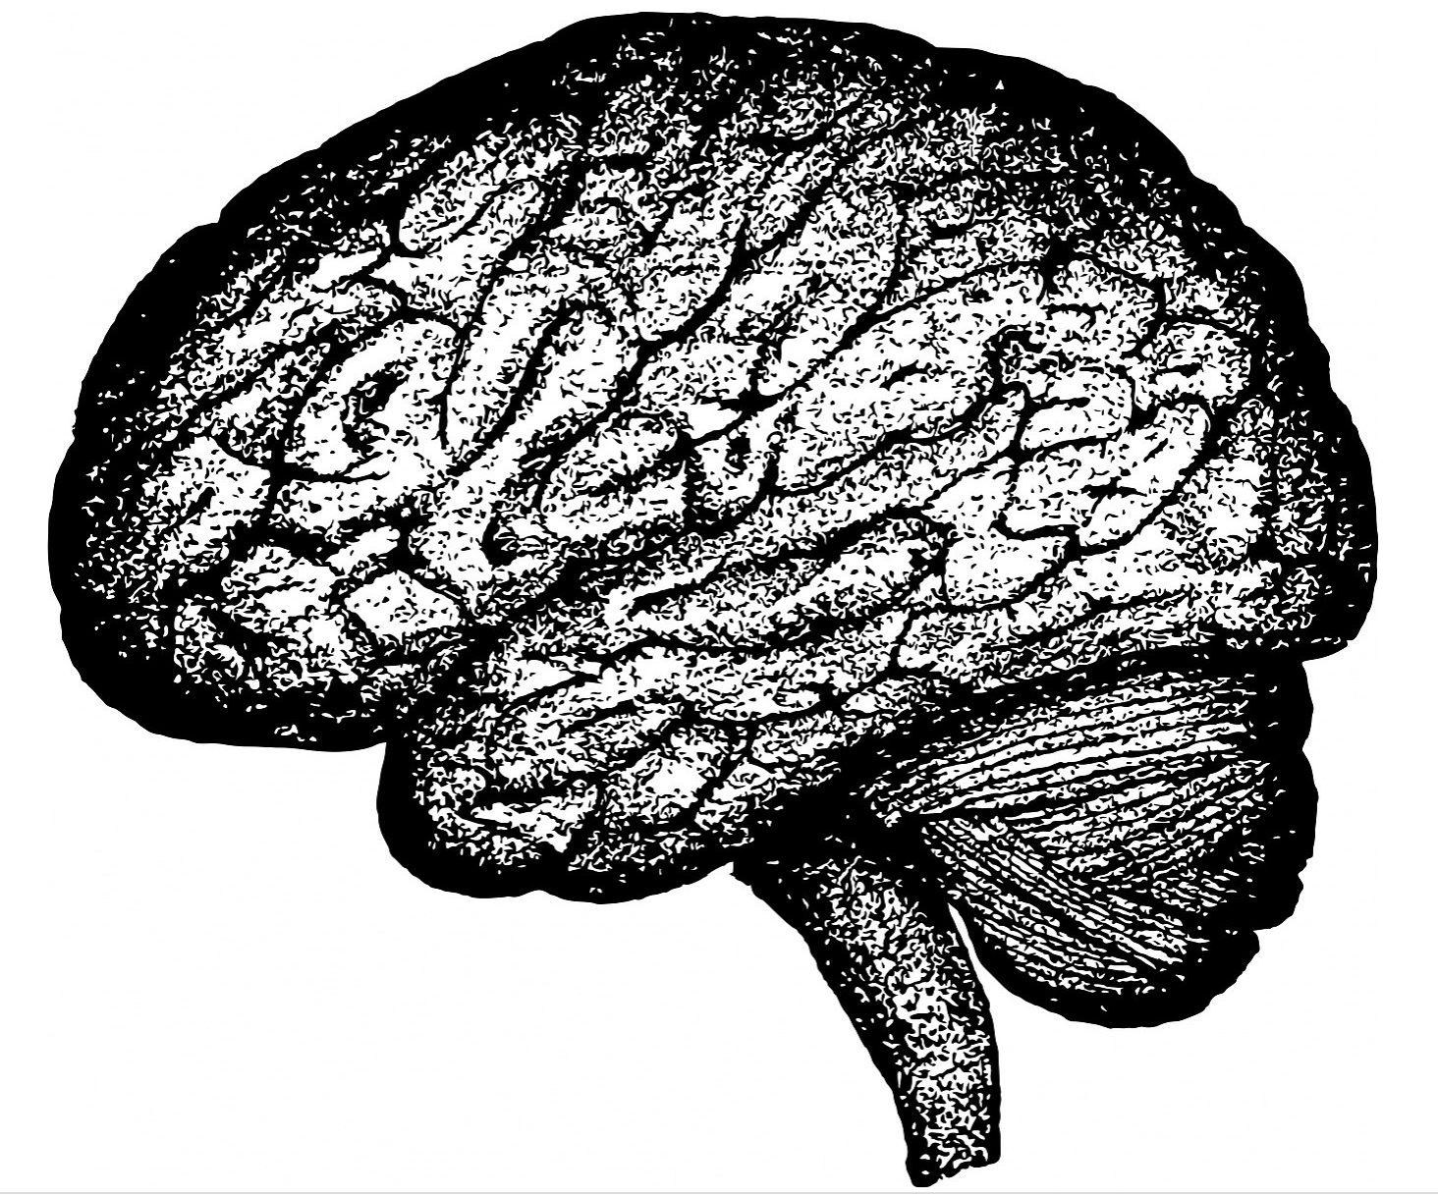
Week 9: Citizenship
Note: EPIK’s Digital Centeredness model is adapted from the Digital Wellness Institute’s six-pronged model that aligns with DWI’s original survey
Notes:
We've spent a lot of time during this series talking about putting on our own oxygen masks first, but ultimately, we hope our individual efforts toward multifaceted Digital Wellness can mean we can have more capacity to do some good in the world, to be influencers for good.

Slide 13
Week 9: Citizenship
"If we collapse politics and civics together…
then we ensure
that politics squeezes out community."
Notes:
This quote comes from Senator Ben Sasse's book, Them. I had no idea who he was or what the book was about; I read it because my daughter-in-law was reading it. But what I discovered were some important insights about how politics and the divisiveness we are experiencing can threaten the stability of our nation and our need as humans for connection and community. Much of civic engagement is about service and relationships, not just politics. Today we will cover some tips for more centered political engagement, and we will conclude by sharing some resources that could help you with community involvement around civic and digital wellness, and we'll also brainstorm together some ideas for community building.

Slide 14
Week 9: Citizenship
Part 1:
Practice Wisdom
for Better Politics

Slide 15
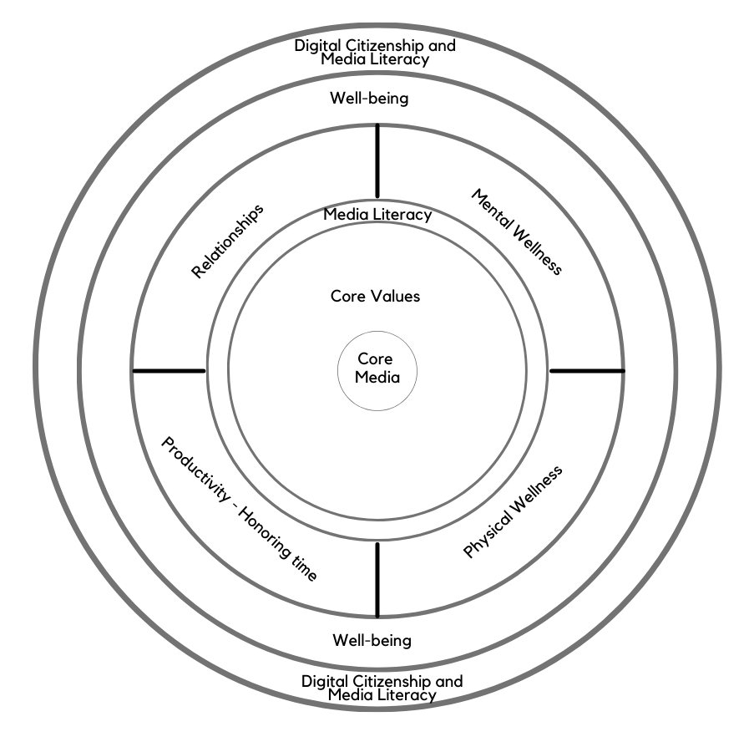
Tip #1: Practice Wisdom/Wise Reasoning
The pursuit of virtue (e.g., pursuing personal ideals and contributing to other people)
A focus on the big picture meaning
Intellectual humility
Adaptive emotion regulation (more reappraisal and less maladaptive thought suppression)
Flexible navigation of uncertainties
Appreciation of the complexity of emotional experiences
Ability to self-distance [consider others' situations]
Compromise
Forgiveness
Self-transcendence
Notes:
During the course of our last run of this series, we discovered research around practicing wisdom or wise reasoning. Some researchers talk about wisdom as being a set set of traits; others talk about wisdom as something one can develop.
Above are some of the concepts that appear in this genre of research, organized here in this list to explore how they relate to the Digital Centeredness model. There are other characteristics that are explored in the research that we did not include here. But, to touch on the bullet list above:
Pursuit of virtue connects to the "start with your center" concept. A big-picture focus and intellectual humility can be fostered through practicing Media Literacy. The next three bullets obviously relate to Mental Wellness (and also Physical and Relational). Navigating uncertainties can also relate to Honoring Time. Media Literacy is a skill that can help us practice considering others' points of view; the pause and Media Literacy questions (or questions we have asked ourselves throughout this series) are questions we can ask when considering the content that others create, or the positions they take. What is *their* center? What experiences have influenced how they view the world, how they choose to show up in the world? Compromise and forgiveness are obviously relational concepts, and can also apply in community and civic settings. And self-transcendence is something that can come the healthier we are.
I didn't include quotes in the slide above for visual simplicity, but you can find these concepts explore in various articles, such as: https://www.researchgate.net/publication/301821371_Wise_Reasoning_in_the_Face_of_Everyday_Life_Challenges (see literature review paragraphs)
https://journals.sagepub.com/doi/10.1177/0956797617722621

Slide 16
Week 9: Citizenship
Part 2:
Practice the Pause
for Better Politics
Notes:
We've talked all through the series about "practicing the pause." Here we are again, with a couple more specific thing we can pause and watch out for ("point and name") – dynamics that can get in the way of healthy relationships and healthy politics.

Slide 17


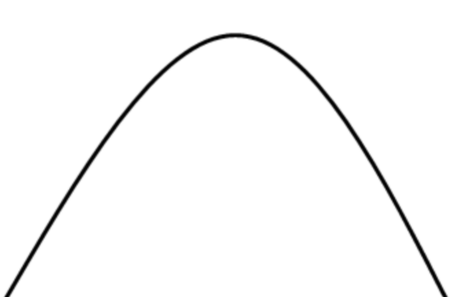

!!!
Tip #2:
Pause and
"point and name"
false dichotomy
!!!
Notes:
But then when we had the high-emotion elements of politics? That's a lot of stimuli that can potentially impact us.

Slide 18
Culture of Democracy=
"Dancing in the tensions"
Notes:
This week's topic also gives us a chance to explore a wellness concept that I like to call "dancing in the tensions." The DWI self-assessment section that we explore also reinforces this notion that there aren't any easy answers when it comes to navigating life in a digital world, so we have the opportunity to be observant, aware, curious as we navigate what wellness looks and feels like for each one of us. The wellness journey is very personal – there is no formula, no one-size-fits-all approach that will work.

Slide 19
Culture of Democracy=
"Dancing in the tensions"
"Many…tensions, even paradoxes, are present in every democratic society."
https://web-archive-2017.ait.org.tw/infousa/zhtw/DOCS/whatsdem/whatdm6.htm
Notes:
See this multi-essay exploration of democracy, formerly on the U.S. Department of State's Bureau of International Information Programs website, now archived here: https://web-archive-2017.ait.org.tw/infousa/zhtw/DOCS/whatsdem/whatdm6.htm

Slide 20
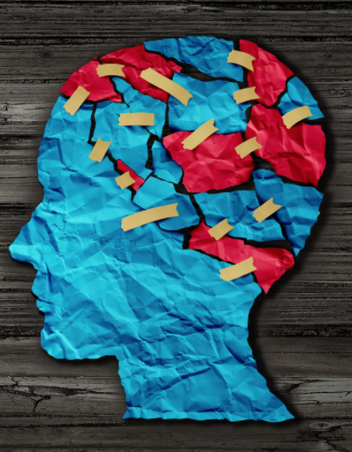
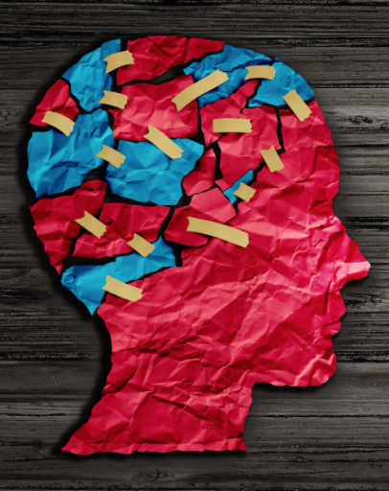
Issues (and people) are complex

Slide 21
Media Literacy for Political and Civic Wellness
“Media [messages] are constructed [and] have embedded values and points of view.”
“Different people experience
the same media message [or issue!] differently.”
Center for Media Literacy
https://www.medialit.org/reading-room/five-key-questions-form-foundation-media-inquiry
…or even the same words (see next slide)
Notes:
See also https://www.medialit.org/sites/default/files/14B_CCKQPoster+5essays.pdf

Slide 22
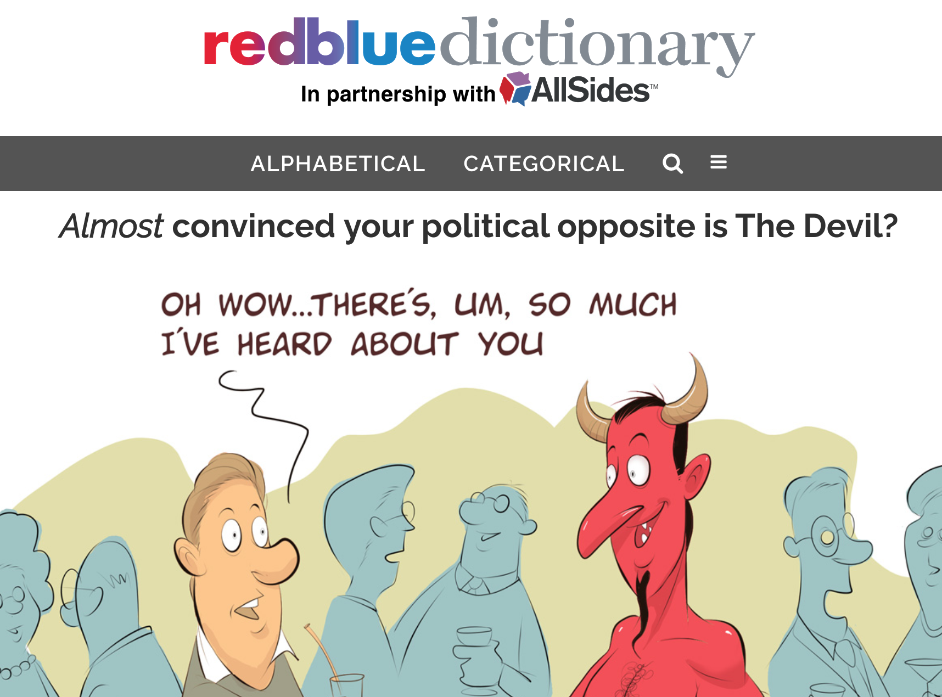
https://redbluedictionary.org/
Notes:
https://redbluedictionary.org/ - Throughout this series, we've tried to reiterate the idea that different language will resonate differently with different people. So we have tried to use a variety of words and concepts to explore various elements of Digital Wellness. This project helps explore how people on different ends of the political spectrum may perceive even a single concept or word in different ways, sometimes quite strikingly so. It's so easy to assume that our lens is the only lens, or that others see through a similar lens. Even outside of the political realm, this is not true. Humans are complex, and that is part of the beauty of being human. But within the political realm, it can be particularly difficult to remember this…and all the more important to do so, since emotions so often run very high.

Slide 23
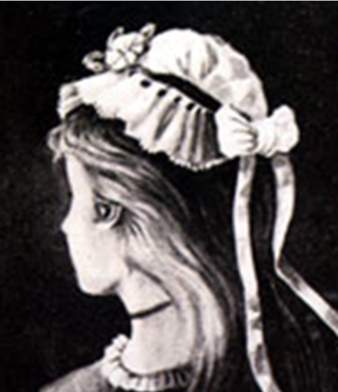
Whom do you see in this postcard?
Notes:
In the public domain. https://en.wikipedia.org/wiki/My_Wife_and_My_Mother-in-Law
I also ran across some recent research that a person's age may influence which woman they see first (our own experiences or biases can influence how we see media messages). This did not play out in our group, however! https://www.ncbi.nlm.nih.gov/pmc/articles/PMC6107502/

Slide 24
Let's go back to the first question:
What's your favorite date?
What did you write?
Notes:
We engage with this question later – the idea here is to respond with the first thing that comes to mind. There is no wrong answer!

Slide 25
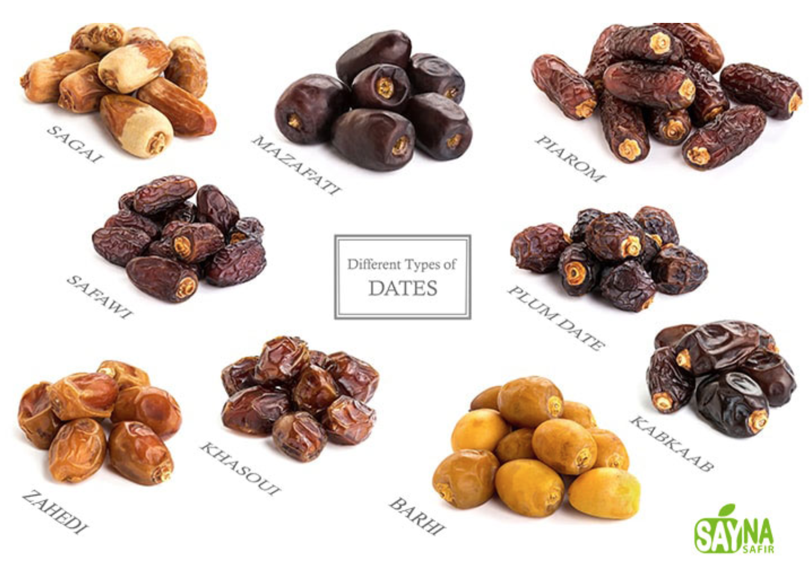
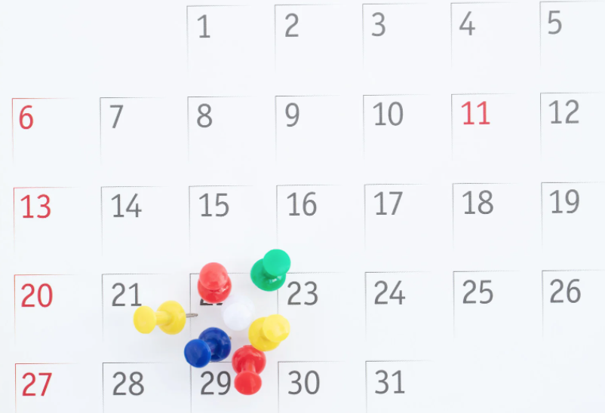

Notes:
Going back to the question we started with today, even when there is no emotional charge per se, our brains can also perceive words or ideas or concepts differently simply depending on what context is freshest in our minds. Imagine how responses might have differed if I had shown only one of these images. Or shown them all while asking the question.
image from https://saynasafir.com/what-are-the-different-types-of-dates/

Slide 26
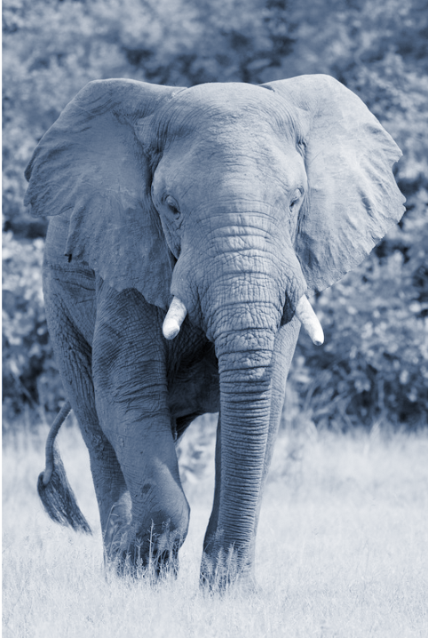
Notes:
We covered four of the six experiences mentioned in the original poem (a poem that captures an old fable from India). Here I've added images for the other two parts of the elephant mentioned in the poem. https://www.commonlit.org/en/texts/the-blind-men-and-the-elephant

Slide 27
These different people…
Disputed loud and long,
Each in his own opinion
Exceeding stiff and strong,
…each was partly in the right,
And all were in the wrong!
Notes:
John Godfrey Saxe, The Poems of John Godfrey Saxe (Boston: James R. Osgood, 1873), 135–36, books.google.com.
available online in places like https://www.commonlit.org/en/texts/the-blind-men-and-the-elephant

Slide 28
"In a democracy, government is only one element coexisting in a social fabric of many and varied institutions, political parties, organizations, and associations."
Note: When we look at things like false dichotomy or Karpman's Drama Triangle, it's not just the government or political parties that can fall prey to such tactics. We all can practice awareness so that we bring the best of ourselves and our energy to the political process. Also, the following slides use red and blue as symbols of the political divides in the United States, but the principles explored could be relevant to any divided issue.
Notes:
https://web-archive-2017.ait.org.tw/infousa/zhtw/DOCS/whatsdem/whatdm2.htm

Slide 29
!!!
!!!
No one has the corner on truth on any political or social issue
Notes:
But then when we had the high-emotion elements of politics? That's a lot of stimuli that can potentially impact us.

Slide 30
!!!
And we violate the core of what free speech is about when we insist otherwise
!!!
Notes:
But then when we had the high-emotion elements of politics? That's a lot of stimuli that can potentially impact us.

Slide 31
What's freedom of speech about?
"Civilized [people] must cherish liberty—as a means of promoting the discovery of truth. So we must not fix our whole attention on the right of anyone to [use media to say what they will]. These rights are incidental; and though they must be preserved, they can be preserved only by regarding them as incidental, as auxiliary to the substance of liberty that must be cherished and cultivated."
"[Free speech] is not the end, but a means to an end. The end is to find the truth."
p.s. I mispronounced auxiliary: /ôɡˈzilyərē,ôɡˈzil(ə)rē/
Notes:
http://www.math.byu.edu/~jarvis/Lippmann.pdf
See also: https://web-archive-2017.ait.org.tw/infousa/zhtw/DOCS/whatsdem/whatdm3.htm

Slide 32
!!!
“[In today's world we experience the] proliferation of “If you’re this then you’re automatically that” and “You’re either with us or you’re against us” politics. These are emotional lines that we hear invoked by everyone from elected officials and lobbyists to movie heroes and villains on a regular basis. …
“Normally, we used forced choice and false dichotomies during times of significant emotional stress. Our intentions may not be to manipulate, but to force the point that we’re in a situation where neutrality is dangerous….
“The problem is that these emotional pleas are often not based in facts….We need to question how the sides are defined. Are these really the only options? Is this the accurate framing for this debate or is this [a false dichotomy]?
“If alternatives exist outside of these forced choices (and they almost always do), then the statements are factually wrong….
The ability to think past either/or situations is the foundation of critical thinking, but still, it requires courage. Getting curious and asking questions happens outside our ideological bunkers. It feels easier and safer to pick a side. The argument is set up in a way that there’s only one real option. If we stay quiet we’re automatically demonized as “the other.”
“The only true option is to refuse to accept the terms of the argument by challenging the framing of the debate…[The] argument is set up to silence dissent and draw lines in the sand that squelch debate, discussion, and questions — the very processes that we know lead to effective problem solving.”
Brené Brown, Braving the Wilderness
!!!
Notes:
But then when we had the high-emotion elements of politics? That's a lot of stimuli that can potentially impact us.

Slide 33
So let's keep
talking, listening, researching, debating...
Notes:
This week's topic also gives us a chance to explore a wellness concept that I like to call "dancing in the tensions." The DWI self-assessment section that we explore also reinforces this notion that there aren't any easy answers when it comes to navigating life in a digital world, so we have the opportunity to be observant, aware, curious as we navigate what wellness looks and feels like for each one of us. The wellness journey is very personal – there is no formula, no one-size-fits-all approach that will work.

Slide 34
…so individually and collectively we can find closer approximations to truth
Notes:
This week's topic also gives us a chance to explore a wellness concept that I like to call "dancing in the tensions." The DWI self-assessment section that we explore also reinforces this notion that there aren't any easy answers when it comes to navigating life in a digital world, so we have the opportunity to be observant, aware, curious as we navigate what wellness looks and feels like for each one of us. The wellness journey is very personal – there is no formula, no one-size-fits-all approach that will work.

Slide 35
Some resources for civil dialogue
Notes:
This week's topic also gives us a chance to explore a wellness concept that I like to call "dancing in the tensions." The DWI self-assessment section that we explore also reinforces this notion that there aren't any easy answers when it comes to navigating life in a digital world, so we have the opportunity to be observant, aware, curious as we navigate what wellness looks and feels like for each one of us. The wellness journey is very personal – there is no formula, no one-size-fits-all approach that will work.

Slide 36

KNOWLEDGE
1. Understanding every human has the right of conscience
2. Feeling a responsibility to protect that right in others
3. Respecting the human dignity of others and their freedom to disagree.
SKILLS
1. Listening to hear and to understand
2. Sitting in discomfort
3. Oral communication skills, such as using sentence frames
ATTITUDE
1. Being curious, which means we desire to learn and understand
2. Overcoming defensiveness
MOTIVATION
1. We are feeling pain and we want the pain to stop
2. We want to collaborate to make our world a better place
These materials were shared with permission from Utah3Rs.org
Notes:
These materials were shared with permission from Utah3Rs.org and can be found in this week's Google Drive folder.

Slide 37
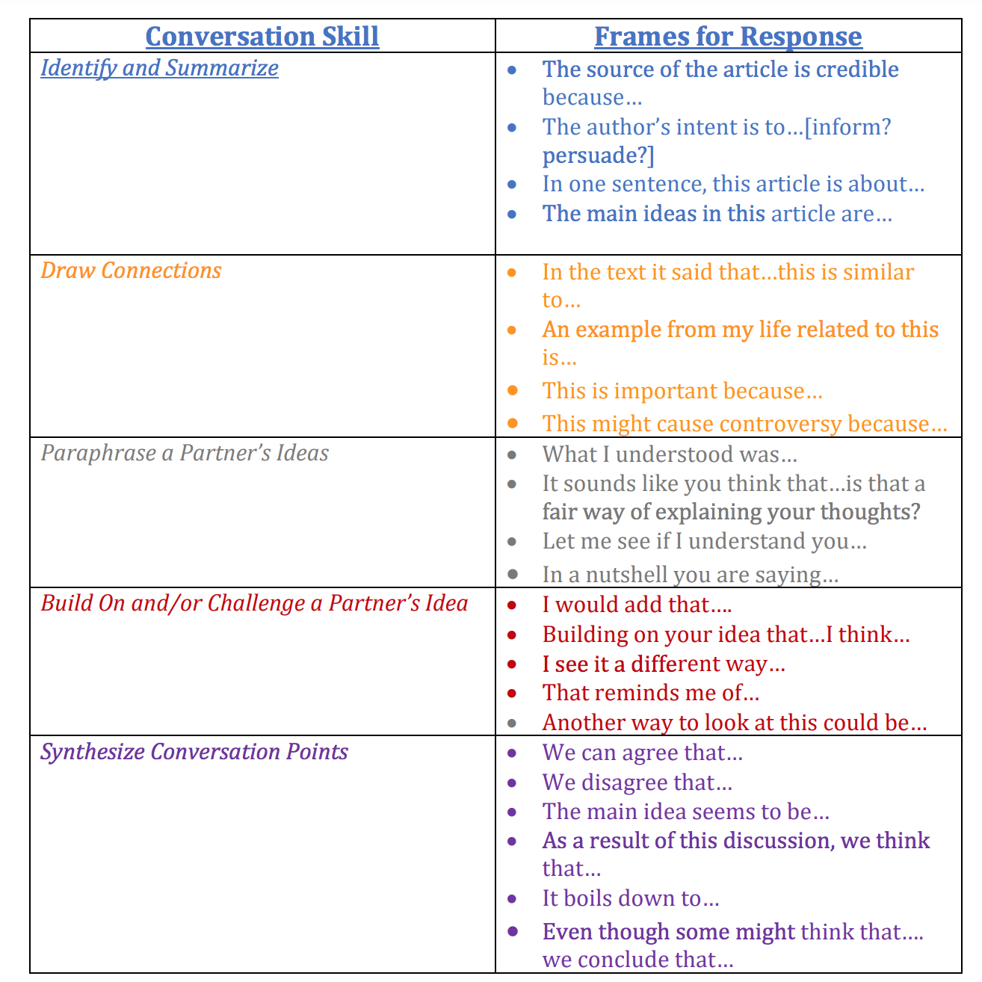

These materials were shared with permission from Utah3Rs.org
Notes:
These materials were shared with permission from Utah3Rs.org and can be found in this week's Google Drive folder.
. These are phrases that can be used to de-fuse conflict where there are different points of view being explored and expressed, language that we can use to both hear others and show up for our own points of view without shutting someone else down.

Slide 38
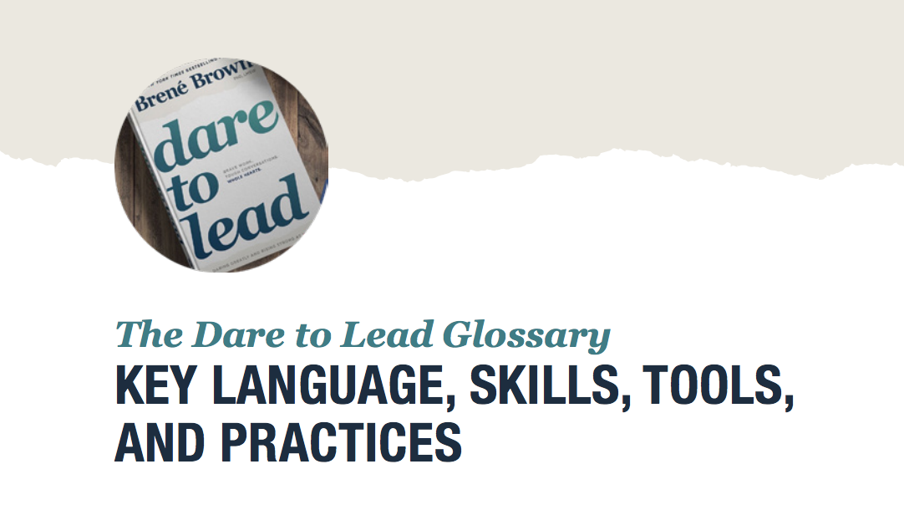
https://daretolead.brenebrown.com/wp-content/uploads/2018/10/Glossary-of-Key-Language-Skills-and-Tools-from-DTL.pdf
Great resources from Brené Brown on creating a culture in your sphere of influence around respect, dignity, care – and healthy, honest communication.
Notes:
There is a reason I am sharing these quotes again this week. These are not just touchy-feely quotes…research supports them! See next slide….

Slide 39
https://redbluedictionary.org/
Notes:
https://redbluedictionary.org/ - (or see https://www.allsides.com/translator) Throughout this series, we've tried to reiterate the idea that different language will resonate differently with different people. So we have tried to use a variety of words and concepts to explore various elements of Digital Wellness. This project helps explore how people on different ends of the political spectrum may perceive even a single concept or word in different ways, sometimes quite strikingly so. It's so easy to assume that our lens is the only lens, or that others see through a similar lens. Even outside of the political realm, this is not true. Humans are complex, and that is part of the beauty of being human. But within the political realm, it can be particularly difficult to remember this…and all the more important to do so, since emotions so often run very high.

Slide 40
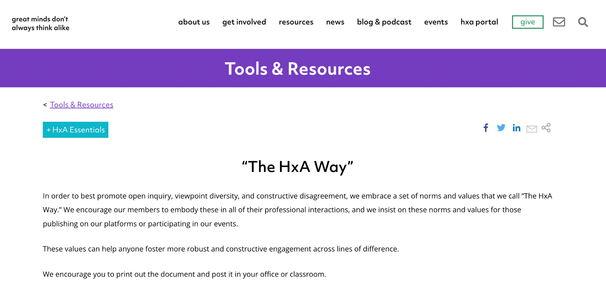
"Great Minds Don't Always Think Alike" - The Heterodox Academy
Five simple values for civil engagement are available in multiple languages
https://heterodoxacademy.org/library/the-hxa-way/
https://heterodoxacademy.org/library/the-hxa-way/

Slide 41
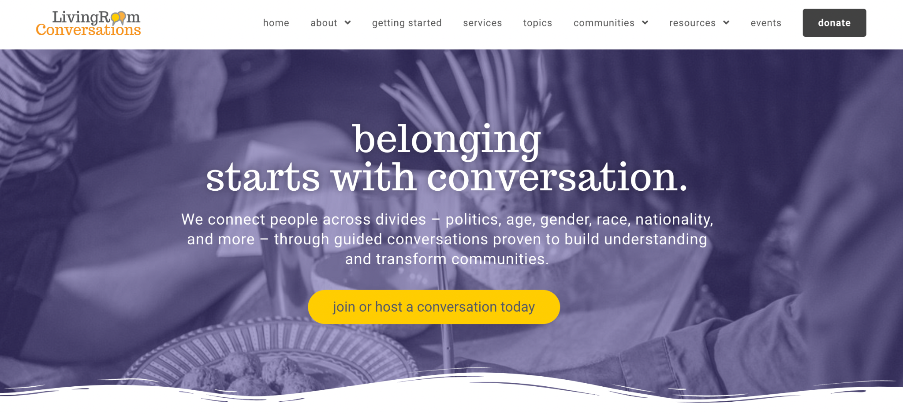
Living Room Conversations
https://livingroomconversations.org/

Slide 42
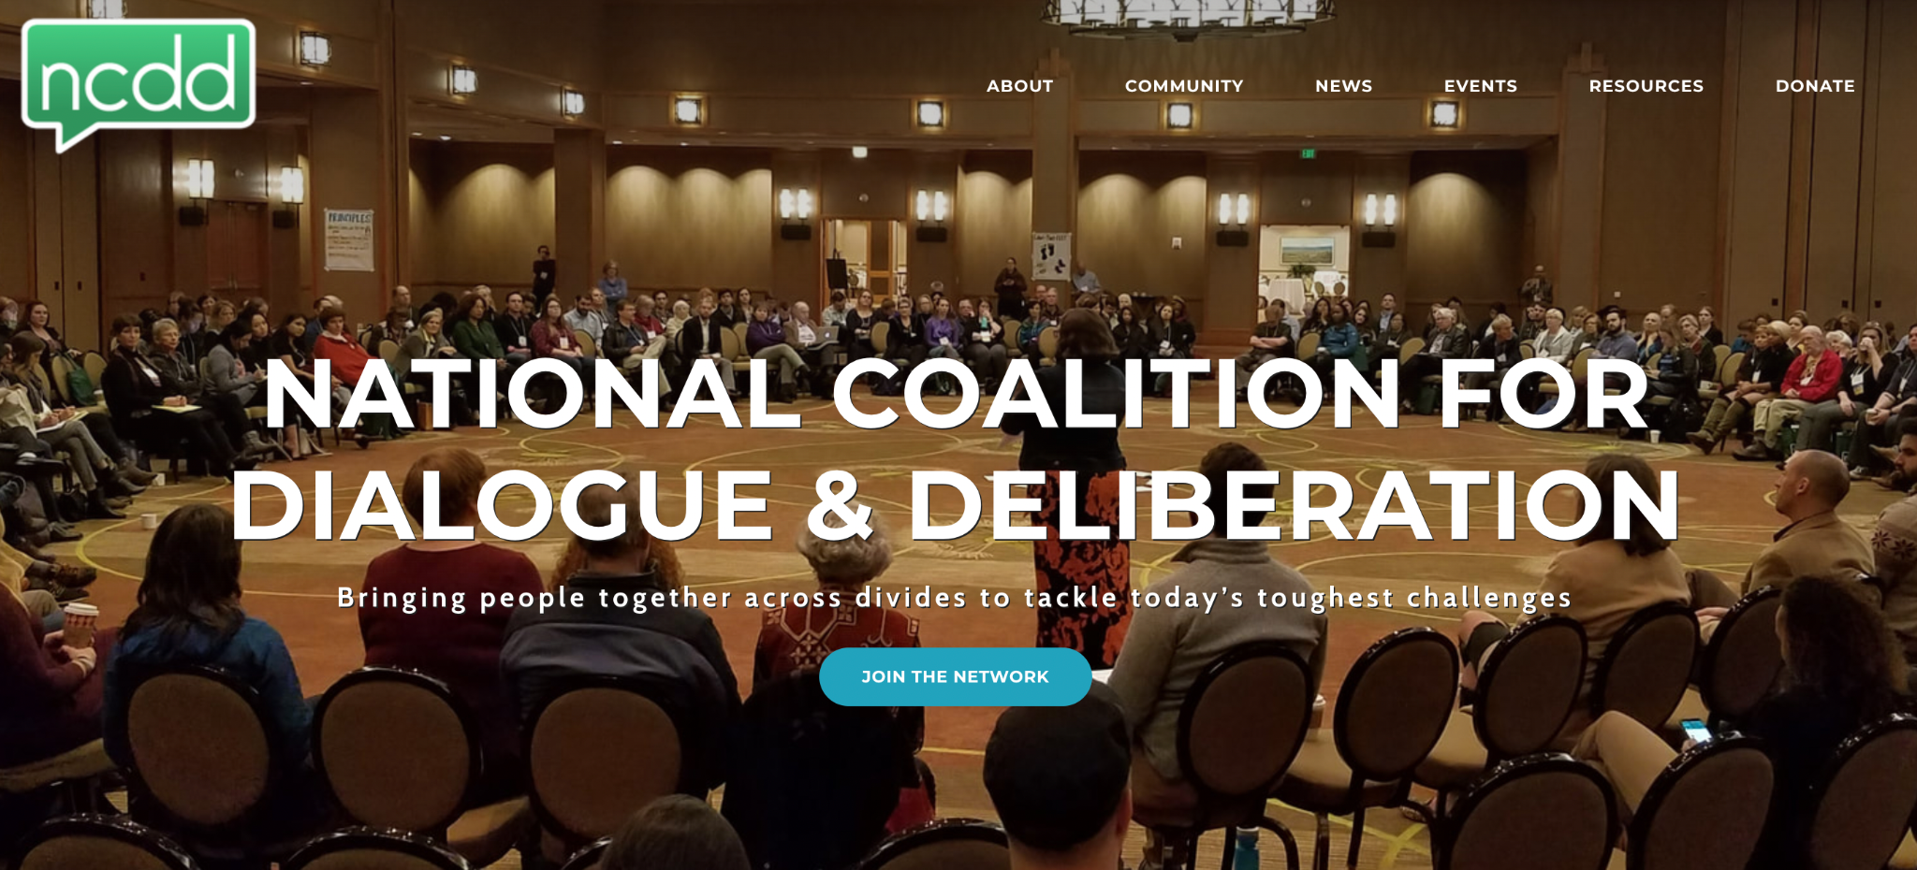
National Coalition for Dialogue and Deliberation
https://www.ncdd.org/

Slide 43
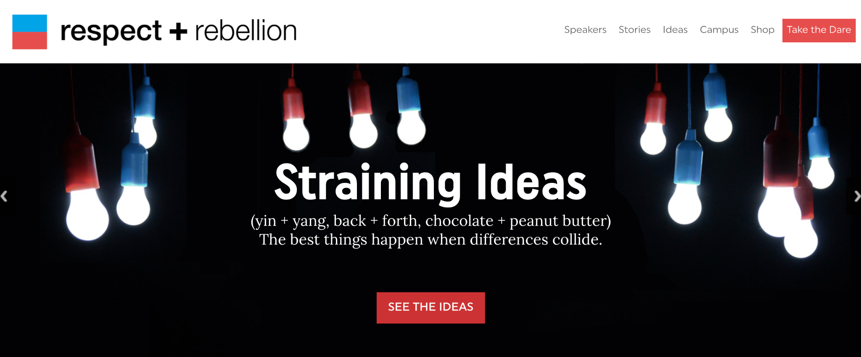
Respect + Rebellion – modeling discussions between people with divergent perspectives: https://www.ncdd.org/

Slide 44
Do you know of other resources?
Please let us know!
Notes:
This week's topic also gives us a chance to explore a wellness concept that I like to call "dancing in the tensions." The DWI self-assessment section that we explore also reinforces this notion that there aren't any easy answers when it comes to navigating life in a digital world, so we have the opportunity to be observant, aware, curious as we navigate what wellness looks and feels like for each one of us. The wellness journey is very personal – there is no formula, no one-size-fits-all approach that will work.

Slide 45
!!!
Tip #3:
Pause and
"point and name"
The Drama Triangle
!!!
Notes:
But then when we had the high-emotion elements of politics? That's a lot of stimuli that can potentially impact us.

Slide 46
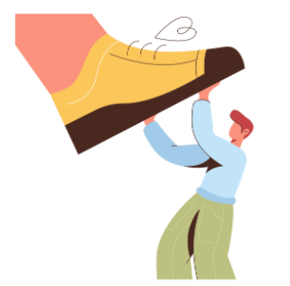

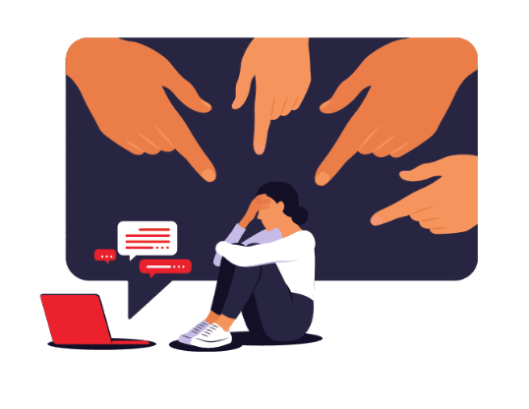
persecutor
rescuer
victim
Notes:
In the drama triangle, there are two "one-up" positions, and one "one-down." These roles can be played by individuals, within one's self, within institutions or dynamics in any system. They can represent actions one takes as well. I hope the following examples can help illustrate how the drama triangle can play out. There are so many different examples we could have used here. What examples come to mind for you?

Slide 47
persecutor:
my oldest
rescuer:
Mom or Dad
victim: my youngest
Notes:
When I was a young mother, I sometimes got caught in the drama triangle with my children, and this portrays an example of how that could happen. (We as a family are still working on being aware of when these kinds of dynamics happen. It can sneak up so quickly and easily! Again, it's a very common dynamic with humans.)
My children are three years apart, and with three children, triangles could easily form. (I have a little motto that I'm trying to reduce the geometry in my life.) It couldn't have been easy to be the youngest, and there were times her older brother was unkind, but when my daughter would come and "tattle" on her brother, I easily slipped into "Momma Bear" mode…an example of where empathy can run amuck. I felt her pain, I immediately wanted to protect her and show up for her (and I wasn't comfortable with what was happening, so rescuing also can be a selfish act, to try to stop the discomfort created by the situation). As a result, I would too often step in too hastily, which means I would skip the part about asking my son for his perspective and would go right to scolding him to appease his sister's emotion. It was a quick-fix solution to swoop in and try to rescue my daughter before getting more information. This did not help her build her own conflict management skills, and this naturally led to another drama triangle dynamic, happening almost in tandem. (see next slide).

Slide 48
persecutor:
Mom/Dad,my youngest
rescuer:
my
middle child
victim: my oldest
Notes:
My son would feel picked on, not heard, and believed that how we as parents responded was unfair (he wasn't wrong). He would also feel frustrated at his sister for the pattern of tattling, and sometimes he would go to his other sister for sympathy and support. But she was just a little girl herself – what could she really do? There was no problem-solving happening here [over time we started to figure out the patterns and we got better at it]
Like most rescuers, she would suffer when put in the middle of all of this, which meant that the continued chaos of the drama triangle could continue to perpetuate itself. (See next slide.)

Slide 49
persecutor:
the dynamic
rescuer:
her
thumb
victim: my middle child
Notes:
A burned-out rescuer can then see herself as the victim (whether consciously or not). The dynamic itself in this situation could be considered the persecutor – something outside of her that is impacting her that she wishes would change.
When they were all young, perhaps if she was feeling this way, she might have turned to sucking her thumb to self-soothe (she was around 5 when we were able to help her wean from thumb-sucking). This is just one simple example of what a little child might do when caught in the middle of something like this. But little children can learn healthier skills. Over time, we started to learn more about things like the drama triangle and better ways to cope and communicate. As mentioned, though, we're still working on it. The drama triangle is very alluring, and easy to fall into without even realizing it.

Slide 50
persecutor:
parent A
rescuer:
parent B
victim: child w/o tech
Notes:
As I have observed and read about what parents of younger children are dealing with today with regard to technology, it's very common for a young child (even pre-tween) to come to her/his parent(s) not just asking for a phone, but insisting that YOU WILL RUIN MY LIFE IF I DON'T GET A PHONE BECAUSE I AM THE ONNNNLLLYYYY ONE IN THE WHOLE WORLD WHO DOESN'T HAVE A PHONE! Now, it can be hard to be different from your peers, but this kind of high-intensity message is an example of the energy of someone with a victim mindset. The world is all bad all the time, and there is someone who can be blamed for that reality, and the victim binds her/himself to something outside her/himself. "I can't be happy unless THEY change my situation for me." In such a scenario, perhaps there is a disagreement between the parents. One parent may hold a boundary and say. "No, I'm sorry dear child, but you are not old enough yet for a phone." The other parent may be hooked by the emotion (again, empathy run amuck) and cave to the child's demands. And what do you have within the system? Discord, disagreement, and power struggles. All elements that run counter to peacemaking, peaceliving, and effective problem-solving.

Slide 51
persecutor:
both parents
rescuer:
friends
victim: child w/o tech
Notes:
…or you could have both parents on board with holding their boundaries, and the child could turn to friends ("Can you believe how awful my parents are? Can you let me hang out at your house where your parents are SO COOL and let you have a device?")
[whenever there is "Can you believe that he/she/they are doing that?" – you can be pretty certain the drama triangle is in play. No wonder gossip is so damaging!

Slide 52
persecutor:
both parents
rescuer:
rule-
breaking
victim: child w/o tech
Notes:
A child could also turn to covert (or overt) rule-breaking.
What alternatives could exist in a situation like this? One example is to leverage the council system, which, of course, will work best when everyone is willing to talk openly and respectfully and allow solutions to distill through the process and with the Spirit's help. But as Paul Bloom mentioned in his video on parenting, it's not good parenting to simply cave to emotional demands of children. Decisions are best made with rational compassion and centered, clear-headed, principle-based reasoning.

Slide 53
persecutor:
Big Tech
rescuer:
Gov't
persona A
victim: all of us
Notes:
When EPIK was first formed, we noticed how common it is to use fear and anger as drivers to try to motivate people to action "against" big tech or "for" the "victims" of Big Tech. To be sure, there is a real power differential in the sense that tech companies have a lot of money, power, and influence. But we don't build wellness for ourselves or for others by playing the victim. That puts our focus outside of ourselves, and keeps us in that victim role. Wellness is about taking personal responsibility for one's life, as the Serenity Prayer notes – asking for help to discern the difference between what we can control and what we can't.
Certainly, there is nothing wrong with having discussions in the public square about how to balance individual and business rights, but so often it becomes a emotional, drama-driven war of either/or, rather than a discussion that considers various needs and points of view. Just like with my little children. To pick a side without listening to the whole range of needs is to likely perpetuate a drama triangle situation (also related to a false dichotomy, which we plan to talk about in week 8).

Slide 54
persecutor:
all of us,
persona A
rescuer:
Gov't
persona B
victim: Big Tech
Notes:
You can see how easily Big Tech could then play the victim in the situation, look for its own advocates…and then, unless participants are intentional and self-aware, an us/them war of ideas and words and weaponizing stories and emotions could easily ensue. This kind of dynamic is unfortunately very common in our civic environment.
Again, this is not to say that discussions shouldn't be happening to help government policy stay up-to-date with the complexities of living in a digital world. But HOW we engage in such conversations and processes makes all the difference between finding true solutions or staying in the drama triangle.

Slide 55
Nobody likes me
Everybody hates me
I think I'll go eat worms
Notes:
Do not ask me why or how this became a nursery rhyme kind of thing, but it did. (Weird, right?) It is even put to song. I would not advise learning the song; it can easily get stuck in your head! :) But the lyrics here are a good example of how the drama triangle can play out within one individual.

Slide 56
persecutor:
Nobody,
Everybody
rescuer:
worms
victim: sad, lonely, believing they are unlovable
Notes:
As is the case with most drama triangle situations, the triangle is fed by narratives that often are on a hamster wheel in someone's head (an example of why we talk about watching and naming our thoughts, looking at them with an objective lens). To believe that one is unlovable is to believe an untruth, but such beliefs are not uncommon in the human experience. But feeding those beliefs can lead to staying stuck in them…or worse. This little nursery rhyme is silly in its "solution" to try to escape the pain that no one in the whole world cares, but this dynamic can lead to other unhealthy "rescuing" situations.

Slide 57
persecutor:
Nobody,
Everybody
rescuer:
unhealthy friends
victim: sad, lonely, believing they are unlovable
Notes:
If someone is stuck in a place of believing they are unlovable and that there is no hope for anything but loneliness and rejection, they could be more susceptible to the influence of unhealthy friends, or even abusive people…

Slide 58
persecutor:
Nobody,
Everybody
rescuer:
"drug of choice"
victim: sad, lonely, believing they are unlovable
Notes:
…or could be susceptible to self-medicating in a variety of ways. I put "drug of choice" because it's not always drugs or alcohol that people turn to. We can turn to things like overworking, overserving (rescuing), numbing out through screens, overeating, overexercising, overspending, etc. Again, staying in the triangle means that problems are not solved, healing is not sought/found, and the emotions and beliefs can often become worse – even though they are built on a sandy foundation of false or partial truths (e.g., there may be some people who don't like me, but that doesn't mean NO ONE likes me).

Slide 59
pain looking out/down
pain
looking
out/down
pain looking up
Notes:
I tend to think that often what drives people to enter or stay in the drama triangle are things like pain…

Slide 60
pride looking out/down
pride
looking
out/down
pride looking up

Slide 61
ignorance looking out/down
ignorance
looking
out/down
ignorance looking out/up
Notes:
Sometimes we get caught in the drama triangle because we don't know any better. It's so common, so human, to respond in these kinds of ways. This is one reason why we wanted to share this model with you – ignorance really isn't bliss, and we can't exercise agency and self-awareness in ignorance.

Slide 62
need for attention looking out/down
need for attention
looking
out/down
need for attention looking out/up
Notes:
Any role in this triangle seeks attention in different ways. This is not the kind of attention that fosters wellness, however!

Slide 63
quick-fix relief-
seeking looking out/down
quick-fix relief-
seeking
looking
out/down
quick-fix relief seeking, looking out/up
Notes:
Any "solution" that might feel accomplished within the triangle is not a true solution and is most definitely only temporary – and likely will only fuel more of the problem.

Slide 64
weariness, looking out/down
weariness,
looking
out/down
weariness, looking out/up
Notes:
When we are weary, we can sometimes engage in thought patterns and behaviors that don't align with our true selves and our true intentions. When you are weary, slow down, refuel, look inward and upward to the true Rescuer for help, and to healthy forms of support. But be alert to the temptation to fall into drama when you are weary.

Slide 65
persecutor
rescuer
What examples come to mind for you?
victim
Notes:
In the drama triangle, there are two "one-up" positions, and one "one-down." These roles can be played by individuals, within one's self, within institutions or dynamics in any system. They can represent actions one takes as well. I hope the following examples can help illustrate how the drama triangle can play out. There are so many different examples we could have used here. What examples come to mind for you?

Slide 66


Creator:
"I can do it"
Challenger:
"You can do it"
Coach:
"How will you do it?"
Notes:
In the world of models, this is one that is often used as an alternative to the drama triangle. The short phrases and roles can be found in many places, such as this one: https://www.encompasscc.org/blog/get-off-the-dreaded-drama-triangle

Slide 67
victim → | Creator: vulnerable and real; seeking healing from patterns of replayed helplessness or blaming; building accountability & self-reliance; choosing trusted people for support and honest external points of view in the journey of growth
persecutor → | Challenger: trusted "external auditor" – offering side-by-side truth-seeking and -sharing without otherizing, talking down, self-aggrandizement or shaming; respecting agency of the creator
rescuer → | Coach: centered, compassionate support with boundaries; reflective listener; grounded ability to give creator space to learn and grow; helping creator listen to and trust their center
Notes:
https://www.youtube.com/watch?v=zkmsjFisW_A -- See also https://www.youtube.com/watch?v=8dO6Wwh_tiU

Slide 68
victim → | Creator: vulnerable and real; seeking healing from patterns of replayed helplessness or blaming; building accountability & self-reliance; choosing trusted people for support and honest external points of view in the journey of growth
persecutor → | Challenger: trusted "external auditor" – offering side-by-side truth-seeking and -sharing without otherizing, talking down, self-aggrandizement or shaming; respecting agency of the creator
rescuer → | Coach: centered, compassionate support with boundaries; reflective listener; grounded ability to give creator space to learn and grow; helping creator listen to and trust their center
Notes:
I curated ideas from various places and from my own understanding of these concepts to create this table.

Slide 69
victim → | Creator: vulnerable and real; seeking healing from patterns of replayed helplessness or blaming; building accountability & self-reliance; choosing trusted people for support and honest external points of view in the journey of growth
persecutor → | Challenger: trusted "external auditor" – offering side-by-side truth-seeking and -sharing without otherizing, talking down, self-aggrandizement or shaming; respecting agency of the creator
rescuer → | Coach: gives centered, compassionate support with boundaries; reflective listener; grounded ability to give creator space to learn and grow; helping creator listen to and trust their center
Notes:
https://www.youtube.com/watch?v=zkmsjFisW_A -- See also https://www.youtube.com/watch?v=8dO6Wwh_tiU

Slide 70
victim → | Build self-awareness and wellness: look inward to core principles, outward to honoring and serving other humans
persecutor → | Build self-awareness and wellness: look inward to core principles, outward to honoring and serving other humans
rescuer → | Build self-awareness and wellness: look inward to core principles, outward to honoring and serving other humans
Notes:
https://www.youtube.com/watch?v=zkmsjFisW_A -- See also https://www.youtube.com/watch?v=8dO6Wwh_tiU

Slide 71
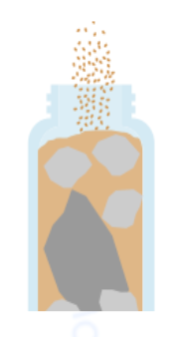
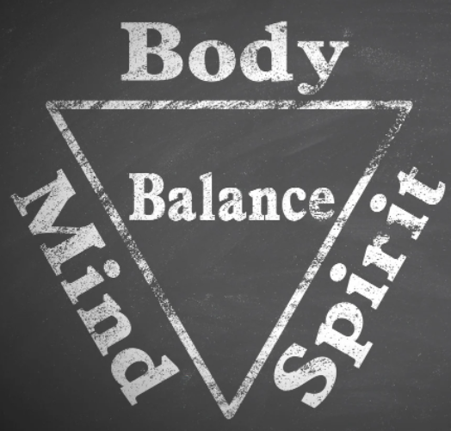
victim →
persecutor →
rescuer →
Notes:
https://www.youtube.com/watch?v=zkmsjFisW_A -- See also https://www.youtube.com/watch?v=8dO6Wwh_tiU

Slide 72
Week 9: Citizenship
Part 2:
Be Builders in Your
Spheres of Influence
Notes:
We've spent a lot of time during this series talking about putting on our own oxygen masks first, but ultimately, we hope our individual efforts toward Digital Wellness can mean we have more capacity to do some good in the world, to be influencers for good.

Slide 73
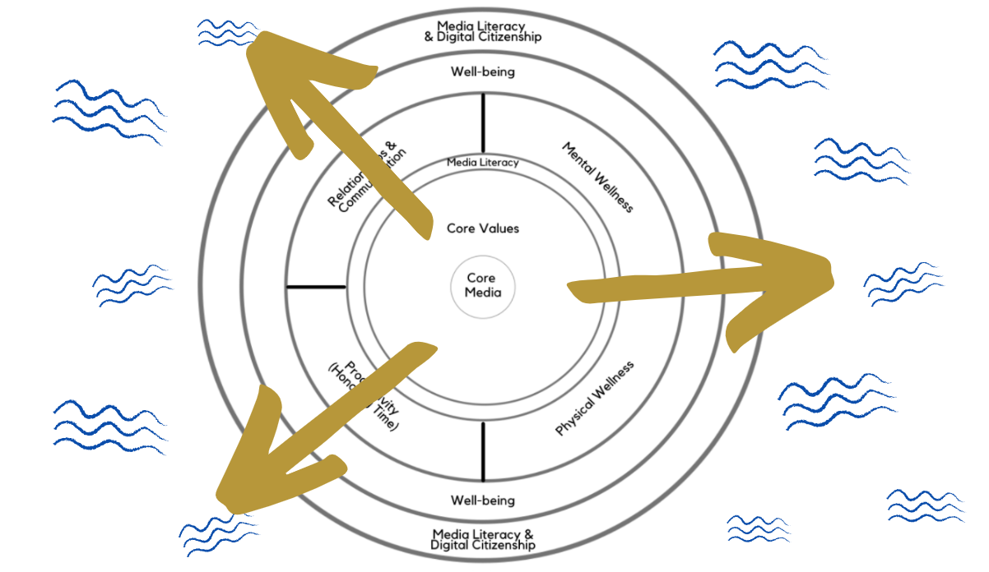
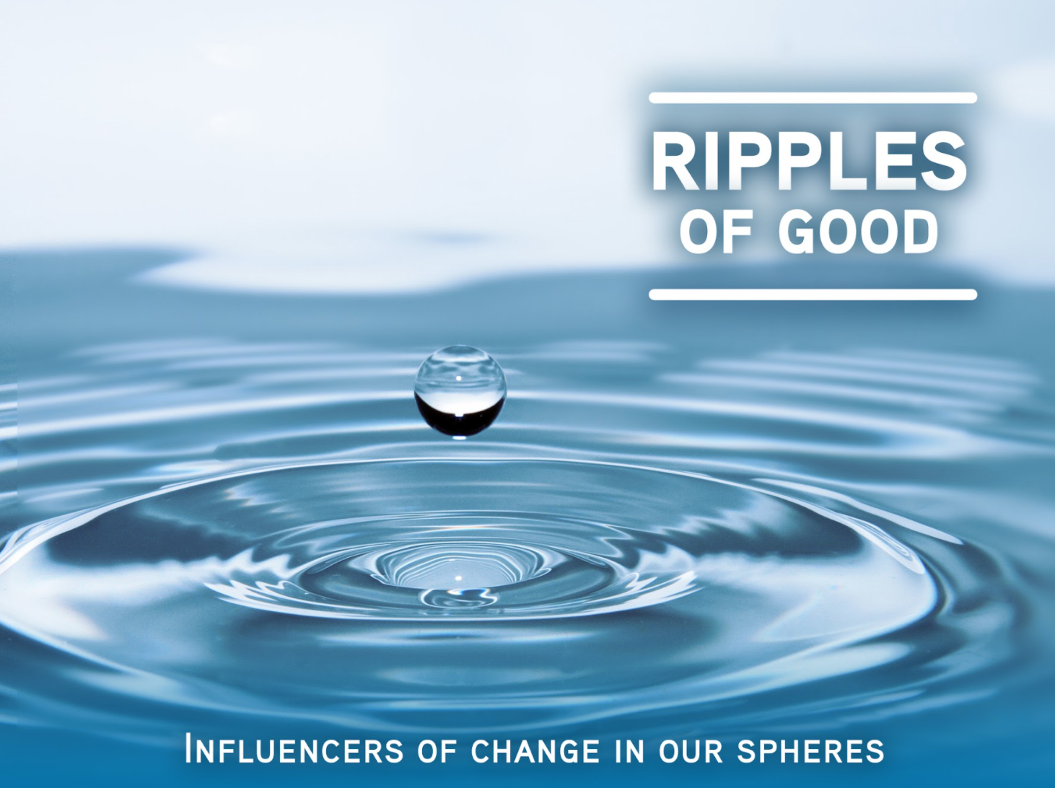
Note: EPIK’s Digital Centeredness model is adapted from the Digital Wellness Institute’s six-pronged model that aligns with DWI’s original survey
Notes:
We've spent a lot of time during this series talking about putting on our own oxygen masks first, but ultimately, we hope our individual efforts toward Digital Wellness can mean we have more capacity to do some good in the world, to be influencers for good. Remember James Fowler! https://www.youtube.com/watch?v=zkmsjFisW_A -- See also https://www.youtube.com/watch?v=8dO6Wwh_tiU

Slide 74
Possible Building Blocks
Notes:
https://www.youtube.com/watch?v=zkmsjFisW_A -- See also https://www.youtube.com/watch?v=8dO6Wwh_tiU

Slide 75

https://docs.google.com/document/d/1S6C8JHYlF_ze0ZuhS_6tmP32b-ljtPJtR8wCaI6DPXk/edit
Notes:
This is an opportunity for schools or districts to take advantage of some funding around civic education that includes media literacy education. If you are involved in a school in Utah, this might be worth sharing with the school.

Slide 76
More information about the grant:
When: Tuesday November 22, 2022 3:00-4:00 PM
Where: on Zoom (you will get link with registration).
﻿Register: https://bit.ly/3tNyvxO
Read about grantees from Round 1: https://docs.google.com/document/d/1pA5kOgV6hwdw0ydWVGYMVgGYzMLEL-xQmwJxy3jHIp4/edit
Or you can read about some brainstormed ideas on how the grant could be used here: https://docs.google.com/document/d/1vtfcz10kr9rclNPIs_JhFADllmW6IANiHxXjjFN8Jrk/edit
https://docs.google.com/document/d/1S6C8JHYlF_ze0ZuhS_6tmP32b-ljtPJtR8wCaI6DPXk/edit
Notes:
This is an opportunity for schools or districts to take advantage of some funding around civic education that includes media literacy education. If you are involved in a school in Utah, this might be worth sharing with the school.

Slide 77

Contact Michelle about the opportunity for committed participants to try this program in their schools or other community setting serving children and/or youth. A generous donor is willing to cover the cost….
Notes:
For those who have attended our series several times, and who are willing to commit to give this program a try in their schools or in another community setting, a generous donor has agreed to cover the cost of "Be a Media Detective" for committed influencers in this series. There would be an expectation of some report back on how you used the resource. Please contact michelle@epik.org to schedule a conversation about this unique opportunity.

Slide 78
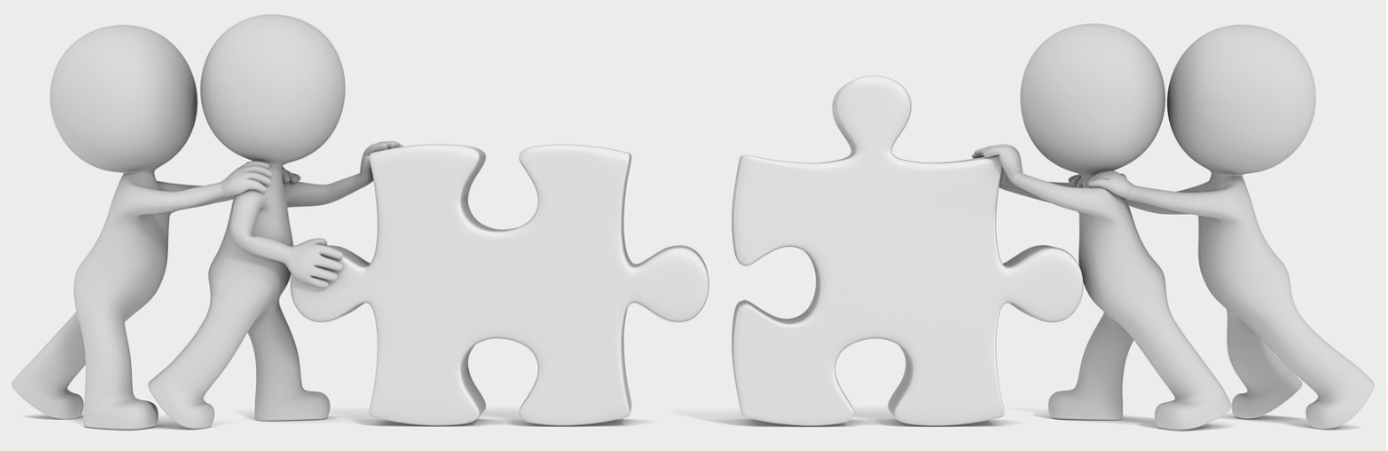
Contact Michelle about other donated programs that generous collaborators have agreed to share with committed participants to try in their schools or other community setting serving children and/or youth.
Notes:
We also have other collaborators in this space who have offered free programs for influencers in our group to try. Again, to respect the generosity of these program providers, we'd ask for some sort of report back on how you used the resource and to provide feedback to the program providers. Please contact michelle@epik.org to schedule a conversation about this opportunity.

Slide 79
"We don't have problems because we belong to too many different groups but rather because we prioritize them wrongly.... What is needed is for people...to agree that our political and policy divides are not our primary identities....
"We're relational beings, and we're meant for community. We're meant to be rooted, not rootless. We're meant to be together, pursuing goals and dreams in common."
Notes:
Senator Ben Sasse, Them

Slide 80
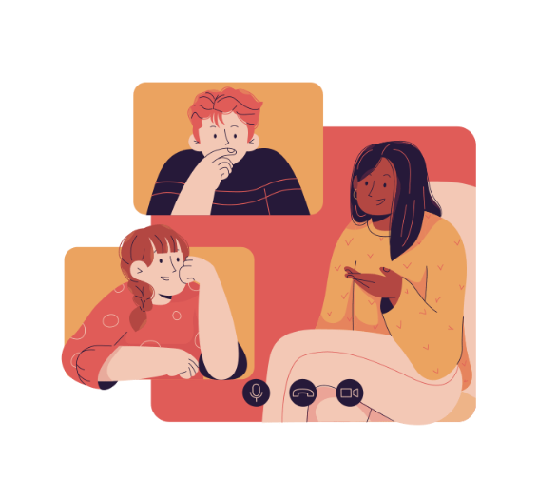
Builders Brainstorm
Notes:
We've spent a lot of time during this series talking about putting on our own oxygen masks first, but ultimately, we hope our individual efforts toward Digital Wellness can mean we have more capacity to do some good in the world, to be influencers for good.

Slide 82

We wish you well(ness)!

Slide 83

Bonus Material

Slide 84

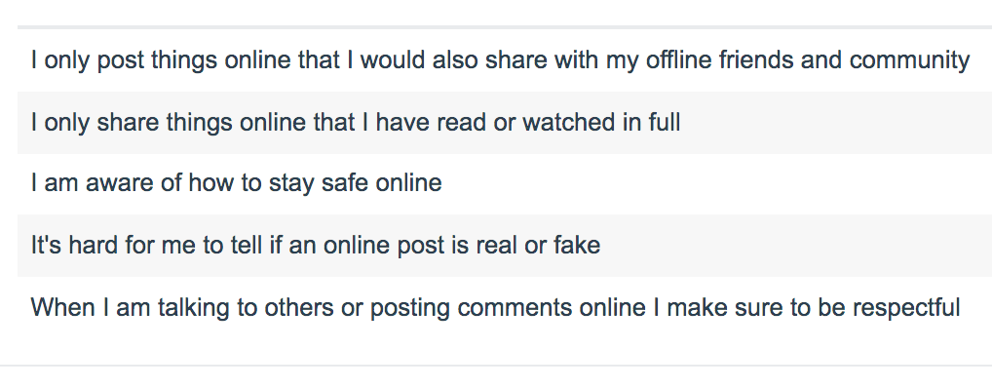
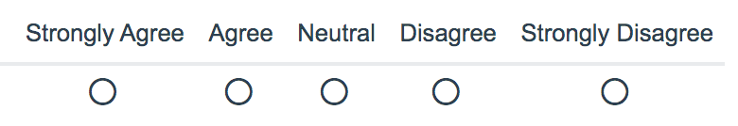
Survey courtesy of DWI: https://survey.alchemer.com/s3/5504604/b153c792d361
Notes:
This week's challenge/invitation is to review the survey questions in the slides below and/or to try one or more of the Media Literacy/Digital Citizenship Activities in the Bonus section. There is also some good material on dancing in the privacy tension. Less privacy = more ease of use in our technology, but more ease of use = less privacy. It's definitely a greased-hump kind of situation!

Slide 85
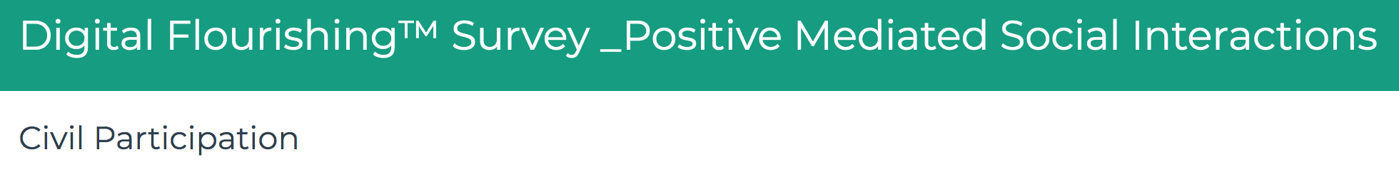
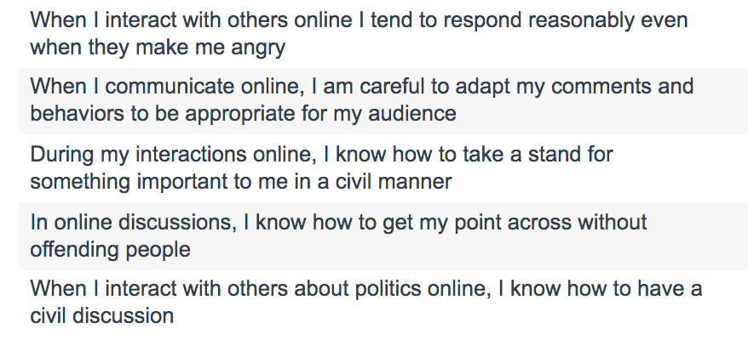
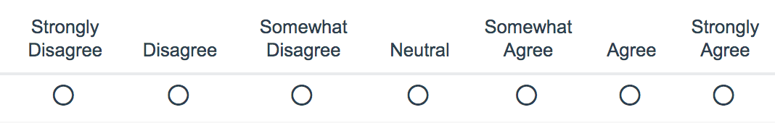
Survey courtesy of DWI: https://survey.alchemer.com/s3/6226945/Digital-Flourishing-Survey-PositiveMediatedSocialInteractions
Notes:
This week's challenge/invitation is to review the survey questions in the slides below and/or to try one or more of the Media Literacy/Digital Citizenship Activities in the Bonus section. There is also some good material on dancing in the privacy tension. Less privacy = more ease of use in our technology, but more ease of use = less privacy. It's definitely a greased-hump kind of situation!

Slide 86
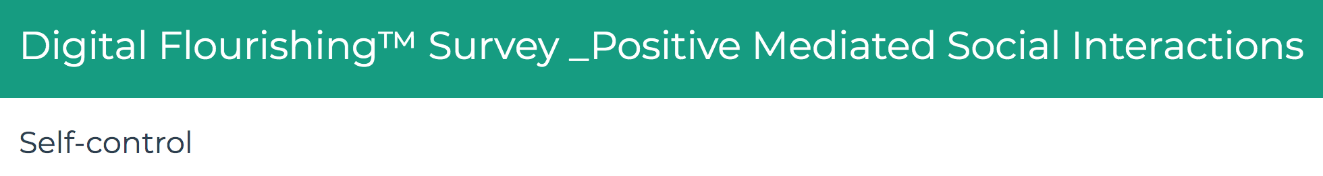
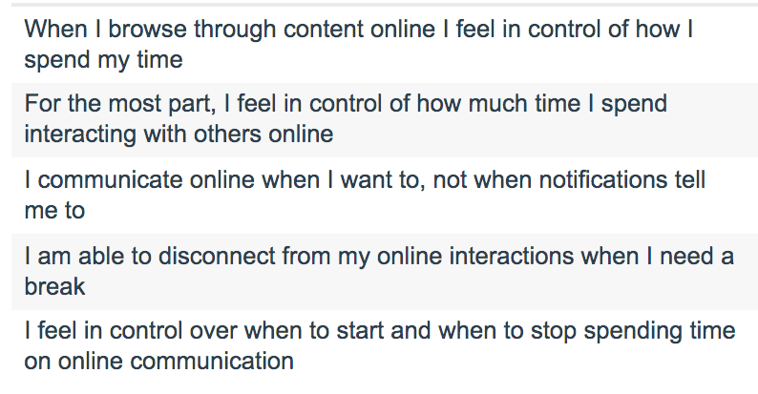
Survey courtesy of DWI: https://survey.alchemer.com/s3/6226945/Digital-Flourishing-Survey-PositiveMediatedSocialInteractions
Notes:
This week's challenge/invitation is to review the survey questions in the slides below and/or to try one or more of the Media Literacy/Digital Citizenship Activities in the Bonus section. There is also some good material on dancing in the privacy tension. Less privacy = more ease of use in our technology, but more ease of use = less privacy. It's definitely a greased-hump kind of situation!

Slide 87
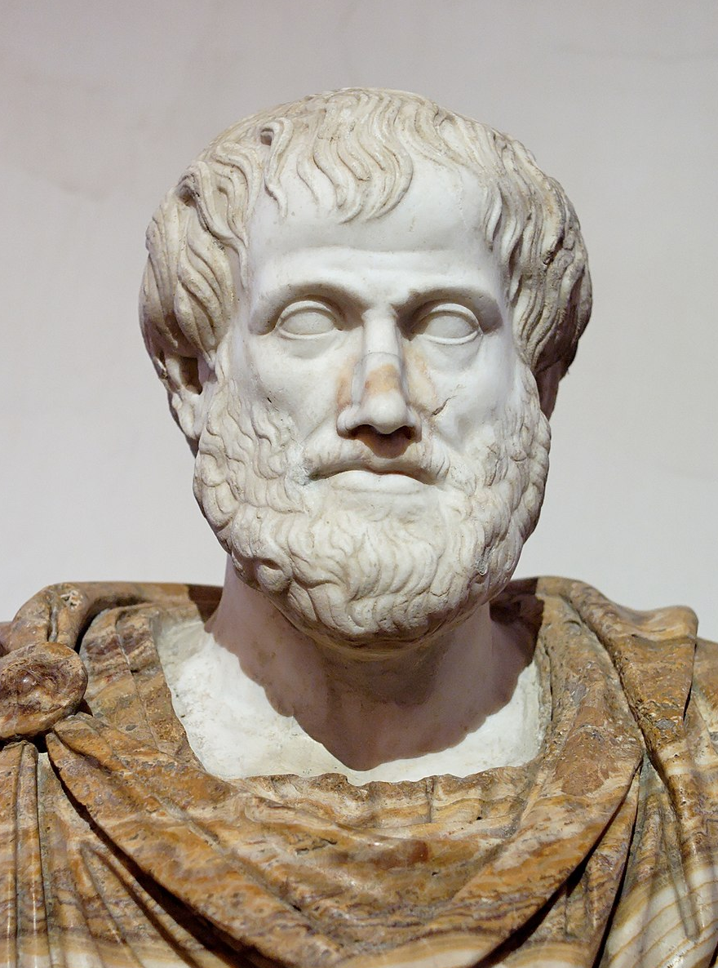
Aristotle: The Golden Mean
"For instance, both fear and confidence and appetite and anger and pity and in general pleasure and pain may be felt both too much and too little, and in both cases not well; but to feel them at the right times, with reference to the right objects, towards the right people, with the right motive, and in the right way, is what is both intermediate and best, and this is characteristic of virtue."
Notes:
We'll be talking more about this next week.
https://www.sacred-texts.com/cla/ari/nico/nico019.htm

Slide 88

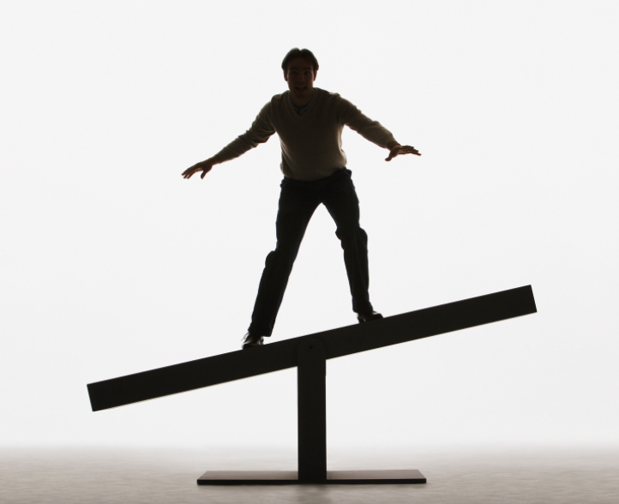
Dancing in the Tensions
See also Barbara Sher’s TEDx talk (When it comes to problem-solving and reaching your goals, there is a tension with solitude, because problems are meant to be solved via connection and collaboration and mutually helping each other) https://www.tedxprague.cz/en/videa/isolation-is-the-dream-killer-not-your-attitude-barbara-sher
  Barbara’s work also reinforces building small networks of support for reaching your goals (where bridging social capital can even become more like bonding social capital)
Notes:
=

Slide 89







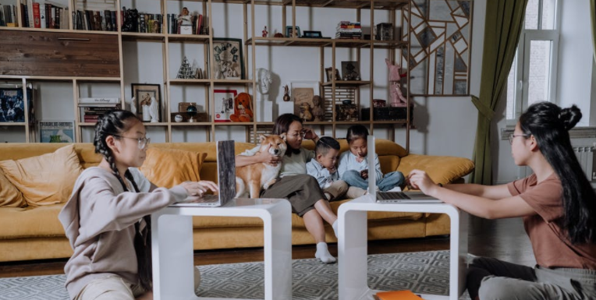
Family Tech Tips
and Resources
Notes:
=

Slide 90
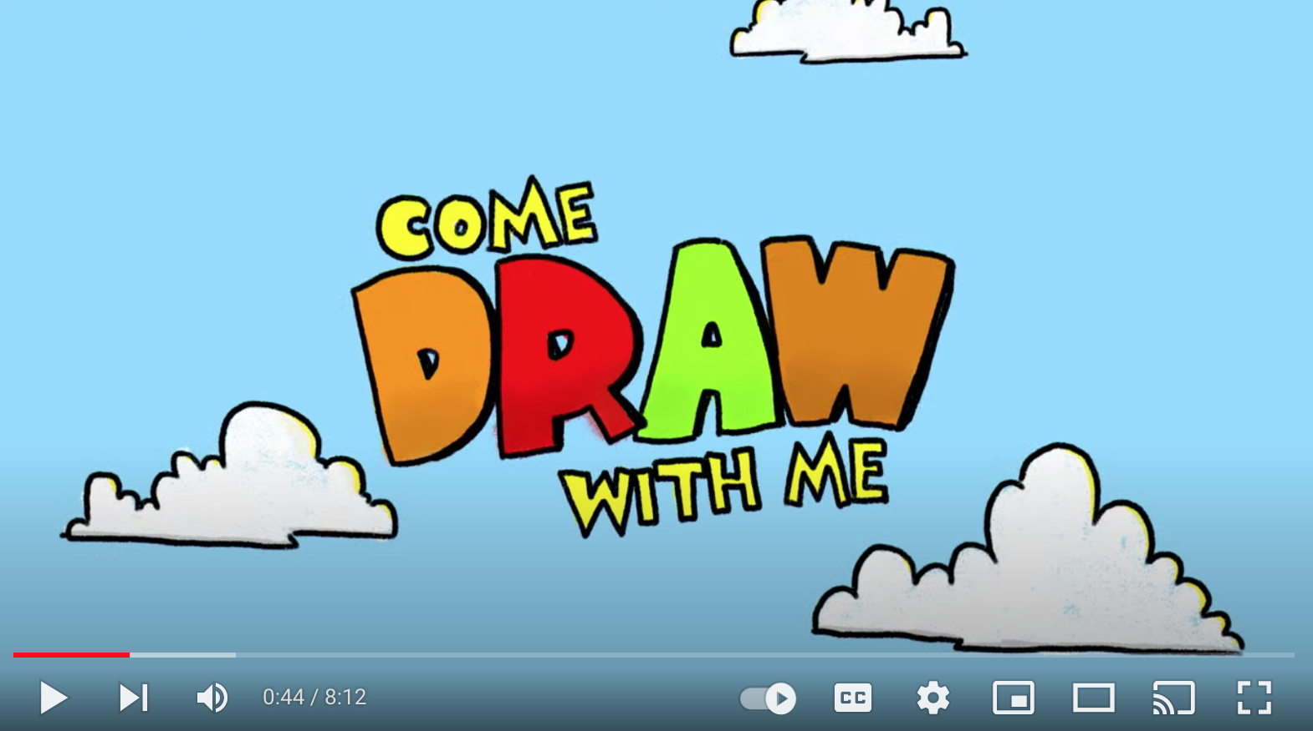
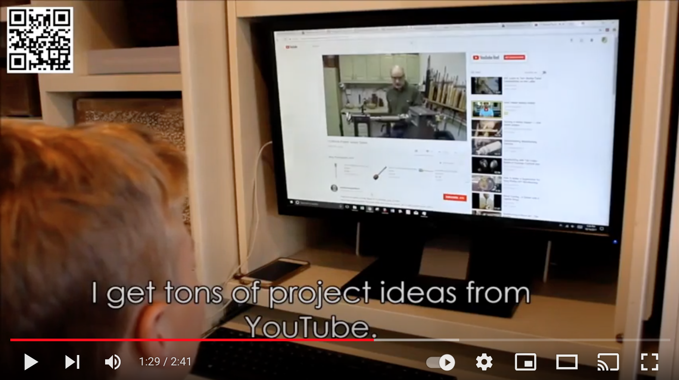
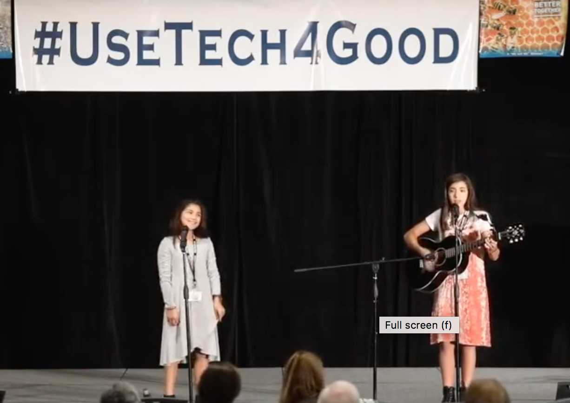
If your children use YouTube…

Slide 91
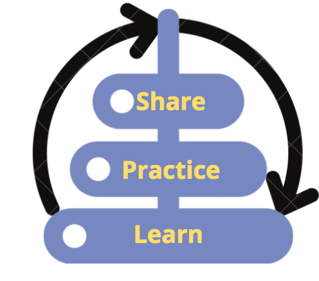
If your children use YouTube…
Make sure the device is in a public area and at least within your visual field and earshot.
Turn off autoplay [avoid rabbit holes and inane (or worse) content]
Put the video on full screen [prevents sidebar distractions & rabbit holes]
Alone as the parent, prepare the video by getting past the initial ad first.
  Watch/listen for intermediate ads, and ads at the end
Agree together with your child on how much time you/they will spend on the activity. [This can help model principles of time-boxing and single-tasking, which are powerful Digital Wellness principles.]
*Wherever possible, use technology *with* your child. This is good for both relationship-building and safety, and side-by-side learning with positive reinforcement can potentially be a protective factor for overall behavioral health, as per Social Development Strategy
Notes:
https://www.instagram.com/p/CU8JuQvBs-K/

Slide 92
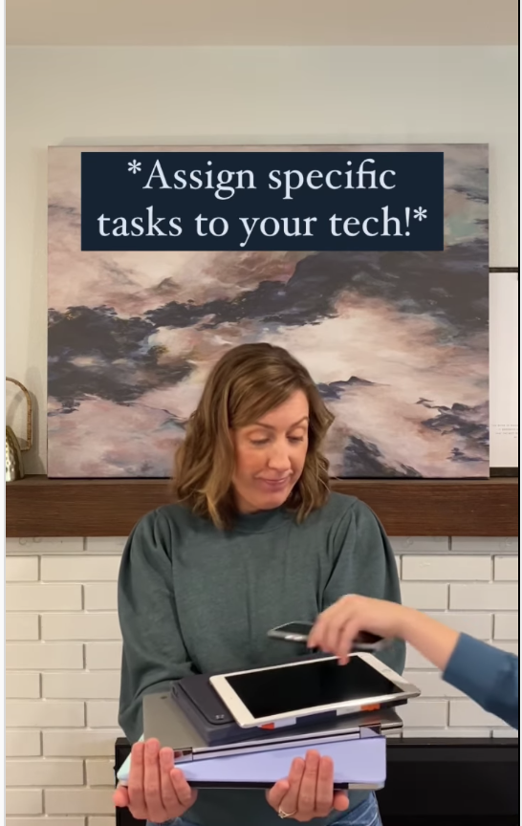
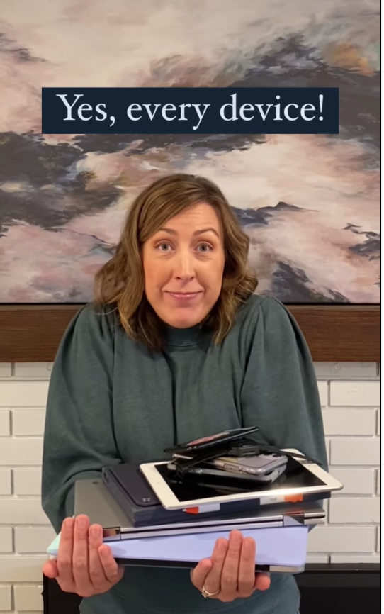
Family tech tip from Better Screen Time
https://www.instagram.com/p/CU8JuQvBs-K/ or @BetterScreenTime or https://www.instagram.com/betterscreentime/
Notes:
https://www.instagram.com/p/CU8JuQvBs-K/ @BetterScreenTime https://www.instagram.com/betterscreentime/

Slide 93

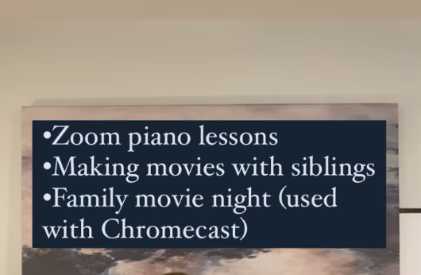
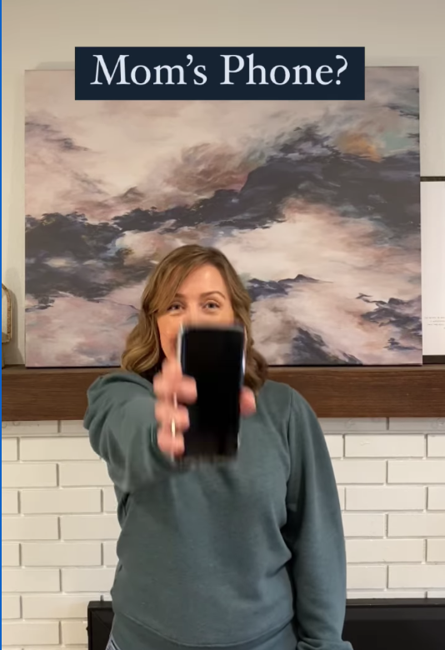




e.g., from Andrea Davis at Better Screen Time
https://www.instagram.com/p/CU8JuQvBs-K/
https://www.instagram.com/betterscreentime/
@BetterScreenTime
Notes:
https://www.betterscreentime.com/create-a-family-technology-plan-not-a-cell-phone-contract/ and quick guide is here:

Slide 94





from WiredHuman.org

Slide 95




Other resources
We know many parents are concerned about pornography so some resources below include that topic
DigCitUtah: https://digcitutah.com/resources-library/ [resources covering various facets of Digital Citizenship and Digital Safety]
Educate Empower Kids: https://educateempowerkids.org/
  Conversations with My Kids: 30 Essential Family Discussions for the Digital Age
  Petra’s Power to See
  Noah’s New Phone: A Story About Using Technology for Good
  Messages About Me: Sydney’s Story, A Girl’s Journey to Healthy Body Image
  Kids and Pornography: A Public Health Crisis
  30 Days to a Stronger Child
  30 Days of Sex Talks [different books for different ages]
  How to Talk to Your Kids About Pornography
Defend Young Minds: https://www.defendyoungminds.com/
Reach10 for young adults: https://reach10.org/
Others you use/like?

Slide 96
Keep these concepts in mind…
The tensions inherent in these topics are relevant to
next week's discussion on Digital Citizenship
Happiness
Fulfillment
Pessimism
Self-expression/presentation
Comfort Zone
Depending on size of group, this will either be a large group discussion or can be broken into smaller groups of 3-4.
Image shared under CC BY-SA 3.0 (https://creativecommons.org/licenses/by-sa/3.0/deed.en). Credit: https://commons.wikimedia.org/wiki/User:Rahulkepapa

Slide 97

from Dr. Seuss' Oh, the Places You'll Go! - a playful way to talk about "dancing in the tensions"
Notes:
Created by Viraj Kothari, https://quotesaga.com/quote/2179

Slide 98
We bring people together
-- bring pieces together --
with a hope for more peace:
from Media Lit
to SEL
[in the school system, this refers to social-emotional learning]
to Digital Cit
and how we can tell
if we each are ready
to walk the walk
of what it takes to
slow down and talk
about hard things
with a soft heart
--learn how to not
tear each other apart,
how not to
tear our society apart.
A little poem written to help a group understand more of EPIK's work (written for teachers and inflruences of K-12 students
Notes:
We've spent a lot of time during this series talking about putting on our own oxygen masks first, but ultimately, we hope our individual efforts toward Digital Wellness can mean we have more capacity to do some good in the world, to be influencers for good.

Slide 99
Big Tech
[and pendulum politics]
makes big money
off of us being at war
we have to learn to do different
more than ever before.
Different does not begin
with "they" "them" or "we"
But instead starts within:
Let peace start in me!*
This can grow some win-win!
This helps us each be more free,
each sourcing renewable energy.
Note: EPIK’s Digital Centeredness model is adapted from the Digital Wellness Institute’s six-pronged model that aligns with DWI’s original survey
Notes:
We've spent a lot of time during this series talking about putting on our own oxygen masks first, but ultimately, we hope our individual efforts toward Digital Wellness can mean we have more capacity to do some good in the world, to be influencers for good.

Slide 100
Reaction (angry mob)
or
Resilience (inside job)?
Which will I choose?
There is so much to gain
By not playing "lose-lose."
Strongly signaling different
to big tech gurus
[and saying no to divisive politics].
Perhaps most of all
I can help make it cool
to do peaceful at home
and at work
and at school
[and in politics].
Notes:
We've spent a lot of time during this series talking about putting on our own oxygen masks first, but ultimately, we hope our individual efforts toward Digital Wellness can mean we have more capacity to do some good in the world, to be influencers for good.

Slide 101


From a site called "Living Compass" :)
Notes:
I tried to find if there was a source of this notion of practicing the pause, but it just seems to be used by many. The first quote is from Lori at Tiny Buddha, and the latter thoughts are from The Rev. Dr. D. Scott Stoner, LMFT (therapist) at Living Compass: https://www.livingcompass.org/wwow/practice-the-pause
A great toolbox of other ideas for building on pause and respect with team work can be found in this resource by Brené Brown: https://daretolead.brenebrown.com/wp-content/uploads/2018/10/Glossary-of-Key-Language-Skills-and-Tools-from-DTL.pdf

Slide 102

Centeredness, Awareness = Personal Responsibility
"In my heart and mind and soul, I know only as our consciences turn us to "Responsible Personal Conduct" will the dream…have any chance of survival."
-Dr. Kenneth D. Wells,
founder of the Freedom Foundation
Notes:
…and personal responsibility. No legislation in the world will be able to eliminate road rage, let alone digital road rage. It's up to us to be responsible, respectful citizens in our digital use and in our civic engagement. These quotes were shared by Dallin H. Oaks at the 1994 Freedom Festival. https://speeches.byu.edu/talks/dallin-h-oaks/1994-freedom-festival/

Slide 103

Politics = not religion or absolute truth
Politics = a process
All are invited to participate
Think "engage peacefully" vs. "win"
Notes:
Media Literacy is broad and deep and yet can also be explored in simple ways. We hope this simple linear exploration can be helpful.

Slide 104
Politics = not religion or absolute truth
Politics = a process
All are invited to participate
Think "engage peacefully" vs. "win"
Notes:
Media Literacy is broad and deep and yet can also be explored in simple ways. We hope this simple linear exploration can be helpful.

Slide 105
Politics = not religion or absolute truth
Politics = a process
All are invited to participate
Think "engage peacefully" vs. "win"
Notes:
Media Literacy is broad and deep and yet can also be explored in simple ways. We hope this simple linear exploration can be helpful.

Slide 106
Politics is not religion or absolute truth
Politics = a process
All are invited to participate
Think "engage peacefully" vs. "win"
Notes:
Media Literacy is broad and deep and yet can also be explored in simple ways. We hope this simple linear exploration can be helpful.

Slide 107
Politics = not religion or absolute truth.
Politics is a process.
All are invited to participate.
Think "engage peacefully" vs. "win."
Other thoughts?
Notes:
Media Literacy is broad and deep and yet can also be explored in simple ways. We hope this simple linear exploration can be helpful.

Slide 108
Digital Driving, Part 1 = Knowledge
Notes:
In Driver's Ed, we start with classes and a manual. We learn nuts and bolts about how a car works, about street signs, about rules of the road…and then eventually we get time to practice. But it all starts with some book knowledge.

Slide 109

"Rules of the Road"
"Norms of appropriate, responsible, and healthy behavior related to technology use, including digital literacy, ethics, etiquette, and security." - Utah's HB213 (2015)
Find more resources at DigCitUtah.com
Notes:
The same is true for Digital Driving. There is information we can learn to improve Digital Citizenship, to understand more about the "rules of the road" for "appropriate, responsible, and healthy behavior" regarding use of technology and social media.
In 2015, Utah became the first state to have a Digital Citizenship bill, and EPIK donated a website to help the Utah State Office of Education help administrators, teachers, and parents to find information ( Digital Citizenship Driver's Ed manual items, if you will) about various elements of Digital Citizenship. There are a lot of different facets of learning how to engage online in a healthy, safe, and respectful way. We don't have the time to go through these topics in detail, and we wanted to focus the bulk of our gathering on Civic Wellness, but you can visit DigCitUtah.com for more information.

Slide 110







Notes:
Perhaps understanding how technology is used to grab and keep our attention (and understanding how our brains work) can help us be better Digital Drivers.

Slide 111
And "Practicing the Pause"
Pause and Ask Questions (PAQ)
Notes:
Media Literacy skills – practicing the pause, as it were, or PAQ (pausing and ask questions…of ourselves, and pausing to ask questions to understand others) is critical for Digital Citizenship and could help foster more Civic Wellness.

Slide 112


e.g., Ethics and Copyright
Over 7300 people commented on plagiarized versions of this story.
The plagiarized version was shared
over 29,000 times.
Nightbirde – millions of unauthorized views of her videos. People in multiple countries making money off of her life, gift, and death.
Notes:
For example, if we pause and ask questions about content we find online, we can ensure that we are practicing and modeling legal content sharing, which not only gives credit where credit is due, but can also be a protection against dis/misinformation. If we don't practice the skill of tracing sources and asking questions of even the fun or inspiring content that moves us emotionally, we could be less likely to do that kind of homework on key issues that are impacting our personal well-being, our families, our communities, our nation, our politics, our public health and peace, and our world.

Slide 113


Tracing sources connects to healthy democracy
Why does it matter to know the source,
even of a silly or fun or inspiring story?
If we don't practice tracing sources, asking questions of content we encounter:
We may be more susceptible to mis/disinformation
We could be unwittingly helping people make money on plagiarized content
We could be unwittingly sharing legally protected content
Notes:
I added this slide to explain more about why tracing sources matters, not just for copyright issues, but for the health of our democratic process.

Slide 114
e.g., Privacy
We've included several resources to help you consider how you would like to navigate the tensions - the greased humps – around privacy
Notes:
Privacy protection is a big issue in our digital world. We have provided extra resources in the Bonus section to help you consider the tensions inherent in this element of Digital Citizenship.

Slide 115

e.g., Privacy: Helping children understand
Notes:
This is an image of a little poster my daughter made in elementary school. I can't remember what grade she was in, but I've kept it all these years because it is relevant to our work at EPIK, and I think it's instructive about how we can help children understand some basic privacy principles, even some Media Literacy (e.g., if someone is promising you quick money, or asking so readily for your information, it's very likely a scam. Pause and Ask Questions (PAQ), do your homework, ask for input, but don't click!)

Slide 116
e.g., (Grand)Parental Privacy & Digital Footprint PAQs
(Potential Downsides to Digital Scrapbooking)
Examples of PAQs, things to think about, before posting pictures of children and grandchildren online:
  Do you want to be creating their digital footprint for them?
  Is this something that could embarrass the child later, or put them at risk for bullying?
  Once something is shared, you have to assume it is no longer private. Are you okay with this possibly being shared or used by others? Research privacy for children and concepts like digital kidnapping (identity theft of children) for more info.
  Is there any identifying information in the photo/information that could indicate where you live, where your child goes to school, etc? [Is GPS off on your device? Do you know how to strip metadata (EXIF data) from photos?]
  Do you want marketers to use what you share about your family to market to you and your connections?
  Have you asked the child(ren) how they feel about it? Think of parallels to body autonomy (“it’s okay to say no if you don’t want to be touched, hugged, kissed” etc.)
Notes:
https://www.commonsensemedia.org/privacy-and-internet-safety/is-it-safe-to-post-pictures-of-my-kid-online https://www.npr.org/sections/health-shots/2016/10/28/499595298/do-parents-invade-childrens-privacy-when-they-post-photos-online
https://www.healthychildren.org/English/family-life/Media/Pages/Sharenting-5-Questions-to-Ask-Before-You-Post.aspx, https://mottpoll.org/sites/default/files/documents/031615_sharenting_0.pdf, https://journals.sagepub.com/doi/full/10.1177/2056305120978376

Slide 117


e.g., Avoiding filter bubbles and biased silos
Notes:
e.g., Flaxman, S., Goel, S., & Rao, J. M. (2016). Filter Bubbles, Echo Chambers, and OnlineNews Consumption. Public Opinion Quarterly, 80(S1), 298–320.https://doi.org/10.1093/poq/nfw006

Slide 118


Let's go back to the driving metaphor…
Notes:
It's not too hard to merge into a freeway that is open like this one, even if we're having a hard day or are under some stress…

Slide 119

Notes:
But what about when there is a lot of traffic, noise, movement. This is not a situation for mindless driving. We need higher attention levels with this kind of situation…and we are more prone to stress both arising from this situation and impacting how we might respond to it.

Slide 120

Notes:
The "information superhighway" as it used to be called, is a very high-traffic place. There is a lot of noise, a lot of potential sources of stress…and that's on a good day. :)

Slide 121
Other (internal and external) stimuli can make merging into traffic more stressful
Notes:
As we have discussed in previous modules, internal and external stimuli, combined with the traffic situation, can make it all more taxing. This is true of the internet as well.

Slide 122




It can all be a recipe for "road rage"

Slide 123

Driving under the influence hurts us all
Notes:
Think of the saying, "A house divided against itself cannot stand" … but how many of our families have been divided because of politics? These last several years have been hard on us all.

Slide 124
Digital Driving, Part 2 = Centeredness and Wisdom
Notes:
So beyond the skills and knowledge of Digital Citizenship concepts, we just keep going back to what our centering principles can be. We need centeredness, wisdom…

Slide 125
…and Personal Responsibility.
"Our whole society really rests on the capacity of its citizens to give 'obedience to the unenforceable.'"
Neal A Maxwell, 1993 Freedom Festival
"In my heart and mind and soul, I know only as our consciences turn us to "Responsible Personal Conduct" will the dream that is America have any chance of survival."
-Dr. Kenneth D. Wells,
founder of the Freedom Foundation at Valley Forge,
Notes:
…and personal responsibility. No legislation in the world will be able to eliminate road rage, let alone digital road rage. It's up to us to be responsible, respectful citizens in our digital use and in our civic engagement. These quotes were shared by Dallin H. Oaks at the 1994 Freedom Festival. https://speeches.byu.edu/talks/dallin-h-oaks/1994-freedom-festival/

Slide 126

= Our own Hero's Journey
Notes:
And this is no small task in today's political, social, and cultural climate. It's its own Hero's Journey.

Slide 127
Practicing Wisdom/Wise Reasoning
The pursuit of virtue (e.g., pursuing personal ideals and contributing to other people)
A focus on the big picture meaning
Intellectual humility
Adaptive emotion regulation (more reappraisal and less maladaptive thought suppression)
Flexible navigation of uncertainties
Appreciation of the complexity of emotional experiences
Ability to self-distance [consider others' situations]
Compromise
Forgiveness
Self-transcendence
Notes:
During the course of this course, we discovered research around practicing wisdom or wise reasoning (before now, we didn't know there was such a thing!) Some researchers talk about wisdom as being a set set of traits; others talk about wisdom as something one can develop. We take the latter perspective.
Above are some of the concepts that appear in this genre of research, organized here in this list to explore how they relate to the Digital Centeredness model. There are other characteristics that are explored in the research that we did not include here. But, to touch on the bullet list above:
Pursuit of virtue connects to the "start with your center" concept. A big-picture focus and intellectual humility can be fostered through practicing Media Literacy. The next three bullets obviously relate to Mental Wellness (and also Physical and Relational). Navigating uncertainties can also relate to Honoring Time. Media Literacy is a skill that can help us practice considering others' points of view; the pause and Media Literacy questions (or questions we have asked ourselves throughout this series) are questions we can ask when considering the content that others create, or the positions they take. What is *their* center? What experiences have influenced how they view the world, how they choose to show up in the world? Compromise and forgiveness are obviously relational concepts, and can also apply in community and civic settings. And self-transcendence is something that can come the healthier we are.
I didn't include quotes in the slide above for visual simplicity, but you can find these concepts explore in various articles, such as: https://www.researchgate.net/publication/301821371_Wise_Reasoning_in_the_Face_of_Everyday_Life_Challenges (see literature review paragraphs)
https://journals.sagepub.com/doi/10.1177/0956797617722621

Slide 128
"In the attention economy,
mindfulness is activism."
~Jay Vidyarthi
Notes:
The "oil" that can help all the "gears" work together is awareness or mindfulness. Mindfulness is essential to wellness, and wellness impacts our activism.

Slide 129

Notes:
There are a few simple things we hope you can remember from this series. One is the concept of practicing the pause, and pausing and asking questions (PAQ). This concept has been woven throughout the modules of this series.

Slide 130


"Point and Name"
Notes:
The idea of pausing and naming is a simple thread that is woven through all that we have talked about to this point. And everything that we have talked about to this point is like pre-work for good relationships.
This concept of "point and name" can apply in various facets of our lives. We can name the kinds of persuasion tactics being used as we practice all of the facets of Wellness. See the following slides, as well as the following ideas:
As we name our centering values, the attributes we want to develop and nurture, they can stay more present in our day-to-day lives. Pointing and naming the Who, What, When, Where, Why, and How with media consumption can help us be more alert and aware with regard to messages all around us (even those that are spoken, not just shared via media sources). We can name the emotions we are feeling (research shows that this simple act can calm down the nervous system). We can look objectively at (name, identify) thoughts we have, especially when we encounter a difficult situation, but also as we look for tender mercies in our lives. We can build awareness by becoming more alert to messages our bodies are sending us, and where we are experiencing stress and other things in our bodies. And when it comes to honoring time, James Clear shares this idea in his book, Atomic Habits. Catch a glimpse of his writing on this here: https://jamesclear.com/habits-scorecard In his book, he calls it "pointing and calling," from a safety process (Shisa Kanko) on Japanese trains that has significantly reduced accidents. This technique can help during transition times between tasks, when it can be easy to fall into distraction. e.g., When I'm done with a chunk of work and need to go eat, I to often find myself wandering into social media land and getting lost there for a bit, when my body really needs food. When I speak out loud what I want to do next, I also feel a little more accountability to myself to follow through, and it helps my brain remember better. James Clear's wife uses this technique to help her remember where she has put her keys or other things. :) https://www.japantimes.co.jp/news/2008/10/21/reference/jr-gestures/ or you can read this blog post about it since the original story is behind a paywall: https://www.christopherroosen.com/blog/2020/4/20/how-the-ritual-of-pointing-and-calling-shisa-kanko-embeds-us-in-the-world
"pointing and calling" - "Shisa Konko"
*Alice Gordenker, “JR Gestures,” Japan Times
(Note: In all of these activities, the pointing doesn't have to be literal. :) )
On the power of pointing and naming, as it were, on improving wellness, habits, etc. see this from James Clear, an excerpt from chapter 4 of his books, Atomic Habits (shared on his website). In his book, he calls it "pointing and calling," from a safety process (Shisa Kanko) on Japanese trains that has significantly reduced accidents. https://www.japantimes.co.jp/news/2008/10/21/reference/jr-gestures/ or you can read this blog post about it since the original story is behind a paywall:
Or see this from Dr. Dan Siegel, an expert in integrative neurobiology: Reflection, Relationships, Resilience as three keys to wellness: https://www.youtube.com/watch?v=LiyaSr5aeho

Slide 131

Notes:
It can be easy to think that we are helpless in a sea of so much distraction and commotion around us, in both the digital and non-digital worlds. But we always, always have the power to choose. In the tech activism world, they often use the word agency. We can be agents in our own lives and choices, and Digital Wellness involves claiming (or re-claiming) our agency, one moment, one hour, one time boxed section, one day at a time.

Slide 132
A second DWI survey on
Social Connectedness (relates to well-being)
https://survey.alchemer.com/s3/6226945/Digital-Flourishing-Survey-PositiveMediatedSocialInteractions
See also resources and research from the Relationships module
Notes:
https://survey.alchemer.com/s3/6226945/Digital-Flourishing-Survey-PositiveMediatedSocialInteractions

Slide 133

Social Connectedness Assessment from DWI
Allows for self-reflection about:
Connectedness
Civil participation
Positive online social comparison
Authentic online self-presentation
Self-control
Notes:
We didn't review the questions from this assessment in this week. We might dig into them a little more in the Digital Citizenship module, but for now, we do invite you to at least skim over the assessment. I neglected to mention in our gathering that this tool has been validated for anyone 12 and up.

Slide 134
A second DWI survey! Social Connectedness
https://survey.alchemer.com/s3/6226945/Digital-Flourishing-Survey-PositiveMediatedSocialInteractions
“Are you getting the most out of your online communication? Do you feel like the way you interact online is helping you flourish in your digital life? Are your online interactions meaningful?”
Measures the following:
  Connectedness
  Civil Participation [this will be revisited in the Digital Citizenship/Media Literacy discussion in two weeks]
  Positive Social Comparison
  Authentic Self-disclosure
  Self-control [this will be revisited in the Digital Citizenship/Media Literacy discussion in two weeks]

Slide 135

Well-being is tied to relationships…for your review
Notes:
You could also think about what relationships in your life in general (not just online) help you feel more connected, less lonely, supported, able to trust. As always, write any other questions that may come to mind that you would like to use for self-assessment. We know ourselves best and know what we want to work on and build awareness around.

