Slide 1
Magic Videos!
Note: If videos don't run directly here in Google Slides, simply click on the Google Drive link in the slide notes on that slide.
**We've included a couple of bonus videos here in addition to the one he created just for our group (see slides 4 & 5).
**Variations of videos on slides 2 & 3 are also in the PTA Relationships module folder: as individual videos, as a spliced video, and included with his presentation from our gathering. https://bit.ly/3sT89uK
Notes:
=

Slide 2
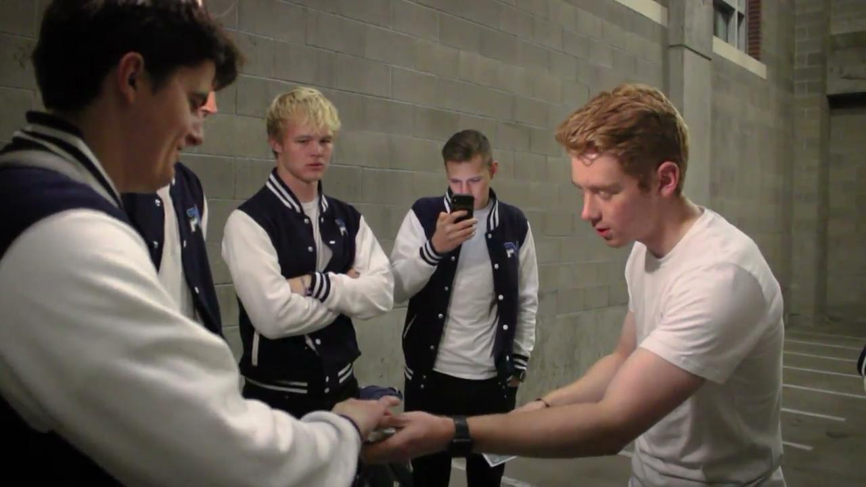
Watch the faces of John's friends as he performs this trick. Imagine yourself there watching.
https://drive.google.com/file/d/1Z37XE3EpU61o8zfGqSQABefgG7yRq3HF/view?usp=sh
Notes:
Video link: https://drive.google.com/file/d/1Z37XE3EpU61o8zfGqSQABefgG7yRq3HF/view?usp=sharing

Slide 3
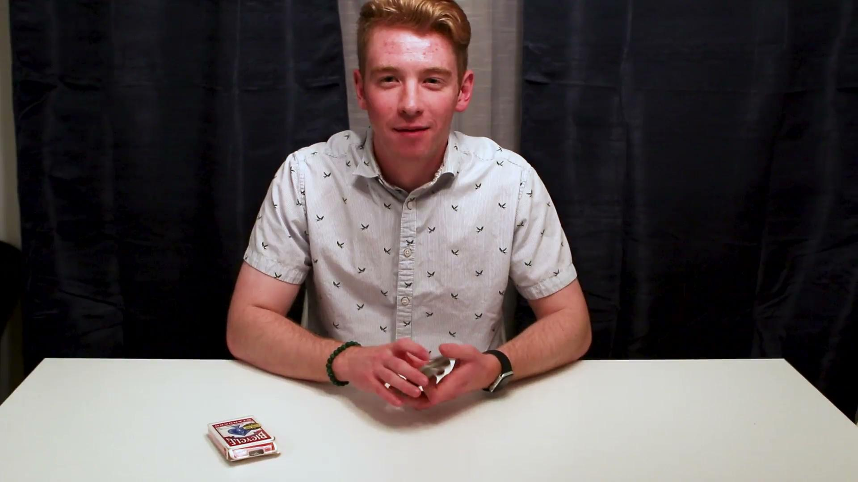
Keep your eyes on John's hands to see if you can catch how he does this trick!
https://drive.google.com/file/d/1BYYCwVJ3hHq5wj166i3Jq9QcWrd7Tq5q/view?usp=sharing
Notes:
Video link: https://drive.google.com/file/d/1BYYCwVJ3hHq5wj166i3Jq9QcWrd7Tq5q/view?usp=sharing

Slide 4
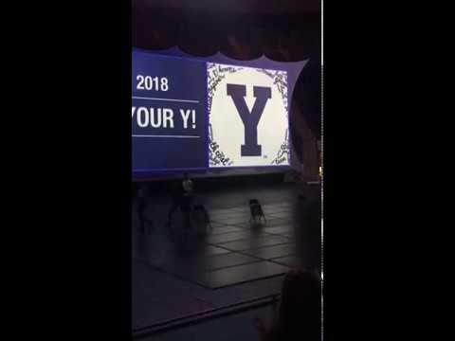
Notes:
https://www.youtube.com/watch?v=h33YqfrDUlc&t=1s

Slide 5
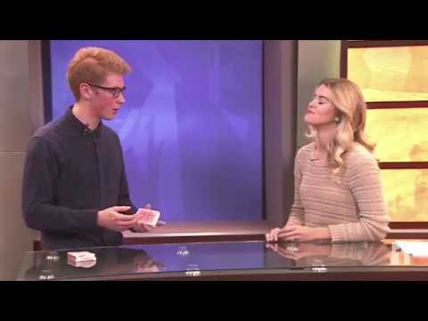
Notes:
Video link: https://www.youtube.com/watch?v=FZu0ZGcLjmo

