Slide 1
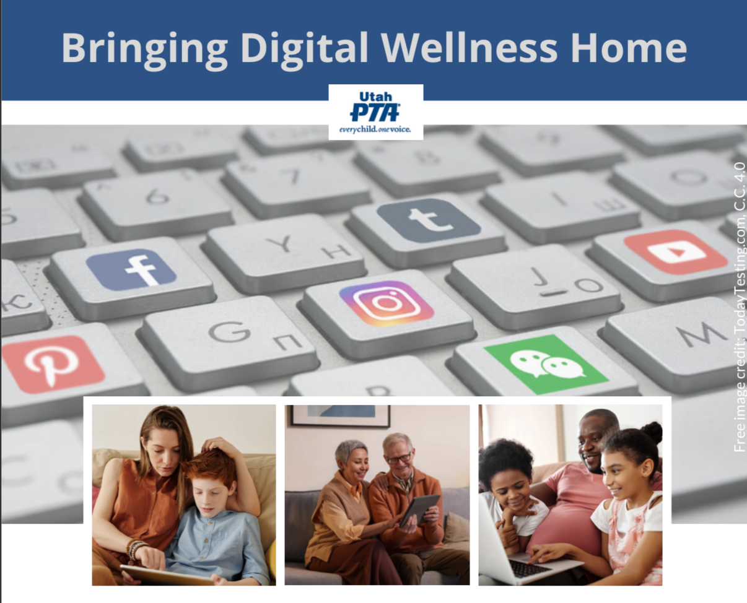
Note: All material in this series is for educational and informational purposes only, and is not meant to be exhaustive or used as a replacement for professional health support.
Notes:
Note: All material in this series is for educational and informational purposes only, and is not meant to be exhaustive or used as a replacement for professional health support. Also, the presentation is best viewed in slideshow format, as some of the slides are animated, but we have also included notes for many of the slides that you might want to review as well. Whatever works best for you!
NOTE: Portions of this work first appeared in or are derived or adapted from the Digital
Wellness Certificate Program. Those portions are Copyright © 2021, Digital Wellness Institute.

Slide 2
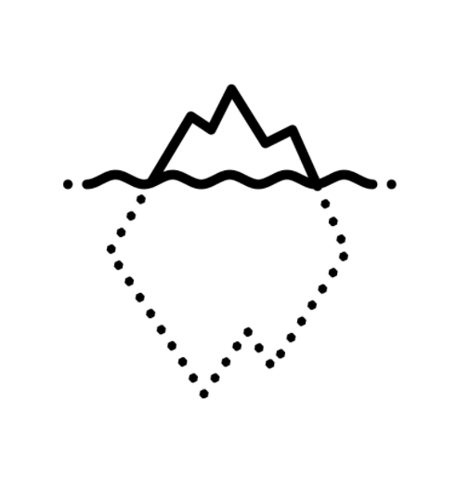
Check-in Activity: Point and Name
"In the attention economy,
mindfulness is activism."
~Jay Vidyarthi
Notes:
For our check-in today, we'll start by piggybacking off a couple of things we explored last week. One was the power of stopping to breathe mindfully (we shared the "inhale for 4, exhale for 6" approach, but you can research other breathing techniques. [Some research supports the idea of a little longer exhale helping with Heart Rate Variability, which is seen as an indicator of resilience that can improve with mindfulness and other wellness practices.)
We will also engage our senses, and revisit the power of "pointing and name" – raising awareness by naming what we are feeling and thinking. Today, we will add to our awareness toolbox by using "point and name" with relation to our five physical senses. (Note: In all of these activities, the pointing doesn't have to be literal. :) )
On the power of pointing and naming, as it were, on improving wellness, habits, etc. see this from James Clear, an excerpt from chapter 4 of his books, Atomic Habits (shared on his website). In his book, he calls it "pointing and calling," from a safety process (Shisa Kanko) on Japanese trains that has significantly reduced accidents. https://www.japantimes.co.jp/news/2008/10/21/reference/jr-gestures/ or you can read this blog post about it since the original story is behind a paywall: https://www.christopherroosen.com/blog/2020/4/20/how-the-ritual-of-pointing-and-calling-shisa-kanko-embeds-us-in-the-world
"pointing and calling" - "Shisa Konko"
*Alice Gordenker, “JR Gestures,” Japan Times

Slide 3
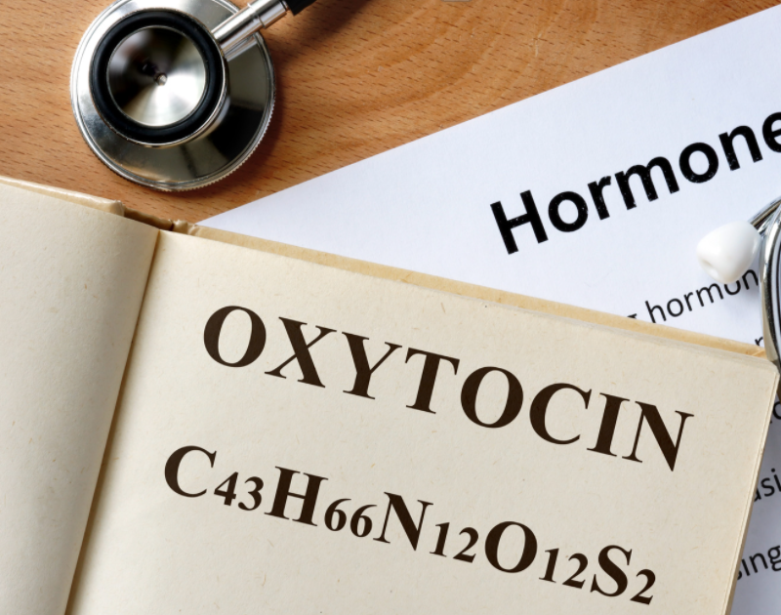
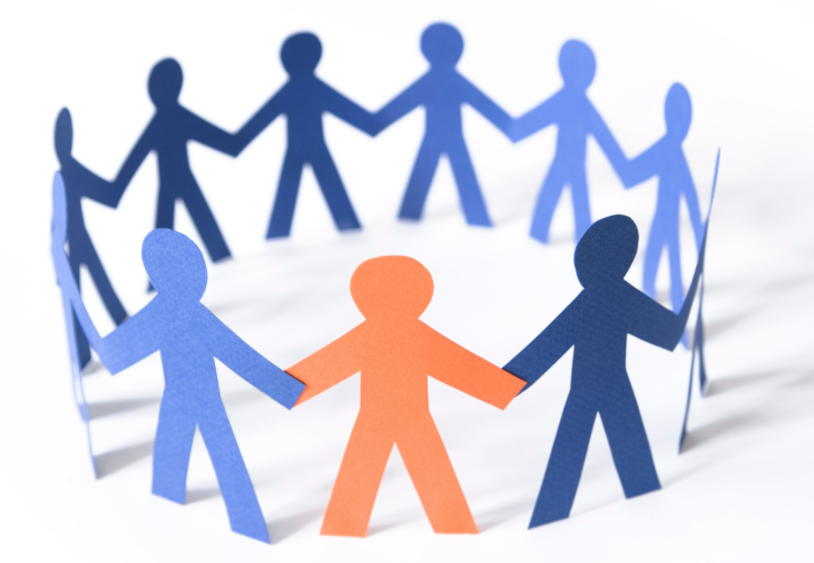
"[Oxytocin is] as much a part of your stress response as the adrenaline that makes your heart pound."
- Dr. Kelly McGonigal
Notes:
We may all feel some stress about the impact of digital technologies on our lives and the lives of those we care about, and by gathering together, we may very well be changing our chemistry by fostering the "tend and befriend" hormones that are built into the stress response. Thank you for being a part of our learning community!
"[Oxytocin is] as much a part of your stress response as the adrenaline that makes your heart pound. And when oxytocin is released in the stress response, it is motivating you to seek support. Your stress response wants to make sure you notice when someone else in your life is struggling so that you can support each other."
"OK, so how is knowing this side of stress going to make you healthier? Well, oxytocin doesn't only act on your brain. It also acts on your body. Oxytocin helps heart cells regenerate and heal from any stress-induced damage. This stress hormone strengthens your heart. And the cool thing is that all of these physical benefits of oxytocin are enhanced by social contact and social support. Your stress response has a built-in mechanism for stress resilience, and that mechanism is human connection."

Slide 4
Discussion #4 Physical Wellness
Bringing Digital Wellness Home

Slide 5
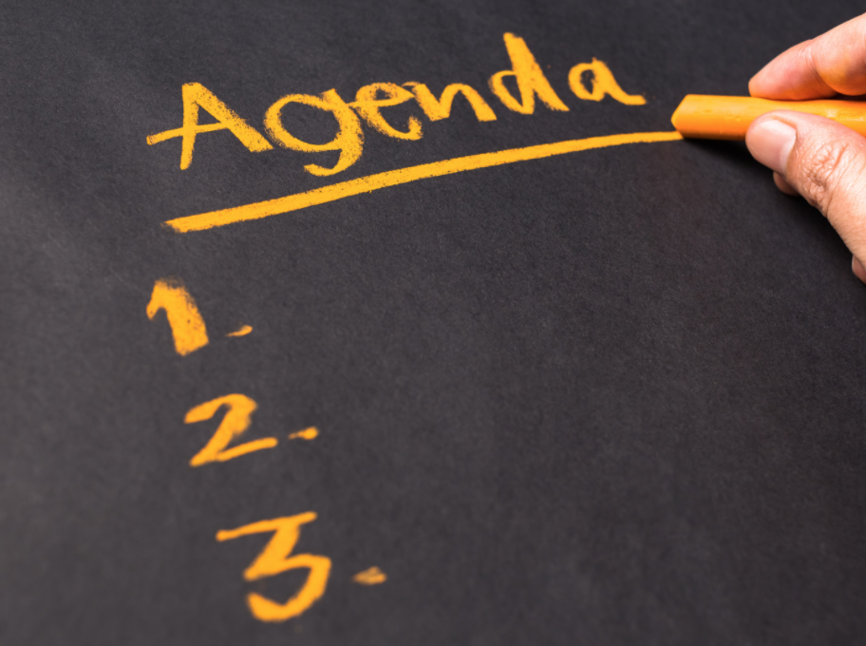
Agenda
Check-in Activity
Content/Concept Sharing
Connection/Discussion Activity
Challenge (Invitation) & Wrap-up
Notes:
For today's gathering, please have a paper and writing utensil (or a digital equivalent).
From its beginnings, EPIK has deliberately designed gatherings to be interactive, participatory, and action-oriented. We'll start every week with something that can help us check in (and build our sense of shared humanity, community, and group safety), explore some content (we'll not be able to cover it all, so we provide a repository of resources for you), and a challenge/invitation to take home and practice and/or share with your family/friends/coworkers.

Slide 6
Check-in: Question
Where in your body do you tend to "feel stress?"
Notes:
We may feel stress in different ways at different times in our bodies, but in general, do you have one area of your body that tends to "feel stress" more than others?

Slide 7
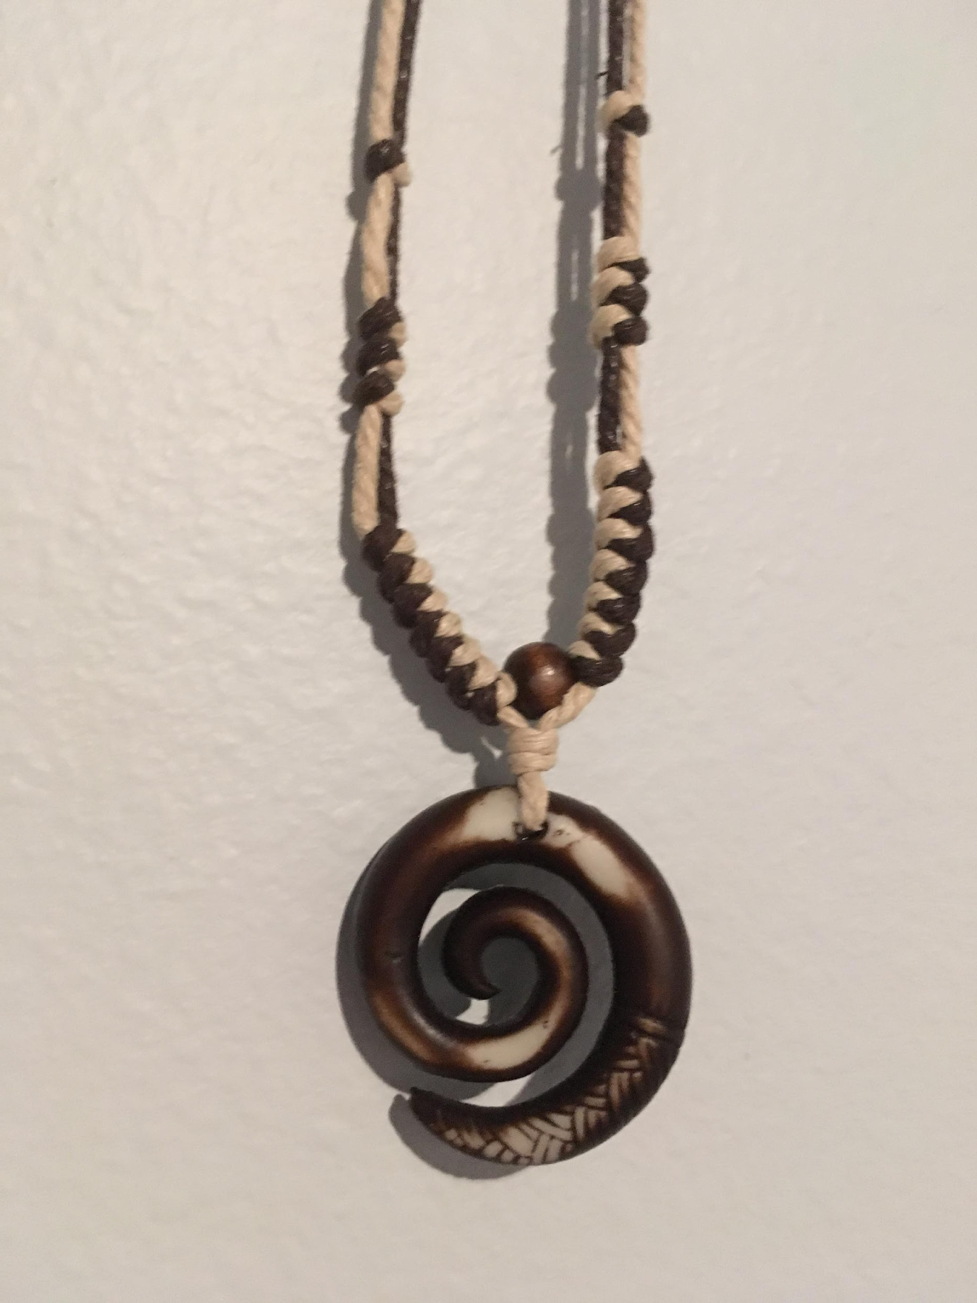
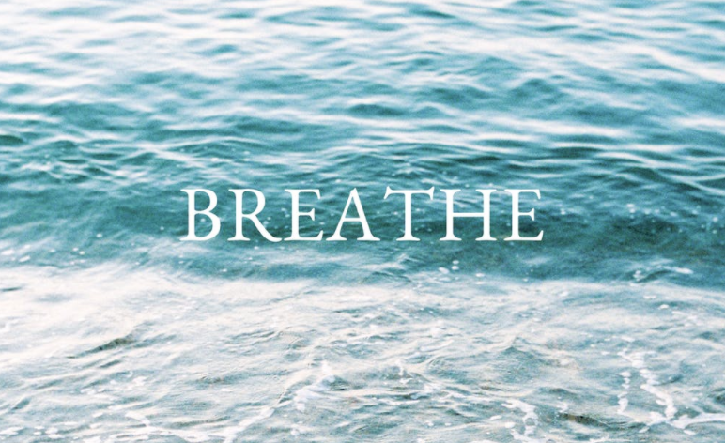
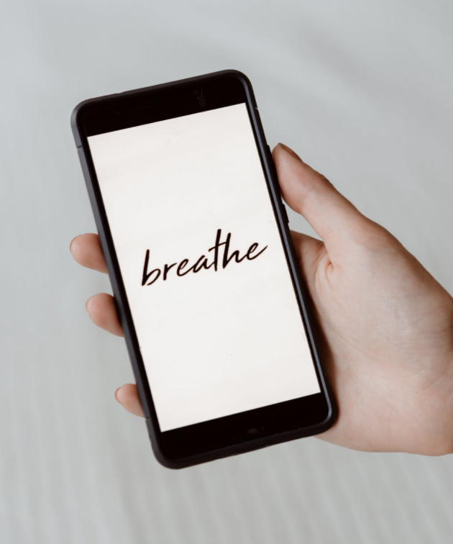
Settle in: Breathe
Notes:
For our check-in today, we'll start by piggybacking off a couple of things we explored last week. One was the power of stopping to breathe mindfully (we shared the "inhale for 4, exhale for 6" approach, but you can research other breathing techniques. [Some research supports the idea of a little longer exhale helping with Heart Rate Variability (HRV), which is seen as an indicator of resilience that can improve with mindfulness and other wellness practices.)
We will also engage our senses, and revisit the power of "pointing and name" – raising awareness by naming what we are feeling and thinking. Today, we will add to our awareness toolbox by using "point and name" with relation to our five physical senses. (Note: In all of these activities, the pointing doesn't have to be literal. :) )
On the power of pointing and naming, as it were, on improving wellness, habits, etc. see this from James Clear, an excerpt from chapter 4 of his books, Atomic Habits (shared on his website). https://jamesclear.com/habits-scorecard

Slide 8
Settle into Your Senses
5 - See
4 - Feel
3 - Hear
2 - Smell
1 - Taste
(or one good thing about yourself)
Notes:
The title of this slide comes from a book by Dr. Stanley Block by the same name. See also https://www.youtube.com/watch?v=tFK9c3N3IVs or a free workshop offered by USU: https://chass.usu.edu/social-work/i-system-institute/building-resilience-workshops
For our check-in today, we'll start by piggybacking off a couple of things we explored last week. One was the power of our breath. Another was the benefit of engaging with our senses, and the other was the power of "pointing and naming" – raising awareness by naming what we are feeling and thinking. Today, we will add to our awareness toolbox by using "point and name" with relation to our five senses. (The pointing doesn't have to be literal.)
On the power of pointing and naming, as it were, on improving wellness, habits, etc. see this from James Clear, an excerpt from chapter 4 of his books, Atomic Habits (shared on his website). https://jamesclear.com/habits-scorecard

Slide 9
Check-in Activity
I'll give you one minute
please put your mic on mute, and you can turn off video for this activity
(Point and) Name
5 things you see (a variation – 5 things of one color)
4 things you feel (touch)
3 things you hear
2 things you smell
1 thing you taste
(or things you like to smell & taste if those senses are hard to tap into at the moment)
Notes:
For our check-in today, we'll start by piggybacking off a couple of things we explored last week. One was the power of stopping to breathe mindfully (we shared the "inhale for 4, exhale for 6" approach, but you can research other breathing techniques. [Some research supports the idea of a little longer exhale helping with Heart Rate Variability, which is seen as an indicator of resilience that can improve with mindfulness and other wellness practices.)
We will also engage our senses, and revisit the power of "pointing and name" – raising awareness by naming what we are feeling and thinking. Today, we will add to our awareness toolbox by using "point and name" with relation to our five physical senses. (Note: In all of these activities, the pointing doesn't have to be literal. :) )
On the power of pointing and naming, as it were, on improving wellness, habits, etc. see this from James Clear, an excerpt from chapter 4 of his books, Atomic Habits (shared on his website).

Slide 10
"Come to your Senses" - Ready, set, go!
5 - See
4 - Feel/Touch
3 - Hear
2 - Smell
1 - Taste
(or one good thing about yourself)
Feedback on the activity:
"That works!"
"Connected me to the space I’m in"
"it helps me be present"
Notes:
The title of this slide comes from a book by Dr. Stanley Block by the same name. See also https://www.youtube.com/watch?v=tFK9c3N3IVs or a free workshop offered by USU: https://chass.usu.edu/social-work/i-system-institute/building-resilience-workshops
For our check-in today, we'll start by piggybacking off a couple of things we explored last week. One was the power of our breath. Another was the benefit of engaging with our senses, and the other was the power of "pointing and naming" – raising awareness by naming what we are feeling and thinking. Today, we will add to our awareness toolbox by using "point and name" with relation to our five senses. (The pointing doesn't have to be literal.)
On the power of pointing and naming, as it were, on improving wellness, habits, etc. see this from James Clear, an excerpt from chapter 4 of his books, Atomic Habits (shared on his website). https://jamesclear.com/habits-scorecard

Slide 11
Agenda
Check-in Activity
Content/Concept Sharing
Connection/Discussion Activities
Challenge (Invitation) for the upcoming week
Notes:
Today we are talking about Physical Wellness. Once again, this is a multifaceted concept, so we will only be scratching the surface but we hope something here will be helpful!

Slide 12
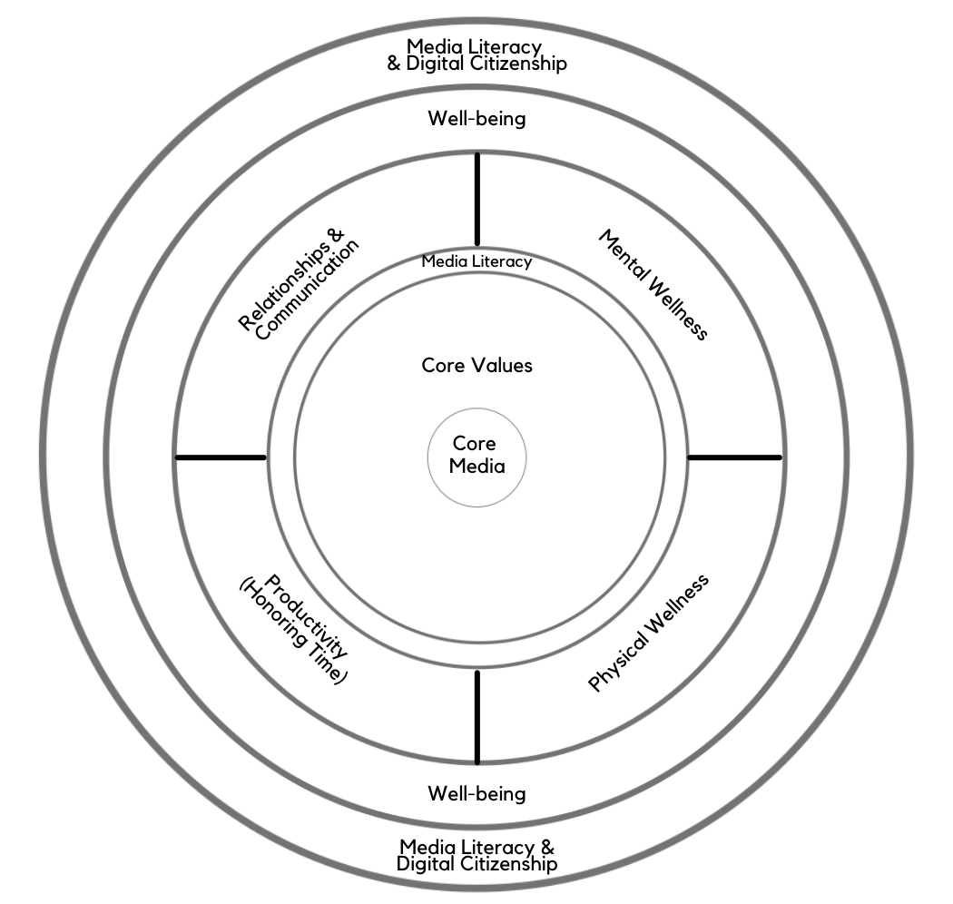
Digital Centeredness Model
Start with Your Center
Media Literacy
Mental Wellness*
Physical Wellness*
Productivity (Honoring time)*
Relationships*
Well-being*
Digital Citizenship* & Media Literacy
Bonus: Social Development Strategy
All of the topics with an asterisk are included in the DWI Digital Wellness self-assessment https://survey.alchemer.com/s3/5504604/b153c792d361
Notes:
What we covered in earlier weeks will be relevant as we engage in each of the different wellness topics that are included in the Digital Wellness Institute's self-assessment. https://survey.alchemer.com/s3/5504604/b153c792d361
There is so much we could cover, and so many ways we could cover this topic. We'll use the DWI self-assessment as our map for most of our topic review today.

Slide 13
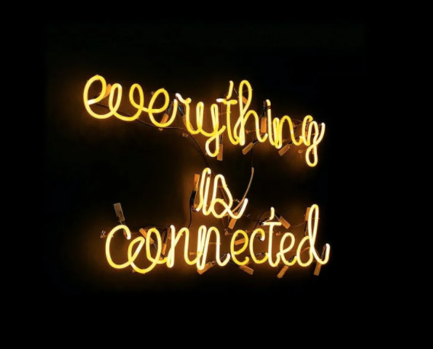
Everything is Connected
Notes:
As we discussed last week, you will see throughout the series that concepts in each module interrelate to other modules. Similarly, although this is a series on Digital Wellness, many concepts we explore relate to Wellness in general. As we progress through the series, consider discussing with someone the overlaps and patterns that you are seeing across modules, or insights that are coming that help you connect concepts at a deeper level.

Slide 14
Digital Centeredness Model
can also be discussed in terms of environments
Notes:
Another way to think about these different elements of the model is to think about different environments. Listen to the recording for more detail on this. Next week, we'll talk about different domains in our lives.

Slide 15
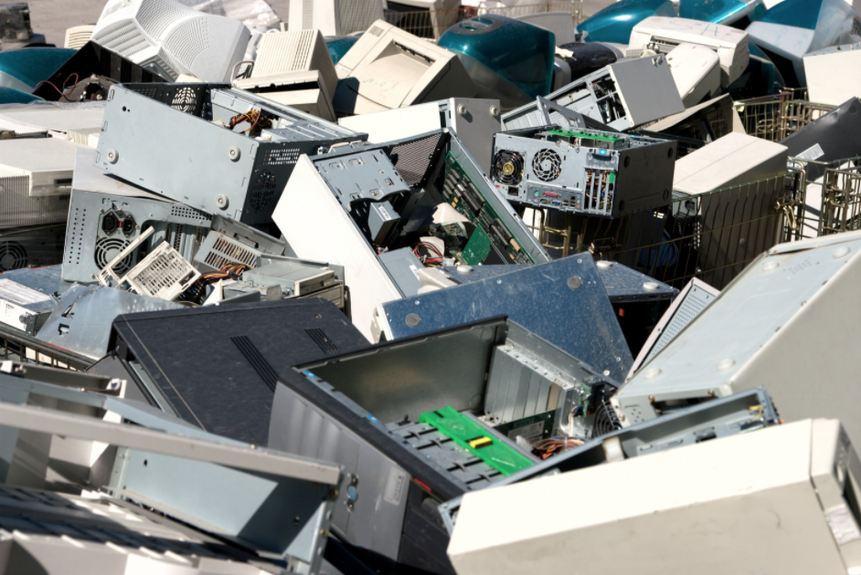
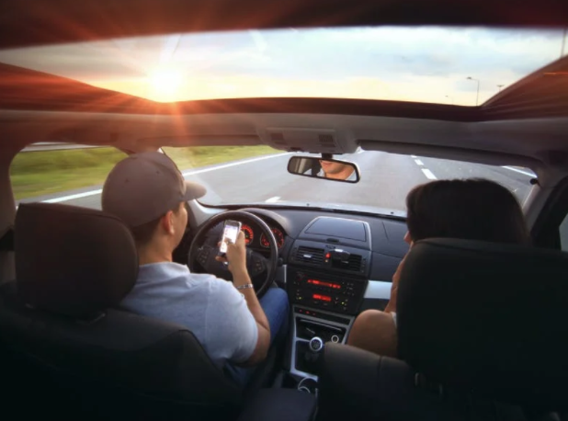
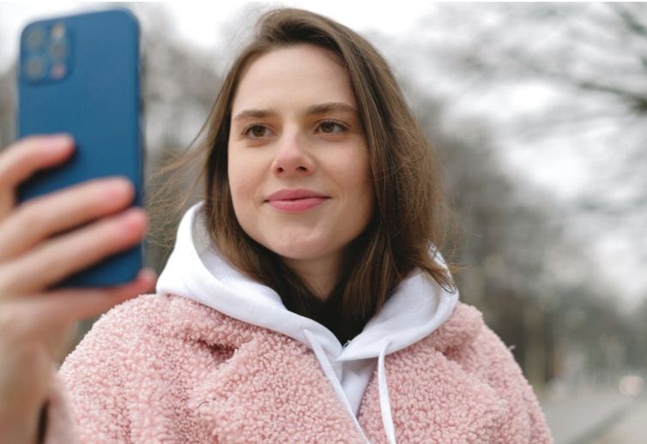
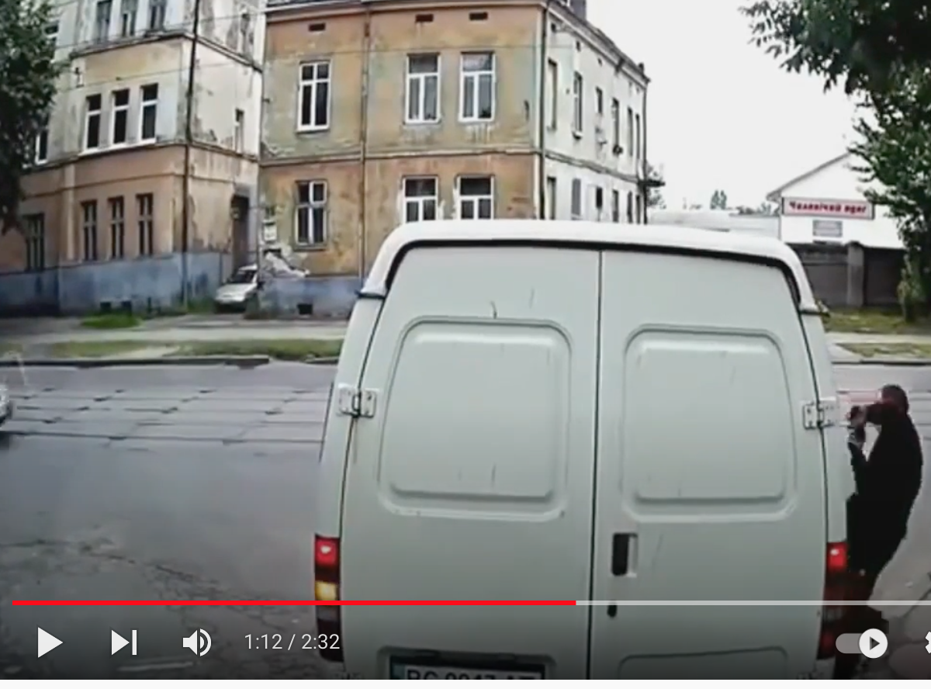
https://www.youtube.com/watch?v=ynvd70b-uCY
Notes:
These pictures are included to get our brain juices going about the impact of digital life/devices/etc on our relationship to our physical space, environment. Even our physical safety. What kinds of pictures might you have added to this collage?
UN link about e-waste: https://www.un.org/sustainabledevelopment/blog/2015/05/un-environment-chief-warns-of-tsunami-of-e-waste-at-conference-on-chemical-treaties/

Slide 16
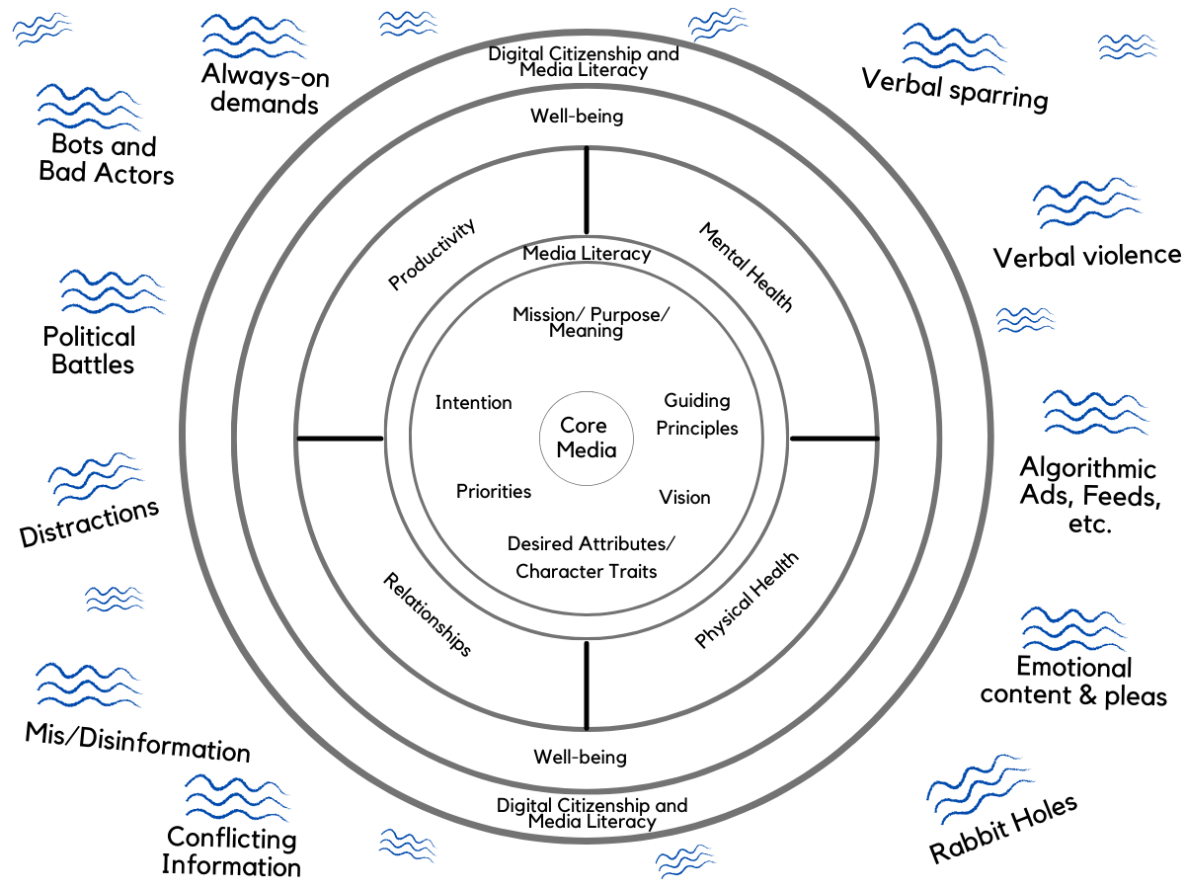
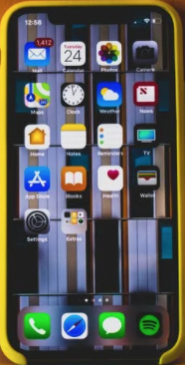
etc.
etc.
How can the water we swim in
(our digitally-saturated environment)
impact our bodies?
What are some simple things we can do to improve physical wellness?
etc.
etc.
etc.
etc.
Notes:
There are so many things "out there" that are bombarding us (or wanting to bombard us)...all the more so because of constant (and instant) access to so many potential inputs. This is the water we swim in. This is a significant part of the environment around us which can impact the environment in our minds, in our bodies, in our physical space, in our relationships, in our work, etc. In many different domains/areas/spheres in our lives.

Slide 17
Befriending the body’s
stress response
Practicing Resilience
Notes:
https://www.ted.com/talks/kelly_mcgonigal_how_to_make_stress_your_friend?language=en – Look at the little girl peeking out to look at what she may have been hiding from before. Note that we are talking about our physical stress responses, but obviously physical and mental wellness are interconnected

Slide 18
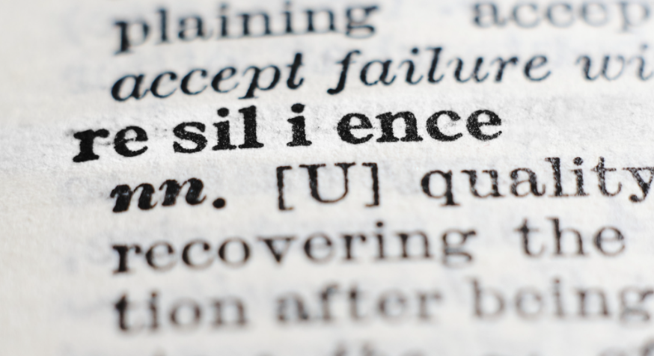
What if the stress response is not a bug, but a feature?
Notes:
See this interview on NPR: https://www.npr.org/transcripts/747384008
https://www.ted.com/talks/kelly_mcgonigal_how_to_make_stress_your_friend?language=en – Ask the question – where does stress tend to show up for you in your body? Note: The two circles represent what happens to blood vessels when experiencing stress as a negative vs. those who have befriended stress. Blood vessels, as shown in a study at Harvard mentioned by Dr. McGonigal, are softer and more relaxed in the lower representation. See the TED talk for more information. Different hormones can also be released depending on our mindset (see her book for more details).

Slide 19
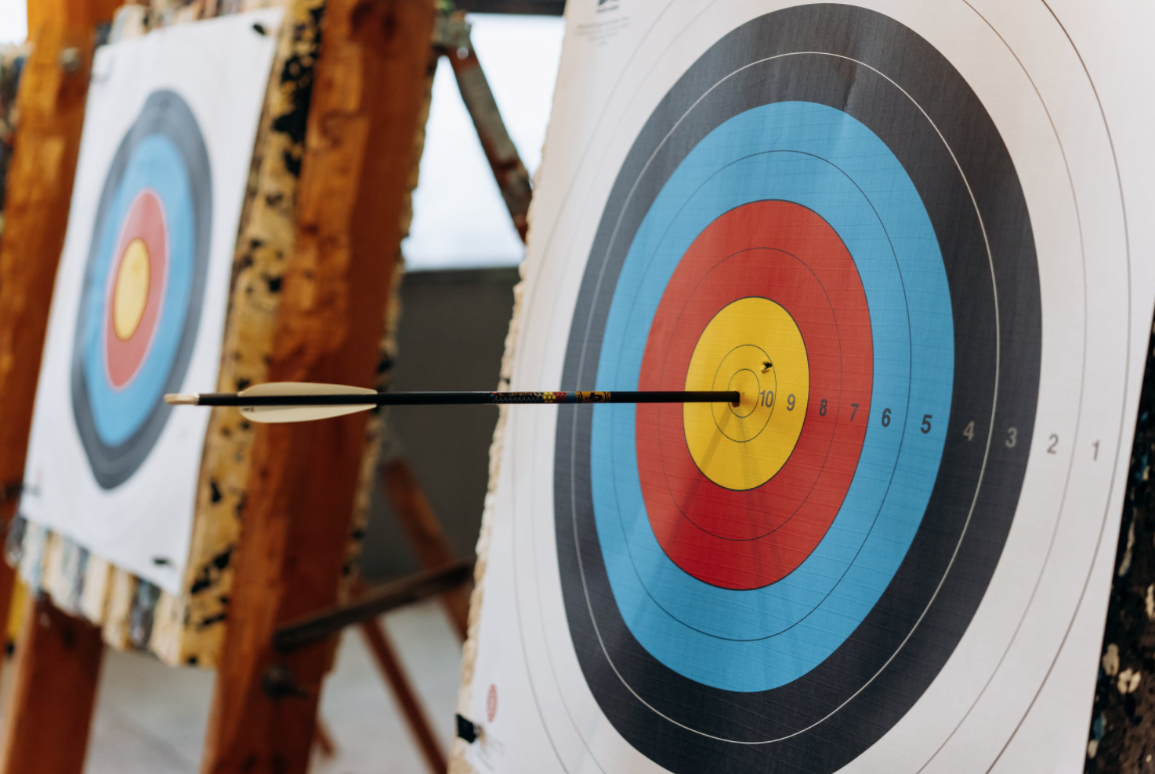
From last week…
"What does this reaction/feeling tell me about what matters to me?"
Notes:
As we discussed last week, when you look at hard emotions, and get curious about them, you may actually discover that your reactions are often connected to the things that matter most to you. We can turn the REaction around, leverage the energy our body is giving to us, and redirect our actions toward things that are more consistent with who we really want to be and how we want to show up in the world. We can turn a reaction into a response. This reframing, this mindset practice, also has the potential to give another entry point into our self-reflection processes regarding what our priorities and core values are. (We'll talk more about being more deliberate about our priorities next week.)

Slide 20
Hope is Built into our Biology
https://www.ted.com/talks/kelly_mcgonigal_how_to_make_stress_your_friend?language=en
“When we change our mindset about stress, even in ‘stressful’ situations, our bodies can respond in healthy ways, even at the cardiovascular and chemical level. Scientists are discovering more that how we think about stress has a great impact on our health vs. just stress itself. In fact, those with a resilient mindset about stress…can show even greater health markers than those not under similar ‘stress.’”
Resilience = reframe into an opportunity
Notes:
https://www.ted.com/talks/kelly_mcgonigal_how_to_make_stress_your_friend?language=en
Note: The two circles represent what happens to blood vessels when experiencing stress as a negative vs. those who have befriended stress. Blood vessels, as shown in a study at Harvard mentioned by Dr. McGonigal, are softer and more relaxed in the lower representation. See the TED talk for more information. Different hormones can also be released depending on our mindset (see her book for more details).
See also this interview on NPR: https://www.npr.org/transcripts/747384008

Slide 21
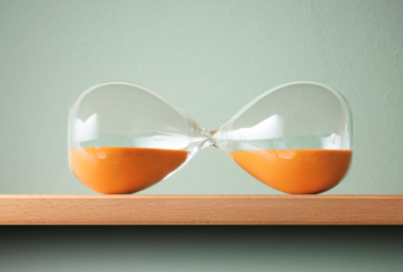
Pause, Ask Questions to practice awareness…
Situation and/or physical responses
Decision/Action
Notes:
Once again, the notion of PAQ comes into play. Media literacy principles apply to physical wellness as well! The process of stopping and asking questions about a stressor in your environment or situation, using questions to reframe the situation in terms of opportunity and gratitude for the body's capabilities and signals, as explored by Dr. Kelly McGonigal (see e.g., next slide) can impact the balance of hormones released during stressful situations.
Once again, by slowing down and plugging into your own mind, you can bring a little more of your internal iceberg above the surface and invite internal biochemistry to support and foster more wellness outcomes. But once again, it is difficult to change or address or understand things we cannot see and name. We talked quite a bit in the spontaneous discussion about the power of naming feelings as part of building awareness or mindfulness.
Remember, "In the attention economy, mindfulness is activism." -Jay Vidyarthi https://medium.com/mindfulness-and-meditation/in-the-attention-economy-mindfulness-is-activism-4241cc766ac

Slide 22
…also using your values as a compass for reframing
"I'm stressed. My heart is pounding. I'm feeling lonely. I'm feeling confused. I'm feeling overwhelmed.
"What's something I can do in this moment that is going to accept that, figure out what it is that matters most and then use some of this energy, use some of this biochemistry to make choices or take actions that are consistent with what matters most?"
Situation
Decision/Action
Notes:
Point and name and reframe. Note how first, Dr. McGonigal encourages awareness and acceptance. "OK, this is happening in my situation and in my mind and emotions and body as a response." But then she invites that prefrontal engagement, and connects that engagement to centering values. This kind of process can transform the stress response from something that can breed more anxiety or sense of failure into positive, conscious action that aligns with who you are and who you want to be and how you want to show up in the world.
Such a process of mindset change can actually change the mix of chemicals and hormones flowing through your body!
Remember, "In the attention economy, mindfulness is activism." -Jay Vidyarthi https://medium.com/mindfulness-and-meditation/in-the-attention-economy-mindfulness-is-activism-4241cc766ac

Slide 23
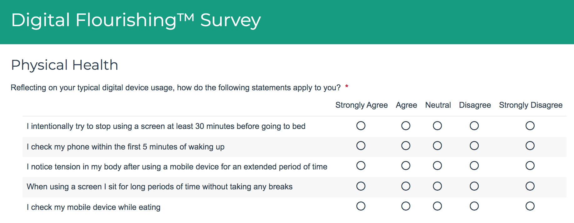
Physical Wellness DWI Self-assessment Review
https://survey.alchemer.com/s3/5504604/b153c792d361
Notes:
https://survey.alchemer.com/s3/5504604/b153c792d361

Slide 24
What questions would you add for yourself?
Notes:
You can create your own questions as well. As you practice Digital Centeredness, you may become more aware of things you want to watch for or practice in the Mental Wellness element of Digital Wellness.

Slide 25
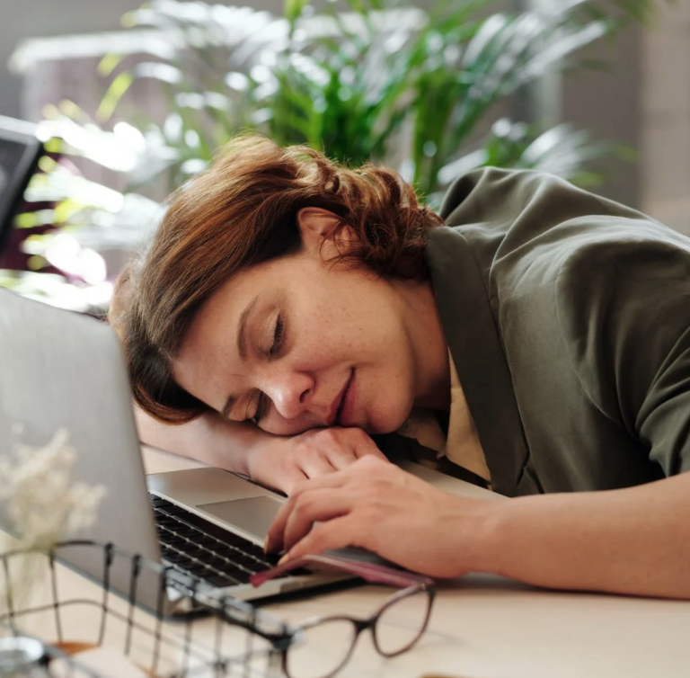
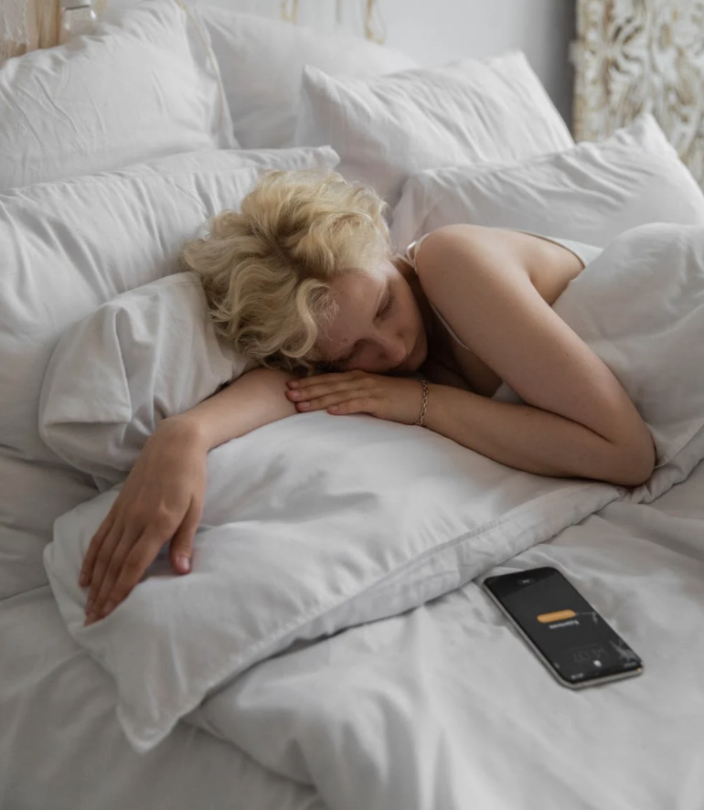
Physical Wellness DWI Self-assessment Review: Sleep Hygiene
Sleep Hygiene and Tech (2 questions, adapted)
Do you use a device immediately before going to bed?
How much time passes in the morning before you check a device?
(+ Is “Mere Presence” an issue with your sleep routine?)
https://survey.alchemer.com/s3/5504604/b153c792d361
Notes:
Mere presence research link: https://www.journals.uchicago.edu/doi/10.1086/691462 – many experts also talk about how having screens in the bedroom can impact sleep, particularly when it comes to personal devices with their ever-presence siren song to check for one more thing….

Slide 26
Physical Health DWI Self-Assessment Review (Q1&2)
Does any of this look familiar?
https://survey.alchemer.com/s3/5504604/b153c792d361
Notes:
If any of this looks familiar, then you are not alone!...

Slide 27
Physical Health DWI Self-assessment Review: Sleep Hygiene
One study showed
74% check devices 15 minutes before sleeping
61% of people check phones 5 minutes after waking up
88% check their phones within 30 minutes of waking up
96% check within an hour of waking up
https://www.bgr.in/news/61-people-check-their-phones-within-5-minutes-after-waking-up-deloitte-435501/
Also see research about blue light impacts on sleep: https://www.sleep.org/ways-technology-affects-sleep/
Notes:
…research support this "not alone"ness
https://www.bgr.in/news/61-people-check-their-phones-within-5-minutes-after-waking-up-deloitte-435501/
Also see research about blue light impacts on sleep: https://www.sleep.org/ways-technology-affects-sleep/

Slide 28
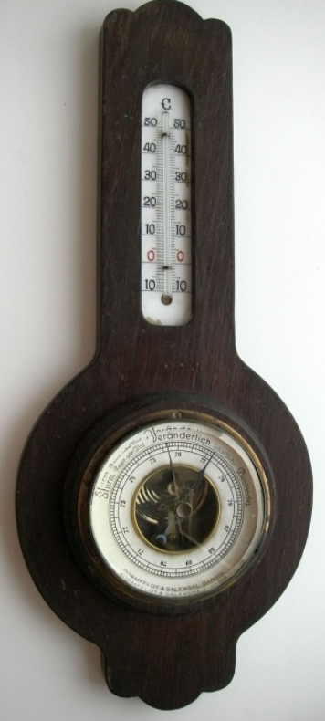
Impact of negative news in the morning
Three minutes of negative news
can decrease positivity by 27%
-Research by Shawn Achor and Michelle Gielan
https://hbr.org/2015/09/consuming-negative-news-can-make-you-less-effective-at-work
Notes:
I find a negative impact on sleep prep when I read negative news at night as well. How about you?

Slide 29
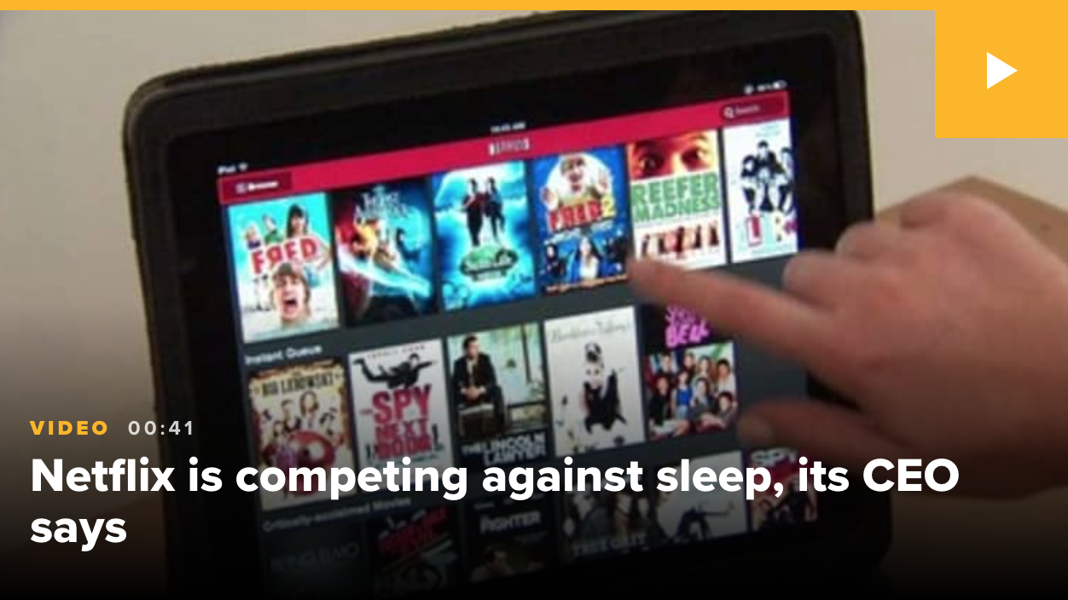
Physical Wellness DWI Self-assessment Review: Sleep Hygiene
Notes:
https://www.cnbc.com/2017/04/17/amazon-hbo-netflix-thinks-its-real-competitor-is--sleep.html – this is an example of what we mean when we talk about “The Attention Economy.” Interestingly, at the time of this discussion, a hearing was happening in Washington about the negative impacts of the algorithm- and profit-driven Attention Economy on the well-being of youth, with input from a former Facebook employee.

Slide 30
Physical Wellness DWI Self-assessment Review: Sleep Hygiene
Blue light can impact the body’s circadian rhythm [biological sleep cycle)
Children are more sensitive to the impacts of blue light
https://www.sleep.org/ways-technology-affects-sleep/
Notes:
https://www.sleep.org/ways-technology-affects-sleep/

Slide 31
Physical Wellness DWI Self-assessment Review: Sleep Hygiene Recommendations
Before bed: at least 30 minutes with no tech
Upon awakening: Do a no-tech morning routine
Remember the impact of negative news
At the very least, try to avoid beginning or ending the day with news
Notes:
Another news article about news: https://michellegielan.com/project/hbr-consuming-negative-news-can-make-you-less-effective-at-work

Slide 32
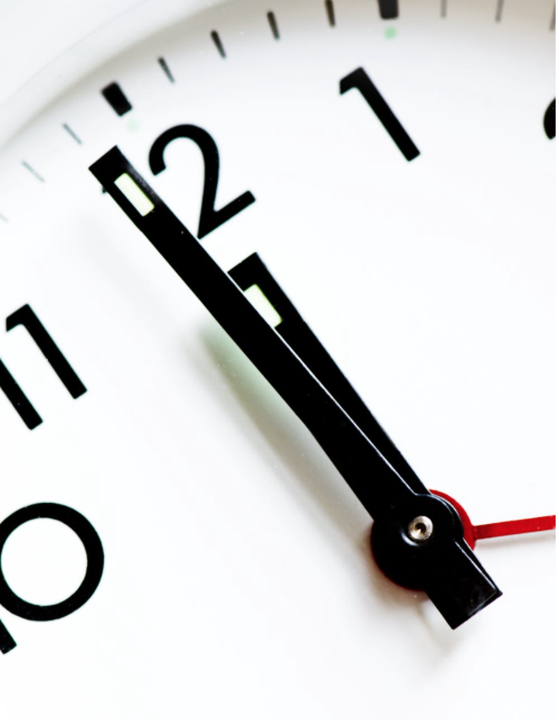
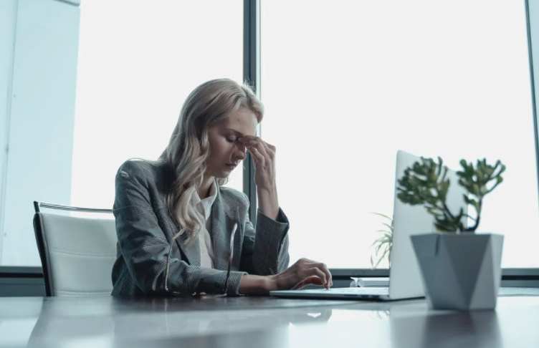
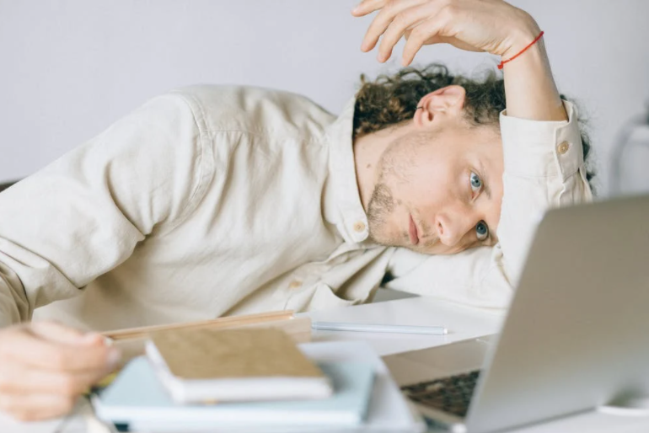
Physical Wellness DWI Self Assessment Review (Q3&4):
Overwork & Physical Strain
Notes:
DWI Survey link: https://survey.alchemer.com/s3/5504604/b153c792d361
These questions might be important for parents to discuss with children who are doing online school or a lot of computer homework

Slide 33
Do you tend toward long stretches of time on devices …
Notes:
DWI Survey link: https://survey.alchemer.com/s3/5504604/b153c792d361
These questions might be important for parents to discuss with children who are doing online school or a lot of computer homework

Slide 34
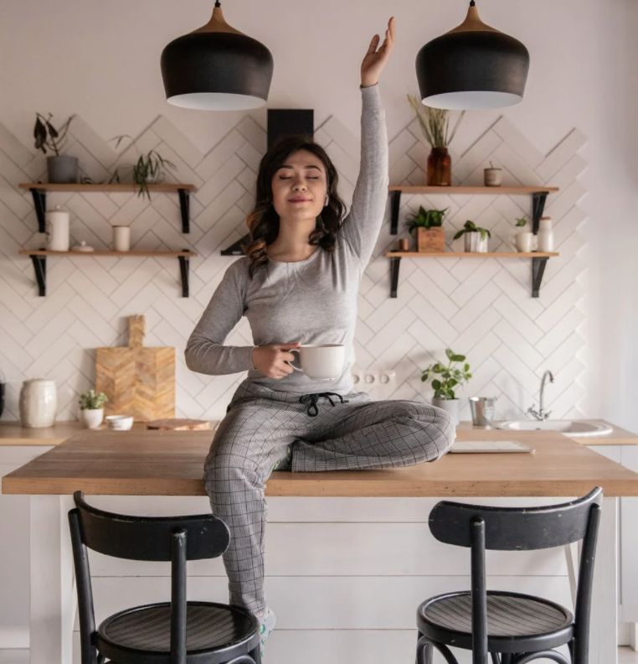
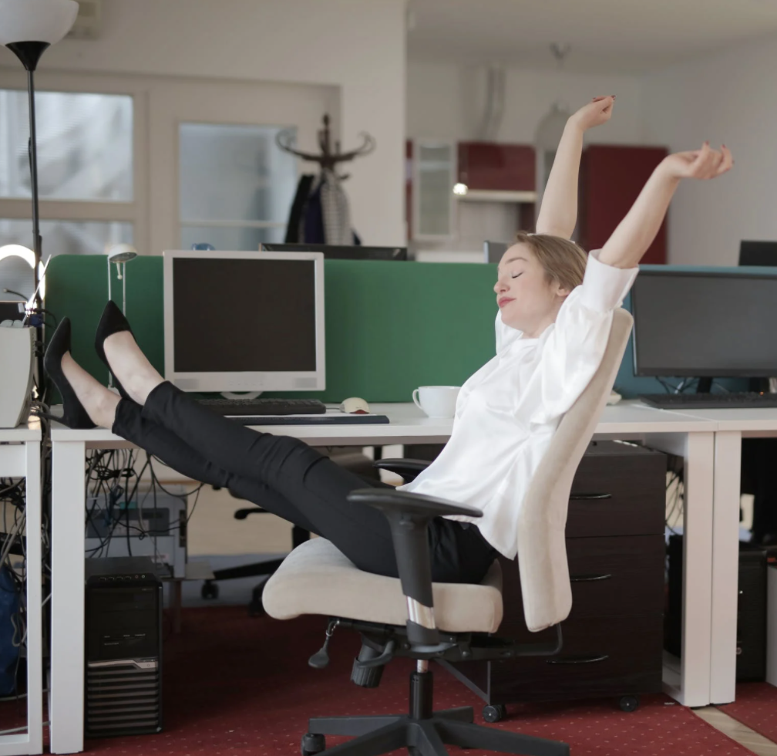
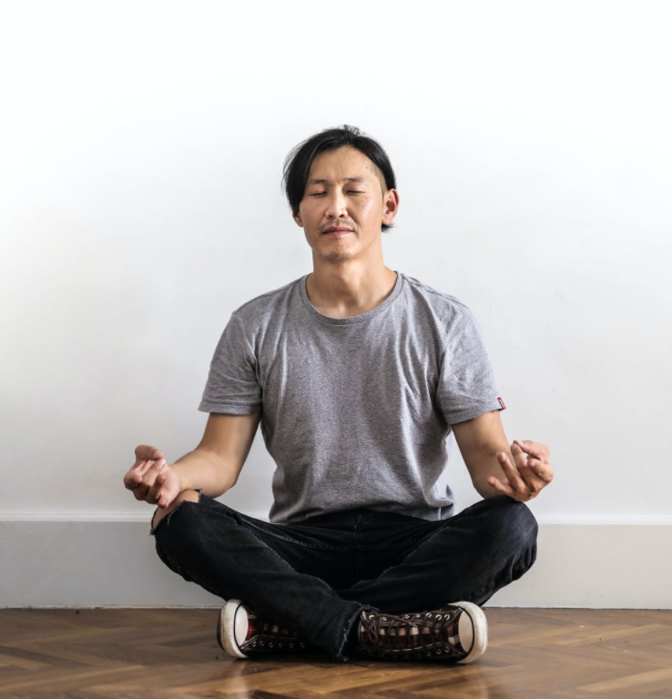
… or do you take deliberate breaks?
https://survey.alchemer.com/s3/5504604/b153c792d361
Notes:
These questions might be important for parents to discuss with children who are doing online school or a lot of computer homework

Slide 35
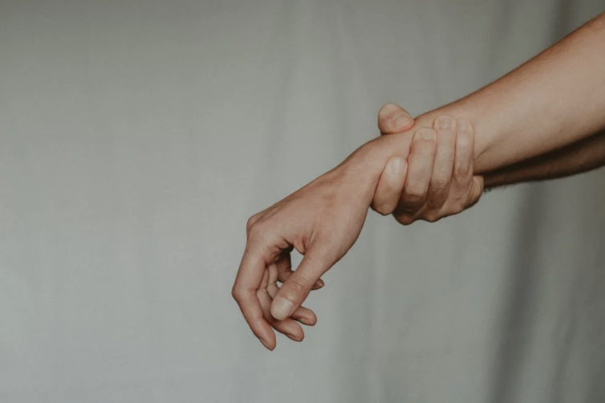
What does your body feel like when you’ve been on a device for a too long? Where in your body do you feel the impact?
Notes:
These questions might be important for parents to discuss with children who are doing online school or a lot of computer homework

Slide 36
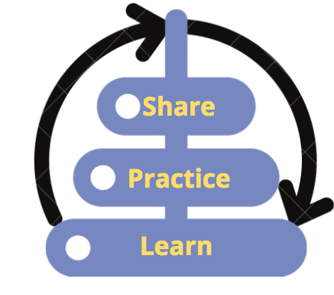
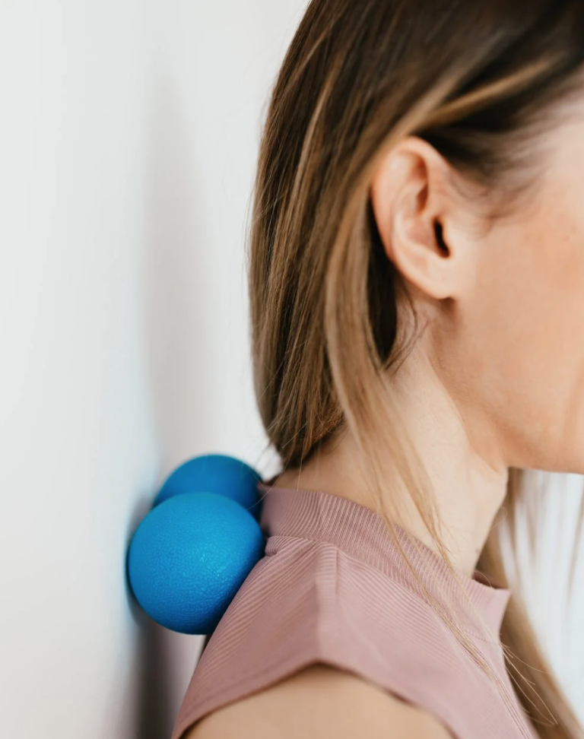
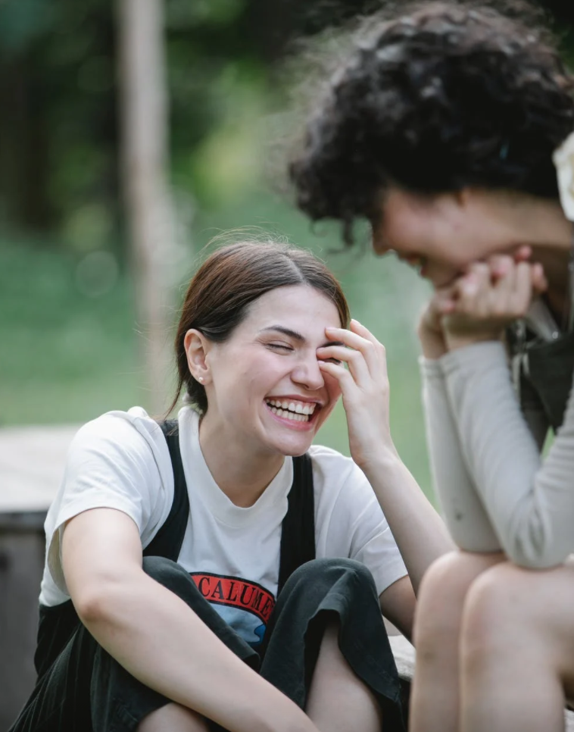
Recommendations re: overwork, physical strain
90 minutes is our typical maximum limit before work fatigue hits*
Recommendation: ~5-15 minutes of a break every 60-90 minutes (or at least 30-60 seconds every 30 minutes)
Note: We’ll be talking more about productivity and time management next week
*https://theenergyproject.com/ideas/activity-does-not-always-equal-productivity/
Notes:
These questions might be important for parents to discuss with children who are doing online school or a lot of computer homework

Slide 37
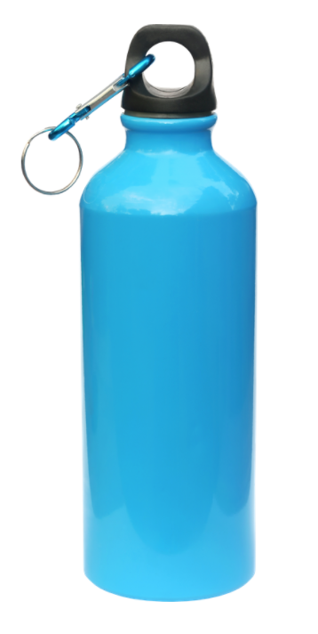
p.s. A simple trick to build in breaks ☺
Notes:
Idea credited to James Garrett, shared in a brain plasticity/brain health small group course. The idea of doing a couple of pushups mentioned in the recording comes from BJ Fogg's book, Tiny Habits.

Slide 38
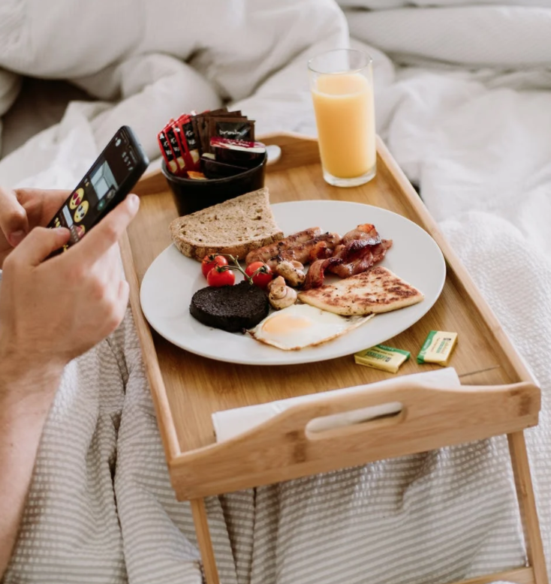
Physical Wellness DWI Self Assessment Review: Q5 Screen-free Eating
How often do you personally practice screen-free eating (or not)?
Remember this man’s wrists when you review bonus materials on ergonomics

Slide 39
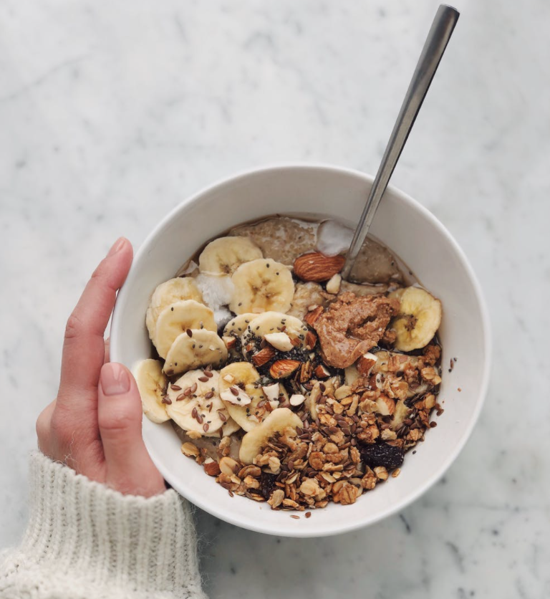
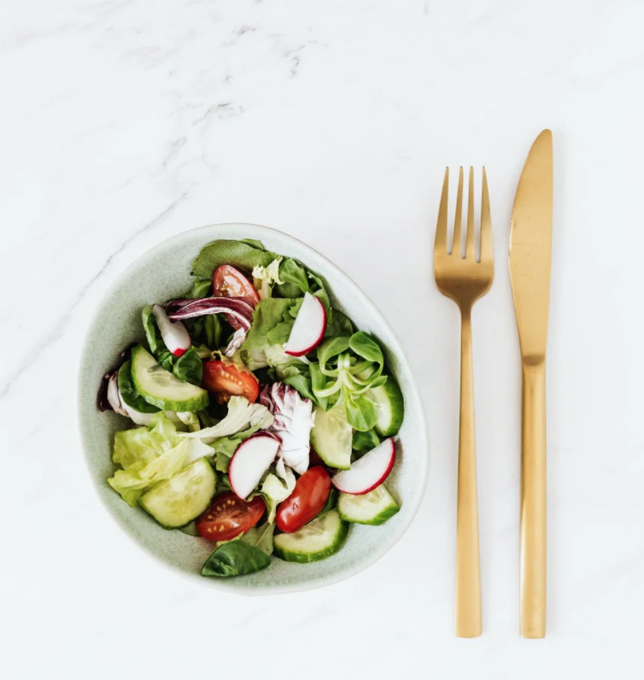
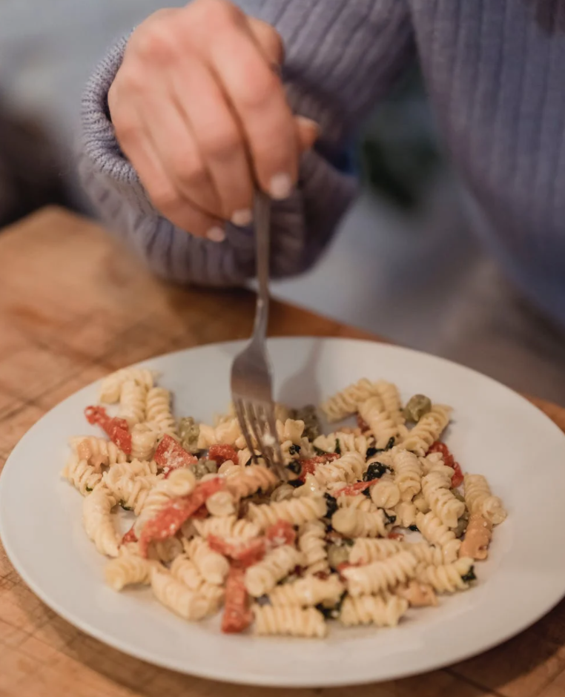
Physical Wellness Recommendation:
Screen-free Eating
Eat at least one meal (or snack) a day screen-free
(aim for more)…good for brain and body!
p.s. This can be good for relationships, too!
Notes:
Someone shared in a discussion elsewhere that single-tasking felt “like a walk in the forest.” Making this one change to do tech-free eating has had a significant impact for EPIK’s Michelle. Some take this idea even further to practice what is called Mindful Eating, something we did not discuss in the Parent Conversation. We’ll be talking more about single-tasking next week.

Slide 40
Physical Wellness Recommendation - A Plea:
Screen-free Driving and Walking
https://www.youtube.com/watch?v=ynvd70b-uCY
Notes:
We wanted to be sure to cover this topic as part of our Physical Wellness discussion. Many statistics show the dangers of texting and driving. Videos like the above even show the dangers of walking and looking at our phones. Our brains really can’t do two environments at once. We’ll talk more about multi-tasking last week, but in this context, this is about physical safety, perhaps even impacting mortality rates.

Slide 41
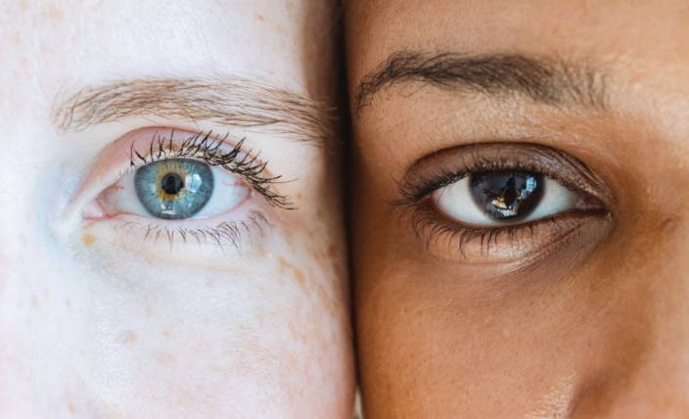
~~~ Blink and Breathe Break ~~~
Blinking can provide
"wakeful rest"
Notes:
https://summit.digitalwellnessday.com/talks/digital-strain-how-it-affects-our-sleep-and-why-our-blinks-matter/
Research on the impact of the blink on the brain: https://www.pnas.org/content/110/2/702 or https://www.researchgate.net/publication/233984548_Blink-related_momentary_activation_of_the_default_mode_network_while_viewing_videos]

Slide 42
Reflection Questions
What are you doing well?
Where are your weak spots?
What one thing do you want to work on this week?
What things have stood out to you from the series so far?

Slide 43
Possible invitations for the coming week
Take the DWI Digital Wellness self-assessment if you haven’t already https://survey.alchemer.com/s3/5504604/b153c792d361
Review today’s slides (or your personal notes) for one physical wellness activity you want to try or practice
Review today’s slides (or your personal notes) for one physical wellness concept to share with someone else: your spouse, a child, or a friend, a colleague, etc. Discuss.

Slide 44
We wish you well.

Slide 45
Bonus Materials

Slide 46
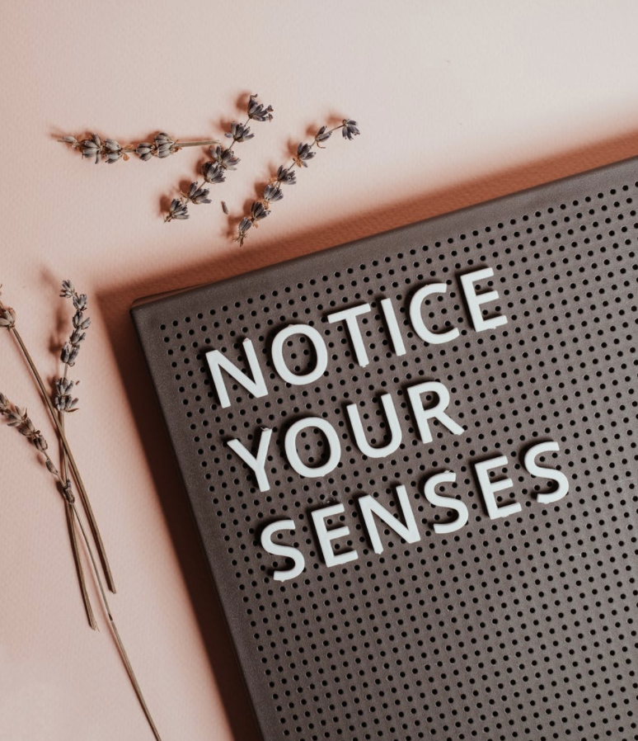
"Come to your Senses" resources
The title of this slide comes from a book by Dr. Stanley Block by the same name. See also https://www.youtube.com/watch?v=tFK9c3N3IVs or a free workshop offered by USU: https://chass.usu.edu/social-work/i-system-institute/building-resilience-workshops
See more in the Resources document in this week's folder
Notes:
On the power of pointing and naming, as it were, on improving wellness, habits, etc. see this from James Clear, an excerpt from chapter 4 of his books, Atomic Habits (shared on his website). https://jamesclear.com/habits-scorecard

Slide 47
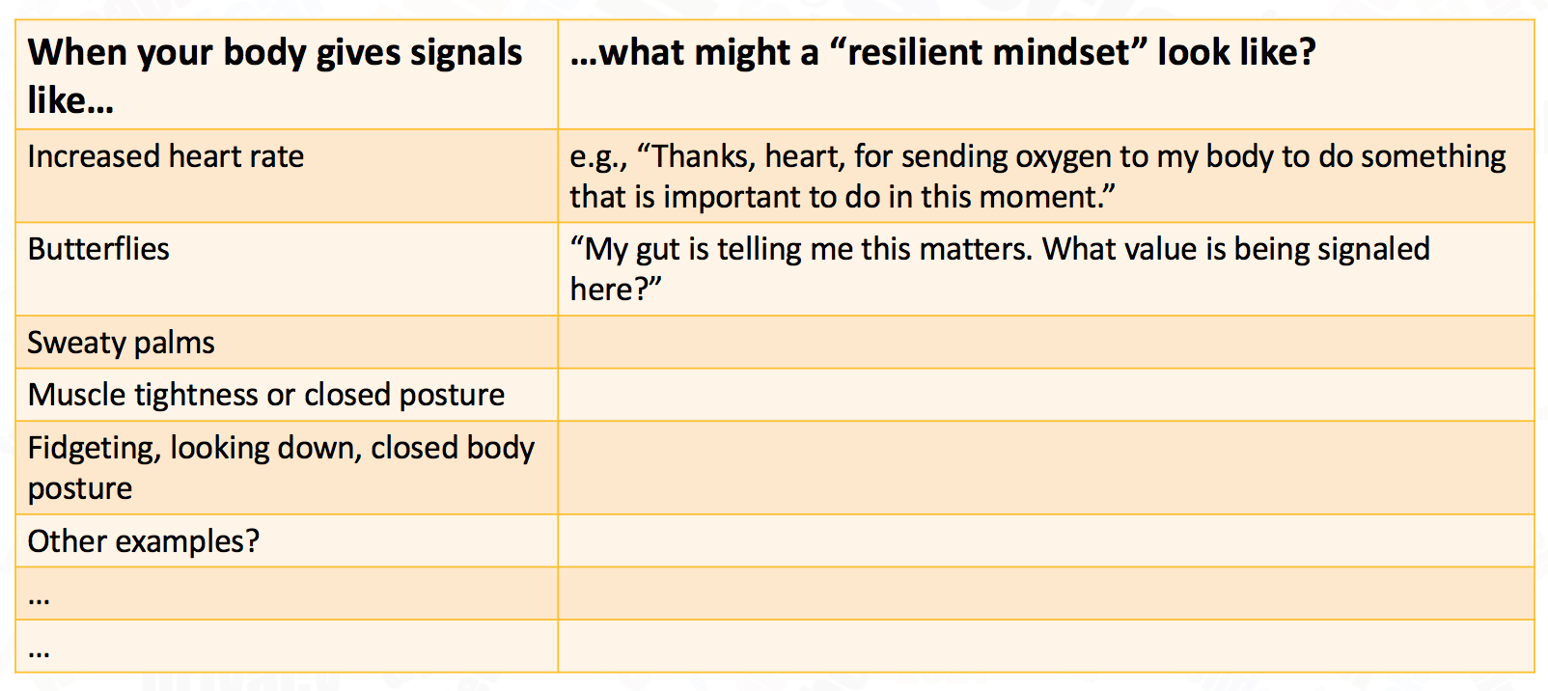
Reframing our mindset about stress
When your body gives signals like… | …what might a “resilient mindset” look like?
Increased heart rate | e.g., “Thanks, heart, for sending oxygen to my body to do something that is important to do in this moment.”
Butterflies | “My gut is telling me this matters. What value is being signaled here?”
Sweaty palms
Muscle tightness or closed posture
Fidgeting, looking down, closed body posture
Other examples?
…
…
Notes:
See The Upside of Stress for research on using the body to reframe and befriend stress. Note especially her notes pages for research she is curating. Or see this paper for another curation of similar ideas: https://cimbaitaly.com/wp-content/uploads/sites/6/2015/12/Als-Book-Club-PDF-December-2015.pdf

Slide 48
A Tech Tension Release Meditation
p.s. You can find many stretches online for
Neck
Lats
Glutes
Wrist extensors
Wrist flexors
Chin tucks
Walks (best outside)
Planks
Side planks
Squats
Skydiver
https://www.youtube.com/watch?v=olpOsrP_bTI
Notes:
Check with a doctor or physical therapist before starting any new routine

Slide 49
The "Mere Presence" Phenomenon
“[T]he "mere presence" of a cell phone may be sufficiently distracting to produce diminished attention and deficits in task-performance, especially for tasks with greater attentional and cognitive demands.”
Notes:
https://repositories.lib.utexas.edu/bitstream/handle/2152/64130/braindrain.pdf?sequence=2: “Working memory capacity” (WMC) reflects the availability of attentional resources, which serve the “central executive” function of controlling and regulating cognitive processes across domains (Baddeley and Hitch 1974; Miyake and Shah 1999; Engle 2002; Baddeley 2003). “Fluid intelligence” (Gf ) represents the ability to reason and solve novel problems, independent of any contributions from acquired skills and knowledge stored in “crystallized intelligence” (Cattell 1987). Similar to WM, Gf stresses the ability to select, store, and manipulate information in a goal-directed manner. Also similar to WM, Gf is constrained by the availability of attentional resources (e.g., Engle et al. 1999; Halford et al. 2007). Crucially, the limited capacity of these domaingeneral resources dictates that using attentional resources for one cognitive process or task leaves fewer available for other tasks; in other words, occupying cognitive resources reduces available cognitive capacity.

Slide 50
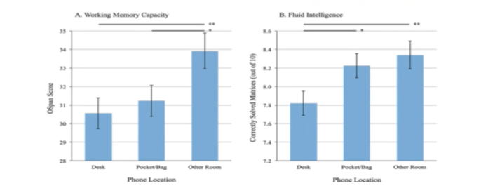
Reduce “brain drain”
=Practice social distancing from your phone!
Working Memory: resources for “controlling and regulating cognitive processes across domains”
Fluid Intelligence: ”ability to reason and solve novel problems” and manage cognitive processes for goal-oriented tasks
https://repositories.lib.utexas.edu/bitstream/handle/2152/64130/braindrain.pdf?sequence=2
Notes:
https://repositories.lib.utexas.edu/bitstream/handle/2152/64130/braindrain.pdf?sequence=2: “Working memory capacity” (WMC) reflects the availability of attentional resources, which serve the “central executive” function of controlling and regulating cognitive processes across domains (Baddeley and Hitch 1974; Miyake and Shah 1999; Engle 2002; Baddeley 2003). “Fluid intelligence” (Gf ) represents the ability to reason and solve novel problems, independent of any contributions from acquired skills and knowledge stored in “crystallized intelligence” (Cattell 1987). Similar to WM, Gf stresses the ability to select, store, and manipulate information in a goal-directed manner. Also similar to WM, Gf is constrained by the availability of attentional resources (e.g., Engle et al. 1999; Halford et al. 2007). Crucially, the limited capacity of these domaingeneral resources dictates that using attentional resources for one cognitive process or task leaves fewer available for other tasks; in other words, occupying cognitive resources reduces available cognitive capacity.

Slide 51
Reduce “brain drain” = “Mere Presence” Phenomenon
Practice social distancing from your phone!
“’Working memory capacity’ (WMC) reflects the availability of attentional resources, which serve the ‘central executive’ function of controlling and regulating cognitive processes across domains (Baddeley and Hitch 1974; Miyake and Shah 1999; Engle 2002; Baddeley 2003). ‘Fluid intelligence’ (Gf ) represents the ability to reason and solve novel problems… (Cattell 1987). Similar to WM, Gf stresses the ability to select, store, and manipulate information in a goal-directed manner. Also similar to WM, Gf is constrained by the availability of attentional resources (e.g., Engle et al. 1999; Halford et al. 2007). Crucially, the limited capacity of these … resources dictates that using attentional resources for one cognitive process or task leaves fewer available for other tasks; in other words, occupying cognitive resources reduces available cognitive capacity.”
https://repositories.lib.utexas.edu/bitstream/handle/2152/64130/braindrain.pdf?sequence=2
Notes:
https://repositories.lib.utexas.edu/bitstream/handle/2152/64130/braindrain.pdf?sequence=2: “Working memory capacity” (WMC) reflects the availability of attentional resources, which serve the “central executive” function of controlling and regulating cognitive processes across domains (Baddeley and Hitch 1974; Miyake and Shah 1999; Engle 2002; Baddeley 2003). “Fluid intelligence” (Gf ) represents the ability to reason and solve novel problems, independent of any contributions from acquired skills and knowledge stored in “crystallized intelligence” (Cattell 1987). Similar to WM, Gf stresses the ability to select, store, and manipulate information in a goal-directed manner. Also similar to WM, Gf is constrained by the availability of attentional resources (e.g., Engle et al. 1999; Halford et al. 2007). Crucially, the limited capacity of these domaingeneral resources dictates that using attentional resources for one cognitive process or task leaves fewer available for other tasks; in other words, occupying cognitive resources reduces available cognitive capacity.

Slide 52
“Mere Presence” Impact on Sleep Hygiene
Mere presence research link: https://www.journals.uchicago.edu/doi/10.1086/691462
Many experts also talk about how having screens in the bedroom can impact sleep, particularly when it comes to personal devices with their ever-presence siren song to check for one more thing….

Slide 53
Today’s Blink and Breathe Break
is also a Digital Wellness tip!
https://www.bettervisionguide.com/digital-eye-strain-infographic/
https://eyecenter.com/2018/07/computer-vision-syndrome/
Notes:
Set timer for 20 seconds so everyone can actually practice it. 20 seconds can feel like a long time when you are in the zone…all the more reason to build in this practice, because we can get lost in the zone

Slide 54
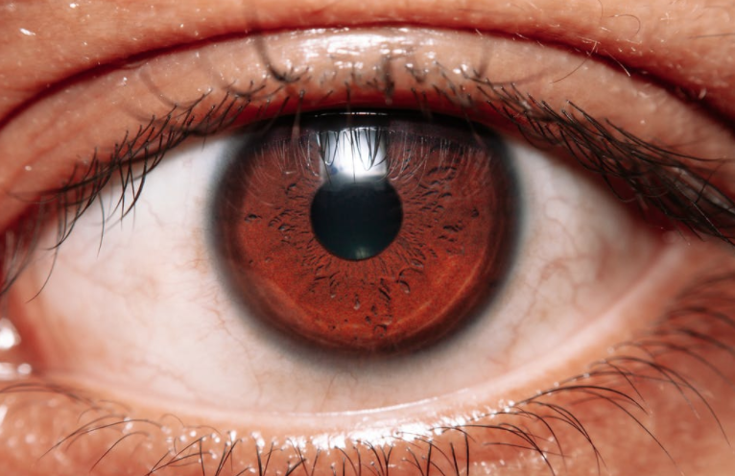
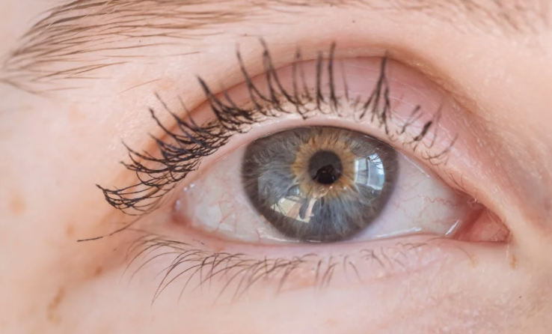
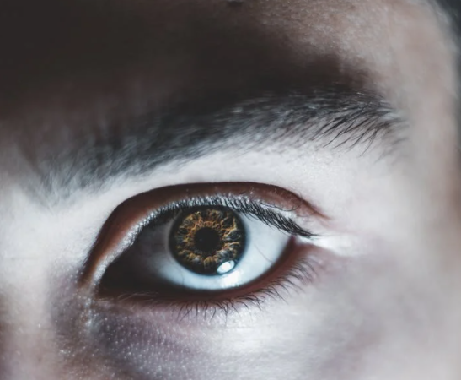
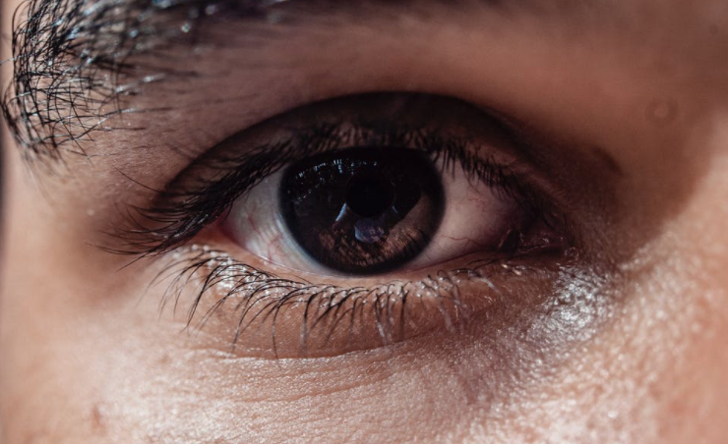
Other tips and tricks
Reducing Eyestrain

Slide 55
Tips and Tricks: Reducing Eyestrain
https://www.bettervisionguide.com/digital-eye-strain-infographic/

Slide 56
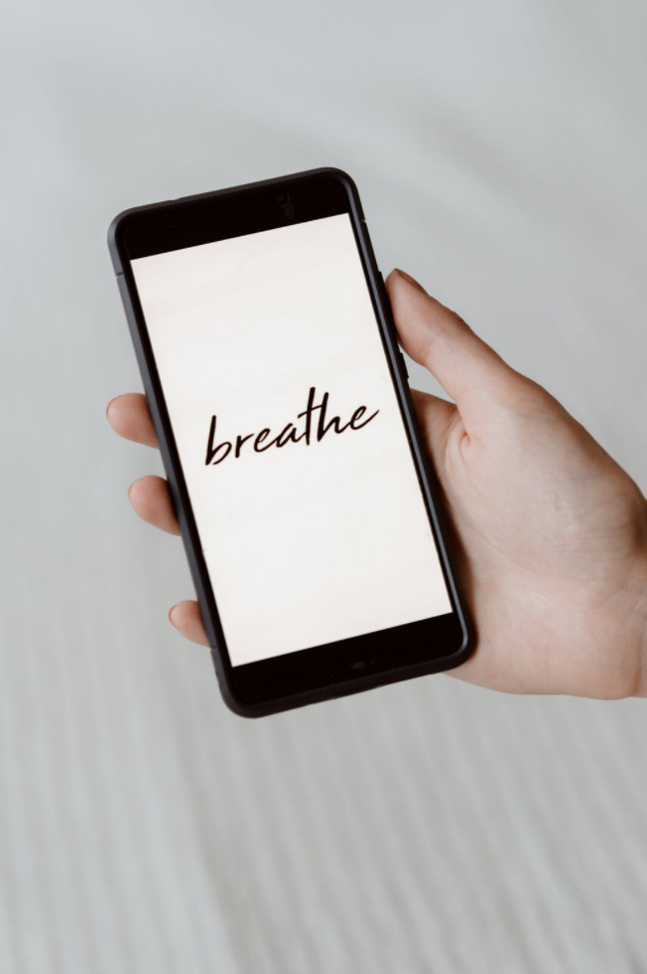
Email (tech) Apnea –
don’t forget to breathe!
We often stop breathing normally while using tech. This can put our body into a higher “stress” state.
What can we do?
Be aware [awareness is key to so many facets of digital health!]
Take a break (even a walk around your workstation)
Dance
Sing
Etc. …similar to many Mental Wellness tips
[In this research, dancers, musicians, highly-trained athletes, and test pilots did not exhibit tech apnea. Why? They’d been taught breathing techniques to manage emotions and energy. Perhaps other practices can provide similar benefits as well?]
https://lindastone.net/2014/11/24/are-you-breathing-do-you-have-email-apnea/

Slide 57
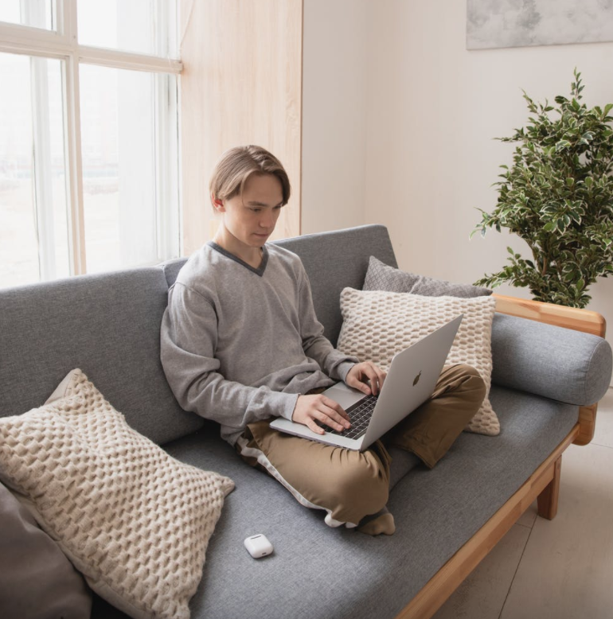
Discussion: Ergonomics Issues
Notes:
What do you see in these examples about ways that physical strain might develop with how devices are being used; variables like posture, position, and environment, or other ergononic issue? What do you see, relate to, or notice in your own device usage? This connects to the question about physical strain and taking breaks.

Slide 58
Tips and Tricks: Ergonomics
Also pay attention to:
-Mouse ergonomics
-Air temperature and flow
-Display brightness
-Keyboard position and design
-Doing stretches
What works for you?
Detailed workstation ideas:
https://ehs.unc.edu/workplace-safety/ergonomics/office/
Notes:
These images are from the DWI course that we took.

Slide 59
Benefits of Writing by Hand?
Since this topic came up in our discussion, I wanted to do a little research on any known benefits of writing by hand (using "old school" methods for note-taking or ). Most sample sizes are relatively small, but patterns show up in the research across nations and years. This is also relevant for conversations about whether children should be learning cursive. The question to consider is, Might there be other benefits outside of the handwriting itself from "learning to write?"
Mueller, Pam A. and Oppenheimer, Daniel M. "The Pen Is Mightier Than the Keyboard: Advantages of Longhand Over Laptop Note Taking." Psychological Science (2014) Vol. 25(6), 1159–1168. https://linguistics.ucla.edu/people/hayes/Teaching/papers/MuellerAndOppenheimer2014OnTakingNotesByHand.pdf
"[T]he mastery of handwriting is based on the involvement of a network of brain structures whose involvement and inter-connection are specific to writing alphabet characters. This network is built upon the joint learning of writing and reading and depends on the level of expertise of the writer."
https://pubmed.ncbi.nlm.nih.gov/28190914/ - "Neuroanatomy of Handwriting and Related Reading and Writing Skills in Adults and Children with and without Learning Disabilities: French-American Connections." Pratiques. 2016 Dec;171-172:3175. doi: 10.4000/pratiques.3175. Epub 2017 Feb 7.

Slide 60
Benefits of Writing by Hand?
Since this topic came up in our discussion, I wanted to do a little research on any known benefits of writing by hand (using "old school" methods for note-taking or ). Most sample sizes are relatively small, but patterns show up in the research across nations and years. This is also relevant for conversations about whether children should be learning cursive. The question to consider is, Might there be other benefits outside of the handwriting itself from "learning to write?"
Research done in Tokyo: https://www.frontiersin.org/articles/10.3389/fnbeh.2021.634158/full "Paper Notebooks vs. Mobile Devices: Brain Activation Differences During Memory Retrieval." Frontiers in Behavioral Neuroscience. (2021) Vol. 15, DOI=10.3389/fnbeh.2021.634158
An article exploring the research:
https://www.u-tokyo.ac.jp/focus/en/press/z0508_00168.html – this article summarizes the researcher's perspective, including noting even the difference of writing by hand on an e-ink device vs. writing by hand on paper. "[P]aper notebooks contain more complex spatial information than digital paper. Physical paper allows for tangible permanence, irregular strokes, and uneven shape, like folded corners. In contrast, digital paper is uniform, has no fixed position when scrolling, and disappears when you close the app." (Michelle here: I'm experimenting with e-ink so this was interesting for me to consider.)
Note: The research from Tokyo also looks at digital vs. paper calendaring. Here's another article summarizing the research. https://www.psychologytoday.com/us/blog/the-athletes-way/202103/4-reasons-writing-things-down-paper-still-reigns-supreme

Slide 61
Benefits of Writing by Hand?
Since this topic came up in our discussion, I wanted to do a little research on any known benefits of writing by hand (using "old school" methods for note-taking or ). Most sample sizes are relatively small, but patterns show up in the research across nations and years. This is also relevant for conversations about whether children should be learning cursive. The question to consider is, Might there be other benefits outside of the handwriting itself from "learning to write?"
E.O. Askvik et al. The importance of cursive handwriting over typewriting for learning in the classroom: a high-density EEG study of 12-year-old children and young adults. Frontiers in Psychology. July 28, 2020. doi: 10.3389/fpsyg.2020.01810.
Someone's summary of this researcher's views: "writing gives you brain “hooks” to hang information on, similar to marking pages in books. Add to this the importance of fine motor skills: a keystroke is repetitive and uncreative, whereas you’re constantly challenging your motor skills when writing." https://bigthink.com/the-present/handwriting-memory/
"The slow nature of handwriting might seem counterintuitive in the digital age, but van der Meer argues that it’s beneficial. You can only think as fast as you can write, whereas typing allows for a quicker transmission of ideas. While on the surface that might seem like a productivity boon, the time necessary for critical reflection is shortened. Not only do you not remember as much information, you likely aren’t thinking through situations as deeply."
Another article about this study: https://www.sciencedaily.com/releases/2020/10/201001113540.htm
https://journals.sagepub.com/doi/10.1177/0963721417709821: James KH. The Importance of Handwriting Experience on the Development of the Literate Brain. Current Directions in Psychological Science. 2017;26(6):502-508. doi:10.1177/0963721417709821 [one summary I read basically said that children who write by hand have parts of their brains activate in ways that are similar to adults' brains, but when they type, there is less brain activation] [Researcher's other works: https://citations.cogs.indiana.edu/profile.php?faculty=khjames]

Slide 62
Benefits of Writing by Hand?
Since this topic came up in our discussion, I wanted to do a little research on any known benefits of writing by hand (using "old school" methods for note-taking or ). Most sample sizes are relatively small, but patterns show up in the research across nations and years. This is also relevant for conversations about whether children should be learning cursive. The question to consider is, Might there be other benefits outside of the handwriting itself from "learning to write?"
A few articles:
An article reviewing research done by professors at University of North Carolina, Greensboro and Johns Hopkins: https://www.iflscience.com/brain/writing-by-hand-most-effectively-increases-reading-skills/
Video: https://www.youtube.com/watch?v=RWT9ETRm6RY
https://www.npr.org/2016/04/17/474525392/attention-students-put-your-laptops-away
https://www.topeducationdegrees.org/proven-reasons-to-write-by-hand/ (I think this is written by the site owner, Tracey M. Armstrong, Ph.D., but can't be sure the way the website is organized.)
https://www.oxfordlearning.com/writing-by-hand-is-good-for-the-brain/

