Slide 1
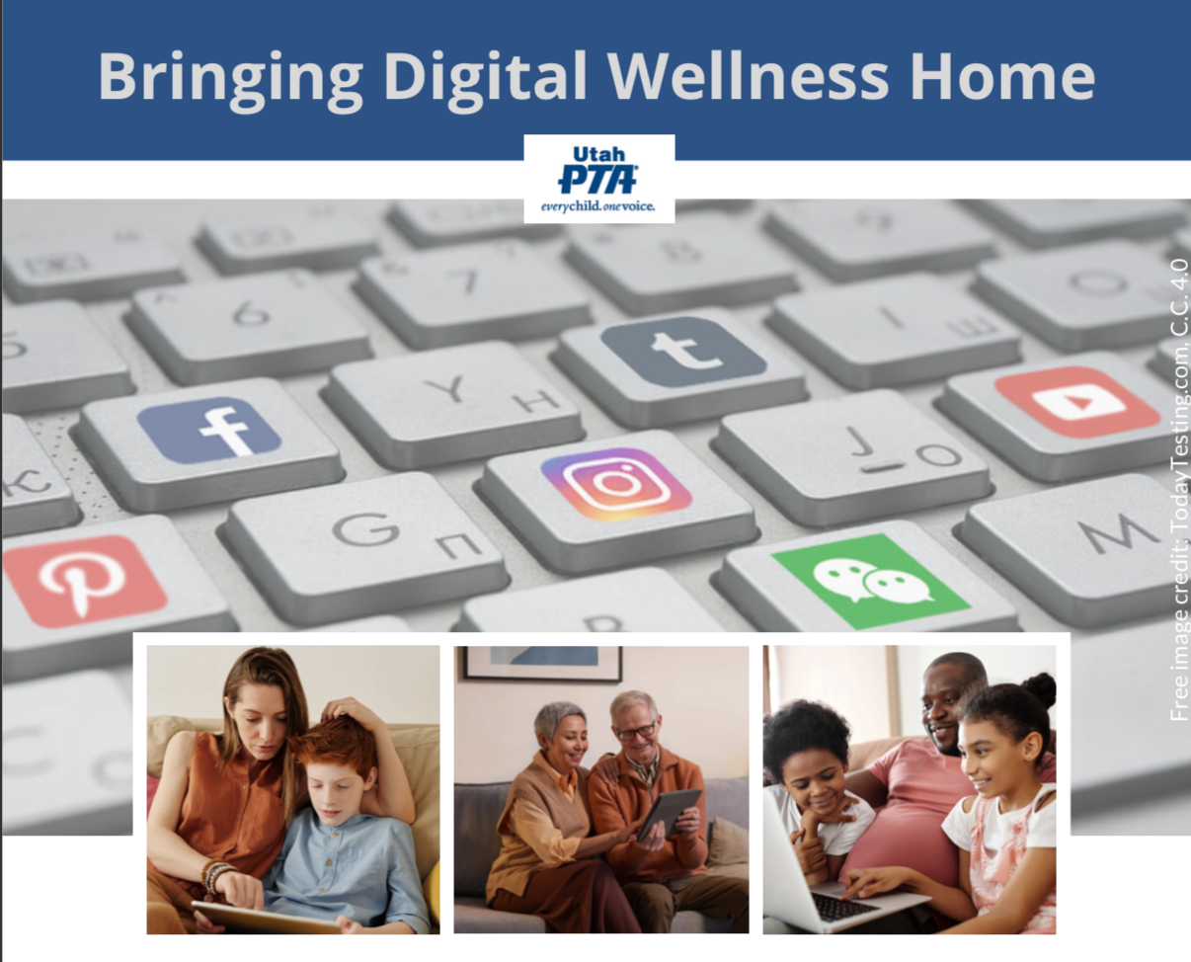
Note: All material in this series is for educational and informational purposes only, and is not meant to be exhaustive or used as a replacement for professional health support.
Notes:
Note: All material in this series is for educational and informational purposes only, and is not meant to be exhaustive or used as a replacement for professional health support. Also, the presentation is best viewed in slideshow format, as some of the slides are animated, but we have also included notes for many of the slides that you might want to review as well. Whatever works best for you!
NOTE: Portions of this work first appeared in or are derived or adapted from the Digital
Wellness Certificate Program. Those portions are Copyright © 2021, Digital Wellness Institute.

Slide 2
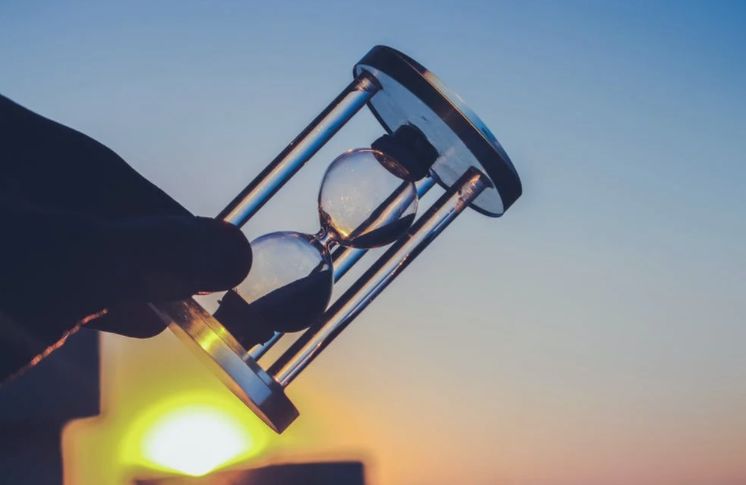
Discussion #4 Productivity: Honoring Time
Bringing Digital Wellness Home
+BONUS MATERIALS
**These discussions are for educational purposes only and should not be used as a substitute for professional health support and personal health research.**

Slide 3
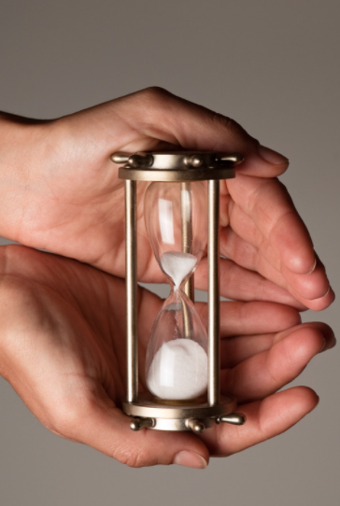
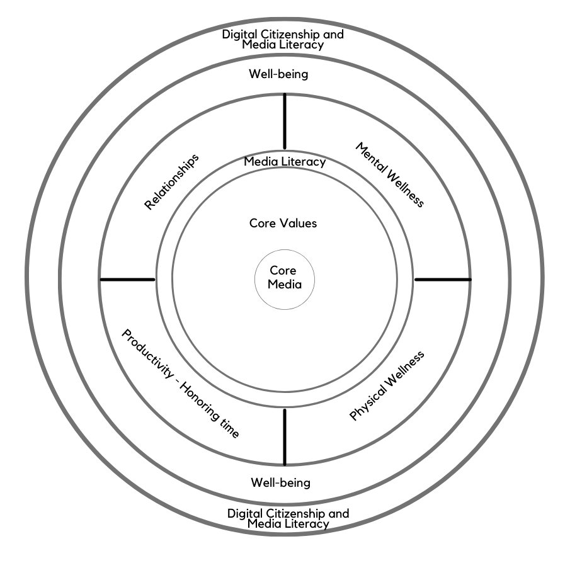
Today’s topic: Productivity, or
Honoring Time
"In the attention economy,
mindfulness is activism."
~Jay Vidyarthi
Note: EPIK’s Digital Centeredness model is adapted from the Digital Wellness Institute’s six-pronged model that aligns with DWI’s original survey
Notes:
As we discussed last week, you will see throughout the series that concepts in each module interrelate to other modules. Similarly, although this is a series on Digital Wellness, many concepts we explore relate to Wellness in general. As we progress through the series, consider discussing with someone the overlaps and patterns that you are seeing across modules, or insights that are coming that help you connect concepts at a deeper level.

Slide 4
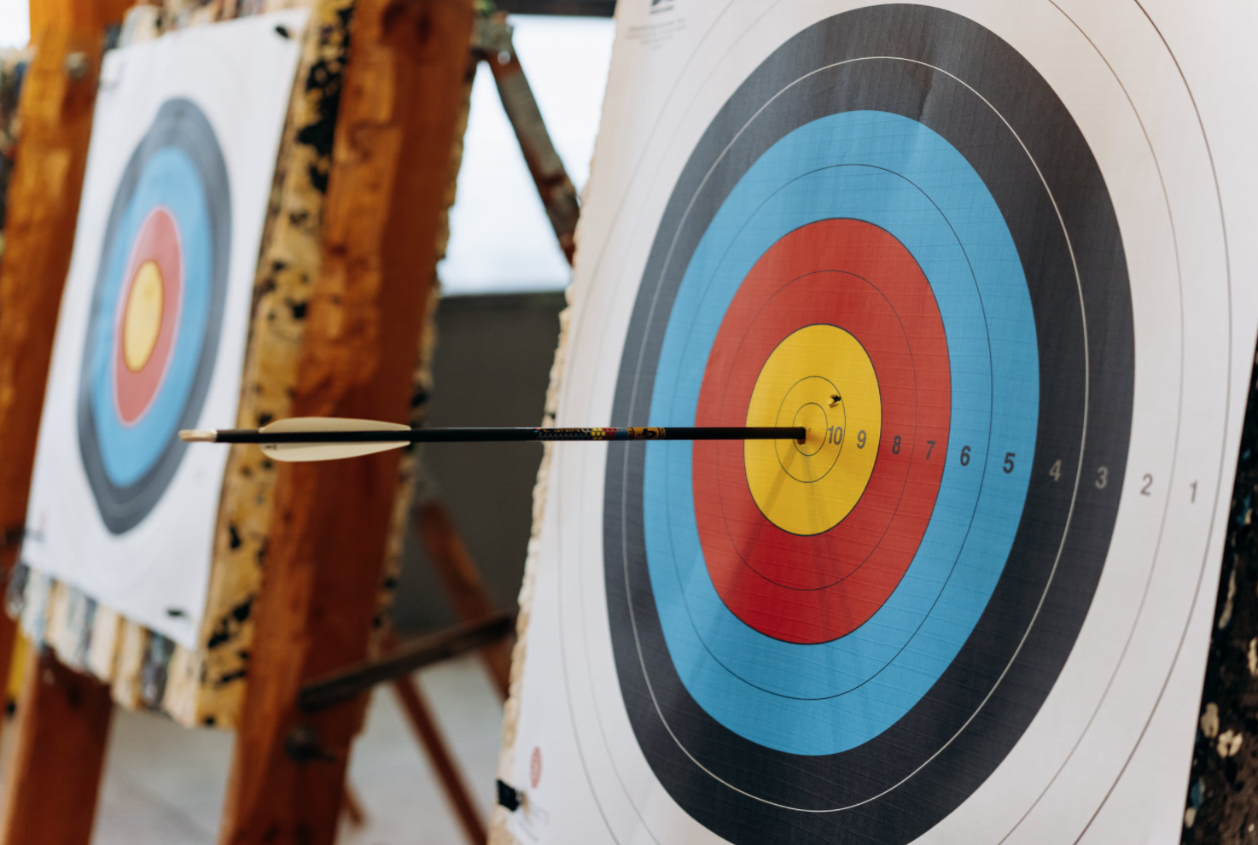
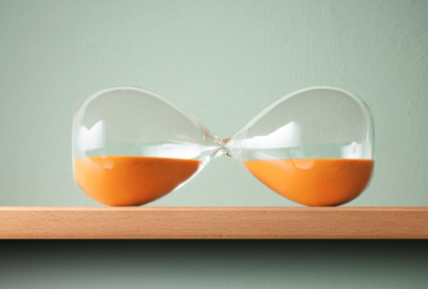
Connections increase complexity…but also distill simplicity
You'll see these familiar concepts from past modules show up again today
Notes:
To this point, we have explored what it can mean to take a values-centered approach (character, attributes – who I want to be/how I want to show up in the world) to Digital Wellness, and how to build awareness and foster agency through skills like media literacy (pausing and asking questions about content), mental wellness (pausing and asking questions about our internal weather), and physical wellness (pausing and asking questions about our sensory experiences and how and where tech might be impacting basic aspects of physical health (like sleep, eating, ergonomics, physical workspace, etc.) Last week, we also talked about how the Digital Centeredness model (remember, it's just a framework for discussing principles), could be considered in terms of different environments. All of these concepts can also be applied to our relationship with time.

Slide 5
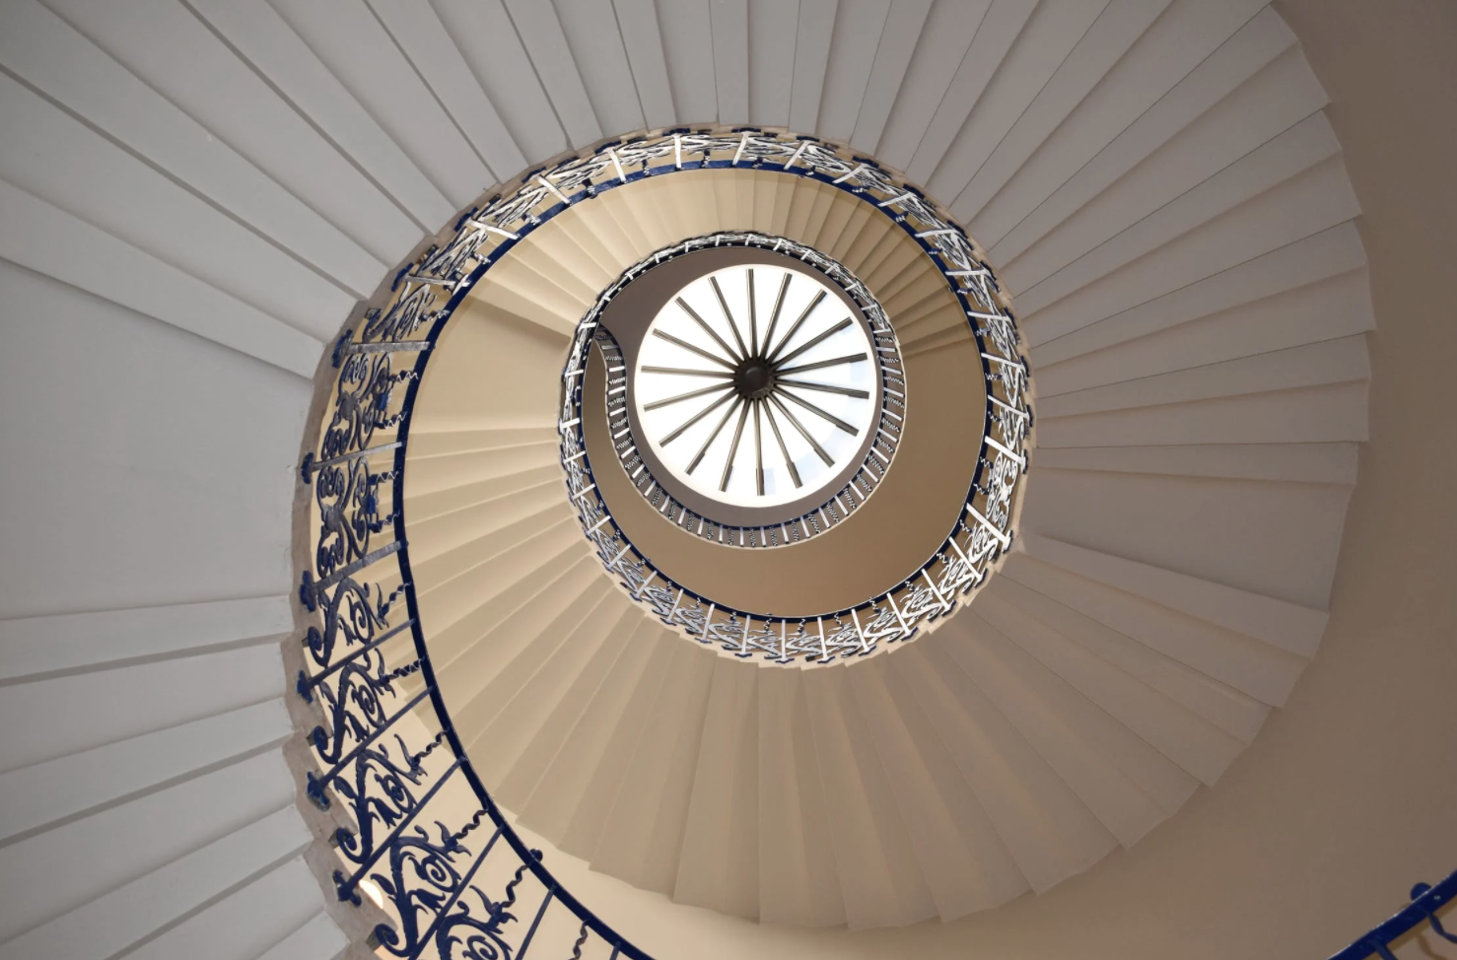
"Any tiny change can be just the push that your brain needs to start spiraling upward."
Dr. Alex Korb, The Upward Spiral Workbook
see also the books Atomic Habits, Tiny Habits
The virtuous cycle can start anywhere. Just start where you are
and try something so doable that you can't fail. If you were to leave this series with only one baby step idea to practice, we would consider that a success!
Notes:
Even as things are interconnected (layered and complex in many ways), the best way to engage change is just a little at a time. This is the 1% rule from Atomic Habits. Or the whole premise of the book Tiny Habits.
In the recent resilience conference in Davis County, Dr. Jacob Hess talked about the virtuous cycle, about how much hope there is for improving wellness. He focused on anxiety and depression, but the same can be true for Digital Wellness improvements. https://www.youtube.com/watch?v=RQj-nRw4TNQ
The virtuous cycle of learning is also real. We provide a lot of different resources so you can touch more ideas and keep the virtuous cycle going (and you may have your own list, and we hope you will help us grow our list). As you compound your literacy of principles related to what we are touching on in this series, true principles (or principles that are right for you where you are right now) can bubble up to the top. Some people call this synchronicity. I love looking for patterns, or even better, love it when they find me. Let the patterns find you.

Slide 6
Honoring Time:
Part 1:
Starting at the beginning…
Notes:
Last week, we touched on the intersection point of technology and the start of our day. So we'll start at the beginning of a day to talk about honoring time. :)

Slide 7
…the beginning of each day
Notes:
Last week, we touched on the intersection point of technology and the start of our day. So we'll start at the beginning of a day to talk about honoring time. :)

Slide 8
Dr. Heidi Hanna ("the Stress Detective") has surveyed over 80,000 people.
What is the top thing that causes people stress in the morning?
Notes:
80,000+ people have been surveyed by Dr. Heidi Hanna, "The Stress Detective." A significant pattern showed up around the question about what what causes people the most stress in the morning. The mindset with which we start our day can impact the state our minds and bodies are in (the mix of chemicals, to use Dr. McGonigal's research).

Slide 9
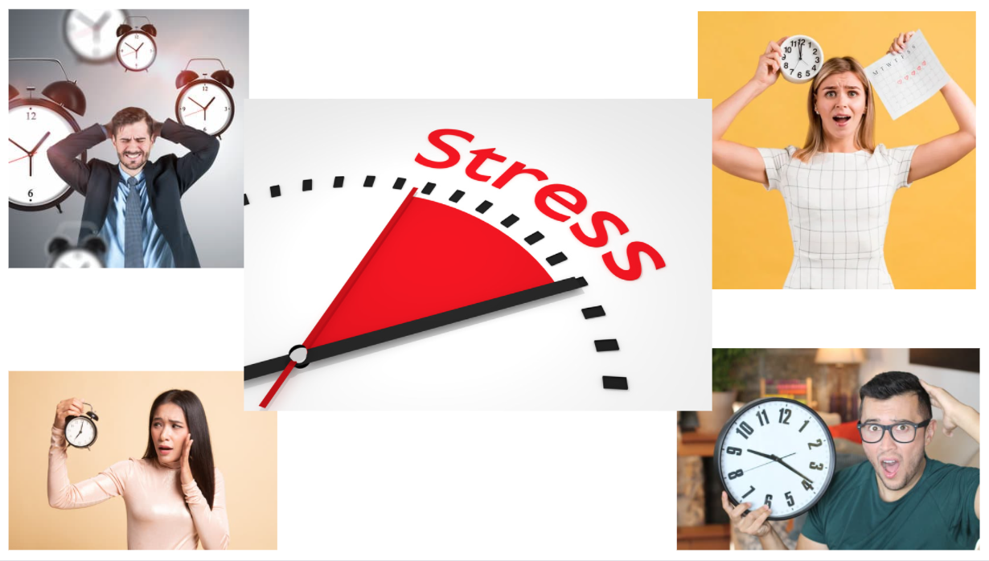
It's the feeling that there isn't enough time to get everything done.
Notes:
Mindset matters, as we learned from Kelly McGonigal. How we think about stress (or in this case, time) can impact how our bodies, minds, emotions (chemicals/hormones) engage. So how we start our day, no matter how packed the day may seem…even for just a few minutes…can make a difference.

Slide 10
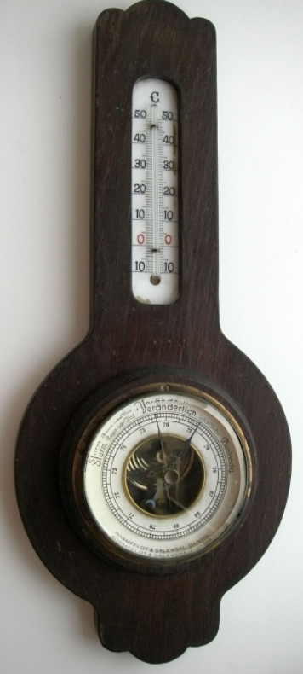
Impact of negative news in the morning
Three minutes of negative news
can decrease positivity by 27%
-Research by Shawn Achor and Michelle Gielan
https://hbr.org/2015/09/consuming-negative-news-can-make-you-less-effective-at-work
Notes:
If external news can have an impact on the rest of our day, what about internal chatter?

Slide 11
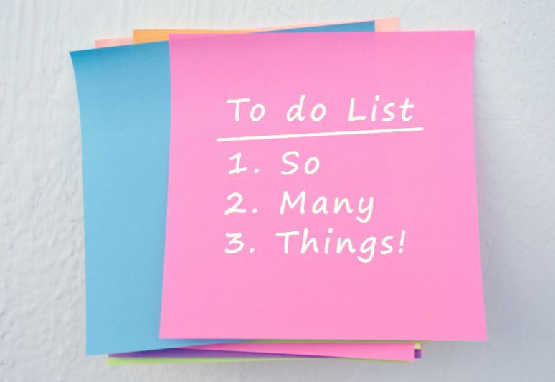
Could our to-do lists be a form of negative news?
Notes:
If we start the day with all the things we haven't yet gotten done, or all the things that loom over our heads, it's likely that our day won't start off with a sense of centeredness or wellness.

Slide 12
"Prime the positive first."
Notes:
This phrase was shared by Dr. Heidi Hanna in our Digital Wellness Certification Course, and perhaps she was channeling Michelle Geilan, whose research she had also shared.

Slide 13
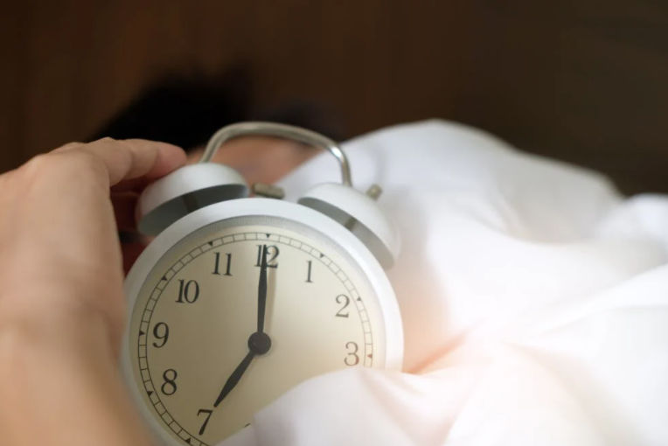
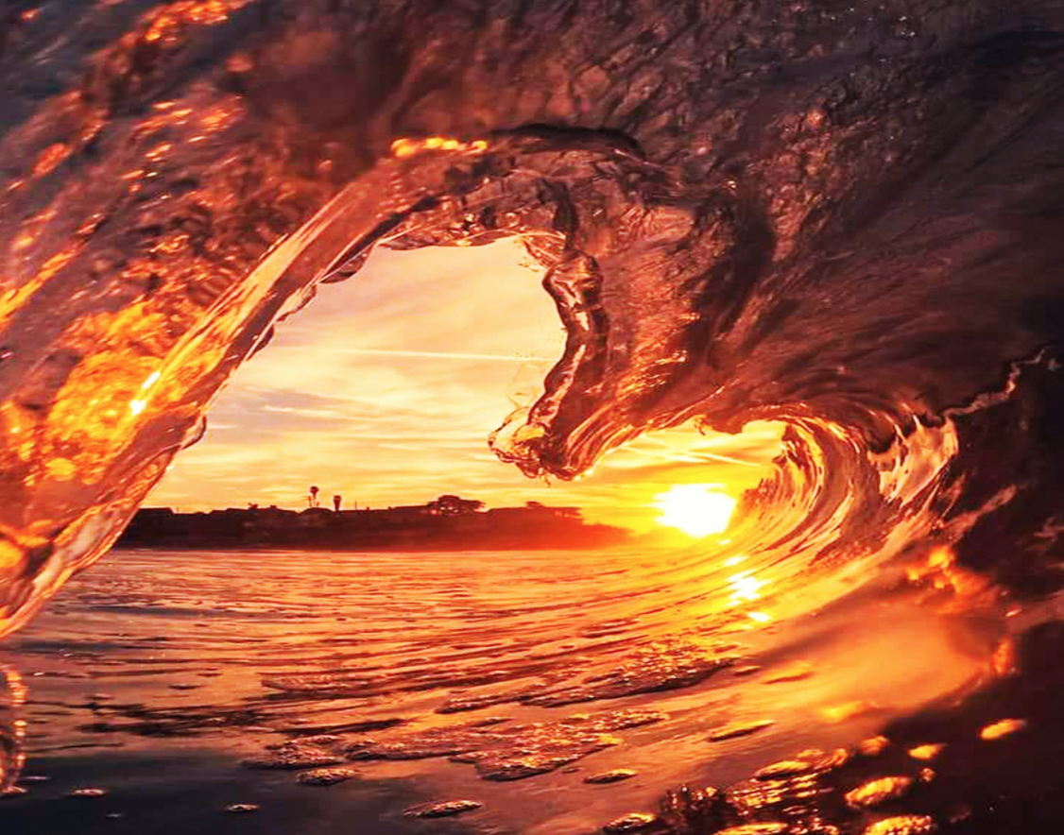
We might say, "Start with your Center"
Dr. Heidi Hanna: “Are you investing [some time each day] to think about who you want to be before you think about what you need to do?” https://heidihanna.com/2019/04/15/create-your-optimal-performance-pulse/
Michelle Gielan: Start your day by priming the positive. Instead of checking email or news first thing, take 2 minutes to send a positive [message] to someone you care about. “It will change how you process your day and how you process your email at 2 o’clock in the afternoon,” she says. https://www.cnbc.com/2016/12/30/checking-email-as-soon-as-you-wake-up-could-be-ruining-your-day.html
Notes:
As we discussed last week, you will see throughout the series that concepts in each module interrelate to other modules. Similarly, although this is a series on Digital Wellness, many concepts we explore relate to Wellness in general. As we progress through the series, consider discussing with someone the overlaps and patterns that you are seeing across modules, or insights that are coming that help you connect concepts at a deeper level.

Slide 14
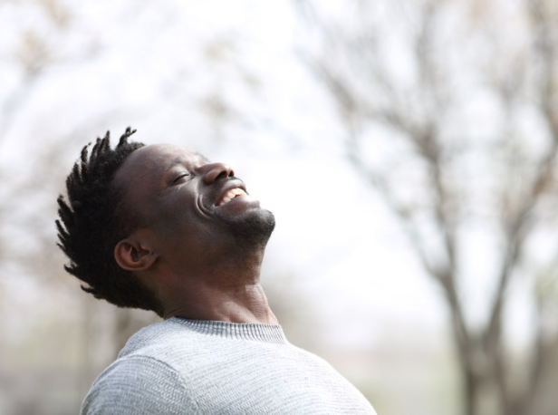
“Time is an unrenewable resource. You can’t get it back. All these things we’ve done to exchange information, to access information at our fingertips, have actually taken away our time for restoring the soul. You’re giving away your soul’s ability to be moved. If we’d spend more time in solitude, we’d value ourselves more.” ― Raymond M. Kethledge, Lead Yourself First: Inspiring Leadership Through Solitude

Slide 15
“Every day, think as you wake up, today I am fortunate to be alive, I have a precious human life, I am not going to waste it."
—the Dalai Lama, quoted by Jay Shetty
"Time has memory. If you do something at the same time every day, it becomes easier and natural. If you do something in the same space every day, it becomes easier and natural.”
― Jay Shetty, Think Like a Monk: Train Your Mind for Peace and Purpose Every Day

Slide 16
“[T]he very moment you wake up each morning…all your wishes and hopes [or checklists?] for the day rush at you like wild animals. And the first job each morning consists simply in [holding] them all back; in listening to that other voice, taking that other point of view, letting that other larger, stronger, quieter life come flowing in. And so on, all day. Standing back from all your natural fussings and frettings; coming in out of the wind…
"We can only do that for moments at first. But from those moments [a] new sort of life will be spreading through our system."
-C.S. Lewis, Mere Christianity

Slide 17
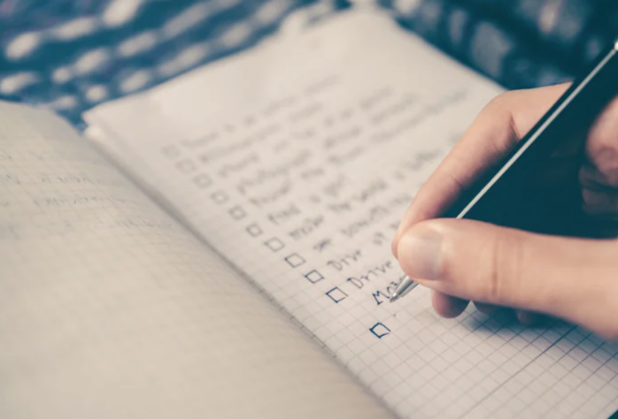
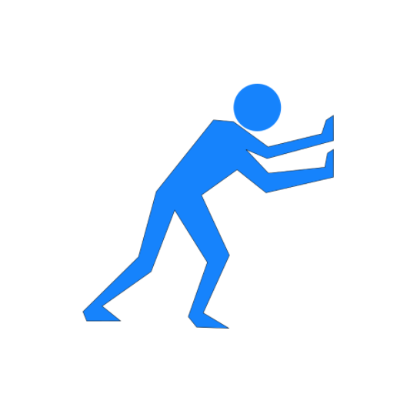
Invitation: Try starting your day with a centering something –
something other than your checklist (more on checklists coming)
(This slide is best viewed in Slideshow mode. There is something beyond the checklist.)
Notes:
Mindset matters, as we learned from Kelly McGonigal. How we think about stress (or in this case, time) can impact how our bodies, minds, emotions (chemicals/hormones) engage. So how we start our day, no matter how packed the day may seem…even for just a few minutes…can make a difference. To start with to-dos may be sacrificing our center in subtle ways. Just give it a try, even for just a couple of minutes, to start somewhere else that can help you feel more calm and connected to who you want to be as a person, how you want to show up for all of those to-dos tapping at your door.

Slide 18
Honoring Time:
Part 2: DWI Question Reflections + tips
Notes:
The DWI self-assessment provides a useful springboard for self-reflection. We'll also touch on a few tips that relate to some of what they talk about. As always, feel free to add your own questions. Also, there is much more material in the Bonus section of this slide deck if you want to do a deeper dive on some of the tips, or see other material we couldn't cover.

Slide 19
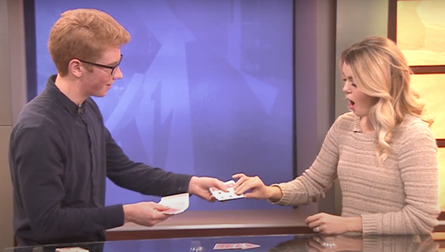
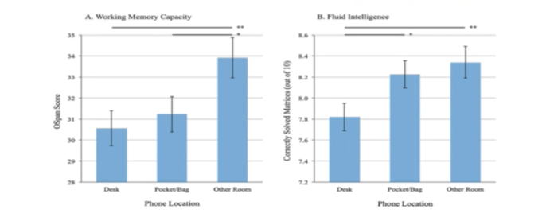
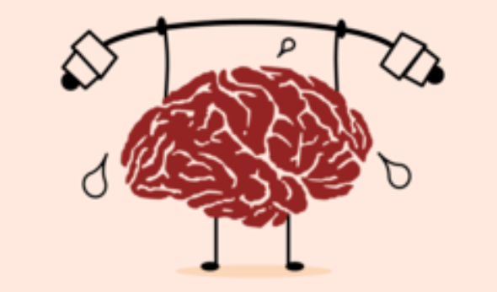
Remember: Our brains are easily distracted
“Mere Presence” Phenomenon
Cognitive Load
Cat Apple Ball Tree Square
Head House Door Box Car
King Hammer Milk Fish Book
Tape Flower Arrow Key Shoe
Residual Attention
Math
Min: (1 minute) x (24 distractions/hour)
Max: (23 minutes) x (24 distractions/hour)
Notes:
We covered most of these topics in the Mental Wellness module, but it can be helpful to remember concrete examples of how easily distracted we humans are.
And here's another brain drain-study around mere presence: https://www.journals.uchicago.edu/doi/10.1086/691462

Slide 20
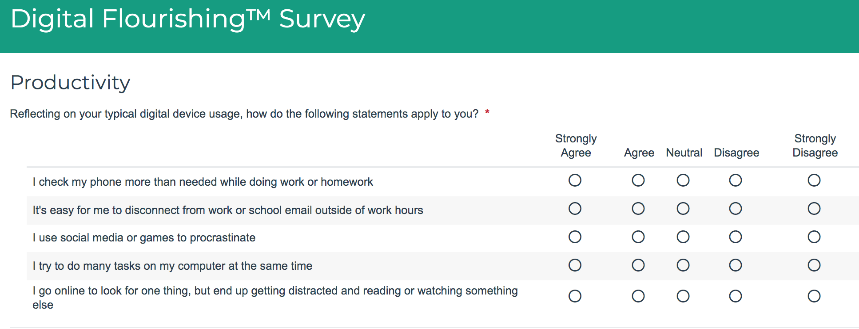
DWI Survey – Productivity Section
Notes:
As always, feel free to add questions that may come to mind for you around this topic.

Slide 21
The "Mere Presence" Phenomenon
“[T]he "mere presence" of a cell phone may be
sufficiently distracting to produce diminished attention
and deficits in task-performance,
especially for tasks with greater attentional and cognitive demands.”
Notes:
https://repositories.lib.utexas.edu/bitstream/handle/2152/64130/braindrain.pdf?sequence=2: “Working memory capacity” (WMC) reflects the availability of attentional resources, which serve the “central executive” function of controlling and regulating cognitive processes across domains (Baddeley and Hitch 1974; Miyake and Shah 1999; Engle 2002; Baddeley 2003). “Fluid intelligence” (Gf ) represents the ability to reason and solve novel problems, independent of any contributions from acquired skills and knowledge stored in “crystallized intelligence” (Cattell 1987). Similar to WM, Gf stresses the ability to select, store, and manipulate information in a goal-directed manner. Also similar to WM, Gf is constrained by the availability of attentional resources (e.g., Engle et al. 1999; Halford et al. 2007). Crucially, the limited capacity of these domaingeneral resources dictates that using attentional resources for one cognitive process or task leaves fewer available for other tasks; in other words, occupying cognitive resources reduces available cognitive capacity.

Slide 22
Tip: Practice social distancing from your phone!
Working Memory: resources for “controlling and regulating cognitive processes across domains”
Fluid Intelligence: ”ability to reason and solve novel problems” and manage cognitive processes for goal-oriented tasks
https://repositories.lib.utexas.edu/bitstream/handle/2152/64130/braindrain.pdf?sequence=2
Notes:
https://repositories.lib.utexas.edu/bitstream/handle/2152/64130/braindrain.pdf?sequence=2: “Working memory capacity” (WMC) reflects the availability of attentional resources, which serve the “central executive” function of controlling and regulating cognitive processes across domains (Baddeley and Hitch 1974; Miyake and Shah 1999; Engle 2002; Baddeley 2003). “Fluid intelligence” (Gf ) represents the ability to reason and solve novel problems, independent of any contributions from acquired skills and knowledge stored in “crystallized intelligence” (Cattell 1987). Similar to WM, Gf stresses the ability to select, store, and manipulate information in a goal-directed manner. Also similar to WM, Gf is constrained by the availability of attentional resources (e.g., Engle et al. 1999; Halford et al. 2007). Crucially, the limited capacity of these domaingeneral resources dictates that using attentional resources for one cognitive process or task leaves fewer available for other tasks; in other words, occupying cognitive resources reduces available cognitive capacity.

Slide 23
Reduce “brain drain” = “Mere Presence” Phenomenon
Practice social distancing from your phone!
“’Working memory capacity’ (WMC) reflects the availability of attentional resources, which serve the ‘central executive’ function of controlling and regulating cognitive processes across domains (Baddeley and Hitch 1974; Miyake and Shah 1999; Engle 2002; Baddeley 2003). ‘Fluid intelligence’ (Gf ) represents the ability to reason and solve novel problems… (Cattell 1987). Similar to WM, Gf stresses the ability to select, store, and manipulate information in a goal-directed manner. Also similar to WM, Gf is constrained by the availability of attentional resources (e.g., Engle et al. 1999; Halford et al. 2007). Crucially, the limited capacity of these … resources dictates that using attentional resources for one cognitive process or task leaves fewer available for other tasks; in other words, occupying cognitive resources reduces available cognitive capacity.”
https://repositories.lib.utexas.edu/bitstream/handle/2152/64130/braindrain.pdf?sequence=2
Notes:
https://repositories.lib.utexas.edu/bitstream/handle/2152/64130/braindrain.pdf?sequence=2: “Working memory capacity” (WMC) reflects the availability of attentional resources, which serve the “central executive” function of controlling and regulating cognitive processes across domains (Baddeley and Hitch 1974; Miyake and Shah 1999; Engle 2002; Baddeley 2003). “Fluid intelligence” (Gf ) represents the ability to reason and solve novel problems, independent of any contributions from acquired skills and knowledge stored in “crystallized intelligence” (Cattell 1987). Similar to WM, Gf stresses the ability to select, store, and manipulate information in a goal-directed manner. Also similar to WM, Gf is constrained by the availability of attentional resources (e.g., Engle et al. 1999; Halford et al. 2007). Crucially, the limited capacity of these domaingeneral resources dictates that using attentional resources for one cognitive process or task leaves fewer available for other tasks; in other words, occupying cognitive resources reduces available cognitive capacity.

Slide 24
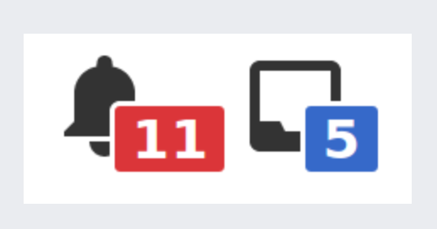
Tip: Say no to defaults! Reduce Notifications
NOTE: Bonus materials include many specifics about how to turn off notifications!
Notifications are ON as a default by tech companies: say no to defaults
2/3 of people don't turn off notifications (Nir)
Ask yourself:
“Are notifications serving me? Are they heading me toward what I want to be doing, being, becoming?"
“Get notifications from people, not products.” -Chris Flack(?)
No notifications during time boxing (more on time boxing later in this discussion)
Notes:
We have several slides in the Bonus section about ways to reduce notifications

Slide 25
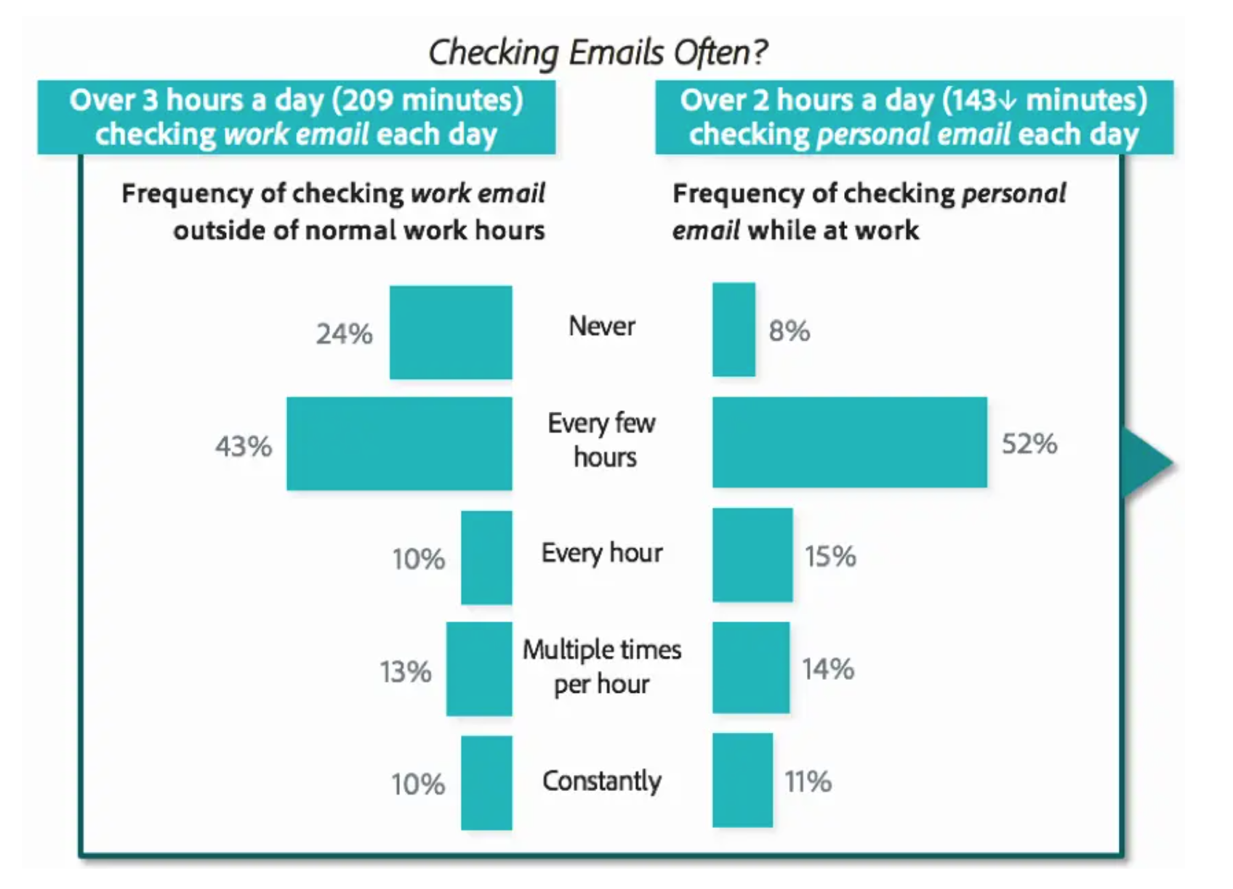
Tip: Schedule time for email (Some recommend only 2x day, touching email 1x)
Adobe study: > 5 hours a day (work & personal); times checked through the day vary
Notes:
You can find more resources on email in the Bonus section and in the resources document, but here are a couple more links:
https://blog.adobe.com/en/publish/2019/09/08/if-you-think-email-is-dead--think-again.html
See also https://www.slideshare.net/adobe/2019-adobe-email-usage-study

Slide 26
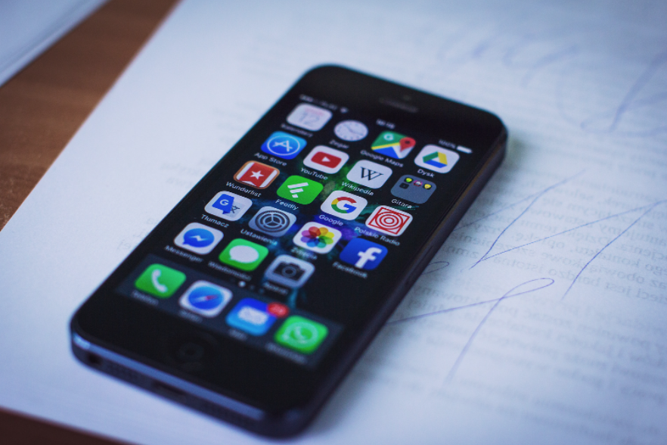
Tip: Increase friction with your digital devices
”Make that next source of information [or app] a little bit more difficult to reach… to [help you] remain in the source of your attention for a longer period of time.”
Dr. Adam Gazzaley M.D. Ph.D. - https://wellbeing.google/get-started/focus-your-time-with-tech/
One example of friction is to remove as many apps and notification-driven tools from your home screen as possible.
Bonus – add something on your home screen that helps remind you of your center. For me it's a drawing my daughter did that helps me remember and recenter around core values.
Notes:
Tech companies design tools to be frictionLESS – so that we can move seamlessly between tools…for as long as possible. This frictionless design can have its upsides, but the cost is that we often end up using our devices more than we intended. Little things like adding more steps between you and your weak-spot tools can help keep you more mindful.

Slide 27
Tip: Practice Single-tasking, -tabbing &/or -apping (Try even for 5 minutes to start)
Can reduce stress
Can build brain’s ability to focus
Can boost creativity
Can increase productivity (get more done!)
“Single tasking feels like taking a walk in the forest”
-a participant in a brain plasticity/growth course
Notes:
As we discussed last week, you will see throughout the series that concepts in each module interrelate to other modules. Similarly, although this is a series on Digital Wellness, many concepts we explore relate to Wellness in general. As we progress through the series, consider discussing with someone the overlaps and patterns that you are seeing across modules, or insights that are coming that help you connect concepts at a deeper level.

Slide 28
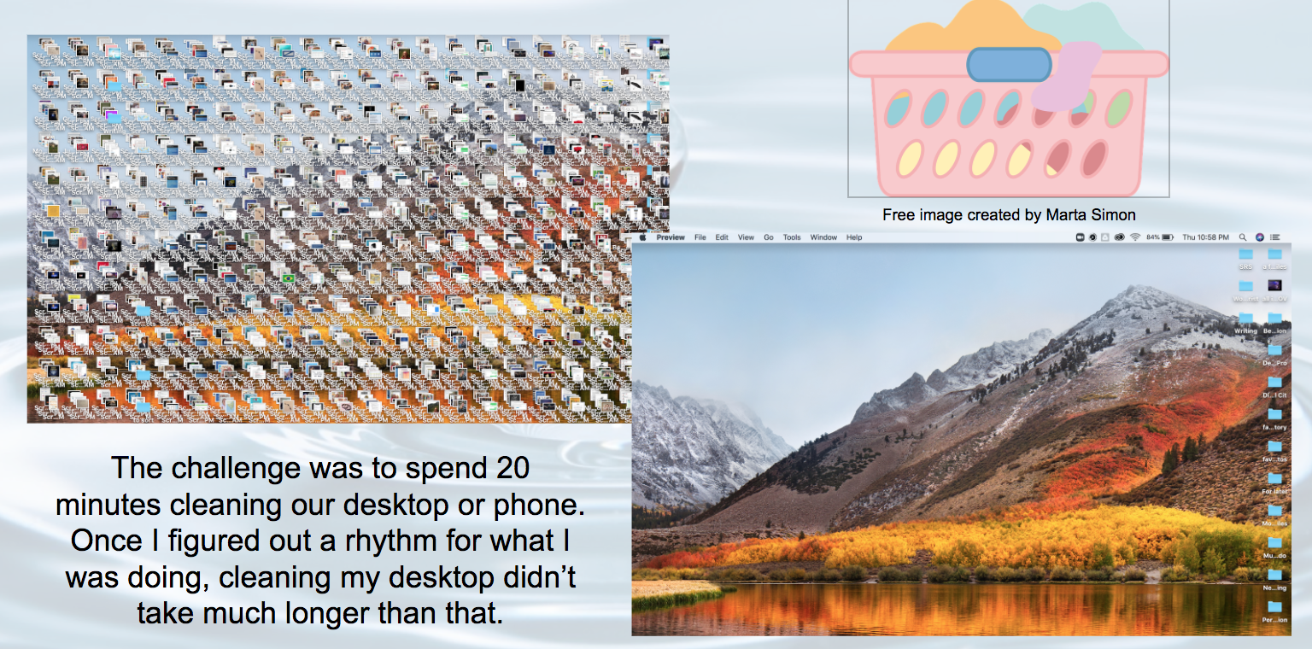
Tip: Do some digital laundry
Notes:
This is a quote from Nir Eyal. I would highly recommend reading some of his materials, e.g., https://www.nirandfar.com/opposite-of-distraction, https://www.nirandfar.com/todo-vs-schedule-builder/ https://www.nirandfar.com/your-calendar/,

Slide 29
Honoring Time:
Part 3: Addressing Distraction
from the Inside-out
Notes:
Last week, we touched on the intersection point of technology and the start of our day. So we'll start at the beginning of a day to talk about honoring time. :)

Slide 30
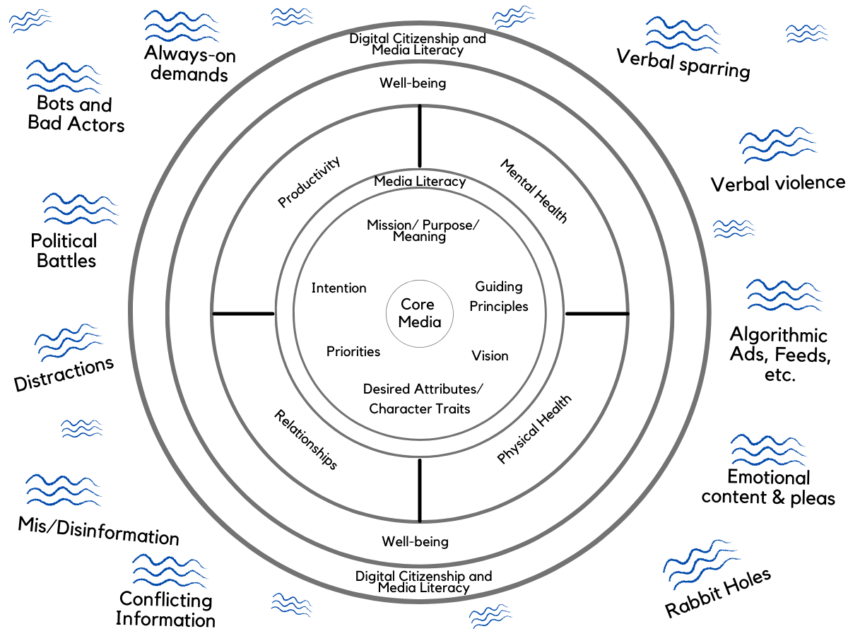
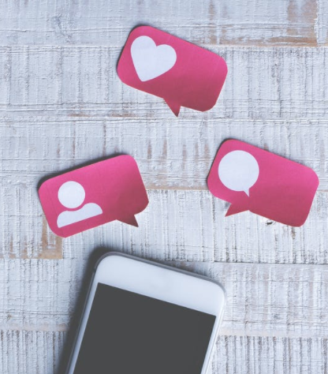
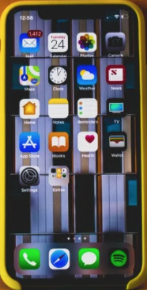
etc.
etc.
We often talk about distraction by focusing on what is happening in the "dings and pings" of tech…and that matters!
AND…
etc.
etc.
etc.
etc.
Notes:
There are so many things "out there" that are bombarding us (or wanting to bombard us)...all the more so because of constant (and instant) access to so many potential inputs. This is the water we swim in.

Slide 31
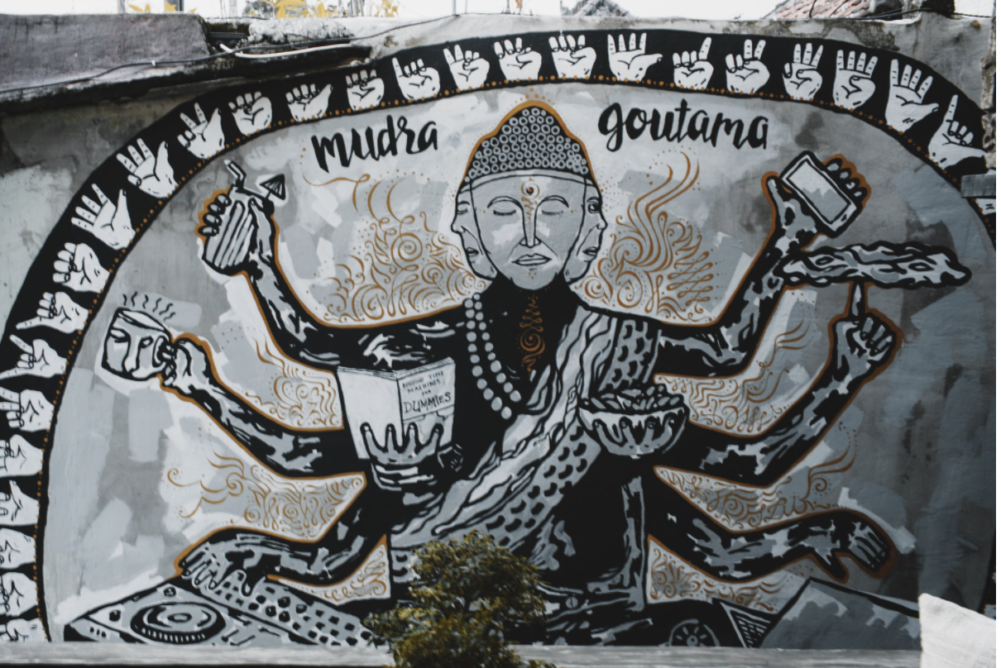
"The best way to understand what distraction is
is to know what it is not."
Nir Eyal
Notes:
This is a quote from Nir Eyal. I would highly recommend reading some of his materials, e.g., https://www.nirandfar.com/opposite-of-distraction, https://www.nirandfar.com/todo-vs-schedule-builder/ https://www.nirandfar.com/your-calendar/,

Slide 32
Said another way:
We can consider the difference between
being in motion
and movement.

Slide 33
…or the difference between being busy
and practicing centered, deliberate action.

Slide 34
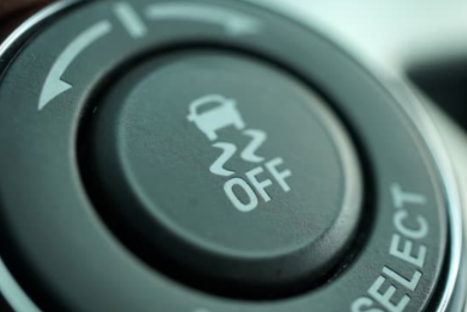
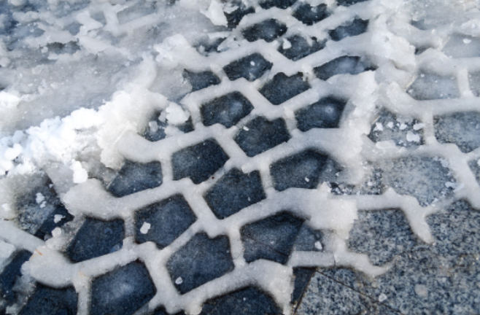
What is the opposite of distraction?
Notes:
I know it's annoying to play "Guess what the teacher is thinking" but this mental exercise is, I think, worth it.
This concept comes from Nir Eyal, author of Indistractable. https://www.nirandfar.com/opposite-of-distraction/ We can be focused on things that aren't in alignment with our values and goals. Traction is when where and how we spend our time matches with our core values and key priorities.

Slide 35
Nir Eyal
"A distraction is something we do that moves us away from what we really want."
"Traction is an action that moves us towards what we really want."
If you are interested in etymology, both words come from the Latin trahere.
Notes:
Emphasis is added in these quotes. This concept comes from Nir Eyal, author of Indistractable. https://www.nirandfar.com/opposite-of-distraction/ We can be focused on things that aren't in alignment with our values and goals. Traction is when where and how we spend our time matches with our core values and key priorities. He has many other blog posts that explore more around building traction.

Slide 36
Nir Eyal
"You can't call something a distraction unless you know what it's distracting you from."
"Any action can be either a distraction or traction depending on what you intend to do with your time."
Notes:
This concept comes from Nir Eyal, author of Indistractable. https://www.nirandfar.com/opposite-of-distraction/ We can be focused on things that aren't in alignment with our values and goals. Traction is when where and how we spend our time matches with our core values and key priorities. He has many other blog posts that explore more around building traction.

Slide 37
Plan for traction: A real-time writing activity
Notes:
This concept comes from Nir Eyal, author of Indistractable. https://www.nirandfar.com/opposite-of-distraction/ We can be focused on things that aren't in alignment with our values and goals. Traction is when where and how we spend our time matches with our

Slide 38
Plan for traction: A real-time writing activity
Start with your center: Core value(s)
We covered this in detail in Week 1, but keep practicing keeping your center in mind. Who do I want to be? How do I want to show up in the world, in my roles and responsibilities? Write your word(s) in the middle circle on your paper.
As a reminder: The value you choose to write about doesn't need to be the only attribute you care about nurturing or developing. It's just something to keep in mind about the kind of person you want to be in all your spheres and spaces.

Slide 39
Plan for traction
2. Define your domains: Key priority categories
e.g., Self, health, relationships, job, service, hobbies/ side projects, recreation, downtime/margin
or, e.g., Mental, Physical, Emotional, Social, Spiritual (some experts call this "the core five")
Notes:
Different people encourage different domain definitions. In this activity, we wanted to encourage you to explore how you would like to define them. The following slides share a few possible prompts for this activity.

Slide 40
Plan for traction
2. Define your domains: Key priority categories
e.g., Self, health, relationships, job, service, hobbies/ side projects, recreation, downtime/margin
or, e.g., Mental, Physical, Emotional, Social, Spiritual, Financial
Notes:
Different people encourage different domain definitions. In this activity, we wanted to encourage you to explore how you would like to define them. The following slides share a few possible prompts for this activity.

Slide 41
Plan for traction:
Mindfully define your domains: Some possible PAQs
What are my key roles and responsibilities?
What matters most to me?
What are the necessary demands on my time?
How do I want to spend my time?
If I were to create an ideal general schedule, what categories would it include?
What things do I want to be spending time on but am not making time for…yet?
Pulls and tugs on time and attention
A mindful time map
Situation and/or physical responses
Decision/Action

Slide 42
Plan for traction: Another prompt idea
Cluster your typical task lists into a few key categories or roles/responsibilities/goal areas
Notes:
This concept comes from Nir Eyal, author of Indistractable. https://www.nirandfar.com/your-calendar/ https://www.nirandfar.com/opposite-of-distraction/ We can be focused on things that aren't in alignment with our values and goals. Traction is when where and how we spend our time matches with our

Slide 43
Draw 3-6 circles and label your domains (or priorities, or key "what matters to me" categories)

Slide 44
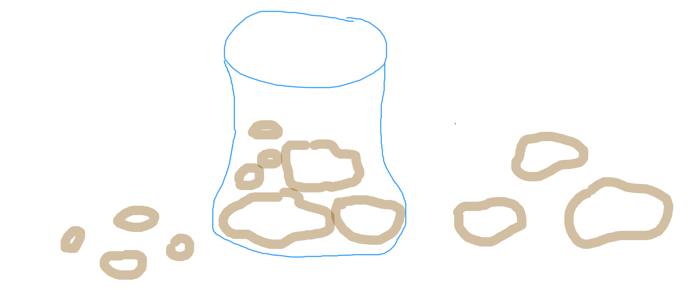
From To-do-listing to Time Boxing
“Put the big rocks in the jar first” including the things you value and the things that are most difficult -- match your time boxes with your energy; e.g., do the harder things when you have more energy and do things that rejuvenate when you are lower on energy

Slide 45
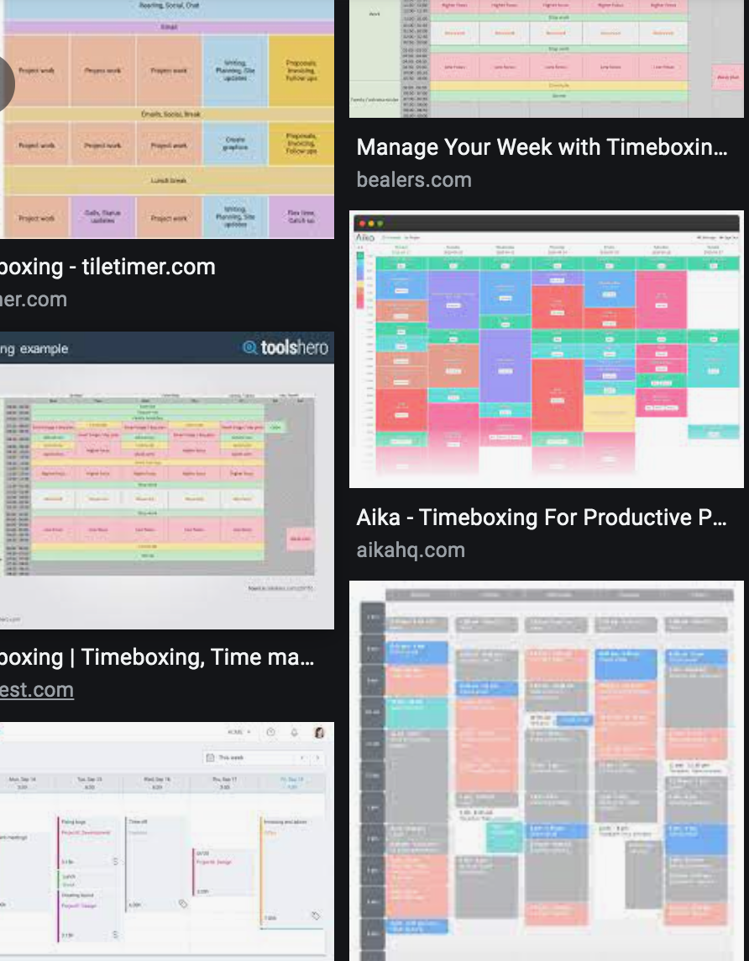
Time Boxing: Schedule what matters most
Time Boxing (Nir Eyal)
"Plan by input [by values & priorities], not [primarily] outputs"
"Schedule your days or someone else will."
Try measuring by this metric: "Did I do what I said I would do for as long as I said I would, without distraction?”
**Schedule rest & relaxation, too!**
Notes:
Emphasis added in quotes above.
To-do lists can create a sense of pressure and failure every day, because there are always things left undone. To-dos can be scheduled and time-boxed, but the recommendation is not to drive your life by a checklist. It’s also just too easy to let other people’s checklists and requests (e.g., through email) creep into your own without deliberate intention with time and attention. https://www.nirandfar.com/timeboxing/ -- but this is not an idea original to Nir. Here’s another example of an article about time boxing. e.g., https://medium.com/dreimannzelt-adventures/7-secrets-to-master-timeboxing-66a744ea9175#:~:text=Timeboxing%20is%20a%20very%20simple,to%20work%20on%20each%20topic.

Slide 46
Like Dave Ramsey's envelope system: "Telling your money where to go, instead of wondering where it went." -John Maxwell
Name your envelope categories
Put only the amount you budget into the envelope
Notes:
https://www.ramseysolutions.com/budgeting/how-to-take-control-of-your-money

Slide 47
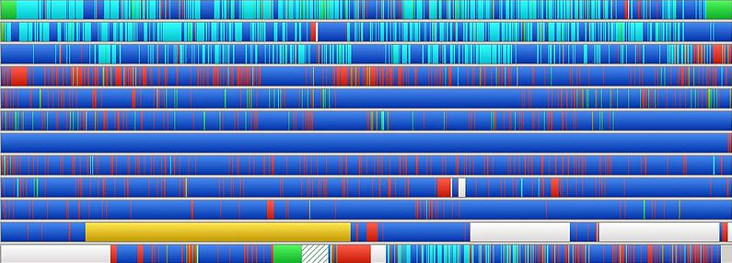
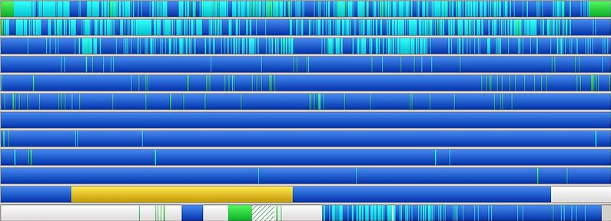
From to-do listing to time boxing -
like defragging your life!
Notes:
We shared a variety of "synonyms" to the principles behind time boxing in these slides so that if it is a new concept you can see parallel patterns in other settings.

Slide 48
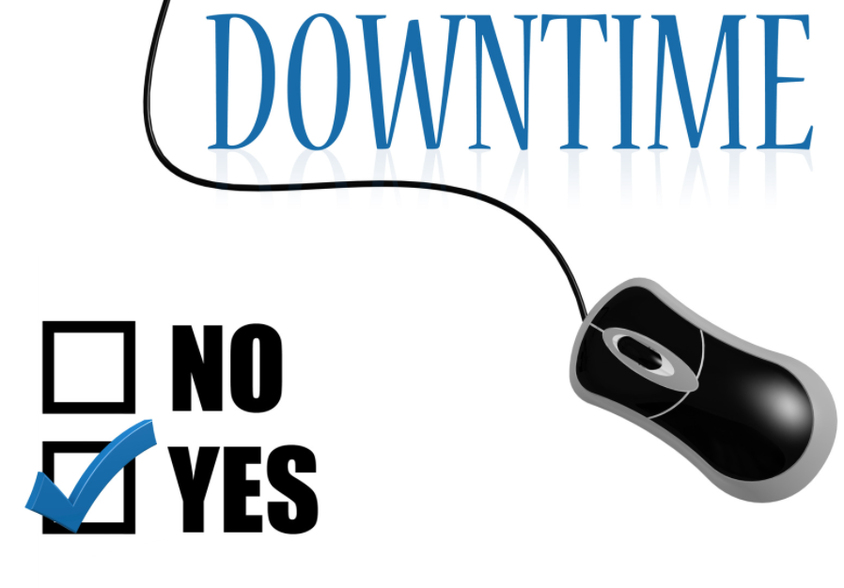
"There’s nothing wrong with scrolling through your Facebook feed, watching YouTube videos or playing a video game, as long as that’s what you intend to do. Taking a break can be good for you. It’s when you do things unintentionally that you get into trouble."
-Nir Eyal (emphasis added)
**We would argue that there is some content on these tools that can be inherently harmful, and there are some video games that also could be categorized as inherently harmful, but that's a different conversation. And a values-centered approach to tech use can also cover those realities.
Notes:
This concept comes from Nir Eyal, author of Indistractable. Quote is from https://www.nirandfar.com/opposite-of-distraction/ We can be focused on things that aren't in alignment with our values and goals, but we can also choose to build in time for using social media or other tools. They aren't inherently bad in and of themselves. Wellness is about deliberateness, integrity, and alignment.

Slide 49
NOTE: This slide was not included in the original discussion.
Nir Eyal: Watch for internal triggers, external triggers, or tweaks you can make in your plans
(see next slide for Nir's Distraction Tracker)
In the Mental Wellness module, we talked about how contracts alone (pacts) don't work because much of what influences our use of technology is what is happening in our internal weather (internal triggers, as Nir Eyal calls them). Being aware of our internal triggers can help us be more alert when we get distracted, and to understand WHY we may sometimes get distracted. Being alert to and responsible for internal triggers is critical to Honoring Time.
Nir's Distraction Tracker can be downloaded here: https://www.nirandfar.com/indistractable-distraction-tracker-pdf
Notes:
This concept comes from Nir Eyal, author of Indistractable. https://www.nirandfar.com/your-calendar/ https://www.nirandfar.com/opposite-of-distraction/ We can be focused on things that aren't in alignment with our values and goals. Traction is when where and how we spend our time matches with our

Slide 50
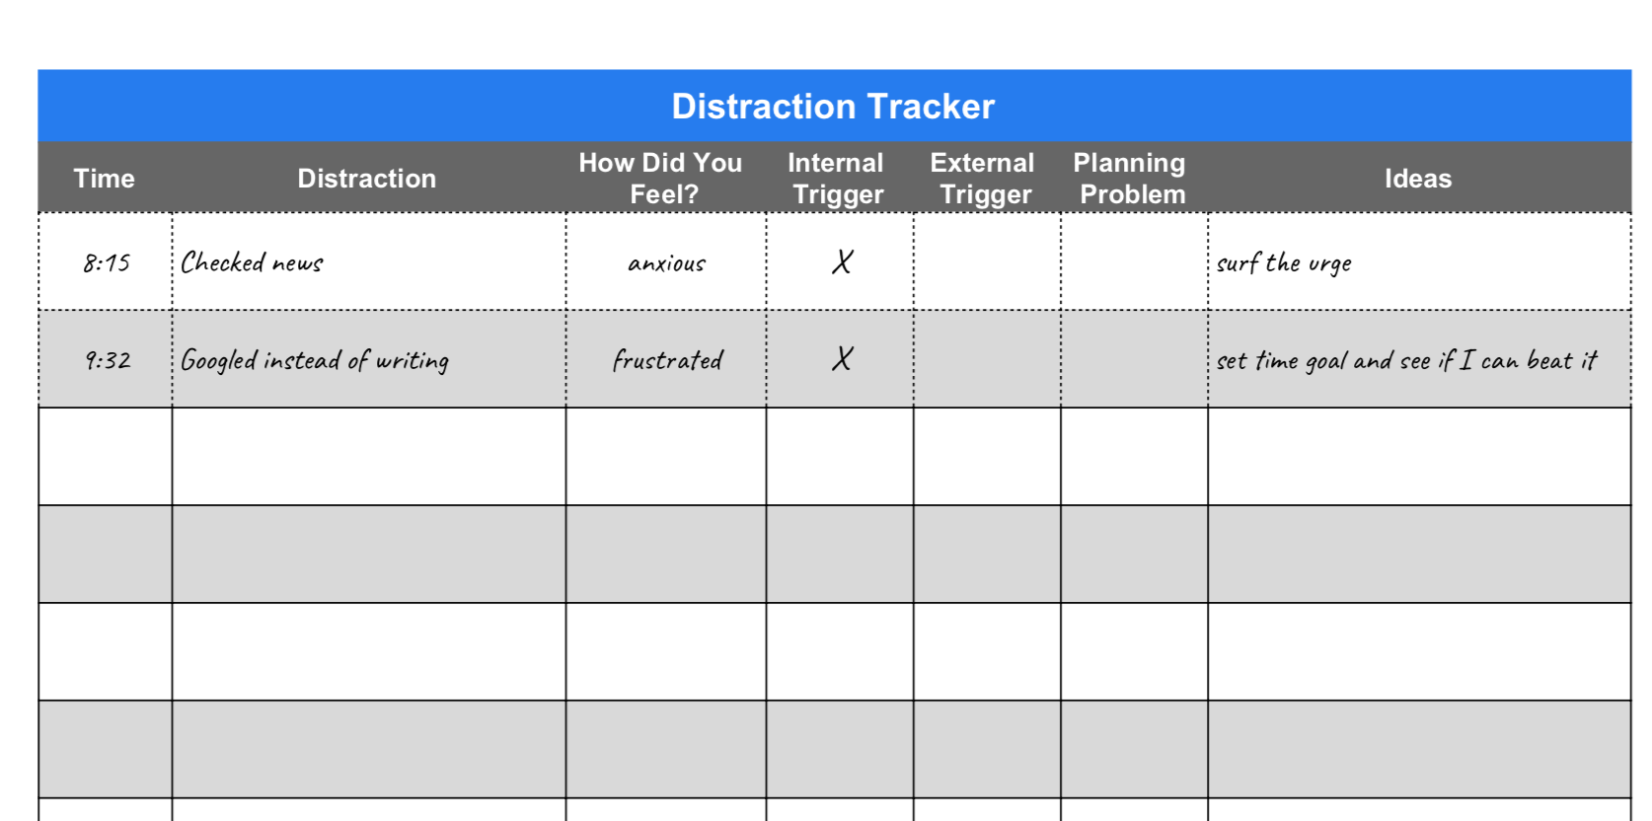
NOTE: This slide was not included in the original discussion.
Nir Eyal: Distraction Tracker
See https://www.nirandfar.com/your-calendar/
Distraction tracker can be downloaded here: https://www.nirandfar.com/indistractable-distraction-tracker-pdf
Notes:
This concept comes from Nir Eyal, author of Indistractable. https://www.nirandfar.com/your-calendar/ https://www.nirandfar.com/opposite-of-distraction/ We can be focused on things that aren't in alignment with our values and goals. Traction is when where and how we spend our time matches with our

Slide 51
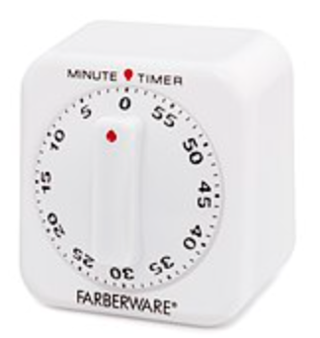
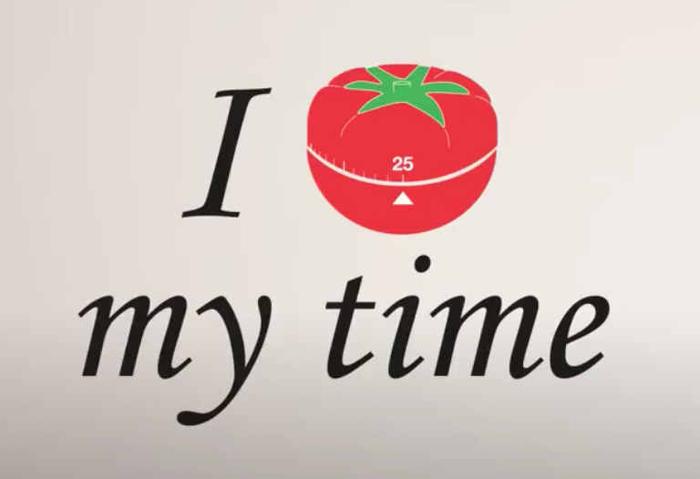
Time Boxing, another version: The Pomodoro® Technique
1 Pomodoro = 25 minutes
Notes:
https://www.youtube.com/watch?v=dnt2lTdcn8g, https://francescocirillo.com/pages/pomodoro-technique

Slide 52
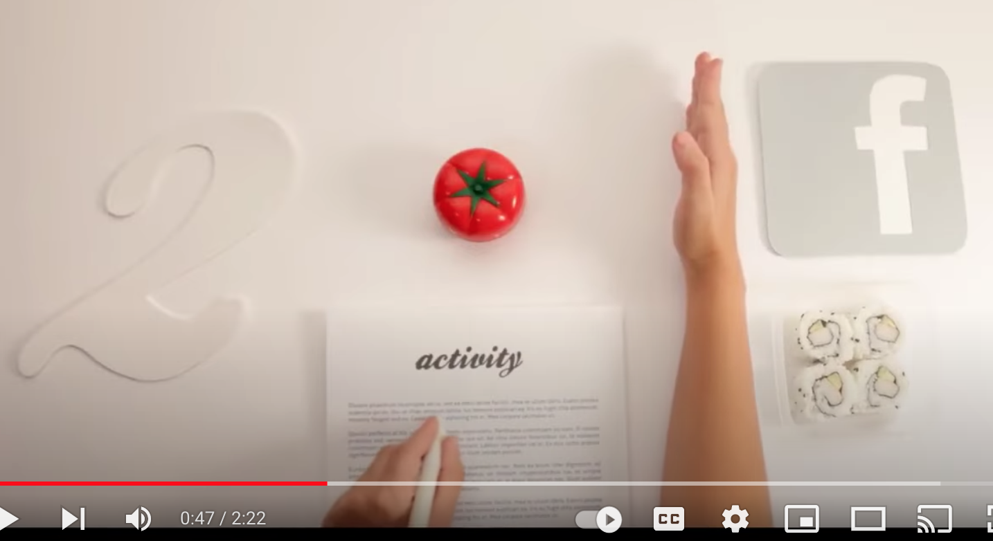
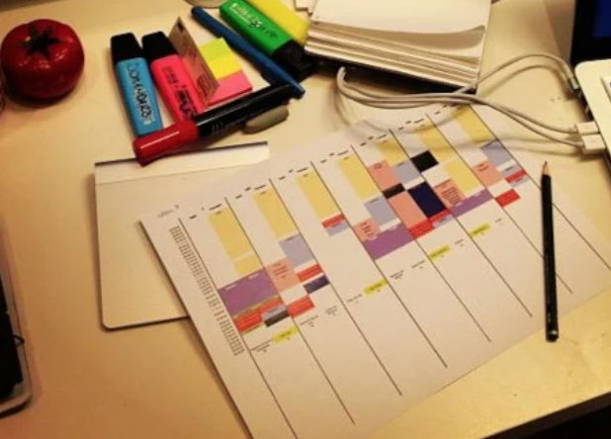
Time Boxing: The Pomodoro® Technique
1 Pomodoro = 25 minutes
Budget and protect “Pomodoros”
CREDITS: Snapshots from video and post at: https://francescocirillo.com/pages/pomodoro-technique
Notes:
https://www.youtube.com/watch?v=dnt2lTdcn8g, https://francescocirillo.com/pages/pomodoro-technique

Slide 53
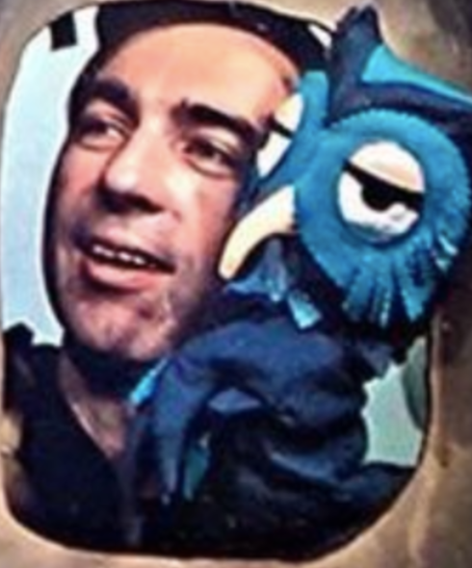
Time Boxing: The Pomodoro® Technique
Back in the day, parents might have said, “This will take one Mister Rogers” ☺
photo credit, in the public domain as listed here:
https://commons.wikimedia.org/wiki/File:Fred_Rogers_and_X_the_Owl_Look_Magazine_photo_1969.png
Notes:
https://www.youtube.com/watch?v=dnt2lTdcn8g, https://francescocirillo.com/pages/pomodoro-technique

Slide 54
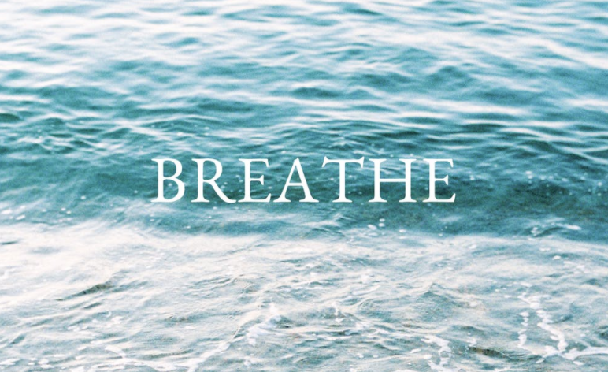
~~~ Blink and Breathe Break ~~~
Remember the 20-20-20 rule:
Take
20 seconds
every
20 minutes
to look out
20 feet
beyond your computer/device
Notes:
There is a lot of information about this practice online, but here are a few links as examples (see also resource links in the Physical Wellness resource document in our shared folder: https://docs.google.com/document/d/1M6jJ3MJfQ4DT85jJDdUvqsUV2GqsyNRl_90yONAoobU/edit?usp=sharing
https://www.optometrytimes.com/view/deconstructing-20-20-20-rule-digital-eye-strain
https://www.healthline.com/health/eye-health/20-20-20-rule
https://www.theeyesight.com/2016/10/24/the-20-20-20-rule-how-to-lessen-the-effects-of-digital-eye-strain/

Slide 55
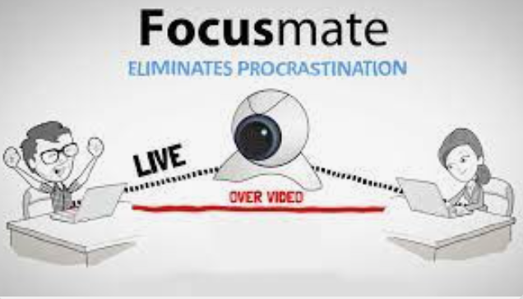
A few more tips for time boxing
1: Have a traction accountability partner
focusmate.com is one resource you could try to connect with others who are trying to use their time more deliberately. Or you could do this with a family member, someone within our learning community, etc.

Slide 56
2. Handling transitions
"Point and name" again, James Clear style
More on the origins of the "pointing and calling" technique from Japan's train safety system can be found here: protocolshttps://jamesclear.com/habits-scorecard
"I am going to do _____, and then I will do _______, and then I will do ________." Be specific, be vocal. At the very least, you can try to be your own accountability partner by saying out loud what you intend to do.
(This technique can help you if you struggle with misplacing things, too.)

Slide 57
3. Use Communications Charters to work with others to protect your time
(We didn't get to cover this, but will be talking about it in the Relationships module)
Notes:
This charter was shared in the DWI course, credit Digital Wellness Institute and Amy Blankston
https://www.forbes.com/sites/darrenmenabney/2021/03/14/to-have-better-remote-meetings-create-a-team-communication-charter/?sh=51e802a68182

Slide 58
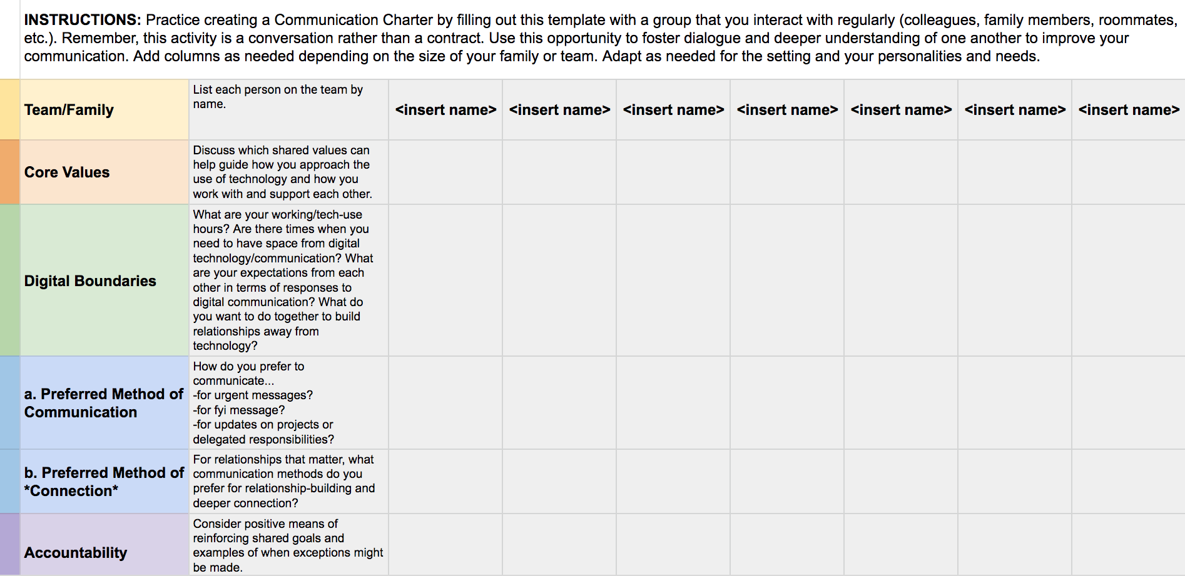
Create Communications Charters
https://docs.google.com/spreadsheets/d/11zDrV4bwSZGxML2MzGi_YqvLiZI23PmRrNBEy7BD3nA/edit?usp=sharing
Notes:
This is a Google worksheet you can copy and use with your team for work or other project teams https://docs.google.com/spreadsheets/d/11zDrV4bwSZGxML2MzGi_YqvLiZI23PmRrNBEy7BD3nA/edit?usp=sharing
There is a lot out there on communications charters, but here is one example of a link with more information:
https://www.forbes.com/sites/darrenmenabney/2021/03/14/to-have-better-remote-meetings-create-a-team-communication-charter/?sh=51e802a68182

Slide 59
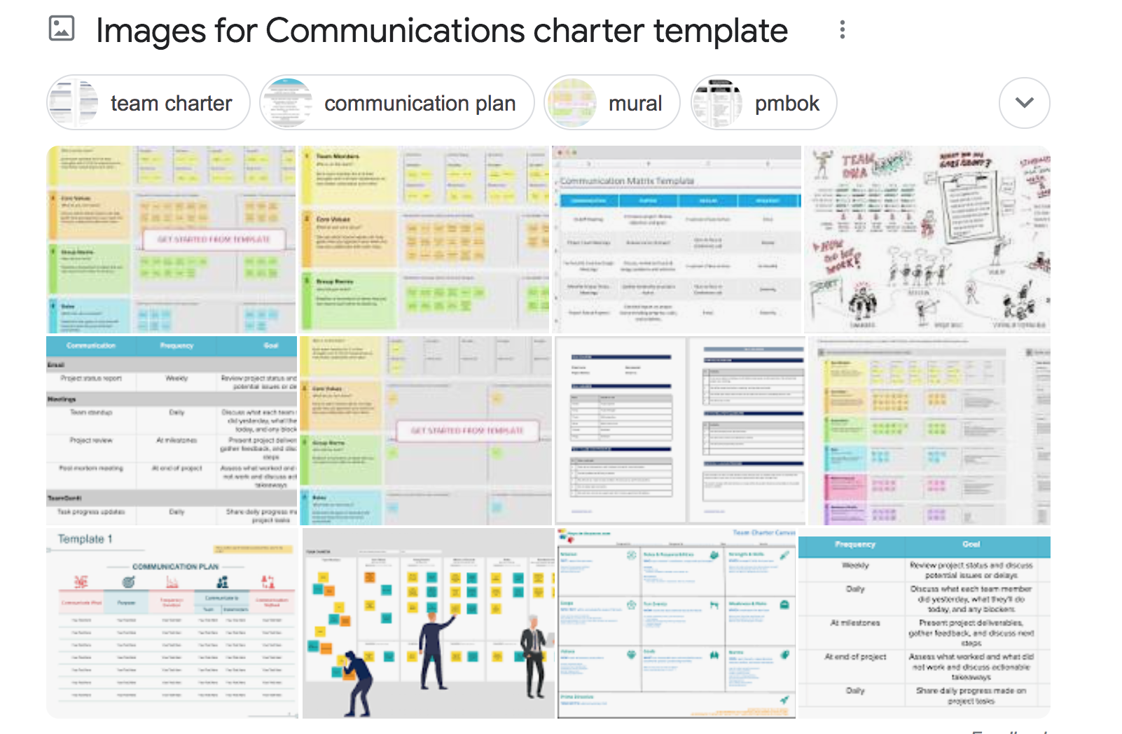
Or…search for "Communications Charter template"

Slide 60
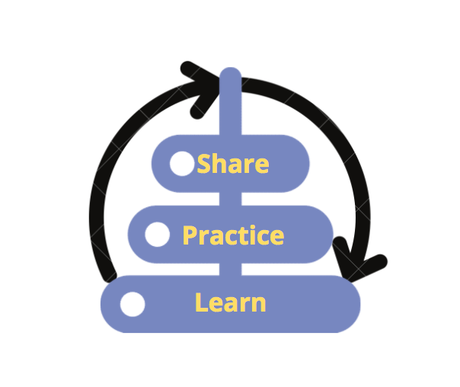
Invitations for the coming week
Take the DWI Digital Wellness self-assessment if you haven’t already https://survey.alchemer.com/s3/5504604/b153c792d361
Review today’s slides for one “Honoring Time” tip you want to try this week
Review today’s slides for one Honoring Time activity to do with someone else: your spouse, a child, or a friend, a colleague, etc. Discuss.

Slide 61
We wish you well(ness)!
"We but mirror the world. All the tendencies present in the outer world are to be found in the world of our body. If we could change ourselves, the tendencies in the world would also change. … We need not wait to see what others do.”
~ Mahatma Gandhi
“In the attention economy, mindfulness is activism.”
-Jay Vidyarthi, Mindful Tech designer and consultant

Slide 62
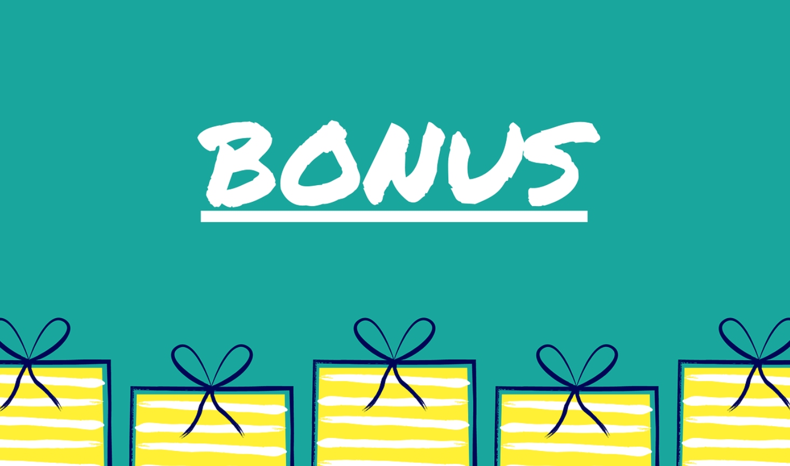
Bonus Material
See more resources, research, and information in the Honoring Time Resource document in the PTA folder https://docs.google.com/document/d/1QgV_axXu8mTfPN5gGdqrMlyRxNA9C_xZiTIg4GIUCCw/edit?usp=sharing

Slide 63
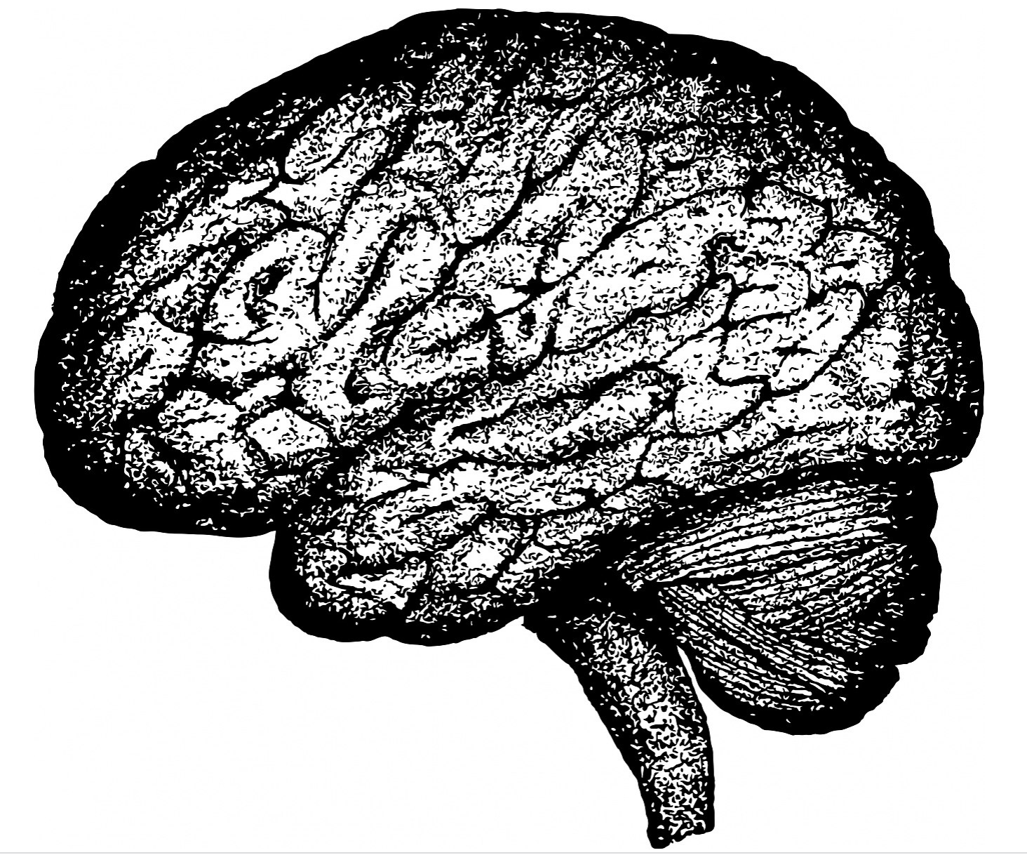
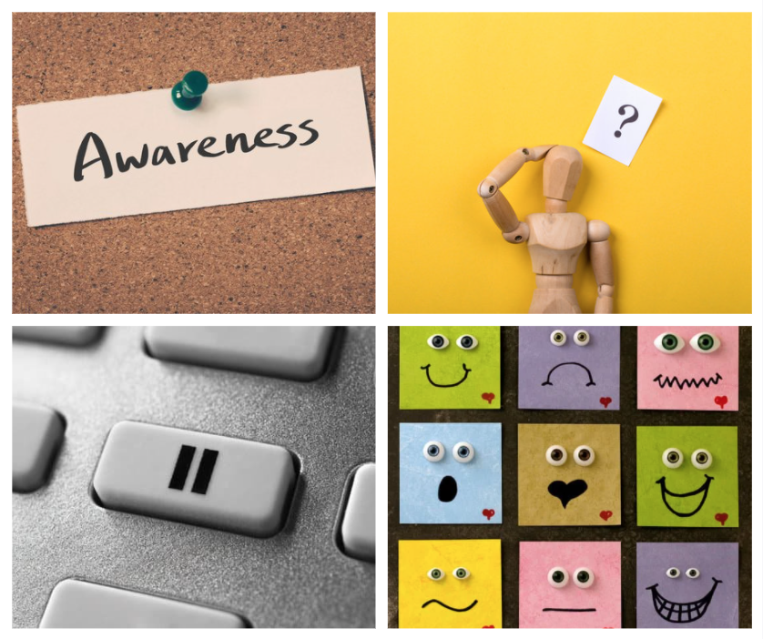
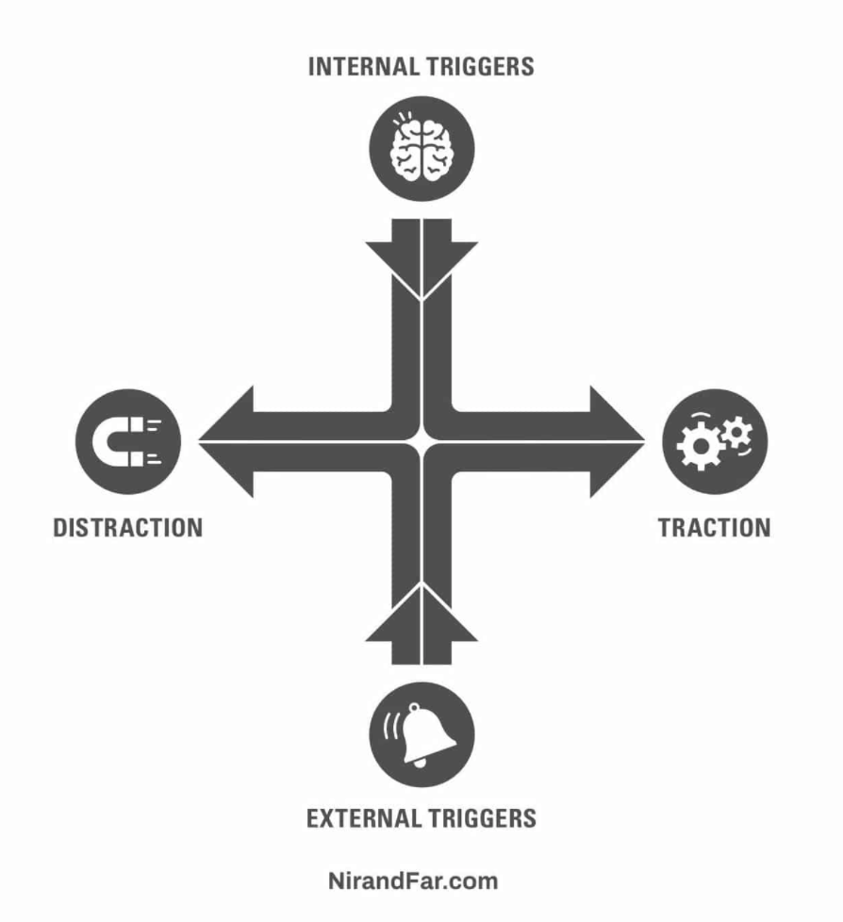
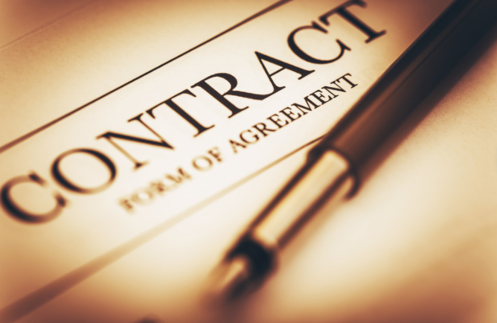
More on Nir Eyal's ideas on Traction – he advises doing these in order
Start with internal triggers
Schedule your values, time box
Address external triggers
Make pacts with yourself
Nir has some great links to tools that help some to reduce external triggers/distractions:
https://www.nirandfar.com/indistractable-tools/
Notes:
Nir Eyal Google Drive time box scheduler: https://docs.google.com/spreadsheets/d/1P6cK8z6SuVwE-p4xqhYUVzfstQpeE5aXCwCUUOsODiY/template/preview
Creately time box maker: https://creately.com/diagram/example/RATEuwfsavn/time-boxing-template
https://www.nirandfar.com/indistractable-tools/
https://www.nirandfar.com/schedule-maker/

Slide 64
Tip: Say no to Defaults! Help to Reduce Notifications
Say no to defaults! Change notifications
On iPhone: https://support.apple.com/guide/iphone/change-notification-settings-iph7c3d96bab/ios
On Android: https://support.google.com/android/answer/9079661?hl=en
On Pixel: https://support.google.com/pixelphone/answer/6111294?hl=en
On Samsung Galaxy s9: https://www.cnet.com/tech/mobile/how-to-turn-off-samsungs-galaxy-notifications-on-the-galaxy-s9/
On Facebook: https://www.facebook.com/help/390022341057202/
On WhatsApp:
For Android: https://faq.whatsapp.com/android/chats/how-to-manage-your-notifications
For iPhone: https://faq.whatsapp.com/iphone/troubleshooting/how-to-manage-your-notifications
For Desktop: https://faq.whatsapp.com/web/chats/how-to-manage-your-notifications
On LinkedIn: https://www.linkedin.com/help/linkedin/answer/76636/managing-your-linkedin-notification-updates?lang=en
On Email: Check your email program/app and/or your device
On Windows 10: https://support.microsoft.com/en-us/windows/change-notification-and-action-settings-in-windows-10-8942c744-6198-fe56-4639-34320cf9444e
On a Mac: https://support.apple.com/en-us/HT204079
On Slack: https://slack.com/help/articles/201355156-Configure-your-Slack-notifications
Microsoft Teams Do Not Disturb: https://techcommunity.microsoft.com/t5/microsoft-teams/automatically-set-do-not-disturb-when-presenting/m-p/736906

Slide 65
Tip: Say no to Defaults! Help to Reduce Notifications
Say no to defaults! Change notifications
On Microsoft Outlook: https://support.microsoft.com/en-us/office/turn-new-message-alert-pop-up-on-or-off-9940c70e-b306-442e-a856-d94b20318481
On Facebook Messenger: https://www.facebook.com/help/messenger-app/330627630326605
Manage Announce notifications with Siri on Airpods or Beats: https://support.apple.com/en-us/HT210406
On Amazon Alexa/Echo: https://www.amazon.com/gp/help/customer/display.html?nodeId=GW65E37ZG4L9BW3P
On Apple Watch: https://support.apple.com/en-us/HT204791
On FitBit: https://help.fitbit.com/articles/en_US/Help_article/2323.htm
Across various devices (a curated instruction list): https://www.businessinsider.com/how-to-turn-off-all-notifications-across-devices
On Voxer: https://support.voxer.com/hc/en-us/articles/204332223-Disable-Enable-Notifications-per-Chat
On Marco Polo: https://support.marcopolo.me/article/69-notification-settings
On Viber:
iPhone: https://help.viber.com/en/article/personalize-your-viber-settings-iphone
Android: https://help.viber.com/en/article/personalize-your-viber-settings-android-phones
On Google News: https://support.google.com/googlenews/answer/9005590?hl=en&co=GENIE.Platform%3DAndroid
On Apple News: https://support.apple.com/en-us/HT211230
On Skype
For desktop: https://support.skype.com/en/faq/FA34811/how-do-i-manage-notifications-in-skype-on-desktop
For mobile: https://support.skype.com/en/faq/fa34746/how-do-i-manage-notifications-in-skype-on-mobile-or-tablet
Notes:
I added the slides about notifications and privacy settings from last week's slide deck for your convenience.

Slide 66
Tip: Say no to Defaults! Help to Reduce Notifications
Say no to defaults! Change notifications
On GroupMe: https://www.swipetips.com/how-to-turn-off-groupme-notifications-on-iphone-or-android/
On Slack: https://slack.com/help/articles/201355156-Configure-your-Slack-notifications
On Instagram: https://help.instagram.com/105448789880240
On Twitter: https://help.twitter.com/en/managing-your-account/enabling-web-and-browser-notifications
On SnapChat:
Android: https://support.snapchat.com/article/android-notifications
Apple: https://support.snapchat.com/en-US/article/ios-notifications
On Clubhouse:
About notifications: https://clubhouseapp.zendesk.com/hc/en-us/articles/360062778193-When-do-I-get-notified-about-people-
Changing notifications: https://clubhouseapp.zendesk.com/hc/en-us/articles/1500002511422-Can-I-adjust-my-notification-settings-
For Facebook game notifications: https://www.facebook.com/help/476337625740088
General Android notifications: https://www.talkandroid.com/guides/beginner/how-to-disable-annoying-android-notifications/
General phone notification help: https://www.wired.com/story/turn-off-notifications-smartphone/
On Nintendo: https://en-americas-support.nintendo.com/app/answers/detail/a_id/22345/~/how-to-change-notification-settings
On XBox One: https://www.howtogeek.com/675283/how-to-turn-off-or-customize-xbox-one-notifications/
On Nintendo: https://en-americas-support.nintendo.com/app/answers/detail/a_id/22345/~/how-to-change-notification-settings
On PS5: https://www.playstation.com/en-us/support/account/manage-notifications-ps5/
Notes:
I added the slides about notifications and privacy settings from last week's slide deck for your convenience.

Slide 67
Tip: Say no to defaults – Increase privacy protection in settings = more friction through privacy settings
The price we pay for ease of use (frictionless digital flow) is…fewer barriers between us and digital distractions!
There is a tension here, but if you build in more log-offs, more two-step verifications, etc. you build in more friction AND protect your privacy
Less privacy means more targeted advertising (e.g., Facebook Pixel)
Be smart about smart tech
https://www.ted.com/talks/finn_lutzow_holm_myrstad_how_tech_companies_deceive_you_into_giving_up_your_data_and_privacy
https://www.washingtonpost.com/video/c/embed/1f882f50-65bb-11e8-81ca-bb14593acaa6
Notes:
See also: https://www.wired.com/story/facebooks-targeted-ads-are-more-complex-than-it-lets-on/, https://www.pewresearch.org/internet/2019/11/15/how-americans-think-about-privacy-and-the-vulnerability-of-their-personal-data/ https://www.consumerreports.org/privacy/how-facebook-tracks-you-even-when-youre-not-on-facebook-a7977954071/ https://applymagicsauce.com/demo https://news.harvard.edu/gazette/story/2017/08/when-it-comes-to-internet-privacy-be-very-afraid-analyst-suggests/. https://www.washingtonpost.com/video/c/embed/1f882f50-65bb-11e8-81ca-bb14593acaa6

Slide 68
Tip: Increase privacy in your tech settings
Google Chrome: https://www.theverge.com/2020/2/11/21126427/google-chrome-privacy-tools-private-network-browser-settings
Instagram: https://www.theverge.com/2020/2/27/21154221/instagram-privacy-how-to-stories-posts-settings-tags-ads-blocking
Facebook: https://www.consumerreports.org/privacy/facebook-privacy-settings-a1775535782/
Snapchat: https://www.lifewire.com/snapchat-privacy-tips-4117444
Whatsapp: https://www.fastcompany.com/90388813/the-ultimate-guide-to-whatsapps-powerful-privacy-options
Google: https://www.wired.com/story/google-tracks-you-privacy/
YouTube: https://www.theverge.com/2019/4/19/18484802/youtube-privacy-protect-how-to-video-preferences-web-ad-personalization
Amazon: https://the-digital-reader.com/2020/02/12/six-default-amazon-security-settings-you-can-change-for-more-privacy/
Other tips part 1: https://www.washingtonpost.com/news/the-switch/wp/2018/06/01/hands-off-my-data-15-default-privacy-settings-you-should-change-right-now/
Other tips, part 2: https://www.washingtonpost.com/news/the-switch/wp/2018/06/15/hands-off-my-data-15-more-default-privacy-settings-you-should-change-on-your-tv-cellphone-plan-linkedin-and-more/
Notes:
See also: https://www.wired.com/story/facebooks-targeted-ads-are-more-complex-than-it-lets-on/, https://www.pewresearch.org/internet/2019/11/15/how-americans-think-about-privacy-and-the-vulnerability-of-their-personal-data/ https://www.consumerreports.org/privacy/how-facebook-tracks-you-even-when-youre-not-on-facebook-a7977954071/ https://applymagicsauce.com/demo

Slide 69
Tip: Increase privacy in your tech settings
More secure online transactions: https://smartasset.com/personal-finance/10-tips-for-secure-online-transactions
Turning off ”listening” capabilities: https://techwellness.com/blogs/expertise/how-to-turn-off-or-disable-microphone-and-camera-to-stop-apps-apple-microsoft-spying or https://www.makeuseof.com/tag/stop-google-android-listening/
What apps use end-to-end encryption? https://www.amnesty.org/en/latest/press-release/2016/10/snapchat-skype-among-apps-not-protecting-users-privacy/
Removing third-party app connections to Facebook: https://www.imore.com/how-to-revoke-facebook-app-permissions
Privacy apps: https://www.safervpn.com/blog/7-best-privacy-apps-for-your-phone/
John, A. (2018). How Facebook Tracks You, Even When You're Not on Facebook.CR Consumer Reports.
The Facebook Dilemma: https://www.pbs.org/wgbh/frontline/film/facebook-dilemma/
Notes:
See also: https://www.wired.com/story/facebooks-targeted-ads-are-more-complex-than-it-lets-on/, https://www.pewresearch.org/internet/2019/11/15/how-americans-think-about-privacy-and-the-vulnerability-of-their-personal-data/ https://www.consumerreports.org/privacy/how-facebook-tracks-you-even-when-youre-not-on-facebook-a7977954071/ https://applymagicsauce.com/demo

Slide 70
“The opposite of distraction is” ______________.
(In physics, this involves friction)
Notes:
NirAndFar.com – the opposite of distraction is TRACTION – “turn your values into time: plan by input, not output”

Slide 71
Tip: Create more Friction (more distance/barriers between you and your dis-tractions)
An example: “I am the type of person who takes care of her body.” Friction might include not having foods like donuts in the house, or making junk foods harder to access in the house.
Notes:
In physics, friction is caused by contact between objects. In the wellness world, friction is created by distance, curiosity and awareness, barriers, added steps between you and the thing that is dis-traction-ing you.

Slide 72
Tip: Increase friction with your digital devices
”Make that next source of information [or app] a little bit more difficult to reach… to [help you] remain in the source of your attention for a longer period of time.”
Dr. Adam Gazzaley M.D. Ph.D. - https://wellbeing.google/get-started/focus-your-time-with-tech/
One example of friction is to remove as many apps and notification-driven tools from your home screen as possible.
Bonus – add something on your home screen that helps remind you of your center. For me it's a drawing my daughter did that helps me remember and recenter around core values. .
Notes:
Tech companies design tools to be frictionLESS – so that we can move seamlessly between tools…for as long as possible. This frictionless design can have its upsides, but the cost is that we often end up using our devices more than we intended. Little things like adding more steps between you and your weak-spot tools can help keep you more mindful.

Slide 73
Tip: More thoughts on friction, changing habits
https://maketime.blog/article/wendy-wood-interview/
Dr. Wendy Wood - another habits expert featured here as well:
https://www.newyorker.com/magazine/2019/10/28/can-brain-science-help-us-break-bad-habits [Her book: Good Habits, Bad Habits]
[don't] be simply defensive about … time and focus on avoiding distraction, but … also be proactive and think about what you want to be making time for; what you actually do want to be focused on.. .
"we can control what happens by changing the cues in our environment."
Notes:
Tech companies design tools to be frictionLESS – so that we can move seamlessly between tools…for as long as possible. This frictionless design can have its upsides, but the cost is that we often end up using our devices more than we intended. Little things like adding more steps between you and your weak-spot tools can help keep you more mindful. Changing cues in your environment can also make a difference. Being deliberate about what you WANT to do and be (vs. trying to reduce distraction from willpower alone) is also recommended by Dr. Wood.

Slide 74
Tip: Create more Friction (traction)- Internally
Notes:
Remember that internal triggers often drive mindless, unproductive, or even destructive use of tech. And many distractions come from inside of us (e.g., internal to-do lists that lead us to wander into bunny trails online or even while engaging at work or home.) Awareness is the first step to honoring time. Learn more about frictionless technology and its downsides: https://www.digitaltrends.com/features/the-frictionless-internet/

Slide 75
Tip: Create more Friction – Physically, e.g.,
VS.
Notes:
When we create distance between ourselves and our priorities and things that can distract, we create more friction between us and the distraction. Distance = friction in the case of wellness. See ideas for wellness-focused physical environments here: https://medium.com/digitalwellnesscollective/feng-shui-for-the-mind-exposing-dopamine-and-variable-rewards-systems-influences-on-our-screen-c7afd237dc7a
https://www.dropbox.com/s/pqgmephg9u8ut3d/Designing%20Spaces%20for%20Digital%20Flourishing%E2%84%A2%20-%20Experiencing%20our%20Environment.pdf?dl=0
https://medium.com/digitalwellnesscollective/feng-shui-for-the-mind-part-2-of-3-dopamine-variable-rewards-systems-de67509b3995

Slide 76
“TRY THIS: AUDIT YOUR TIME Spend a week tracking how much time you devote to the following: family, friends, health, and self. (Note that we’re leaving out sleeping, eating, and working. Work, in all its forms, can sprawl without boundaries. If this is the case for you, then set your own definition of when you are “officially” at work and make “extra work” one of your categories.) The areas where you spend the most time should match what you value the most. Say the amount of time that your job requires exceeds how important it is to you. That’s a sign that you need to look very closely at that decision. You’re deciding to spend time on something that doesn’t feel important to you. What are the values behind that decision? Are your earnings from your job ultimately serving your values?”
― Jay Shetty, Think Like a Monk: Train Your Mind for Peace and Purpose Every Day
Notes:
Some more thoughts from Jay Shetty

Slide 77
“No matter what you think your values are, your actions tell the real story. What we do with our spare time shows what we value. For instance, you might put spending time with your family at the top of your list of values, but if you spend all your free time playing golf, your actions don’t match your values, and you need to do some self-examination.”
― Jay Shetty, Think Like a Monk: Train Your Mind for Peace and Purpose Every Day
“A very small shift in direction can lead to a very meaningful change in destination”
― James Clear, Atomic Habits: An Easy & Proven Way to Build Good Habits & Break Bad Ones
Notes:
Some more thoughts from Jay Shetty

Slide 78
“It is easy to get bogged down trying to find the optimal plan for change: the fastest way to lose weight, the best program to build muscle, the perfect idea for a side hustle. We are so focused on figuring out the best approach that we never get around to taking action. As Voltaire once wrote, “The best is the enemy of the good.” I refer to this as the difference between being in motion and taking action. The two ideas sound similar, but they’re not the same. When you’re in motion, you’re planning and strategizing and learning. Those are all good things, but they don’t produce a result. Action [TRACTION], on the other hand, is the type of behavior that will deliver an outcome. If I outline twenty ideas for articles I want to write, that’s motion. If I actually sit down and write an article, that’s action.”
― James Clear, Atomic Habits: An Easy & Proven Way to Build Good Habits & Break Bad Ones
Notes:
Some more thoughts from Jay Shetty

Slide 79
“If motion doesn’t lead to results, why do we do it? Sometimes we do it because we actually need to plan or learn more. But more often than not, we do it because motion allows us to feel like we’re making progress without running the risk of failure. Most of us are experts at avoiding criticism. It doesn’t feel good to fail or to be judged publicly, so we tend to avoid situations where that might happen. And that’s the biggest reason why you slip into motion rather than taking action: you want to delay failure.”
― James Clear, Atomic Habits: An Easy & Proven Way to Build Good Habits & Break Bad Ones
Notes:
Some more thoughts from Jay Shetty

Slide 80
Amy Blankston, co-founder of Digital Wellness Institute:
"I was reading recently [a] blog about how we have...time blocks in our lives that if you count up the number of blocks of time you have until you die, which is a little bit morbid, you begin to realize, I have X number of dinners with my family. I have this much time to write this book. I have that much time to learn a new instrument and all of a sudden time, the value of time really rises to the surface of, we begin to say, okay, yes, I want to check that, but what's best for me right now, who I want to be is the person who can find balance amidst all of that temptation and say this is what I needed to do. It's developing that discipline that is adjusting to the new era that we're living in."
https://findingbrave.org/wp-content/uploads/2017/08/Transcript-FInding-Brave-Episode-39-Amy-Blankson-How-to-Leverage-Technology-to-Increase-Your-Happiness.pdf
Notes:
Some more thoughts from Jay Shetty

Slide 81
We can check our cell phones around 100 times a day! https://www.bankmycell.com/blog/smartphone-addiction/
This music video captures the challenges of living in a "Check Your Phone" culture:
https://www.youtube.com/watch?v=sVaw2ggTydc
Notes:
Some more thoughts from Jay Shetty

Slide 82
What do you see?
Notes:
Time on tech leaves us susceptible to losing a sense of our center and who we want to be, as defined by our own inner work, not by all the myriad voices and forces ‘out there.’ Solitude = when you are alone with your own thoughts and mind…an idea from Lead Yourself First. This quote above is from The Social Dilemma -- one expert's perspective on what the product is of Big Tech. Jaron argues that it's not just our attention that is the product, but outcomes of behaviors and perceptions that have been influenced (if not manipulated) by technology.

Slide 83
What do you see?

Slide 84
A values-centered approach to time
=Easier to define distraction
In art, the negative space is the space
around and between the desired object of attention.
Notes:
In art, the negative space is the space around and between the object of attention.

Slide 85
Who do you want to become?
“I am the type of person who ___________.”
Notes:
More can be found in James Clear’s book, or in this snippet from his book from his website, which also includes the image and quote: https://jamesclear.com/identity-based-habits

Slide 86
Who do you want to become?
(Writing helps us define this more…)
Notes:
More can be found in James Clear’s book, or in this snippet from his book from his website, which also includes the image and quote: https://jamesclear.com/identity-based-habits

Slide 87
Who do you want to become?
Be clear and specific about defining your values
Notes:
More can be found in James Clear’s book, or in this snippet from his book from his website, which also includes the image and quote: https://jamesclear.com/identity-based-habits

Slide 88
James Clear:
Who do you want to become?
Outcomes
Processes
Identity
"I am the type of person who _________________"
Notes:
More can be found in James Clear’s book, or in this snippet from his book from his website, which also includes the image and quote: https://jamesclear.com/identity-based-habits.

Slide 89
More thoughts on a values focus
Outcomes
Processes
Identity
Notes:
More can be found in James Clear’s book, or in this snippet from his book from his website, which also includes the image and quote: https://jamesclear.com/identity-based-habits.

Slide 90
"I am the type of person who _________________"
Outcomes
Processes
Identity

Slide 91
Bonus: More data on email etc.
Survey courtesy of DWI: https://survey.alchemer.com/s3/5504604/b153c792d361

Slide 92
Some research about email
Adobe study: > 5 hours a day (work & personal); times checked through the day vary
https://blog.adobe.com/en/publish/2019/09/08/if-you-think-email-is-dead--think-again.html
See also https://www.slideshare.net/adobe/2019-adobe-email-usage-study

Slide 93
Some research about email
Emails can unwittingly surrender your time to someone else’s values or priorities (this can be true of any electronic media, including social media feeds and news feeds)
Each email sent can produce four more:
“Emails don't die - they spawn like zombies from the walking dead!” Amy Blankston
Email can consume hours of one’s day (some research estimates 2.5 hours lost on average)
Even one email can cost a lot in internal distraction (Erica Dawahn: see image below)
https://summit.digitalwellnessday.com/talks/how-to-read-digital-body-language/
Notes:
More research on email included in the bonus section at the end of these slides

Slide 94
Some research about email
Adobe study: First tech touch of the day
 | Checking in bed | Checking during breakfast/getting ready | Checking during commute
Work email | 13% | 25% | 15%
Personal email | 15% | 42% | 16%
Social media | 26% | 25% | 11%
https://blog.adobe.com/en/publish/2019/09/08/if-you-think-email-is-dead--think-again.html
See also https://www.slideshare.net/adobe/2019-adobe-email-usage-study

Slide 95
Some thoughts about email
"Email is a constant distraction that prevents us from engaging in proper, meaningful thinking. Lightening your email load allows you to get [traction] into important work, rather than just managing minutiae." https://www.forbes.com/sites/annabelacton/2017/07/13/innovators-challenge-how-to-stop-wasting-time-on-emails/?sh=536d6bec9788
see also https://blog.adobe.com/en/publish/2019/09/08/if-you-think-email-is-dead--think-again.html
See also https://www.slideshare.net/adobe/2019-adobe-email-usage-study

Slide 96
Some ideas for managing communications
Disrupt your habits to respect morning, mealtime, evening, and bedtime routines
Some people like to go for zero emails (+/-) [
Some people do batch email engagement (+/-)
Others set specific times in the day to check email
Nir Eyal and others – don’t start the day with email
James Clear (author of Atomic Habits): “Don’t open email until noon” https://jamesclear.com/productivity [that page is a gold mine of information]
Communications charters can help
E.g., What tools work best for each person?
What can family/ team agree on to ID urgent tasks and create time and space around others and/or protect important times of the day and create a culture where “always on” is not rewarded/encouraged?
Graphic credit: Chris Flack
Notes:
(https://www.mindtools.com/pages/article/developing-communications-charter.htm)
https://www.forbes.com/sites/darrenmenabney/2021/03/14/to-have-better-remote-meetings-create-a-team-communication-charter/?sh=51e802a68182

Slide 97
Managing email and other communications
What works for you?
What isn’t working for you?

Slide 98
DWI Productivity Self-assessment Question 3:
Using social media, games, email to procrastinate
Nir Eyal: “We must understand the discomfort we are trying to escape”
”Time management is pain management” ~Nir Eyal, Indistractable
(see also Attention Economy and Mental Health modules)
Survey courtesy of DWI: https://survey.alchemer.com/s3/5504604/b153c792d361

Slide 99
DWI Productivity Survey Question 3:
Using social media, games, email to procrastinate

Slide 100
DWI Productivity Self-assessment Question 4:
Multitasking (and/or Task-Switching)
Survey courtesy of DWI: https://survey.alchemer.com/s3/5504604/b153c792d361

Slide 101
DWI Productivity Self-assessment Question 4:
Multitasking (and/or Task-Switching)
Another simple example:
How many tabs do you have open on your browser right now?
OR
How many apps are currently open on your phone?

Slide 102
Productivity through different lenses
What resonates with you?
Nir Eyal:
Measure not to-dos but by time spent: Did I do what I said I would do for as long as I said I would, without distraction?
Turn your values into time
Plan inputs, not outputs https://www.bbc.co.uk/ideas/videos/five-ways-to-distraction-proof-your-mind/p07v2qvt
Watch for internal triggers if you get off traction
Watch for external triggers if you get off traction
Observe if the off-track moments are more from planning tweaks that are needed
More at NirandFar.com

Slide 103
Productivity through various lenses
What resonates with you?
Nir Eyal:
Indistractable model (the order matters – don’t start with pacts)
1. Master internal triggers
2. MAKE time for traction (schedule your priorities)
3. Hack back external triggers (e.g., turn off notifications, social distance from your phone, look at other environmental cues and setups)
4. Prevent distractions with pacts
Image is a Google search screenshot. Do your own search on time boxing and see what you find!

Slide 104
Nir Eyal: Distraction Tracker
https://www.nirandfar.com/your-calendar/
Distraction tracker can be downloaded here: https://www.nirandfar.com/indistractable-distraction-tracker-pdf

Slide 105
Productivity through various lenses
What resonates with you?
Nir Eyal: “"Schedule your days or someone else will."
Time boxing (free tool: https://www.nirandfar.com/schedule-maker/)
Image is a Google search screenshot. Do your own search on time boxing and see what you find!

Slide 106
Productivity through various lenses
What resonates with you?
Productivity: “Getting things done without sacrificing everything we care about along the way.” -Charles Duhigg
https://brenebrown.com/podcast/brene-with-charles-duhigg-on-habits-and-productivity/
In this interview with Brené Brown, Duhigg also talks about constantly revisiting what productivity means at any given moment, even reassessing your calendar during the week to be sure what you are doing is in alignment with what you really want to be doing.
https://www.facebook.com/brenebrown/posts/371566174333723

Slide 107
Productivity through various lenses
What resonates with you?
Beware of tools that promise to help you do things that run counter to what you really want/need to be doing!
Notes:
https://www.brainyquote.com/quotes/peter_drucker_105338

Slide 108
Productivity through various lenses
What resonates with you?
“Where focus goes, energy flows. And if you don't take the time to focus on [and be mindful/intentional/deliberate about] what matters, then you're living a life of someone else's design.”
~Tony Robbins
This idea of “where your focus goes, your energy flows” shows up often in wellness/meditation/motivation spaces.

Slide 109
Productivity through various lenses
What resonates with you?
Flow: “a state in which people are so involved in an activity that nothing else seems to matter; the experience is so enjoyable that people will continue to do it even at great cost, for the sheer sake of doing it.” (Mikal Cskikszentmihalyi, 1990)
Illustrating concepts in Cal Newport’s book, Deep Work
https://www.youtube.com/watch?v=_RMtnDaxmPw

Slide 110
Productivity through various lenses
What resonates with you?
The Slow Movement(s)
https://www.slowmovement.com/
See also
https://www.slowfood.com/
Carlo Petrini’s work
Carl Honoré TED talk
Cal Newport TED talk
Harvard student letter: “Slow Down”
Carl Honoré

Slide 111
More Productivity Tips, Tricks, Hacks
Image courtesy of Digital Wellness Institute (DWI)

Slide 112
More tips to “turn values into time” (Nir Eyal)
Nurture your values
Start small (1% changes)
Honor crossroads moments
Practice single-tasking
Try time boxing
Notes:
NirAndFar.com – the opposite of distraction is TRACTION – “turn your values into time: plan by input, not output.” This is a practice. Our brains easily slip into to-do mode, into performance/checklist mode, into measuring based on busyness and activity level vs. on the flow of our lives and how and if it matches with our core intentions. Our brains and bodies can learn more centered, peaceful, intentional ways of living as we set those intentions and practice. “Intention for our attention” – adapted thought from Nina Herscher, CEO of DWI

Slide 113
Tip #1: Start Small
“1. Decide the type of person you want to be.
2. Prove it to yourself with small wins….
“The results can come later.”
James Clear, Atomic Habits
Also sometimes called the
”Act As if” principle.
Also applies to collaborative work!
Notes:
This quote can be found in James Clear’s book, or in this snippet from his book from his website, which also includes the image and quote: https://jamesclear.com/identity-based-habits

Slide 114
Tip #1: Start Small
Do any “small wins” come to mind that you could try this week to align with the person you are trying to be?

Slide 115
Tip #2: Honor “Crossroads” moments with yourself and your people
https://www.oprah.com/oprahs-lifeclass/does-your-face-light-up-video
Notes:
https://www.oprah.com/oprahs-lifeclass/does-your-face-light-up-video
See also bonus tips later in the slideshow for ideas from various experts about what they do to start their day

Slide 116
Tips 3 and 4
(Single-tasking and Time Boxing)
were addressed in the main discussion

Slide 117
A continuum to consider
“Lost souls are not that different from those in the zone. The zone is enjoyable. But when that joy becomes an obsession one becomes disconnected from life.”
Distraction
/Fragmentation
Deep Work
Shallow Work
Getting lost

