Slide 1
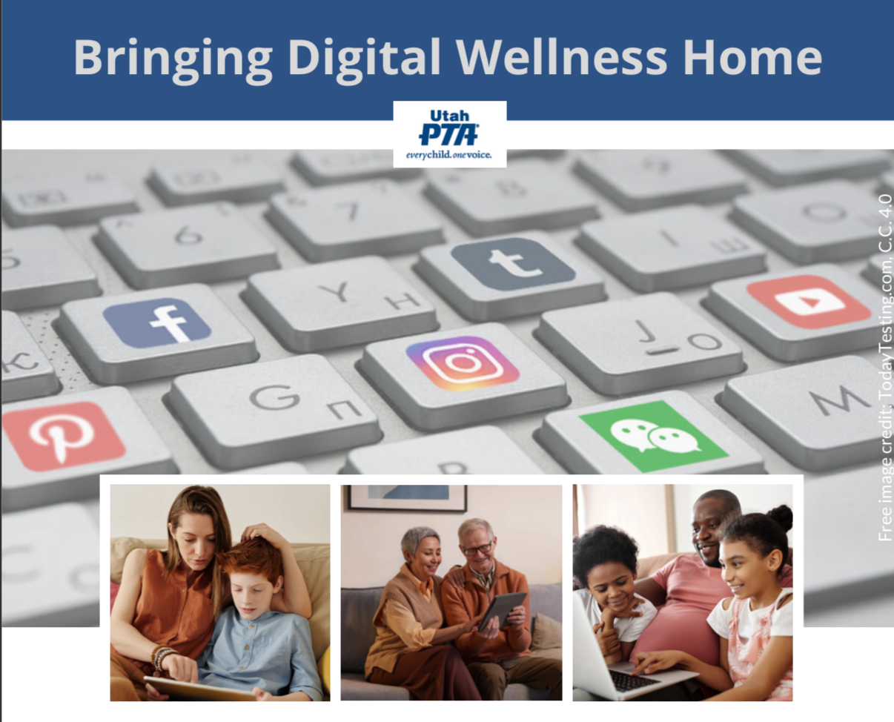
Note: All material in this series is for educational and informational purposes only, and is not meant to be exhaustive or used as a replacement for professional health support. Also, any sharing of resources doesn't imply full endorsement of all of that person or group's work. We share what we find helpful, but invite you to use your media literacy skills in all your study and research.
Notes:
Note: All material in this series is for educational and informational purposes only, and is not meant to be exhaustive or used as a replacement for professional health support. Also, the presentation is best viewed in slideshow format, as some of the slides are animated, but we have also included notes for many of the slides that you might want to review as well. Whatever works best for you!
NOTE: Portions of this work first appeared in or are derived or adapted from the Digital
Wellness Certificate Program. Those portions are Copyright © 2021, Digital Wellness Institute.

Slide 2
Discussion #6 Relationships
Bringing Digital Wellness Home
Notes:
Sherry Turkle's video gets to some of why I chose this image from Big Hero 6. There is a lot of great potential with AI, and real risks, too, of potentially replacing human relationships with technology. (If you haven't seen Big Hero 6, it's worth a watch and presents some of these tensions in an interesting way.)

Slide 3
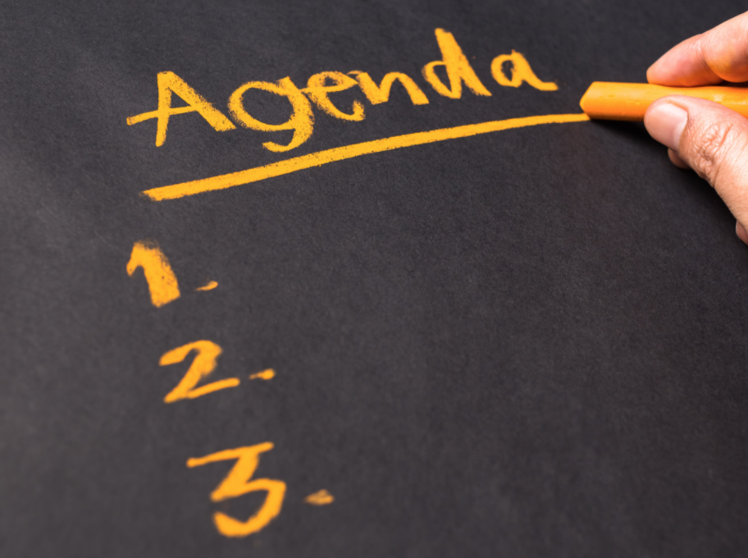
Agenda
Check-in
Survey Review & Invitations
Content/Concept Sharing
Change-up: Guest magician!
Notes:
Because we had a guest at the end of the hour, we changed up the schedule a bit this time around.

Slide 4
Agenda
Check-in
Survey Review & Invitations
Content/Concept Sharing
Change-up: Guest magician!
Notes:
From its beginnings, EPIK has deliberately designed gatherings to be interactive, participatory, and action-oriented. We'll start every week with something that can help us check in (and build our sense of shared humanity, community, and group safety), explore some content (we'll not be able to cover it all, so we provide a repository of resources for you), and a challenge/invitation to take home and practice and/or share with your family/friends/coworkers.

Slide 5
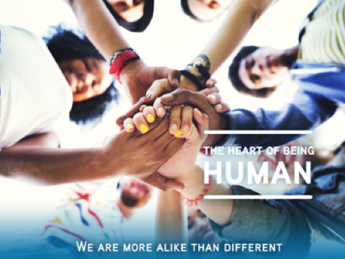
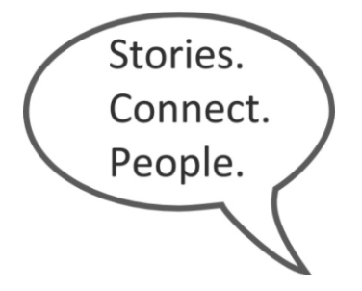
Think of an "embarrassing moment" experience
OR Think of an "I wanted to freeze the moment" experience
Notes:
This is the typical way that EPIK likes to begin its meetings – with a "Stories Connect People" activity. [See more question prompts in the Stories Connect People document we've included in this week's Google Folder. https://docs.google.com/document/d/1sHOKQlRVyBt45q2QVcpmdV0EP5KLC4OegfXkSTylGjg/edit?usp=sharing)
We’ll take a few minutes to share stories with each other.
Here's a little history about the internal company research by Tribalry, a local company. The founders, from a family of 10 children, learned through these simple exercises that even with the people closest to you, you often don’t know what’s inside of them, what their stories are. Taking time for each others’ stories is critical to building relationships and trust, whether that be in close relationships or in business relationships. And taking time for conversation can help relationships grow from weak ties to stronger bonds. Stories connect people! Or, as Jared Stewart, co-founder of Tribalry says, "The shortest distance between two people is a story."

Slide 6
Agenda
Check-in
Survey Review & Invitations
Content/Concept Sharing
Change-up: Guest magician!
Notes:
We started where we might have otherwise ended the meeting, with the self-assessment review and invitations for the week, to accommodate our guest speaker.

Slide 7
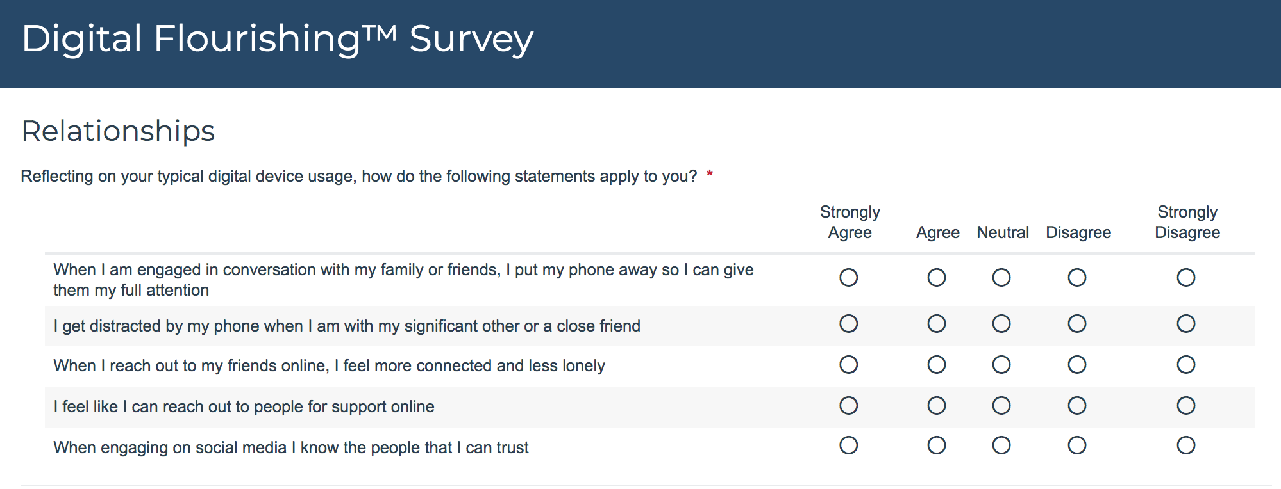
DWI Digital Wellness Self-assessment Questions
Notes:
You could also think about what relationships in your life in general (not just online) help you feel more connected, less lonely, supported, able to trust. As always, write any other questions that may come to mind that you would like to use for self-assessment. We know ourselves best and know what we want to work on and build awareness around.

Slide 8
Social Connectedness Assessment from DWI
Allows for self-reflection about:
Connectedness
Civil participation
Positive online social comparison
Authentic online self-presentation
Self-control
Notes:
We didn't review the questions from this assessment in this week. We might dig into them a little more in the Digital Citizenship module, but for now, we do invite you to at least skim over the assessment. I neglected to mention in our gathering that this tool has been validated for anyone 12 and up.

Slide 9
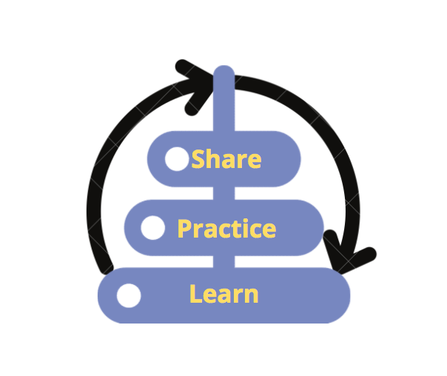
Invitations for the coming week
Take the DWI Digital Wellness self-assessment if you haven’t already https://survey.alchemer.com/s3/5504604/b153c792d361
Take the DWI Social Connectedness Survey: https://survey.alchemer.com/s3/6226945/Digital-Flourishing-Survey-PositiveMediatedSocialInteractions
Review today’s slides for one Relationships improvement you want to work on this week (self, bonding & building relationships, bridging capital)
Review today’s slides for one Relationships concept to share and discuss with someone else

Slide 10
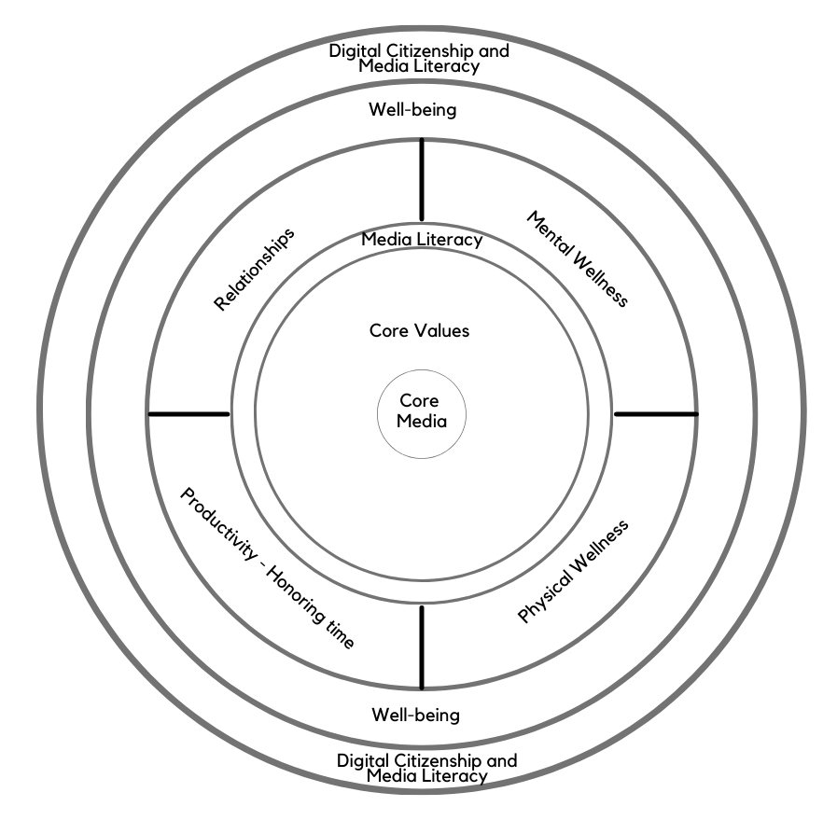
Today’s topic: Relationships
Note: EPIK’s Digital Centeredness model is adapted from the Digital Wellness Institute’s six-pronged model that aligns with DWI’s original survey
Notes:
You can see that this week I drew the circle a bit wider than usual. We've talked along the way about how the topics interconnect, but when it comes to relationships, the connections between our own wellness and our ability and capacity to help and serve others are strong. We all have experienced how our degree of centeredness, whether we are being bombarded by and overwhelmed by external messages we're trying to sift through (or worrying about), our mental and physical states, our "to-do" related stress, etc. can all impact how we interact with others. Everything we focus on in "putting our own oxygen mask on first" can impact how and if and how well we can engage in all types of relationships.

Slide 11
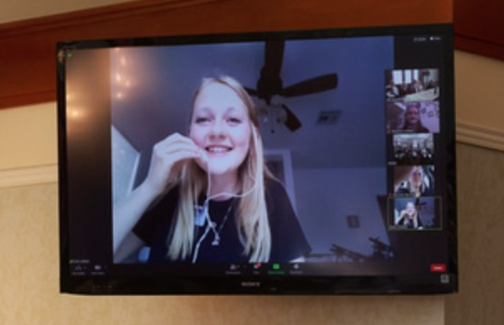
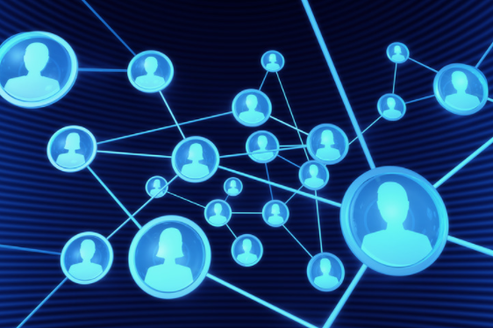
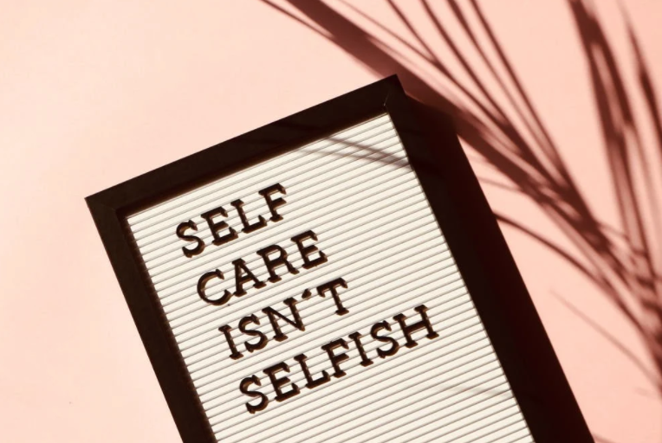
Three Relationship Categories
Relationship with self
Relationship with family, close friends, close support networks (Bonding social capital)
The “getting things done” connections (including weak and dormant ties) (Bridging social capital)
Notes:
These categories can be relevant to the question someone asked in the registration form about helping teens navigate social media. When we understand different types of relationships and connections, we can make more deliberate decisions about how/if we use tools as part of our relationship dynamics, and we can exercise our self-reflection muscle to discern whether what we are doing is building true relationship or may be giving us more the illusion of relationship or connection. We can also think of these categories when we assess priorities for time boxing as well. e.g., "How much time per week do I want to spend on bridging relationships vs. bonding relationships?" "How much time do I want to devote to filling my own well so I have capacity to give to and help others, and to show up in my relationships with integrity to who I am trying to be?"

Slide 12
Relationship Category #1: Self
Notes:
We've spent most of our time to this point talking about building wellness for ourselves, so we'll touch on this only briefly today.

Slide 13
Relationship Category #1: Self
"If we’d spend more time in solitude, we’d value ourselves more.”
Solitude = "a subjective state of mind, in which the mind, isolated from input from other minds, works through a problem on its own."
"A leader who silences the din not only around her mind but inside it can then hear the delicate voice of intuition, which may have already made connections that her conscious mind has not."
Quotes are from the book, Lead Yourself First.
Notes:
We read the first quote last week, but I wanted to share a few more thoughts from Lead Yourself First.

Slide 14
"We but mirror the world. All the tendencies present in the outer world are to be found in the world of our body. If we could change ourselves, the tendencies in the world would also change. … We need not wait to see what others do.”
~ Mahatma Gandhi
“In the attention economy, mindfulness is activism.”
-Jay Vidyarthi, Mindful Tech designer and consultant
Notes:
There is a reason I am sharing these quotes again this week. These are not just touchy-feely quotes…research supports them! See next slide….

Slide 15
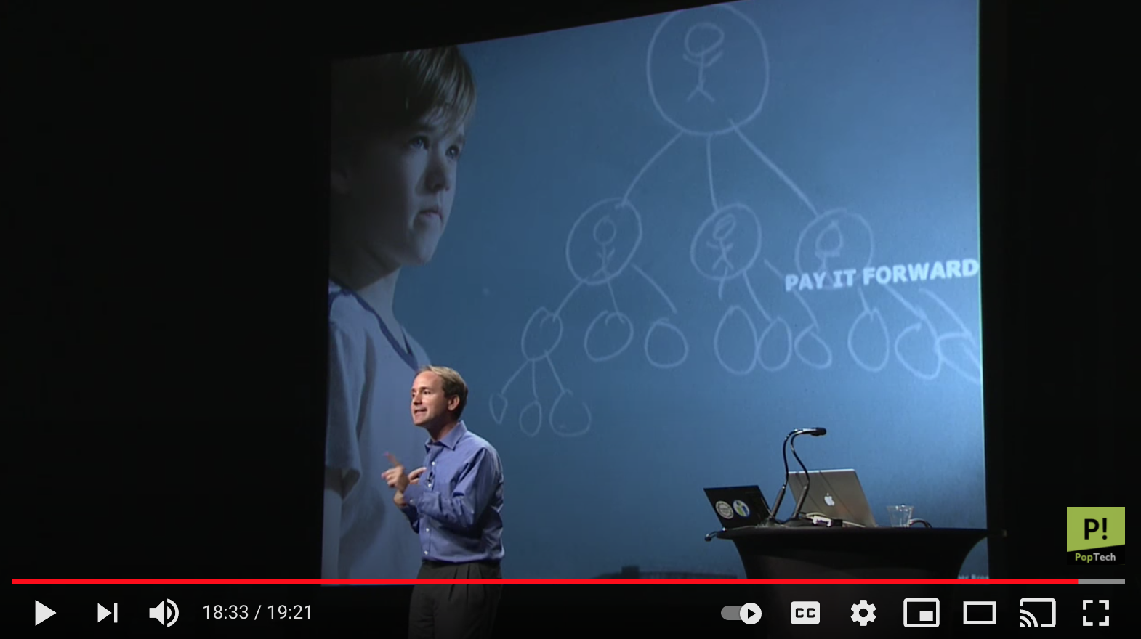
Personal wellness choices can impact others,
three degrees out!
“I’m not just changing my own outcome. I’m potentially changing my son’s life. And my son’s friend’s life. And my son’s friend’s mother’s life. I’m not just taking care of myself…[but taking care of people I care about].” ~ James Fowler (and Nicholas Christakis)
Notes:
https://www.youtube.com/watch?v=zkmsjFisW_A -- See also https://www.youtube.com/watch?v=8dO6Wwh_tiU

Slide 16
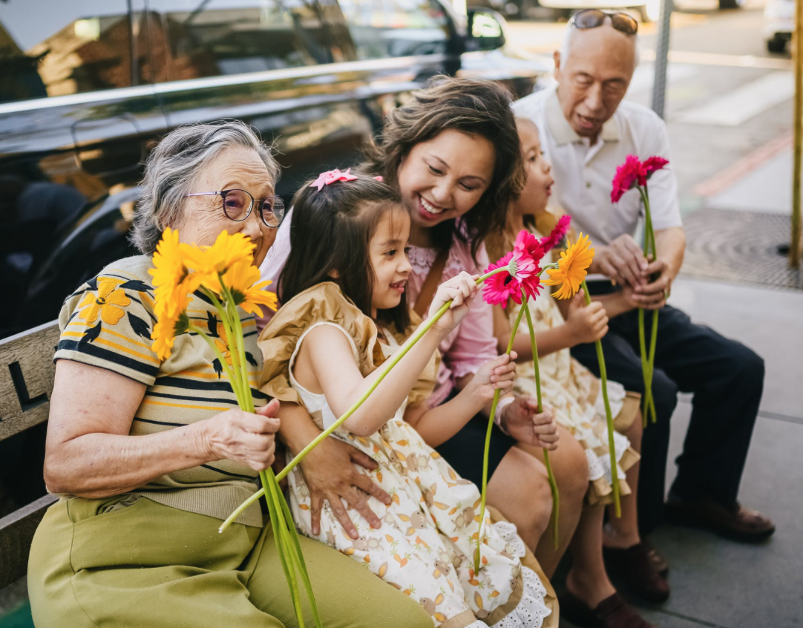
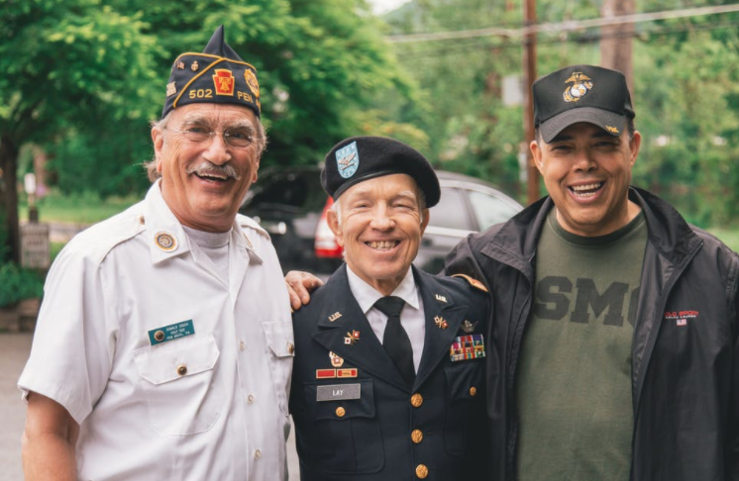
Relationship Category #2: Bonding Social Capital
Relationship with self
Relationship with family, close friends, close support networks (Bonding social capital, connections that Build)
The “getting things done” connections (including weak and dormant ties) (Bridging social capital)
Notes:
We wanted to spend the bulk of our time talking about bonding relationships. Another word that could be a synonym for Bonding relationships is Building relationships. Who helps bring constructive, building energy into our lives? Are we working to be builders in our spheres of influence, especially with those closest to us?

Slide 17
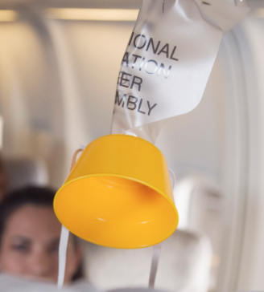
Relationship Category #2: Bonding
Social Capital (connections that Build)
Notes:
Before we reflect on how we foster bonding and building in our relationships, let's take a few minutes to look at the relationships that help build us.

Slide 18
Think & Write:
Who are the individuals (or groups) who bring
bonding and building energy into your life?
Notes:
Writing is a powerful tool. You will see in the recording that we gave people some time to write in response to this question.

Slide 19
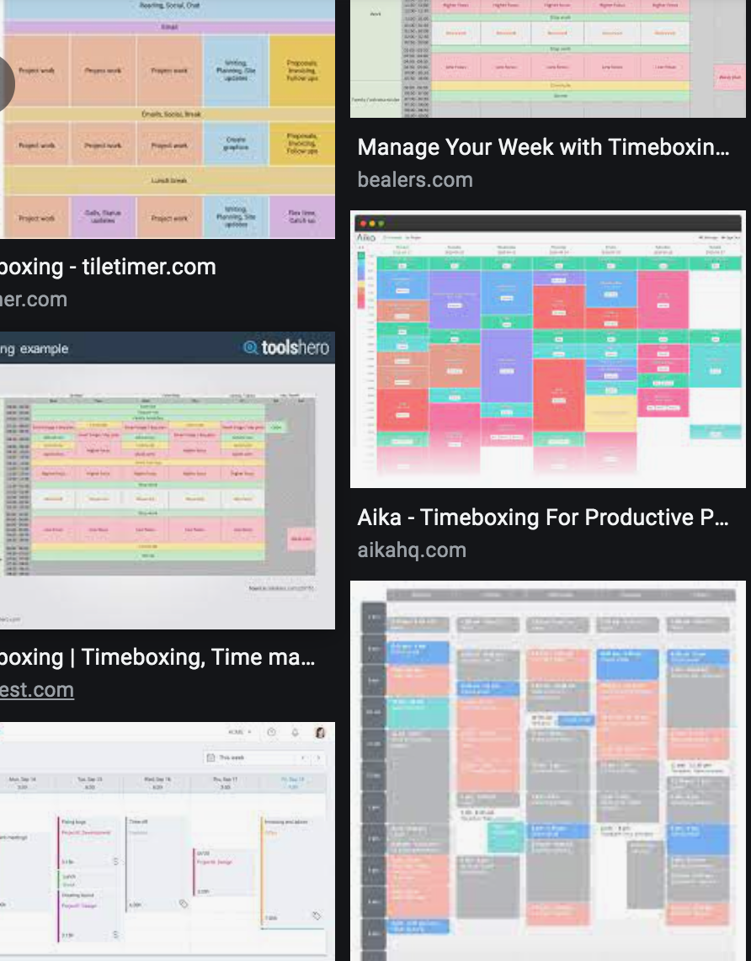
Reflect:
Do they get some intentional "time box" space?
Notes:
A reflection question…

Slide 20
Reflect:
Does tech foster or interfere with these relationships?
Notes:
Another reflection question to keep in mind in an ongoing way. I deliberately chose images that capture how technology can help build and foster bonding. We all know what images look like of the opposite.

Slide 21
Too often tech is not used for true bonding,
but rather gives us the appearance of connection
Notes:
=

Slide 22
Or we may spend more time than we really need to in Bridging vs. Bonding Social connections
Notes:
=

Slide 23
Some Ideas for Communications & Relationships
Be present with your people
Respect crossroads moments: e.g., morning, after school, mealtime, evening, and bedtime routines (for self and with loved ones, if applicable)
Get notifications from people not products (see Bonus slides)
Create Communications Charters
Communicate about what communication tools work best for what purposes
What can family/ team agree on to ID urgent tasks and create time and space around others and/or protect important times of the day and create a culture where “always on” is not rewarded/encouraged?
Notes:
https://www.mindtools.com/pages/article/developing-communications-charter.htm
https://www.forbes.com/sites/darrenmenabney/2021/03/14/to-have-better-remote-meetings-create-a-team-communication-charter/?sh=51e802a68182

Slide 24
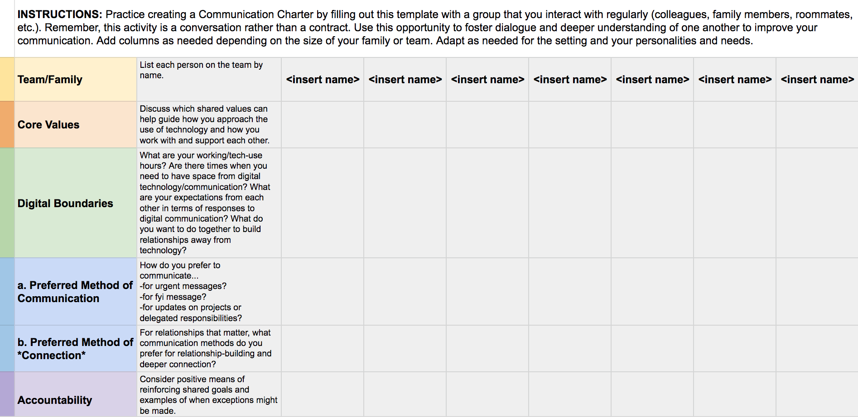
Create Communications Charters
https://docs.google.com/spreadsheets/d/11zDrV4bwSZGxML2MzGi_YqvLiZI23PmRrNBEy7BD3nA/edit?usp=sharing
Notes:
This is a Google worksheet you can copy and use with your team for work or other project teams https://docs.google.com/spreadsheets/d/11zDrV4bwSZGxML2MzGi_YqvLiZI23PmRrNBEy7BD3nA/edit?usp=sharing
There is a lot out there on communications charters, but here is one example of a link with more information:
https://www.forbes.com/sites/darrenmenabney/2021/03/14/to-have-better-remote-meetings-create-a-team-communication-charter/?sh=51e802a68182

Slide 25
Category #3: Bridging Social Capital
Relationship with self
Relationship with family, close friends, close support networks (Bonding social capital, connections that Build)
The “getting things done” connections (including weak and dormant ties) (Bridging social capital)
Notes:
=

Slide 26
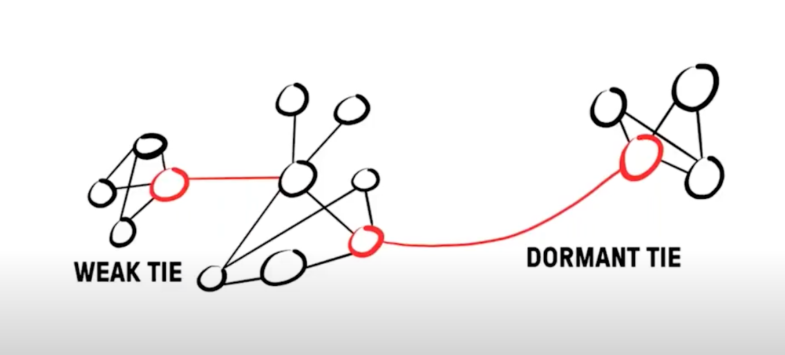
Bridging Social Capital can also Build
David Burkus – even an hour a week on “weak ties” can improve your professional and personal network – opportunities to be helped and to help
Friend of a Friend ...: Understanding the Hidden Networks That Can Transform Your Life and Your Career by David Burkus
Notes:
=

Slide 27
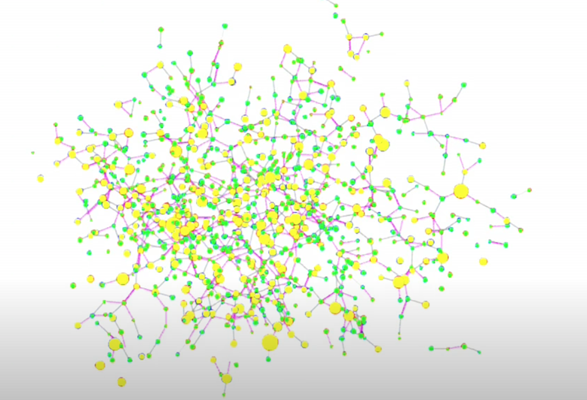
The Power of Networks
Our existing social relationships impact our health, and…
https://www.youtube.com/watch?v=zkmsjFisW_A

Slide 28
…We also can make choices about the social waters
in which we swim
"The [groups] we belong to shape our behavior…. [You can choose to] join a group where your desired behavior is the normal behavior." ~James Clear
Notes:
Especially in a digital world, this is true. We have so many choices about where to spend our connection time. [We’ll talk more about connection with the intent to understand others in the Digital Citizenship module, but it’s essential to keep center in order to do that, so for now, we are focusing here on building your networks deliberately to have enough of the water you want to swim in ever-present…at that deep values level, not just at task levels.)

Slide 29
Let's Go Back to Bonding
Attachment, Relationship-building, Presence…
Relationship with self
Relationship with family, close friends, close support networks (Bonding social capital, connections that Build)
The “getting things done” connections (including weak and dormant ties) (Bridging social capital)
Notes:
https://www.youtube.com/watch?v=apzXGEbZht0
But relationships are full of ebbs and flows of rupture and repair

Slide 30
This video no longer appears on UMass's website. See next slide
Notes:
https://www.youtube.com/watch?v=apzXGEbZht0
Still face experiment with dads: https://www.youtube.com/watch?v=BUwEwv3Wl58 Debrief with dads: https://www.youtube.com/watch?v=rLNiXnJccUQ
But relationships are full of ebbs and flows of rupture and repair (see later slides)

Slide 31
https://vimeo.com/119255263
Used to be called "The Still Face Experiment" which is no longer legally available
Note: I did not show the last part of the video where Dr. Tronick shares his closing thoughts. There are links in the slide notes below that show the Still Face Experiment with dads as well. This video is not shown in the recording, but my research shows that the video can get recognition if embedded in a slide deck. The video appears on UMass's website.
Notes:
https://vimeo.com/119255263
Still face experiment with dads: https://www.youtube.com/watch?v=BUwEwv3Wl58 Debrief with dads: https://www.youtube.com/watch?v=rLNiXnJccUQ
But relationships are full of ebbs and flows of rupture and repair (see later slides)

Slide 32
A moment that changed (and is still impacting) my parenting
from author Toni Morrison
https://www.oprah.com/oprahs-lifeclass/does-your-face-light-up-video
(I started the video at about the 0:36 mark.)
Notes:
https://www.oprah.com/oprahs-lifeclass/does-your-face-light-up-video

Slide 33
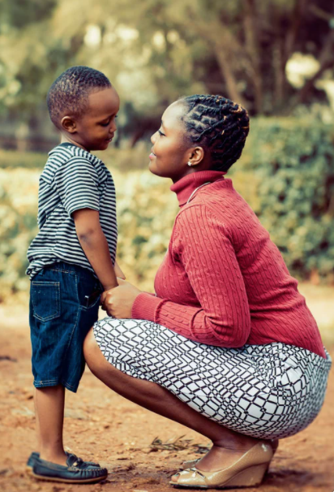
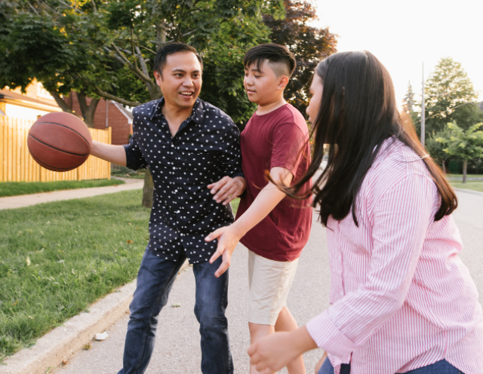
Gabor Maté: Hold Onto Your Kids
"It is the role of culture to cultivate connections between the dependent [children] and the dependable [parents/caring adults] and to prevent attachment voids from occurring."
Notes:
This is a remarkable book that explains the problems of a primary peer orientation in youth, and how critical attachment with parents and/or caring adults is for healthy development of children and youth. This is a book I wish I'd had when my children were young. I discovered it as they were beginning to launch.

Slide 34
Relationships are in constant state of mismatch…it's the repair that matters…
coming back to co-regulation
“Repairing ruptures is the most essential thing in parenting.”
UCLA neuropsychiatrist Dan Siegel
https://greatergood.berkeley.edu/article/item/family_conflict_is_normal_its_the_repair_that_matters
Notes:
https://greatergood.berkeley.edu/article/item/family_conflict_is_normal_its_the_repair_that_matters
See also this interview with Dr. Tronick: https://www.youtube.com/watch?v=O8AdOai6wug

Slide 35
Relationships are in constant state of mismatch…it's the repair that matters…
coming back to co-regulation
"Even in healthy, securely attached relationships, caregivers and babies are in sync only 30% of the time. The other 70%, they’re mismatched, out of synch, or making repairs and coming back together. Cheeringly, even babies work toward repairs with their gazes, smiles, gestures, protests, and calls."
"Life is a series of mismatches, miscommunications, and misattunements that are quickly repaired, says Tronick, and then again become miscoordinated and stressful, and again are repaired. This occurs thousands of times in a day, and millions of times over a year."
“Repairing ruptures is the most essential thing in parenting.”
UCLA neuropsychiatrist Dan Siegel
“Relationships shrink to the size of the field of repair,” says Rick Hanson, psychologist
Notes:
https://greatergood.berkeley.edu/article/item/family_conflict_is_normal_its_the_repair_that_matters

Slide 36
Keep the three categories in mind as we listen to Dr. Sherry Turkle
Relationship with self
Relationship with family, close friends, close support networks (Bonding social capital)
The “getting things done” connections (including weak and dormant ties) (Bridging social capital)
self
bonding
bridging
Notes:
=

Slide 37
And consider Dr. Turkle's thoughts on the difference between
connection
and conversation.

Slide 38
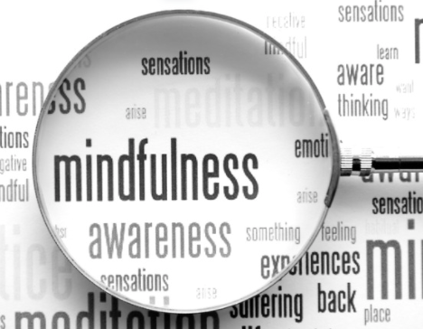
A mindfulness practice is to
attune yourself to your intuition even as you are listening to others' words. So as you listen,
note any any thoughts, ideas, insights, or feelings
that you sense under, around, or beyond her words.
If you feel so inclined,
take a moment to write
what you felt as you listened.

Slide 39
Notes:
Keep the three categories in mind as you listen to this clip. I started the clip at about 2:35, but I would recommend watching the whole video.
https://www.ted.com/talks/sherry_turkle_connected_but_alone/transcript?language=en – start at 2:48, run until 9:36 [on 1.5 speed, this takes just a little over 5 minutes): Sherry Turkle is the Abby Rockefeller Mauzé Professor of the Social Studies of Science and Technology in the Program in Science, Technology, and Society at MIT, and the founding director of the MIT Initiative on Technology and Self. Professor Turkle received a joint doctorate in sociology and personality psychology from Harvard University and is a licensed clinical psychologist. https://sherryturkle.mit.edu/
02:51
So just to take some quick examples: People text or do email during corporate board meetings. They text and shop and go on Facebook during classes, during presentations, actually during all meetings. People talk to me about the important new skill of making eye contact while you're texting. (Laughter) People explain to me that it's hard, but that it can be done. Parents text and do email at breakfast and at dinner while their children complain about not having their parents' full attention. But then these same children deny each other their full attention. This is a recent shot of my daughter and her friends being together while not being together. And we even text at funerals. I study this. We remove ourselves from our grief or from our revery and we go into our phones.
03:56
Why does this matter? It matters to me because I think we're setting ourselves up for trouble -- trouble certainly in how we relate to each other, but also trouble in how we relate to ourselves and our capacity for self-reflection. We're getting used to a new way of being alone together. People want to be with each other, but also elsewhere -- connected to all the different places they want to be. People want to customize their lives. They want to go in and out of all the places they are because the thing that matters most to them is control over where they put their attention. So you want to go to that board meeting, but you only want to pay attention to the bits that interest you. And some people think that's a good thing. But you can end up hiding from each other, even as we're all constantly connected to each other.
04:56
A 50-year-old business man lamented to me that he feels he doesn't have colleagues anymore at work. When he goes to work, he doesn't stop by to talk to anybody, he doesn't call. And he says he doesn't want to interrupt his colleagues because, he says, "They're too busy on their email." But then he stops himself and he says, "You know, I'm not telling you the truth. I'm the one who doesn't want to be interrupted. I think I should want to, but actually I'd rather just do things on my Blackberry."
05:27
Across the generations, I see that people can't get enough of each other, if and only if they can have each other at a distance, in amounts they can control. I call it the Goldilocks effect: not too close, not too far, just right. But what might feel just right for that middle-aged executive can be a problem for an adolescent who needs to develop face-to-face relationships. An 18-year-old boy who uses texting for almost everything says to me wistfully, "Someday, someday, but certainly not now, I'd like to learn how to have a conversation."
06:14
When I ask people "What's wrong with having a conversation?" People say, "I'll tell you what's wrong with having a conversation. It takes place in real time and you can't control what you're going to say." So that's the bottom line. Texting, email, posting, all of these things let us present the self as we want to be. We get to edit, and that means we get to delete, and that means we get to retouch, the face, the voice, the flesh, the body -- not too little, not too much, just right.
06:57
Human relationships are rich and they're messy and they're demanding. And we clean them up with technology. And when we do, one of the things that can happen is that we sacrifice conversation for mere connection. We short-change ourselves. And over time, we seem to forget this, or we seem to stop caring.
07:24
I was caught off guard when Stephen Colbert asked me a profound question, a profound question. He said, "Don't all those little tweets, don't all those little sips of online communication, add up to one big gulp of real conversation?" My answer was no, they don't add up. Connecting in sips may work for gathering discrete bits of information, they may work for saying, "I'm thinking about you," or even for saying, "I love you," -- I mean, look at how I felt when I got that text from my daughter -- but they don't really work for learning about each other, for really coming to know and understand each other. And we use conversations with each other to learn how to have conversations with ourselves. So a flight from conversation can really matter because it can compromise our capacity for self-reflection. For kids growing up, that skill is the bedrock of development.
08:49
Over and over I hear, "I would rather text than talk." And what I'm seeing is that people get so used to being short-changed out of real conversation, so used to getting by with less, that they've become almost willing to dispense with people altogether. So for example, many people share with me this wish, that some day a more advanced version of Siri, the digital assistant on Apple's iPhone, will be more like a best friend, someone who will listen when others won't. I believe this wish reflects a painful truth that I've learned in the past 15 years. That feeling that no one is listening to me is very important in our relationships with technology. That's why it's so appealing to have a Facebook page or a Twitter feed -- so many automatic listeners. And the feeling that no one is listening to me make us want to spend time with machines that seem to care about us.

Slide 40
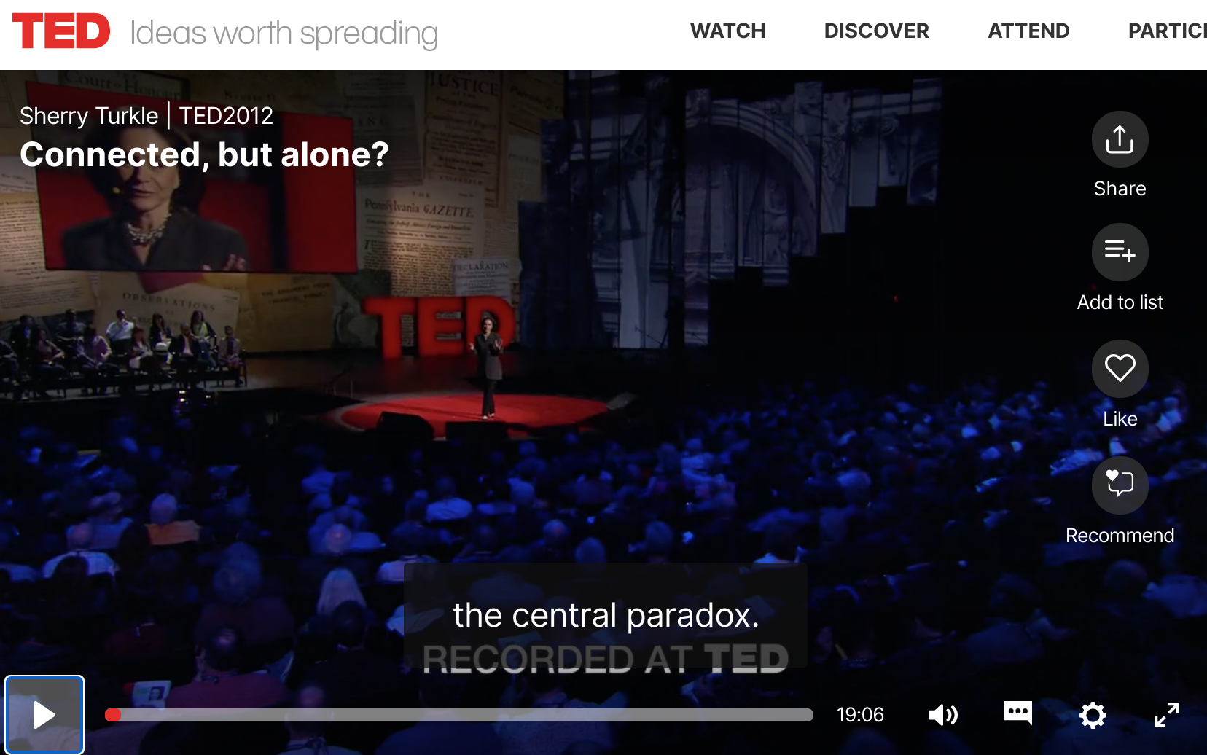
Thoughts?
Insights?
Reflections?

Slide 41
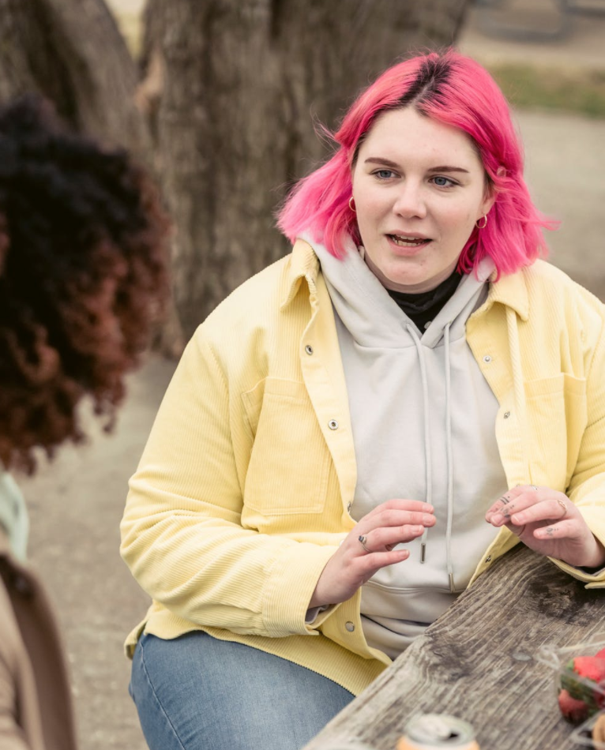
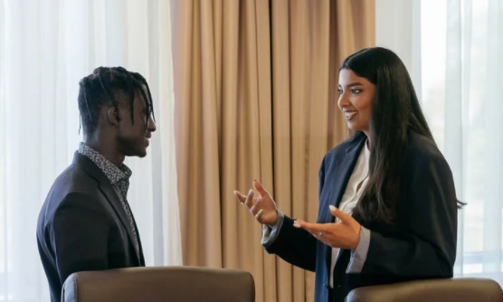
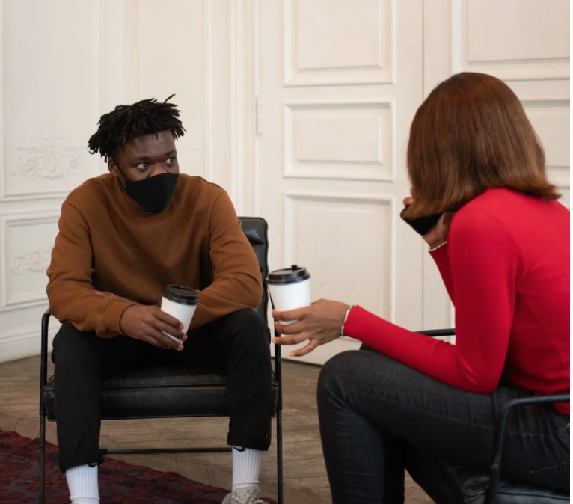
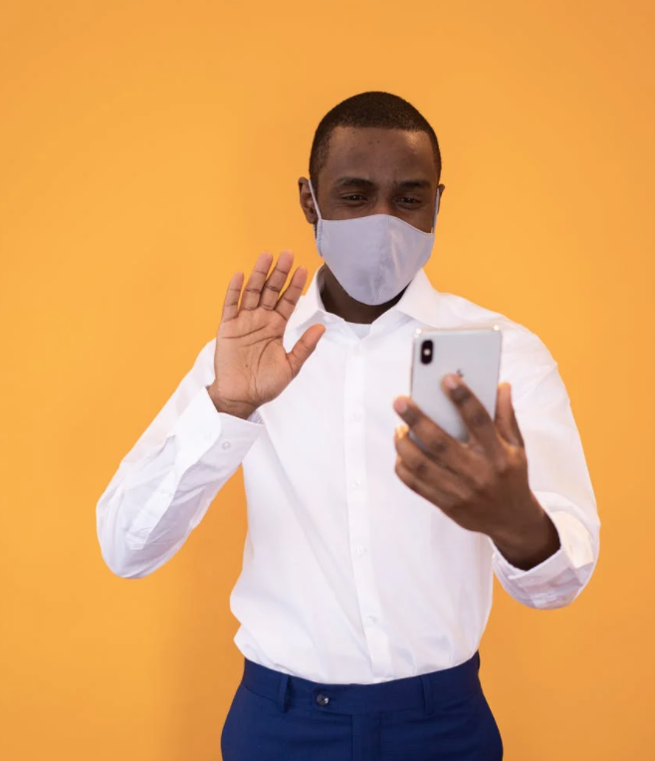
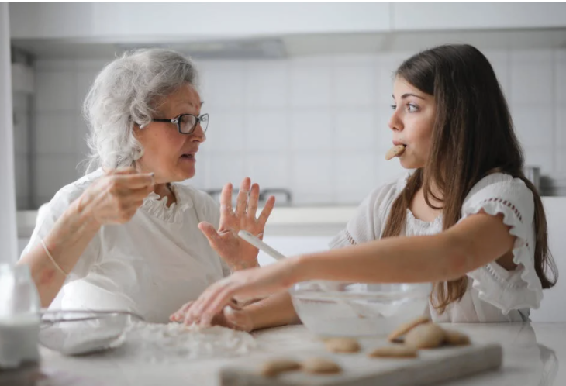
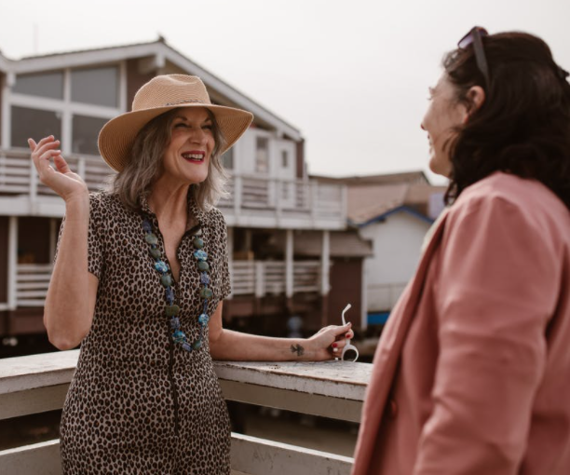
The power of conversation
“[W]e use conversations with each other to learn how to have conversations with ourselves. So a flight from conversation [retreat into technology or surface connection] can really matter because it can compromise our capacity for self-reflection. For kids growing up, that skill is the bedrock of development.” [And adults need the skill, too!] –Sherry Turkle
Notes:
=

Slide 42
One last thought from Dr. Turkle
As COVID started to impact our relationship with technology even more, Dr. Turkle said the following:
This is “a liminal time. It's like a time out of time. It's a time betwixt and between where you get a chance - the rules are broken and you get a chance to reassess what you really need. And I think that's what we have now. We have a chance to come back and not be wowed by technology and reassess the virtue of the human and relationships and to act more deliberately in our relationship with them.”
–Dr. Sherry Turkle
You can also learn a little more about Dr. Turkle's life in this interview: https://www.npr.org/2021/03/10/975607758/in-the-empathy-diaries-sherry-turkle-considers-the-burden-of-family-secrets
Notes:
https://www.npr.org/2021/03/10/975607758/in-the-empathy-diaries-sherry-turkle-considers-the-burden-of-family-secrets

Slide 43
Juggling, dancing in the tensions
As with most things in life, it's a balancing act to nurture our relationships with ourselves, with those we care most about (Bonding relationships) and with Bridging relationships.
Notes:
We didn't have time to cover this in our discussion, but it's worth reflecting on (see next slide)

Slide 44
Dancing in the Tensions
See also Barbara Sher’s TEDx talk (When it comes to problem-solving and reaching your goals, there is a tension with solitude, because problems are meant to be solved via connection and collaboration and mutually helping each other) https://www.tedxprague.cz/en/videa/isolation-is-the-dream-killer-not-your-attitude-barbara-sher
Barbara’s work also reinforces building small networks of support for reaching your goals (where bridging social capital can even become more like bonding social capital)
Notes:
=

Slide 45
“You not Them” principle
Back to center, again ☺
“We can avoid authoritarian interactions with children [and others] by focusing on our own values and actions; we can’t draw from empty wells.”
~Jodi Chaffee, of the Family Culture Movement https://familyculture-movement.captivate.fm/
https://www.youtube.com/watch?v=wJSzi9ypOCo
“A leader needs to have presence, to show up to the moment grounded in one’s self, as centered as one can be, ready to hear, to listen, to discern.” ― Raymond M. Kethledge, Lead Yourself First: Inspiring Leadership Through Solitude
Notes:
This and other quotes are in the Bonus section.

Slide 46
Stay mindful: Technology has the potential
to either hinder or facilitate relationships

Slide 47
We wish you well(ness)!

Slide 48
Bonus Material

Slide 49
A second DWI survey! Social Connectedness
https://survey.alchemer.com/s3/6226945/Digital-Flourishing-Survey-PositiveMediatedSocialInteractions
“Are you getting the most out of your online communication? Do you feel like the way you interact online is helping you flourish in your digital life? Are your online interactions meaningful?”
Measures the following:
Connectedness
Civil Participation [this will be revisited in the Digital Citizenship/Media Literacy discussion in two weeks]
Positive Social Comparison
Authentic Self-disclosure
Self-control [this will be revisited in the Digital Citizenship/Media Literacy discussion in two weeks]

Slide 50
Tip: Say no to Defaults! Help to Reduce Notifications
Say no to defaults! Change notifications
On iPhone: https://support.apple.com/guide/iphone/change-notification-settings-iph7c3d96bab/ios
On Android: https://support.google.com/android/answer/9079661?hl=en
On Pixel: https://support.google.com/pixelphone/answer/6111294?hl=en
On Samsung Galaxy s9: https://www.cnet.com/tech/mobile/how-to-turn-off-samsungs-galaxy-notifications-on-the-galaxy-s9/
On Facebook: https://www.facebook.com/help/390022341057202/
On WhatsApp:
For Android: https://faq.whatsapp.com/android/chats/how-to-manage-your-notifications
For iPhone: https://faq.whatsapp.com/iphone/troubleshooting/how-to-manage-your-notifications
For Desktop: https://faq.whatsapp.com/web/chats/how-to-manage-your-notifications
On LinkedIn: https://www.linkedin.com/help/linkedin/answer/76636/managing-your-linkedin-notification-updates?lang=en
On Email: Check your email program/app and/or your device
On Windows 10: https://support.microsoft.com/en-us/windows/change-notification-and-action-settings-in-windows-10-8942c744-6198-fe56-4639-34320cf9444e
On a Mac: https://support.apple.com/en-us/HT204079
On Slack: https://slack.com/help/articles/201355156-Configure-your-Slack-notifications
Microsoft Teams Do Not Disturb: https://techcommunity.microsoft.com/t5/microsoft-teams/automatically-set-do-not-disturb-when-presenting/m-p/736906
Notes:
I added the slides about notifications and privacy settings from last week's slide deck for your convenience.

Slide 51
Tip: Say no to Defaults! Help to Reduce Notifications
Say no to defaults! Change notifications
On Microsoft Outlook: https://support.microsoft.com/en-us/office/turn-new-message-alert-pop-up-on-or-off-9940c70e-b306-442e-a856-d94b20318481
On Facebook Messenger: https://www.facebook.com/help/messenger-app/330627630326605
Manage Announce notifications with Siri on Airpods or Beats: https://support.apple.com/en-us/HT210406
On Amazon Alexa/Echo: https://www.amazon.com/gp/help/customer/display.html?nodeId=GW65E37ZG4L9BW3P
On Apple Watch: https://support.apple.com/en-us/HT204791
On FitBit: https://help.fitbit.com/articles/en_US/Help_article/2323.htm
Across various devices (a curated instruction list): https://www.businessinsider.com/how-to-turn-off-all-notifications-across-devices
On Voxer: https://support.voxer.com/hc/en-us/articles/204332223-Disable-Enable-Notifications-per-Chat
On Marco Polo: https://support.marcopolo.me/article/69-notification-settings
On Viber:
iPhone: https://help.viber.com/en/article/personalize-your-viber-settings-iphone
Android: https://help.viber.com/en/article/personalize-your-viber-settings-android-phones
On Google News: https://support.google.com/googlenews/answer/9005590?hl=en&co=GENIE.Platform%3DAndroid
On Apple News: https://support.apple.com/en-us/HT211230
On Skype
For desktop: https://support.skype.com/en/faq/FA34811/how-do-i-manage-notifications-in-skype-on-desktop
For mobile: https://support.skype.com/en/faq/fa34746/how-do-i-manage-notifications-in-skype-on-mobile-or-tablet
Notes:
I added the slides about notifications and privacy settings from last week's slide deck for your convenience.

Slide 52
Tip: Say no to Defaults! Help to Reduce Notifications
Say no to defaults! Change notifications
On GroupMe: https://www.swipetips.com/how-to-turn-off-groupme-notifications-on-iphone-or-android/
On Slack: https://slack.com/help/articles/201355156-Configure-your-Slack-notifications
On Instagram: https://help.instagram.com/105448789880240
On Twitter: https://help.twitter.com/en/managing-your-account/enabling-web-and-browser-notifications
On SnapChat:
Android: https://support.snapchat.com/article/android-notifications
Apple: https://support.snapchat.com/en-US/article/ios-notifications
On Clubhouse:
About notifications: https://clubhouseapp.zendesk.com/hc/en-us/articles/360062778193-When-do-I-get-notified-about-people-
Changing notifications: https://clubhouseapp.zendesk.com/hc/en-us/articles/1500002511422-Can-I-adjust-my-notification-settings-
For Facebook game notifications: https://www.facebook.com/help/476337625740088
General Android notifications: https://www.talkandroid.com/guides/beginner/how-to-disable-annoying-android-notifications/
General phone notification help: https://www.wired.com/story/turn-off-notifications-smartphone/
On Nintendo: https://en-americas-support.nintendo.com/app/answers/detail/a_id/22345/~/how-to-change-notification-settings
On XBox One: https://www.howtogeek.com/675283/how-to-turn-off-or-customize-xbox-one-notifications/
On Nintendo: https://en-americas-support.nintendo.com/app/answers/detail/a_id/22345/~/how-to-change-notification-settings
On PS5: https://www.playstation.com/en-us/support/account/manage-notifications-ps5/
Notes:
I added the slides about notifications and privacy settings from last week's slide deck for your convenience.

Slide 53
Tip: Say no to defaults – Increase privacy protection in settings = more friction through privacy settings
The price we pay for ease of use (frictionless digital flow) is…fewer barriers between us and digital distractions!
There is a tension here, but if you build in more log-offs, more two-step verifications, etc. you build in more friction AND protect your privacy
Less privacy means more targeted advertising (e.g., Facebook Pixel)
Be smart about smart tech
https://www.ted.com/talks/finn_lutzow_holm_myrstad_how_tech_companies_deceive_you_into_giving_up_your_data_and_privacy
https://www.washingtonpost.com/video/c/embed/1f882f50-65bb-11e8-81ca-bb14593acaa6
Notes:
See also: https://www.wired.com/story/facebooks-targeted-ads-are-more-complex-than-it-lets-on/, https://www.pewresearch.org/internet/2019/11/15/how-americans-think-about-privacy-and-the-vulnerability-of-their-personal-data/ https://www.consumerreports.org/privacy/how-facebook-tracks-you-even-when-youre-not-on-facebook-a7977954071/ https://applymagicsauce.com/demo https://news.harvard.edu/gazette/story/2017/08/when-it-comes-to-internet-privacy-be-very-afraid-analyst-suggests/. https://www.washingtonpost.com/video/c/embed/1f882f50-65bb-11e8-81ca-bb14593acaa6

Slide 54
Tip: Increase privacy in your tech settings
Google Chrome: https://www.theverge.com/2020/2/11/21126427/google-chrome-privacy-tools-private-network-browser-settings
Instagram: https://www.theverge.com/2020/2/27/21154221/instagram-privacy-how-to-stories-posts-settings-tags-ads-blocking
Facebook: https://www.consumerreports.org/privacy/facebook-privacy-settings-a1775535782/
Snapchat: https://www.lifewire.com/snapchat-privacy-tips-4117444
Whatsapp: https://www.fastcompany.com/90388813/the-ultimate-guide-to-whatsapps-powerful-privacy-options
Google: https://www.wired.com/story/google-tracks-you-privacy/
YouTube: https://www.theverge.com/2019/4/19/18484802/youtube-privacy-protect-how-to-video-preferences-web-ad-personalization
Amazon: https://the-digital-reader.com/2020/02/12/six-default-amazon-security-settings-you-can-change-for-more-privacy/
Other tips part 1: https://www.washingtonpost.com/news/the-switch/wp/2018/06/01/hands-off-my-data-15-default-privacy-settings-you-should-change-right-now/
Other tips, part 2: https://www.washingtonpost.com/news/the-switch/wp/2018/06/15/hands-off-my-data-15-more-default-privacy-settings-you-should-change-on-your-tv-cellphone-plan-linkedin-and-more/
Notes:
See also: https://www.wired.com/story/facebooks-targeted-ads-are-more-complex-than-it-lets-on/, https://www.pewresearch.org/internet/2019/11/15/how-americans-think-about-privacy-and-the-vulnerability-of-their-personal-data/ https://www.consumerreports.org/privacy/how-facebook-tracks-you-even-when-youre-not-on-facebook-a7977954071/ https://applymagicsauce.com/demo

Slide 55
Tip: Increase privacy in your tech settings
More secure online transactions: https://smartasset.com/personal-finance/10-tips-for-secure-online-transactions
Turning off ”listening” capabilities: https://techwellness.com/blogs/expertise/how-to-turn-off-or-disable-microphone-and-camera-to-stop-apps-apple-microsoft-spying or https://www.makeuseof.com/tag/stop-google-android-listening/
What apps use end-to-end encryption? https://www.amnesty.org/en/latest/press-release/2016/10/snapchat-skype-among-apps-not-protecting-users-privacy/
Removing third-party app connections to Facebook: https://www.imore.com/how-to-revoke-facebook-app-permissions
Privacy apps: https://www.safervpn.com/blog/7-best-privacy-apps-for-your-phone/
John, A. (2018). How Facebook Tracks You, Even When You're Not on Facebook.CR Consumer Reports.
The Facebook Dilemma: https://www.pbs.org/wgbh/frontline/film/facebook-dilemma/
Notes:
See also: https://www.wired.com/story/facebooks-targeted-ads-are-more-complex-than-it-lets-on/, https://www.pewresearch.org/internet/2019/11/15/how-americans-think-about-privacy-and-the-vulnerability-of-their-personal-data/ https://www.consumerreports.org/privacy/how-facebook-tracks-you-even-when-youre-not-on-facebook-a7977954071/ https://applymagicsauce.com/demo

Slide 56
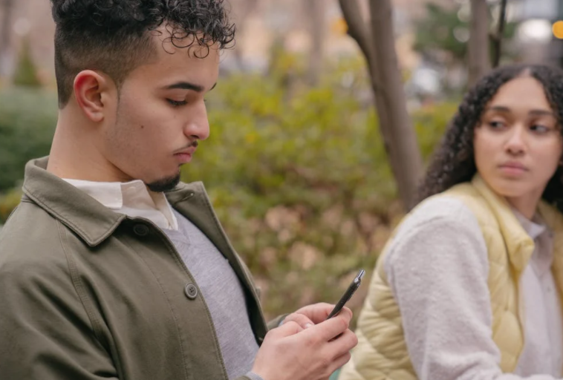
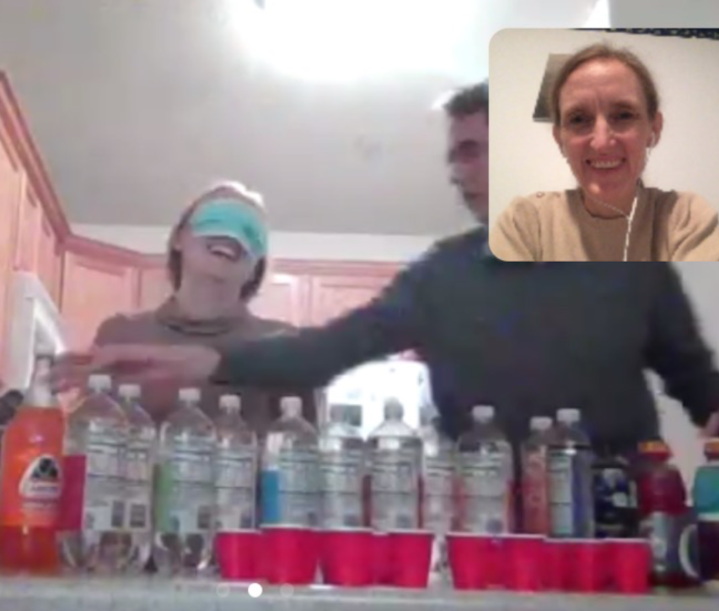
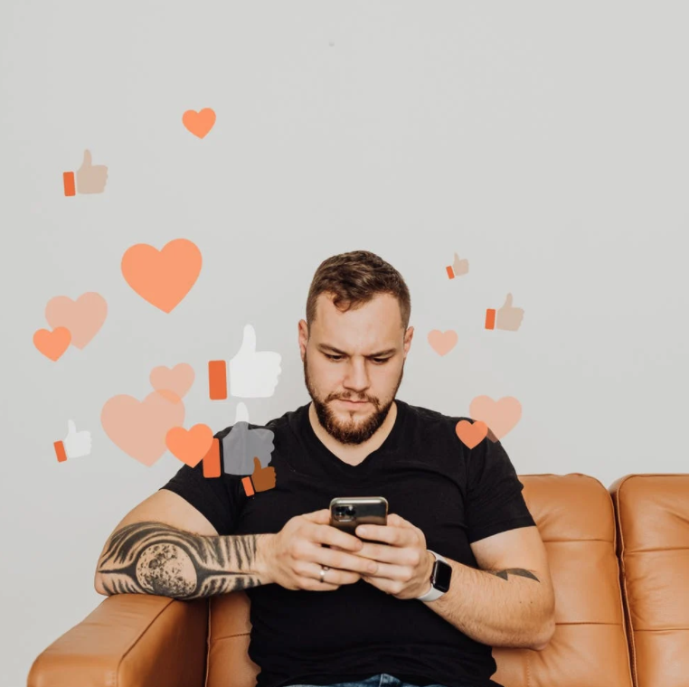
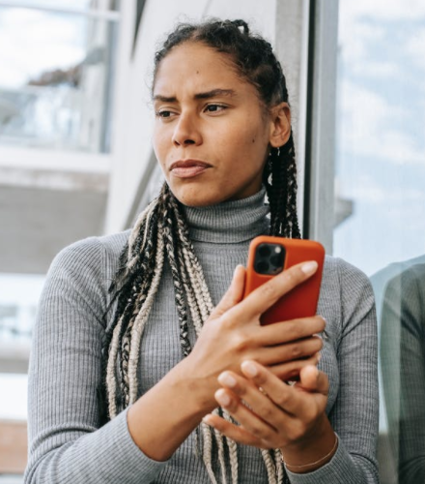
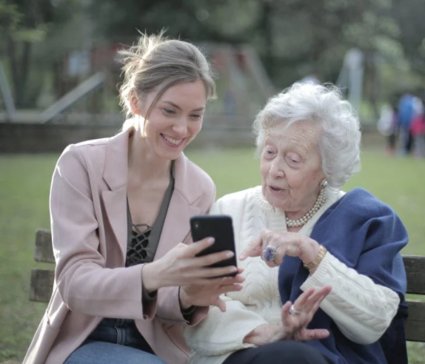
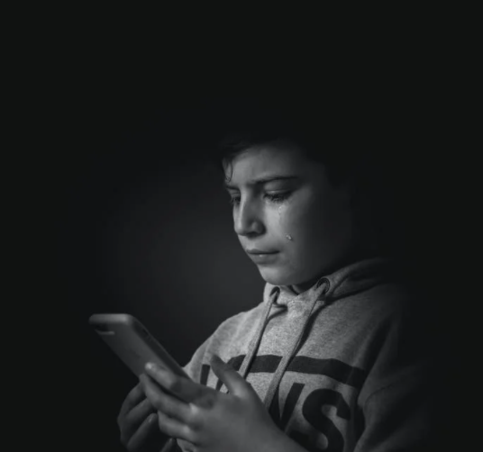
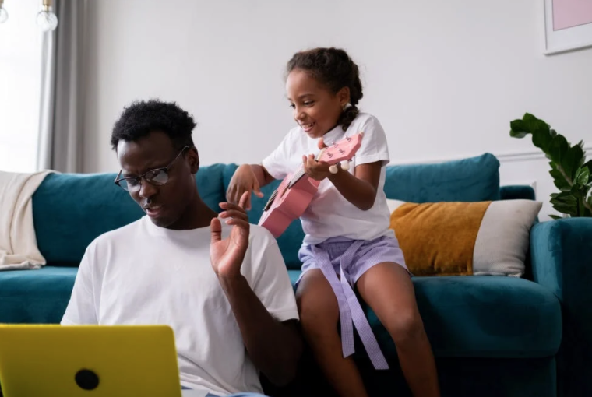
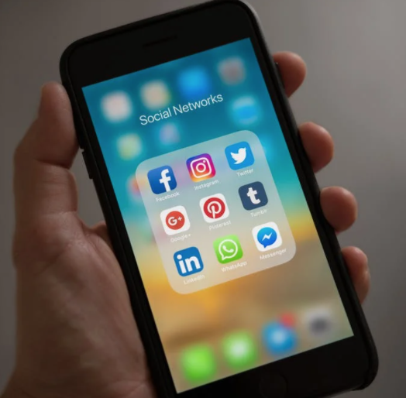
Images you can use for Discussions at Home
Notes:
Pexels.com has many other image options that can be used for free. Just be careful; as with most resource sites, there may be content there that may not be appropriate for children and youth.

Slide 57
Research for your Reference
Notes:
See also Kelly McGonigal’s book on the social-belonging intervention research.

Slide 58
Research for your Reference
Harvard Study on Adult Development
https://www.adultdevelopmentstudy.org/
- - - - -
“The clearest message that we get from this 75-year study is this: Good relationships keep us happier and healthier. Period.”
“Social connections are really good for us, and … loneliness kills.”
“[I]t's the quality of your close relationships that matters”
“It turns out that people who are more socially connected to family, to friends, to community, are happier, they're physically healthier, and they live longer than people who are less well connected.”
“[T]he people who fared the best were the people who leaned in to relationships, with family, with friends, with community.”

Slide 59
Research for your Reference
Harvard Study on Adult Development
https://www.adultdevelopmentstudy.org/
https://www.inc.com/melanie-curtin/want-a-life-of-fulfillment-a-75-year-harvard-study-says-to-prioritize-this-one-t.html
- - - - -
“It's the quality of the relationships--how much vulnerability and depth exists within them; how safe you feel sharing with one another; the extent to which you can relax and be seen for who you truly are, and truly see another.”
“[T]here are two foundational elements to this: ‘One is love. The other is finding a way of coping with life that does not push love away.’” -George Vaillant
Notes:
These quotes

Slide 60
Connection: Fundamental to human health
Brigham Young University
https://socialhealth.byu.edu/
- - - - -
e.g.,
Holt-Lunstad, J, Smith, T.B., *Baker, M., *Harris, T., & *Stephenson, D. (2015). Loneliness and Social Isolation as Risk Factors for Mortality: A Meta-Analytic Review. Perspectives on Psychological Science, 10 (2), 227-237. doi: 10.1177/1745691614568352
Holt-Lunstad, J., & *Clark, B.D. (2014). Social stressors and cardiovascular response: Influence of ambivalent relationships and behavioral ambivalence. International Journal of Psychophysiology, 93(3), 381-389. doi:10.1016/j.ijpsycho.2014.05.014
Holt-Lunstad J. (2013). Social Integration, Social Networks and Health, Stress. International Encyclopedia of the Social and Behavioral Sciences (2nd Edition). Elsevier​
Holt-Lunstad, J. & Uchino, B.N. (2013). Social Support and Health. In Health Behavior: Theory, Research and Practice (5th Edition). Jossey-Bass Publishers, a Company of John Wiley & Sons, Inc.
Holt-Lunstad, J. (2012). Social Support and Longevity: A Review. Social and Personality COMPASS, 6, 41–53, DOI: 10.1111/j.1751-9004.2011.00406.x

Slide 61
“Everybody feels they are different…from everybody else, when really in at least some ways we are all the same.”
Notes:
https://www.science.org/doi/10.1126/sciadv.aay3689. See also: Walton, G. M. & Cohen, G. L. (2007). A question of belonging: Race, social fit, and achievement. Journal of Personality and Social Psychology, 92, 82-96.

Slide 62
Other research
● Bilgin, O., & Taş, İ. (2018). Effects of perceived social support and psychological
resilience on social media addiction among university students.
● Chotpitayasunondh, V., & Douglas, K. M. (2016). How “phubbing” becomes the norm: The antecedents and consequences of snubbing via smartphone. Computers in Human Behavior, 63, 9-18.
● Crowley, J. P., Allred, R. J., Follon, J., & Volkmer, C. (2018). Replication of the mere presence hypothesis: The effects of cell phones on face-to-face conversations. Communication Studies, 69(3), 283-293.
● Drouin, M., Reining, L., Flanagan, M., Carpenter, M., & Toscos, T. (2018). College Students in Distress: Can Social Media Be a Source of Social Support?. College Student Journal, 52(4), 494-504.
● Hunter, J. F., Hooker, E. D., Rohleder, N., & Pressman, S. D. (2018). The use of smartphones as a digital security blanket: The influence of phone use and availability on psychological and physiological responses to social exclusion. Psychosomatic medicine, 80( 4), 345-352.
● Lanette, S. (2018). The Mere Presence of Mobile Phones During Parent-Teen Interactions. UC Irvine.
● Misra, S., Cheng, L., Genevie, J., & Yuan, M. (2016). The iPhone Effect: The Quality of In-Person Social Interactions in the Presence of Mobile Devices. Environment and Behavior, 48(2), 275–298.
● Priya, H. (2019). The Mere Presence Effect Applied to General Practitioner Consultations (Doctoral dissertation, ResearchSpace@ Auckland).
● Przybylski, A. K., & Weinstein, N. (2013). Can you connect with me now? How the presence of mobile communication technology influences face-to-face conversation quality. Journal of Social and Personal Relationships, 30(3), 237–246.

Slide 63
Other research
http://ccare.stanford.edu/uncategorized/connectedness-health-the-science-of-social-connection-infographic/
● Archer, C., & Kao, K. T. (2018). Mother, baby and Facebook makes three: does social media provide social support for new mothers?. Media International Australia, 168(1), 122-139.
Phua, J., Jin, S., & Kim, J. J. (2017). Uses and gratifications of social networking sites for bridging and bonding social capital: A comparison of Facebook, Twitter, Instagram, and Snapchat. Computers in Human Behavior, 72, 115-122. https://www.scholars.northwestern.edu/en/publications/uses-and-gratifications-of-social-networking-sites-for-bridging-a
Anderson, Monica and Jingjing Jiang. Teens and their experiences with Social Media, Pew Research Center, November 28, 2018. https://www.pewresearch.org/internet/2018/11/28/teens-and-their-experiences-on-social-media/
Marjolijn L. Antheunis & Mariek M. P. Vanden Abeele & Saskia Kanters, 2015. "The Impact of Facebook Use on Micro-Level Social Capital: A Synthesis," Societies, MDPI, Open Access Journal, vol. 5(2), pages 1-21, April. https://ideas.repec.org/a/gam/jsoctx/v5y2015i2p399-419d49046.html
● Shensa, A., Sidani, J. E., yi Lin, L., Bowman, N. D., & Primack, B. A. (2016). Social media use and perceived emotional support among US young adults. Journal of community health, 41(3), 541-549.
Utz, S. (2016). Is LinkedIn making you more successful? The informational benefits derived from public social media. New Media & Society, 18(11), 2685–2702. https://doi.org/10.1177/1461444815604143 or https://journals.sagepub.com/doi/full/10.1177/1461444815604143#articleCitationDownloadContainer

Slide 64
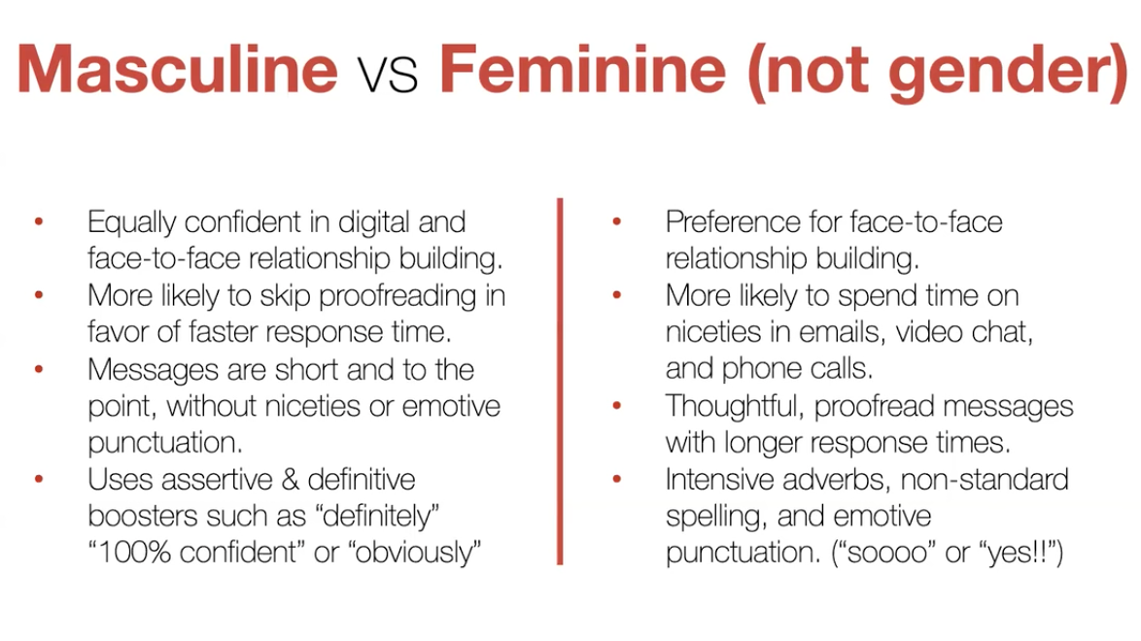
For all kinds of relationships with others:
Digital Communication Styles vary
By generation (e.g., Digital Natives vs. Digital Adapter
Masculine vs Feminine (not gender but communication style)
By culture (e.g., Eastern/Western)
By personality (e.g., Introvert/Extrovert)
Erica Dawahn: How to Read Digital Body Language: https://summit.digitalwellnessday.com/talks/how-to-read-digital-body-language/
Notes:
=

Slide 65
More quotes and thoughts re: Caring for Self
Honoring time with self: Overcoming solitude deprivation
“We aren’t taught to value taking time out to [consider] what matters to us…[so we can be more deliberate about]…how to focus on what matters."-Elisha Goldstein (from his blog, https://elishagoldstein.com)
“A lack of silence and solitude leads to anxiety, which leads to demonization based on differences, which leads to conflict, which leads to violence.” ““A leader needs to have presence, to show up to the moment grounded in one’s self, as centered as one can be, ready to hear, to listen, to discern.” from Lead Yourself First
“How much we know and understand ourselves is critically important, but there is something that is even more essential to living a Wholehearted life: loving ourselves.” Brené Brown (The Gifts of Imperfection)
"Solitude is where you find yourself so that you can reach out to other people and form real attachments." ~Sherry Turkle https://www.ted.com/talks/sherry_turkle_connected_but_alone/transcript?language=en
"We but mirror the world. All the tendencies present in the outer world are to be found in the world of our body. If we could change ourselves, the tendencies in the world would also change. … We need not wait to see what others do.” Mahatma Gandhi
Notes:
=

Slide 66
How we treat ourselves can impact those we care about: The Power of Networks
“I’m not just changing my own outcome. I’m potentially changing my son’s life. And my son’s friend’s life. And my son’s friend’s mother’s life. I’m not just taking care of myself…[but taking care of people I care about].”
Notes:
https://www.youtube.com/watch?v=zkmsjFisW_A -- See also https://www.youtube.com/watch?v=8dO6Wwh_tiU

Slide 67
Communications Charters
Notes:
This charter was shared in the DWI course, credit Digital Wellness Institute and Amy Blankston
https://www.forbes.com/sites/darrenmenabney/2021/03/14/to-have-better-remote-meetings-create-a-team-communication-charter/?sh=51e802a68182

Slide 68
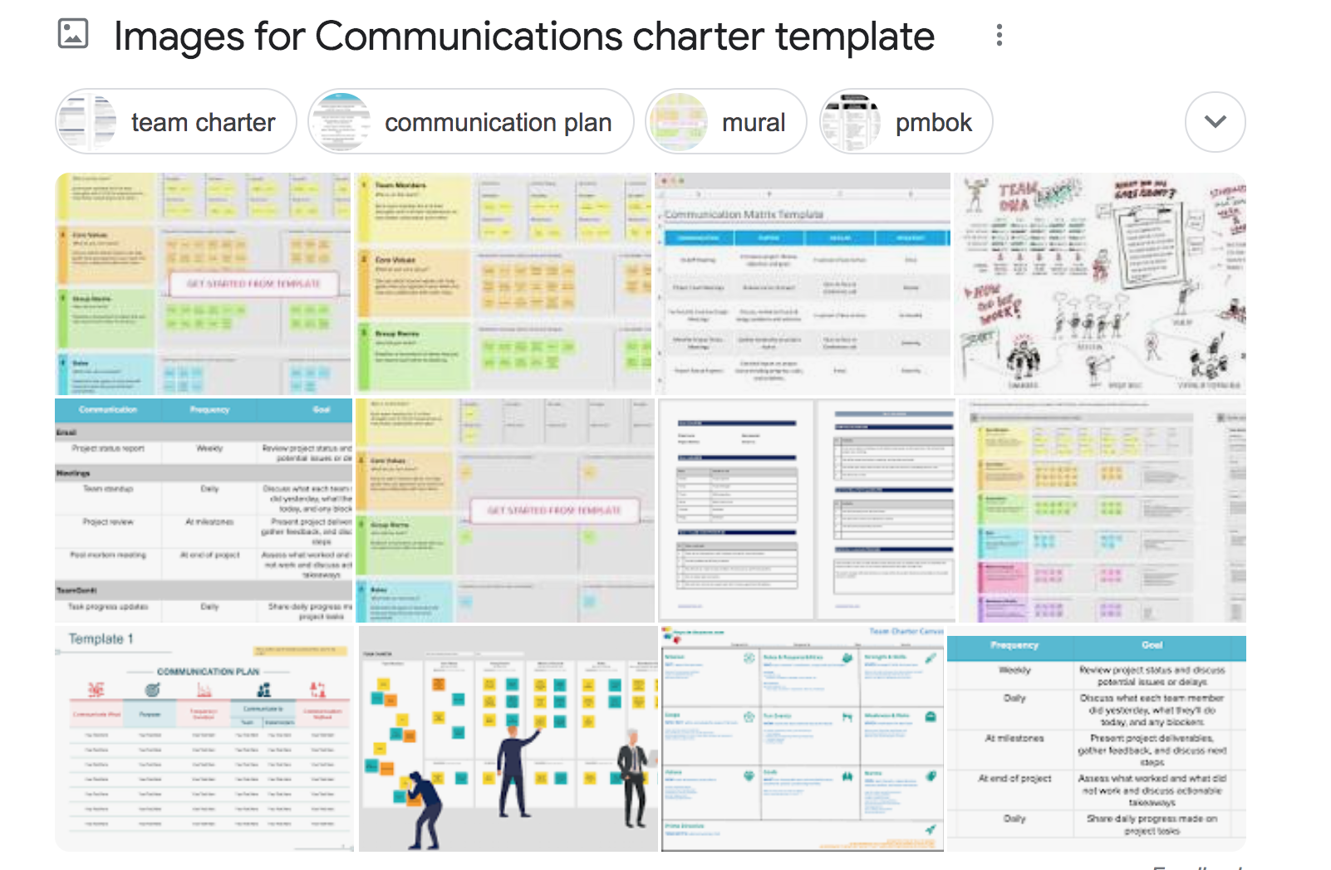
Search for "Communications Charter template"
for more ideas
Notes:
some links: (https://www.mindtools.com/pages/article/developing-communications-charter.htm)
https://www.forbes.com/sites/darrenmenabney/2021/03/14/to-have-better-remote-meetings-create-a-team-communication-charter/?sh=51e802a68182

