Slide 1
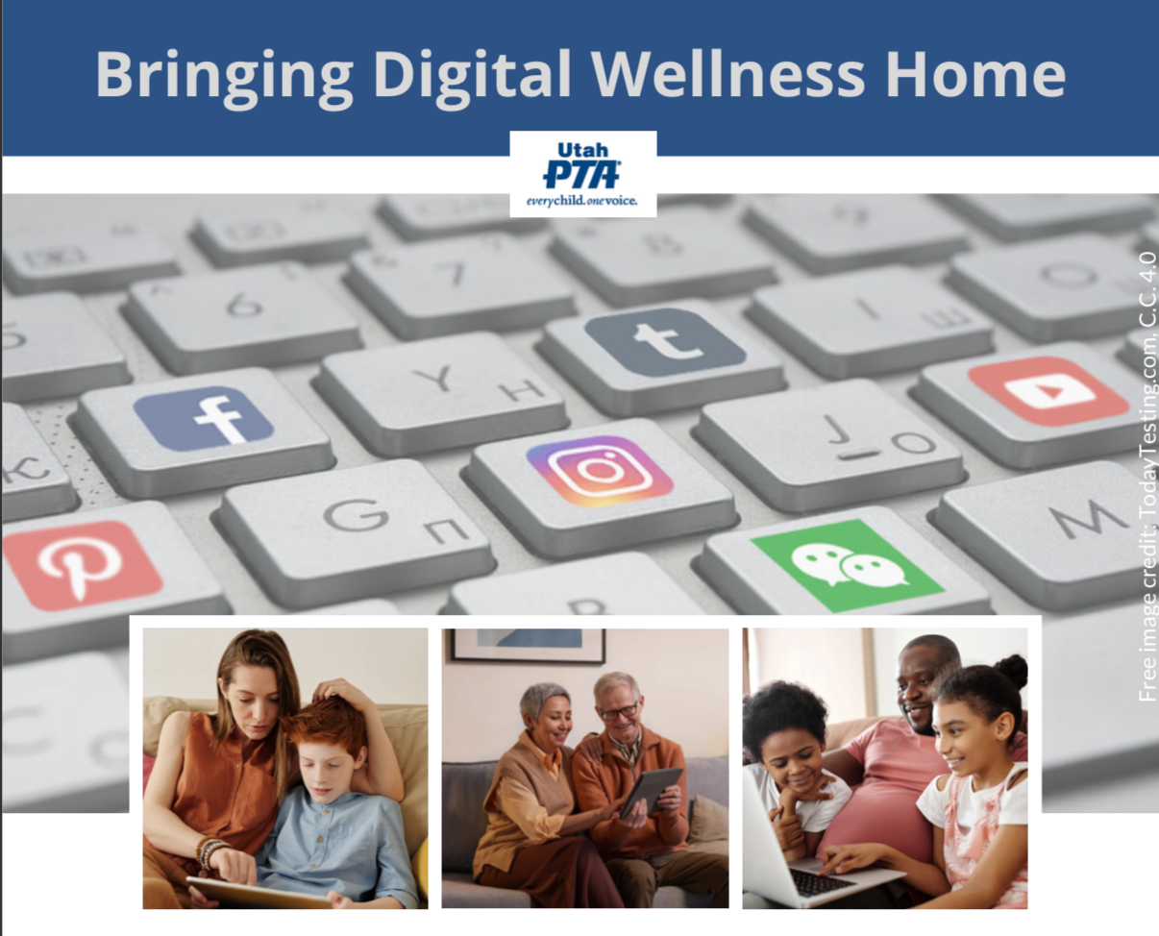
Note: All material in this series is for educational and informational purposes only, and is not meant to be exhaustive or used as a replacement for professional health support. Also, any sharing of resources doesn't imply full endorsement of all of that person or group's work. We share what we find helpful, but invite you to use your media literacy skills in all your study and research.
Notes:
Note: All material in this series is for educational and informational purposes only, and is not meant to be exhaustive or used as a replacement for professional health support. Also, the presentation is best viewed in slideshow format, as some of the slides are animated, but we have also included notes for many of the slides that you might want to review as well. Whatever works best for you!
NOTE: Portions of this work first appeared in or are derived or adapted from the Digital
Wellness Certificate Program. Those portions are Copyright © 2021, Digital Wellness Institute.

Slide 2
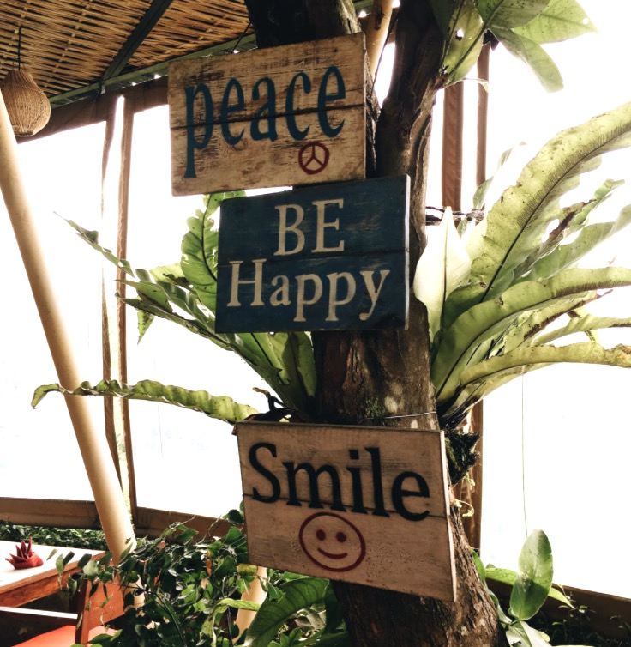
Discussion #7 Well-being
Bringing Digital Wellness Home
Notes:
Sherry Turkle's video gets to some of why I chose this image from Big Hero 6. There is a lot of great potential with AI, and real risks, too, of potentially replacing human relationships with technology. (If you haven't seen Big Hero 6, it's worth a watch and presents some of these tensions in an interesting way.)

Slide 3
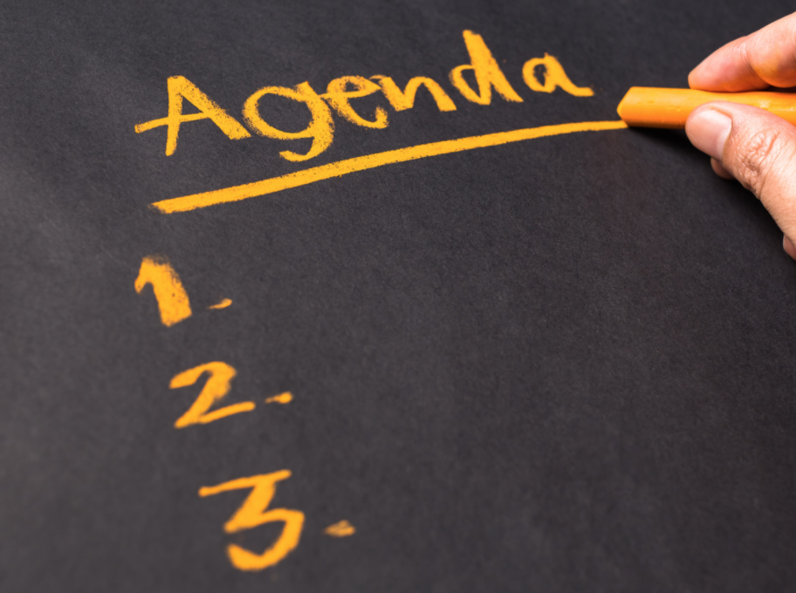
Agenda
Check-in
Content/Concept Sharing & Connection/Discussion
(These were combined this week)
Challenge/Invitation for the week
(The challenge for the week was folded into the Check-in Activity)
Notes:
Because we had a guest at the end of the hour, we changed up the schedule a bit this time around.

Slide 4
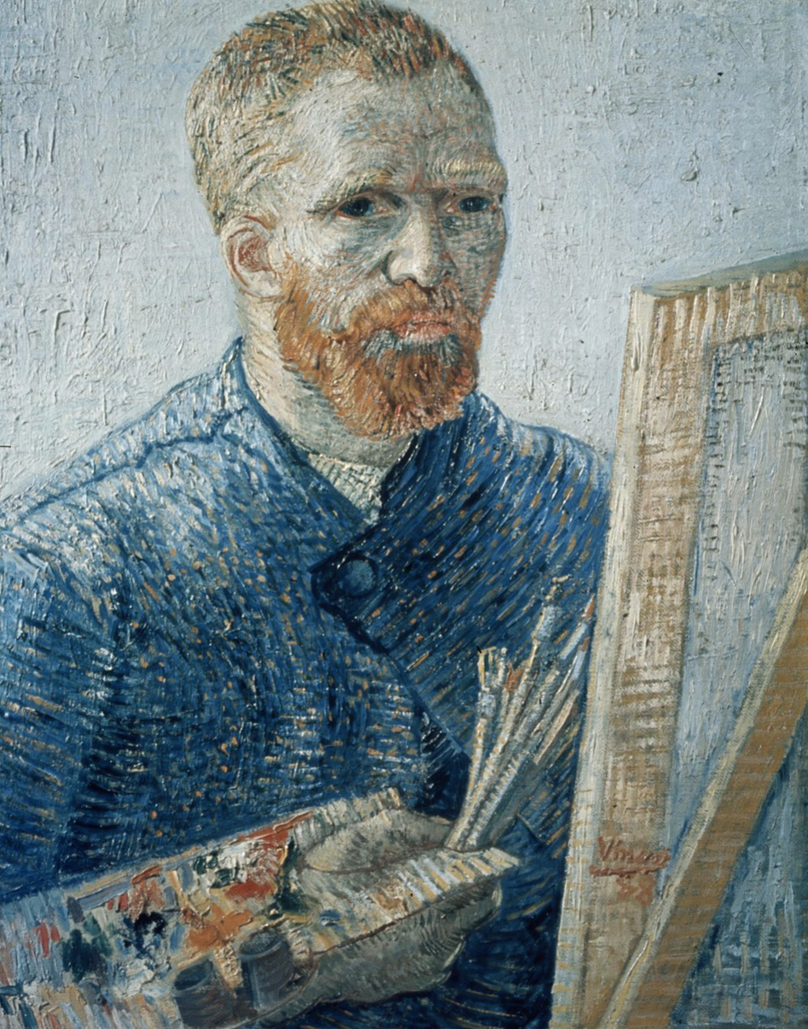
Agenda
Check-in
Content/Concept Sharing
Connection/Discussion:
Challenge/Invitation for the week
[H]ow can one remain dedicated to…a task without allowing oneself to be lured from it or distracted, unless one reflects and organizes one’s life according to principles?
"[T]he great doesn’t happen through impulse alone, and is a succession of little things that are brought together." -Vincent Van Gogh
Notes:
From its beginnings, EPIK has deliberately designed gatherings to be interactive, participatory, and action-oriented. We'll start every week with something that can help us check in (and build our sense of shared humanity, community, and group safety), explore some content (we'll not be able to cover it all, so we provide a repository of resources for you), and a challenge/invitation to take home and practice and/or share with your family/friends/coworkers.
Today I shared two quotes from Vincent Van Gogh – one that connects beautifully with the heart of what we are about in this series, and one that introduces the idea for today's Check-in Activity.
Image: In the public domain from https://commons.wikimedia.org/wiki/File:Foto_van_een_zelfportret_van_Vincent_van_Gogh,_Bestanddeelnr_255-9139.jpg
quote: https://vangoghletters.org/vg/letters/let274/letter.html - Website: Van Gogh Museum of Amsterdam: Vincent van Gogh Letters, Letter number: 274, Letter from: Vincent van Gogh, Location: The Hague, Letter to: Theo van Gogh, Date: October 22, 1882, Website description: Van Gogh

Slide 5
Check-in: Celebrate Small Wins!
Notes:
You'll see on the next slide why I chose this image for our Check-in Activity….

Slide 6
Check-in: Celebrate Small Wins!
"People change best by feeling good, not by feeling bad."
"Our brains want to feel good. Celebrating small wins gives them something to repattern our life around."
"Celebrate successes, no matter how small they are. This is how we take advantage of our neurochemistry."
"Celebration: Something you do to create a positive feeling inside of yourself (this feeling is called Shine)"
-Dr. BJ Fogg, Tiny Habits

Slide 7
Think and Write: What is at least one small win you have experienced in the past six weeks?
Notes:
30 second free write – write at least one small win you have noticed or experienced…and feel free to write as many as come to mind in this time

Slide 8
Share: One small win you have experienced
Notes:
Your invitation for the week is to share at least one small win from this series with someone you know.

Slide 9
Around the Zoom:
One small win I have experienced is
Notes:
After each person shares, those who are on video can join in using the sign language version of applause.

Slide 10
Agenda
Check-in & Challenge
Content/Concept Sharing &
Connection/Discussion (ended up being combined)
Notes:
Digital Wellness Institute Survey: Well-being Section https://survey.alchemer.com/s3/5504604/b153c792d361

Slide 11
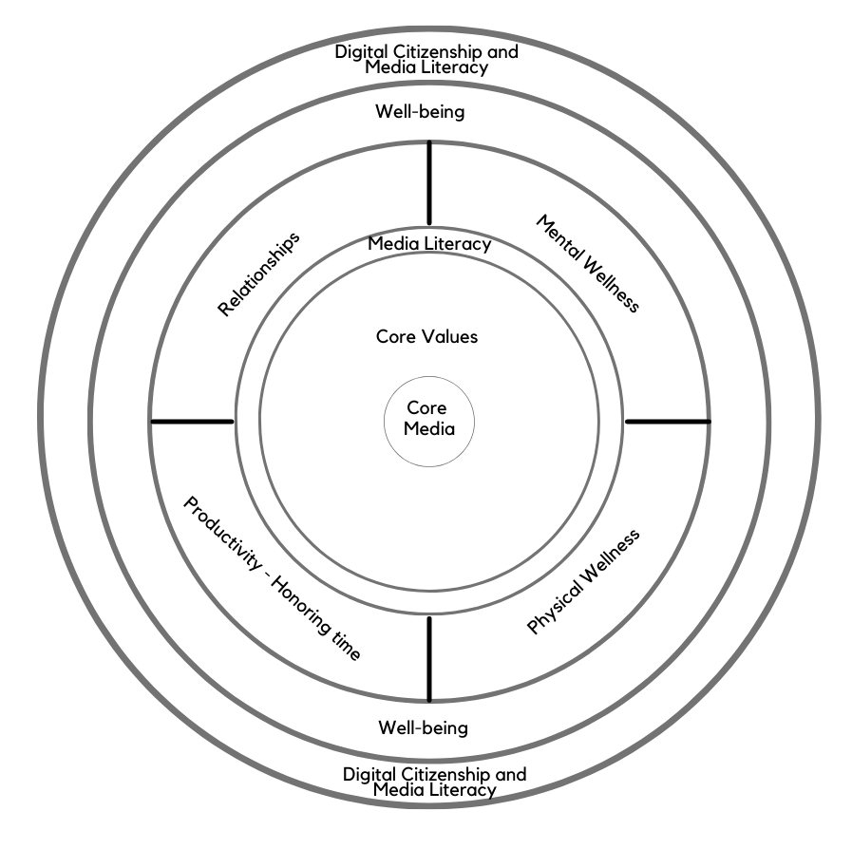
Today’s topic: Well-being in a Digital Age
Note: EPIK’s Digital Centeredness model is adapted from the Digital Wellness Institute’s six-pronged model that aligns with DWI’s original survey
Notes:
Wellness in a digital world is about learning to co-exist in healthy ways with that world. Today we'll share a few visual and conceptual "synonyms" for navigating well-being in a digital world.

Slide 12
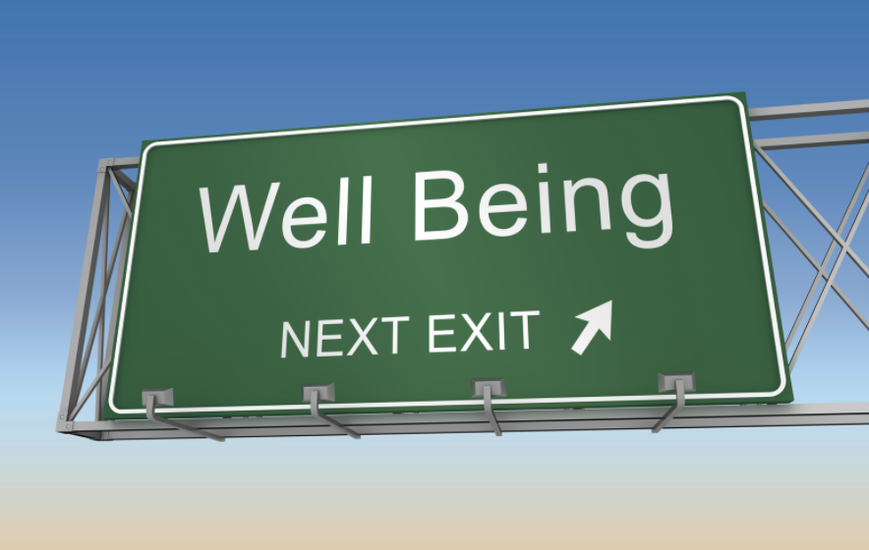
Digital Well-being is not a destination…
Notes:
…because wellness is, as we have discussed, not a destination, a formula, a checklist, a one-and-done kind of thing. It's a constant practice toward a more balanced way of life where technology can foster and support our intentions and goals, and where we build habits and mindsets that help us keep technology in its proper place in our lives, our days, our moments….

Slide 13
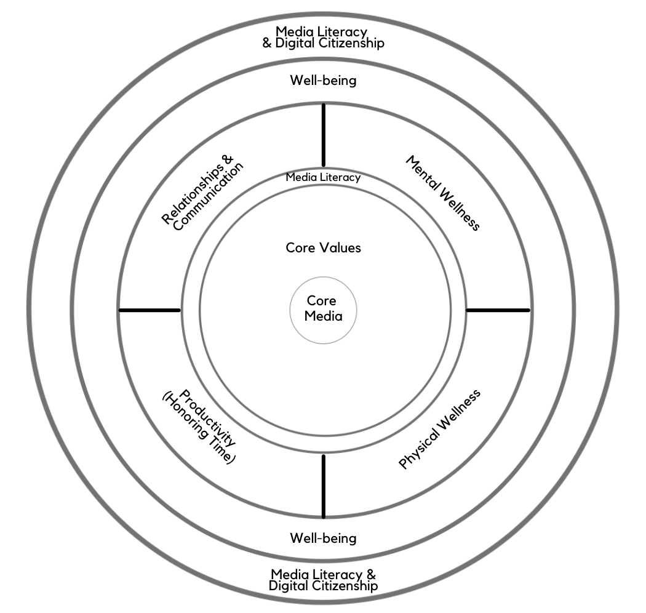
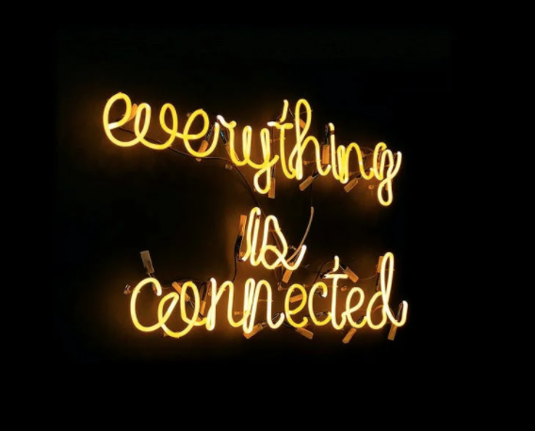
But more like a dance with many life domains…
Notes:
As we have discussed, concepts in each module interrelate to other modules. Similarly, although this is a series on Digital Wellness, many concepts we explore relate to Wellness in general. We hope you have been able to benefit by the interrelated concepts in the modules to this point.

Slide 14
…a dance within and between relationships
Relationship with self
Relationship with family, close friends, close support networks (Bonding social capital)
The “getting things done” connections (including weak and dormant ties) (Bridging social capital)
self
bonding
bridging
Notes:
A lot of what we have covered has been focused on "putting on our own oxygen masks." We can't really help others be digitally well if we don't start with ourselves (learn and practice, then share). That said, wellness within only the realm of self is not really wellness. We need others, too, and they need us. So digital well-being involves discretion and discernment about caring for self, and considering the impact of technology on our relationships and our ability to be aware of others, too.

Slide 15
…building awareness and practicing interrelated elements of life and wellness
Notes:
Wellness in a digital world is about learning to co-exist in healthy ways with that world. At any given moment in time or in any given phase of our lives, how to balance things may look different – for each person, for each situation, for each family or group. There are so many moving parts to consider in building wellness!

Slide 16
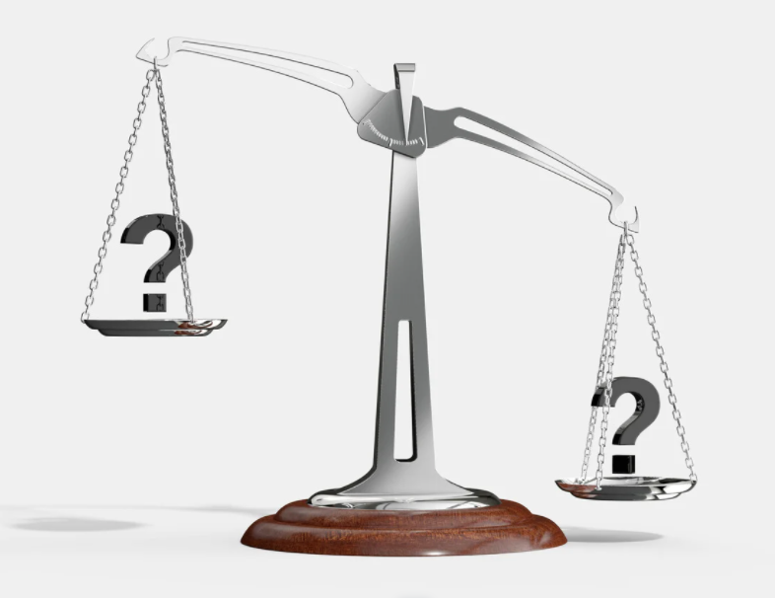
…an ongoing balancing act
Notes:
When we began the series, we talked about the effort to reduce the negatives and leverage the positives when it comes to technology. Through the series, we've also discovered that what is useful in one setting may be harmful in another. For example, if we have scheduled downtime to watch a movie on Netflix or catch up with people on Facebook or Instagram, or "veg" while watching some YouTube videos, that is different than mindlessly wandering and getting lost in rabbit holes. As another example, email can be a useful tool if we use it deliberately, but it can be harmful if we get caught up in it in the middle of the night when our bodies and minds need rest. Again, there is no formula – well-being is about awareness, mindfulness, deliberateness. Or, better said, it's about practicing these things.

Slide 17
Notes:
Here are a few more images that capture this balancing act of digital well-being. What images come to mind for you?

Slide 18
Remember the both in this Brian Solis quote?
“[Digital wellness is a] deep self-exploration for understanding where we are in this life and our relationship with technology, or the relationship technology has with us…
"…recognizing that as many things as we juggle at once…as many ways and as many different platforms we [use to] communicate...they all take their toll. Little by little but inevitably...they take their toll. [A]nd that impacts [us] in ways that -- unfortunately when it counts – are going to reveal themselves….
"[S]o this is about going on a journey, not necessarily to take control of technology …[but to] realize that there's…a bigger opportunity for…[how we approach] management of day-to-day life and how [we] use technology in that life…."
“[The goal is to]...get in front of distractions, to get in front of all the potential that we might be missing today.”
Notes:
We reviewed this quote in our first module as we talked about the "both" of Digital Wellness - of being aware of the downsides/risks/negatives and seeking to build awareness and intention so we can leverage positives in ways that can help us fulfill our potential and be aligned with who we really want to be.
As you through this quote (again, or for the first time), what are the warnings, concerns, negatives (etc.) mentioned? What are the words that show the positive possibilities we might discover as we learn about and practice Digital Wellness principles?
Transcript created from Brian Solis, https://www.youtube.com/watch?v=Kbcilw2WJVw

Slide 19
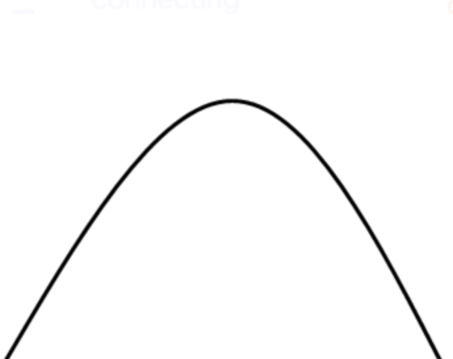
Digital Well-being can be like a greased hump
Notes:
=

Slide 20
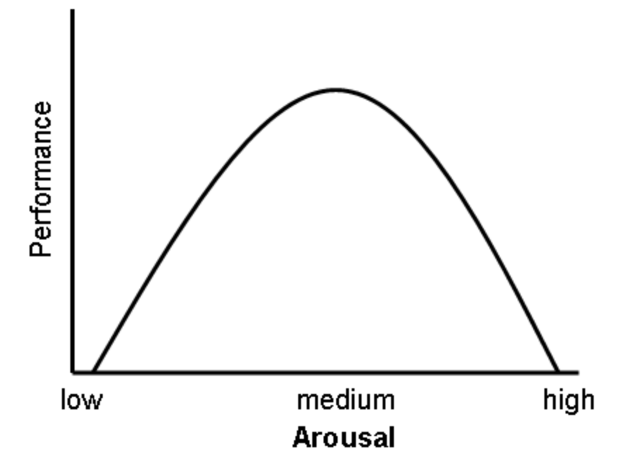
Inverted U theory or Yerkes-Dodson law
Notes:
This simple model could be used for other variables, like the tensions between isolation and social connection. Too much isolation on one end can minimize wellness, where overstimulation with too much social connection and a dearth of isolation can also have its impacts. We could also think of this in terms of digital use itself. We may not be able to do the things we need to do if we don't have *some* digital access, but its very easy to swing to the other side of a curve like this and get flooded with too many tools, too many messages/ads/opinions/lights/sounds/pings/dings.

Slide 21
Consider a continuum
Notes:
Another possible tool to consider the balancing act, or finding happy mediums, in digital well-being is a continuum. Most of us wouldn't be able to do what we need to do with zero technology, and there are real benefits (like this series!) that come because of technology. But, as we've all experienced, it is not hard to get overwhelmed or flooded by too many digital things going on or vying for our attention.
We could draw more continua (continuums) for various modules.

Slide 22
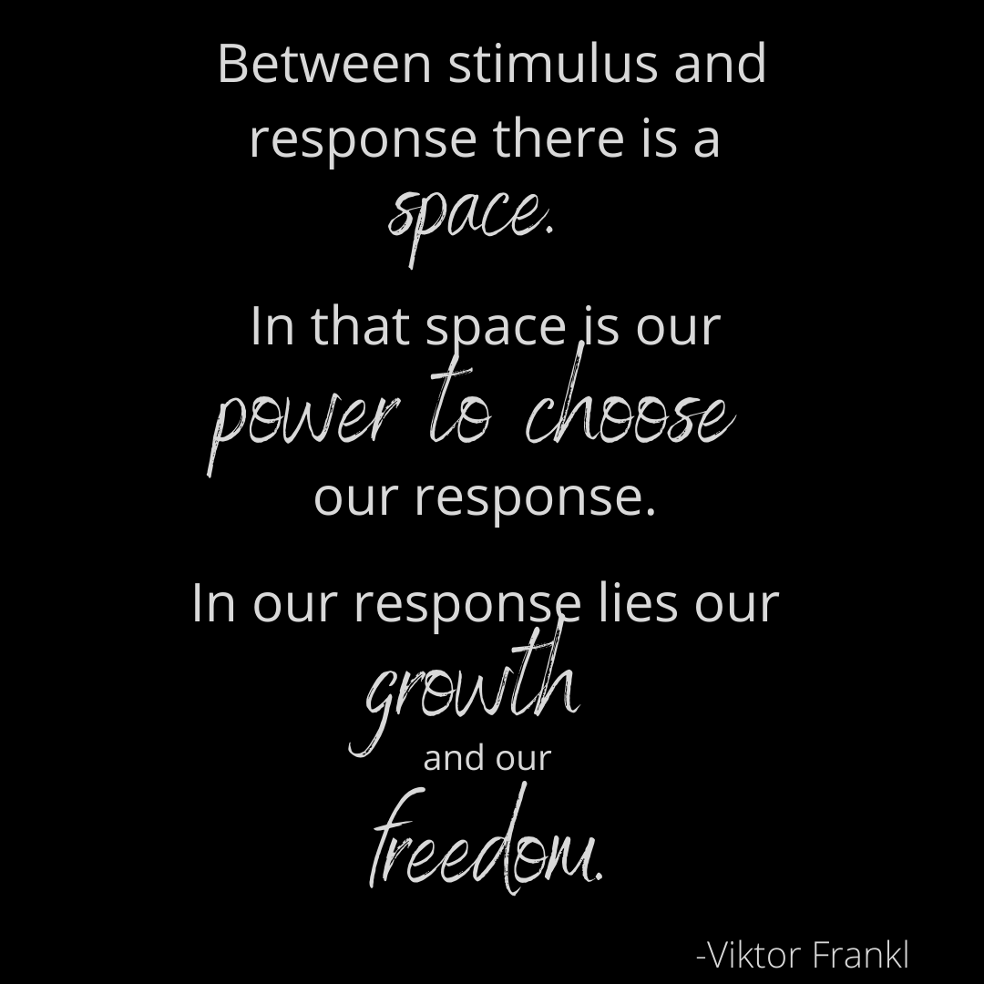
Notes:
The notion of stopping to pause and ask questions (PAQ, as we discussed in the Media Literacy module, the Mental Wellness Module, and the Physical Wellness Module) can help mediate the impact of the extremes. We can use this same concept for how and when and where and why we use (or don't use) technology in our relationships and with how we organize our time.

Slide 23
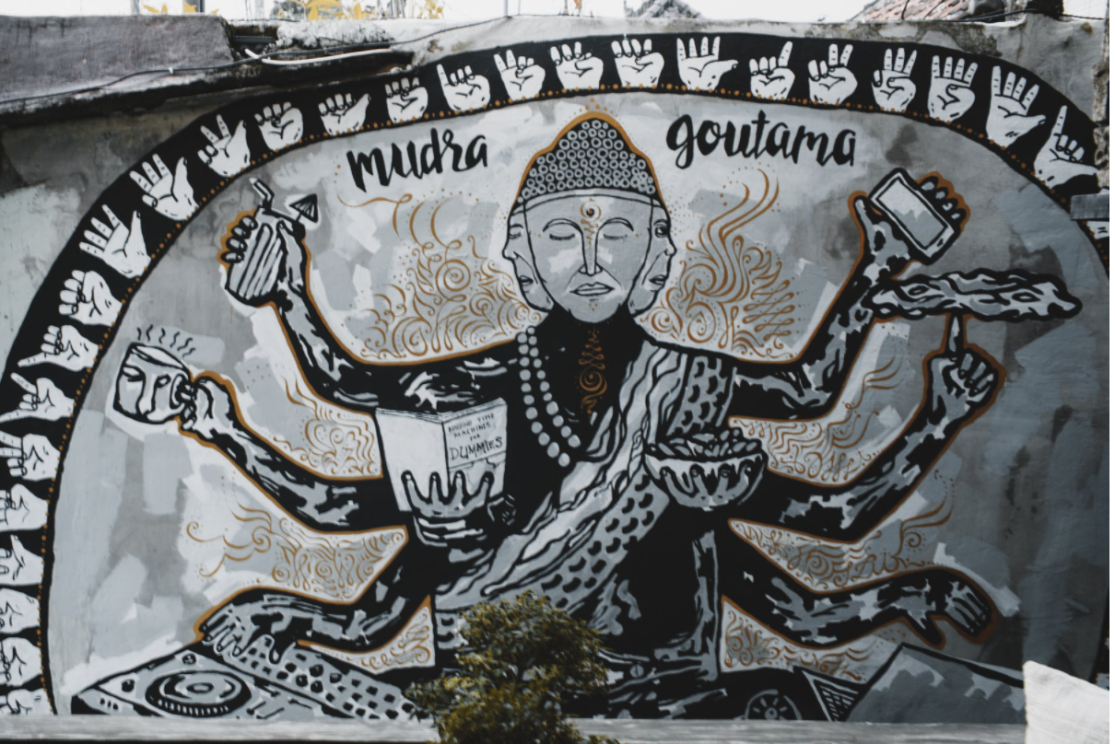
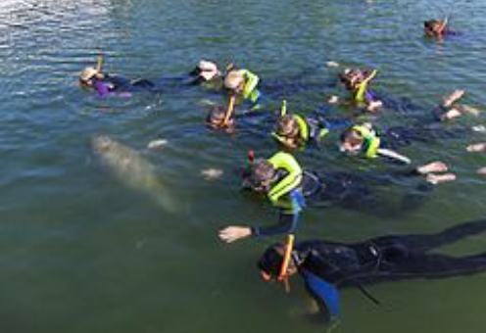
We could use continuums
for different modules, e.g.,
“Lost souls are not that different from those in the zone. The zone is enjoyable. But when that joy becomes an obsession one becomes disconnected from life.”
Distraction
/Fragmentation
Deep Work
Shallow Work
Notes:
Here's an example of how we could use a continuum to explore one of our modules. This one is relevant to the Honoring Time module.

Slide 24
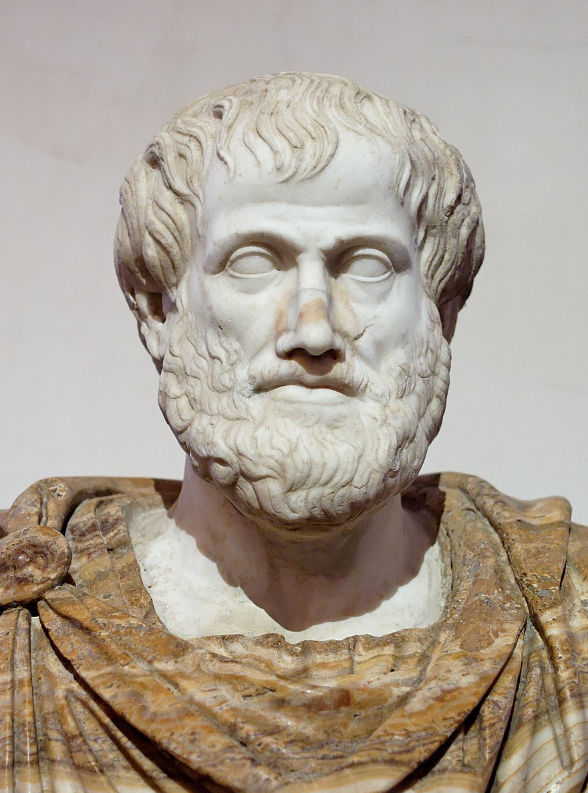
Aristotle: The Golden Mean
"[I]n [passion and action] there is excess, defect, and the intermediate….
"Virtue, then, is a state of character concerned with choice, lying in a mean, i.e. the mean relative to us, this being determined by a rational principle, and by that principle by which the man of practical wisdom would determine it."
Notes:
Aristotle sums it up well.
https://www.sacred-texts.com/cla/ari/nico/nico019.htm

Slide 25
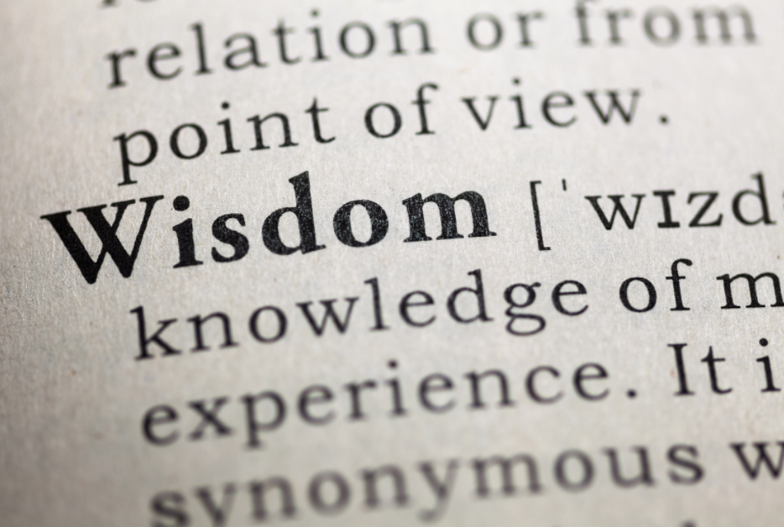
Practicing Wisdom/Wise Reasoning
https://www.researchgate.net/publication/301821371_Wise_Reasoning_in_the_Face_of_Everyday_Life_Challenges
Notes:
Next week, we'll talk a little more about the research around wise reasoning and how it relates to Digital and Civic Wellness.

Slide 26
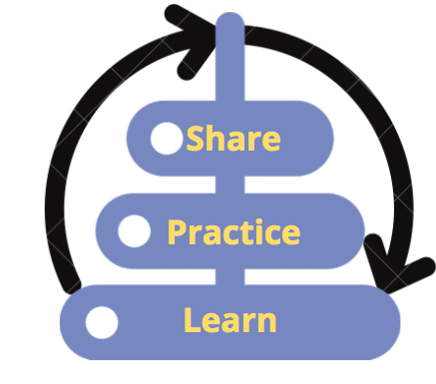
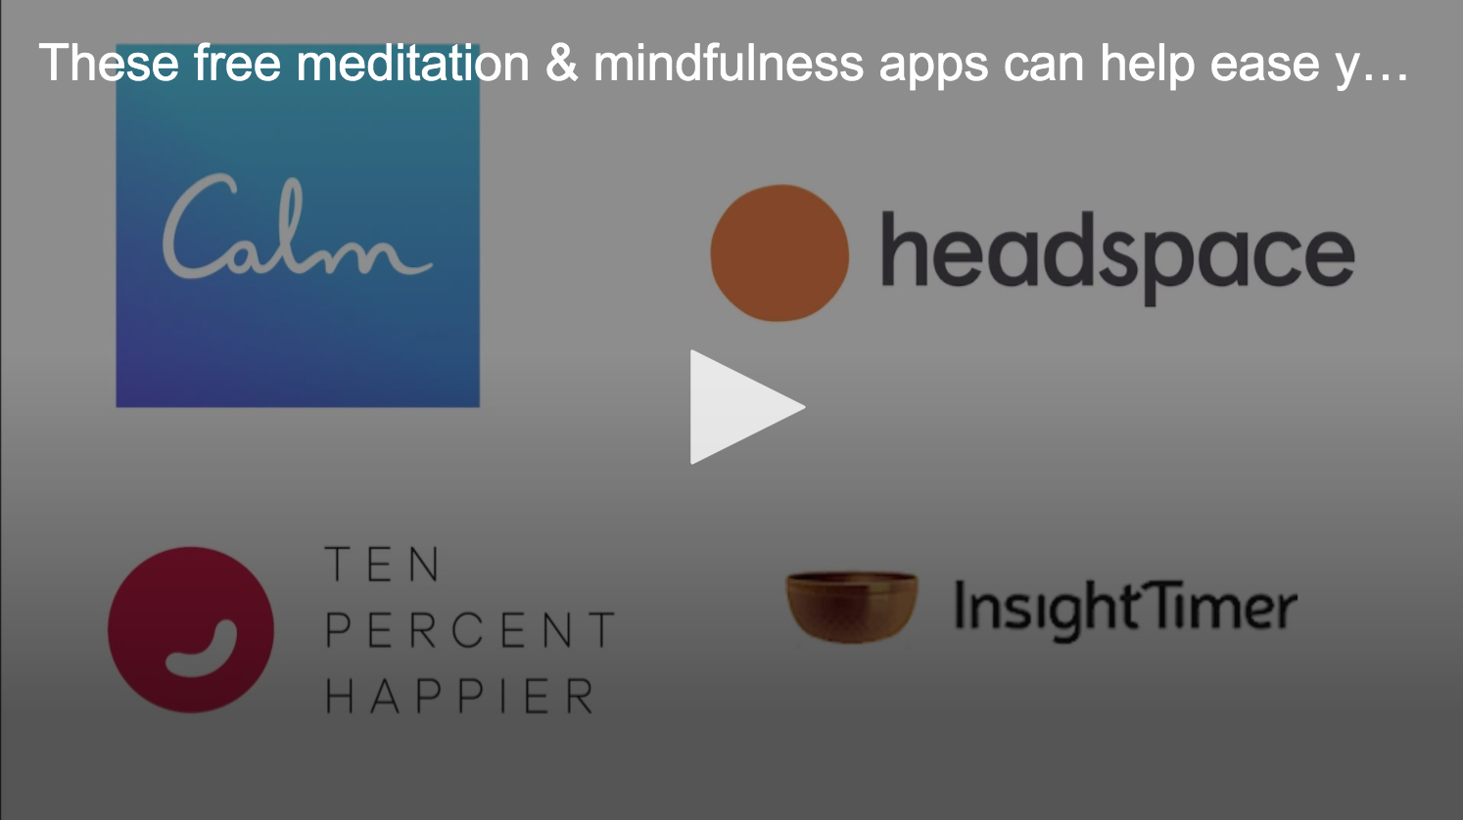
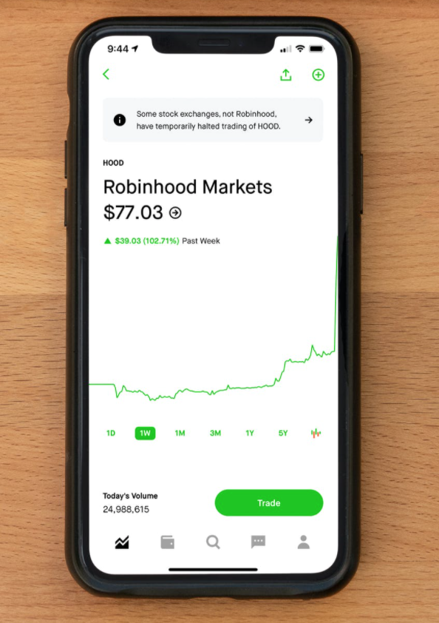
Think/Write:
What devices/tools/apps do you use most?
Notes:
Before we move into reviewing the Digital Wellness Institute's Well-being section of their self-assessment, please take a few moments to write down the tools you use most. The tools we use most offer more opportunities for us to experience both the benefits and the downsides of technology. Those tools are the ones with which we most likely will have to navigate the "balancing act" we've been discussing.

Slide 27
DWI Survey Questions: Well-being Section
Our springboard for discussion and reflection today
Notes:
=

Slide 28
Survey courtesy of DWI: https://survey.alchemer.com/s3/5504604/b153c792d361
Notes:
Before we go into detail with these questions, what tensions, nuances, both/and, continuums, etc. come to mind? This section of the survey is one that could produce a lot of "it depends" – and that is what we want to explore today together.
https://survey.alchemer.com/s3/5504604/b153c792d361
We hope you will listen to the recording to get others' thoughts on each of these questions.

Slide 29
Q1: “I feel happy when I use my favorite social media, online game or application”
Survey courtesy DWI: https://survey.alchemer.com/s3/5504604/b153c792d361
Notes:
We hope you will listen to the recording to get others' thoughts on each of these questions.

Slide 30
PAQ: Thought Questions about Q1:
What does it mean to you to feel happy?
Is feeling happy always the goal of online activity?
Notes:
We hope you will listen to the recording to get others' thoughts on each of these questions.
e.g, Someone personally working in a space that includes exposure to sad or hard information may not always feel happy, but what they are doing may still be in line with their “Why” and ”Who” and “What” values –
enough to choose to hold space for the hard.
Values-centeredness, self-awareness, deliberateness, and self-honesty are critical to maintaining well-being in all digital situations, but all the more so in these kinds of circumstances.

Slide 31
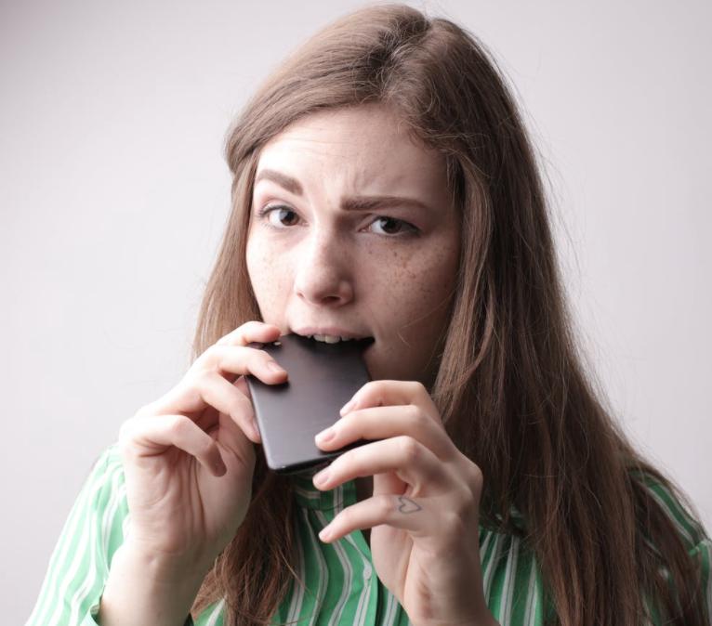
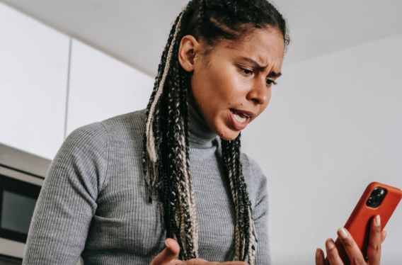
Q2: “I derive a lot of fulfillment from connecting with my friends and family online”
(bonding capital?)
Survey courtesy DWI: https://survey.alchemer.com/s3/5504604/b153c792d361
Notes:
We hope you will listen to the recording to get others' thoughts on each of these questions.

Slide 32
Remember the difference between connection and conversation from Dr. Sherry Turkle
Notes:
See last week’s discussion on relationships for more: https://docs.google.com/presentation/d/1OV77NYwEIelaV6YGghYZljZZC62vkCnw/edit?usp=sharing&ouid=111168784920600095642&rtpof=true&sd=true
Also, see
https://www.ted.com/talks/sherry_turkle_connected_but_alone/transcript?language=en – start at 2:48, run until 9:36 [on 1.5 speed, this takes just a little over 5 minutes): Sherry Turkle is the Abby Rockefeller Mauzé Professor of the Social Studies of Science and Technology in the Program in Science, Technology, and Society at MIT, and the founding director of the MIT Initiative on Technology and Self. Professor Turkle received a joint doctorate in sociology and personality psychology from Harvard University and is a licensed clinical psychologist. https://sherryturkle.mit.edu/
02:51
So just to take some quick examples: People text or do email during corporate board meetings. They text and shop and go on Facebook during classes, during presentations, actually during all meetings. People talk to me about the important new skill of making eye contact while you're texting. (Laughter) People explain to me that it's hard, but that it can be done. Parents text and do email at breakfast and at dinner while their children complain about not having their parents' full attention. But then these same children deny each other their full attention. This is a recent shot of my daughter and her friends being together while not being together. And we even text at funerals. I study this. We remove ourselves from our grief or from our revery and we go into our phones.
03:56
Why does this matter? It matters to me because I think we're setting ourselves up for trouble -- trouble certainly in how we relate to each other, but also trouble in how we relate to ourselves and our capacity for self-reflection. We're getting used to a new way of being alone together. People want to be with each other, but also elsewhere -- connected to all the different places they want to be. People want to customize their lives. They want to go in and out of all the places they are because the thing that matters most to them is control over where they put their attention. So you want to go to that board meeting, but you only want to pay attention to the bits that interest you. And some people think that's a good thing. But you can end up hiding from each other, even as we're all constantly connected to each other.
04:56
A 50-year-old business man lamented to me that he feels he doesn't have colleagues anymore at work. When he goes to work, he doesn't stop by to talk to anybody, he doesn't call. And he says he doesn't want to interrupt his colleagues because, he says, "They're too busy on their email." But then he stops himself and he says, "You know, I'm not telling you the truth. I'm the one who doesn't want to be interrupted. I think I should want to, but actually I'd rather just do things on my Blackberry."
05:27
Across the generations, I see that people can't get enough of each other, if and only if they can have each other at a distance, in amounts they can control. I call it the Goldilocks effect: not too close, not too far, just right. But what might feel just right for that middle-aged executive can be a problem for an adolescent who needs to develop face-to-face relationships. An 18-year-old boy who uses texting for almost everything says to me wistfully, "Someday, someday, but certainly not now, I'd like to learn how to have a conversation."
06:14
When I ask people "What's wrong with having a conversation?" People say, "I'll tell you what's wrong with having a conversation. It takes place in real time and you can't control what you're going to say." So that's the bottom line. Texting, email, posting, all of these things let us present the self as we want to be. We get to edit, and that means we get to delete, and that means we get to retouch, the face, the voice, the flesh, the body -- not too little, not too much, just right.
06:57
Human relationships are rich and they're messy and they're demanding. And we clean them up with technology. And when we do, one of the things that can happen is that we sacrifice conversation for mere connection. We short-change ourselves. And over time, we seem to forget this, or we seem to stop caring.
07:24
I was caught off guard when Stephen Colbert asked me a profound question, a profound question. He said, "Don't all those little tweets, don't all those little sips of online communication, add up to one big gulp of real conversation?" My answer was no, they don't add up. Connecting in sips may work for gathering discrete bits of information, they may work for saying, "I'm thinking about you," or even for saying, "I love you," -- I mean, look at how I felt when I got that text from my daughter -- but they don't really work for learning about each other, for really coming to know and understand each other. And we use conversations with each other to learn how to have conversations with ourselves. So a flight from conversation can really matter because it can compromise our capacity for self-reflection. For kids growing up, that skill is the bedrock of development.
08:49
Over and over I hear, "I would rather text than talk." And what I'm seeing is that people get so used to being short-changed out of real conversation, so used to getting by with less, that they've become almost willing to dispense with people altogether. So for example, many people share with me this wish, that some day a more advanced version of Siri, the digital assistant on Apple's iPhone, will be more like a best friend, someone who will listen when others won't. I believe this wish reflects a painful truth that I've learned in the past 15 years. That feeling that no one is listening to me is very important in our relationships with technology. That's why it's so appealing to have a Facebook page or a Twitter feed -- so many automatic listeners. And the feeling that no one is listening to me make us want to spend time with machines that seem to care about us.

Slide 33
And a continuum re: depth of relationship
Bonding Capital
Distraction
/Fragmentation
Bridging Capital – Shallow Relationships
Notes:
Another example of how a continuum could be used to examine balance and wisdom and order in various facets of Digital Wellness.
See last week’s discussion slides for more about relationships: https://docs.google.com/presentation/d/1OV77NYwEIelaV6YGghYZljZZC62vkCnw/edit?usp=sharing&ouid=111168784920600095642&rtpof=true&sd=true

Slide 34
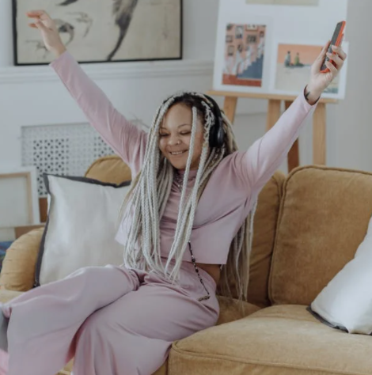
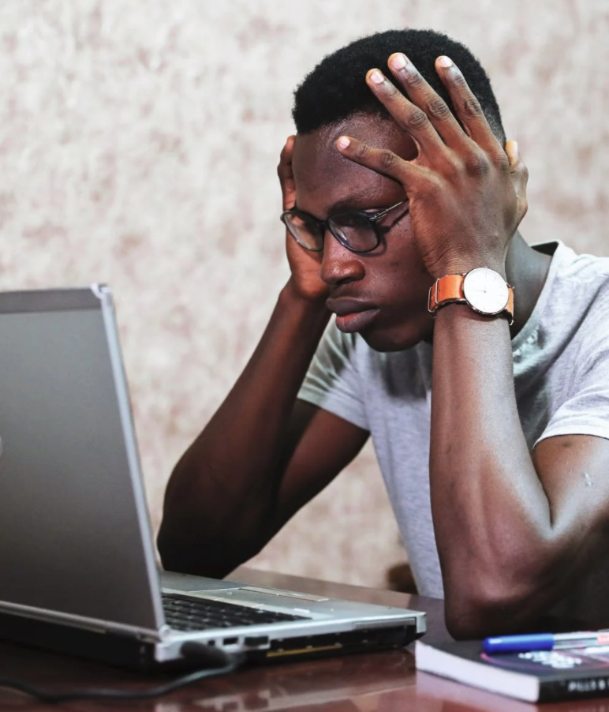
Q3: “Using social media makes me feel pessimistic”
Survey courtesy DWI: https://survey.alchemer.com/s3/5504604/b153c792d361
Notes:
We hope you will listen to the recording to get others' thoughts on each of these questions.

Slide 35
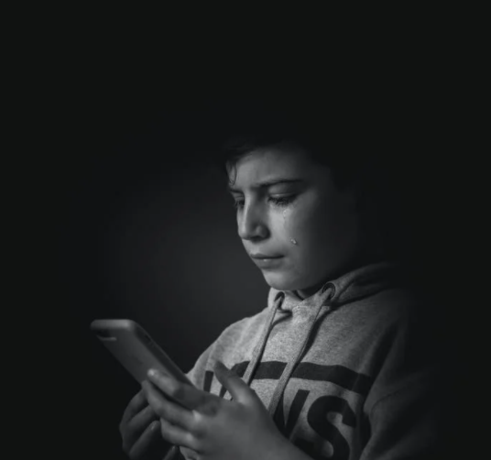
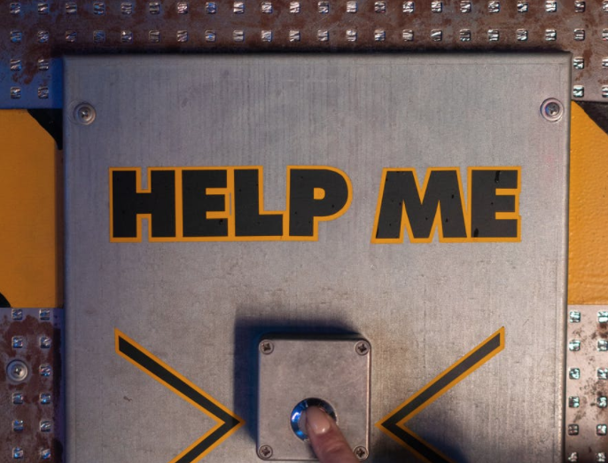
Q4: “Digital applications or social media give me the opportunity for self-expression”
Survey courtesy DWI: https://survey.alchemer.com/s3/5504604/b153c792d361
Notes:
=

Slide 36
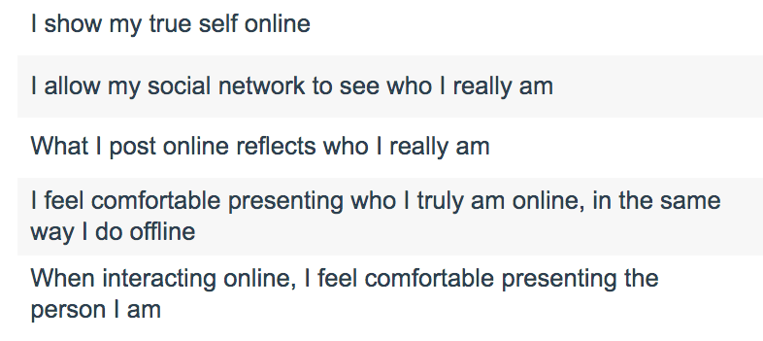
Survey courtesy of DWI: https://survey.alchemer.com/s3/6226945/Digital-Flourishing-Survey-PositiveMediatedSocialInteractions
Notes:
https://survey.alchemer.com/s3/6226945/Digital-Flourishing-Survey-PositiveMediatedSocialInteractions

Slide 37
Thought Questions about Q4:
What does self-expression mean or look like to/for you?
How do you determine how, when, where, why, and with whom to engage in online self-expression?
How might we help children navigate this?
Survey courtesy DWI: https://survey.alchemer.com/s3/5504604/b153c792d361
Notes:
We hope you will listen to the recording to get others' thoughts on each of these questions.

Slide 38
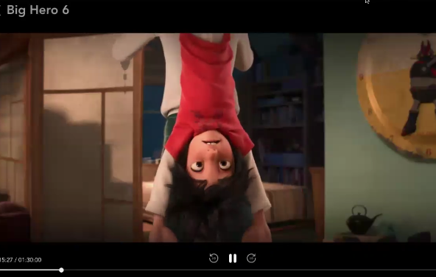
Q5: “Digital applications or social media inspire me to get out of my comfort zone”
e.g., creative expression, civic engagement, compassion, intellectual curiosity, humility
Survey courtesy DWI: https://survey.alchemer.com/s3/5504604/b153c792d361
Notes:
We reached our time limit before being able to discuss this question, but there are many tensions inherent in this question that are worth exploring. We'll be covering some of these concepts in the Digital Citizenship section as well.
See also https://survey.alchemer.com/s3/6226945/Digital-Flourishing-Survey-PositiveMediatedSocialInteractions

Slide 39
Keep these concepts in mind…
The tensions inherent in these topics are relevant to
next week's discussion on Digital Citizenship
Happiness
Fulfillment
Pessimism
Self-expression/presentation
Comfort Zone
Depending on size of group, this will either be a large group discussion or can be broken into smaller groups of 3-4.
Image shared under CC BY-SA 3.0 (https://creativecommons.org/licenses/by-sa/3.0/deed.en). Credit: https://commons.wikimedia.org/wiki/User:Rahulkepapa

Slide 40
Dancing in the Tensions
See also Barbara Sher’s TEDx talk (When it comes to problem-solving and reaching your goals, there is a tension with solitude, because problems are meant to be solved via connection and collaboration and mutually helping each other) https://www.tedxprague.cz/en/videa/isolation-is-the-dream-killer-not-your-attitude-barbara-sher
Barbara’s work also reinforces building small networks of support for reaching your goals (where bridging social capital can even become more like bonding social capital)
Notes:
=

Slide 41
We wish you well(ness)!

Slide 42
Bonus Material

Slide 43
Aristotle: The Golden Mean
"For instance, both fear and confidence and appetite and anger and pity and in general pleasure and pain may be felt both too much and too little, and in both cases not well; but to feel them at the right times, with reference to the right objects, towards the right people, with the right motive, and in the right way, is what is both intermediate and best, and this is characteristic of virtue."
Notes:
We'll be talking more about this next week.
https://www.sacred-texts.com/cla/ari/nico/nico019.htm

Slide 44
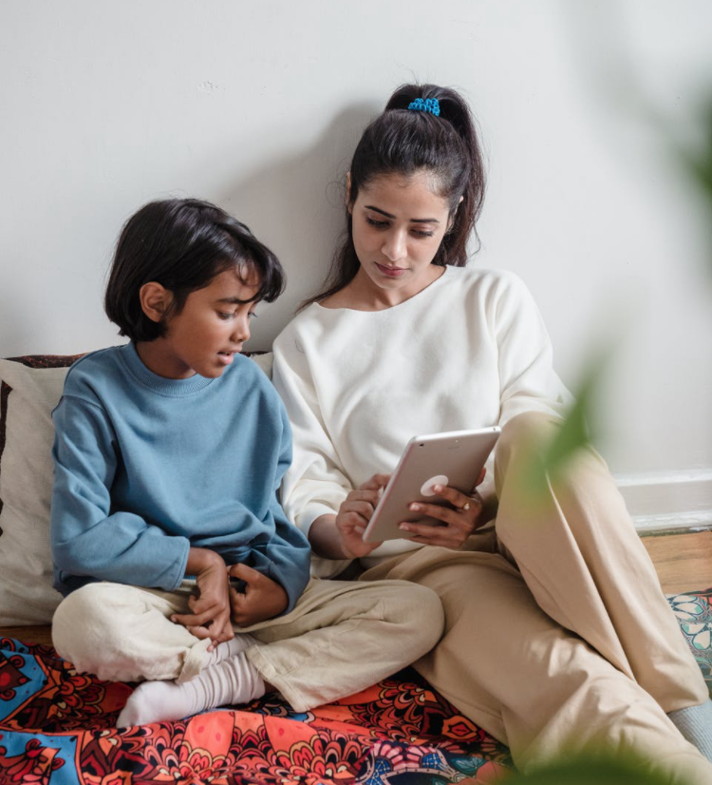
Family Tech Tips
and Resources
Notes:
=

Slide 45
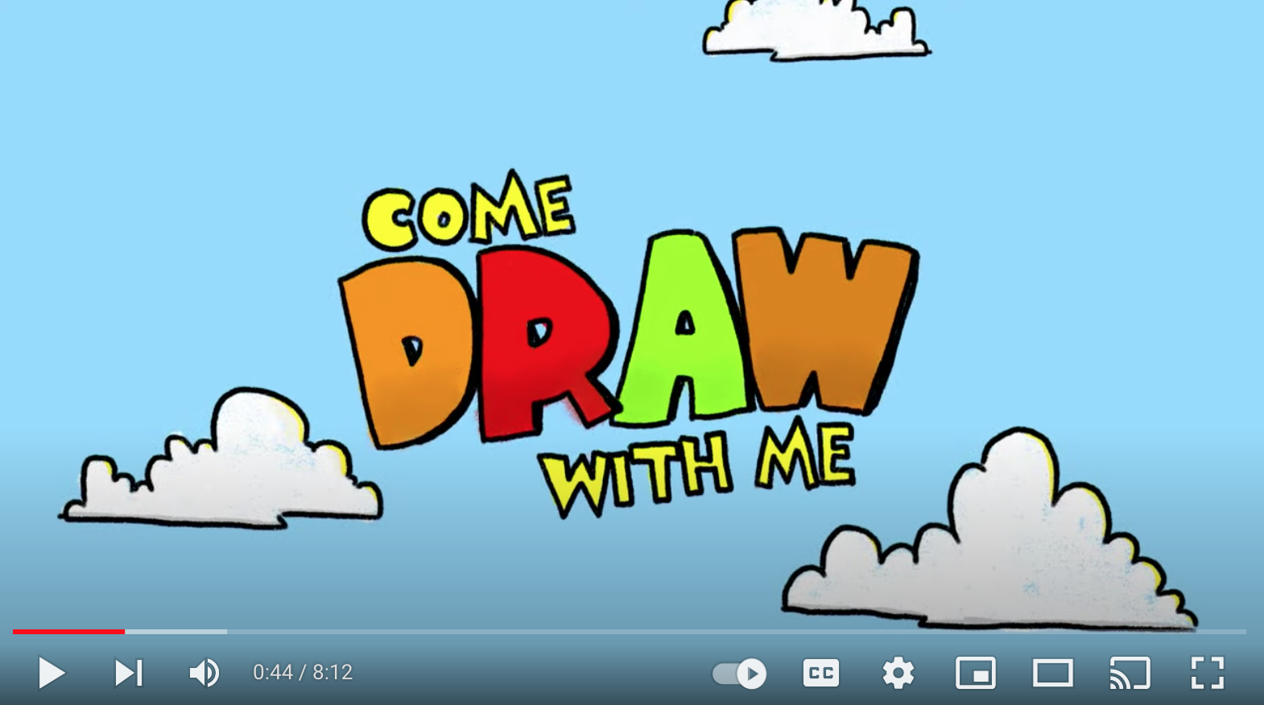
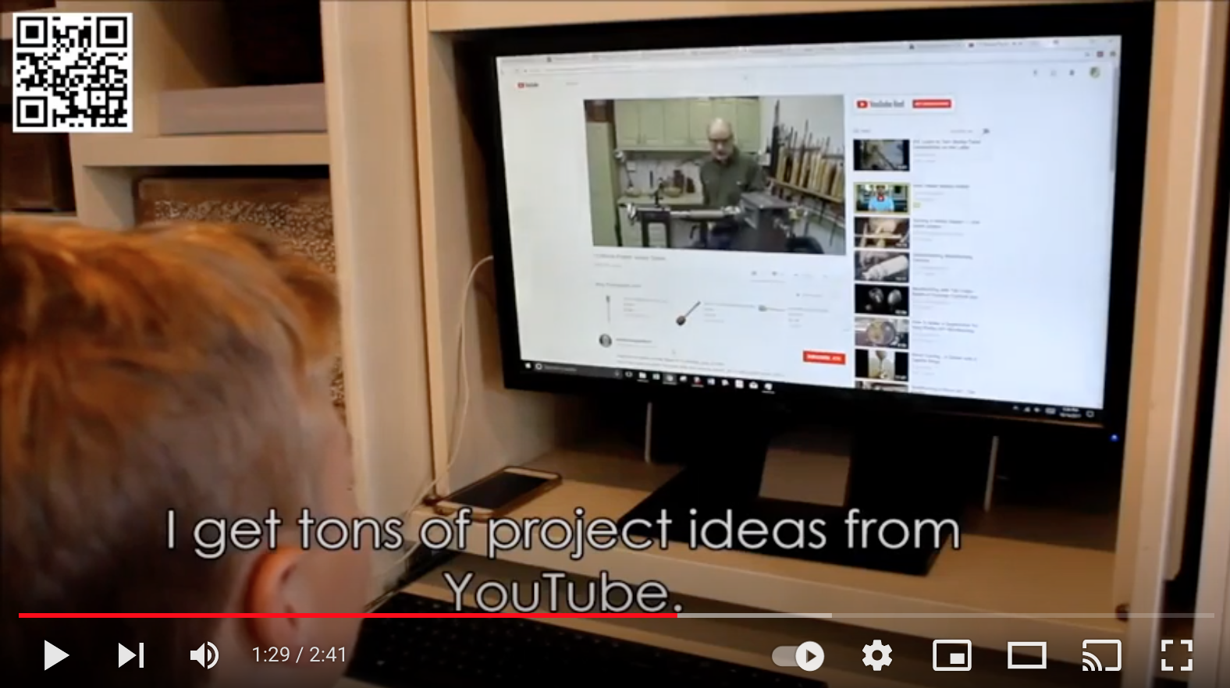
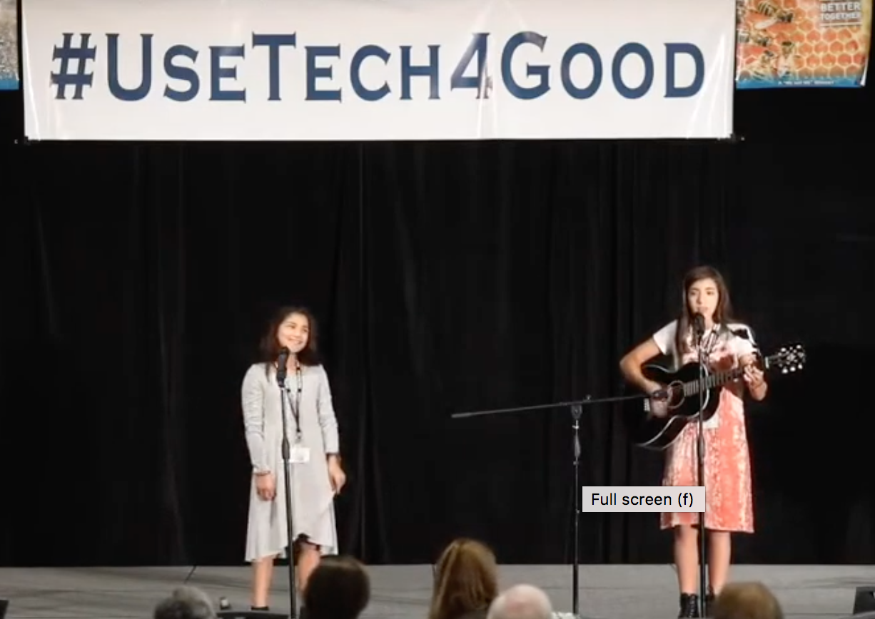
If your children use YouTube…

Slide 46
If your children use YouTube…
Make sure the device is in a public area and at least within your visual field and earshot.
Turn off autoplay [avoid rabbit holes and inane (or worse) content]
Put the video on full screen [prevents sidebar distractions & rabbit holes]
Alone as the parent, prepare the video by getting past the initial ad first.
Watch/listen for intermediate ads, and ads at the end
Agree together with your child on how much time you/they will spend on the activity. [This can help model principles of time-boxing and single-tasking, which are powerful Digital Wellness principles.] *Wherever possible, use technology *with* your child. This is good for both relationship-building and safety, and side-by-side learning with positive reinforcement can potentially be a protective factor for overall behavioral health, as per Social Development Strategy
Notes:
https://www.instagram.com/p/CU8JuQvBs-K/

Slide 47
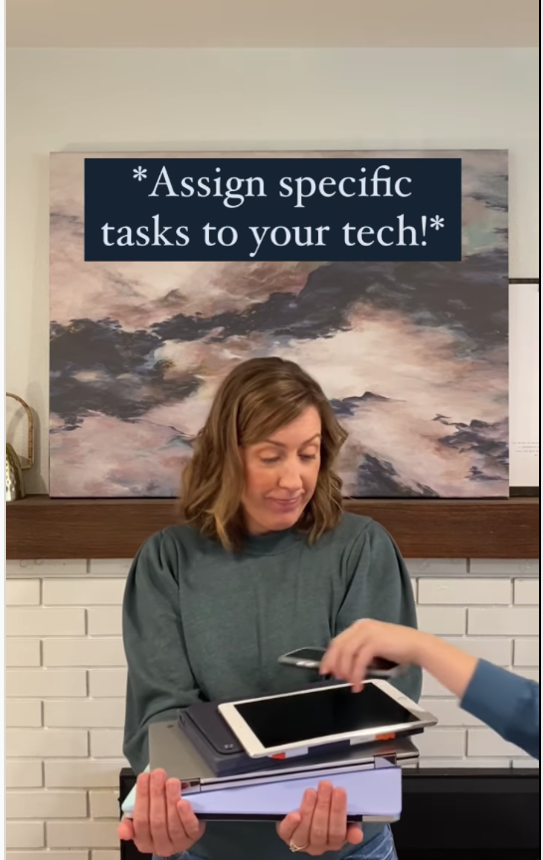
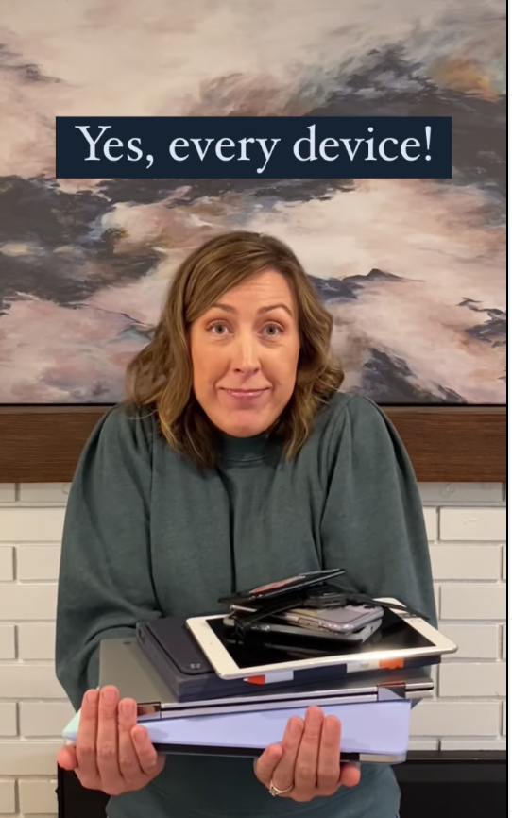
Family tech tip from Better Screen Time
https://www.instagram.com/p/CU8JuQvBs-K/ or @BetterScreenTime or https://www.instagram.com/betterscreentime/
Notes:
https://www.instagram.com/p/CU8JuQvBs-K/ @BetterScreenTime https://www.instagram.com/betterscreentime/

Slide 48
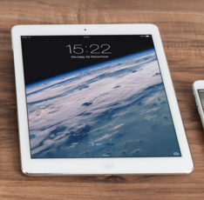
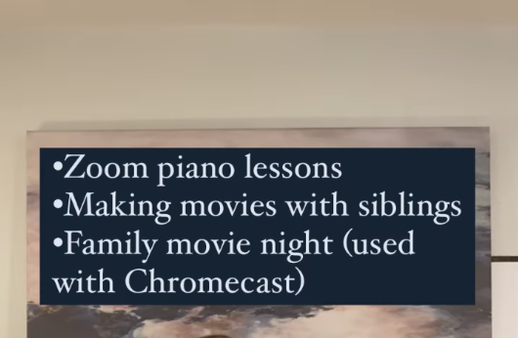
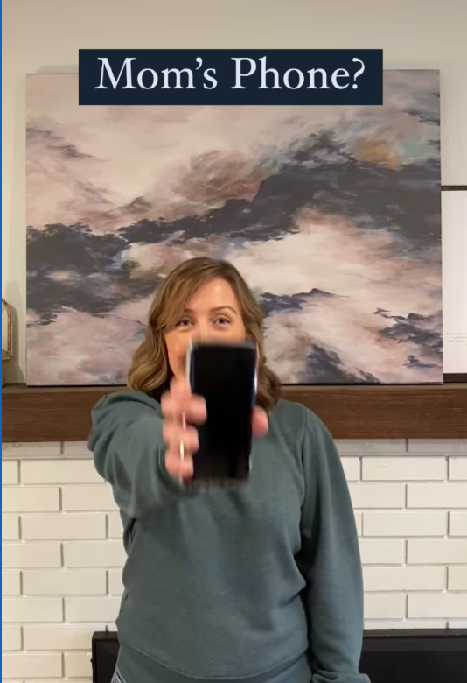
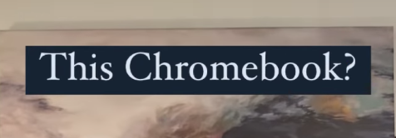
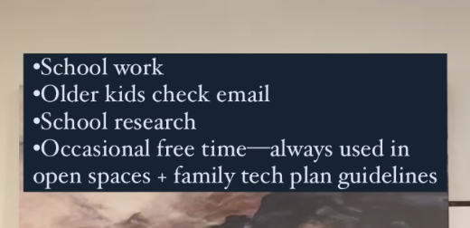
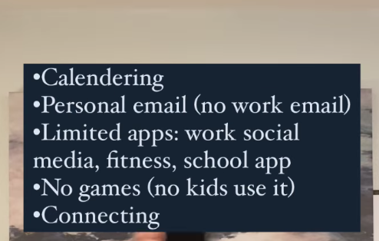
e.g., from Andrea Davis at Better Screen Time
https://www.instagram.com/p/CU8JuQvBs-K/
https://www.instagram.com/betterscreentime/
@BetterScreenTime
Notes:
https://www.betterscreentime.com/create-a-family-technology-plan-not-a-cell-phone-contract/ and quick guide is here:

Slide 49
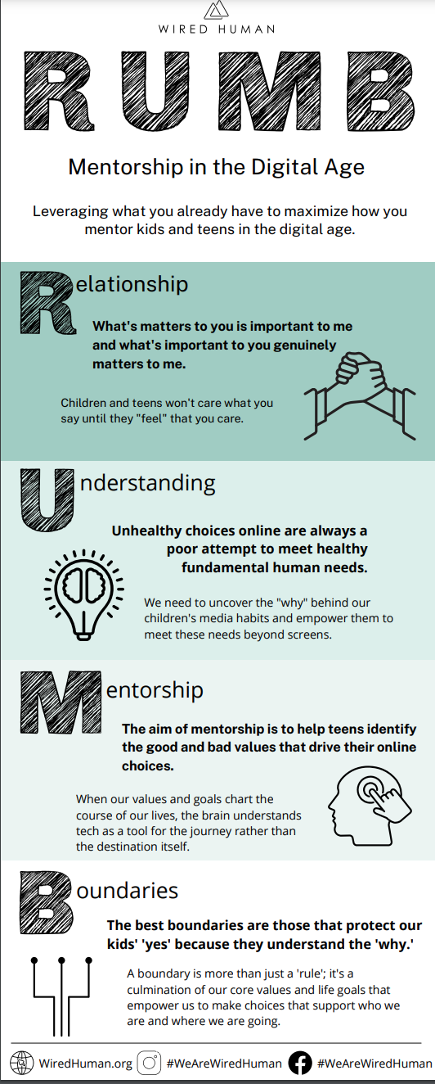
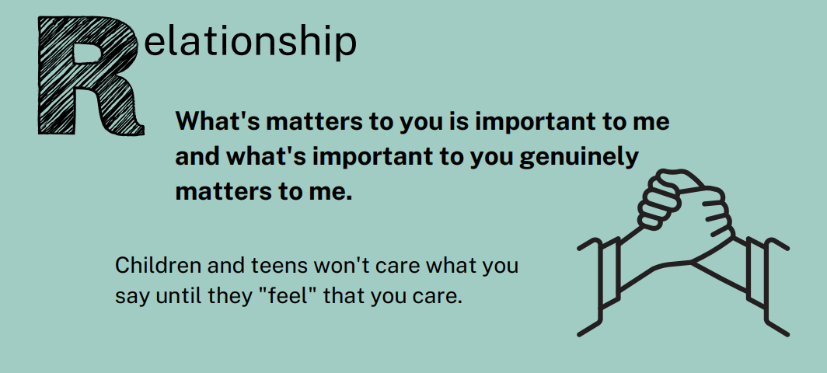
from WiredHuman.org

Slide 50
Other resources
We know many parents are concerned about pornography so some resources below include that topic
DigCitUtah: https://digcitutah.com/resources-library/ [resources covering various facets of Digital Citizenship and Digital Safety]
Educate Empower Kids: https://educateempowerkids.org/
Conversations with My Kids: 30 Essential Family Discussions for the Digital Age
Petra’s Power to See
Noah’s New Phone: A Story About Using Technology for Good
Messages About Me: Sydney’s Story, A Girl’s Journey to Healthy Body Image
Kids and Pornography: A Public Health Crisis
30 Days to a Stronger Child
30 Days of Sex Talks [different books for different ages]
How to Talk to Your Kids About Pornography
Defend Young Minds: https://www.defendyoungminds.com/
Reach10 for young adults: https://reach10.org/
Others you use/like?

Slide 51
A second DWI survey on
Social Connectedness (relates to well-being)
https://survey.alchemer.com/s3/6226945/Digital-Flourishing-Survey-PositiveMediatedSocialInteractions
See also resources and research from the Relationships module
Notes:
https://survey.alchemer.com/s3/6226945/Digital-Flourishing-Survey-PositiveMediatedSocialInteractions

Slide 52
Social Connectedness Assessment from DWI
Allows for self-reflection about:
Connectedness
Civil participation
Positive online social comparison
Authentic online self-presentation
Self-control
Notes:
We didn't review the questions from this assessment in this week. We might dig into them a little more in the Digital Citizenship module, but for now, we do invite you to at least skim over the assessment. I neglected to mention in our gathering that this tool has been validated for anyone 12 and up.

Slide 53
A second DWI survey! Social Connectedness
https://survey.alchemer.com/s3/6226945/Digital-Flourishing-Survey-PositiveMediatedSocialInteractions
“Are you getting the most out of your online communication? Do you feel like the way you interact online is helping you flourish in your digital life? Are your online interactions meaningful?”
Measures the following:
Connectedness
Civil Participation [this will be revisited in the Digital Citizenship/Media Literacy discussion in two weeks]
Positive Social Comparison
Authentic Self-disclosure
Self-control [this will be revisited in the Digital Citizenship/Media Literacy discussion in two weeks]

Slide 54
Possible action items for the coming week
What would you like to focus on this week?

Slide 55
Possible action items for the coming week
Pay attention this week to how you feel when using your digital tools. Ask your family members to share their reflections about their own experiences with tech this week.
Consider making a task list with your family for each digital device in your home
Share the DWI Digital Wellness self-assessment and discuss with someone https://survey.alchemer.com/s3/5504604/b153c792d361
Take the DWI Social Connectedness Survey: https://survey.alchemer.com/s3/6226945/Digital-Flourishing-Survey-PositiveMediatedSocialInteractions

Slide 56
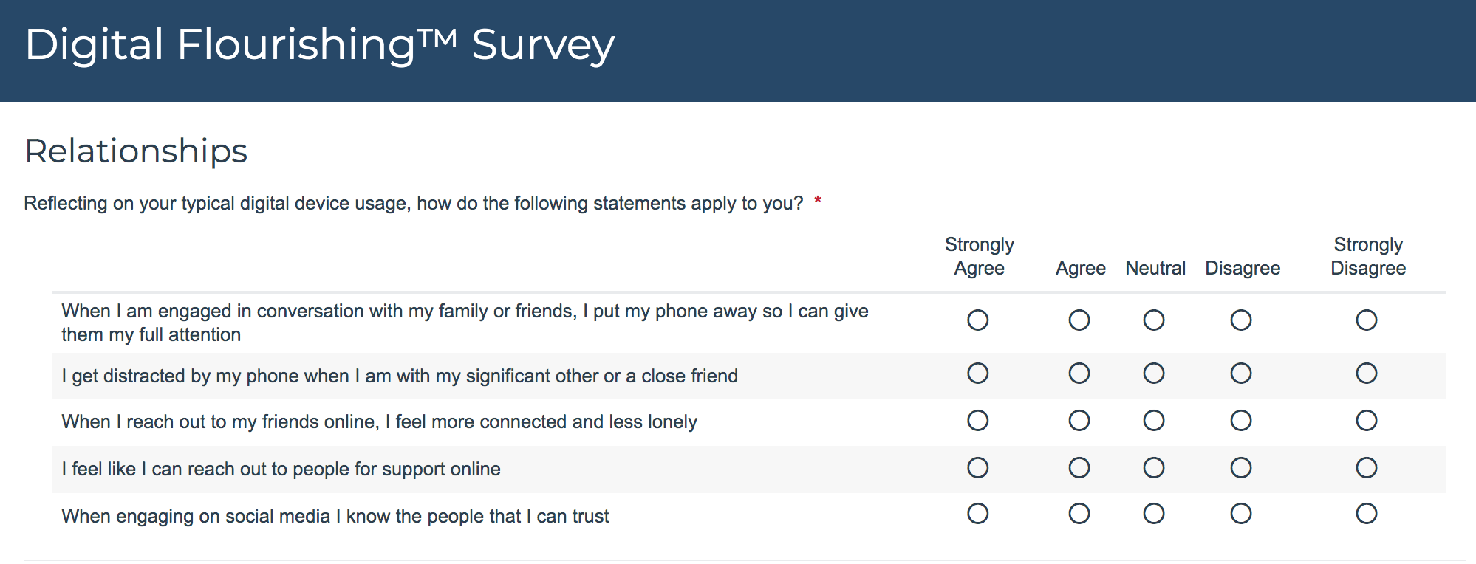
Well-being is tied to relationships…for your review
Notes:
You could also think about what relationships in your life in general (not just online) help you feel more connected, less lonely, supported, able to trust. As always, write any other questions that may come to mind that you would like to use for self-assessment. We know ourselves best and know what we want to work on and build awareness around.

