Slide 1
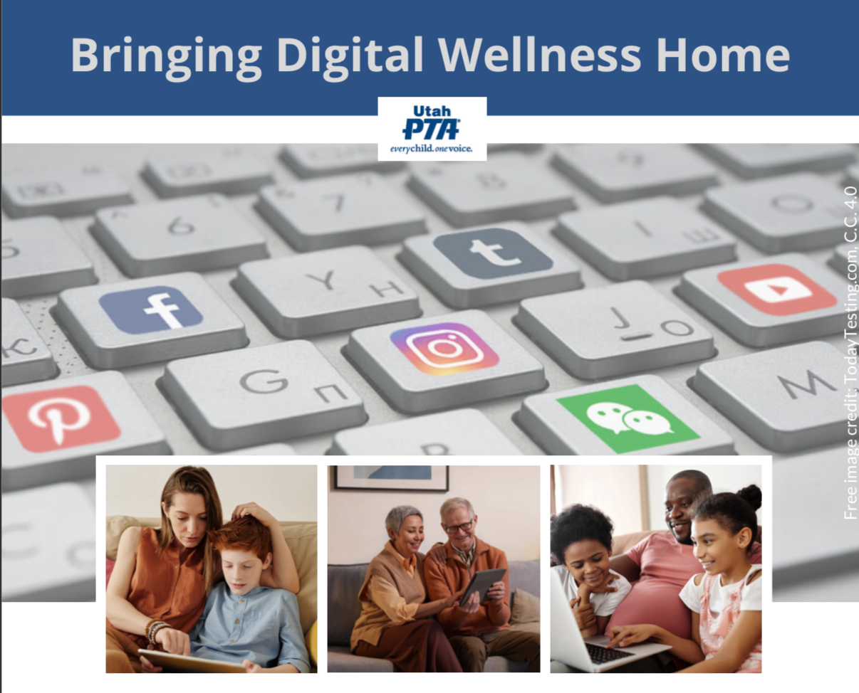
Note: All material in this series is for educational and informational purposes only, and is not meant to be exhaustive or used as a replacement for professional health support. Also, any sharing of resources doesn't imply full endorsement of all of that person or group's work. We share what we find helpful, but invite you to use your media literacy skills in all your study and research.
Notes:
Note: All material in this series is for educational and informational purposes only, and is not meant to be exhaustive or used as a replacement for professional health support. Also, the presentation is best viewed in slideshow format, as some of the slides are animated, but we have also included notes for many of the slides that you might want to review as well. Whatever works best for you!
NOTE: Portions of this work first appeared in or are derived or adapted from the Digital
Wellness Certificate Program. Those portions are Copyright © 2021, Digital Wellness Institute.

Slide 2
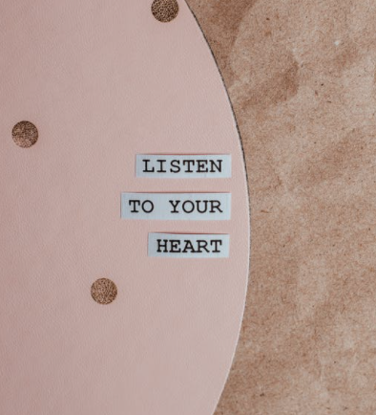
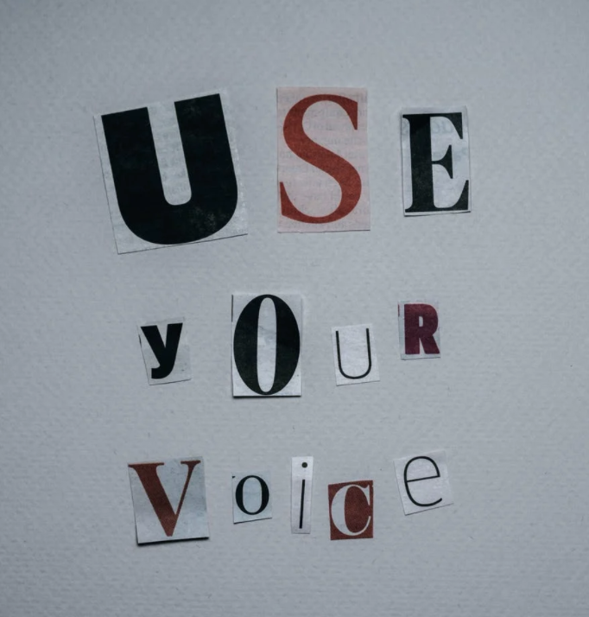
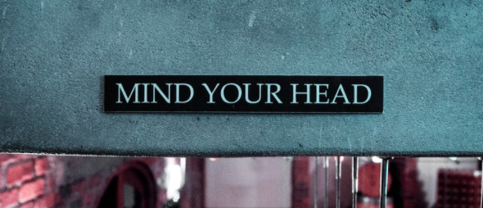
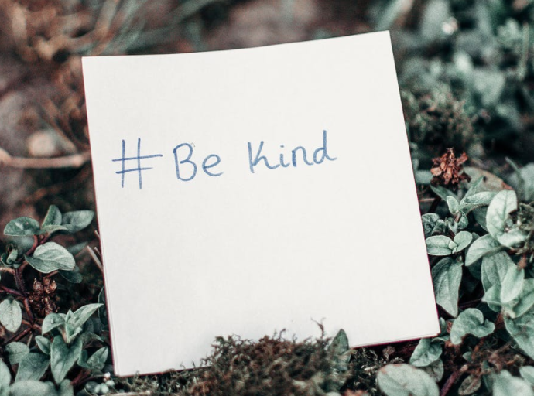
Discussion #8 Media Literacy, Digital Citizenship, Civic Wellness
Bringing Digital Wellness Home

Slide 3
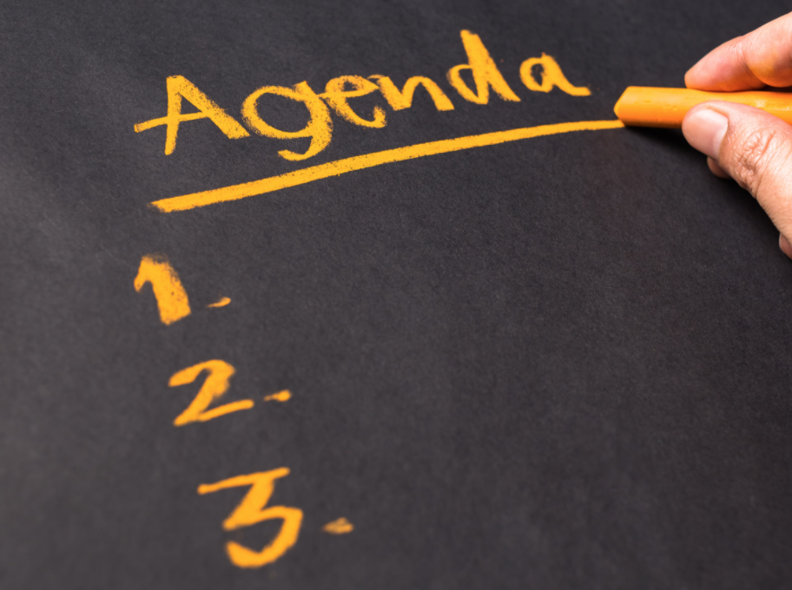
Agenda
Challenge
Check-in
Content/Concept Sharing
Connection/Discussion
Notes:
We changed up our schedule a little this week.

Slide 4
Agenda
Challenge - Survey ?s and/or Activities
Check-in
Content/Concept Sharing
Connection/Discussion
Notes:
This week's challenge/invitation is to review the survey questions in the slides below and/or to try one or more of the Media Literacy/Digital Citizenship Activities in the Bonus section. There is also some good material on dancing in the privacy tension. Less privacy = more ease of use in our technology, but more ease of use = less privacy. It's definitely a greased-hump kind of situation!

Slide 5
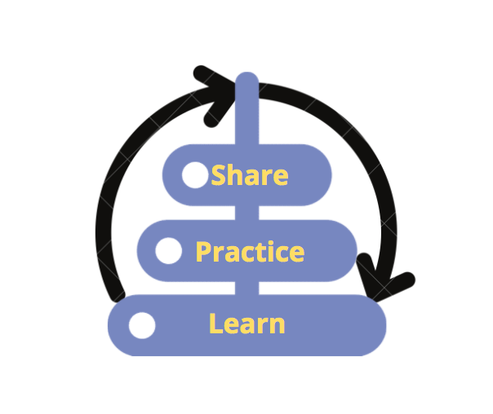
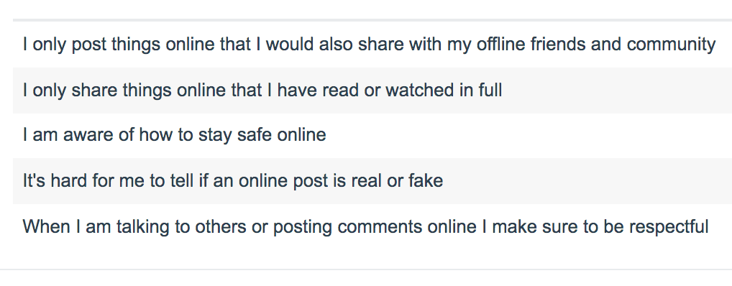
Survey courtesy of DWI: https://survey.alchemer.com/s3/5504604/b153c792d361
Notes:
This week's challenge/invitation is to review the survey questions in the slides below and/or to try one or more of the Media Literacy/Digital Citizenship Activities in the Bonus section. There is also some good material on dancing in the privacy tension. Less privacy = more ease of use in our technology, but more ease of use = less privacy. It's definitely a greased-hump kind of situation!

Slide 6
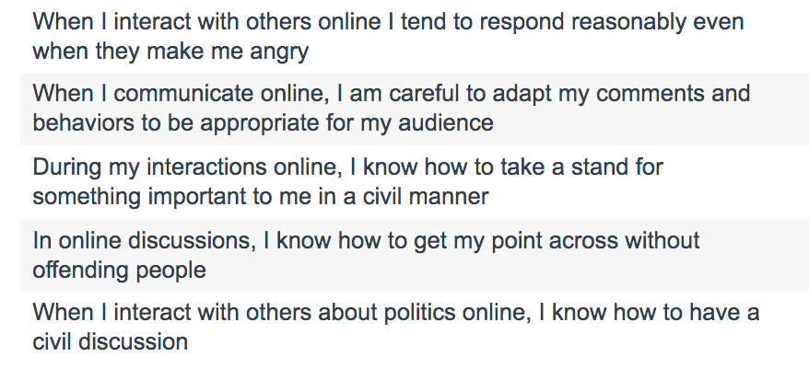
Survey courtesy of DWI: https://survey.alchemer.com/s3/6226945/Digital-Flourishing-Survey-PositiveMediatedSocialInteractions
Notes:
This week's challenge/invitation is to review the survey questions in the slides below and/or to try one or more of the Media Literacy/Digital Citizenship Activities in the Bonus section. There is also some good material on dancing in the privacy tension. Less privacy = more ease of use in our technology, but more ease of use = less privacy. It's definitely a greased-hump kind of situation!

Slide 7
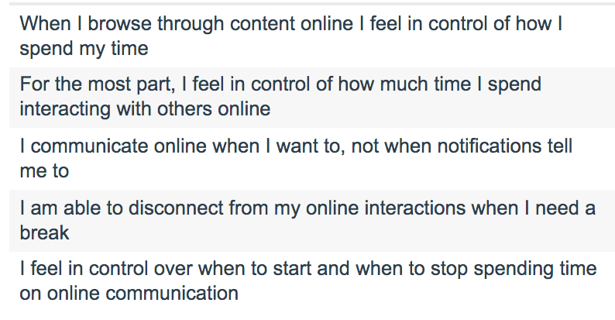
Survey courtesy of DWI: https://survey.alchemer.com/s3/6226945/Digital-Flourishing-Survey-PositiveMediatedSocialInteractions
Notes:
This week's challenge/invitation is to review the survey questions in the slides below and/or to try one or more of the Media Literacy/Digital Citizenship Activities in the Bonus section. There is also some good material on dancing in the privacy tension. Less privacy = more ease of use in our technology, but more ease of use = less privacy. It's definitely a greased-hump kind of situation!

Slide 8
See the end of this document for lots of Bonus material
Notes:
This week's challenge/invitation is to review the survey questions in the slides below and/or to try one or more of the Media Literacy/Digital Citizenship Activities in the Bonus section. There is also some good material on dancing in the privacy tension. Less privacy = more ease of use in our technology, but more ease of use = less privacy. It's definitely a greased-hump kind of situation!

Slide 9
Agenda
Challenge
Check-in
Content/Concept Sharing
Connection/Discussion
Notes:
From its beginnings, EPIK has deliberately designed gatherings to be interactive, participatory, and action-oriented. We'll start every week with something that can help us check in (and build our sense of shared humanity, community, and group safety), explore some content (we'll not be able to cover it all, so we provide a repository of resources for you), and a challenge/invitation to take home and practice and/or share with your family/friends/coworkers.

Slide 10
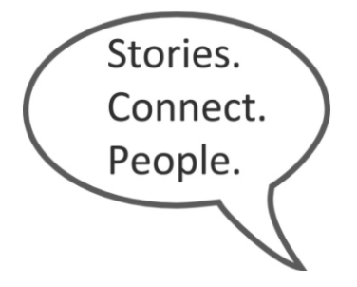
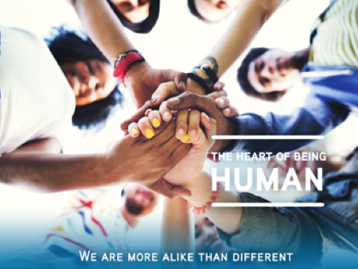
Think, Write, Share Activity
"The closest distance between two people is a story." Jared Stewart
Think:
What are three things on your bucket list?
Notes:
This is the typical way that EPIK likes to begin its meetings – with a "Stories Connect People" activity. [See more question prompts in the Stories Connect People document we've included in this week's Google Folder. https://docs.google.com/document/d/1hSOj0ozMSzQ11HNUY9v0BstRopf9SD7JrYxnbIhvSrU/edit?usp=sharing)
We’ll take a few minutes to share stories with each other.
Here's a little history about the internal company research by Tribalry, a local company that taught us about this methodology. The founders, from a family of 10 children, learned through these simple exercises that even with the people closest to you, you often don’t know what’s inside of them, what their stories are. Taking time for each others’ stories is critical to building relationships and trust, whether that be in close relationships or in business relationships. And taking time for conversation can help relationships grow from weak ties to stronger bonds. Stories connect people! Or, as Jared Stewart, co-founder of Tribalry says, "The shortest distance between two people is a story."

Slide 11
Write:
List your three bucket list items in the chat
For me: go to Israel, go to England, and write a book
Notes:
This is the typical way that EPIK likes to begin its meetings – with a "Stories Connect People" activity. [See more question prompts in the Stories Connect People document we've included in this week's Google Folder. https://docs.google.com/document/d/1hSOj0ozMSzQ11HNUY9v0BstRopf9SD7JrYxnbIhvSrU/edit?usp=sharing)
We’ll take a few minutes to share stories with each other.
Here's a little history about the internal company research by Tribalry, a local company that taught us about this methodology. The founders, from a family of 10 children, learned through these simple exercises that even with the people closest to you, you often don’t know what’s inside of them, what their stories are. Taking time for each others’ stories is critical to building relationships and trust, whether that be in close relationships or in business relationships. And taking time for conversation can help relationships grow from weak ties to stronger bonds. Stories connect people! Or, as Jared Stewart, co-founder of Tribalry says, "The shortest distance between two people is a story."

Slide 12
Share:
What is your why for one bucket list item?
Think: Pick one item on your bucket list. What is a story behind why that dream is on your bucket list?
Share. Here are the ground rules:
In your breakout rooms, you will each have one minute to share that story with your group.
Everyone gets a full minute…no less, no more. The idea here is to give everyone equal opportunity to have a voice. If you finish early, others can ask you a question so you can share more and use up the rest of your time.*
Follow alphabetical order of first names for ease of flow.
Please self-time (or ask someone in your group to time for you).
If you are the one sharing and the timer goes off, please just say, “And, I’m done!” or "Thank you, I pass" even if you are in the middle of a sentence. ☺
*I’ll share a story to model. Expect me to take less than a minute, so please help me take up my time!
Notes:
This is the typical way that EPIK likes to begin its meetings – with a "Stories Connect People" activity. [See more question prompts in the Stories Connect People document we've included in this week's Google Folder. https://docs.google.com/document/d/1hSOj0ozMSzQ11HNUY9v0BstRopf9SD7JrYxnbIhvSrU/edit?usp=sharing)
We’ll take a few minutes to share stories with each other.
Here's a little history about the internal company research by Tribalry, a local company that taught us about this methodology. The founders, from a family of 10 children, learned through these simple exercises that even with the people closest to you, you often don’t know what’s inside of them, what their stories are. Taking time for each others’ stories is critical to building relationships and trust, whether that be in close relationships or in business relationships. And taking time for conversation can help relationships grow from weak ties to stronger bonds. Stories connect people! Or, as Jared Stewart, co-founder of Tribalry says, "The shortest distance between two people is a story."

Slide 13
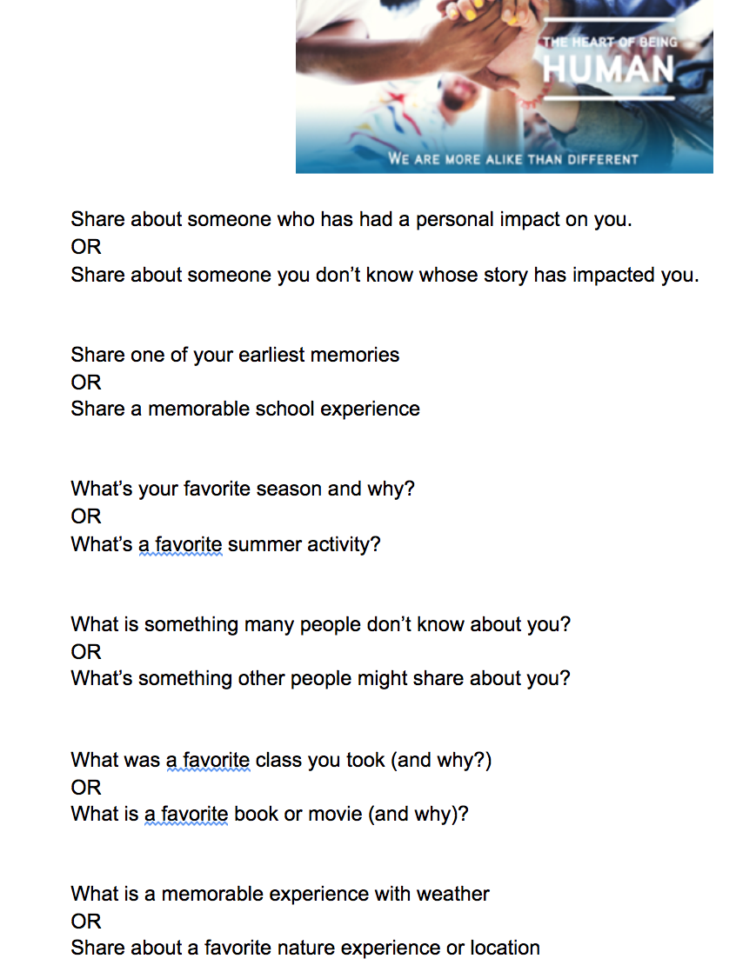
A reminder about "Stories Connect People"
"The closest distance between two people is a story." -Jared Stewart
Find story question prompts and other activities in the PTA Relationships Module folder @https://docs.google.com/document/d/1sHOKQlRVyBt45q2QVcpmdV0EP5KLC4OegfXkSTylGjg/edit?usp=sharing
Notes:
This is the typical way that EPIK likes to begin its meetings – with a "Stories Connect People" activity. [See more question prompts in the Stories Connect People document we've included in this week's Google Folder. https://docs.google.com/document/d/1hSOj0ozMSzQ11HNUY9v0BstRopf9SD7JrYxnbIhvSrU/edit?usp=sharing)
We’ll take a few minutes to share stories with each other.
Here's a little history about the internal company research by Tribalry, a local company that taught us about this methodology. The founders, from a family of 10 children, learned through these simple exercises that even with the people closest to you, you often don’t know what’s inside of them, what their stories are. Taking time for each others’ stories is critical to building relationships and trust, whether that be in close relationships or in business relationships. And taking time for conversation can help relationships grow from weak ties to stronger bonds. Stories connect people! Or, as Jared Stewart, co-founder of Tribalry says, "The shortest distance between two people is a story."

Slide 14
Agenda
Challenge
Check-in
Content/Concept Sharing
Connection/Discussion

Slide 15
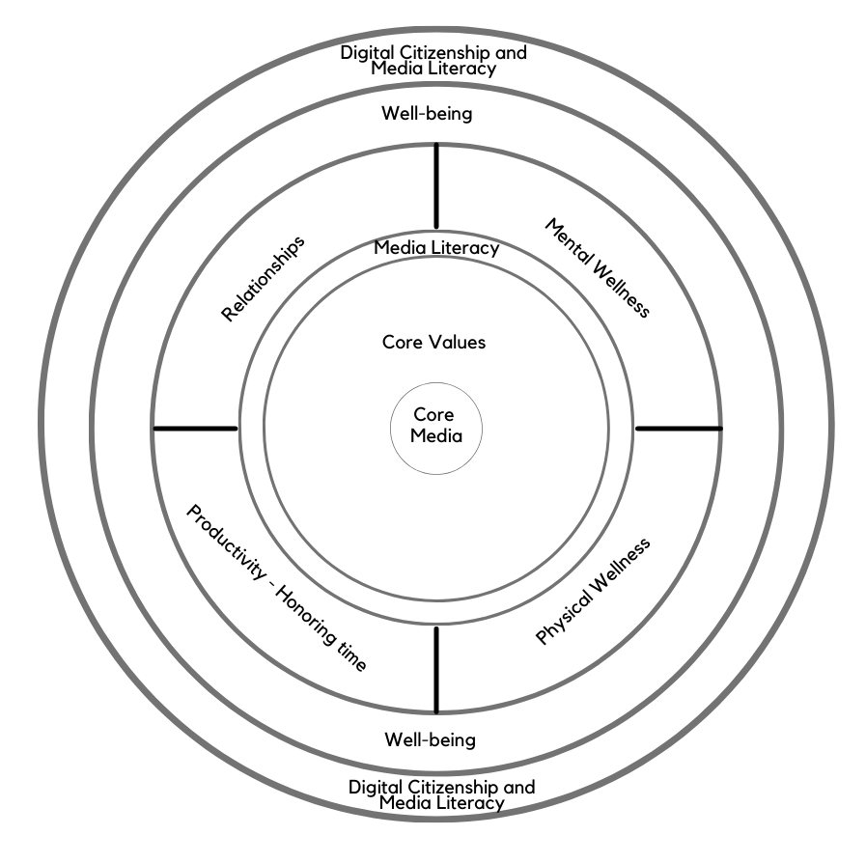
Today’s topic: Media Literacy (again),
Digital Citizenship, and Civic Wellness
Note: EPIK’s Digital Centeredness model is adapted from the Digital Wellness Institute’s six-pronged model that aligns with DWI’s original survey
Notes:
We've spent a lot of time during this series talking about putting on our own oxygen masks first, but ultimately, we hope our individual efforts toward Digital Wellness can mean we have more capacity to do some good in the world, to be influencers for good.

Slide 16
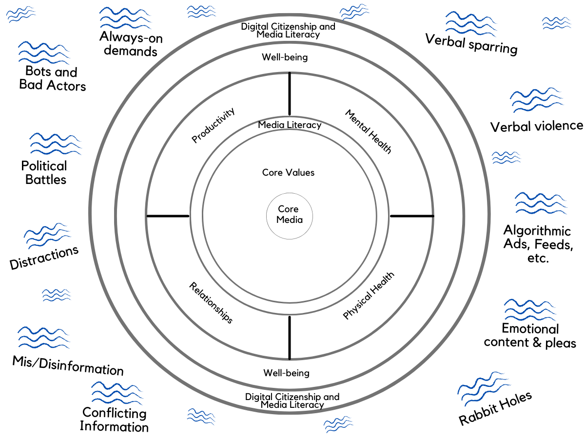
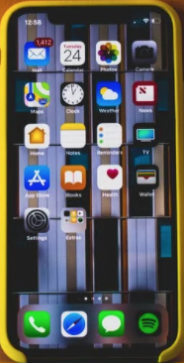
From Attention Economy overwhelm…
Notes:
The Attention Economy definitely can have its impact on us, but by practicing Digital Wellness principles, we hope we can be able to start to change the direction to having more attention to things that matter, including helping in our communities and contributing in a positive way to the public square (bridging connections, in a building way).

Slide 17
…to more attention-filled living
Notes:
The Attention Economy definitely can have its impact on us, but by practicing Digital Wellness principles, we hope we can be able to start to change the direction to having more attention to first sending out peace, compassion, and care for others from a mindful center, and helping in our communities and contributing in a positive way to the public square (nurturing bridging connections in a way that builds).

Slide 18
Notes:
Just a few reminders from what we have discussed (please keep in mind all you have learned to this point)

Slide 19
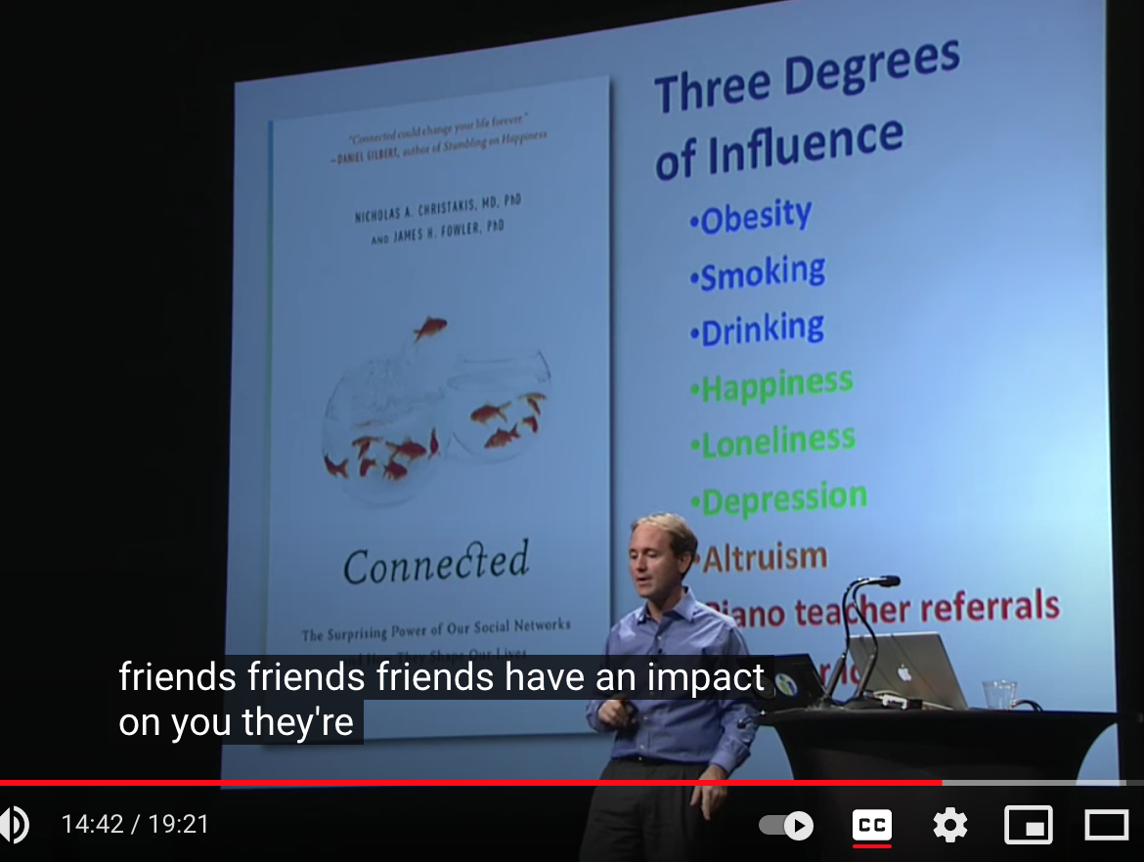
Our personal choices can impact hundreds of people three degrees out
This is true for anything from risky behaviors to altruism to financial panic to kindness to obesity to loneliness to depression to happiness to innovation to civic behaviors
https://www.youtube.com/watch?v=zkmsjFisW_A
See also: https://www.youtube.com/watch?v=2U-tOghblfE&t=174s
Notes:
=

Slide 20
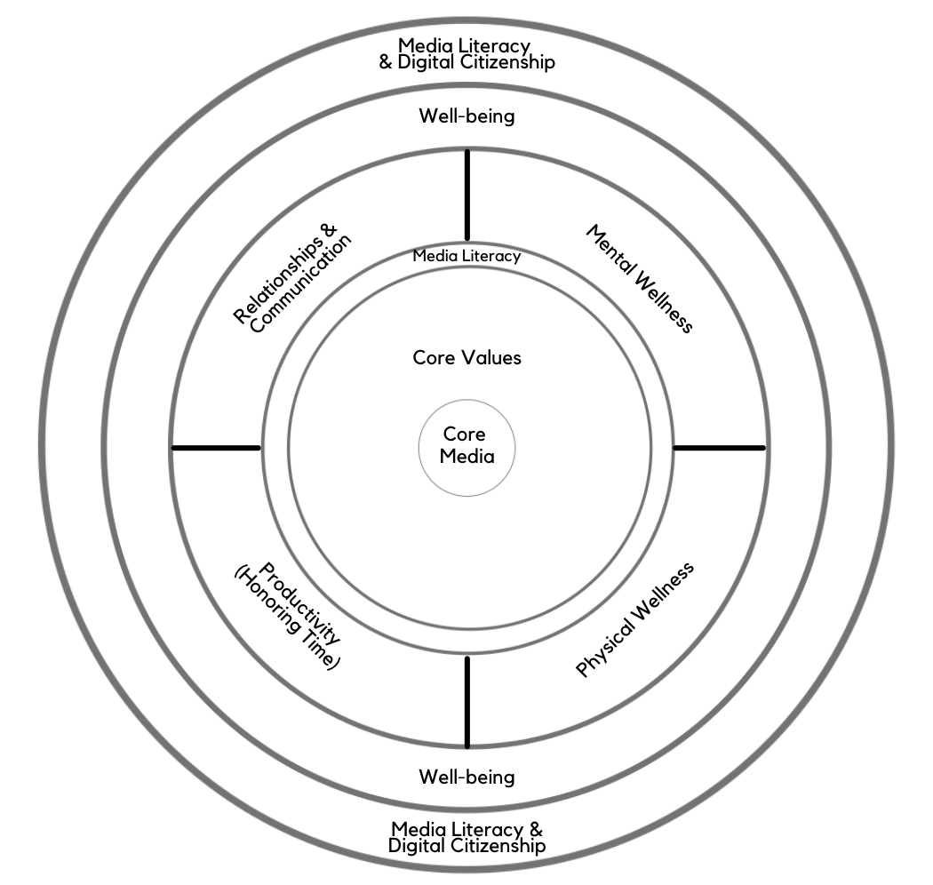
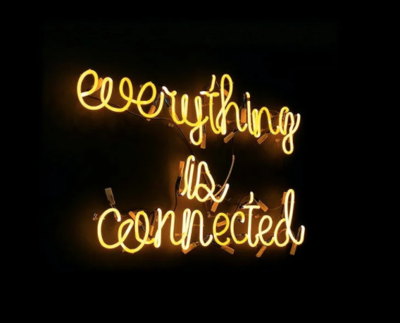
Notes:
As we have discussed, concepts in each module interrelate to other modules. Similarly, although this is a series on Digital Wellness, many concepts we explore relate to Wellness in general. We hope you have been able to benefit by the interrelated concepts in the modules to this point. We can bring everything we have learned to this point to bear on Digital Citizenship and Civic Wellness.

Slide 21
Media Literacy = Critical Wellness Concept & Skill
Self
Wellness & Relationships
Community Involvement, Service, and Civic Engagement
Notes:
We'll be going back to the very core today and then building out from there to the potential community level impact of practicing Media Literacy.
Self – how do media help me define, refine and recenter on my values? How can Media Literacy help enrich my life and learning (e.g., art appreciation)?
Expanding into more specifics, how can practicing Media Literacy help me build mental wellness, physical wellness, healthier time habits, and healthier relationships and communication?
How can Media Literacy impact my overall well-being?
How can Media Literacy help me be a positive influence in my community and in the public square?

Slide 22
Media Literacy (PAQ) can help with relationships
Self
self
bonding
Wellness & Relationships
bridging
Community Involvement, Service, and Civic Engagement
Relationship with self
Relationship with family, close friends, close support networks (Bonding social capital)
The “getting things done” connections (including weak and dormant ties) (Bridging social capital)
Notes:
We were fascinated to revisit a previous version of the series slide deck to see the parallels between relationship types and where and how Media Literacy fits into our model. This wasn't planned…it's just how things have emerged and interconnected along the way. This series is teaching us at EPIK, too, in remarkable ways.
Self – how do media help me define, refine and recenter on my values? How can Media Literacy help enrich my life and learning (e.g., art appreciation)?
Expanding into more specifics, how can practicing Media Literacy help me build mental wellness, physical wellness, healthier time habits, and healthier relationships and communication?
How can Media Literacy impact my overall well-being?
How can Media Literacy help me be a positive influence in my community and in the public square?

Slide 23
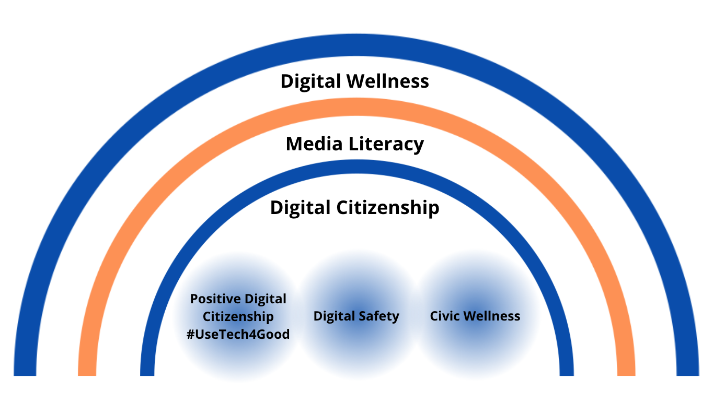
Notes:
This is another way to think about some of the interrelationships between Digital Wellness, Media Literacy, Digital Citizenship (and sub-elements of Digital Citizenship)...as nested umbrellas.

Slide 24
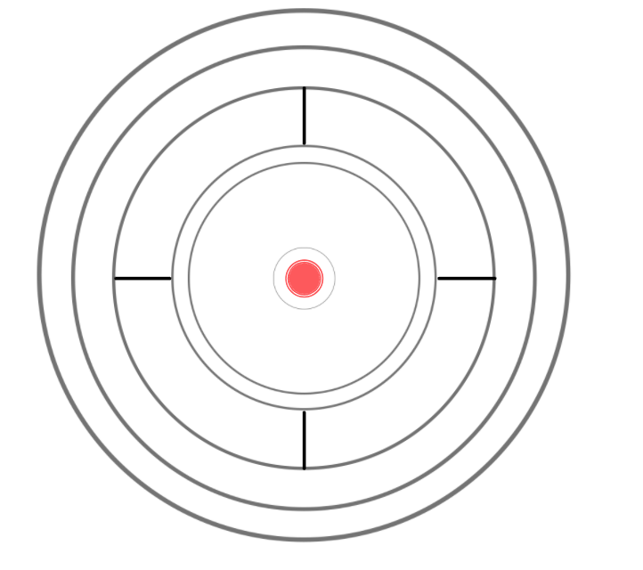
Start at the Bullseye: Core (Touchstone) Media
Notes:
Another word for "Core Media" is touchstone media. Why and how can classical and other such literature and art help us in our quest for Digital and Civic Wellness?

Slide 25
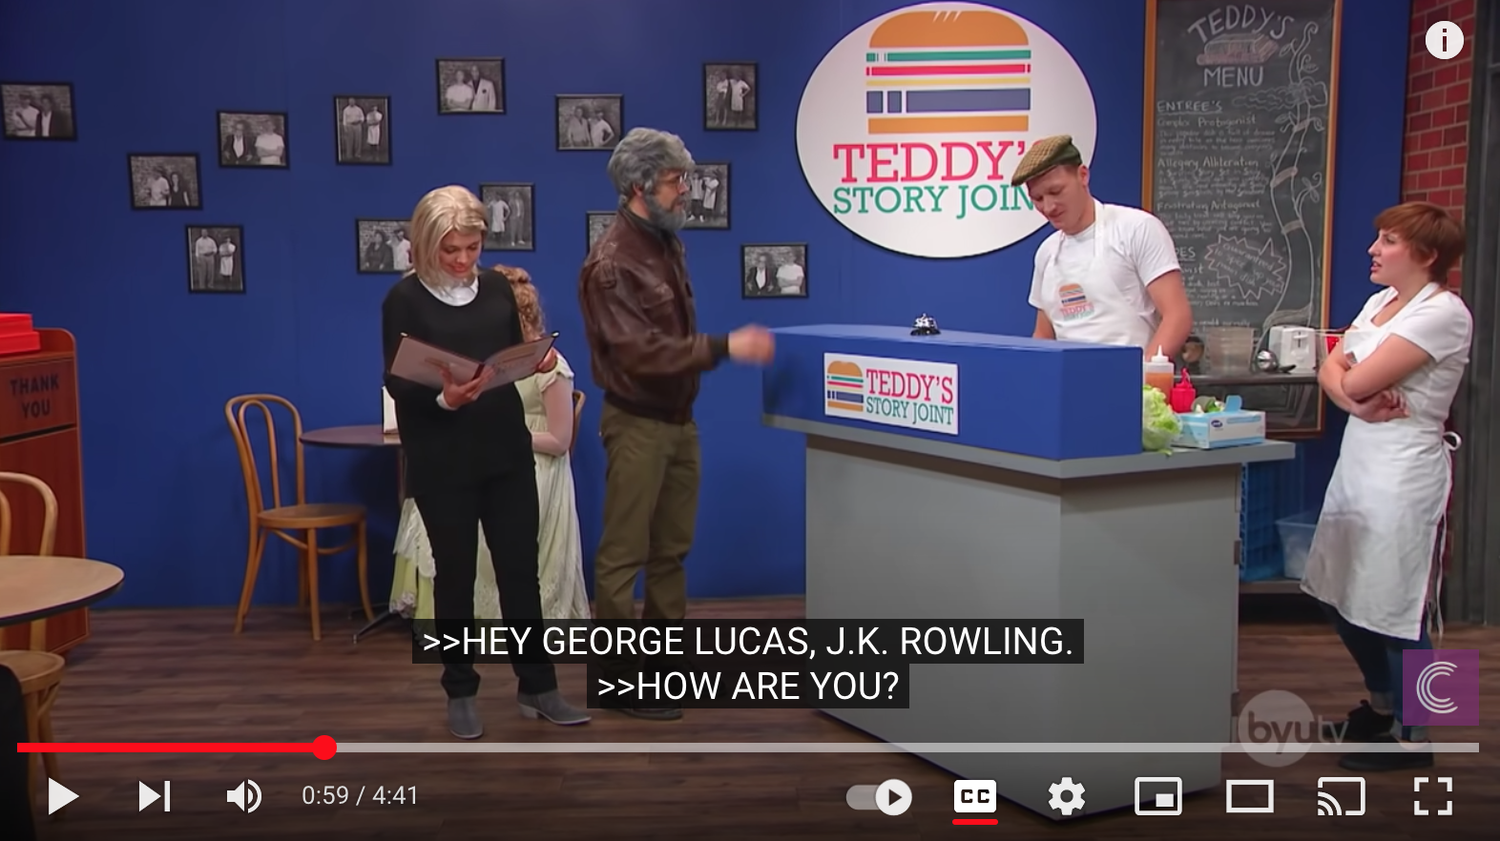
Notes:
0:58 to 2:06 – a little comic relief – but it's funny because it's true. Not only can we find similarities between characters, but we can especially find similarities between plots in epic stories and sagas, both ancient and modern.
https://www.youtube.com/watch?v=7uHUb2qXVdw

Slide 26
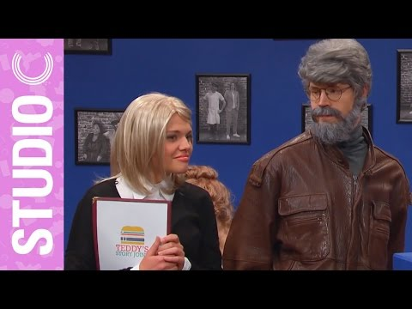

Slide 27
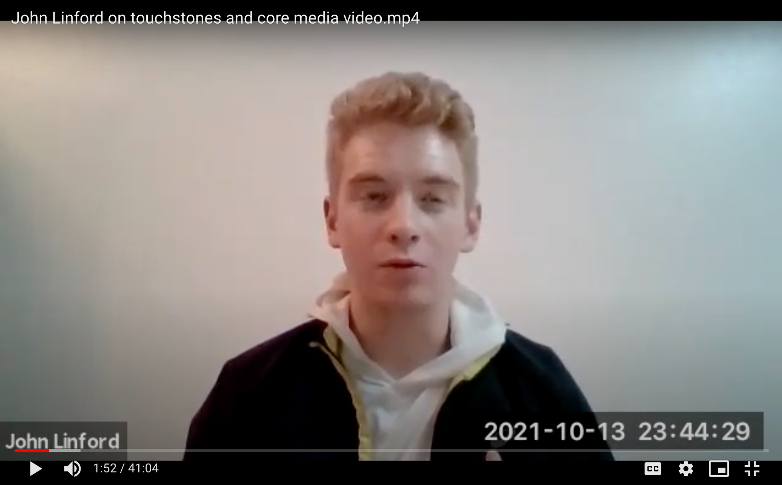
cued up at https://youtu.be/aQyWz5A5PN0?t=109
Notes:
1:52 - 2:58 https://drive.google.com/file/d/1fDEtqq4e-pTHur7WiqeXQtdJkjzM1NT_/view?usp=sharing or you can find it cued up here: https://youtu.be/aQyWz5A5PN0?t=109

Slide 28
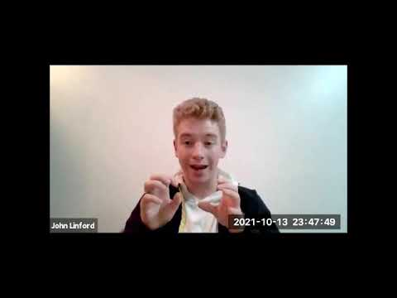
Notes:
1:52 - 2:58 https://drive.google.com/file/d/1fDEtqq4e-pTHur7WiqeXQtdJkjzM1NT_/view?usp=sharing

Slide 29
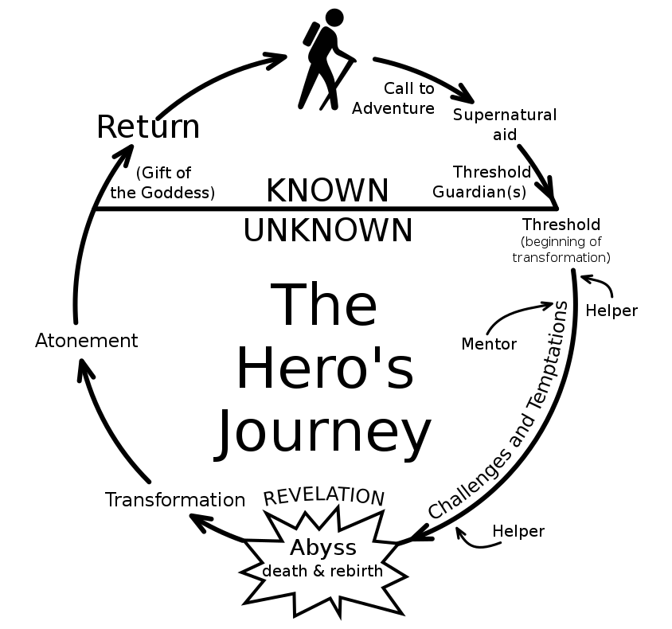
The Hero's Journey in Greek Mythology
as captured by Joseph Campbell
Notes:
John mentioned how exploring Classical literature in his educational experience helped him understand more about The Hero's Journey. It's the human journey, even if some of the language in this particular model may or may not resonate with you. In a sense, Digital Wellness is its own hero's journey. We've learned some things, maybe felt some insights come (supernatural aid can be replaced by something like "true principles" in this setting). We've done some diving beneath the surface of our icebergs…and when we try to implement Digital Wellness principles in the high-stress environments often associated with the public square, we may find more challenges awaiting our journey.

Slide 30
The Driver's Journey - Stephanie's story
Notes:
Last week, Stephanie shared some insights about how her mom taught her to think about her responsibility to show up well in the world. She used the analogy of driving. We wanted to piggyback off of that story in our gathering today. (This is a Driver's Ed picture :) )

Slide 31
The Driver's Journey - from Stephanie
This was my attempt at transcribing what she shared last week. See last week's video to hear Stephanie's share
https://drive.google.com/file/d/1YKQrrlgXO6r4W52UKqXNW02E4g9X8dZq/view?usp=sharing
"My mom used to always remind me to think about driving. You are alone in a car, you don't really have to talk to anybody and you can behave a certain way as you are driving – to either be part of the larger group and contribute – or be kind of bossy or mean or pushy or cutting people off or not following rules, etc. And that was her way to show me how to behave in the right way.
"And now there's this whole other avenue of social networks where you can be passive-aggressive and you can behave certain ways and kind of show your true character in the ways you use social media….
"[Y]ou have to put a lot of trust in people that you are driving down the freeway with – that they're going to stay at a certain speed or they're not going to suddenly swerve over into the lane or they're going to follow the same type of rules, etc. When those things go awry or when they go haywire or they're not really behaving themselves, it can throw a lot of people off. So that's kind of the mentality I have with social media. [It's what my mom taught me ([even before we had] social media]): Hey, be a good driver."
Notes:
From last week's discussion. See video here: https://drive.google.com/file/d/1YKQrrlgXO6r4W52UKqXNW02E4g9X8dZq/view?usp=sharing

Slide 32
Digital Driving, Part 1 = Knowledge
Notes:
In Driver's Ed, we start with classes and a manual. We learn nuts and bolts about how a car works, about street signs, about rules of the road…and then eventually we get time to practice. But it all starts with some book knowledge.

Slide 33
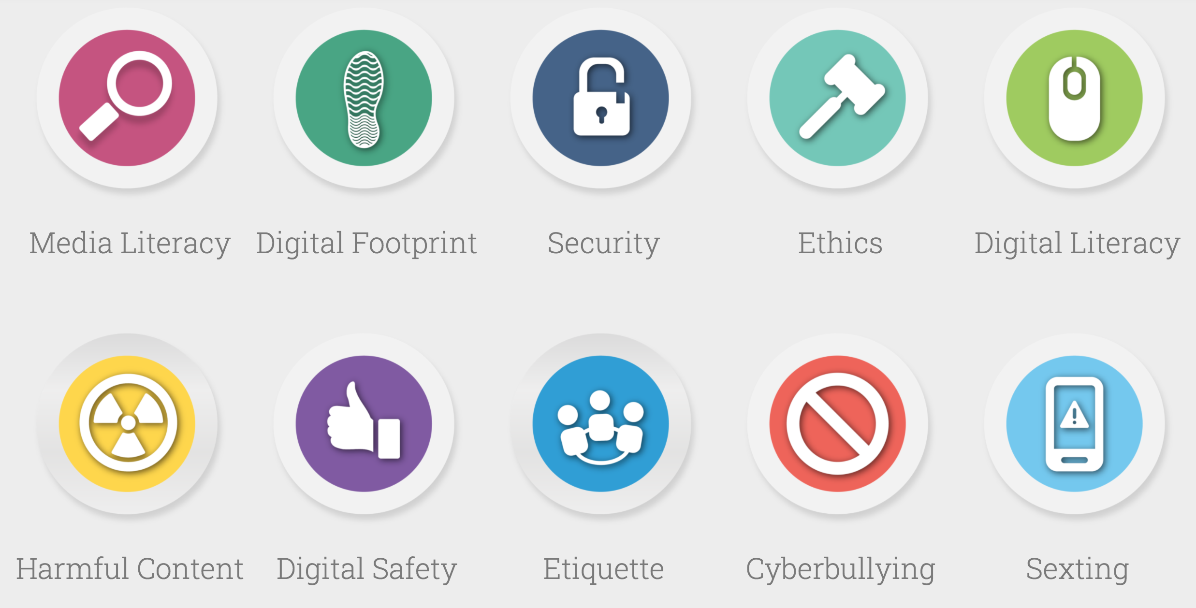
"Rules of the Road"
"Norms of appropriate, responsible, and healthy behavior related to technology use, including digital literacy, ethics, etiquette, and security." - Utah's HB213 (2015)
Find more resources at DigCitUtah.com
Notes:
The same is true for Digital Driving. There is information we can learn to improve Digital Citizenship, to understand more about the "rules of the road" for "appropriate, responsible, and healthy behavior" regarding use of technology and social media.
In 2015, Utah became the first state to have a Digital Citizenship bill, and EPIK donated a website to help the Utah State Office of Education help administrators, teachers, and parents to find information ( Digital Citizenship Driver's Ed manual items, if you will) about various elements of Digital Citizenship. There are a lot of different facets of learning how to engage online in a healthy, safe, and respectful way. We don't have the time to go through these topics in detail, and we wanted to focus the bulk of our gathering on Civic Wellness, but you can visit DigCitUtah.com for more information.

Slide 34
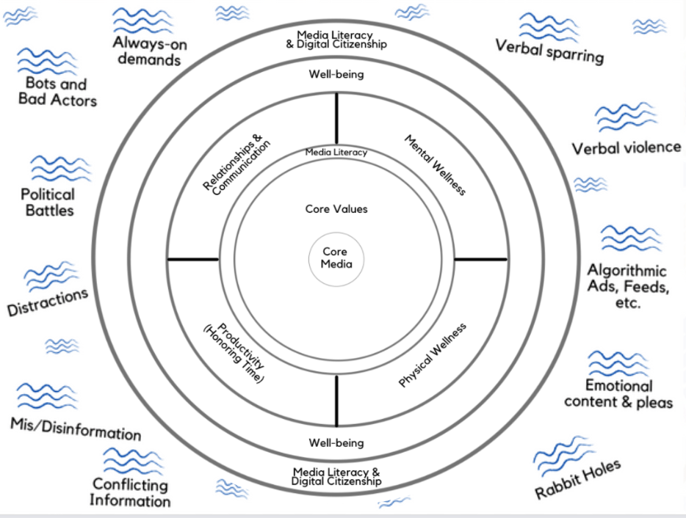
Notes:
Perhaps understanding how technology is used to grab and keep our attention (and understanding how our brains work) can help us be better Digital Drivers.

Slide 35
And "Practicing the Pause"
Pause and Ask Questions (PAQ)
Notes:
Media Literacy skills – practicing the pause, as it were, or PAQ (pausing and ask questions…of ourselves, and pausing to ask questions to understand others) is critical for Digital Citizenship and could help foster more Civic Wellness.

Slide 36
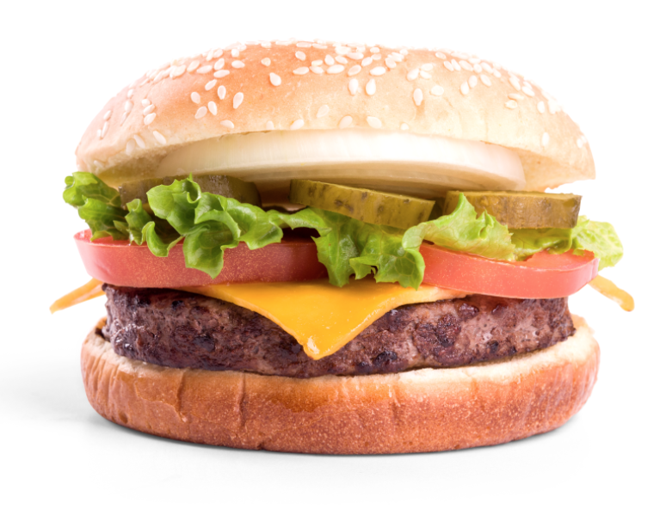
e.g., Ethics and Copyright
Over 7300 people commented on plagiarized versions of this story.
The plagiarized version was shared
over 29,000 times.
Nightbirde – millions of unauthorized views of her videos. People in multiple countries making money off of her life, gift, and death.
Notes:
For example, if we pause and ask questions about content we find online, we can ensure that we are practicing and modeling legal content sharing, which not only gives credit where credit is due, but can also be a protection against dis/misinformation. If we don't practice the skill of tracing sources and asking questions of even the fun or inspiring content that moves us emotionally, we could be less likely to do that kind of homework on key issues that are impacting our personal well-being, our families, our communities, our nation, our politics, our public health and peace, and our world.

Slide 37
Tracing sources connects to healthy democracy
Why does it matter to know the source,
even of a silly or fun or inspiring story?
If we don't practice tracing sources, asking questions of content we encounter:
We may be more susceptible to mis/disinformation
We could be unwittingly helping people make money on plagiarized content
We could be unwittingly sharing legally protected content
Notes:
I added this slide to explain more about why tracing sources matters, not just for copyright issues, but for the health of our democratic process.

Slide 38
e.g., Privacy
We've included several resources to help you consider how you would like to navigate the tensions - the greased humps – around privacy
Notes:
Privacy protection is a big issue in our digital world. We have provided extra resources in the Bonus section to help you consider the tensions inherent in this element of Digital Citizenship.

Slide 39
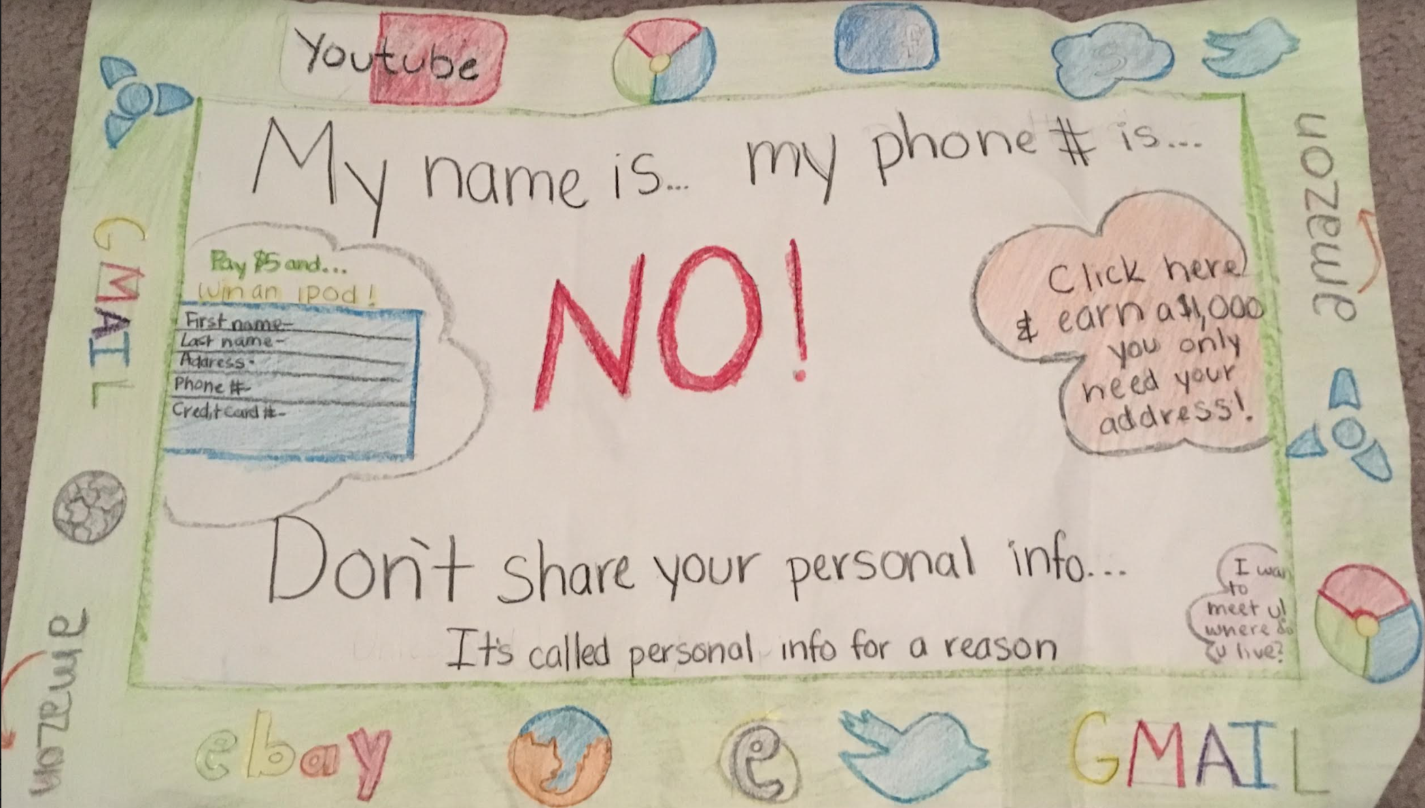
e.g., Privacy: Helping children understand
Notes:
This is an image of a little poster my daughter made in elementary school. I can't remember what grade she was in, but I've kept it all these years because it is relevant to our work at EPIK, and I think it's instructive about how we can help children understand some basic privacy principles, even some Media Literacy (e.g., if someone is promising you quick money, or asking so readily for your information, it's very likely a scam. Pause and Ask Questions (PAQ), do your homework, ask for input, but don't click!)

Slide 40
e.g., (Grand)Parental Privacy & Digital Footprint PAQs
(Potential Downsides to Digital Scrapbooking)
Examples of PAQs, things to think about, before posting pictures of children and grandchildren online:
Do you want to be creating their digital footprint for them?
Is this something that could embarrass the child later, or put them at risk for bullying?
Once something is shared, you have to assume it is no longer private. Are you okay with this possibly being shared or used by others? Research privacy for children and concepts like digital kidnapping (identity theft of children) for more info.
Is there any identifying information in the photo/information that could indicate where you live, where your child goes to school, etc? [Is GPS off on your device? Do you know how to strip metadata (EXIF data) from photos?]
Do you want marketers to use what you share about your family to market to you and your connections?
Have you asked the child(ren) how they feel about it? Think of parallels to body autonomy (“it’s okay to say no if you don’t want to be touched, hugged, kissed” etc.)
Notes:
https://www.commonsensemedia.org/privacy-and-internet-safety/is-it-safe-to-post-pictures-of-my-kid-online https://www.npr.org/sections/health-shots/2016/10/28/499595298/do-parents-invade-childrens-privacy-when-they-post-photos-online
https://www.healthychildren.org/English/family-life/Media/Pages/Sharenting-5-Questions-to-Ask-Before-You-Post.aspx, https://mottpoll.org/sites/default/files/documents/031615_sharenting_0.pdf, https://journals.sagepub.com/doi/full/10.1177/2056305120978376

Slide 41
e.g., Avoiding filter bubbles and biased silos
Notes:
e.g., Flaxman, S., Goel, S., & Rao, J. M. (2016). Filter Bubbles, Echo Chambers, and OnlineNews Consumption. Public Opinion Quarterly, 80(S1), 298–320.https://doi.org/10.1093/poq/nfw006

Slide 42
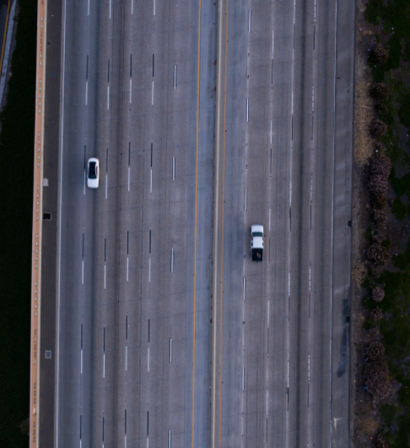
Let's go back to the driving metaphor…
Notes:
It's not too hard to merge into a freeway that is open like this one, even if we're having a hard day or are under some stress…

Slide 43
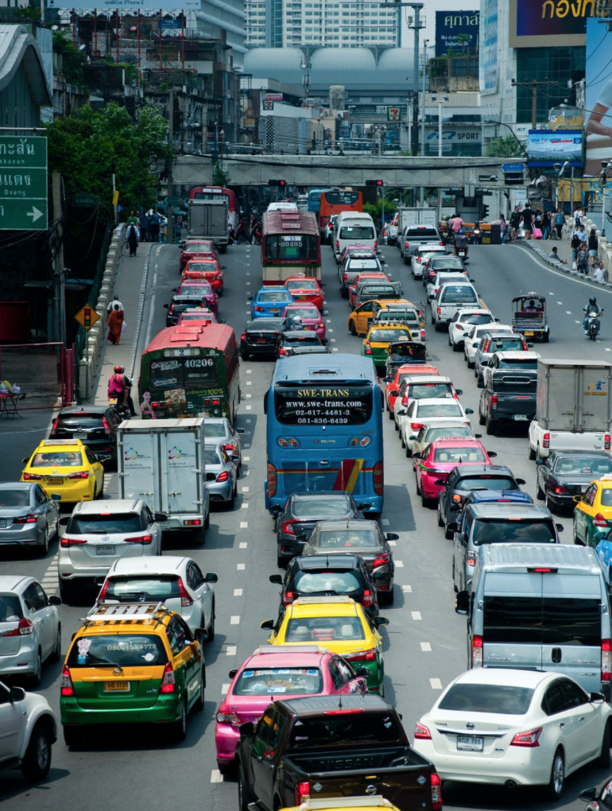
Notes:
But what about when there is a lot of traffic, noise, movement. This is not a situation for mindless driving. We need higher attention levels with this kind of situation…and we are more prone to stress both arising from this situation and impacting how we might respond to it.

Slide 44
Notes:
The "information superhighway" as it used to be called, is a very high-traffic place. There is a lot of noise, a lot of potential sources of stress…and that's on a good day. :)

Slide 45
Other (internal and external) stimuli can make merging into traffic more stressful
Notes:
As we have discussed in previous modules, internal and external stimuli, combined with the traffic situation, can make it all more taxing. This is true of the internet as well.

Slide 46
And then we add high-octane political battles to the mix!
Notes:
But then when we had the high-emotion elements of politics? That's a lot of stimuli that can potentially impact us.

Slide 47
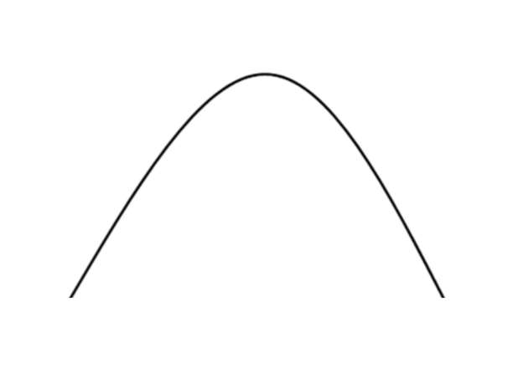
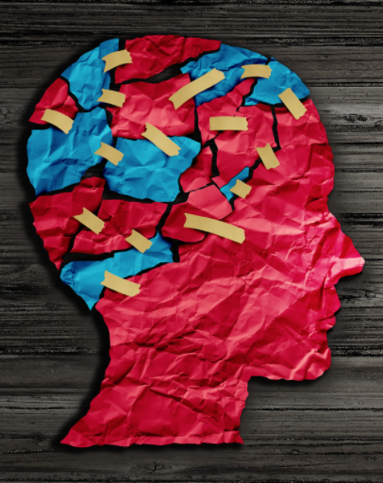
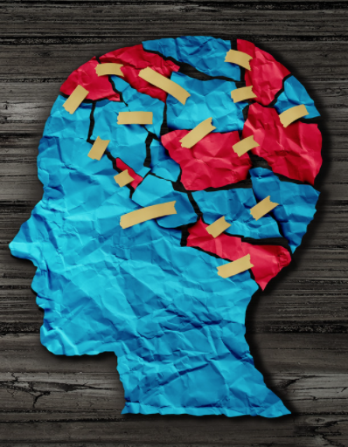
!!!
When we treat
individual hot-button topics
as if they are
core values,
we can get off center
(and risk dehumanizing each other)
!!!
Notes:
Media Literacy is broad and deep and yet can also be explored in simple ways. We hope this simple linear exploration can be helpful.

Slide 48
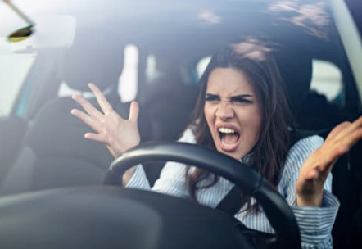
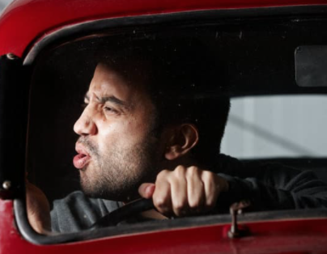
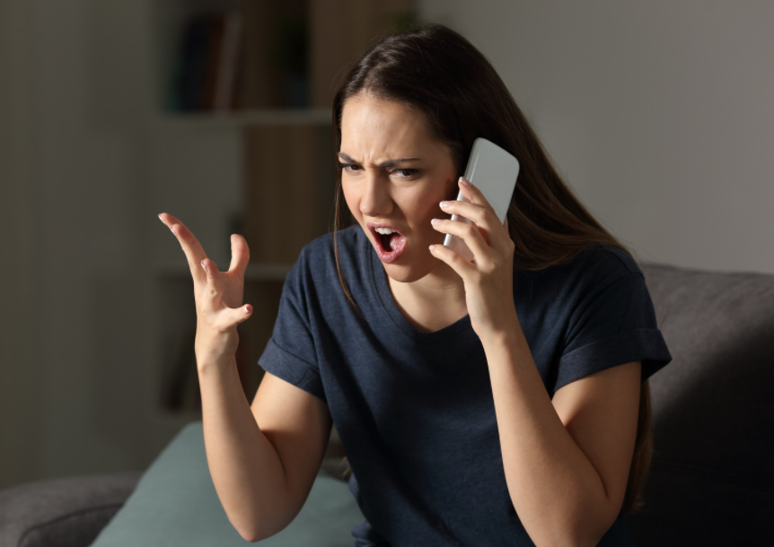
It can all be a recipe for "road rage"

Slide 49
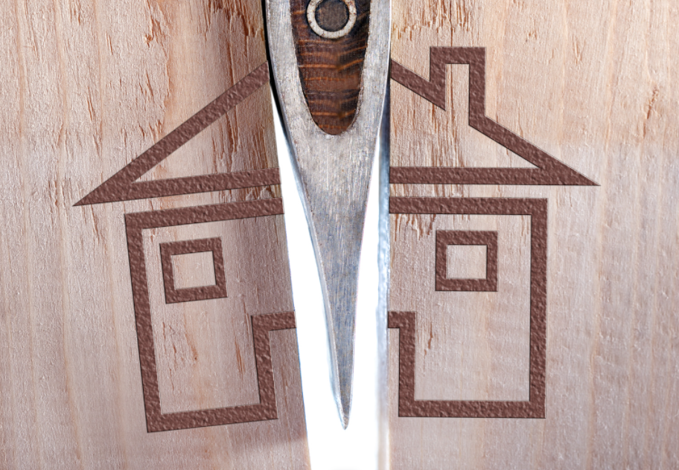
Driving under the influence hurts us all
Notes:
Think of the saying, "A house divided against itself cannot stand" … but how many of our families have been divided because of politics? These last several years have been hard on us all.

Slide 50
Digital Driving, Part 2 = Centeredness and Wisdom
Notes:
So beyond the skills and knowledge of Digital Citizenship concepts, we just keep going back to what our centering principles can be. We need centeredness, wisdom…

Slide 51
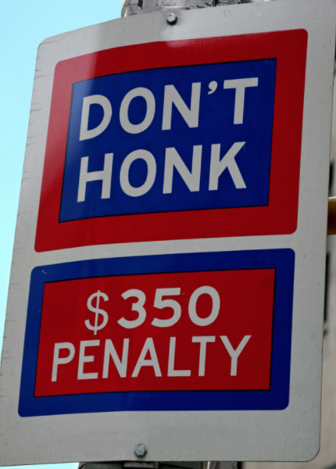
…and Personal Responsibility.
"Our whole society really rests on the capacity of its citizens to give 'obedience to the unenforceable.'"
Neal A Maxwell, 1993 Freedom Festival
"In my heart and mind and soul, I know only as our consciences turn us to "Responsible Personal Conduct" will the dream that is America have any chance of survival."
-Dr. Kenneth D. Wells,
founder of the Freedom Foundation at Valley Forge,
Notes:
…and personal responsibility. No legislation in the world will be able to eliminate road rage, let alone digital road rage. It's up to us to be responsible, respectful citizens in our digital use and in our civic engagement. These quotes were shared by Dallin H. Oaks at the 1994 Freedom Festival. https://speeches.byu.edu/talks/dallin-h-oaks/1994-freedom-festival/

Slide 52
= Our own Hero's Journey
Notes:
And this is no small task in today's political, social, and cultural climate. It's its own Hero's Journey.

Slide 53
Practicing Wisdom/Wise Reasoning
The pursuit of virtue (e.g., pursuing personal ideals and contributing to other people)
A focus on the big picture meaning
Intellectual humility
Adaptive emotion regulation (more reappraisal and less maladaptive thought suppression)
Flexible navigation of uncertainties
Appreciation of the complexity of emotional experiences
Ability to self-distance [consider others' situations]
Compromise
Forgiveness
Self-transcendence
Notes:
During the course of this course, we discovered research around practicing wisdom or wise reasoning (before now, we didn't know there was such a thing!) Some researchers talk about wisdom as being a set set of traits; others talk about wisdom as something one can develop. We take the latter perspective.
Above are some of the concepts that appear in this genre of research, organized here in this list to explore how they relate to the Digital Centeredness model. There are other characteristics that are explored in the research that we did not include here. But, to touch on the bullet list above:
Pursuit of virtue connects to the "start with your center" concept. A big-picture focus and intellectual humility can be fostered through practicing Media Literacy. The next three bullets obviously relate to Mental Wellness (and also Physical and Relational). Navigating uncertainties can also relate to Honoring Time. Media Literacy is a skill that can help us practice considering others' points of view; the pause and Media Literacy questions (or questions we have asked ourselves throughout this series) are questions we can ask when considering the content that others create, or the positions they take. What is *their* center? What experiences have influenced how they view the world, how they choose to show up in the world? Compromise and forgiveness are obviously relational concepts, and can also apply in community and civic settings. And self-transcendence is something that can come the healthier we are.
I didn't include quotes in the slide above for visual simplicity, but you can find these concepts explore in various articles, such as: https://www.researchgate.net/publication/301821371_Wise_Reasoning_in_the_Face_of_Everyday_Life_Challenges (see literature review paragraphs)
https://journals.sagepub.com/doi/10.1177/0956797617722621

Slide 54
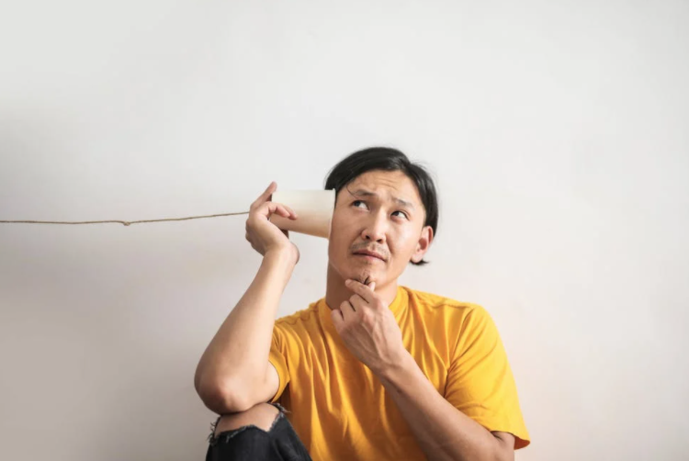
An Important Media Literacy/Civic Wellness principle
“Different people experience
the same media message [or issue!] differently.”
Center for Media Literacy
https://www.medialit.org/reading-room/five-key-questions-form-foundation-media-inquiry
PAQ: “How might different people understand [or respond to or experience] this message [issue] differently from me?”

Slide 55
An Important Media Literacy/Civic Wellness principle
p.s. Center for Media Literacy also teaches that media are created with varying values.
Center for Media Literacy
https://www.medialit.org/reading-room/five-key-questions-form-foundation-media-inquiry
Ergo, we should not be surprised when our values don't match up with everything we see, hear, read, or watch. We should not be surprised that not all media will represent all views or experiences.
I once heard someone say that you know free speech is working when something someone else says bugs you. :)

Slide 56
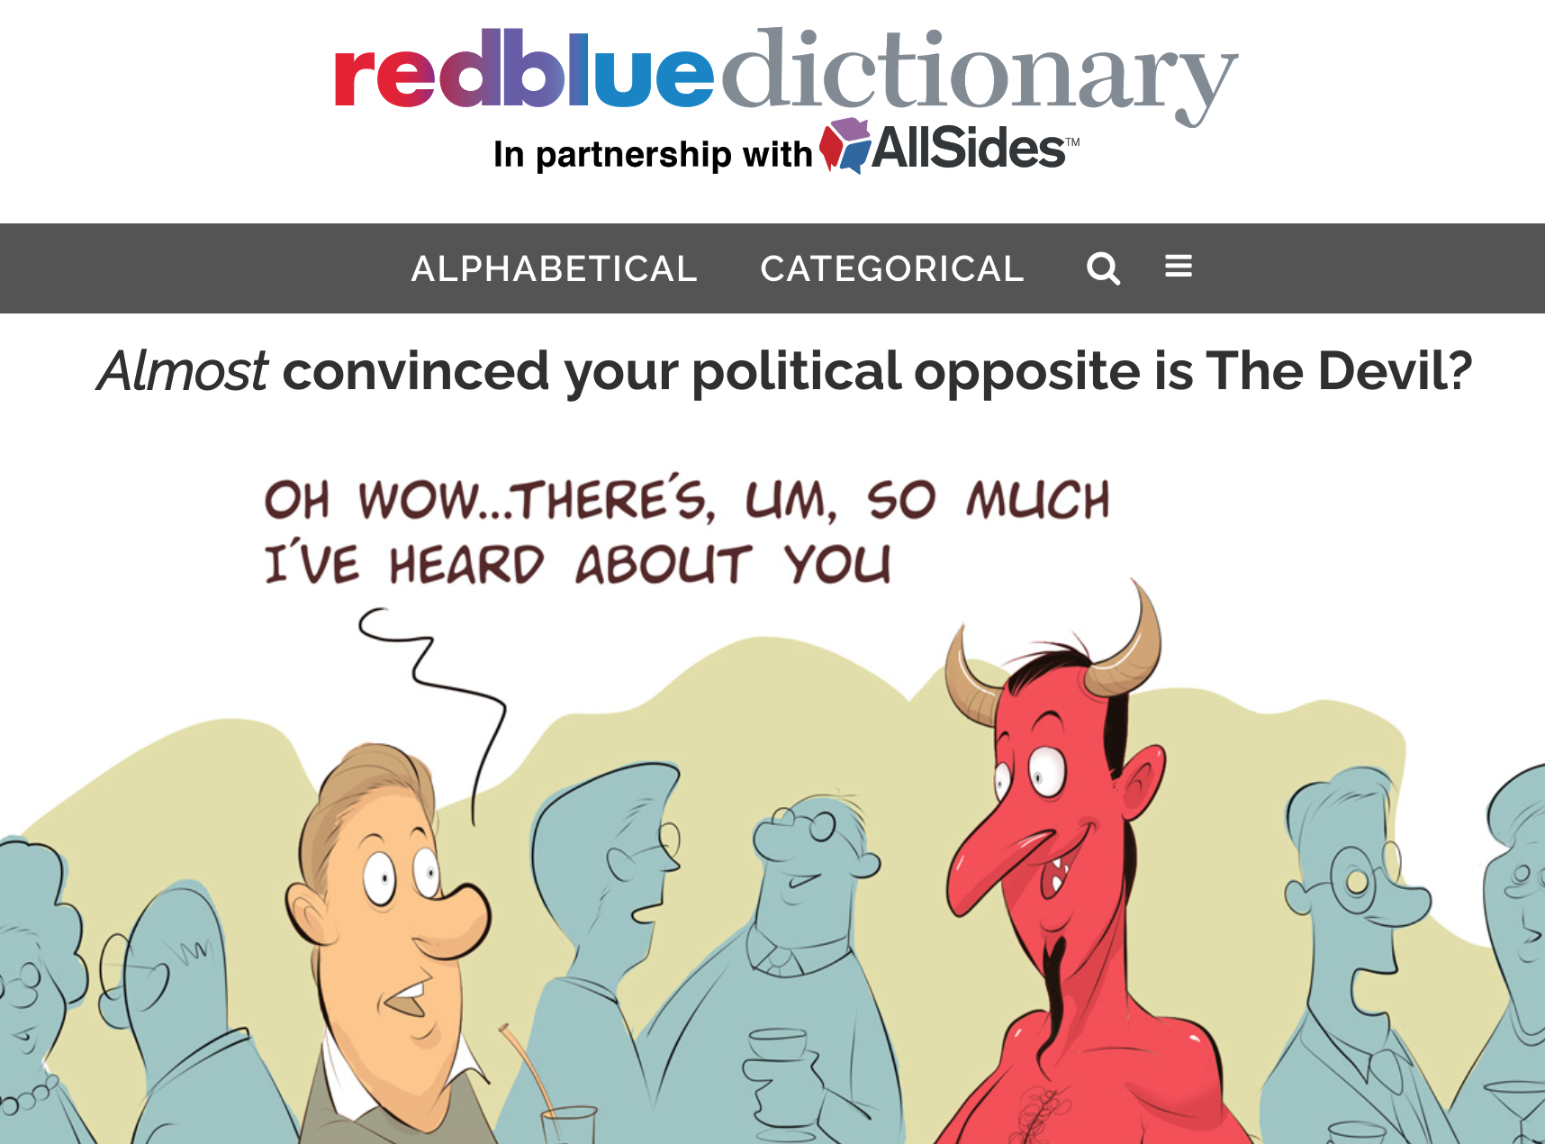
https://redbluedictionary.org/
Notes:
https://redbluedictionary.org/ - Throughout this series, we've tried to reiterate the idea that different language will resonate differently with different people. So we have tried to use a variety of words and concepts to explore various elements of Digital Wellness. This project helps explore how people on different ends of the political spectrum may perceive a concept or word in different ways, sometimes quite strikingly so. It's so easy to assume that our lens is the only lens, or that others see through a similar lens. Even outside of the political realm, this is not true. Humans are complex, and that is part of the beauty of being human. But within the political realm, it can be particularly difficult to remember this…and all the more important to do so, since emotions so often run very high.

Slide 57
Notes:
It can be easy to box ourselves or others into one "side" or the other, but if we were to look past individual issues, we might be surprised at how most of us aren't starkly single-minded when it comes to politics. And part of what makes politics work is when various views can be explored. Often solutions are found outside of or beyond or between the endpoints of false dichotomy.

Slide 58
!!!
When we treat
individual hot-button topics
as
core values,
we can get off center
(and risk dehumanizing each other)
!!!
Notes:
Media Literacy is broad and deep and yet can also be explored in simple ways. We hope this simple linear exploration can be helpful.

Slide 59
!!!
False dichotomies are usually false
A quote we didn't have time to read
“[In today's world we experience the] proliferation of “If you’re this then you’re automatically that” and “You’re either with us or you’re against us” politics. These are emotional lines that we hear invoked by everyone from elected officials and lobbyists to movie heroes and villains on a regular basis. …
“Normally, we used forced choice and false dichotomies during times of significant emotional stress. Our intentions may not be to manipulate, but to force the point that we’re in a situation where neutrality is dangerous….
“The problem is that these emotional pleas are often not based in facts, and they prey on our fears of not belonging or being seen as wrong or part of the problem. We need to question how the sides are defined. Are these really the only options? Is this the accurate framing for this debate or is this [a false dichotomy]?
“If alternatives exist outside of these forced choices (and they almost always do), then the statements are factually wrong. It’s turning an emotion-driven approach into weaponized belonging. And it always benefits the person throwing down the gauntlet and brandishing those forced, false choices.
“The ability to think past either/or situations is the foundation of critical thinking, but still, it requires courage. Getting curious and asking questions happens outside our ideological bunkers. It feels easier and safer to pick a side. The argument is set up in a way that there’s only one real option. If we stay quiet we’re automatically demonized as “the other.”
“The only true option is to refuse to accept the terms of the argument by challenging the framing of the debate…[The] argument is set up to silence dissent and draw lines in the sand that squelch debate, discussion, and questions — the very processes that we know lead to effective problem solving.”
Brené Brown, Braving the Wilderness
!!!

Slide 60
Communicating around centering principles and
listening to others and their stories
can help us avoid accidents and injuries
Notes:
For an exploration of the concept of core media or touchstone media, see a video (or audio) discussion with John Linford here https://drive.google.com/drive/folders/1rmA1in4Kl53vkJJW4s3T3p8pCEKWUmYf?usp=sharing

Slide 61
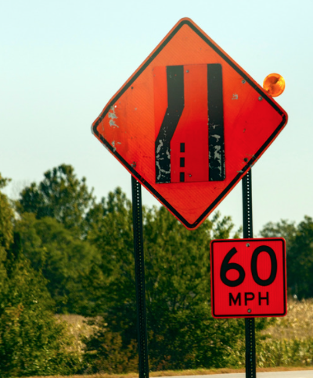
Let's slow down so we can all drive on the same road, together
Notes:
In reality, we may not be able to "merge" ideologically with others in many situations, but we can learn and practice slowing down, being alert to false dichotomy, and being mindful about how we can do our part to foster a culture where we can co-exist peacefully

Slide 62
!!!
sensational
superficial
selective
!!!
Notes:
Jared Halverson has shared some ideas he learned in his doctoral training at Vanderbilt. These three warning signs are what he indicated are often part of the kind of emotional (sometimes manipulative) rhetoric that can be used when things like false dichotomy, black/white thinking, "us vs. them" approaches, etc. are in play. Again, watching for these kinds of techniques in messaging is a Media Literacy skill. No issue is so simple as to be able to be reduced to one story or one viewpoint. We can be careful about not using isolated, emotional stories ourselves to try to win support for our point of view. The more solid we are on a position, the less we'll need to use these kinds of tactics to defend it. We can use wise reasoning, patterns of facts and research, and other grounded means to make a case. And we can practice listening beyond the rhetoric in our personal spheres and in our digital driving, because who knows what we might learn by listening? As said in the previous quote, problem-solving rarely occurs in the realm of false dichotomy and wars of words that can be high in emotion but low in facts. [Of course, facts can be manipulated, too. It's yet another reason why it's good to read and listen to a variety of points of view to start to identify where bias may be creeping in on any side of an issue.]

Slide 63
!!!
On the dangers of empathy & outrage
NOT because caring about others can be harmful to the political process,
but because being emotionally activated by a narrow set of selective stories can be
"How could empathy steer us wrong?...Empathy is a spotlight focusing on certain people in the here and now. This makes us care more about them, but it leaves us insensitive to the long-term consequences of our acts and blind as well to the suffering of those we do not or cannot empathize with. Empathy is biased, pushing us in the direction of parochialism and racism. It is shortsighted, motivating actions that might make things better in the short term but lead to tragic results in the future. It is innumerate, favoring the one over the many. It can spark violence; our empathy for those close to us is a powerful force for war and atrocity toward others. It is corrosive in personal relationships; it exhausts the spirit and can diminish the force of kindness and love.”
― Paul Bloom, Against Empathy: The Case for Rational Compassion
“Outrage is weakness. It is the muting of rational thinking and the triumph of emotion. Despite what you’ve been hearing and seeing as of late, it is not a virtue. It is not something to be celebrated, nor praised, nor aspired to. It is a deeply human emotion—even understandable at times—but rarely is it productive, virtuous, or useful. It is an emotion to overcome, not accept, and overcoming it requires mental strength."
― Dan Crenshaw, Fortitude: Resilience in the Age of Outrage
!!!
"In politics and policy, trying to feel the pain of others is a bad idea. Empathy distorts our reasoning and makes us biased, tribal and often cruel."
-Paul Bloom https://www.wsj.com/articles/the-perils-of-empathy-1480689513
Notes:
These are bonus quotes not included in the original slide deck. These authors have influenced our thinking on using rational compassion that is care-oriented vs. emotionally-driven passion that is anger-oriented and could hinder wise reasoning abilities. Stoking anger is a political tool that can influence people to make very poor decisions that have no statistical support, and thus can actually harm more people in the short and long-term.

Slide 64
!!!
On the dangers of empathy & outrage
NOT because caring about others can be harmful to personal wellness and the political process,
but because being emotionally activated by selective stories can be
"Emotional empathy is what allows a person to tune into someone else's emotional state: if the person in front of you is happy, you soon start to smile; if they suffer, you feel and share their pain. Empathy is turned inward, to the self. It is the effect the emotions of others have on you….Tania Singer's experiments showed, in broad terms, that while empathy distress may lead to burnout, altruistic love and compassion, on the other hand, can replenish our ability to take care of others with serenity, kindness and courage….
"Empathy on its own, without the support of altruism and compassion, is like an electrical pump lacking oil : it ends up burning."
Matthieu Ricard, Buddhist monk, humanitarian, author (emphasis added)
!!!
"[W]ise thinking varies from one situation to another, with self-focused contexts inhibiting wise thinking." Wisdom researcher Igor Grossman, https://journals.sagepub.com/doi/10.1177/1745691616672066
"Th[e] distinction between empathy and compassion is critical for the argument [I make]. And it is supported by neuroscience research. In a review article, Tania Singer and Olga Klimecki describe how they make sense of this distinction: 'In contrast to empathy, compassion does not mean sharing the suffering of the other: rather, it is characterized by feelings of warmth, concern and care for the other, as well as a strong motivation to improve the other’s well-being. Compassion is feeling for and not feeling with the other.'"
― Paul Bloom, Against Empathy: The Case for Rational Compassion (emphasis added)
Notes:
These are bonus quotes not included in the original slide deck. An abstract to the research referred to can be found here: https://pubmed.ncbi.nlm.nih.gov/25247366/ [Sharing resources like these does not imply full endorsement of the work or the individual.] See also: https://taniasinger.de/the-resource-project/ and https://www.social.mpg.de/

Slide 65
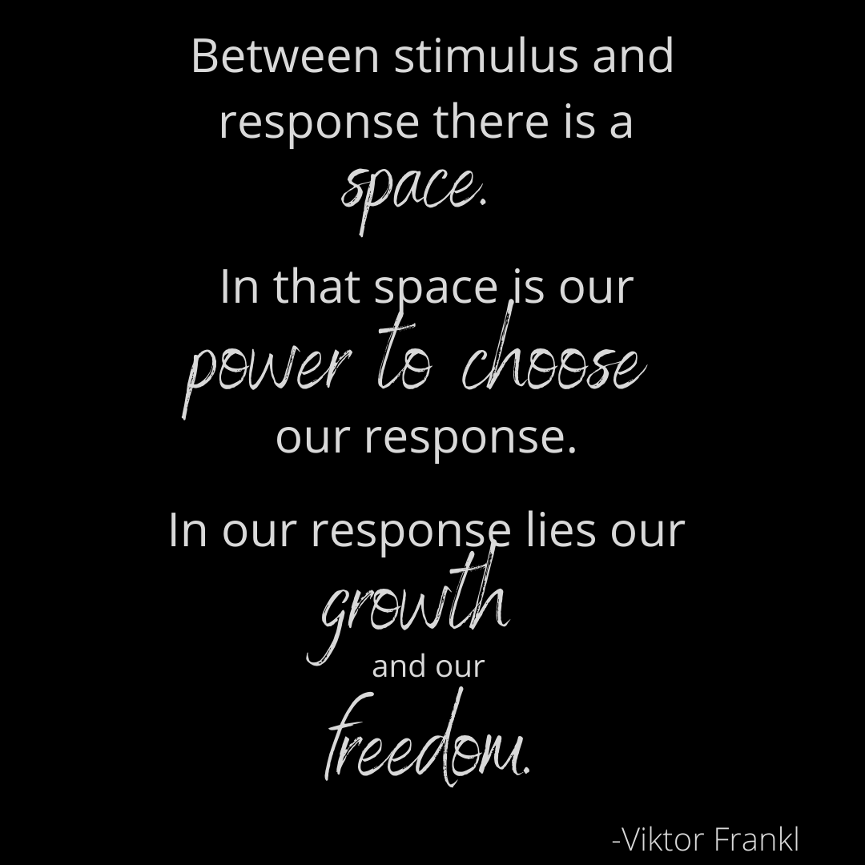
Notes:
Media Literacy is broad and deep and yet can also be explored in simple ways. We hope this simple linear exploration can be helpful.

Slide 66
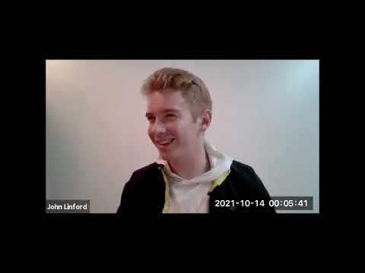
John talks about how having touchstone media and principles helps him self-check and practice listening and asking questions
Video cued to where we started here: https://youtu.be/O0cdHvtA7I4?t=301
Notes:
start at 5:02 to 6:15
https://youtu.be/O0cdHvtA7I4?t=301
John talks about how having touchstone media and principles helps him self-check and practice listening and asking questions

Slide 67
KNOWLEDGE
1. Understanding every human has the right of conscience
2. Feeling a responsibility to protect that right in others
3. Respecting the human dignity of others and their freedom to disagree.
SKILLS
1. Listening to hear and to understand
2. Sitting in discomfort
3. Oral communication skills, such as using sentence frames
ATTITUDE
1. Being curious, which means we desire to learn and understand
2. Overcoming defensiveness
MOTIVATION
1. We are feeling pain and we want the pain to stop
2. We want to collaborate to make our world a better place
These materials were shared with permission from Utah3Rs.org
Notes:
These materials were shared with permission from Utah3Rs.org and can be found in this week's Google Drive folder.

Slide 68
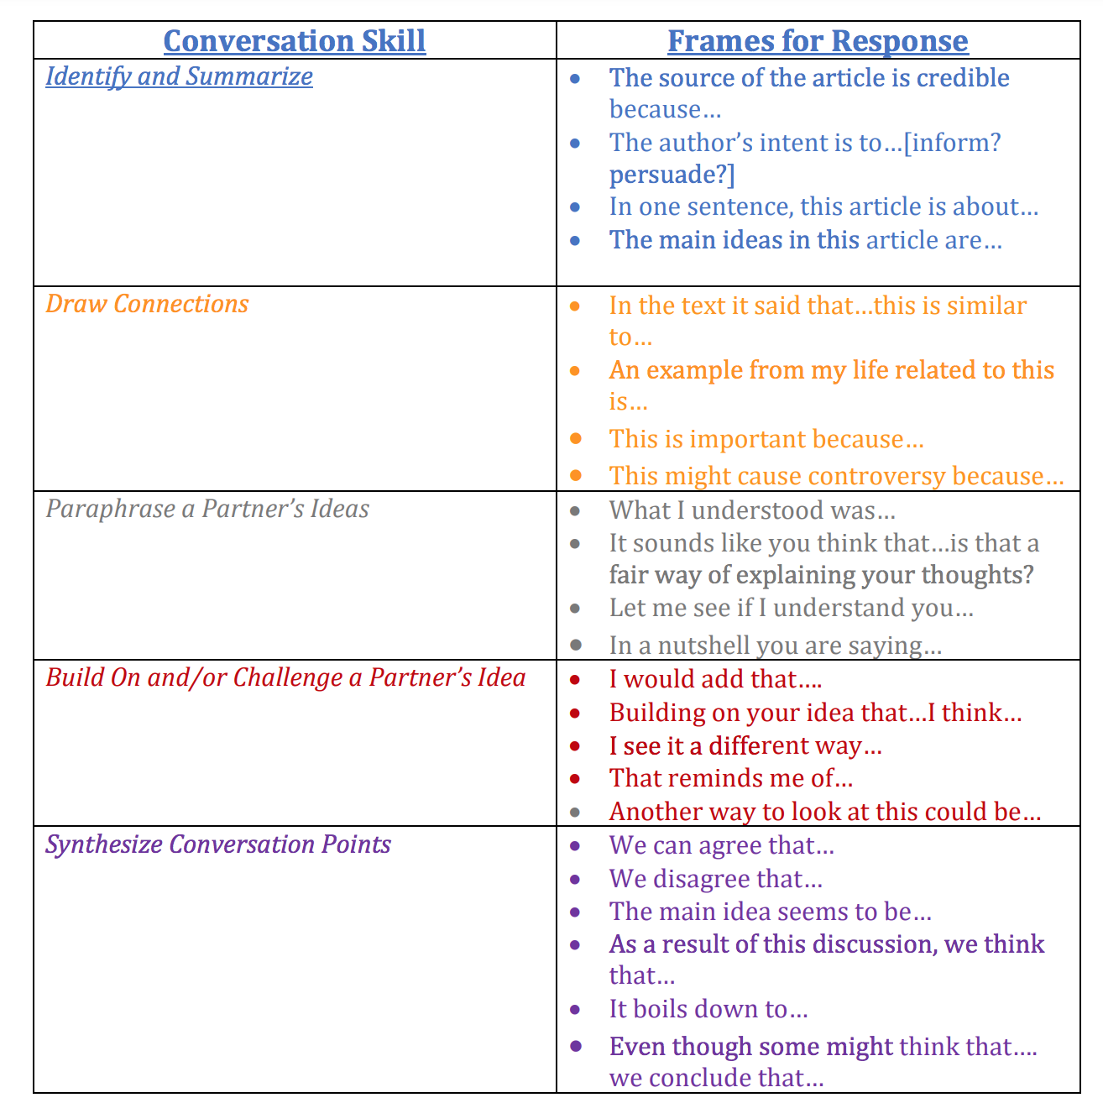
These materials were shared with permission from Utah3Rs.org
Notes:
These materials were shared with permission from Utah3Rs.org and can be found in this week's Google Drive folder.
. These are phrases that can be used to de-fuse conflict where there are different points of view being explored and expressed, language that we can use to both hear others and show up for our own points of view without shutting someone else down.

Slide 69
Digital Citizenship and Civic Wellness
How do I want to show up in the world?
+What is right behavior when it comes to how to treat others?
Notes:
We may not always agree on what "right behavior" means, but at some level, we all know what road rage looks like on the road. We can consider what that looks like in our digital and civic spheres, and seek to practice the inside-out, wisdom-driven, "rationally compassionate" approaches to our digital and civic engagement.

Slide 70
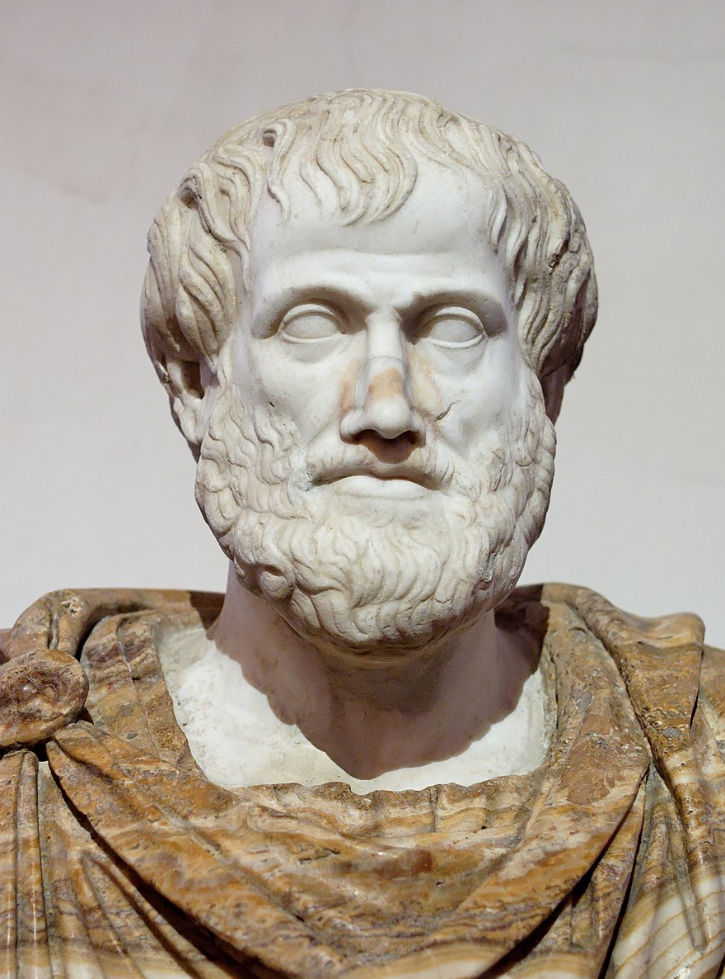
Aristotle: The Golden Mean
"[B]oth fear and confidence and appetite and anger and pity and in general pleasure and pain may be felt both too much and too little, and in both cases not well; but to feel them at the right times, with reference to the right objects, towards the right people, with the right motive, and in the right way, is what is both intermediate and best, and this is characteristic of virtue."
Notes:
https://www.sacred-texts.com/cla/ari/nico/nico019.htm

Slide 71
Discussion
As you think about a hard situation you have experienced, or a hot-button issue that leaves you feeling a bit hot-under-the-collar, what principles, ideas, tools, practices, etc. from this series could help you navigate that situation
from a more centered place?
Notes:
As you think about a hard situation you have experienced, or a hot-button issue that leaves you feeling a bit hot-under-the-collar, what principles, ideas, tools, practices, etc. from this series could help you navigate that situation from a more centered place?

Slide 72
Bonus Material

Slide 73
Table of Contents for Bonus Material
A few extra slides (a couple of quotes, one repeat slide, and one we didn't get to cover in Week 6)
Activities to practice Media Literacy, DigCit, Civic Wellness
Tips to assess your privacy settings (includes notification resources previously shared)
Privacy is a paradox, a greased hump – we want ease of use with digital devices, but more ease tends to mean less privacy

Slide 74
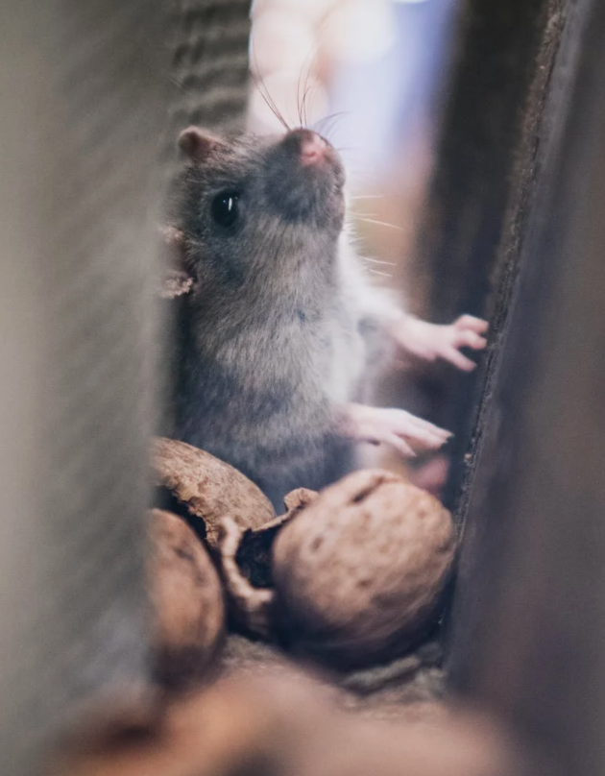
Another quote: Rats in the Cellar

Slide 75
Rats in the Cellar
"When I come to my evening….and try to reckon up [my] day, nine times out of ten the most obvious [violation of my values] one is some sin against charity; I have sulked or snapped or sneered or snubbed or stormed. And the excuse that immediately springs to my mind is that the provocation was so sudden and unexpected; I was caught off my guard, I had not time to collect myself. Now that may be an extenuating circumstance as regards those particular acts: they would obviously be worse if they had been deliberate and premeditated."
Note: EPIK’s Digital Centeredness model is adapted from the Digital Wellness Institute’s six-pronged model that aligns with DWI’s original survey

Slide 76
Rats in the Cellar
"When I come to my evening….and try to reckon up [my] day, nine times out of ten the most obvious [violation of my values] one is some sin against charity; I have sulked or snapped or sneered or snubbed or stormed. And the excuse that immediately springs to my mind is that the provocation was so sudden and unexpected; I was caught off my guard, I had not time to collect myself. Now that may be an extenuating circumstance as regards those particular acts: they would obviously be worse if they had been deliberate and premeditated."
Note: EPIK’s Digital Centeredness model is adapted from the Digital Wellness Institute’s six-pronged model that aligns with DWI’s original survey

Slide 77
Rats in the Cellar
"On the other hand, surely what a [person] does when he is taken off …guard is the best evidence for what sort of a [person] [s]he is? Surely what pops out before the [person] has time to put on a disguise is the truth? If there are rats in the cellar you are most likely to see them if you go in very suddenly. But the suddenness does not create the rats: it only prevents them from hiding. In the same way the suddenness of the provocation does not make me an ill-tempered man; it only shows me what an ill-tempered man I am. The rats are always there in the cellar, but if you go in shouting and noisily they will have taken cover before you switch on the light. ”
Note: EPIK’s Digital Centeredness model is adapted from the Digital Wellness Institute’s six-pronged model that aligns with DWI’s original survey

Slide 78
We need each other: Connecting center to center
"As a practical basis for co-existence, we should accept the reality that we are fellow citizens who need each other. This requires us to accept some laws we dislike, and to live peacefully with some persons whose values differ from our own. Amid such inevitable differences, we should make every effort to understand the experiences and concerns of others, especially when they differ from our own.
"We can only succeed in this effort to the extent that we acknowledge and respect each other’s highest ideals and human experiences."
-Dallin H. Oaks, at a speech at University of Virginia, https://bit.ly/3ucgzwP
Note: EPIK’s Digital Centeredness model is adapted from the Digital Wellness Institute’s six-pronged model that aligns with DWI’s original survey

Slide 79
Getting Curious about Messages, from all Mediums
A slide from our Media Literacy module, for review
Media Literacy: I "mustache" questions
of messages that cross my path, via any delivery system (medium),
whether external or internal
I get to ask questions. Asking questions is a gift. And it is a skill I can practice.
I want to ask questions to be more awake, aware, and agency-driven…to be an active learner, an actor not a reactor.
I will expand my world as I engage with curiosity and inquisitiveness.
Asking questions builds Media Literacy muscles. I can grow in Media Literacy capacity.
Notes:
hat tip to Deanna Lambson from WhiteRibbonWeek.org who uses mustaches in her Be a Media Detective resources – which you will receive as a gift from an anonymous donor to use at home and in your spheres of influence. The fact that a mustache was the first word cloud shape presented me to was sheer coincidence, but a timely coincidence nonetheless.

Slide 80
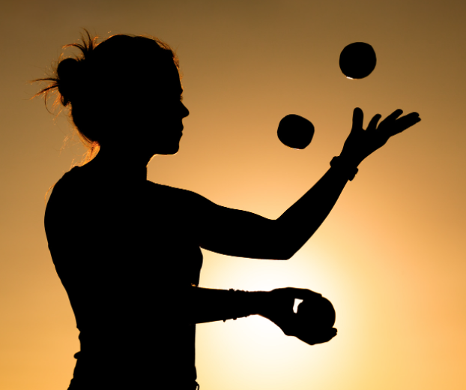
Dancing in the Tensions
…between solitude (essential to personal wellness) and collaboration (essential to civic and community wellness and…and often useful in personal problem-solving as well)
See also Barbara Sher’s TEDx talk (When it comes to problem-solving and reaching your goals, there is a tension with solitude, because problems are meant to be solved via connection and collaboration and mutually helping each other) https://www.tedxprague.cz/en/videa/isolation-is-the-dream-killer-not-your-attitude-barbara-sher
Barbara’s work also reinforces building small networks of support for reaching your goals (where bridging social capital can even become more like bonding social capital)
Notes:
=

Slide 81
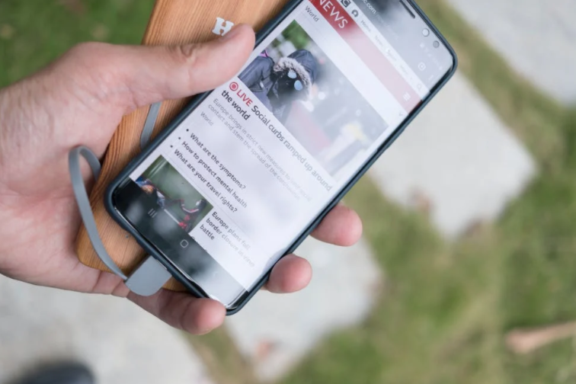
Ideas for Media Literacy/Civic Wellness Activities
Help for Headline-itis, v.1
You can do this activity alone or with family or friends or colleagues (etc).
Pick three headlines that have recently caught your attention.
Do 5HW (Who, What, When, Where, Why, How) on the headline alone first.
Then read the entire story. Do 5HW again.
Do you think the headline accurately captures the story? Does it capture what you got out of the story? What do you wish had been covered?
Bonus: Find headlines that tell the other “side” of the story and do the same activities with those stories.
Notes:
=

Slide 82
Ideas for Media Literacy/Civic Wellness Activities
Help for Headline-itis, v.2
You can do this activity alone or with family, friends, colleagues, etc.
Scroll through the top 10 stories in your favorite news resource
How many stories are political in nature?
How many seem to want to induce negative emotions?
How many share something of general human interest (nonpartisan, inspirational content)?
Bonus question: How many headlines did you have to skim before you found something of general human interest?
Notes:
=

Slide 83
Ideas for Media Literacy/Civic Wellness Activities
Help for Headline-itis, v.3
You can do this activity alone or with family, friends, colleagues, etc.
As you finish each day this week (or at the end of each time period you have set for news-checking. Write down any headline topics that are lingering in your head.
What issues are keeping you awake at night? Are these issues incited by outside forces and distracting you from your center, or are they reflecting issues you want to do something about that align with your core right now?
If it’s the latter, give some thought as to what you want to do and talk about your ideas with a trusted friend.
Notes:
=

Slide 84
Ideas for Media Literacy/Civic Wellness Activities
Stage a Discussion
Pick a topic that isn’t too charged but still has relevance to our social/cultural/political environment.
Come prepared with news articles that represent different "sides" of the issue
Divide randomly into two groups.
Assign Group 1 one “side” to represent and Group 2 the other. Then switch. (10-15 minutes prep, 5 minutes presentation.) Instead of debating the topic, use KSAM and the sentence frames tool from Utah3Rs to practice using de-fusing phrases.
Discuss. How did that feel? What are your observations about these tools?
Notes:
=

Slide 85
Ideas for Media Literacy/Civic Wellness Activities
Stage a Debate (or Gauge the Gauntlet)
Pick a topic that isn’t too charged but still has relevance to our social/cultural/political environment.
Plan a COVID-friendly or virtual event in advance so people have time to do a little research on both sides of a topic.
Divide randomly into two groups.
Assign Group 1 one “side” to debate and Group 2 the other. Then switch. (10-15 minutes prep, 5 minutes presentation.)
Discuss. How did that feel? Can you see any Venn diagram spaces within the debate? etc.
Notes:
=

Slide 86
Ideas for Media Literacy/Civic Wellness Activities
Stage a Debate: Food for Thought for Discussion
"Normally, we used forced choice and false dichotomies during times of significant emotional stress. Our intentions may not be to manipulate, but to force the point that we’re in a situation where neutrality is dangerous. ...
"The problem is that these emotional pleas…prey on our fears of not belonging or being seen as wrong or part of the problem. We need to question how the sides are defined. Are these really the only options? Is this the accurate framing for this debate….?
"If alternatives exist outside of these forced choices (and they almost always do), then the statements are factually wrong. It’s turning an emotion-driven approach into weaponized belonging. And it always benefits the person throwing down the gauntlet and brandishing those forced, false choices.
"The ability to think past either/or situations is the foundation of critical thinking, but still, it requires courage. Getting curious and asking questions happens outside our ideological bunkers. It feels easier and safer to pick a side. The argument is set up in a way that there’s only one real option. If we stay quiet we’re automatically demonized as ‘the other.’
"The only true option is to refuse to accept the terms of the argument by challenging the framing of the debate. But make no mistake; this is opting for the wilderness. Why? Because the argument is set up to silence dissent and draw lines in the sand that squelch debate, discussion, and questions—the very processes that we know lead to effective problem solving.”
-Brené Brown, Braving the Wilderness
Notes:
=

Slide 87
Ideas for Media Literacy/Civic Wellness Activities
Quote-a-Rama, or Three Lies and a Truth
Invite individuals in your circle to do some homework on incorrect quotes, misattributed quotes, or quotes shared that don’t have a known source.
Have an activity where everyone shares three quotes that aren’t accurate, and one that is. See who can pick the true quote.
Turn this into a game or competition as desired.
Discuss why and how even sharing false quotes can be harmful to democracy, and why the opposite is true.
Notes:
=

Slide 88
Quote-a-Rama: Food for Thought & Discussion
Some research on why people share inaccurate content
“[P]eople do care more about accuracy than other content dimensions, but accuracy nonetheless often has little effect on sharing, because (ii) the social media context focuses their attention on other factors such as the desire to attract and please followers/friends or to signal one’s group membership.”
But, the researchers found, attention can be "primed" toward accuracy {just reminding the brain that it matters} to influence content sharing.
Ergo, there is a sort of attention economy in our own brains. If we value accuracy of information, we can remind ourselves of that before engaging with and deciding what to share online. [Could this apply to consciously giving attention to other values before engaging online? Why not try?]
Research study reported in Nature: https://www.nature.com/articles/s41586-021-03344-2
Emphasis added.
Notes:
=

Slide 89
Ideas for Media Literacy/Civic Wellness Activities
Pause the Like
For at least one week, refrain from liking (or disliking) anyone’s content on social media.
Observe how you feel, what you think, what you want to actually say or do (or not say or do) in response.
If you actually like something, let the person know what your thoughts are and why one-on-one. Focus on the person, not the pixelized content. Let them know you see them.
If after a week you still feel like engaging around political content, find ways offline to do so. Consider even writing a representative.
Remember, algorithms often thrive on discord, division, and emotional discussion. +Bad actors leverage this.
Notes:
=

Slide 90
Increase privacy in your tech settings:
Basic ideas around the "privacy paradox"
The price we pay for ease of use (frictionless digital flow) is less privacy (and more distraction)
There is a tension here, but if you build in more log-offs, more two-step verifications, etc. you build in more friction to honor time and protect your privacy
Less privacy means more targeted advertising (e.g., Facebook Pixel)
Be smart about smart tech
Notes:
See also: https://www.wired.com/story/facebooks-targeted-ads-are-more-complex-than-it-lets-on/, https://www.pewresearch.org/internet/2019/11/15/how-americans-think-about-privacy-and-the-vulnerability-of-their-personal-data/ https://www.consumerreports.org/privacy/how-facebook-tracks-you-even-when-youre-not-on-facebook-a7977954071/ https://applymagicsauce.com/demo , https://www.ted.com/talks/finn_lutzow_holm_myrstad_how_tech_companies_deceive_you_into_giving_up_your_data_and_privacy, https://news.harvard.edu/gazette/story/2017/08/when-it-comes-to-internet-privacy-be-very-afraid-analyst-suggests/

Slide 91
Increase privacy in your tech settings
Turn off location monitoring unless being used in real-time by an app (like Maps)
Turn off microphone when not being used
When making online purchases, use only SSL sites or use PayPal
Don’t input personal information on sites that aren’t SSL certified (look for the padlock icon or a green URL or https:// at the beginning of a URL)
Consider only using messenger apps with 3rd party end-to-end encryption (see next slide)
Notes:
See also: https://www.wired.com/story/facebooks-targeted-ads-are-more-complex-than-it-lets-on/, https://www.pewresearch.org/internet/2019/11/15/how-americans-think-about-privacy-and-the-vulnerability-of-their-personal-data/ https://www.consumerreports.org/privacy/how-facebook-tracks-you-even-when-youre-not-on-facebook-a7977954071/ https://applymagicsauce.com/demo , https://www.ted.com/talks/finn_lutzow_holm_myrstad_how_tech_companies_deceive_you_into_giving_up_your_data_and_privacy, https://news.harvard.edu/gazette/story/2017/08/when-it-comes-to-internet-privacy-be-very-afraid-analyst-suggests/

Slide 92
Apps with end-to-end encryption
Messaging apps with end-to-end encryption:
Facetime
Messages
Google Duo
Line messaging app
Has the feature but not as default:
Facebook Messenger
Does not have end-to-end encryption at all:
Skype
Snapchat
Google Hangouts
Notes:
https://www.amnesty.org/en/latest/press-release/2016/10/snapchat-skype-among-apps-not-protecting-users-privacy/

Slide 93
Increase privacy in your tech settings
6. Check privacy settings on the apps you use most
7. Keep parts of your life offline (think about what you share about your children and grandchildren, too)
8. Consider getting involved with lobbying for more consumer control over data, opt-in/opt-out options, etc.
9. Learn about things like Facebook pixels and where to download your data that FB stores:
https://www.facebook.com/dyi
Notes:
See also: https://www.wired.com/story/facebooks-targeted-ads-are-more-complex-than-it-lets-on/, https://www.pewresearch.org/internet/2019/11/15/how-americans-think-about-privacy-and-the-vulnerability-of-their-personal-data/ https://www.consumerreports.org/privacy/how-facebook-tracks-you-even-when-youre-not-on-facebook-a7977954071/ https://applymagicsauce.com/demo , https://www.ted.com/talks/finn_lutzow_holm_myrstad_how_tech_companies_deceive_you_into_giving_up_your_data_and_privacy, https://news.harvard.edu/gazette/story/2017/08/when-it-comes-to-internet-privacy-be-very-afraid-analyst-suggests/

Slide 94
Increase privacy in your tech settings
10. Change settings so that you are logged off of accounts when you close a browser
11. Disable access to third-party apps on Facebook: https://www.imore.com/how-to-revoke-facebook-app-permissions
12. Avoid putting “identifying details” on public sites. Recommendations include avoiding photo tagging, for example
13. Consider using search engines like DuckDuckGo that don’t store personal data
See, e.g., https://www.ted.com/talks/finn_lutzow_holm_myrstad_how_tech_companies_deceive_you_into_giving_up_your_data_and_privacy
Notes:
See also: https://www.wired.com/story/facebooks-targeted-ads-are-more-complex-than-it-lets-on/, https://www.pewresearch.org/internet/2019/11/15/how-americans-think-about-privacy-and-the-vulnerability-of-their-personal-data/ https://www.consumerreports.org/privacy/how-facebook-tracks-you-even-when-youre-not-on-facebook-a7977954071/ https://applymagicsauce.com/demo , https://www.ted.com/talks/finn_lutzow_holm_myrstad_how_tech_companies_deceive_you_into_giving_up_your_data_and_privacy, https://news.harvard.edu/gazette/story/2017/08/when-it-comes-to-internet-privacy-be-very-afraid-analyst-suggests/

Slide 95
Tip: Increase privacy in your tech settings
Google Chrome: https://www.theverge.com/2020/2/11/21126427/google-chrome-privacy-tools-private-network-browser-settings
Instagram: https://www.theverge.com/2020/2/27/21154221/instagram-privacy-how-to-stories-posts-settings-tags-ads-blocking
Facebook: https://www.consumerreports.org/privacy/facebook-privacy-settings-a1775535782/
Snapchat: https://www.lifewire.com/snapchat-privacy-tips-4117444
Whatsapp: https://www.fastcompany.com/90388813/the-ultimate-guide-to-whatsapps-powerful-privacy-options
Google: https://www.wired.com/story/google-tracks-you-privacy/
YouTube: https://www.theverge.com/2019/4/19/18484802/youtube-privacy-protect-how-to-video-preferences-web-ad-personalization
Amazon: https://the-digital-reader.com/2020/02/12/six-default-amazon-security-settings-you-can-change-for-more-privacy/
Other tips part 1: https://www.washingtonpost.com/news/the-switch/wp/2018/06/01/hands-off-my-data-15-default-privacy-settings-you-should-change-right-now/
Other tips, part 2: https://www.washingtonpost.com/news/the-switch/wp/2018/06/15/hands-off-my-data-15-more-default-privacy-settings-you-should-change-on-your-tv-cellphone-plan-linkedin-and-more/
Notes:
See also: https://www.wired.com/story/facebooks-targeted-ads-are-more-complex-than-it-lets-on/, https://www.pewresearch.org/internet/2019/11/15/how-americans-think-about-privacy-and-the-vulnerability-of-their-personal-data/ https://www.consumerreports.org/privacy/how-facebook-tracks-you-even-when-youre-not-on-facebook-a7977954071/ https://applymagicsauce.com/demo

Slide 96
A Quote on Privacy
“Google [and other data-gathering “free” tech] knows quite a lot about all of us. No one ever lies to a search engine. I used to say that Google knows more about me than my wife does, but that doesn’t go far enough. Google knows me even better, because Google has perfect memory in a way that people don’t.”
—Bruce Schneier, cybersecurity expert
Notes:
https://news.harvard.edu/gazette/story/2017/08/when-it-comes-to-internet-privacy-be-very-afraid-analyst-suggests/

Slide 97
Tip: Say no to Defaults! Help to Reduce Notifications
Say no to defaults! Change notifications
On iPhone: https://support.apple.com/guide/iphone/change-notification-settings-iph7c3d96bab/ios
On Android: https://support.google.com/android/answer/9079661?hl=en
On Pixel: https://support.google.com/pixelphone/answer/6111294?hl=en
On Samsung Galaxy s9: https://www.cnet.com/tech/mobile/how-to-turn-off-samsungs-galaxy-notifications-on-the-galaxy-s9/
On Facebook: https://www.facebook.com/help/390022341057202/
On WhatsApp:
For Android: https://faq.whatsapp.com/android/chats/how-to-manage-your-notifications
For iPhone: https://faq.whatsapp.com/iphone/troubleshooting/how-to-manage-your-notifications
For Desktop: https://faq.whatsapp.com/web/chats/how-to-manage-your-notifications
On LinkedIn: https://www.linkedin.com/help/linkedin/answer/76636/managing-your-linkedin-notification-updates?lang=en
On Email: Check your email program/app and/or your device
On Windows 10: https://support.microsoft.com/en-us/windows/change-notification-and-action-settings-in-windows-10-8942c744-6198-fe56-4639-34320cf9444e
On a Mac: https://support.apple.com/en-us/HT204079
On Slack: https://slack.com/help/articles/201355156-Configure-your-Slack-notifications
Microsoft Teams Do Not Disturb: https://techcommunity.microsoft.com/t5/microsoft-teams/automatically-set-do-not-disturb-when-presenting/m-p/736906
Notes:
We've shared some of these resources in various weeks' materials for your convenience.

Slide 98
Tip: Say no to Defaults! Help to Reduce Notifications
Say no to defaults! Change notifications
On Microsoft Outlook: https://support.microsoft.com/en-us/office/turn-new-message-alert-pop-up-on-or-off-9940c70e-b306-442e-a856-d94b20318481
On Facebook Messenger: https://www.facebook.com/help/messenger-app/330627630326605
Manage Announce notifications with Siri on Airpods or Beats: https://support.apple.com/en-us/HT210406
On Amazon Alexa/Echo: https://www.amazon.com/gp/help/customer/display.html?nodeId=GW65E37ZG4L9BW3P
On Apple Watch: https://support.apple.com/en-us/HT204791
On FitBit: https://help.fitbit.com/articles/en_US/Help_article/2323.htm
Across various devices (a curated instruction list): https://www.businessinsider.com/how-to-turn-off-all-notifications-across-devices
On Voxer: https://support.voxer.com/hc/en-us/articles/204332223-Disable-Enable-Notifications-per-Chat
On Marco Polo: https://support.marcopolo.me/article/69-notification-settings
On Viber:
iPhone: https://help.viber.com/en/article/personalize-your-viber-settings-iphone
Android: https://help.viber.com/en/article/personalize-your-viber-settings-android-phones
On Google News: https://support.google.com/googlenews/answer/9005590?hl=en&co=GENIE.Platform%3DAndroid
On Apple News: https://support.apple.com/en-us/HT211230
On Skype
For desktop: https://support.skype.com/en/faq/FA34811/how-do-i-manage-notifications-in-skype-on-desktop
For mobile: https://support.skype.com/en/faq/fa34746/how-do-i-manage-notifications-in-skype-on-mobile-or-tablet
Notes:
I added the slides about notifications and privacy settings from last week's slide deck for your convenience.

Slide 99
Tip: Say no to Defaults! Help to Reduce Notifications
Say no to defaults! Change notifications
On GroupMe: https://www.swipetips.com/how-to-turn-off-groupme-notifications-on-iphone-or-android/
On Slack: https://slack.com/help/articles/201355156-Configure-your-Slack-notifications
On Instagram: https://help.instagram.com/105448789880240
On Twitter: https://help.twitter.com/en/managing-your-account/enabling-web-and-browser-notifications
On SnapChat:
Android: https://support.snapchat.com/article/android-notifications
Apple: https://support.snapchat.com/en-US/article/ios-notifications
On Clubhouse:
About notifications: https://clubhouseapp.zendesk.com/hc/en-us/articles/360062778193-When-do-I-get-notified-about-people-
Changing notifications: https://clubhouseapp.zendesk.com/hc/en-us/articles/1500002511422-Can-I-adjust-my-notification-settings-
For Facebook game notifications: https://www.facebook.com/help/476337625740088
General Android notifications: https://www.talkandroid.com/guides/beginner/how-to-disable-annoying-android-notifications/
General phone notification help: https://www.wired.com/story/turn-off-notifications-smartphone/
On Nintendo: https://en-americas-support.nintendo.com/app/answers/detail/a_id/22345/~/how-to-change-notification-settings
On XBox One: https://www.howtogeek.com/675283/how-to-turn-off-or-customize-xbox-one-notifications/
On Nintendo: https://en-americas-support.nintendo.com/app/answers/detail/a_id/22345/~/how-to-change-notification-settings
On PS5: https://www.playstation.com/en-us/support/account/manage-notifications-ps5/
Notes:
I added the slides about notifications and privacy settings from last week's slide deck for your convenience.

Slide 100
We wish you well(ness)!

